Slide 1
Discovering OLAP Dimensions in Semi-Structured Data
Report 3
Team 5:
Muriel Banze
Sahil Shah
Siddharth Chauhan

Slide 2
Table of Contents
Summary
Summary of references
Motivation
Why
Contribution
Novelty
Validation
References

Slide 3
Summary
This paper explores the application of OLAP to non-compliant data scenarios such as semi-structured data.
It also covers the details on how to provide OLAP to the public stream containing the content created by users, such as Twitter data.
Main goal: To discover features of the original dataset that can be translated into dimensions and facts. The final result is improved by the integration of external sources, such as language and GPS being applied to structures obtained from content-driven discovery.

Slide 4
Summary continued…
As per the Twitter developer documentations terminology, the model consists of three object classes namely
a. Status Objects (Tweets),
b. User Objects (Nicknames, Avatars, etc.) and
c. Timelines (User activity).
Data transformation: The heterogeneous JSON object are converted to XML and the output is buffered as a staging area in the BaseX database.
The Dimensional Fact Model (x-DFM) provides constructs such as categories, fuzzy hierarchies, degenerate dimensions and derived measures.
Each tweet instance, along with location, time and other user characteristics, is considered as a fact with the lowest grain level.
Messages tweeted as semi-structured records containing more than 60 fields can be enriched/refined with additionally extracted features that are essential for analysis.
Once the categories were found at the logical and conceptual level, the slowly changing dimensions (SCD) are implemented to store the current state in the dimensions and previous iterations are stored in the time dimension.

Slide 5
Summary of References
Abelló, A., Samos, J., & Saltor, F. (2001, September). A framework for the classification and description of multidimensional data models. In International Conference on Database and Expert Systems Applications (pp. 668-677). Springer, Berlin, Heidelberg
This paper talks about methods for analysing multidimensional models. For classification, two types of orthogonal sets are used, first, on the basis of type of concept and construct and second, based on the phase of design. Reference papers referred to in this subject address topics related to extending multidimensional data model limitations.
Han, J. (1997, October). OLAP mining: An integration of OLAP with data mining. In Proceedings of the 7th IFIP (Vol. 2, pp. 1-9)
A technique called ‘mining then cubing’ where OLAP and DM methods are integrated have been discussed in this paper. This mechanism allows the OLAP operator applications in mining the data.

Slide 6
Summary of References continued…
MacLennan, J., Tang, Z., & Crivat, B. (2008). Mining OLAP Cubes, ch. 13.
This paper describes implementing a function as documented in the Microsoft SQL Server, denoted by 'data mining dimensions' Much as the regular OLAP dimensions are built, the dimensions consist of classifications made by clustering algorithms based on the initial facts and can be used and materialized.
Kwak, H., Lee, C., Park, H., & Moon, S. (2010, April). What is Twitter, a social network or a news media?. In Proceedings of the 19th international conference on World wide web (pp. 591-600).
The Twitter API system was discovered by inspecting the topological characteristics that can be used as a means for exchanging information. It was noted that, irrespective of the followers of the original tweet, any post that was retweeted would certainly hit at least a 1000 users on average.
Java, A., Song, X., Finin, T., & Tseng, B. (2007, August). Why we twitter: understanding microblogging usage and communities. In Proceedings of the 9th WebKDD and 1st SNA-KDD 2007 workshop on Web mining and social network analysis (pp. 56-65).
The dynamic classification of the user table consists of Conversations, Sharing information, Daily chatter and reporting. Depending on the number of tweets or mailing direct messages to different users or linking to a specific area/discussion, the user would be allocated to either of the classification instances.

Slide 7
Motivation
In recent years, the proliferation of social network activity has led to the creation of vast amounts of user-related data, such as status updates, messaging, blog and forum posts, leading to emergence of new fields of data analysis such as Social Media Analysis and Social Network Analysis.
This huge data needs a platform to be stored and analysed. Data warehousing has unsteady performance of these high social media data which is usually in semi-structured or unstructured format.
The overall concept appears to be impractical, when OLAP cubes are being transformed and distributed along a set of consistent structured dimensions, particularly for applications that have semi-structured data.
Twitter appears to be a motivating example since it consists of vast amounts of information generated over time.

Slide 8
Motivation continued…
It is possible to convert this unstructured data into a set of OLAP cubes with an automated ETL process.
There are attributes in the structure of the original data stream that can be used as cube dimensions and measures. Implementing simple computations to complex methods will allow the easy acquisition of categories, hierarchies and additional parameters.

Slide 9
Why is the paper hard to solve?
The main aim of this paper is to integrate the data warehousing and mining on the high stream incoming online data that is present in semi-structured or complex data format.
The challenge was to transform semi-structured data into multidimensional cubes. The attributes in a dimension can be organized into a granularity hierarchy. Levels to allow operations for drill-down and roll-up.
It is difficult to mapping semi-structured data to multidimensional cubes because heterogeneity is admitted by the original format whereas a static structure is imposed by the target one. The degree of heterogeneity is fairly low in the case of the Twitter source, affecting only a few data fields.
The problem lies in converting the JSON objects to the XML format after acquiring the data.

Slide 10
Contribution
The paper contributed in the field of Data warehousing by extending the OLAP capabilities using content-driven discovery of facts and dimensions.
It also discovers new elements using data mining techniques such as classification.
The paper gives great emphasis on challenges associated with generating, maintaining and querying newly discovered elements of the cube.
Furthermore, the paper's main contribution can be seen in the enrichment of existing data through incorporation of dynamic characters like user activity, popularity, messaging behaviour etc.

Slide 11
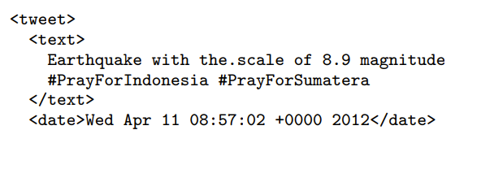
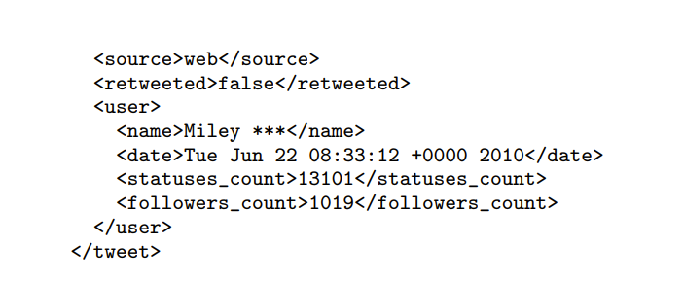
Novelty
The heterogeneous and rigid structure of the data makes it difficult to map semi-structured data to multi-dimensional cubes.
The author uses a unique approach of converting JSON input objects coming from Twitter to XML format and uses a highly efficient BaseX storage as its staging area.

Slide 12
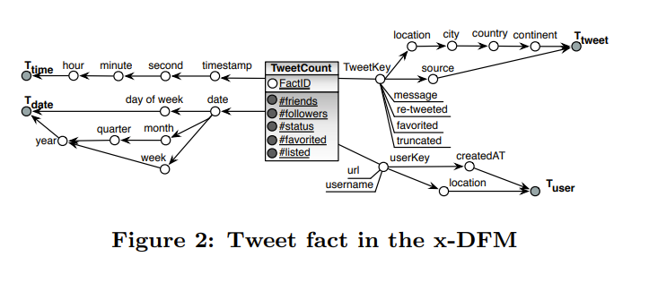
This transformation is used further for obtaining relational view from XML schema and mapping to multi dimensional models.
The paper uses extended Dimensional fact Model (x-DFM) graphical notations where dimensions are designed as graphs of hierarchy, levels are represented by nodes and roll-up operations through edges.

Slide 13
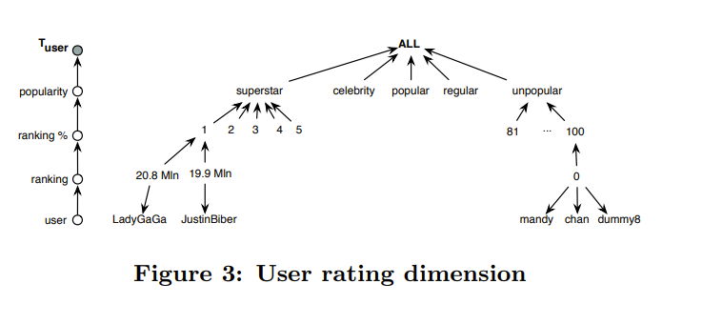
Novelty continued…
While modelling of the newly discovered elements to existing dimensions generates a number of challenges in implementing, querying and maintaining.
The author provides a unique approach of handling static, derived and discovered elements through an example which is based on user number of followers and friends, current ranking is calculated that help in classifying the popularity of user as superstar, celebrity, popular, regular or unpopular.

Slide 14
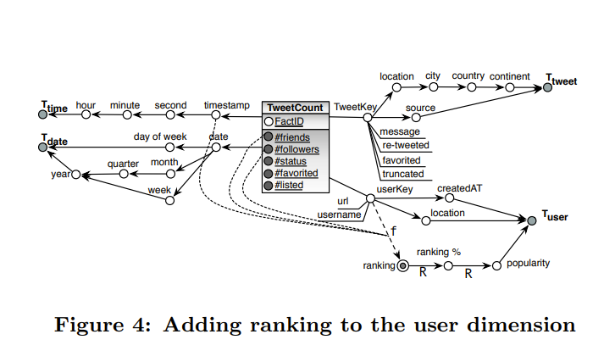
Novelty continued…

Slide 15
Validation
In this paper the author uses semi-structured data for extraction of multidimensional data cube for OLAP and including the static, derived and dynamic categories in the existing model using Data Mining methods.
The paper considered different sources to enrich the data using external sources and API’s for application of knowledge discovery techniques.
The author further validates the novelty of newly discovered categories at the conceptual and logical level by implementing slowly changing Dimensions.

Slide 16
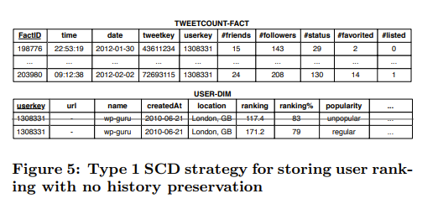
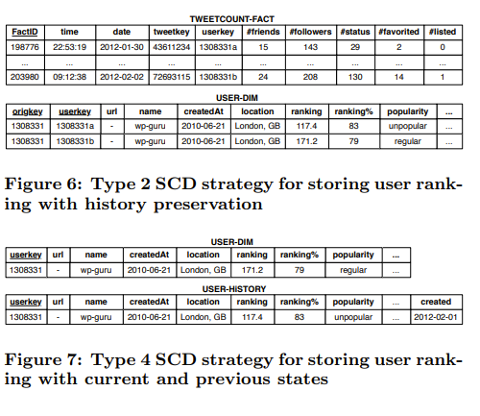
In short the authors successfully demonstrated how their proposed method can be used to extract measures and dimensions from the XML schema and finally mapping it into a multidimensional model.

Slide 17
References
Mansmann, S., Rehman, N. U., Weiler, A., & Scholl, M. H. (2014). Discovering OLAP dimensions in semi-structured data. Information Systems, 44, 120-133.
Abelló, A., Samos, J., & Saltor, F. (2001, September). A framework for the classification and description of multidimensional data models. In International Conference on Database and Expert Systems Applications (pp. 668-677). Springer, Berlin, Heidelberg.
Han, J. (1997, October). OLAP mining: An integration of OLAP with data mining. In Proceedings of the 7th IFIP (Vol. 2, pp. 1-9).
MacLennan, J., Tang, Z., & Crivat, B. (2008). Mining OLAP Cubes, ch. 13
Mansmann, S., Rehman, N. U., Weiler, A., & Scholl, M. H. (2014). Discovering OLAP dimensions in semi-structured data. Information Systems, 44, 120-133.
Java, A., Song, X., Finin, T., & Tseng, B. (2007, August). Why we twitter: understanding microblogging usage and communities. In Proceedings of the 9th WebKDD and 1st SNA-KDD 2007 workshop on Web mining and social network analysis (pp. 56-65).
Strauch, C. (2011). NoSQL databases. Lecture selected topics on software-technology ultra-large scale sites. Manuscript. Stuttgart Media University.
Krikorian, R. (2012). Developing for@ twitterapi (techcrunch disrupt hackathon).
Grün, C., Holupirek, A., Kramis, M., Scholl, M. H., & Waldvogel, M. (2006). Pushing xpath accelerator to its limits. In ExpDB.
Kimball, R., & Ross, M. (2011). The data warehouse toolkit: the complete guide to dimensional modeling. John Wiley & Sons.

Slide 18
Thank You!

