Slide 1

THE PRODUCT COMPANY
TEAM 5
MURIEL BANZE
SAHIL SHAH
SIDDHARTH CHAUHAN

Slide 2
TABLE OF CONTENTS
Data Mart Design Definition
Universe of Discourse
Information Package
Entity Definitions
Dimensional Model
Data Staging: ETL – Data Extract File Definitions
Data Staging: ETL – Source-to-Target Mappings
SQL Code – Tables & Constraints
Data Staging Activities – ETL
Data Cleansing
Data Transformation
Table Population
End User Applications
Queries
A View
Aggregated Mata Marts
Handling Slowly Changing Dimensions (SCD)
Many-to-Many (N-M) Relationship Implementation Option
Appendix (Fix Lab #3 Problems)

Slide 3
DATA MART DESIGN DEFINITION
Universe of Discourse
The universe of discourse for the data mart is to handle The Product Company's distribution to its consumers across its three branches, namely PEC, TPCE, TPCW.
In order to maximize revenue with lower costs and maintain a stable relationship with vendors, the data mart also handles historical revenues, reports and net profit for all divisions.

Slide 4
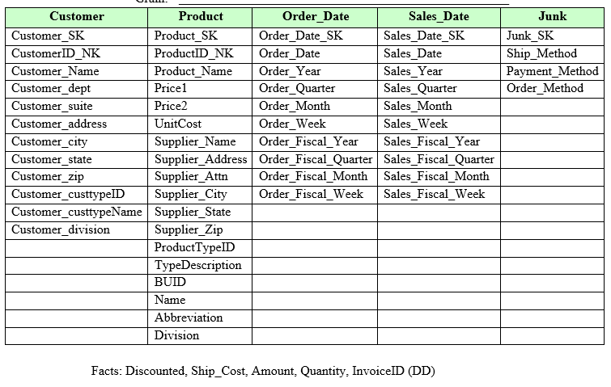
INFORMATION PACKAGE
Process Name: TPC and its Division's Financial Results.
Grain: Daily Sales for each customer, Product

Slide 5
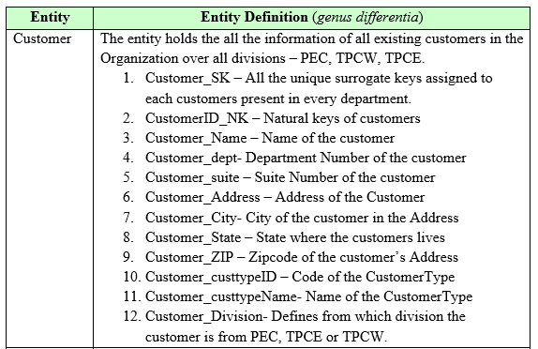
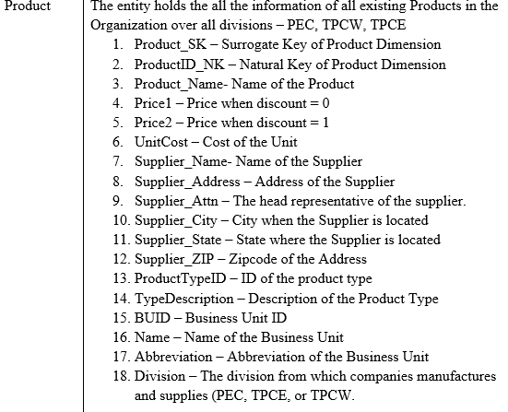
ENTITY DEFINITIONS – CUSTOMER AND PRODUCT TABLES

Slide 6
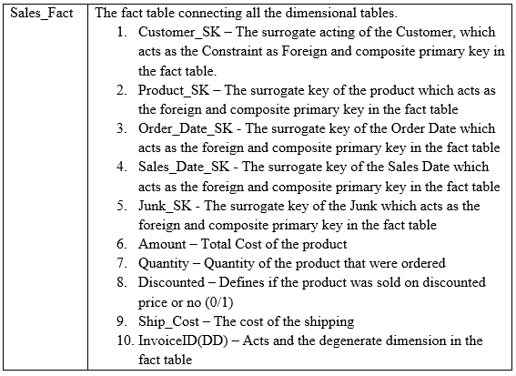
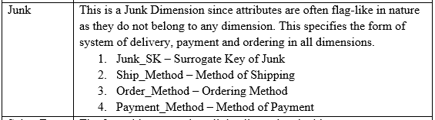
ENTITY DEFINITIONS – JUNK AND FACT TABLES

Slide 7
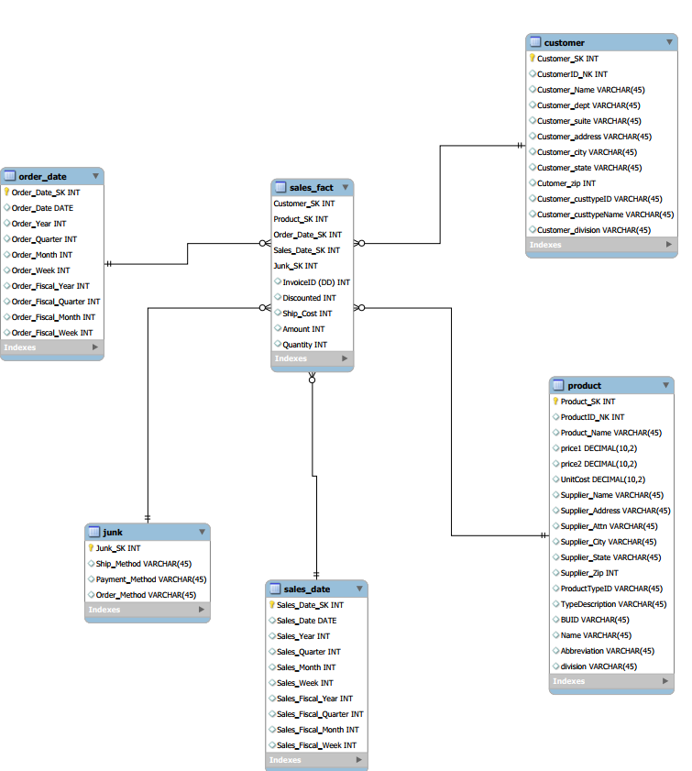
DIMENSIONAL MODEL

Slide 8
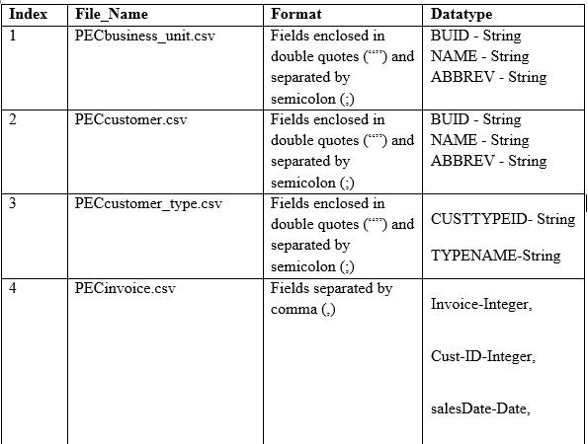
DATA STAGING: ETL – DATA EXTRACT FILE DEFINITIONS
Data Source – PEC

Slide 9
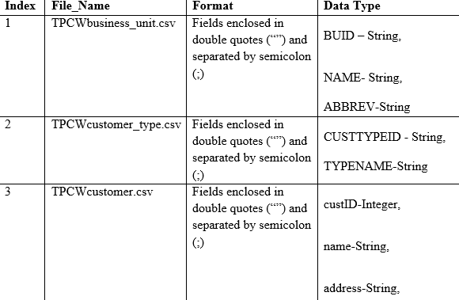
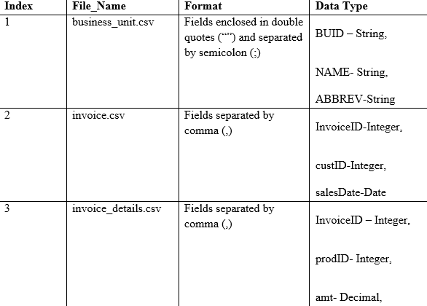
DATA STAGING CONTINUED…
Data Source – TPCW
Data Source – TPCE

Slide 10
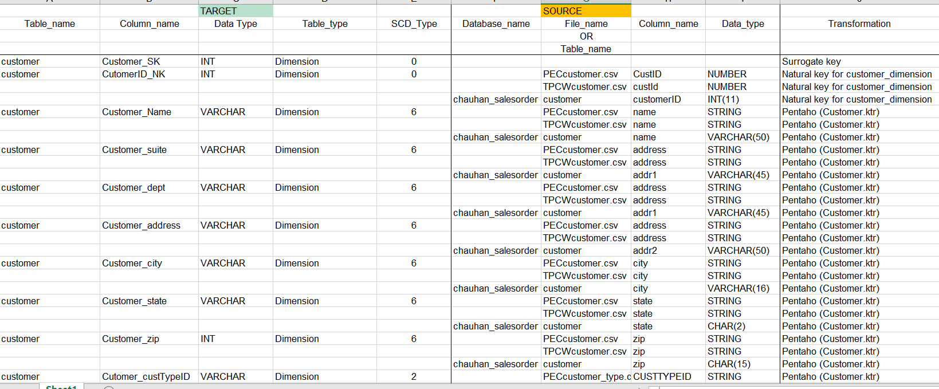
DATA STAGING: ETL – SOURCE-TO-TARGET MAPPINGS
Snapshot displaying source to target mapping of data
Reference File : Mapping.xlsx

Slide 11

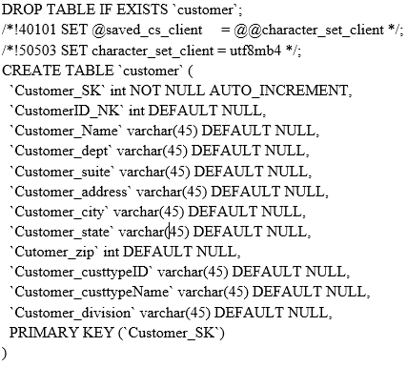
SQL CODE – TABLES & CONSTRAINTS
Creating `salesorder_5_2201`
Query
Customer dimension:
Query

Slide 12
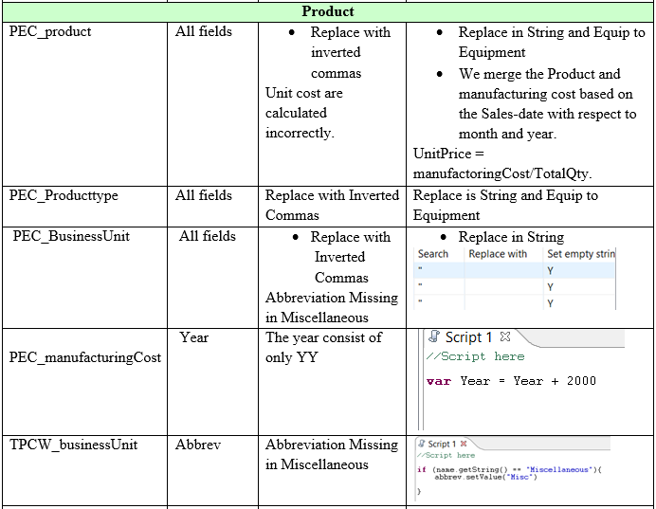
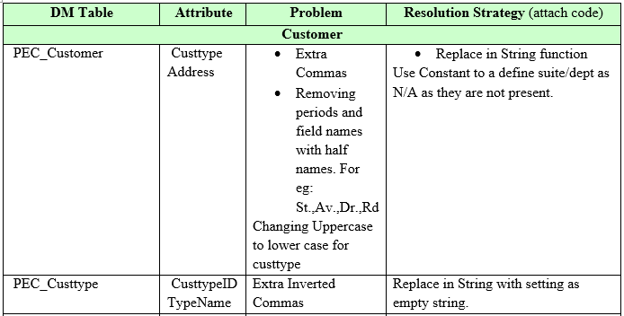
DATA STAGING ACTIVITIES - ETL
Data Cleansing:
Snapshot displaying data cleansing for Customer dimension
Snapshot displaying data cleansing for Product dimension

Slide 13
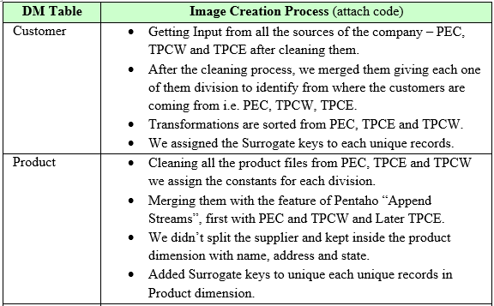
DATA STAGING ACTIVITIES CONTINUED…
Data Transformation:
Snapshot displaying data transformation for Customer and Product dimension

Slide 14
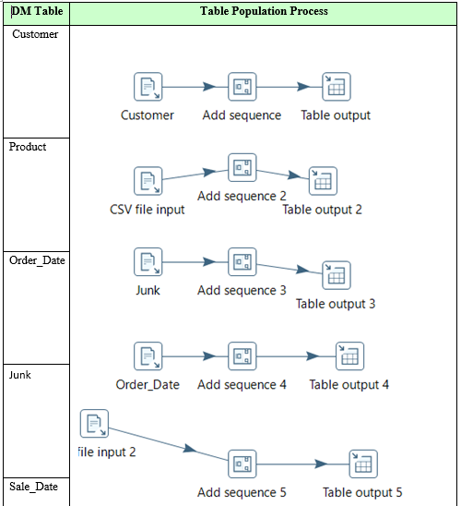
DATA STAGING ACTIVITIES CONTINUED…
Table Population:
Snapshot displaying data population for Customer, Product, Order date, Junk and Sales date dimensions

Slide 15
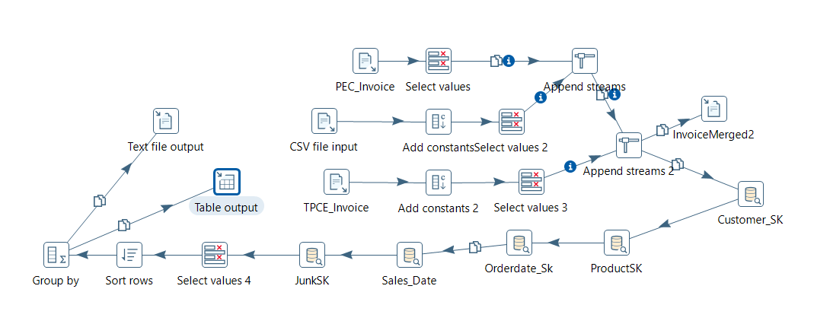
DATA STAGING ACTIVITIES CONTINUED…
Sales_Fact
Merging each tables using Database Lookup with surrogate keys of Customer, Product, Sales_Date, Order_Date and Junk.
Matching the records based on Natural Keys and Division in similarity.
Group by the records for redundant records of the same SK for the population of the fact table.
Snapshot displaying data transformation for Sales fact dimension

Slide 16
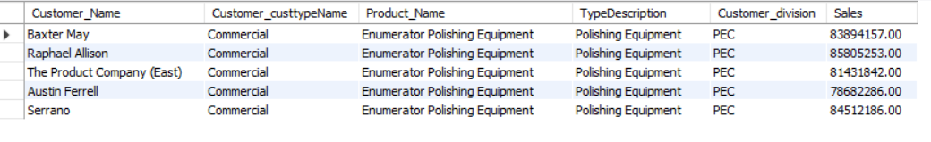
END USER APPLICATIONS
Queries:
Report that is showing Top 5 Customers of Each Division with customer_Type, Product description, name and total sales amount. (PEC, TPCE, TPCW)
1. Query for PEC:
select c.Customer_Name, c.Customer_custtypeName, p.Product_Name, p.TypeDescription, c.Customer_division, SUM(Amount) as Sales from sales_fact AS sf
join customer AS c using(Customer_SK)
join product as p using(Product_SK)
where c.Customer_division = "PEC"
group by c.Customer_Name, C.Customer_state
order by sum(Sales) DESC LIMIT 5;
Output:

Slide 17
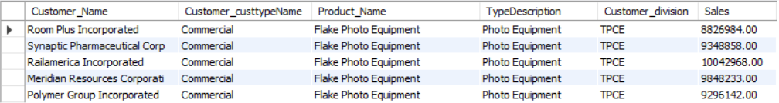
END USER APPLICATIONS – QUERIES CONTINUED…
2. Query for TPEC:
select c.Customer_Name, c.Customer_custtypeName,p.Product_Name, p.TypeDescription, c.Customer_division,SUM(Amount) as Sales from sales_fact AS sf
join customer AS c using(Customer_SK)
join product as p using(Product_SK)
where c.Customer_division = "TPCE"
group by c.Customer_Name, C.Customer_state
order by sum(Sales) DESC LIMIT 5;
Output:
Supporting Index(es): Customer_Name, Customer_custtypeName, Customer_Division(Customer), Product_Name, TypeDescription(Product), Sales(sales_fact)

Slide 18
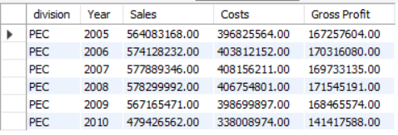
END USER APPLICATIONS – VIEW
A View:
The view reports the sales report for each year, sales, cost and calculate the profit with respect to division to see who did good in all those years.
1. Query for PEC:
CREATE VIEW PEC_gross_profit_year AS
SELECT view1.division, view1.Year, view1.Sales, view1.Costs, (view1.Sales-view1.Costs) 'Gross Profit'
FROM (SELECT p.division, s.Sales_Year 'Year', SUM(salesfact.Amount) 'Sales', SUM(p.UnitCost * salesfact.Quantity) 'Costs'
FROM sales_fact salesfact JOIN product p USING (Product_SK)
JOIN sales_date s USING (Sales_Date_SK)
WHERE p.division = "PEC"
GROUP BY s.Sales_Year) view1;
Query:
select * from PEC_gross_profit_year;

Slide 19
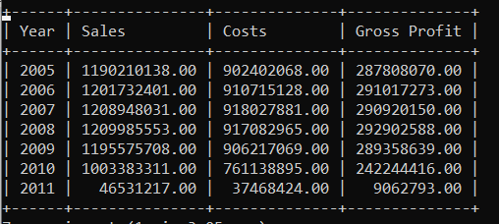
END USER APPLICATIONS – VIEWS CONTINUED…
2. Query for overall all the divisions
CREATE VIEW alldivisions_gross_profit_year AS
SELECT view4.division, view4.Year, view4.Sales, view4.Costs, (view4.Sales-view4.Costs) 'Gross Profit'
FROM
(SELECT p.division, s.Sales_Year 'Year', SUM(salesfact.Amount) 'Sales', SUM(p.UnitCost * salesfact.Quantity) 'Costs'
FROM sales_fact salesfact JOIN product p USING (Product_SK)
JOIN sales_date s USING (Sales_Date_SK)
GROUP BY s.Sales_Year) view4;
Query:
select * from alldivisons_gross_profit_year;

Slide 20
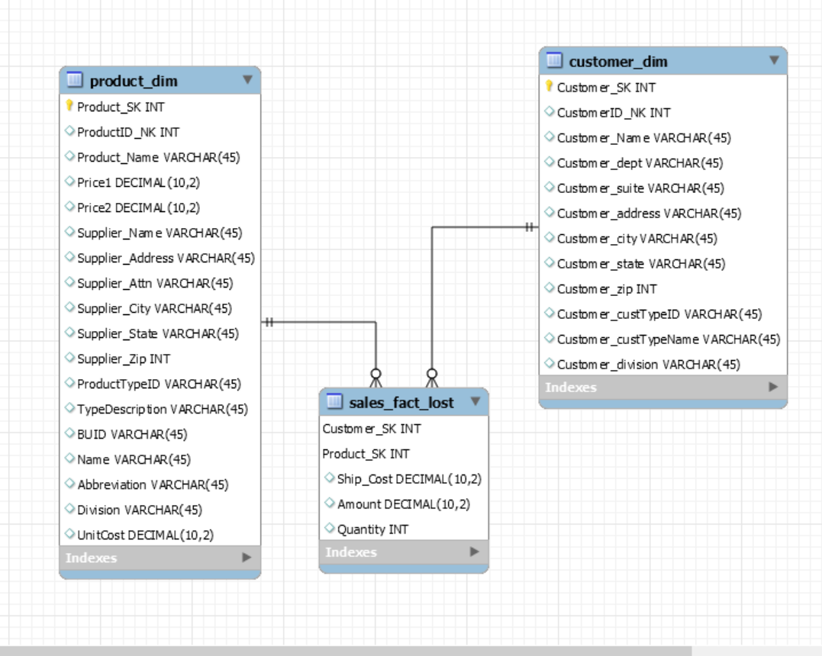
END USER APPLICATIONS – AGGREGATED DATA MARTS
Aggregated Mata Marts:
Lost Aggregated Data Mart
Aggregation method: Lost Dimension
Use Case: In this use case we kept Customer and Product dimension. In lost aggregated dimension, one or more dimensions are removed, in this use case we removed sales date, Order date, Junk Dimension. The remaining dimensions can be used in finding the most popular product and the top customers.
Creation of Tables: For this kind of aggregation we created the tables using MySQL Workbench and used “Forward Engineering” to further create the data mart
Snapshot displaying ERD for lost aggregated data mart

Slide 21
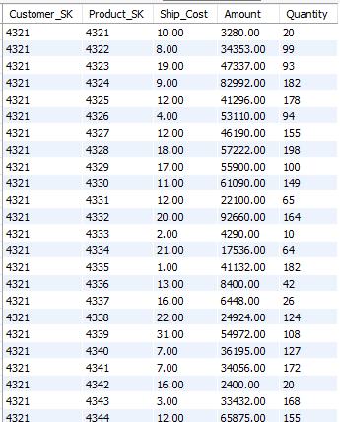
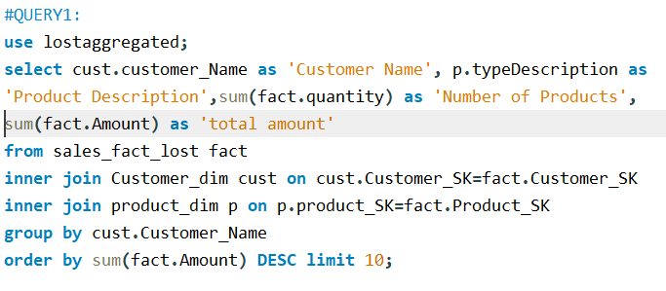
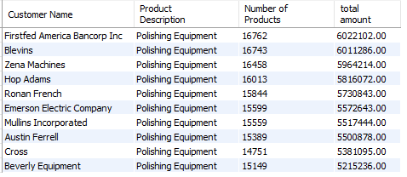
AGGREGATED DATA MARTS CONTINUED....
User Queries:
File: LostAggregation.mwb
Snapshot displaying Output of the fact table
Snapshot displaying result for Query 1

Slide 22
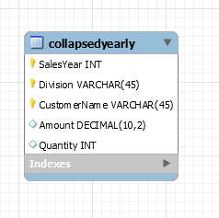
AGGREGATED DATA MARTS CONTINUED....
Collapsed Aggregation
Aggregation Method: Collapsed Aggregation Dimension
Use Case: In collapsed aggregated Data mart we removed the surrogate key and use the attributes of useful dimensions and combines them into fact table. Here we used sales_year from sales_date dimension, Division and CustomerName from Customer dimension.
Snapshot displaying ERD for Collapsed aggregated data mart

Slide 23
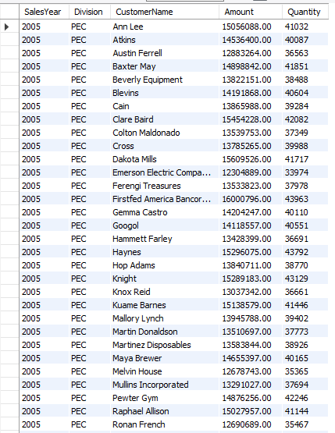
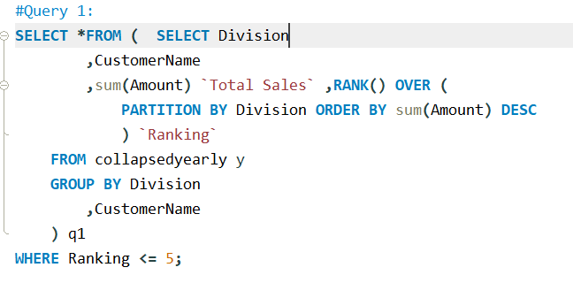
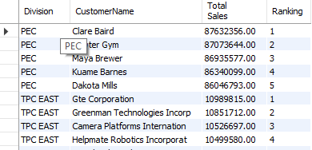
AGGREGATED DATA MARTS CONTINUED....
User Queries:
Snapshot displaying the final result after implementing the collapsed aggregation method
Snapshot displaying result for Query 1

Slide 24
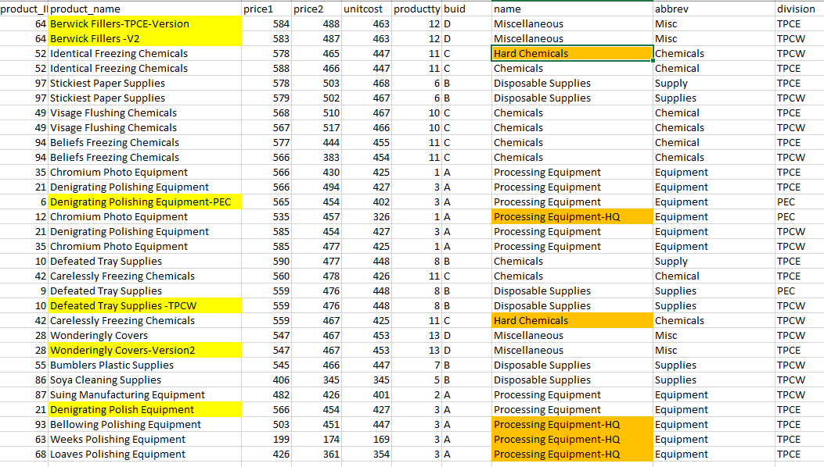
HANDLING SLOWLY CHANGING DIMENSIONS (SCD)
Created Sample Slowly Changing Dimension records in Product and Customer dimension
Source File : SCD_Data/SCD1_Data
Rows : 30
Highlighted Parts:
Product_Name (Yellow) : SCD1 Implementation
Name(Orange): SCD1 Implementation

Slide 25
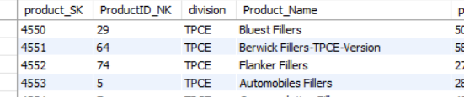
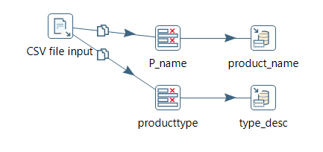
SCD TYPE 1
SCD Type 1:
The implementation of the type1 on columns Product_name and name from Product table as history is not necessary to be kept as it is and it can change overtime.
We implemented SCD1 using the Pentaho, the file is SCD1.ktr, where we used the feature Output->Insert/Update to implement type1
Output:
Snapshot displaying SCD type 1 implemented using Pentaho

Slide 26
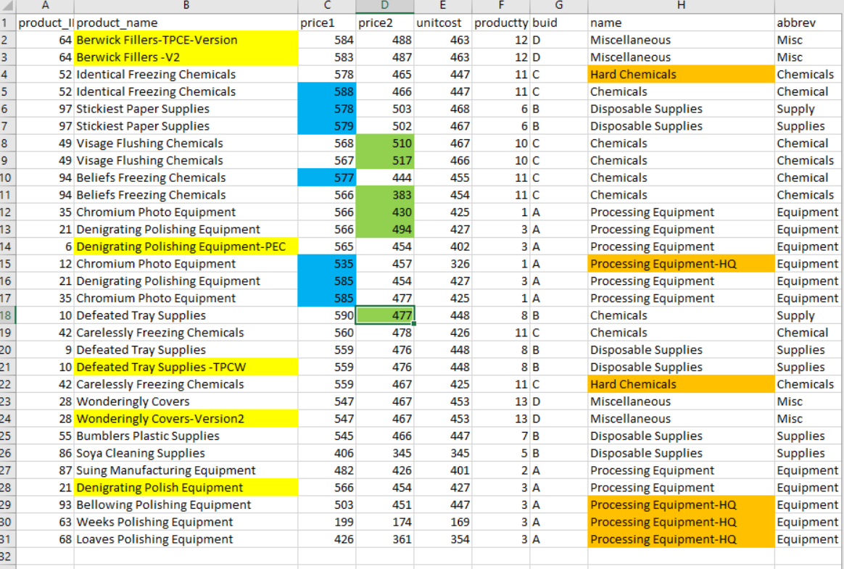
SCD TYPE 2
SCD Type 2
Source : SCD1_Data
Rows:30
Highlighted Part:
Price1 (Blue) : SCD type 2
Price2 (Green) : SCD type 2

Slide 27
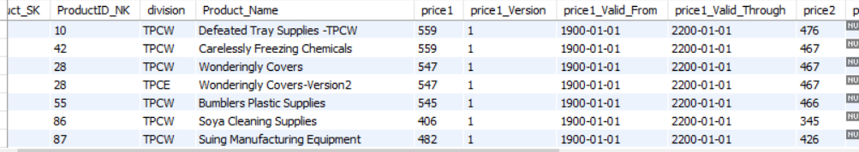
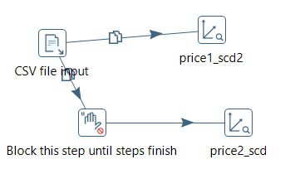
SCD TYPE 2 CONTINUED…
SCD Type 2:
Implementing the price 1 and price2 to keep the track of the changes in the prices with their version numbers.
Implemented using the Dimension lookup/Update for Type2
Output:
Snapshot displaying SCD type 2 implemented using Pentaho

Slide 28
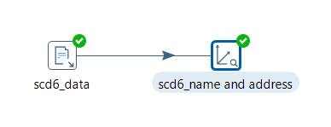
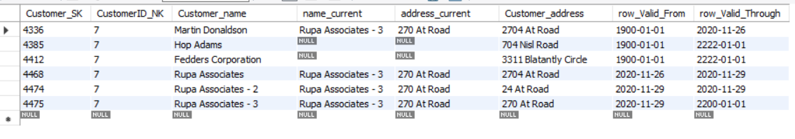
SCD TYPE 6
SCD Type 6
We implemented SCD Type-6 on the columns name and address from the customer_dimension. We did so because the history of these attributes is important and should be maintained.
Also, Type 6 SCD adds a current field that determines the current record and the date it is valid till.
We implemented SCD-6 using Pentaho transformation (scd6.ktr). In the transformation, we used the step Data Warehouse → Dimension lookup/ update to implement SCD Type-6.
Snapshot displaying SCD type 6 implemented using Pentaho
Output:

Slide 29
MANY-TO-MANY (N-M) RELATIONSHIP IMPLEMENTATION OPTION
A Many-to-Many relationship is defined as a relationship between a parent and the child tables in a database. A parent row consists of multiple child rows in the other table. In a relational database design, many-to-many relationships are not permitted due to the following issues:
Causes data redundancy
Difficulty in inserting, updating, and deleting the data.
In many real-world applications N:M relationships are often used and normalizing the fact table is not an option

Slide 30
MANY-TO-MANY (N-M) RELATIONSHIP IMPLEMENTATION OPTION CONTINUED…
Several approaches exist in dealing Many-to-Many relationships such as:
Joining or Bridging tables.
Lowering the grain of the fact table
De-normalizing the Dimension Table by Positional-Flag Attributes
De-normalizing the Dimension Table by Non-Positional attributes & a Concatenated Field
For our model we have decided to implement the Bridge method. Here a look-up table is created which consists of the surrogate keys for both the Product and Shipping company.
We intent to find details of the supplier which in our case is present in the Product dimension. Here, many-to-many relationship can occur since there is a possibility of suppliers have multiple shipping contracts. Likewise, the shipping company can have multiple suppliers. The Kimball’s method is a better approach since it minimizes redundancy. In this case the issue lies in assigning weights allotted to a contractor. The bridge method would reduce redundancy by making sure these weights do not exceed 1
Rowen, W., Song, I. Y., Medsker, C., & Ewen, E. (2001). An analysis of many-to-many relationships between fact and dimension tables in dimensional modeling. In International Workshop on Design and Management of Data Warehouses (DMDW 2001), Interlaken Switzerland (pp. 1-13).

Slide 31
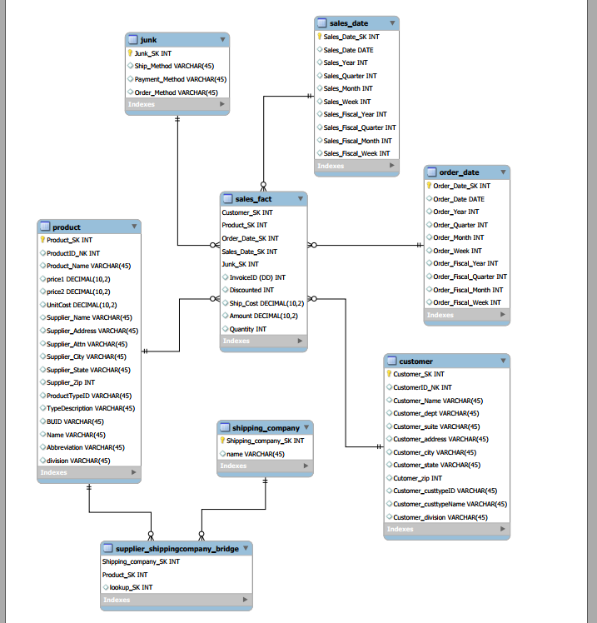
Many to Many relationship using Bridge table

Slide 32
APPENDIX (FIX LAB #3 PROBLEMS)
Rationale for Final Schema Design: The designing of the final schema design, we merged the Supplier in the Product itself to keep the track the whole product values as the same. The reason behind it, because the two divisions can sell the same product, but prices and supplier can be different, so it's easy to keep intact to track down the information.

Slide 33

THANK YOU

