Slide 1


Machine learning to predict factors contributing to treatment success for drugs / alcohol substance use disorder
Muriel Banze
Information Technology and Analytics
Rochester Institute of Technology
Supervised by
Dr. Michael McQuaid Prof. David Patric
Project Committee Chair. Project Committee

Slide 2
Table of Contents
Introduction
Problem Statement
Literature Review
Goals and Objectives
Methodology
Results
Conclusions
Limitations and Future Scope
Lessons Learned
References

Slide 3


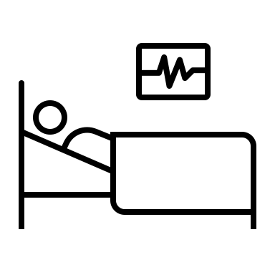
INTRODUCTION
Substance abuse such as drugs or alcohol has always been an issue that has had a significant impact on an individual’s health and maintaining sobriety following treatment has always been challenging.
Repeated use of illegal substances can lead to cognitive impairment and physical deterioration, both of which could adversely impact daily activities.
According to the Centers for Disease Control and Prevention (CDC), about 841,000 individuals have died of overdose since 1999.
By understanding the basic needs of individuals based on the severity of their addiction, we can administer the right kind of treatment to avoid relapse.

Slide 4
Problem Statement
In an ideal scenario, a person with a substance abuse disorder would be cared for properly and would not relapse.
In reality, most patients do not receive the right services and are released early due to poor diagnosis.
As a result, there is a need to discover factors that can help to a healthy recovery once the patient’s treatment is completed. Machine learning can be used to estimate the chances of a patient recovering from substance abuse depending on the various services provided at the facility.

Slide 5
Literature Review
Machine learning has been used to detect substance abuse, assess hazards, and predict treatment effectiveness. Nath et al., 2017 presented a methodology for determining whether or not a person has consumed volatile substances. Artificial neural networks were employed, with ANN-D predicting volatile drug consumption and ANN-C determining time of usage for day, week, month, and year. According to this study, personality characteristics, impulsivity, demography, and sensation were important features included in the analysis. The drawback to this study is that just five factors are not enough attributes to provide a high accuracy in the ANN-C model.
Afzali et al. (2019) describes adolescent usage of alcohol by making a cross cultural evaluation between Canada and Australia. Using machine learning it compared using binary logistic classification along with RF, SVM, lasso. The drawback of this study was that personality traits were not considered since it can be a factor contributing to consuming alcohol.
Chawla et al. (2002), defines various approaches to dealing with imbalanced classes. The SMOTE technique for synthetic data generation is examined to determine the difference in model performance. This study also suggests that using both SMOTE and under sampling approaches resulted in higher prediction accuracies.

Slide 6
Goals and Objectives
The overall goal of this project is to suggest factors that can aid in successful treatment. This project will indicate the number of days for a patient to fully recover.
Goal 1: Data pre-processing:
Objective 1: Analyze the dataset from the US Department of Health and Human Services.
Objective 2: Carry out data pre-processing tasks such as handling null values and feature selection.
Objective 3: Split the dataset into train and test sets and check for imbalanced data.
Goal 2: Perform Exploratory Data analysis:
Objective 1: Build machine learning algorithms such as Logistic regression, K-Nearest Neighbor, Decision trees, Naive Bayes, and Random Forest.
Objective 2: Select the best performing model based on accuracy, precision, recall, specificity, ROC (Receiver Operating Characteristics) curve and AUC values.
Objective 3: Based on various input data, make predictions to identify essential factors for successful treatment completion.
Goal 3: Data visualization:
Objective 1: Create visualizations based upon the frequency distributions for the features using bar charts and show the best factors that are crucial for treatment completion.

Slide 7
Methodology
Data source and description
The dataset was obtained from the website for Substance Abuse and Mental Health Services Administration SAMHDA of the United States Department of Health and Human Services SAMHDA, 2021
This dataset comprises of about 1,722,503 rows along with 76 columns and to implement our model, only a subset of data is used. This subset consists of about 193,267 rows of data with 30 columns. (Independent - 29, Dependent - 1)

Slide 8
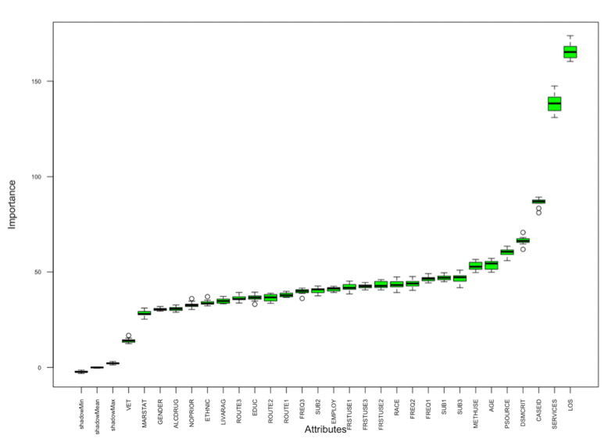
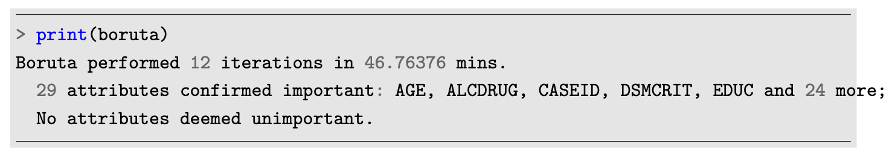
Data Pre-processing
Taking care of missing data
Feature selection
Wrapper method using Boruta algorithm
The Boruta algorithm tries to capture features from the dataset that are important with respect to the response variable. This algorithm gives a call on the significance of features on the dataset.
Figure 2: Code Output from the Boruta Algorithm
Figure 1: Box plot displaying Attributes ranked by Importance using the Boruta Algorithm

Slide 9
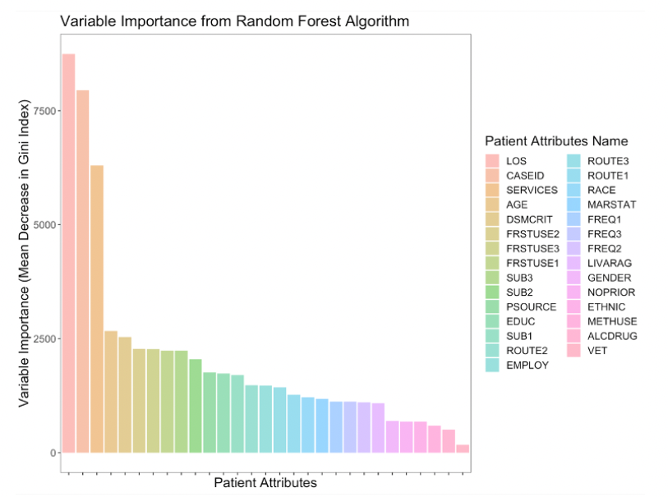
Data Pre-processing
Using Random Forest
Random forest utilizes a tree- based technique that ranks nodes depending on how effectively they improve node purity.
Figure 3: Bar chart displaying Attributes ranked by Importance using the Random Forest algorithm

Slide 10
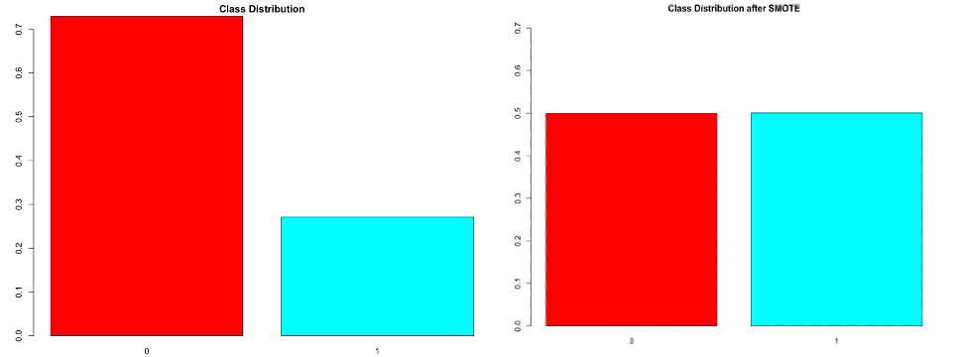
Data Pre-processing
Handling class imbalance
The dataset consists of imbalanced classes since the distribution is unequal and is highly skewed on the 0 (i.e., Treatment Incomplete).
Low sensitivity = 5176 successful treatment.
High specificity = 26430 Incomplete treatment.
The main aim of this project is to not predict 0’s but predict 1’s i.e., determine the maximum likelihood that a patient will complete the treatment.
Methods:
I. Oversampling
ii. Under sampling
iii. Synthetic minority sampling technique (SMOTE)
Figure 4: Bar chart displaying Class Distribution of Treatment Status before and after using the SMOTE technique

Slide 11
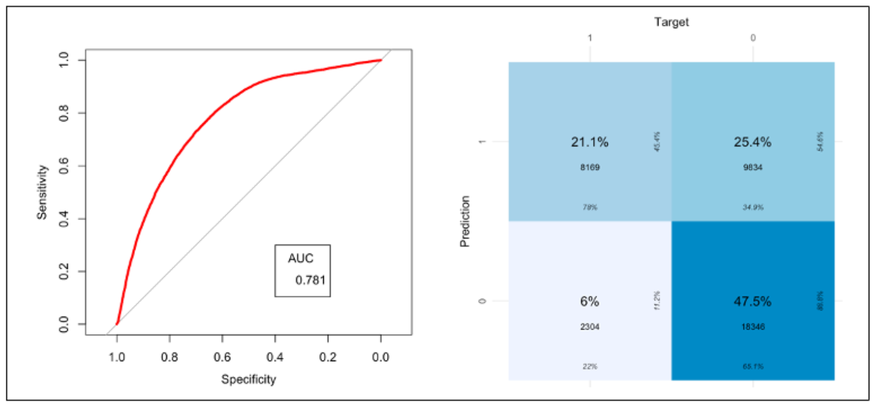
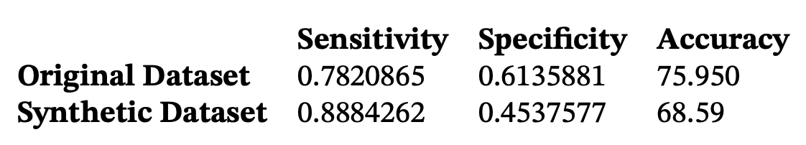
Machine Learning Algorithms
Logistic Regression
Logistic Regression is a supervised classification approach that assigns observations (features x) to one of a number of discrete classes (response y).
The sensitivity, i.e., predicting class 0 (treatment incomplete), was enhanced by utilizing synthetic data, but the specificity of predicting class 1 (Treatment complete) was only 0.45
Figure 5: ROC Curve and Confusion Matrix for Logistic Regression synthetic dataset
Table 1: Comparing performance metrics of Original and Synthetic Data sets using Logistic Regression

Slide 12
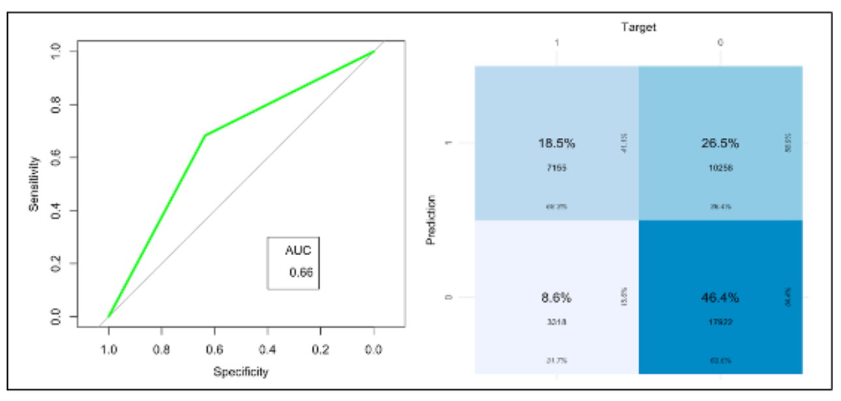
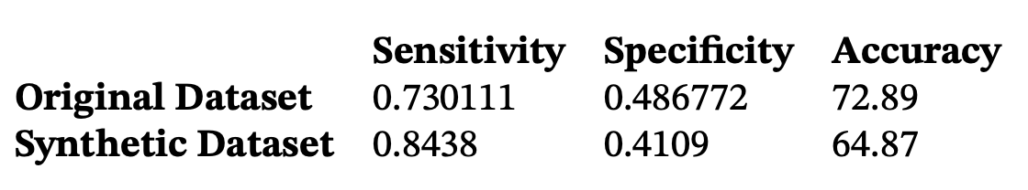
Machine Learning Algorithms
K – Nearest Neighbors
K-Nearest Neighbors (K-NN) is a supervised machine learning method that predicts output data points based on input data labels. The KNN method employs the notion of feature similarity, which it accomplishes by determining the proximity or similarity of the input data point to its neighbor and classifying it appropriately to the class that is highly similar in nature.
Figure 6: ROC Curve and Confusion Matrix for the KNN synthetic dataset
Table 2: comparing performance metrics of Original and Synthetic Data sets using K-Nearest Neighbors

Slide 13
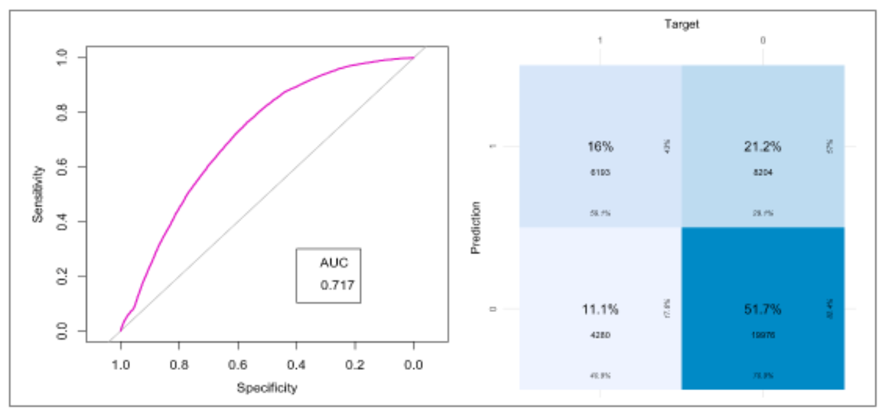
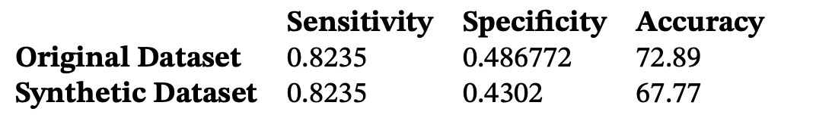
Machine Learning Algorithms
Naive Bayes
Naïve Bayes is also a supervised learning algorithm that consists of a family of simple probabilistic classifiers that are based on the Bayes theorem. It consists of strong ”nave” independent assumptions between the features of the dataset.
Figure 7: ROC Curve and Confusion Matrix for the Naive Bayes synthetic dataset
Table 3: comparing performance metrics of Original and Synthetic Data sets using Naive Bayes Accuracy

Slide 14
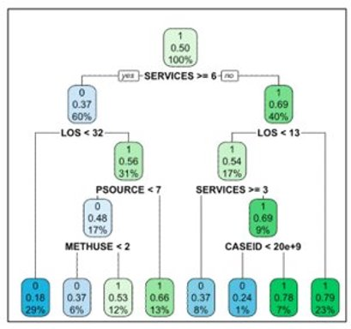
Machine Learning Algorithms
Decision Trees
The Decision Tree method is a supervised learning machine learning technique that may be used to solve classification and regression problems. This tree has the structure of an inverted tree, with each node representing a feature/predictor variable and the connections linking these nodes indicating decisions.
Figure 8: Plot for the Decision Tree algorithm on synthetic dataset

Slide 15
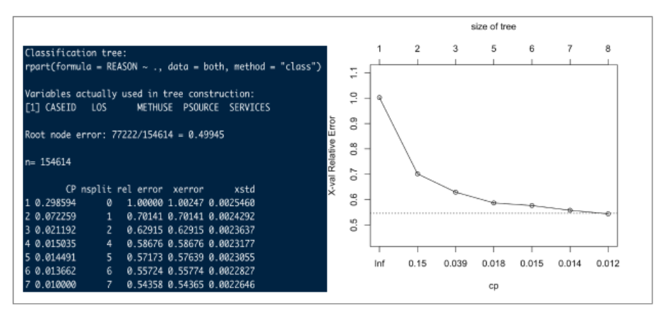
Machine Learning Algorithms
Pruning decision tree on the synthetic dataset
Pruning decision trees is a technique implemented in machine learning algorithms to reduce the size of the decision trees.
This is done by pruning i.e., removing non-critical and redundant section of the trees which helps in improving the accuracy, reduces complexity and reduces over-fitting of noise from the train set.
Figure 9: Number of variables used to construct the decision tree and Display Cp error rate

Slide 16
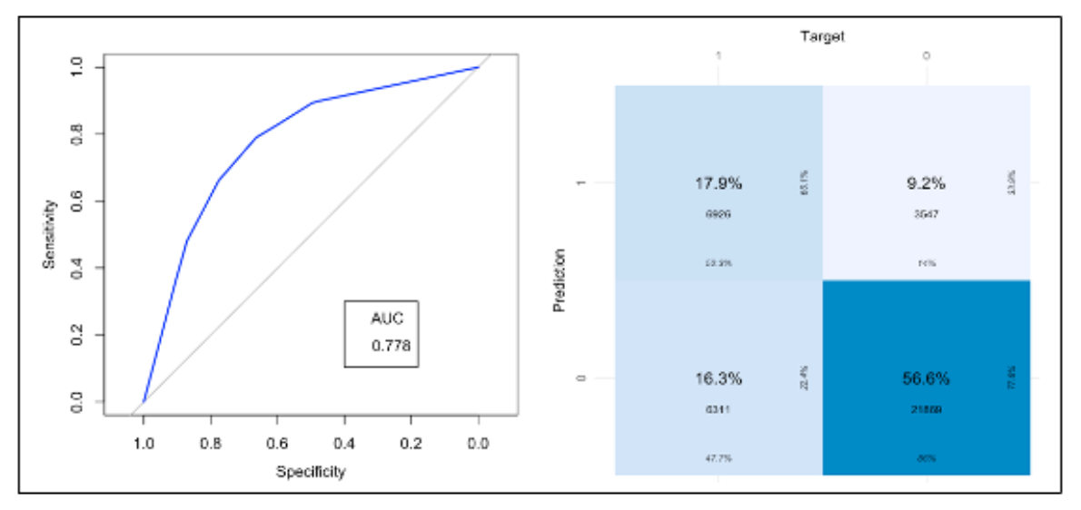
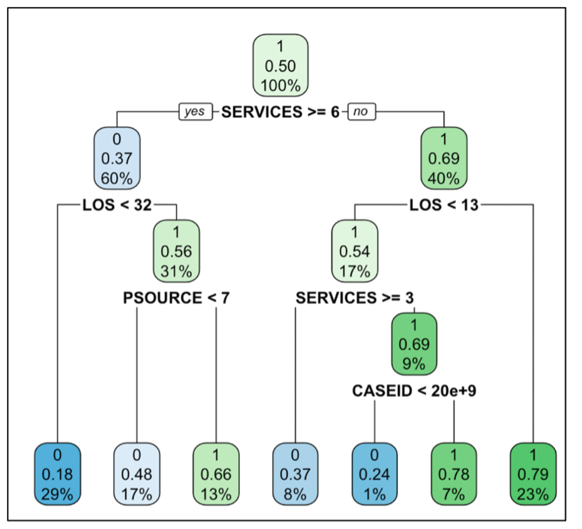
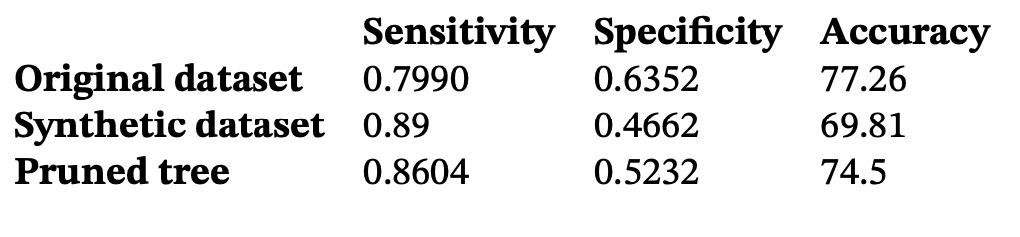
Machine Learning Algorithms – PRUNED Decision tree
Figure 11: ROC Curve and Confusion Matrix for Pruned Decision Tree
Figure 10: Pruned Decision Tree
Table 4: Comparing performance metrics of Original and Synthetic Data sets using Decision Trees

Slide 17
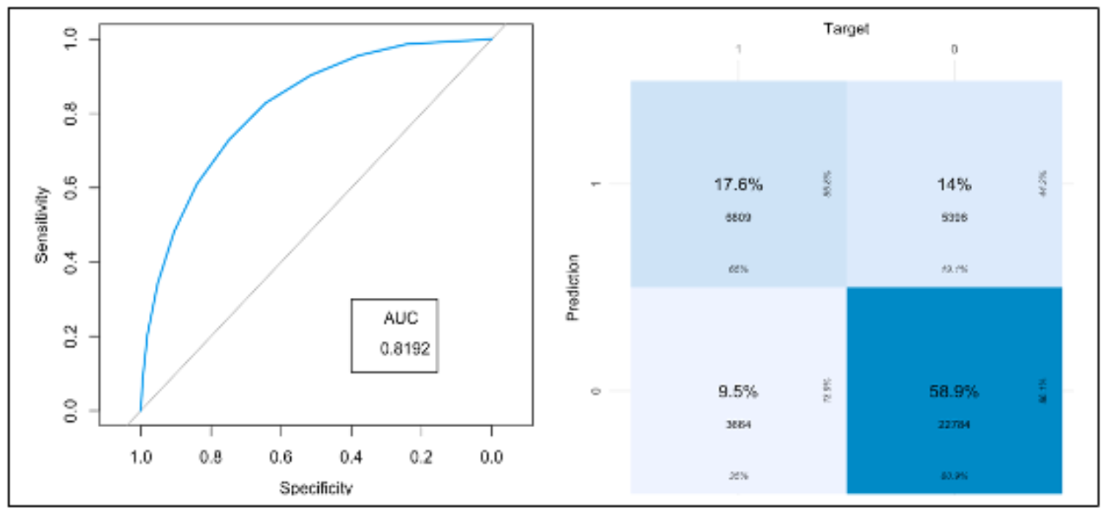
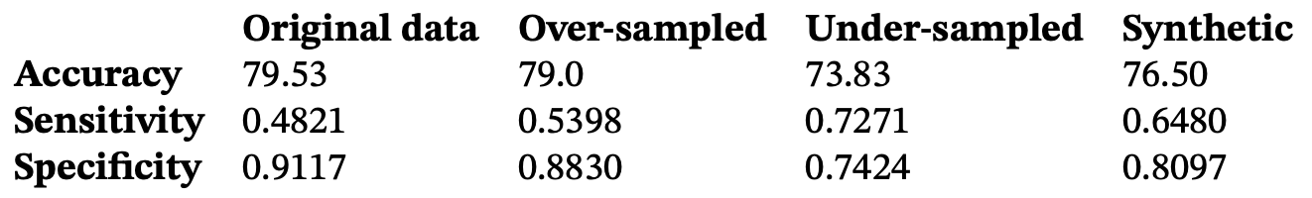
Machine Learning Algorithms
Random Forest (Core Algorithm)
Random Forest algorithms also known as bootstrap aggregation regression trees that can deal with models having high variance and low predictive powers. It is used for both classification and regression which creates a forest with many trees.
Figure 12: ROC Curve and Confusion Matrix for the Random Forest synthetic dataset
Table 5: Comparing performance metrics of Original, Over-sampled, Under- sampled and Synthetic Data sets using Random Forest

Slide 18
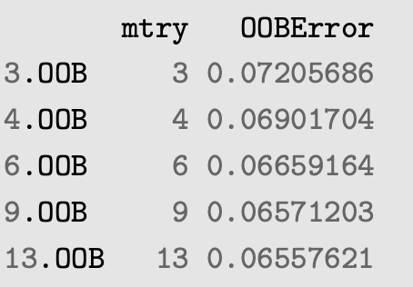
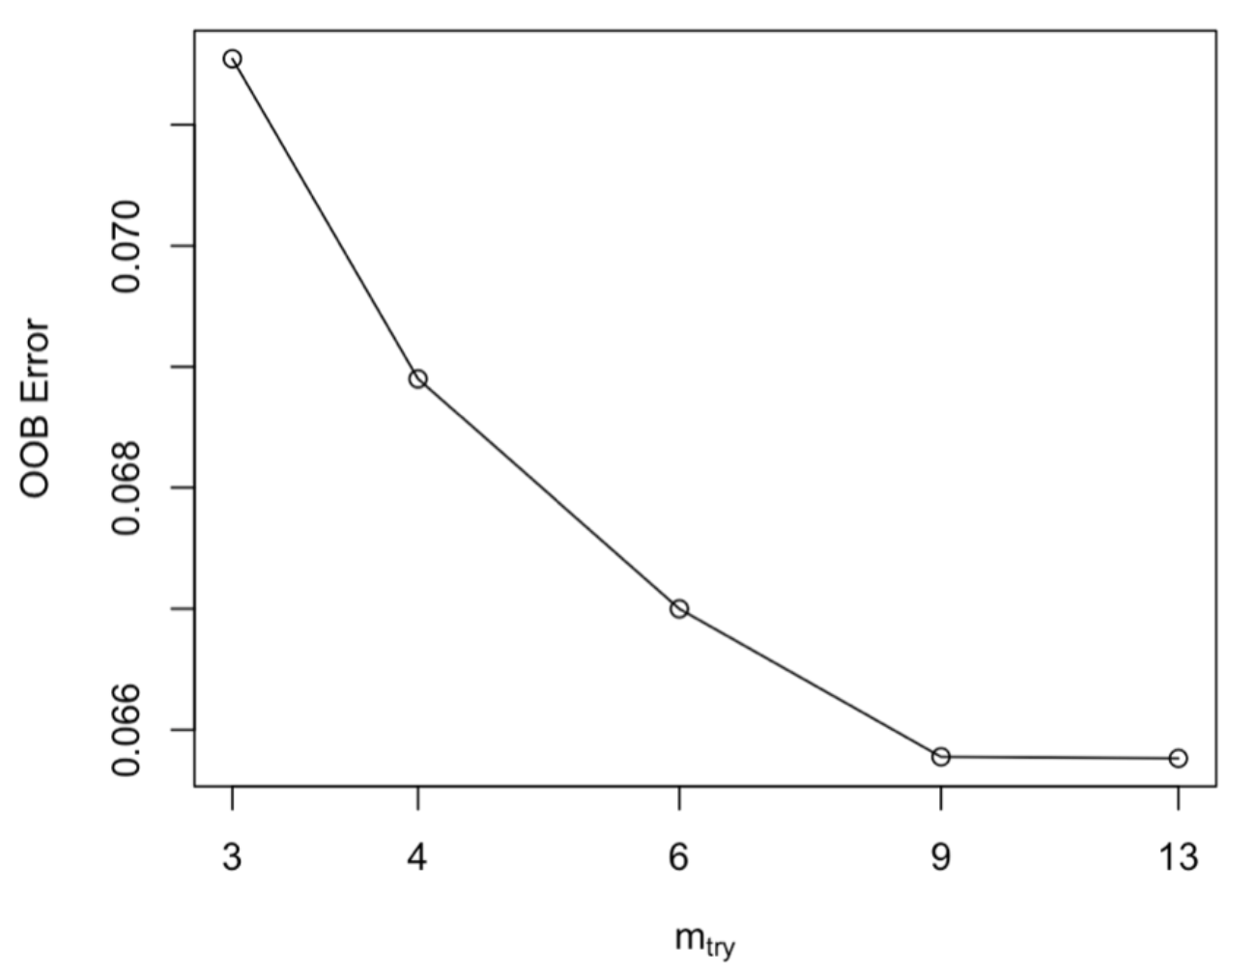
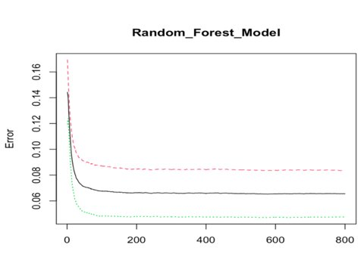
Machine Learning Algorithms - Fine tuning
Hyper-parameter tuning: The parameters such as ntree and mtry can be used to increase the model’s predictive accuracy.
ntree: The ntree parameter indicates the number of trees to grow. Larger trees are complex and are computationally expensive to build. Default value of ntree = 500, Accuracy = 77%
mtry: The mtry parameter indicates to the number of variables that need to be selected during a node split. To avoid the chances of over-fitting, ensure that the values of mtry are not small.
Figure 13: Tune Random Forest algorithm to find the optimal mtry parameter
Figure 14: Plot showing the value for mtry vs OOB Error
Figure 15: Plot displaying tree size vs error rate

Slide 19
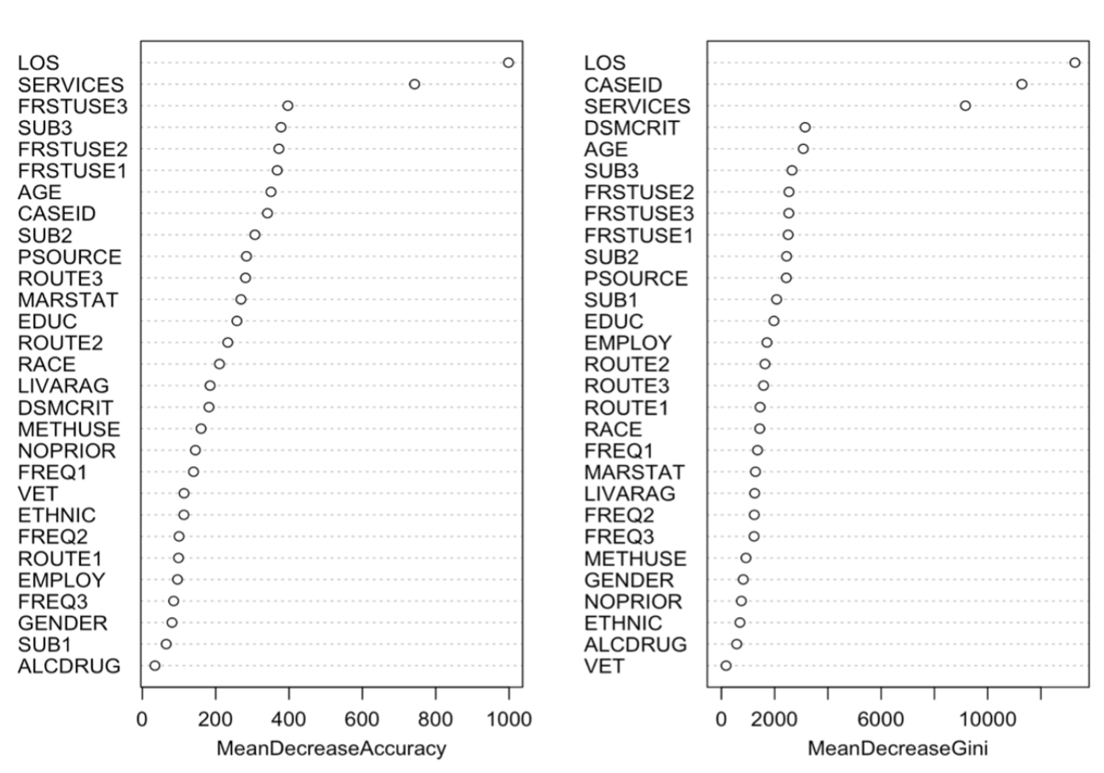
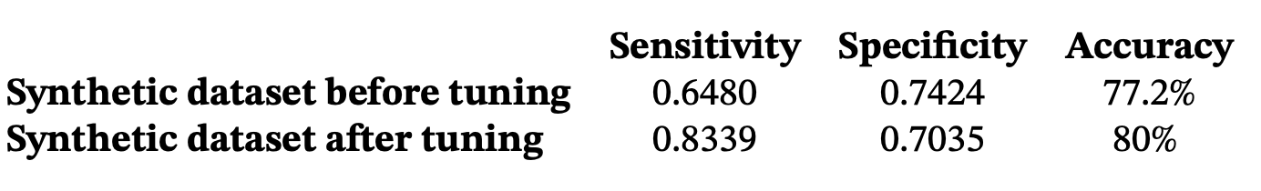
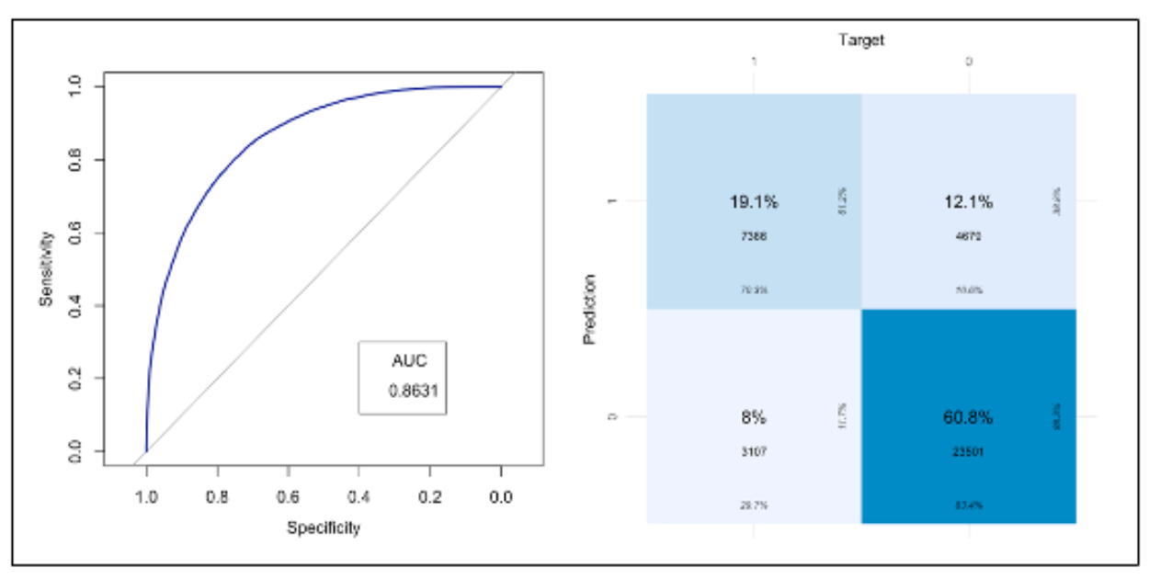
Machine Learning Algorithms - Fine tuning
Table 6: Comparing performance metrics of both synthetic data before and after fine tuning
Figure 16: Plot displaying mean decrease of attributes using Accuracy and Gini Index
Figure 17: ROC Curve and Confusion Matrix for fine-tuned Random Forest dataset

Slide 20
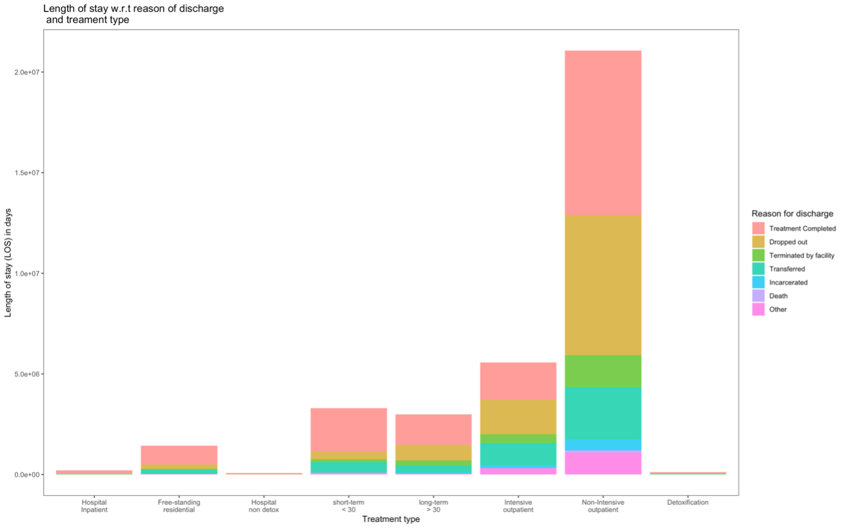
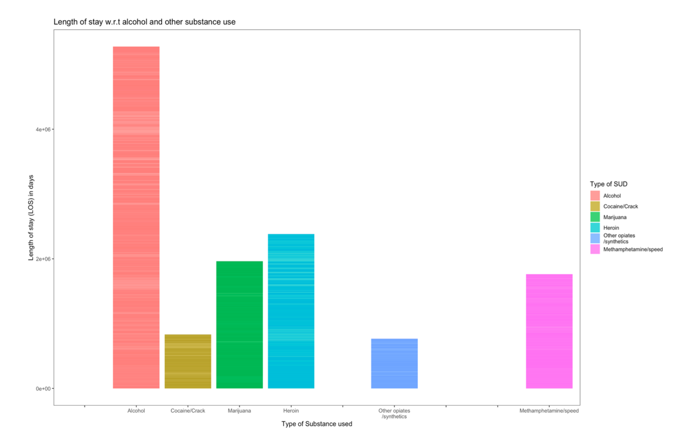
Data Visualizations
According to the Random forest algorithm, the most important factor is the LOS (Length of stay) variable see Figure 16, Stacked bar charts are created to visualize how Length of stay relates to other variables such as the type of treatment and the type of substances consumed.
Hospital Inpatient | Free-standing residential | Hospital non detox | Short term < 30 | Long term > 30 | Intensive outpatient | Non-Intensive outpatient | Detoxification
 | Alcohol | Cocaine/Crack | Marijuana | Heroin |  | Other opiates | MDMA
Figure 18: Bar chart indicating Length of stay w.r.t Reason of discharge and Treatment type
Figure 19: Bar chart indicating Substance in use vs Length of stay

Slide 21
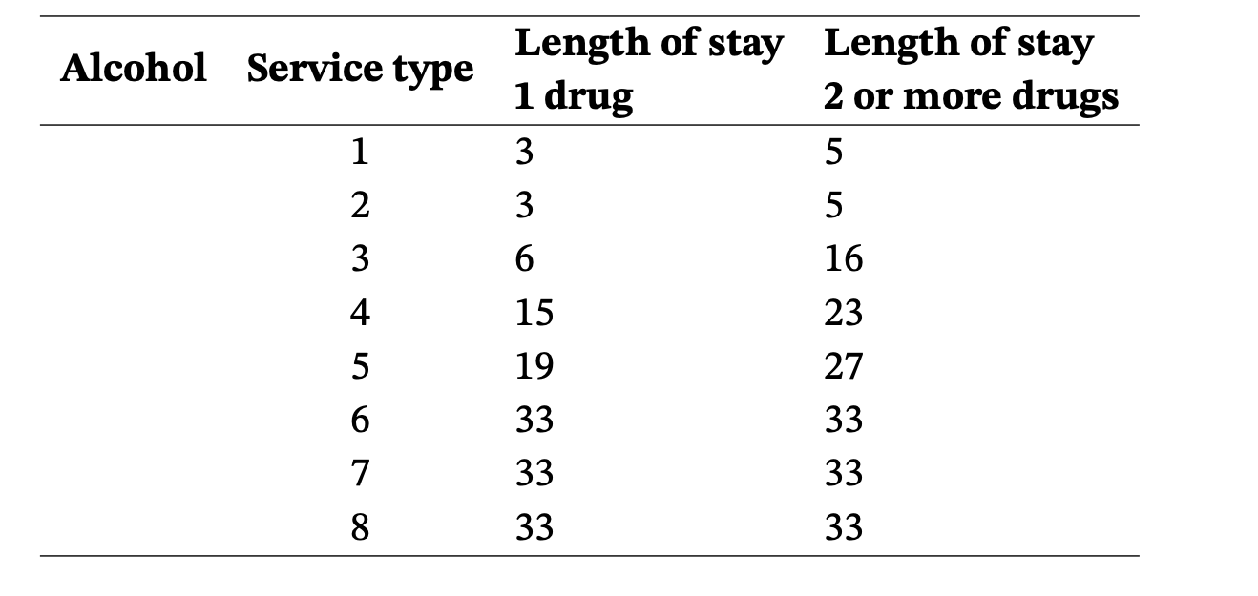
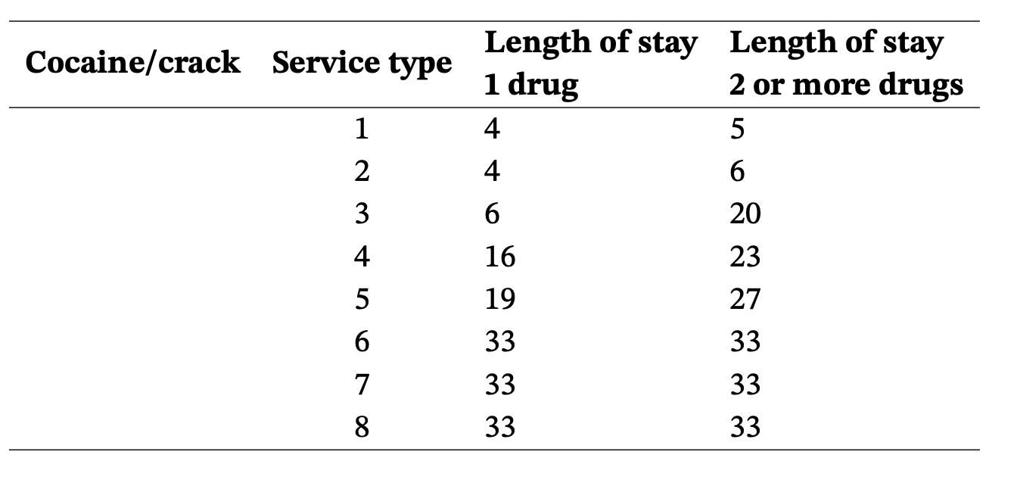
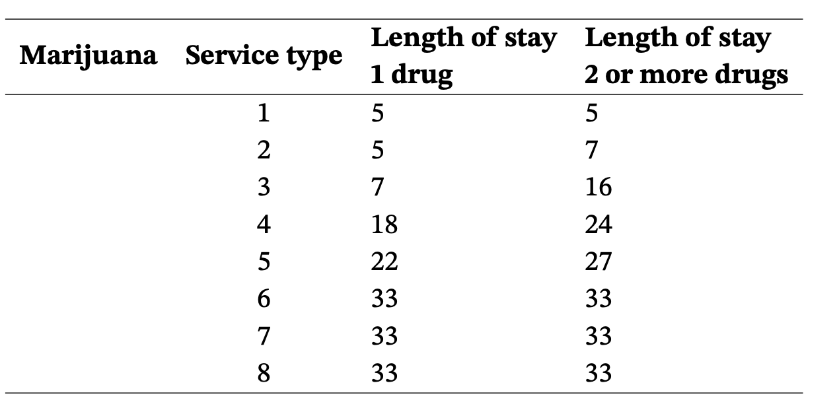
Final Results
Below are the table comparisons for each type of service with the type of addiction is- sues see Table 7-13. Analysis was performed for each of the 7 types of alcohol/drug addiction by iterating through 8 different types of services and the length of stay factor.
The predictive model in Table 7-13 displays the number of days required based on the service type for intoxicants such as Alcohol, Cocaine, Marijuana, Heroin, Non-prescription methadone, and other opiates.
Table 7: Alcohol Consumption
Table 8: Cocaine/crack Consumption
Table 9: Marijuana/Hashish Consumption

Slide 22
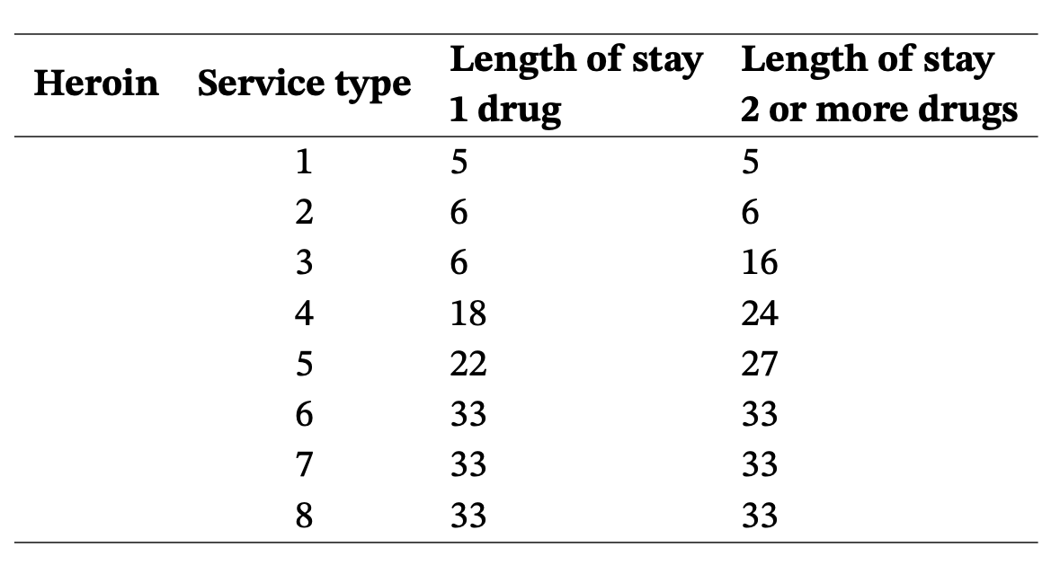
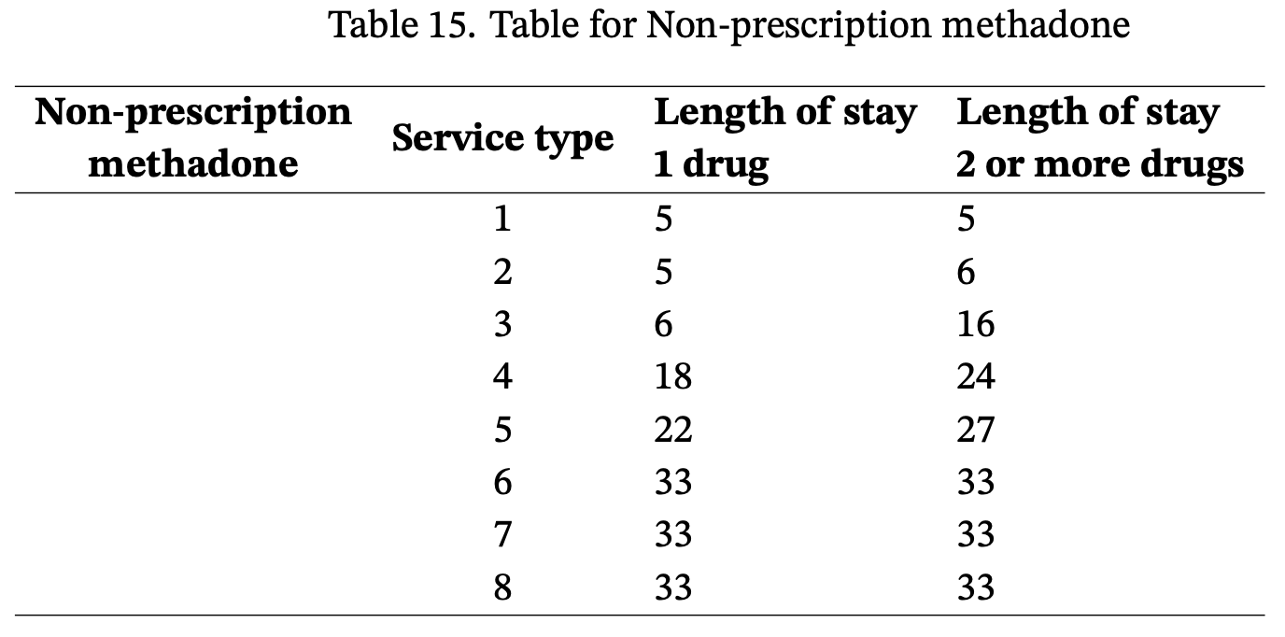
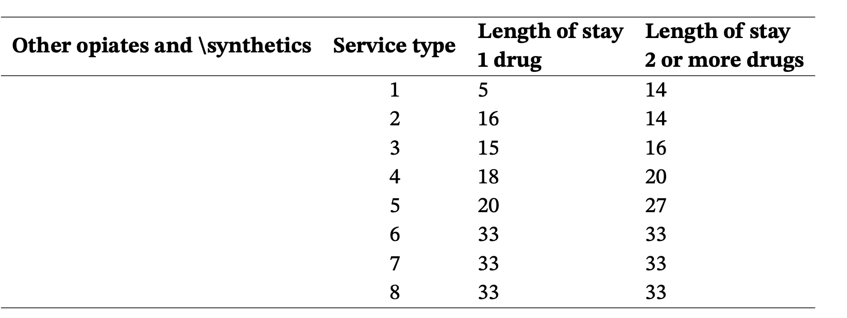
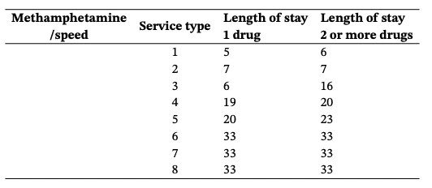
Final Results
Table 10: Heroin Consumption
Table 11: Non-prescription methadone
Consumption
Table 12: Other opiates and synthetics
Consumption
Table 13: Methamphetamine/speed
Consumption

Slide 23
Conclusion
The goal of this project is to identify factors that can contribute to a patient’s healthy recovery, depending on the services available.
Data pre-processing was done to ensure that data was in an acceptable format before creating machine learning models.
Exploratory data analysis was used to construct models, with the Random Forest model outperforming the others in terms of computing performance over large data sets, such as the 190,000+ rows of data in this project.
The Random Forest algorithm, in comparison to other algorithms, was able to manage massive data sets due to characteristics such as OOB error detection and variable importance mechanisms.
Hyper-parameter tuning further aided in improving the accuracy of the model to 80%. This model accurately predicts, up to 80% of the time, the minimum number of days required for a patient’s successful recovery from drug addiction.

Slide 24
Limitations and Future Scope
Limitations
One of the project’s limitations is that the model has a 20% chance of being inaccurate when displaying the number of days required to complete the treatment.
Chances of class overlap thus introducing additional noise using SMOTE technique.
Random Forest algorithm is computationally demanding.
Future Scope
The project’s future goals include obtaining more valuable data including the patients history of consuming drugs and history of seeking care assistance to cure drug addiction.
The next goal is to improve the model’s accuracy by fine-tuning it to more than 90%.
Build a dashboard for quick and easy visual analysis.

Slide 25
Lessons learned
Support Vector Machine algorithm works best for a smaller dataset as its training complexity is dependent on the size of the dataset.
Hyper parameter tuning using Grid search on the entire dataset is computationally expensive. To test it out, select a random sample from the dataset and choose the top attributes.
For faster data access and to prevent file corruption, large files should be stored in relational databases rather than in csv format.
Before fitting a final model to the entire dataset, start with a smaller sample of it. Aids in quick turnaround of results and spot checks.

Slide 26
References
SAMHDA. (2021). Samhda, substance abuse and mental health data archive @ONLINE.https://www.datafiles.samhsa.gov/dataset/teds-d-2019-ds0001-teds-d-2019- ds0001.
Tapia-Galisteo, J., Iniesta, J. M., Pérez-Gandía, C., García-Sáez, G., Puértolas, D. U., Izquierdo, F. J., & Hernando, M. E. (2020). Prediction of cocaine inpatient treatment success using machine learning on high-dimensional heterogeneous data. IEEE Access, 8, 218936–218953. ﷟HYPE://doi.org/10.1109/ACCESS.2020.3041895.
Afzali, M. H., Sunderland, M., Stewart, S., Masse, B., Seguin, J., Newton, N., Teesson, M., & Conrod, P. (2019). Machine-learning prediction of adolescent alcohol use: A cross-study, cross-cultural validation. Addiction, 114(4), 662–671.
Overdose, O. (2018). Understanding the epidemic. Atlanta, Centers for Disease Control and Prevention.
Chawla, N. V., Bowyer, K. W., Hall, L. O., & Kegelmeyer, W. P. (2002). Smote: Syn- thetic minority over-sampling technique [Copyright - © 2002. Notwithstanding the ProQuest Terms and Conditions, you may use this content in accordance with the associated terms available at https://www.jair.org/index.php/- jair/about; Last updated - 2021-07-23]. The Journal of Artificial Intelligence Re- search, 16, 321–357.

Slide 27
THANK YOU

