Slide 1

Digital Twin of a Hand Exoskeleton for Model-Based Control and Functional Safety in Rehabilitation Scenarios
Master’s Degree in Automation Engineering
Thesis in Robotics
Supervisor
Prof. Paolo Lino
Co-supervisors
Prof. Stefano Mazzoleni
Amelia Gioscia, PhD candidate
Company tutors (Bosch)
Pietro De Carlo
Michele Tomaselli
Adriano Sciusco
Candidate
Marcello Bari

Slide 2
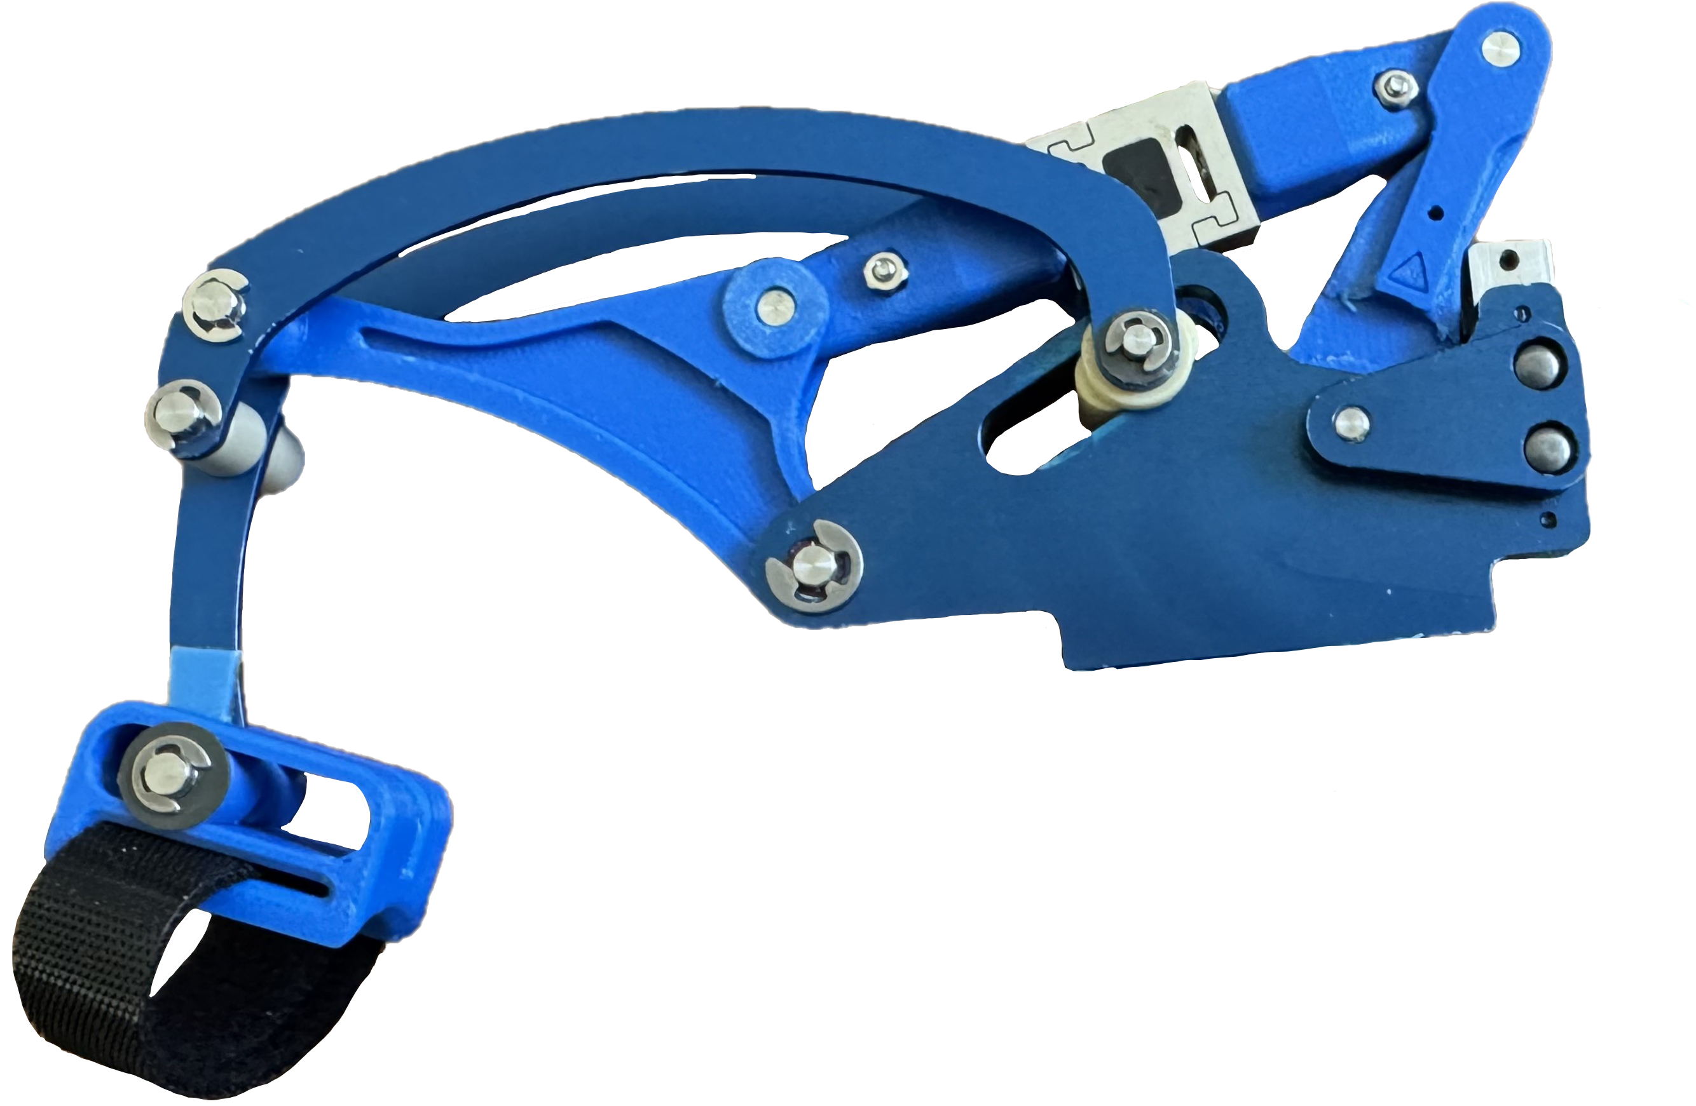

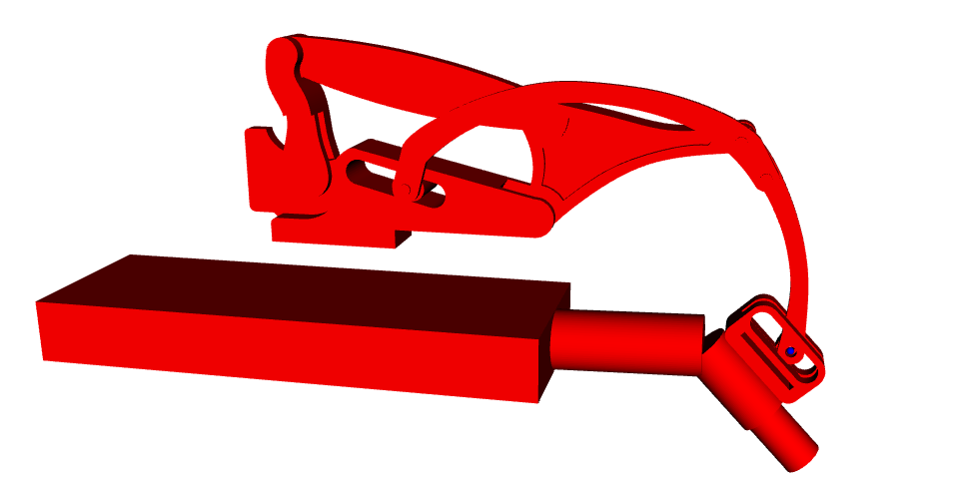

LOGO
LABORATORIO
LOGO
AZIENDA
PARTNER
Digital Twin
The Digital Twin Paradigm
A virtual counterpart of the physical system — reproducing mechanics, dynamics, control and safety behavior — enables the designer to evaluate choices, tune controllers, verify safety strategies before any hardware exists or any patient is involved and monitor the hardware’s performance during runtime.
Fewer hardware iterations • Lower cost • Safer early-stage testing
Marcello Bari • Digital Twin of a Hand Exoskeleton

Slide 3
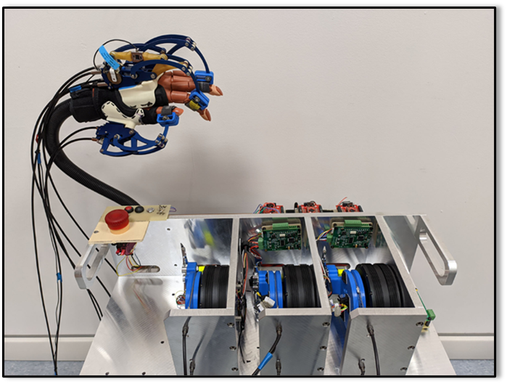
LOGO
LABORATORIO
LOGO
AZIENDA
PARTNER
Prototype HES
Developed by Humanware S.r.l. (Pisa) in collaboration with the MDM Lab at the University of Florence
Realized within the BMIFOCUS research project, funded by the Tuscany Region
Designed for Assistance-As-Needed (AAN) hand rehabilitation, targeting patients recovering after neurological injury or surgery
Supports independent actuation of three fingers: thumb, index, and middle
Designed to be lightweight (< 0.5 kg wearable part), adaptable to different hand sizes, and safe for direct human interaction
Marcello Bari • Digital Twin of a Hand Exoskeleton

Slide 4







LOGO
LABORATORIO
LOGO
AZIENDA
PARTNER
Objectives and Development Pipeline
01
02
03
04
05
06
Mechanical
Design
Kinematics &
Dynamics
Compliant
Control
Functional
Safety
Model-Based
Detection
HW Prototype Integration
CAD + URDF
closed chains
Constrained FK
reduced-order
Cascade
admittance + PD
3-layer
state machine
Observers
residuals
Interface spec
for HIL
Framework
Entirely implemented in ROS2, built on the Pinocchio rigid-body dynamics library, and organized as nine modular packages that can be independently developed, tested and deployed.
Single-finger module serves as the proof of concept; the architecture is designed to scale to the full three-finger prototype.
Marcello Bari • Digital Twin of a Hand Exoskeleton

Slide 5
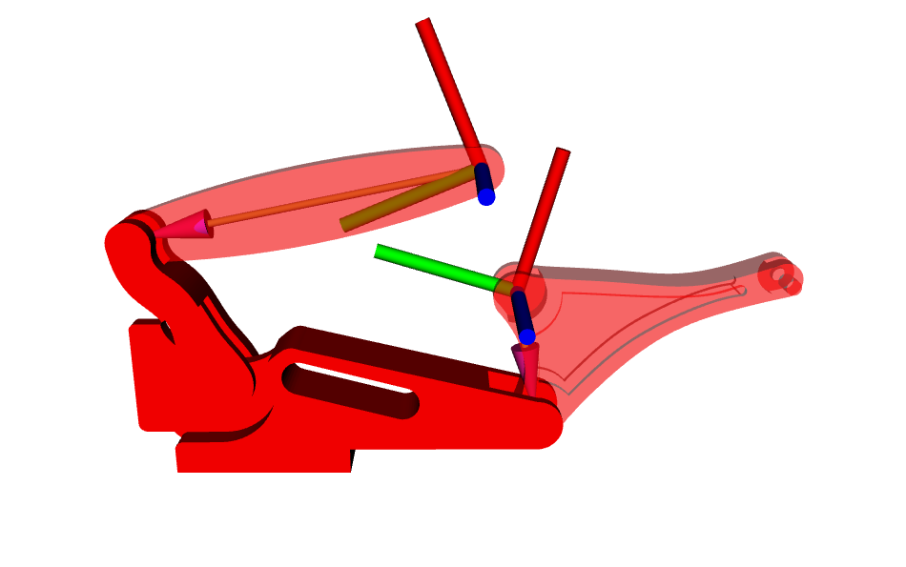

LOGO
LABORATORIO
LOGO
AZIENDA
PARTNER
Mechanical Design and URDF Modeling
From CAD to a simulation-ready robot description
Pipeline:
Parametric CAD modeling in Fusion 360 from Bartalucci's reference dimensions (no technical drawing was provided)
Geometric and structural validation against the original assembly
URDF generation through the ACDC4Robot plugin
Integration into the ROS 2 description package for visualization and simulation
The closed kinematic chain problem
URDF does NOT support closed-loop topologies
Strategy: open selected revolute joints and replace them with coincident auxiliary frames
Loop-closure enforced numerically at runtime
Eng. Bartalucci has collaborated with HumanWare in the first prototyping phase during his thesis work and some results were presented there
Marcello Bari • Digital Twin of a Hand Exoskeleton

Slide 6
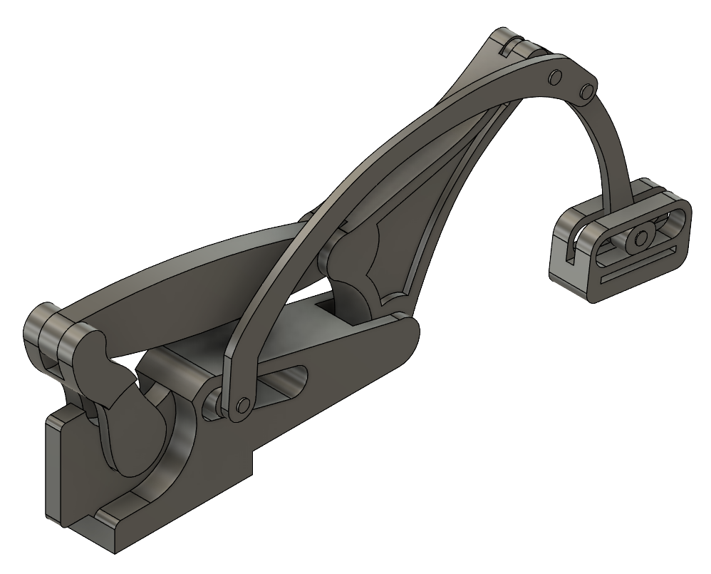
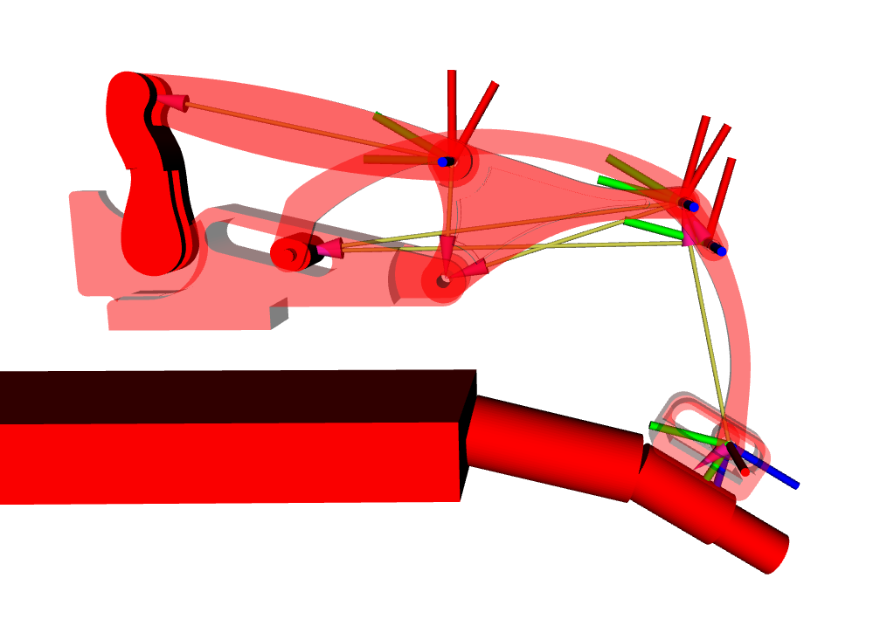
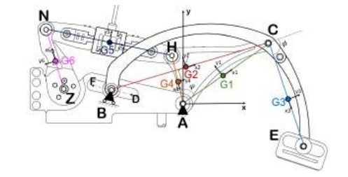
LOGO
LABORATORIO
LOGO
AZIENDA
PARTNER
Mechanical Design and URDF Modeling
From CAD to a simulation-ready robot description
Scheme on Bartalucci thesis
3D model on Fusion360
URDF model in RViz
When the Prototype Changes Size – Redoing the CAD Model
Only constraint: keep auxiliary frame names unchanged.
The closed-kinematic function uses these names to find the correct frames to work with.
Marcello Bari • Digital Twin of a Hand Exoskeleton

Slide 7
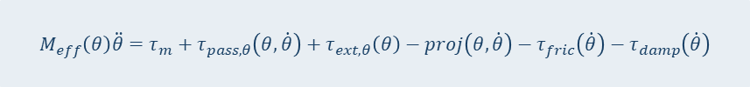

LOGO
LABORATORIO
LOGO
AZIENDA
PARTNER
Kinematic and Dynamic Modeling
The technical core of the thesis
Constrained Forward Kinematics
Reduced-Order Dynamics
Loop-closure constraints enforced numerically at runtime by a nonlinear solver, yielding an implicit mapping:
Full multibody dynamics projected onto the single actuated DOF via the constraint Jacobian:
$$q = q(θ)$$
$$M_{eff}\left(θ\right)\ddot{θ}=τ_{m}+τ_{pass,θ}\left(θ,\dot{θ}\right)+τ_{ext,θ}\left(θ\right)−proj\left(θ,\dot{θ}\right)−τ_{fric}\left(\dot{θ}\right)−τ_{damp}\left(\dot{θ}\right)$$
Every configuration at runtime must be kinematically admissible and consistent with the physical mechanism.
Inertial, Coriolis, friction, passive biomechanical and external contributions condensed into a scalar nonlinear ODE.
Closed Constrained Forward Kinematic and Reduced Dynamics are both solved in a ROS node at 200Hz
Later, the step() function is presented and the main points are highlighted
Marcello Bari • Digital Twin of a Hand Exoskeleton

Slide 8

LOGO
LABORATORIO
LOGO
AZIENDA
PARTNER
Kinematic and Dynamic Modeling
Closed-chain kinematics – Rapid Overview (1/2)
The exoskeleton has multiple closed kinematic loops but is modelled as an open-chain URDF. For each opened joint, a pair of auxiliary frames (A, B) is introduced. At runtime, their coincidence is enforced as a positional constraint:
$$Φ_{i}(q)= p_{A_{i}}(q) − p_{B_{i}}(q)=0$$
Given the current crank angle $θ$, the full consistent configuration $q(θ)$ is recovered by solving:
$$q\left(θ\right)=\arg{\min_{x}{|}Φ\left(q\left(x\right)\right)}|^{2}+P\left(x\right) \text{s}\text{.}\text{t}\text{.} q_{θ}=θ$$
where $x$are the free joints and $P(x)$ is a soft joint-limit penalty. The solver is warm-started from the previous configuration (Trust-Region Reflective, Pinocchio forward kinematics at each iteration).
Key output: the implicit map $q=q\left(θ\right)$ — every crank angle uniquely determines a kinematically admissible full configuration.
Marcello Bari • Digital Twin of a Hand Exoskeleton

Slide 9


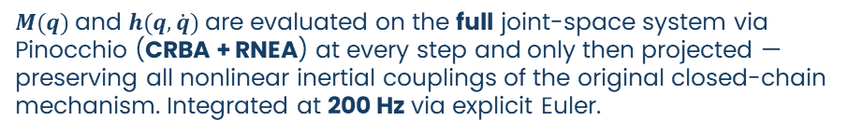

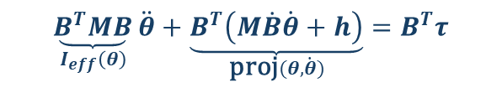

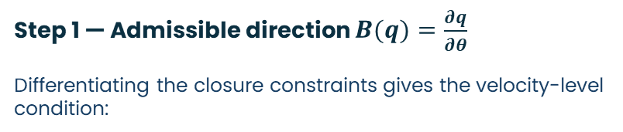
LOGO
LABORATORIO
LOGO
AZIENDA
PARTNER
Kinematic and Dynamic Modeling
Reduction to 1-DOF scalar dynamics – Rapid Overview (2/2)
Step 1 — Admissible direction $B(q)=\frac{∂q}{∂θ}$
Differentiating the closure constraints gives the velocity-level condition:
Pre-multiplying by $B^{T}$ eliminates λ (since $B^{T}J^{T}λ=0$ by construction):
$$\underset{I_{eff}\left(θ\right)}{\underbrace{B^{T}MB}}\ddot{θ}+\underset{\text{proj}(θ, \dot{θ})}{\underbrace{B^{T}\left(M\dot{B}\dot{θ}+h\right)}}=B^{T}τ$$
$$A\left(q\right)\dot{q}=0 A\left(q\right)=J_{A}\left(q\right)−J_{B}\left(q\right)$$
The null space is one-dimensional (1 DOF), so:
$$\dot{q}=B\left(q\right)\dot{θ}, \ddot{q}=B\left(q\right)\ddot{θ}+\dot{B}\left(q\right)\dot{θ}$$
Step 3 — Final scalar equation
$B(q)$is computed numerically by fixing $B_{θ}=1$ and solving $A_{red}x_{red}=−A e_{θ}$ in the least-squares sense.
$$I_{\text{eff}}\left(θ\right)\ddot{θ}=τ_{m}−\text{proj}\left(θ,\dot{θ}\right)−τ_{\text{fric}}−τ_{\text{ext}}−τ_{\text{pass}}$$
$M(q)$and $h(q, \dot{q})$are evaluated on the full joint-space system via Pinocchio (CRBA + RNEA) at every step and only then projected — preserving all nonlinear inertial couplings of the original closed-chain mechanism. Integrated at 200 Hz via explicit Euler.
Step 2 — Projection (eliminate constraint forces)
Starting from the full constrained dynamics:
$$M\left(q\right)\ddot{q}+h\left(q,\dot{q}\right)=τ+J^{T}\left(q\right)λ$$
Marcello Bari • Digital Twin of a Hand Exoskeleton

Slide 10
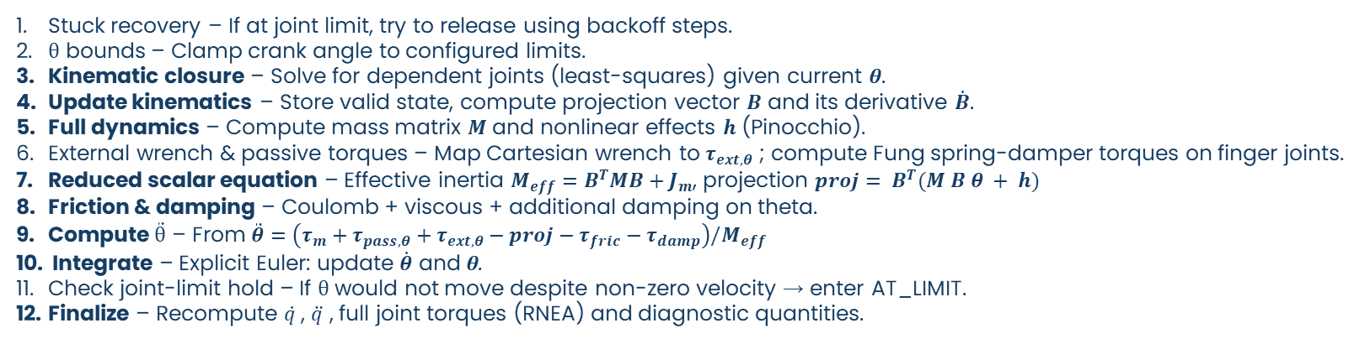
LOGO
LABORATORIO
LOGO
AZIENDA
PARTNER
Kinematic and Dynamic Modeling
The technical core of the thesis
exoskeletron_dynamics:
new_dynamics_with_hand.py:
def step():
Stuck recovery – If at joint limit, try to release using backoff steps.
θ bounds – Clamp crank angle to configured limits.
Kinematic closure – Solve for dependent joints (least‑squares) given current θ.
Update kinematics – Store valid state, compute projection vector $B$ and its derivative $\dot{B}$.
Full dynamics – Compute mass matrix $M$ and nonlinear effects $h$ (Pinocchio).
External wrench & passive torques – Map Cartesian wrench to $τ_{ext,θ}$ ; compute Fung spring‑damper torques on finger joints.
Reduced scalar equation – Effective inertia $M_{eff}=B^{T}MB+J_{m}$, projection $proj= B^{T}(M Ḃ θ + h)$
Friction & damping – Coulomb + viscous + additional damping on theta.
Compute $\ddot{θ}$ – From $\ddot{θ}=\left(τ_{m}+τ_{pass,θ}+τ_{ext,θ}−proj−τ_{fric}−τ_{damp}\right)/M_{eff}$
Integrate – Explicit Euler: update $\dot{θ}$ and θ.
Check joint‑limit hold – If θ would not move despite non‑zero velocity → enter AT_LIMIT.
Finalize – Recompute $q̇$ , $q̈$ , full joint torques (RNEA) and diagnostic quantities.
Marcello Bari • Digital Twin of a Hand Exoskeleton

Slide 11

LOGO
LABORATORIO
LOGO
AZIENDA
PARTNER
Cascade Admittance-Trajectory Control
Compliant interaction with accurate reference tracking
Admittance Controller Translates the estimated external force into a reference trajectory through a second-order overdamped virtual dynamics
Key features: explicit Euler integration at 200 Hz, saturation on virtual velocity and position as an additional safety layer, and bumpless startup (the virtual state is initialised from the actual plant state read from `/joint_states`, preventing unsafe initial transients).
Trajectory Controller (PD + Feed-Forward). Regulates the motor torque $τ_{m}$to track the reference generated by the outer loop.
Key features: the PD feedback is combined with a model-based feed-forward term that pre-cancels the known nonlinear contributions leaving only the residual tracking error to the feedback. This allows moderate gains without sacrificing bandwidth, consistently with the time-scale separation required by the cascade architecture.
/input
/exo_dynamics/external_wrench
/admittance_ctrl
/trajectory_ref
/trajectory_ctrl
/torque
/dynamics
/exo_dynamics/ff_terms
/joint_states
/joint_states
/exo_dynamics/tau_ext_theta
Marcello Bari • Digital Twin of a Hand Exoskeleton

Slide 12
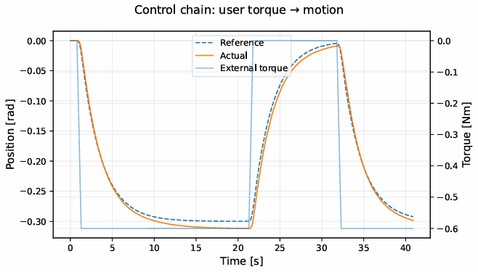
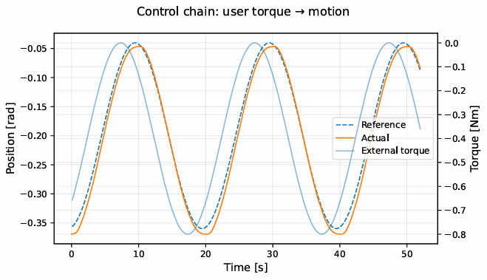
LOGO
LABORATORIO
LOGO
AZIENDA
PARTNER
Cascade Admittance-Trajectory Control
Compliant interaction with accurate reference tracking
Marcello Bari • Digital Twin of a Hand Exoskeleton

Slide 13

LOGO
LABORATORIO
LOGO
AZIENDA
PARTNER
Functional Safety Architecture
Defense-in-depth across three cooperating layers
ENFORCEMENT
DETECTION
GOVERNANCE
ExoBridge
FaultMonitorMode
StateMachine (C++)
Gateway node mediating all control signals between controllers and plant, inserted transparently via ROS 2 topic remapping.
Runs at 200 Hz, functional even if higher-level supervision is unavailable.
Four operating modes (nominal, compliant, torque_limit, stop) applying mode-dependent torque and trajectory clamping.
Per-channel watchdogs on torque, trajectory, joint states, and external force.
Publishes a 200 Hz status vector including both pre- and post-clamp torque to support downgrade logic.
Primary software-based detection plugin, active during nominal operation.
Four-level severity classification on post-clamp torque and crank velocity, evaluated at 200 Hz.
Debounced escalation to suppress spurious threshold crossings, with a startup grace period.
Asynchronous service requests to the state machine, preserving real-time responsiveness.
All thresholds and timeouts tunable via safety_params.yaml without recompilation.
Plugin-based C++ state machine (pluginlib) managing four safety states with a well-defined transition graph.
Fault latching on SAFE_STOP, requiring explicit operator reset.
Bridge supervision through liveness monitoring and mode coherence checks.
Four ROS 2 services for external requests; consolidated SafetyStatus diagnostic published at 10 Hz.
Optional automatic downgrade for controlled de-escalation from degraded states.
Marcello Bari • Digital Twin of a Hand Exoskeleton

Slide 14
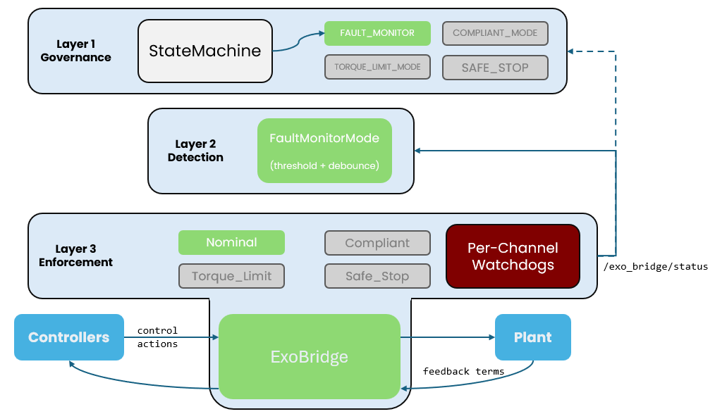
LOGO
LABORATORIO
LOGO
AZIENDA
PARTNER
Functional Safety Architecture
Defense-in-depth across three cooperating layers
Scenario: offset on /torque greater than TORQUE_LIMIT threshold
t = 0 s — nominal operation
The system runs in FAULT_MONITOR. The FaultMonitorMode plugin reads /exo_bridge/status at 200 Hz, tau_out is within all thresholds, and all debounce counters are at zero. The bridge operates in nominal mode — signals pass through unmodified.
Marcello Bari • Digital Twin of a Hand Exoskeleton

Slide 15

LOGO
LABORATORIO
LOGO
AZIENDA
PARTNER
Functional Safety Architecture
Defense-in-depth across three cooperating layers
Scenario: offset on /torque greater than TORQUE_LIMIT threshold
t = N s — fault injector activated
ros2 param set /fault_injector fault_type offset
ros2 param set /fault_injector fault_magnitude 3.0
ros2 param set /fault_injector fault_active true
Marcello Bari • Digital Twin of a Hand Exoskeleton

Slide 16
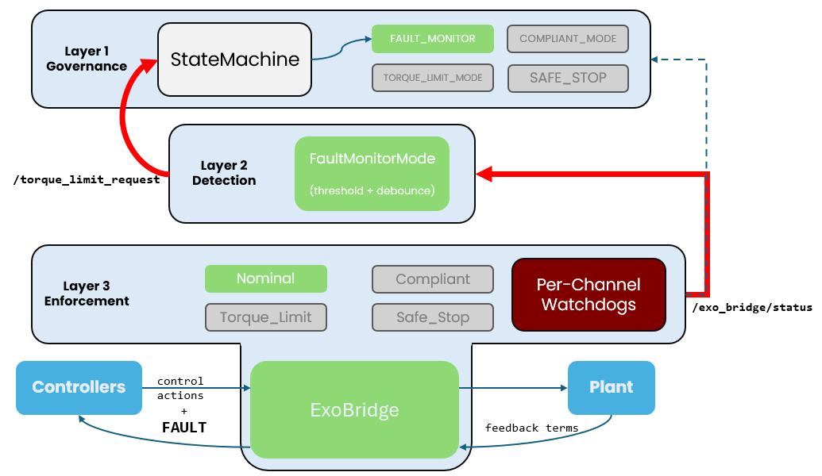
LOGO
LABORATORIO
LOGO
AZIENDA
PARTNER
Functional Safety Architecture
Defense-in-depth across three cooperating layers
Scenario: offset on /torque greater than TORQUE_LIMIT threshold
t = N + 5 ms — first faulted sample reaches bridge
The bridge receives /torque_faulted with the corrupted value and forwards it to the plant (still in nominal mode — no clamping applied). It then publishes /exo_bridge/status with tau_out = real_value + 3.0 Nm.
FaultMonitorMode reads that message and evaluates:
tau_out exceeds tau_torque_limit_threshold → instantaneous severity = TORQUE_LIMIT
counters are incremented: compliant_counter_ = 1, torque_counter_ = 1
debounce threshold not yet reached — no escalation
t = N + 10 ms — second sample
Same result. compliant_counter_ = 2, torque_counter_ = 2. Still below threshold.
t = N + 15 ms — third sample, debounce fires
torque_counter_ = 3 reaches the threshold. debounced_entry_level() returns TORQUE_LIMIT.
FaultMonitorMode checks that this is more severe than the last requested level (NOMINAL) and calls the /torque_limit_request service on the StateMachine with data: true. The call is asynchronous — it does not block the detection thread.
Marcello Bari • Digital Twin of a Hand Exoskeleton

Slide 17
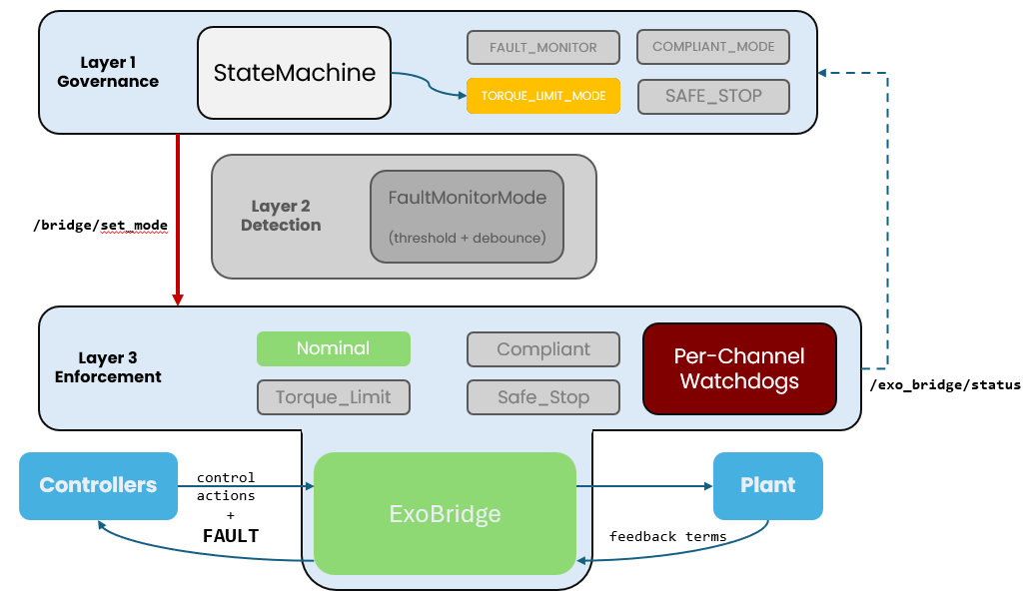
LOGO
LABORATORIO
LOGO
AZIENDA
PARTNER
Functional Safety Architecture
Defense-in-depth across three cooperating layers
Scenario: offset on /torque greater than TORQUE_LIMIT threshold
t = N + 15–17 ms — state transition
The StateMachine receives the request and processes it through request_state_change():
can_transition_to(TORQUE_LIMIT_MODE) → true
The active plugin (FaultMonitorMode) is stopped and destroyed: obj_->stop(); obj_.reset()
A new instance of TorqueLimitMode is loaded via pluginlib
TorqueLimitMode::initialize() calls /bridge/set_mode with "torque_limit"
transition_in_progress_ is cleared, the mode mismatch counter is reset
Layer 2 is now inactive: no plugin is monitoring thresholds anymore.
Marcello Bari • Digital Twin of a Hand Exoskeleton

Slide 18
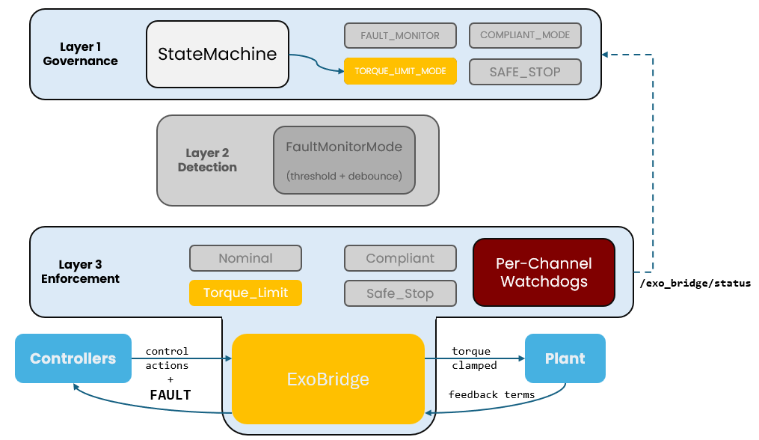
LOGO
LABORATORIO
LOGO
AZIENDA
PARTNER
Functional Safety Architecture
Defense-in-depth across three cooperating layers
Scenario: offset on /torque greater than TORQUE_LIMIT threshold
t = N + 17–19 ms — bridge updates operating mode
The bridge receives the set_mode("torque_limit") service response and switches control_mode.
From this point on, every torque command is clamped to ±torque_limit_clamp.
The StateMachine reads the next /exo_bridge/status message and sees mode_id = 1 (torque_limit): coherence confirmed, mode_mismatch_count_ stays at zero.
t = N + 20 ms onwards — stable degraded operation
The system runs in TORQUE_LIMIT_MODE. The user receives less force than the controller intends to apply, but is protected. The bridge keeps publishing status at 200 Hz; the StateMachine reads it for coherence checks and, if enabled, for the automatic downgrade counter.
FaultMonitorMode no longer exists in memory.
If automatic downgrade is disabled (default), the system stays in this state until the operator explicitly calls:
ros2 service call /reset_safety_request std_srvs/srv/Trigger
Marcello Bari • Digital Twin of a Hand Exoskeleton

Slide 19
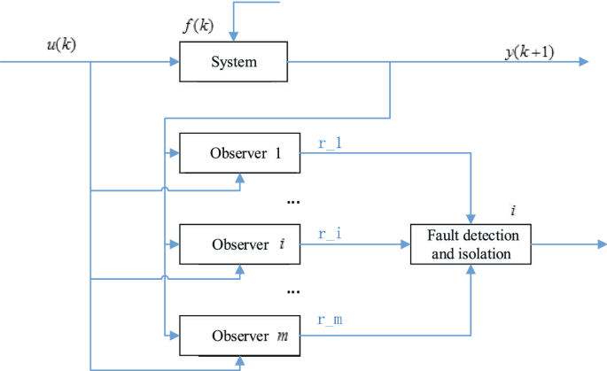

LOGO
LABORATORIO
LOGO
AZIENDA
PARTNER
Model-Based Fault Detection
Observer layers for sensor health monitoring
Threshold-based safety
«Is this signal too big?»
Effective for: large torque spikes • communication timeouts • complete signal loss
Faults within nominal bounds remain undetected: slow sensor drift • small persistent force bias • gradual actuator degradation
Model-based FDI
«Is this signal consistent with the physics?»
Multiple observer were created to evaluete the measured quantities against the observed ones
STATUS
Not yet in the decision chain
Fully operational
Runs at 200 Hz alongside plant, controllers and safety nodes.
Integration through the reserved SENSOR_DEGRADED_MODE state is identified as future work.
Marcello Bari • Digital Twin of a Hand Exoskeleton

Slide 20
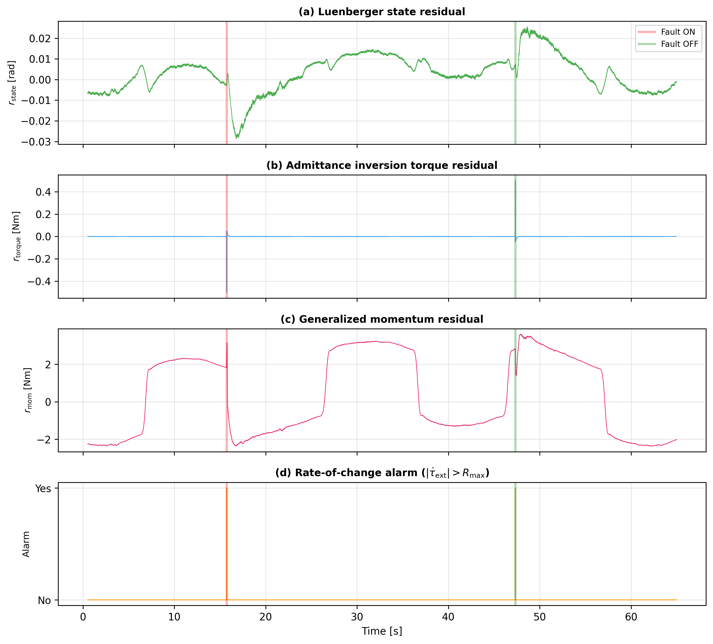





LOGO
LABORATORIO
LOGO
AZIENDA
PARTNER
Model-Based Fault Detection
Response to $τ_{ext}$ offset fault (User Force sensor)
Luenberger observer
$$r=θ_{meas}−\hat{θ}$$
Slow, smooth deviation after fault ON. Recovers gradually after fault OFF. Baseline ~10⁻⁴ rad.
Primary target: encoder faults
Compares measured position to model prediction. Slow for force-channel faults (~1–1.5 s): effect must propagate through admittance → tracking loop.
Admittance inversion
Flat (zero) throughout — observer is invalidated because the admittance reference is saturated during the experiment.
Valid only when ref is unsaturated
$$r_{torque}=τ_{ext,meas}−τ̂_{ext}$$
Compares measured position to model prediction. Slow for force-channel faults (~1–1.5 s): effect must propagate through admittance → tracking loop.
Momentum observer
Fast step response (~40–60 ms) clearly tracking the injected offset. Primary detector for force-channel faults
Primary target: $τ_{ext}$ and torque faults
$$r_{mom}=K_{mom}⋅\left(p−σ\right),p = M \dot{θ}$$
Tracks generalized momentum integral σ. Residual converges to torque discrepancy without computing noisy $\ddot{θ}$.
Rate-of-change guard
Binary alarm fires exactly at fault ON/OFF transitions. Blind to sustained offsets — complementary to momentum observer.
Fastest detector: 1 sample, impulsive faults only
$$alarm = |Δτ_{ext}/Δt|> R_{max}$$
Human muscles cannot produce force steps (bandwidth ~5–10 Hz). Any discontinuity >100 Nm/s is necessarily artificial. Latency: 1 sample (5 ms).
Marcello Bari • Digital Twin of a Hand Exoskeleton

Slide 21
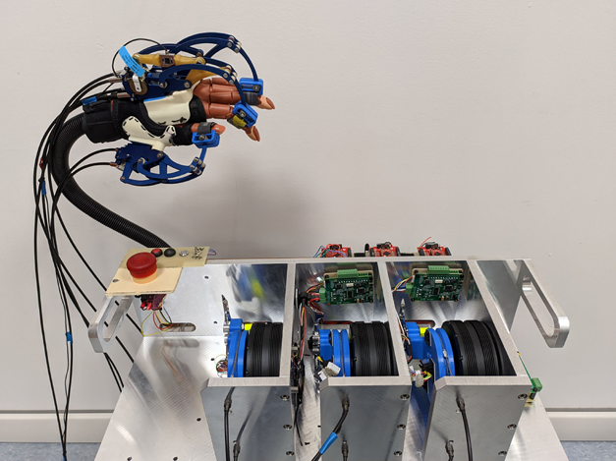
LOGO
LABORATORIO
LOGO
AZIENDA
PARTNER
Hardware Prototype
OEM Software Modifications (BoardClient & GUI)
Three main modifications with respect to the Humanware baseline:
Robust Auto-Reconnection — stale-RX watchdog detecting silent streams and triggering automatic serial reconnection
Thread-Safe GUI Updates — producer-consumer queue pattern decoupling the serial RX thread from the Tkinter GUI thread, preventing race conditions
Derived Velocity Estimation — firmware returns NaN for vel_counts_s; replaced by two offline pipelines:
  Local linear regression (sliding window, robust to missing samples)
  Savitzky-Golay differentiation (smoother output, preferred for kinematic analysis)
Data Logging & Analysis
Mixed-schema CSV logging (telemetry rows + event rows) for precise command/sensor alignment
IQR-based spike rejection (k=5)
Multi-panel time-series
Prototype developed by HumanWare
Marcello Bari • Digital Twin of a Hand Exoskeleton

Slide 22
LOGO
LABORATORIO
LOGO
AZIENDA
PARTNER
Conclusion & Future Work
CONTRIBUTIONS
Future Work
URDF model of a closed-chain mechanism via software-enforced loop closure
Reduced-order dynamics projected on the single actuated DOF — real-time at 200 Hz
Cascade admittance–trajectory control with model-based feed-forward
Three-layer defense-in-depth functional safety architecture
Fault injection framework for systematic safety validation
Observer-based detection module with four complementary layers
Comprehensive hardware documentation for future HIL integration
Hardware-in-the-loop integration via the existing WebSocket distributed control interface
Observer integration into the safety chain through the reserved SENSOR_DEGRADED_MODE state
Systematic threshold calibration and decision logic design for the FDI module
Extension to the full three-finger configuration with per-finger fault management
Implementation of clinical rehabilitation protocols as configurable admittance trajectories
Experimental validation of the functional safety architecture on the physical prototype
Marcello Bari • Digital Twin of a Hand Exoskeleton

Slide 23
LOGO
LABORATORIO
LOGO
AZIENDA
PARTNER
Thanks for the attention
Code repo + docs @ https://github.com/mbari-github/HES_DigitalTwin
Marcello Bari • Digital Twin of a Hand Exoskeleton

