Slide 1
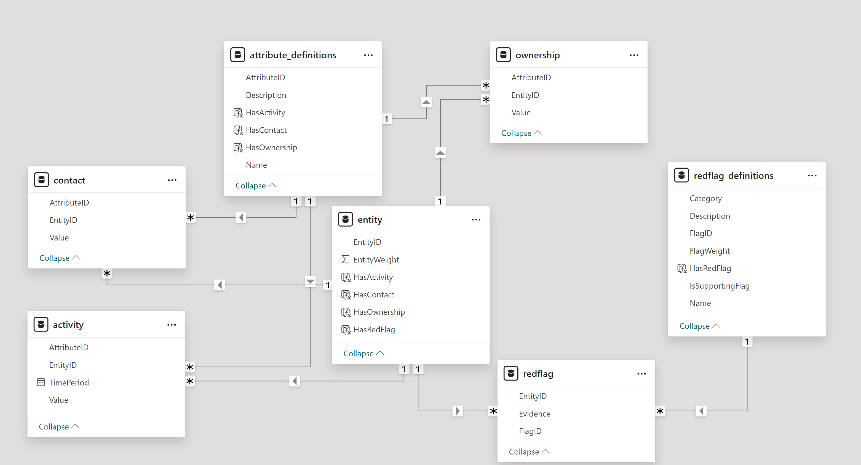
Beneficial Ownership Engine Data Model^{1,2}
Integrity checks:
⁠There must be no duplicate rows in any of the 7 input files.
In the ‘entity’ file all 'EntityID' values must have at least one entry in the 'activity' file.
All ‘EntityID’ values in the ‘activity’ file must be defined in the ‘entity’ file.
In the ‘attribute_definitions’ file, each AttributeID, except for ‘EntityWeight’, must be in either the activity file, or the contact file, or the ownership file.
In the ‘redflag_definitions’ file, all FlagIDs must have at least one entry in the redflag file.
All ‘EntityID’ values in the ‘contact’ file must be defined in the ‘entity’ file. The contact file may have several entries for an EntityID.
All ‘EntityID’ values in the ‘ownership’ file must be defined in the ‘entity’ file. The ownership file may have several entries for an EntityID.
All ‘EntityID’ values in the ‘redflag’ file must be defined in the ‘entity’ file.
All ‘AttributeID’ values in the ‘contact’ file must be defined in the ‘attribute_definitions’ file.
All ‘AttributeID’ values in the ‘activity’ file must be defined in the ‘attribute_definitions’. file
All ‘AttributeID’ values in the ‘ownership’ file must be defined in the ‘attribute_definitions’ file.
All ‘RedFlagID’ values in the ‘redflag’ file must be defined in the ‘redflag_definitions’ file.
AttributeID
1 –Table names in this diagram may differ from the filenames used for Beneficial Ownership Engine input csv format files.
2 – Outlined table columns are integrity checks included in the Power BI file, not in the input data files. See the following slide for details.

Slide 2
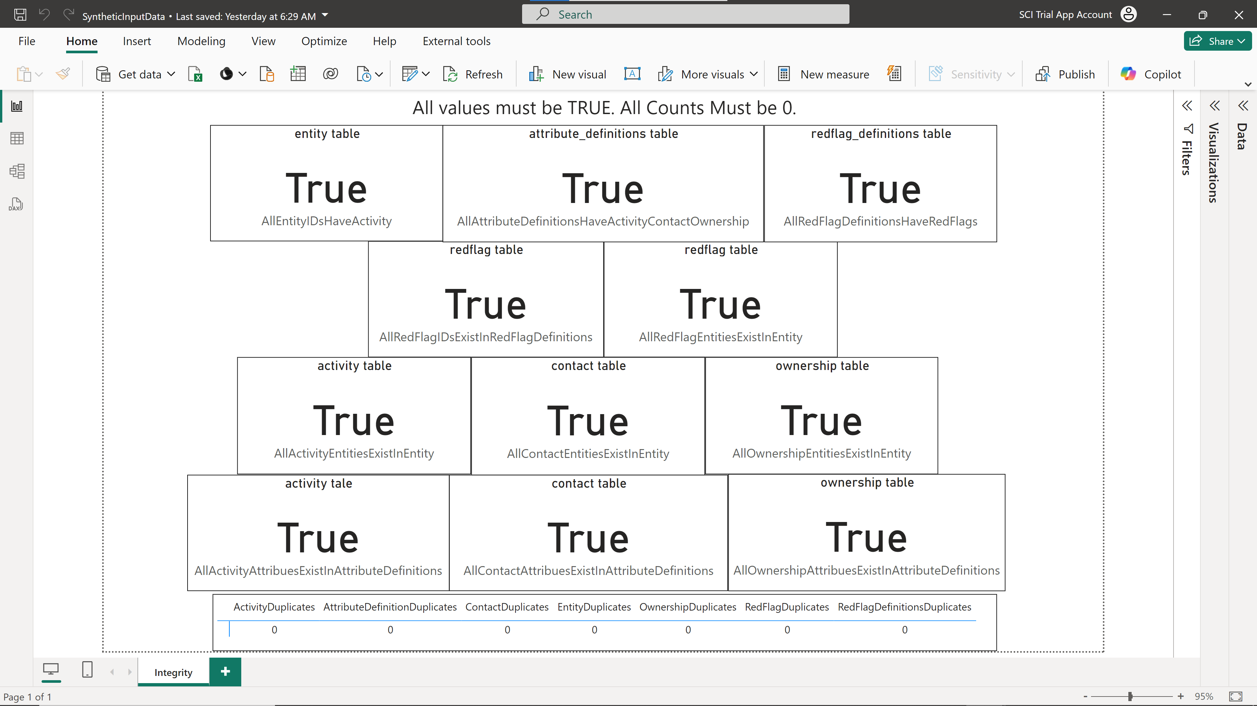
Power BI Report for Input Data Integrity Checks
Integrity checks (see the Power BI file):
There must be no duplicate rows in any of the 7 input files.
In ‘entity’ table, there must be no ‘False’ entries in the HasActivity column.
In ‘attribute_definitions’ table, all rows in IntegrityCheck must be ‘True’, except ‘EntityWeight’.
In ‘redflag_definitions’ table, there should be no ‘False’ entries in the HasRedFlag column.
All ‘EntityID’ values in ‘activity’ must be defined in the ‘entity’ table.
All ‘EntityID’ values in ‘contact’ must be defined in the ‘entity’ table.
All ‘EntityID’ values in ‘ownership’ must be defined in the ‘entity’ table.
All ‘EntityID’ values in ‘redflag’ must be defined in ‘entity’.
All ‘AttributeID’ values in ‘contact’ must be defined in ‘attribute_definitions’.
All ‘AttributeID’ values in ‘activity’ must be defined in ‘attribute_definitions’.
All ‘AttributeID’ values in ‘ownership’ must be defined in ‘attribute_definitions’.
All ‘RedFlagID’ values in ‘redflag’ must be defined in ‘redflag_definitions’

Slide 3
Steps to Create Beneficial Ownership Engine input datafiles.
Step 1: Entity file – create a list of companies you want to include. Weight each company in the list. For example, the Entity Weight could be the contract value over a specified period.
Step 2: Red Flag and Red Flag Definitions files - Create a list of the types of red flags (we can help provide additional guidance if needed). Start with a small set, for example 10-20 red flags. At the same time, create the Entity Red Flag file, which contains the red flags for each company. Each company can have 0 or more than 1 red flag.
Step3: Ownership file. Create a list of owners and partners/shareholders for each company in the Entity file.
Step 4: Contact file. Create a list of information about the companies that are in the Entity file.
Step 5: Activity file. For each company aggregated to a given period, for example quarterly, list the important procurement activities.
Step 6: Attribute Definitions file. Create a list of the attributes that were referenced in Activity, Contact, and Ownership input files.

Slide 4
Step 1: Entity File
Used in EntityRedFlag, Ownership, Contact, and Activity, csv files.
This file contains a weight for each entity that will impact total risk score. Entities with larger values will have higher risk scores.
“Entities” are companies.
EntityWeight is assigned a value of 1 by default.
To assign risk relative to company size, different EntityWeights can be entered for different companies.
All other factors being equal, Beneficial Ownership Engine will assign higher risk to companies with a higher EntityWeight.
For examle, EntityWeight could be assigned values equal to the total yearly revenue for each entity/company.
EntityID | EntityWeight
0 | 4680148.5
1 | 6651819.5
2 | 5618855
3 | 5249877
4 | 3989045.2
5 | 3988944.5
6 | 3428937.5
7 | 6108496
8 | 5256234.5
9 | 5547763
10 | 2958185.5
11 | 6879470.5
12 | 5963863
13 | 4201670
14 | 4091569.2
Column | Data Type
EntityID | string
EntityWeight | string
For example, the weight could be the 5-year total contract value.

Slide 5
Step 2: Red Flag Definitions & Red Flag Files
Column | Data Type
FlagID | string
Category | string
Name | string
Description | string
IsSupportingFlag | boolean
FlagWeight | double
FlagID | Category | Name | Description | IsSupportingFlag | FlagWeight
F1 | Procurement | Noncompetitive processes | contract awarded without call for tenders | FALSE | 1
F2 | Procurement | Noncompetitive processes | Contract awarded after shortened advertised period | FALSE | 5
F3 | Procurement | Noncompetitive processes | High winning rate | FALSE | 1
F4 | Collusion | Top Loser | Number of competitors | FALSE | 2
F5 | Collusion | Top loser | Low winning rate | FALSE | 5
F6 | Political Connections | politically-exposed person | A company owner is a politically-exposed person | TRUE | 2
F7 | Blacklisted | Sanctioned | The company was sanctioned | FALSE | 3
F8 | Blacklisted | Contracts while sanctioned | company was awarded while sanctioned | FALSE | 3
F9 | Supplier Characteristics | Convicted owner | The company is owned by a convicted person | FALSE | 3
Red Flag Definition This file contains data on company red flag types.
Note: IsSupportingFlag provides a simple mechanism to reduce noise in the risk calculation process based on domain knowledge. A supporting red flag with IsSupportingFlag = TRUE is only considered if it appears together with red flags from other categories.
Red Flags
This file contains details of red flags associated with an entity. The Evidence attribute can be any text or a JSON-formatted string that contains fine-grained details of a given red flag. This information is displayed in the company risk report.
EntityID | FlagID | Evidence
1416 | F7 | FININT: Entity 1416 is linked to flag market division in data sources on money transactions
1525 | F6 | OSINT: Entity 1525 is linked to flag politically-exposed person in open data sources
1537 | F3 | OSINT: Entity 1537 is linked to flag litigated in open data sources
1666 | F4 | DNINT: Entity 1666 is linked to flag front person in digital network intelligence data
1728 | F1 | OSINT: Entity 1728 is linked to flag fined in open data sources
1863 | F7 | FININT: Entity 1863 is linked to flag market division in data sources on money transactions
2067 | F9 | FININT: Entity 2067 is linked to flag price fixing in data sources on money transactions
2399 | F9 | FININT: Entity 2399 is linked to flag price fixing in data sources on money transactions
2649 | F8 | FININT: Entity 2649 is linked to flag bid rigging in data sources on money transactions
2846 | F9 | FININT: Entity 2846 is linked to flag price fixing in data sources on money transactions
2862 | F5 | OSINT: Entity 2862 is linked to flag convicted criminal in open data sources
2870 | F2 | OSINT: Entity 2870 is linked to flag sanctioned in open data sources
Column | Data Type
EntityID | string
FlagID | string
Evidence | string

Slide 6
Step 3: Ownership File
This table contains company ownership structure.
For example, individual partners, corporate partners.
This is modelled as a static relationship.
Note: Corporate partners should be included in the Entity table.
EntityID | AttributeID | Value
3 | beneficial_owner | JACQUELINE MONROE(ID:9)
3066 | beneficial_owner | BRIDGET WALLACE(ID:34)
30 | beneficial_owner | JAMES ROBINSON(ID:69)
9744 | beneficial_owner | STEPHANIE MANNING(ID:163)
10518 | beneficial_owner | SEAN MORROW(ID:247)
192 | beneficial_owner | JENNIFER ALI(ID:425)
202 | beneficial_owner | PETER SHEPHERD(ID:443)
205 | beneficial_owner | MIRANDA HICKS(ID:450)
206 | beneficial_owner | TYLER ZAVALA(ID:452)
225 | beneficial_owner | WILLIE LARA(ID:485)
227 | beneficial_owner | ASHLEY MORENO(ID:493)
6 | beneficial_owner | MONICA ELLIS(ID:508)
8 | beneficial_owner | SAMANTHA HALE(ID:540)
196 | beneficial_owner | VANESSA HOWARD(ID:605)
294 | beneficial_owner | JONATHAN BATES(ID:632)
Column | Data Type
EntityID | string
AttributeID | string
Value | string

Slide 7
Step 4: Contact File
EntityID | AttributeID | Value
2502 | address | 0120 KEY VILLAGE LISASHIRE LOUISIANA 25612 UNITED STATES
2487 | address | 88795 JACOBS VILLAGE ALISONPORT MISSOURI 29333 UNITED STATES
2531 | address | 178 BROWN INLET EAST ROYTON MICHIGAN 88697 UNITED STATES
2737 | address | 3886 STEPHEN GLENS FRANKLINHAVEN WASHINGTON 40598 UNITED STATES
2557 | address | 326 LEE DAM MORRISTON WEST VIRGINIA 46319 UNITED STATES
2590 | address | 41467 RUSSELL VALLEYS RICHARDSBERG ARKANSAS 68344 UNITED STATES
2595 | address | 43162 NORMAN LOCKS WEST ANDREWFORT WASHINGTON 89995 UNITED STATES
2599 | address | 47129 SARAH STREET WEST KYLEBOROUGH MARYLAND 39029 UNITED STATES
2601 | address | 8699 MARY FORT PORT LEONARD ARIZONA 83389 UNITED STATES
14105 | address | 36255 LUCAS STRAVENUE NORTH MICHAELPORT OKLAHOMA 82402 UNITED STATES
2626 | address | 104 ALVARADO PRAIRIE NEW MARYVILLE GEORGIA 26728 UNITED STATES
2639 | address | 4016 JOSEPH SKYWAY BRYANVIEW SOUTH DAKOTA 37109 UNITED STATES
2639 | address | 78740 PAULA CIRCLES SOUTH DAVIDMOUTH NEVADA 78223 UNITED STATES
16650 | address | 8470 MCGRATH FLAT AYALABOROUGH ARIZONA 12027 UNITED STATES
2714 | address | 014 WILLIAMS KNOLLS PORT KIMBERLY ALABAMA 72374 UNITED STATES
2720 | address | 9295 DEBORAH MEWS SARABERG ALASKA 20523 UNITED STATES
2754 | address | 75134 EARL BRIDGE MATTHEWBURGH MISSOURI 57503 UNITED STATES
11353 | address | 834 BENNETT RADIAL ROWETON MONTANA 44211 UNITED STATES
This file contains company contact details.
For example, company name, address, phone, email, website.
This is modelled as a static relationship.
NOTE: The Value field must not contain commas
Column | Data Type
EntityID | string
AttributeID | string
Value | string

Slide 8
Step 5: Activity File
This file contains company procurement (e.g., bidding) activity aggregated to a given period length, e.g., quarterly.
This is typically the largest file (1-100MB).
EntityID | AttributeID | Value | TimePeriod
1293 | tender | tender:396 | 2023-01
9058 | item | item:57282 | 2023-11
19997 | buyer | buyer:63682 | 2023-06
Column | Data Type
EntityID | string
AttributeID | string
Value | string
TimePeriod | string

Slide 9
Step 6: Attribute Definitions File
Used in Activity, Contact, Ownership csv files.
This file contains:
Attribute ID: an ID for the attribute (no spaces)
Name: a descriptive text label for the attribute
Description: a longer text description for the attribute
For example, company's headquarter details, size, number of partners, etc.
These attributes:
• Establish links or connections between company nodes
• That is, they determine covariates in the relational risk computations
• Comprise the Summary Attributes in the Entity Overview section of the final report
Note: some attributeIDs will be used as part of node labels in the evidence graphs, so keep labels as compact strings instead of numeric IDs, and use the Description for verbose details.
AttributeID | Name | Description
company_name | name | company name
phone | phone number | company phone number
email | email | company email
address | address | company address
beneficial_owner | beneficial owner | beneficial owner of the company
director | company director | director of the company
tender | Tender | id of tender in public procurement
item | Item | id of line item in public procurement
buyer | Buyer | id of buyer in public procurement
EntityWeight | contract value | total contract value awarded to the entity in the past 5 years
Column | Data Type
AttributeID | string
Name | string
Description | string

Slide 10
Configuration Parameters
File sizes – processing time is a function of the number of companies. Reduce the number or company entities to lower processing time.
Change BOE configuration parameters:
Modify or remove fuzzy matching
Make ’n_connected_components’ small
Reduced depth parameter: max_path_length

