Slide 1
Can ai pass the sproochentest?
Cédric Lothritz
  Saturday, 13rd December, 2025

Slide 2
Topic of the Talk
How do language models understand text?
How can we make words understandable to computers?
How do we know if a computer has mastered the language?
Can a computer pass the national language exam for Luxembourgish?

Slide 3
Quick animal pop quiz!

Slide 4
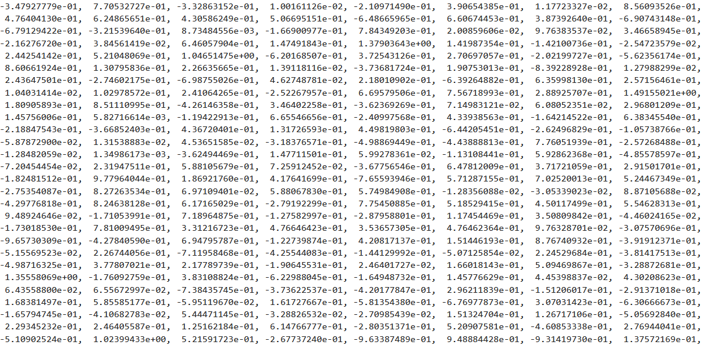
Quick animal pop quiz!

Slide 5
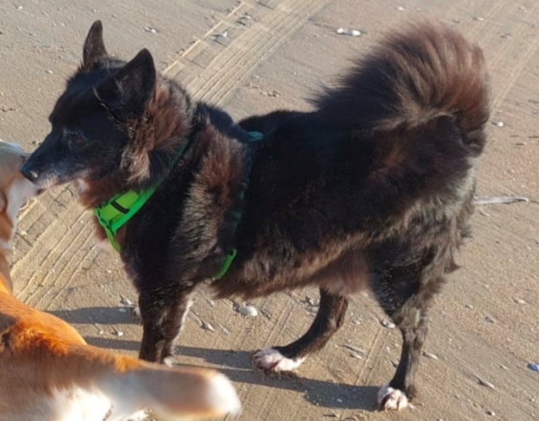
Quick animal pop quiz!

Slide 6
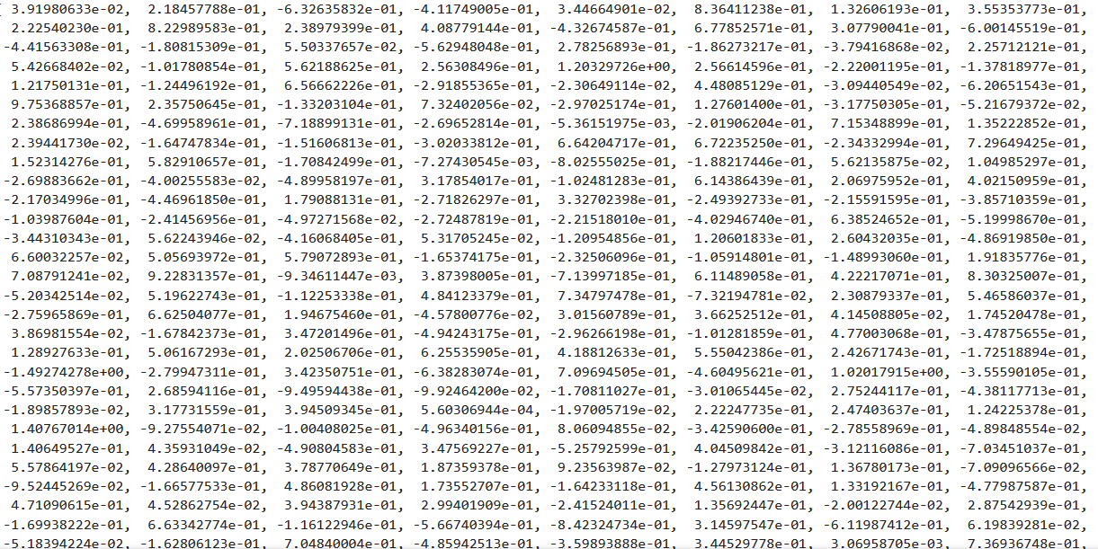
Quick animal pop quiz!

Slide 7
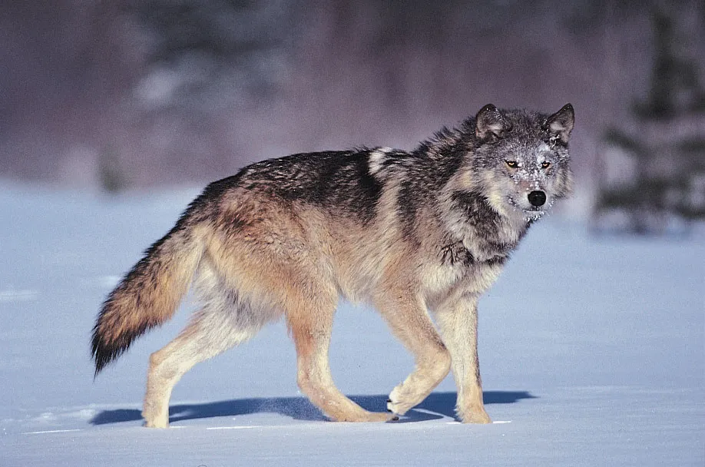
Quick animal pop quiz!
© Jeff Lepore Photo Researchers

Slide 8
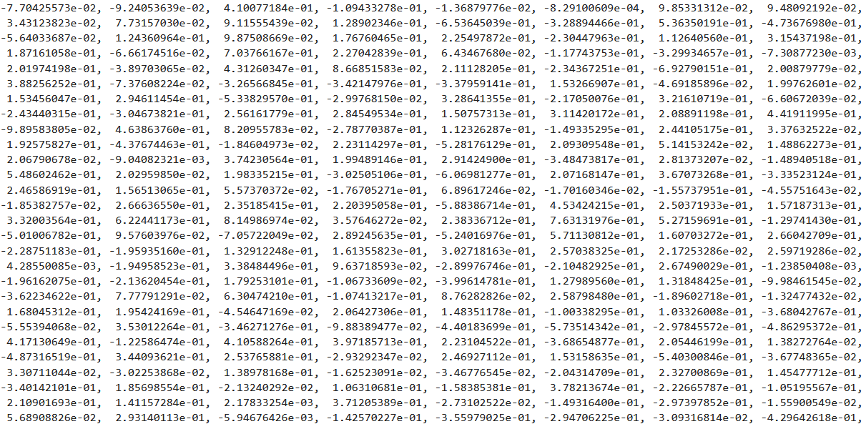
Klengen DéiereQuiz

Slide 9
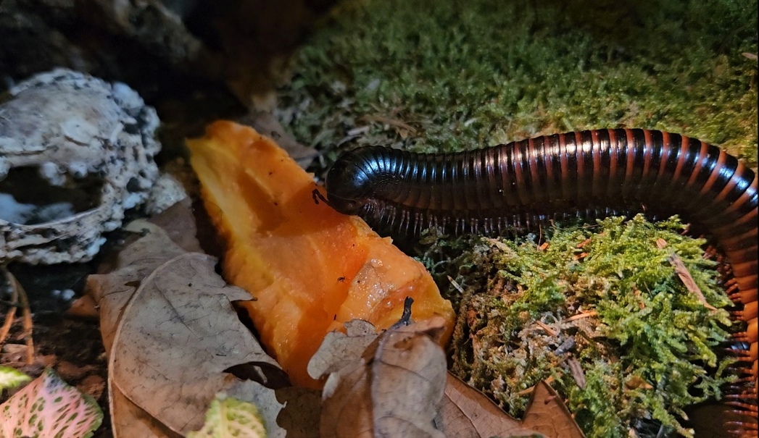
Quick animal pop quiz!
🥹
😱
🤔

Slide 10

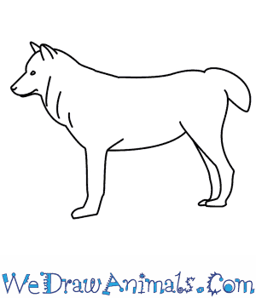
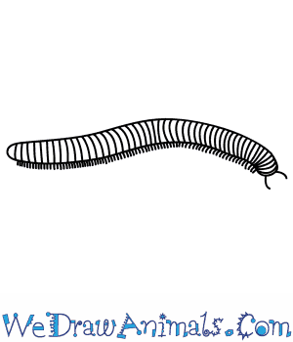
How can we represent words?
What do you see when you think of an animal?
An image?
A description?
A list of features?
Or maybe a
mathematical representation?
The dog (Canis familiaris or Canis lupus familiaris) is a domesticated descendant of the gray wolf. Also called the domestic dog, it was selectively bred from a population of wolves
Class: Mammal
Diet: Carnivorous
Life span: 10-15 years
?
Class: Mammal
Diet: Carnivorous
Life span: 6-8 years
The wolf (Canis lupus;^{[b]} pl.: wolves), also known as the grey wolf or gray wolf, is a canine native to Eurasia and North America. More than thirty subspecies of Canis lupus have been recognized, including the dog and dingo
Millipedes (originating from the Latin mille, "thousand", and pes, "foot")^{[1][2]} are a group of arthropods that are characterised by having two pairs of jointed legs on most body segments.
Class: Diplopode
Diet: Detrivorous
Life span: 5-10 years
© Wikipedia

Slide 11
How can we represent words?
Let’s categorise animals in a numerical way!
Size:
Number of legs:
Life span:
100+
Cat
Dog
Fox
Wolf
Millipede
White shark
Snail
Ara
Galapagos
Tortoise
Anaconda
Blue whale
Number
4
0
1
2
Metres
5
30
2
1
0

Slide 12
How can we represent words?
Let’s categorise animals in a numerical way!
Size:
Number of legs:
Life span:
100+
Millipede
Number
4
Fox
Cat
2
Dog
Wolf
1
Snail
0
1
2
Metres
5
5
30
Ara
Years
10
Galapagos
Tortoise
50
Anaconda
100+
White shark
Blue whale

Slide 13
How can we represent words?
What do you see when you think of an animal?
Dog = (1 , 4, 13)
An image?
A description?
A list of features?
Or maybe a
mathematical representation?
Wolf = (1.5, 4, 6)
Millipede = (0.3, 200, 10)

Slide 14
How can we represent words?
Let’s categorise animals in a numerical way!
Distance between two animals:
The closer, the more similar
100+
Millipede
Number
4
Fox
d = 3
2
d = 10
d = 7
d = 221
Dog
Wolf
1
0
1
2
Metres
5
5
30
Years
10
d = 82
50
100+
Blue whale

Slide 15
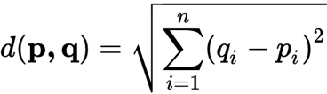



How can we represent words?
We don’t need to measure the distance, we can calculate it!
In general:
In a 3-dimensional space:

Slide 16
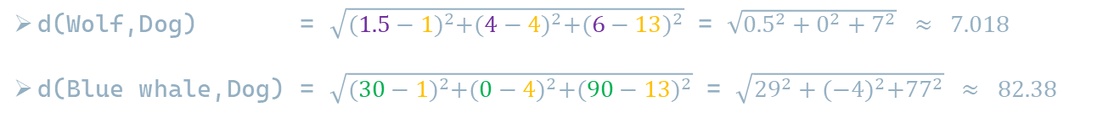
How can we represent words?
We don’t need to measure the distance, we can calculate it!
In a 3-dimensional space:
Dog = ( 1 , 4, 13)
Wolf = ( 1.5, 4, 6)
Blue whale = (30 , 0, 90)
d(Wolf,Dog) = $\sqrt{{(1.5−1)}^{2}+{(4−4)}^{2}+{(6−13)}^{2}}$ = $\sqrt{{0.5}^{2}+0^{2}+7^{2}} ≈ 7.018$
d(Blue whale,Dog) = $\sqrt{{(30−1)}^{2}+{(0−4)}^{2}+{(90−13)}^{2}}$ = $\sqrt{{29}^{2}+{(−4)}^{2}+{77}^{2}} ≈ 82.38$

Slide 17
How can we represent words?
What does that have to do with language models?
100+
The same idea to represent words!
A few differences:
        Not only animals!
        A lot more dimensions!
Millipede
Number
4
Fox
Cat
2
Dog
Wolf
1
Snail
0
1
2
Metres
5
5
30
Ara
Years
10
Galapagos
Tortoise
50
Anaconda
100+
White shark
Blue whale
17

Slide 18
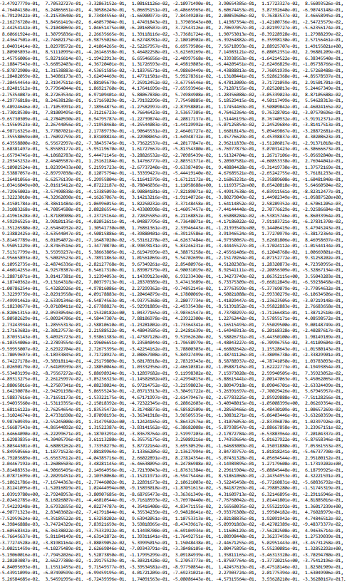
How can we represent words?
What does that have to do with language models?
Dog = ( 1 , 4, 13)
3 Dimensions
768 Dimensions!
18
)

Slide 19



How can we represent words?
What does that have to do with language models?
In general:
In a 3-dimensional space:
d3 (Dog,Wolf) = $7.018$
d3 (Dog,Blue whale) = $82.38$
d768(Dog,Wolf) = 8.513
d768(Dog,Blue whale) = $13.07$

Slide 20
How can we represent words?
What does that have to do with language models?
100+
The same idea to represent words!
A few differences:
        Not only animals!
        A lot more dimensions!
        Not interpretable for humans!
Millipede
Number
4
Fox
Cat
2
Dog
Wolf
1
Snail
0
1
2
Metres
5
5
30
Ara
Years
10
Galapagos
Tortoise
50
Anaconda
100+
White shark
Blue whale
20

Slide 21
How can we represent words?
What does that have to do with language models?
Dog = ( 1 , 4, 13)
21
)

Slide 22
How do we know if a Computer has mastered the language?
How can we test language models?
Dog = ( 1 , 4, 13)
22
)

Slide 23
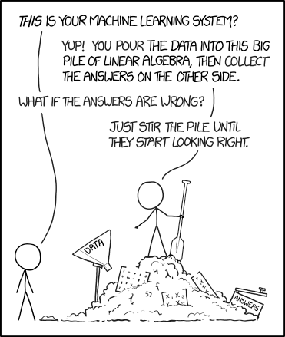
How do we know if a Computer has mastered the language?
How can we test language models?
23
)

Slide 24
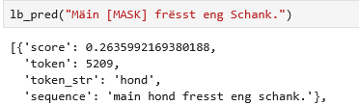


How do we know if a Computer has mastered the language?
With mad libs texts?
My ______ is eating a bone.
The ______ is a descendent of the wolf.

Slide 25
How do we know if a Computer has mastered the language?
With text-based exercises?
“The quick brown fox jumps over the lazy dog” -> Mark all adjectives!
“Zolwerknapp is sited in the Minett region.” -> Tell me which words are names!
“The movie is boring.” -> Tell me whether this sentence is neutral, positive or negative!
-> Summarise this text!
Millipedes (originating from the Latin mille, "thousand", and pes, "foot")^{[1][2]} are a group of arthropods that are characterised by having two pairs of jointed legs on most body segments.

Slide 26
How do we know if a Computer has mastered the language?
Problems with tests for language models:
Most language models are catered towards wide-spread languages, mainly English
Language models, and especially LLMs need a huge amount of data to learn the language
Testing benchmarks for low-resource languages are scarce, if they exist at all
Current LLMs have often seen testing data during their training

Slide 27
Can an llm pass the national language exam for Luxembourgish?
Language proficiency exams:
However, language exams are typically more readily available, diverse, and of high quality
We can ask LLMs to solve language exams to test their proficiency
We can find out when and why LLMs fail in the language
We can compare the proficiency of LLMs

Slide 28
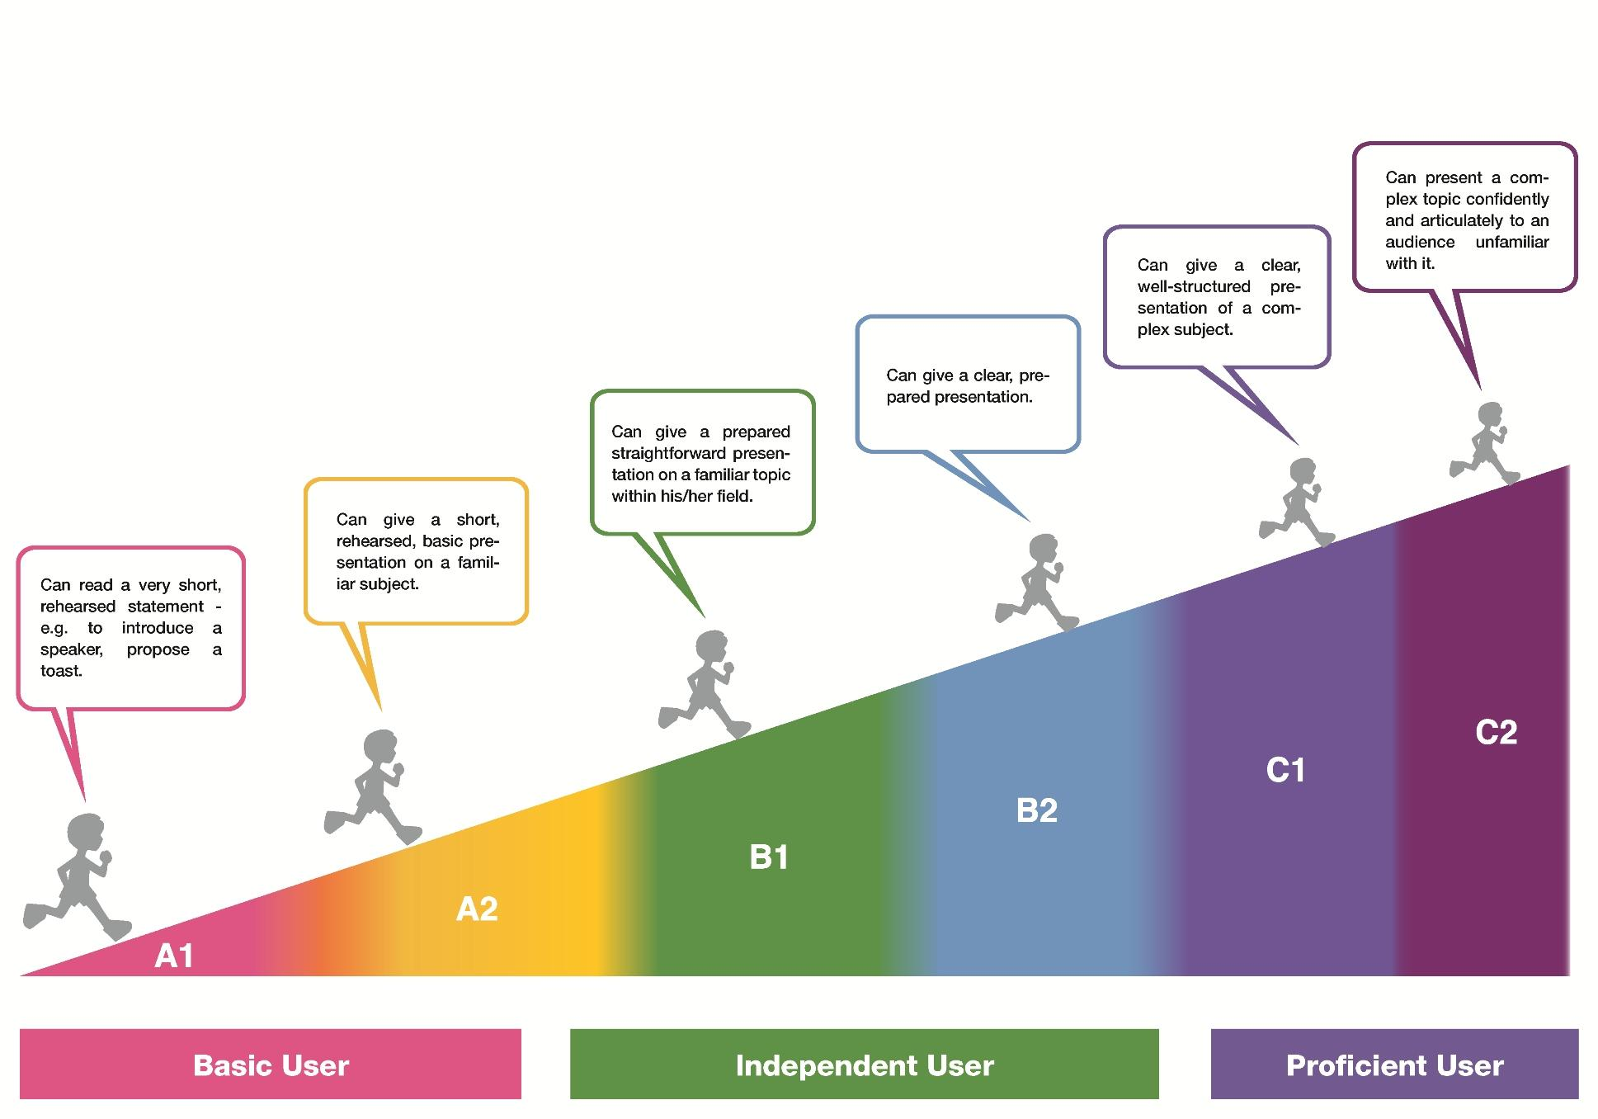
Can an llm pass the national language exam for Luxembourgish?
© Badges for Languages

Slide 29
Can an llm pass the national language exam for Luxembourgish?
Language proficiency exams:
We received around exams containing a total of 600 questions from the Institut National des Langues Luxembourg (INLL)
Exams range from A1 to C2 and broadly fall into four categories (Vocabulary, Grammar, Reading Comprehension, Listening Comprehension)
We tested 54 recent LLMs on those exams

Slide 30
Can an llm pass the national language exam for Luxembourgish?
Example Grammar Question:
T: Op ______ Weiere kann een am Wanter Schlittschong fueren.
Translation: On _____ ponds, one can go ice-skating in winter.
Possible Answers: zougefruer, zoufréieren, zougefruere, zougefrueren
Test categories: verbs, verbs_past_tense, n_rule

Slide 31
Can an llm pass the national language exam for Luxembourgish?
Example Grammar Question:
TEXT: Op [BLANK] Weiere kann een am Wanter Schlittschong fueren.
ANSWERS: [zougefruer, zoufréieren, zougefruere, zougefrueren]

Slide 32
Can an llm pass the national language exam for Luxembourgish?
Testing Pipeline
Grading + Score
language exams
Test LLMs
Prompts
Answers
Data Visualisation

Slide 33
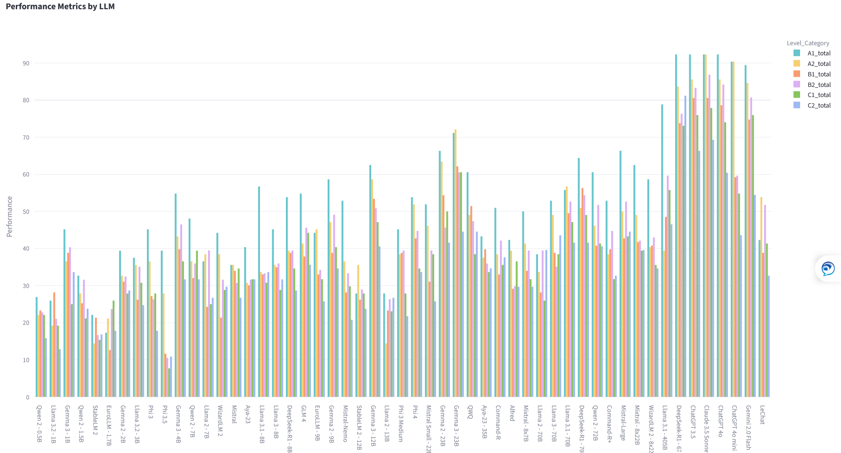
Can an llm pass the national language exam for Luxembourgish?
Exam Results

Slide 34
Can an llm pass the national language exam for Luxembourgish?
Coarse-grained Categories
Vocabulary
Grammar
Reading Comprehension

Slide 35
Can an llm pass the national language exam for Luxembourgish?
Fine-grained Categories
Idiom
Noun
Verb
Adjective
Native
Gender
Pronouns
Verbs
Adjectives
Tense
Past tense
Present tense
Subjunctive tense
Modal verbs
Prepositions
Cases
True/False
Simple
Complex
Vocabulary
Grammar
Comprehension

Slide 36
Can an llm pass the national language exam for Luxembourgish?
What types of questions are difficult for LLMs?
Vocabulary: questions relating to native words and idioms
Example: Q: Eis Mataarbechter sinn esou zefridde mat hiren Aarbechtskonditiounen,
datt si mengen, si hätten den Herrgott mat der décker ____.
A: Zéif, Nues, Hand
Grammar: questions where possible answers are very similar, e.g. adjectives, cases
Example: Q: Op ___ Weiere kann een de Wanter Schlittschong fueren.
A: zougefruer, zougefruerene, zougefruerenen, zougefréieren
Comprehension: questions requiring full understanding of a given text, i.e. complex texts

Slide 37
Can an llm pass the national language exam for Luxembourgish?
What did we learn?
Language models use numbers and maths to ‘learn’ human language
We need a lot of resources and data to not only train language models, but also test them
Language proficiency exams might be an insightful way to test LLMs

Slide 38
Can an llm pass the national language exam for Luxembourgish?
Can an llm become a citizen of Luxembourg?
Yes!
No…

Slide 39
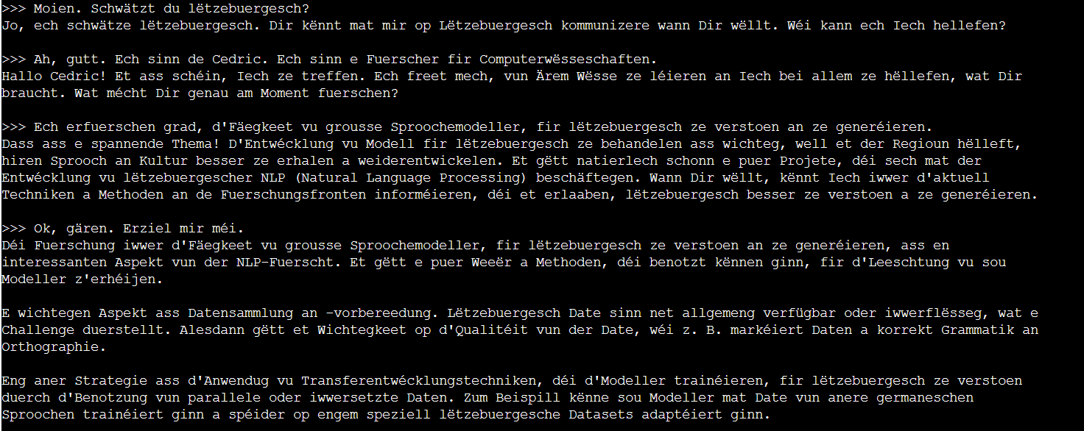
Apertus
A first test: 8B

Slide 40
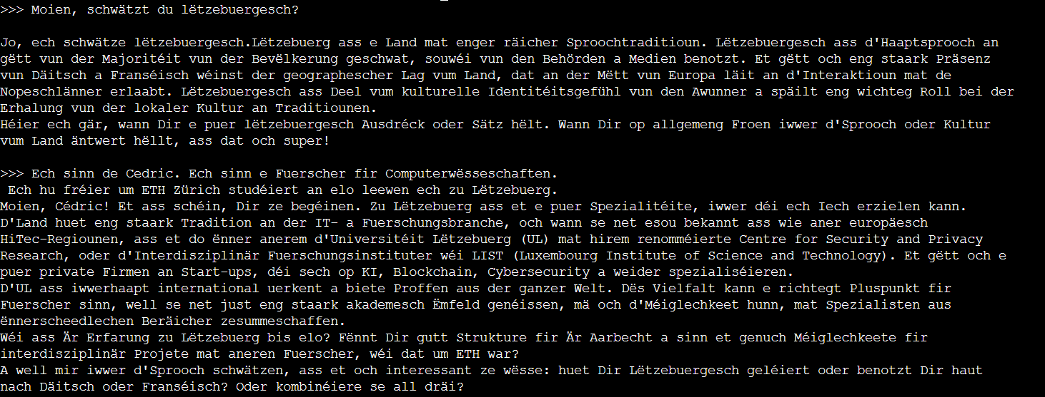
Apertus
A first test: 70B

Slide 41
Thank you
Contact
Cédric LOTHRITZ
  cedric.lothritz@list.lu

