Slide 1
Data-Driven Approach to Setting Ticket Price for Big Mountain Resort
By: Melissa BARONA
Springboard capstone project 1

Slide 2
Our Client: Big Mountain Resort
Big Mountain Resort is a ski resort located in Montana.
Big Mountain Resort offers spectacular views of Glacier National Park and Flathead National Forest, with access to 105 trails.
~ 350,000 visitors a year
Offers 11 lifts, 2 T-bars, and 1 magic carpet for novice skiers
The longest run is named Hellfire and is 3.3 miles in length
The base elevation is 4,464 ft, and the summit is 6,817 ft with a vertical drop of 2,353 ft.
Big Mountain Resort has recently installed an additional chair lift to help increase the distribution of visitors across the mountain.
This additional chair increases their operating costs by $1,540,000 this season.

Slide 3
Problem Identification
Problem
Solution
Implement a data-driven strategy that capitalizes on Big Mountain Resort’s facilities
provide guidance on how to select a better value for its ticket price
Big Mountain currently bases its premium on the average price of resorts in its market segment
* Big Mountain Resort currently charges $81.00 for the adult weekend ticket price

Slide 4
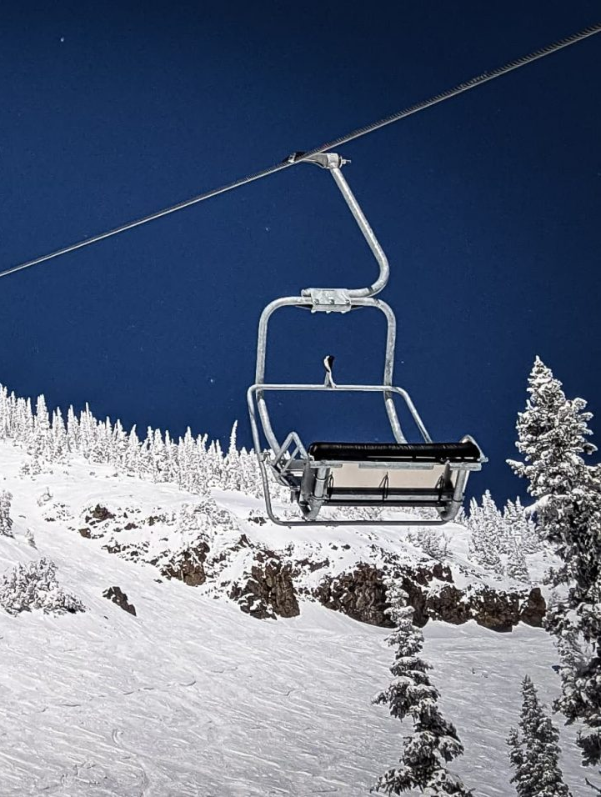
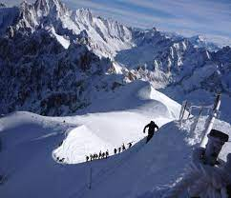
key findings and Recommendation
Key Findings
Recommendation
Big Mountain outperforms most ski resorts in the U.S. In these facilities that visitors value most:
Vertical drop
Number of runs
Total chairs
Snow making area
Number of fast quads
Distance of the longest run
Number of trams
Skiable terrain area
Increase adult weekend to $97.86
Increase vertical drop by 150 ft
Increase profits by $ 2 M
Add 1 run
Install 1 chair lift

Slide 5

Modeling
Details of the dataset
Models
Dataset containing information from 277 resorts in the U.S. that can be considered part of the same market share as Big Mountain
Columns include information on:
Adult weekend and weekday prices
Vertical drop
elevation of ski resort
number of chairlifts, trams, fastquads
total skiable area and snowmaking area
days the resort was open and projected days open
The performance of the following models were evaluated
Linear Model
Random Forest Model

Slide 6
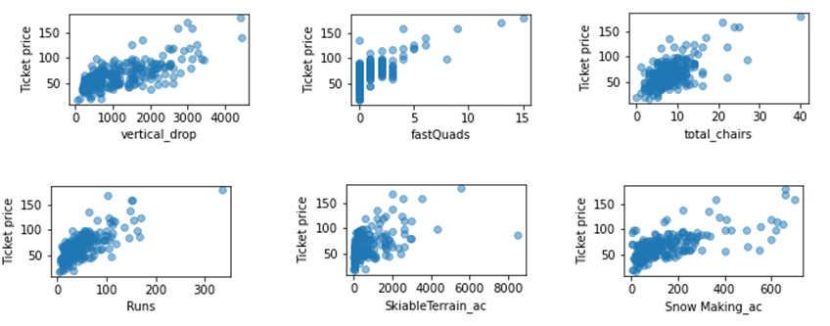
Models revealed the facilities that visitors value the most

Slide 7
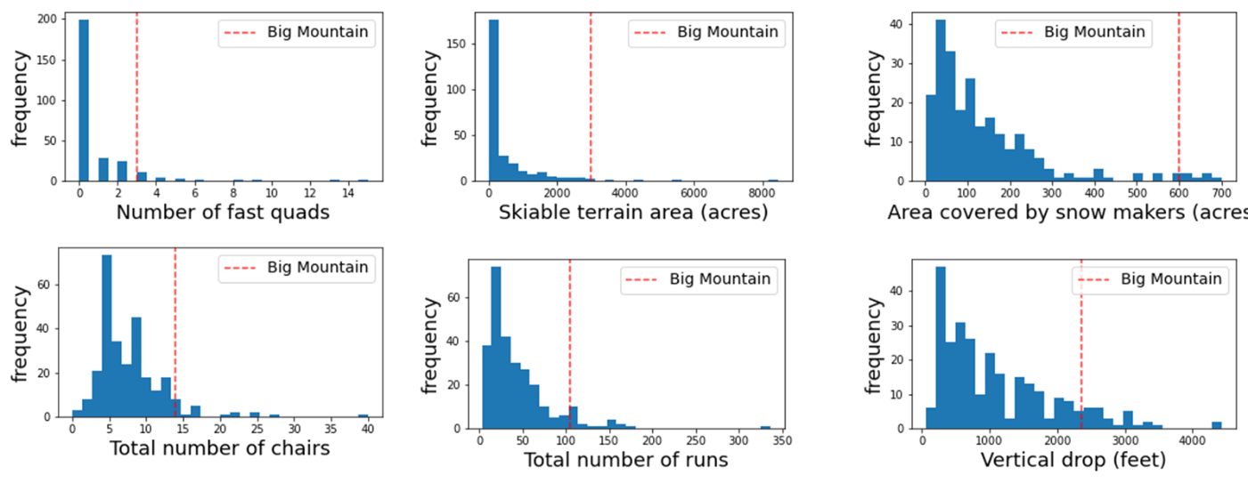
Big Mountain Resort outperforms most U.S. resorts in facilities visitors value the most

Slide 8
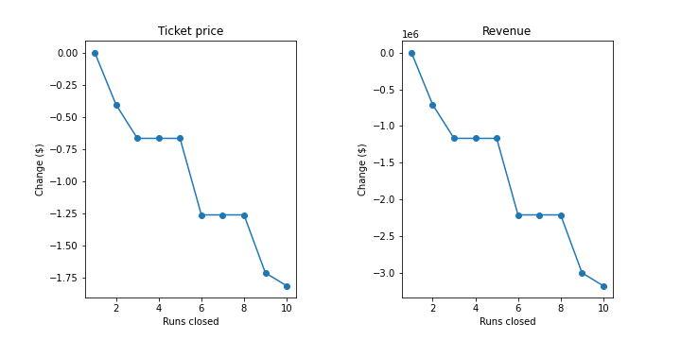
Analysis – Using the random forest model for different case scenarios
Scenario 1: closing up to 10 runs
To cut expenses:
Up to 1 run can be closed and the ticket price would stay the same and make no difference on the revenue
Closing 2 to 10 runs could decrease revenue by $ 0.5-3.5 M

Slide 9
Analysis – Using the random forest model for different case scenarios
Scenario 2
Increase vertical drop by 150 ft
Install an additional chair lift
Scenario 3
Same as scenario 2
Add 2 acres of snow
Scenario 4
Increase the longest run by 0.2 miles
Add 4 acres of snow making
Add a run
Increase price to $97.86
Increase profits by $2 M
Increase price to $97.86
Increase profits by $2 M
Makes no difference in revenue

Slide 10
Summary and Conclusions
Currently, Big Mountain Resort charges $81.00 for the adult weekend ticket price
The model suggests that the resort should be charging $95.87, with a margin of $10.39
Big Mountain Resort outperforms most U.S. resorts in the facilities that visitors value the most, including vertical drop, number of chairs, and number of runs
If the resort wants to cut down on costs, up to 1 run can be closed with no effect on revenue
Ticket price can be increased by $1.99 and profits can be increased by $ 2 M if the vertical drop is increased by 150 ft, 1 additional chair lift is installed, and 1 run is added
The model can be improved with additional data such as number of visitors and operating costs

