Slide 1
Auto-tagging Global Giving Projects
By: Melissa Barona
Springboard Capstone Project 3

Slide 2

Problem identification
Problem: It can be tedious, expensive, and time-consuming to manually assign each project to a theme
Solution: Create an auto-tagging system to classify projects using machine learning
Notes:
Business impact vs. entry-level

Slide 3
Product Vision
An auto-tagger that properly tags a project based on the context of its description
Child Protection
An appropriate classification of a project to a theme is essential for attracting the ideal donor that will continue to support the mission of the project.
Education
Gender Equality
School
Protect children in schools
girls in schools

Slide 4
Our best classifier: A word2vec transformation and support vector machine model
Data Collection
Use API to collect project information
Pre-processing and Feature Engineering
Bag of words
Modeling and Validation
Naïve Bayes
Support Vector Machine
TF-IDF
word2vec

Slide 5
Our best classifier: A word2vec transformation and support vector machine model
Model | Overall Accuracy
 | Training Set | Testing Set
TF-IDF/Naïve Bayes | 0.94 | 0.92
TF-IDF/Linear SVM | 0.94 | 0.84
Word2vec/Naïve Bayes | 0.70 | 0.71
Word2vec/RDF SVM | 0.99 | 0.84

Slide 6
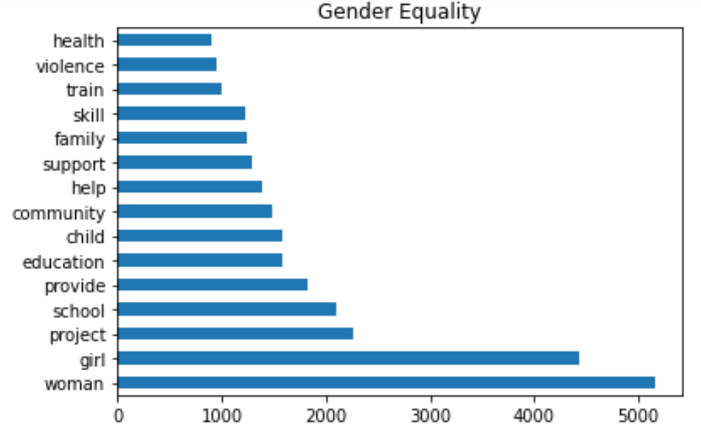
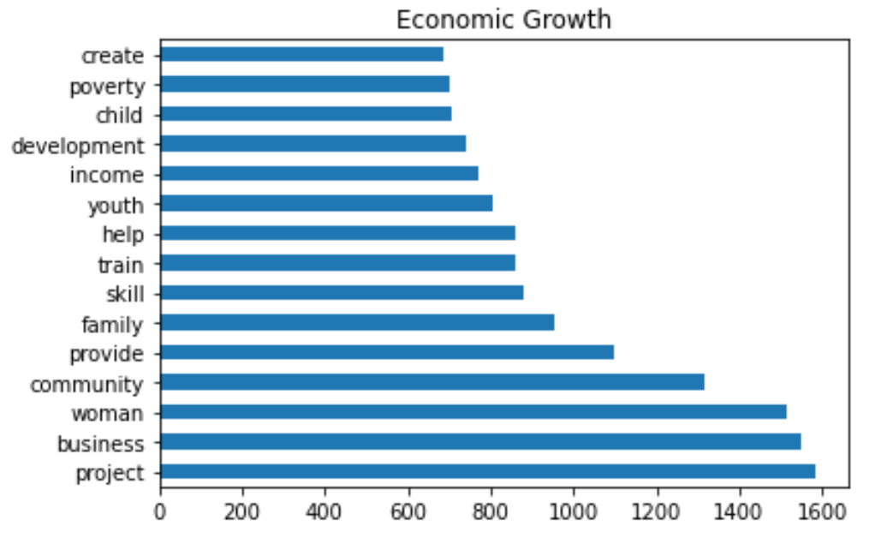
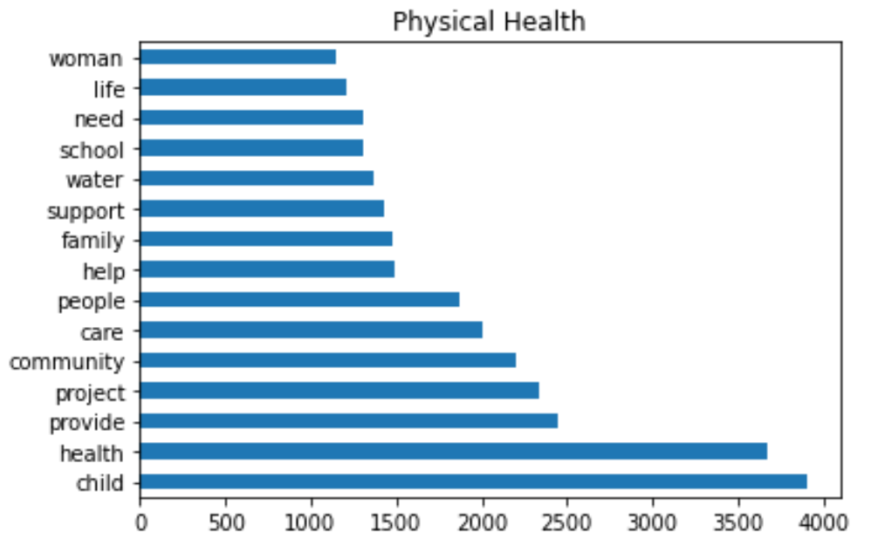
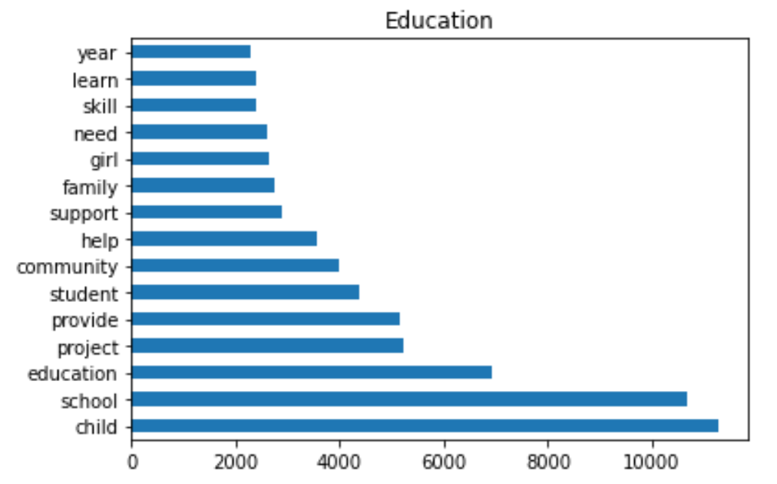
Building the auto-tagging classifier: What words will matter the most when classifying?
‘Project’, ‘provide’, ‘help’, ‘child’, ‘community’, and ‘family’ appear in all categories
‘School’, ‘education’, ‘woman’, and ‘girl’ appear often in both ‘Gender Equality’ and ‘Education’ texts which can lead to some texts being misclassified under these themes
‘Water’ and ‘health’ are most frequent in ‘Physical Health’ and ‘development’
‘income’ are most frequent in ‘Economic Growth’ texts

Slide 7
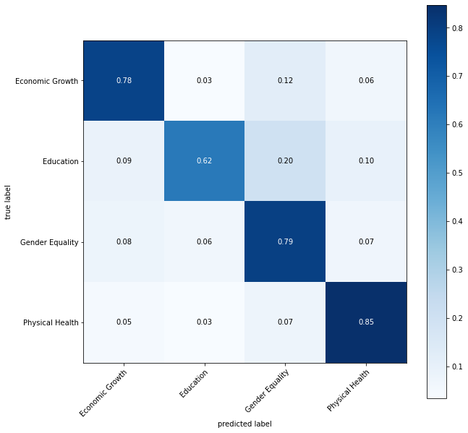
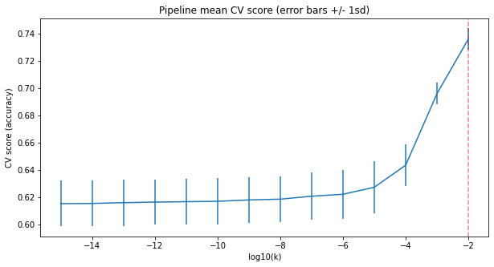
Building the auto-tagging classifier: The TF-IDF/Naïve Bayes MODEL misclassifies “Education” projects the most
Hyper-parameter tuning
Best variance smoothing

Slide 8
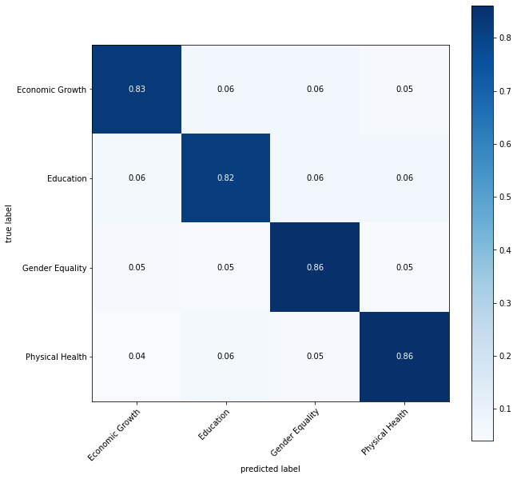
Building the auto-tagging classifier: The TF-IDF/SVM model is more accurate, but much slower to train
TF-IDF/Linear SVM model correctly classifies 20% more “Education” projects than the TF-IDF/Naïve Bayes model

Slide 9
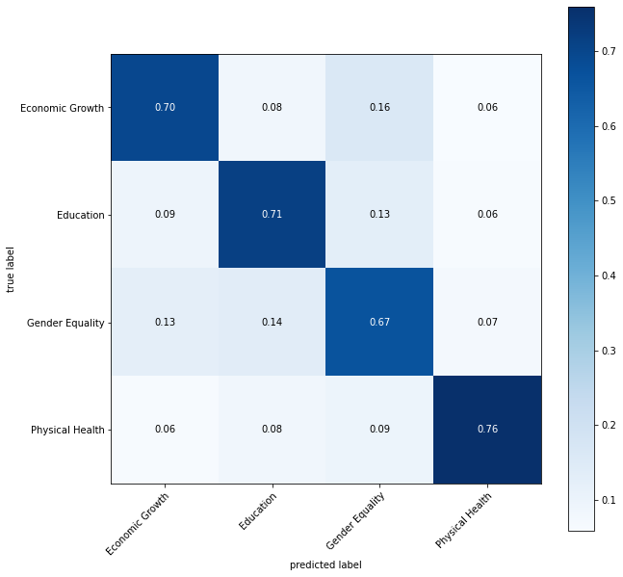
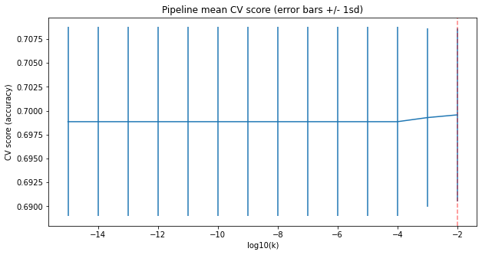
Building the auto-tagging classifier: The word2vec/Naïve Bayes MODEL misclassifies “Gender equality” projects the most
Tuning the variance smoothing parameter has no effect on the performance of the model
Notes:
It is highly embedded, 300 dimensions, not features

Slide 10
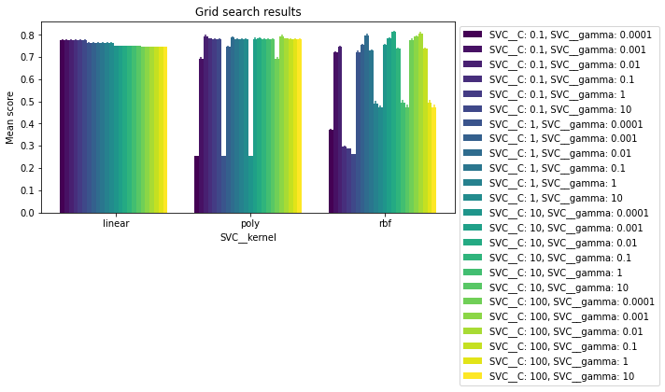
The most optimal classifier: A word2vec/SVM model
The SVM model was tuned using different kernels and different values for the parameters C and gamma
Just as good, easier to train
Best model
The best performing kernel is RBF with parameter values C = 10 and gamma = 0.01
A linear SVM model with C = 0.1 performs well with an accuracy of nearly 0.80

Slide 11
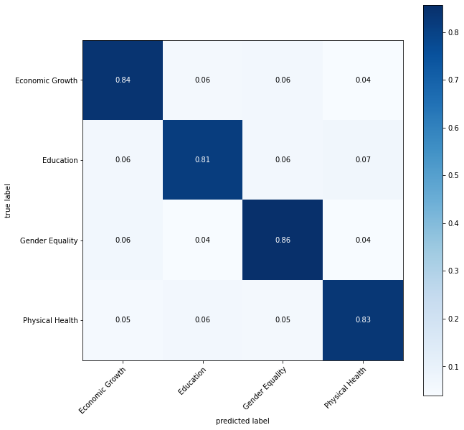
The most optimal classifier: A word2vec/SVM model
Word2vec/RBF SVM model correctly classifies 19% more “Gender Equality” projects than the word2vec/Naïve Bayes model

Slide 12
Future Improvements
Apply the word2vec word-embedding method to the entire dataset of containing all 38,811 projects and fit a radial SVM model
Depending on how accurate this model is, the challenges of this next step will continue to be distinguishing among projects with similar language and identifying a metric that can assess how correctly the model classifies these projects, but also gives merit to partially correct classification
Notes:
More business impact, where do I envision a product, suggest a topic

