Slide 1
COMPUTER INTRODUCTION
Course Instructor: Mr. MLELI

Slide 2
What is Computer?
Is an electronic machine that accept data input, process data input, stores information and retrieves information s when needed.
OR
A computer is an electronic device, operating under the control of instructions stored in its own memory that can accept data (input), process the data according to specified rules, produce information (output), and store the information for future use.

Slide 3
What is Computer? Cont……..
DATA
It is the collection of raw facts, figures & symbols, E.g. Names of students and their marks in different subjects listed in random order.
INFORMATION
It is the data that is processed & presented in an organized manner. Ex : When the names of students are arranged in alphabetical order, total and average marks are calculated & presented in a tabular form, it is information

Slide 4
Input Devices
An input device is essentially a piece of hardware that sends data to a computer. Most input devices either interact with or control the computer in some way. The most common input devices are the mouse and the keyboard, but there are many others.

Slide 5
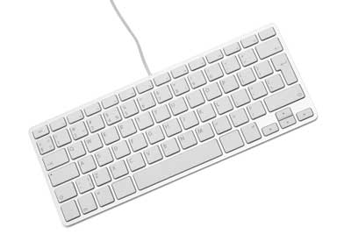
Input Devices Cont.…….
Keyboard
Keyboard is the most common and very popular input device which helps to input data to the computer. The layout of the keyboard is like that of traditional typewriter, although there are some additional keys provided for performing additional functions.

Slide 6
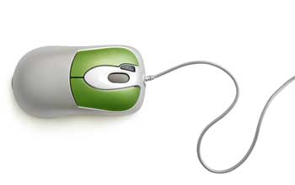
Input Devices Cont.…….
II. Mouse
Mouse is the most popular pointing device. It is a very famous cursor-control device having a small palm size box with a round ball at its base, which senses the movement of the mouse and sends corresponding signals to the CPU when the mouse buttons are pressed.
Generally, it has two buttons called the left and the right button and a wheel is present between the buttons. A mouse can be used to control the position of the cursor on the screen, but it cannot be used to enter text into the computer.

Slide 7
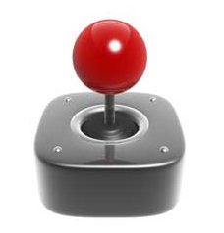
Input Devices Cont.…….
Joystick
Joystick is also a pointing device, which is used to move the cursor position on a monitor screen. It is a stick having a spherical ball at its both lower and upper ends. The lower spherical ball moves in a socket. The joystick can be moved in all four directions.
The function of the joystick is similar to that of a mouse. It is mainly used in Computer Aided Designing (CAD) and playing computer games.

Slide 8
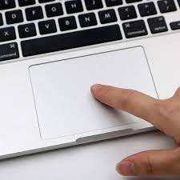
Input Devices Cont.…….
IV. Touchpad
The touchpad also known as trackpad, is an input device that is primarily integrated with a laptop. It is pointing device like a surface that can detect the movements of our fingers and move the pointer accordingly. It is nothing but a common alternative to a mouse and also helps to make computer devices compact, small, and lightweight.

Slide 9
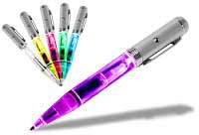
Input Devices Cont.…….
Light Pen
Light pen is a pointing device similar to a pen. It is used to select a displayed menu item or draw pictures on the monitor screen. It consists of a photocell and an optical system placed in a small tube.
When the tip of a light pen is moved over the monitor screen and the pen button is pressed, its photocell sensing element detects the screen location and sends the corresponding signal to the CPU.

Slide 10
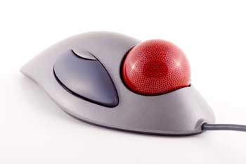
Input Devices Cont.…….
Track Ball
Track ball is an input device that is mostly used in notebook or laptop computer, instead of a mouse. This is a ball which is half inserted and by moving fingers on the ball, the pointer can be moved.
Since the whole device is not moved, a track ball requires less space than a mouse. A track ball comes in various shapes like a ball, a button, or a square.

Slide 11
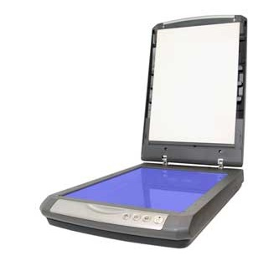
Input Devices Cont.…….
Scanner
Scanner is an input device, which works more like a photocopy machine. It is used when some information is available on paper and it is to be transferred to the hard disk of the computer for further manipulation.
Scanner captures images from the source which are then converted into a digital form that can be stored on the disk. These images can be edited before they are printed.

Slide 12
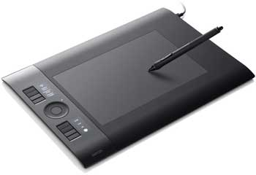
Input Devices Cont.…….
VIII. Digitizer
Digitizer is an input device which converts analog information into digital form. Digitizer can convert a signal from the television or camera into a series of numbers that could be stored in a computer. They can be used by the computer to create a picture of whatever the camera had been pointed at. Sometimes known as Graphic Tablet.
Digitizer is also known as Tablet or Graphics Tablet as it converts graphics and pictorial data into binary inputs. A graphic tablet as digitizer is used for fine works of drawing and image manipulation applications.

Slide 13
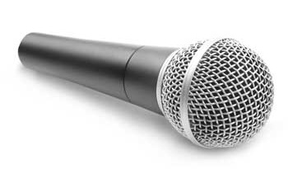
Input Devices Cont.…….
IX. Microphone
Microphone is an input device to input sound that is then stored in a digital form. The microphone is used for various applications such as adding sound to a multimedia presentation or for mixing music.

Slide 14
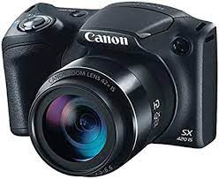
Input Devices Cont.…….
Digital Camera
A digital camera is an input device that is used to capture images and video in digital form. This allows users to store the captured media files in a memory card and transfer them to the computer. Digital cameras use an image sensor chip to capture images rather than the film used by traditional cameras of the old days.

Slide 15
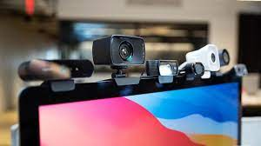
Input Devices Cont.…….
Webcam
Webcam can capture images and videos and convert them into a digital form. A webcam is slightly different from a digital camera. Unlike digital camera s, webcam cannot operate independently. They should be connected to a computer. Also, webcams have no inbuilt memory they use the computer’s storage to save captured data. Webcams are most commonly used for video chatting and live-streaming videos.

Slide 16
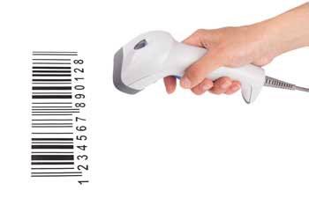
Input Devices Cont.…….
Bar code Readers
Bar Code Reader is a device used for reading bar coded data (data in the form of light and dark lines). Bar coded data is generally used in labelling goods, numbering the books, etc. It may be a handheld scanner or may be embedded in a stationary scanner. Bar Code Reader scans a bar code image, converts it into an alphanumeric value, which is then fed to the computer that the bar code reader is connected to.

Slide 17
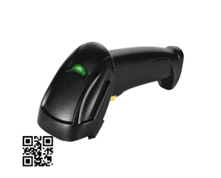
Input Devices Cont.…….
The QR Code reader , also known as the QR code scanner, is an input device used to read QR codes. QR codes are computer-generated patterns that store or hold a modest amount of data. They do not require a database to store information separately. QR Code readers are almost identical in functionalities to bar code readers.

Slide 18
Central Processing Unit
A CPU is brain of a computer. It is responsible for all functions and processes. Regarding computing power, the CPU is the most important element of a computer system.
The central processing unit (CPU) or processor, is the unit which performs most of the processing inside a computer. It processes all instructions received by software running on the PC and by other hardware components, and acts as a powerful calculator.
The CPU is placed into a specific square-shaped socket found on all motherboards by inserting its metallic connectors or pins found on the underside. Each socket is built with a specific pin layout to support only a specific type of processor.
Since modern CPUs produce a lot of heat and are prone to overheating, they must be kept cool with appropriate fans or ventilation systems, and covered with heat sinks and thermal paste.
To control instructions and data flow to and from other parts of the computer, the CPU relies heavily on a chipset, which is a group of microchips located on the motherboard.

Slide 19
CPU Cont.……..
Many new computer users may improperly call their System Case the CPU. When referring to your computer, it's proper to refer to them as the "computer" and not a CPU. The CPU is a chip inside the computer.
CPU It is the part of the computer that carries out the instructions of a computer program. It is the unit that reads and executes program instructions. Hence it is known as the brain of the computer. The CPU consists of storage or memory unit, Arithmetic Logic Unit (ALU) and control unit (CU).

Slide 20
CPU Cont.……..
Memory Unit
It is also known as the primary storage or main memory. It stores data, program instructions, internal results and final output temporarily before it is sent to an appropriate output device. It consists of thousands of cells called storage locations. These cells activate with off-on or binary digits(0,1) mechanism. Thus a character either a letter or numerical digit is stored as a string of (0,1) Binary digits ( BITS). These bits are used to store instructions and data by their combinations.
Before the actual processing starts the data and the instructions fed to the computer through the input units are stored in this primary storage unit. Similarly, the data which is to be output from the computer system is also temporarily stored in the primary memory. It is also the area where intermediate results of calculations are stored. The main memory has the storage section that holds the computer programs during execution. Thus the primary unit
Stores data and programs during actual processing
Stores temporary results of intermediate processing
Stores results of execution temporarily

Slide 21
CPU Cont.……..
Arithmetic Logic Unit (ALU)
It is the unit where all Arithmetic operations (addition, subtraction etc.) and logical functions such as true or false, male or female are performed. Once data are fed into the main memory from input devices, they are held and transferred as needed to ALU where processing takes place. No process occurs in primary storage. Intermediate generated results in ALU are temporarily placed in memory until needed at later time. Data may move from primary memory to ALU and back again to storage many times before the process is finalized.
The Arithmetic Logic Unit (ALU) actually executes the instructions and performs all the calculations and decisions. The data is held in the primary storage unit and transferred to the ALU whenever needed. Data can be moved from the primary storage to the arithmetic logic unit a number of times before the entire processing is complete. After the completion, the results are sent to the output storage section and the output devices.

Slide 22
CPU Cont.……..
Control Unit
It acts as a central nervous system and ensures that the information is stored correctly and the program instructions are followed in proper sequence as well as the data are selected from the memory as necessary. It also coordinates all the input and output devices of a system.
The Control Unit controls the operations of the entire computer system. The control unit gets the instructions from the programs stored in primary storage unit interprets these instruction an subsequently directs the other units to execute the instructions. Thus it manages and coordinates the entire computer system.
The control unit of the central processing unit regulates and integrates the operations of the computer. It selects and retrieves instructions from the main memory in proper sequence and interprets them so as to activate the other functional elements of the system at the appropriate moment to perform their respective operations.

Slide 23
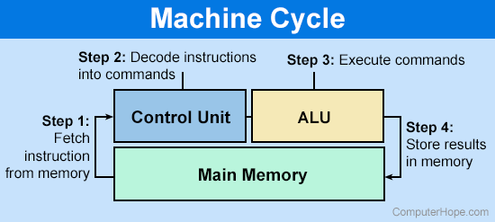
CPU Cont.……..

Slide 24
Storage Unit
A storage device is any type of computing hardware that is used for storing, porting or extracting data files and objects. Storage devices can hold and store information both temporarily and permanently. They may be internal or external to a computer, server or computing device.
Storage devices are one of the core components of any computing device. They store virtually all of the data and applications on a computer, except for hardware firmware which is generally managed through separate read-only memory or ROM.
Storage devices are available in different forms, depending on the type of underlying device. For example, a standard computer has multiple storage devices including RAM, a cache, and a hard disk. The same device may also have optical disk drives and externally connected USB drives.
There are two different types of storage devices;

Slide 25
Storage Unit Cont.……
Primary storage devices
Generally smaller in size, primary storage (also known as main memory) is the component of the computer that holds data, programs and instructions that are currently in use and are internal to the computer. They have the fastest data access speed. These types of devices include RAM, ROM and cache memory.
RAM: Random Access Memory (RAM) is a memory scheme within the computer system responsible for storing data on a temporary basis, so that it can be promptly accessed by the processor as and when needed. It is volatile in nature, which means that data will be erased once supply to the storage device is turned off. RAM stores data randomly and the processor accesses these data randomly from the RAM storage. RAM is considered "random access" because you can access any memory cell directly if you know the row and column that intersect at that cell.
Read-only memory (ROM) is a type of non-volatile memory used in computers and other electronic devices. Data stored in ROM can only be modified slowly, with difficulty, or not at all, so it is mainly used to store firmware (software that is closely tied to specific hardware, and unlikely to need frequent updates) or application software in plug-in cartridges.

Slide 26
Storage Unit Cont.……
Cache memory is generally joined onto the motherboard and installed on the core processor or main RAM. It provides quicker access by storing an instance of the programs or data regularly accessed by the processor. With the information in cache memory, the processor does not need to go to RAM or the hard drive to get the data, it already has an instance of it in its memory. An example of this is using the Internet and a web browser. The cache will store the website's HTML, images and other information so that a page will load more rapidly after its first visit.

Slide 27
Storage Unit Cont.……
Secondary storage devices
Secondary storage devices usually have larger storage capacity, and they store data permanently. They can be either internal or external to the computer. These types of devices include the hard disk, the optical disk drive and USB storage device.
Secondary storage (also known as external memory or auxiliary storage), differs from primary storage in that it is not directly accessible by the CPU. The computer usually uses its input/output channels to access secondary storage and transfers the desired data using intermediate area in primary storage. Secondary storage does not lose the data when the device is powered down it is non-volatile. Per unit, it is typically also two orders of magnitude less expensive than primary storage. Modern computer systems typically have two orders of magnitude more secondary storage than primary storage and data are kept for a longer time there.

Slide 28
Storage Unit Cont.……
Hard drive (HD): A hard disk is part of a unit, often called a "disk drive," "hard drive," or "hard disk drive," that store and provides relatively quick access to large amounts of data on an electromagnetically charged surface or set of surfaces.
Optical Disk: an optical disc drive (ODD) is a disk drive that uses laser light as part of the process of reading or writing data to or from optical discs. Some drives can only read from discs, but recent drives are commonly both readers and recorders, also called burners or writers. Compact discs, DVDs, and Blu-ray discs are common types of optical media which can be read and recorded by such drives. Optical drive is the generic name; drives are usually described as "CD" "DVD", or "Bluray", followed by "drive", "writer", etc. There are three main types of optical media: CD, DVD, and Blu-ray disc. CDs can store up to 700 megabytes (MB) of data and DVDs can store up to 8.4 GB of data. Blu-ray discs, which are the newest type of optical media, can store up to 50 GB of data. This storage capacity is a clear advantage over the floppy disk storage media (a magnetic media), which only has a capacity of 1.44 MB

Slide 29
Storage Unit Cont.……
Flash Disk A storage module made of flash memory chips. A Flash disks have no mechanical platters or access arms, but the term "disk" is used because the data are accessed as if they were on a hard drive. The disk storage structure is emulated.

Slide 30
Output Unit
An output device is any piece of computer hardware equipment used to communicate the results of data processing carried out by an information processing system (such as a computer) which converts the electronically generated information into human-readable form.
The key distinction between an input device and an output device is that an input device sends data to the computer, whereas an output device receives data from the computer.
For example, using a microphone to record a podcast is an example of using an input device. Listening to the recorded podcast through a connected speaker is an example of using an output device. Both output and input devices are examples of auxiliary or peripheral devices.

Slide 31
Output Unit Cont.……
Monitor – This is the most common computer output device. It creates a visual display by the use of which users can view processed data. Monitors come in various sizes and resolutions.
Printer – this device generates a hard copy version of processed data, like documents and photographs. The computer transmits the image data to the printer, which then physically recreates the image, typically on paper.
Speakers – speakers are attached to computers to facilitate the output of sound; sound cards are required in the computer for speakers to function. The different kinds of speakers range from simple, two-speaker output devices right the way up to surround-sound multi-channel units.
Headset – this is a combination of speakers and microphone. It is mostly used by gamers, and is also a great tool for communicating with family and friends over the internet using some VOIP program or other.

Slide 32
Output Unit Cont.……
Projector – this is a display device that projects a computer-created image onto another surface: usually some sort of whiteboard or wall. The computer transmits the image data to its video card, which then sends the video image to the projector. It is most often used for presentations, or for viewing videos.

Slide 33
Advantages of computers
High speed
Computer is a very fast device.
It is capable of performing calculation of very large amount of data.
The computer has units of speed in microsecond, nanosecond, and even the picosecond.
It can perform millions of calculations in a few seconds as compared to man who will spend many months to perform the same task.
Accuracy
In addition to being very fast, computers are very accurate.
The calculations are 100% error free.
Computers perform all jobs with 100% accuracy provided that the input is correct.
Storage
Memory is a very important characteristic of computers.
A computer has much more storage capacity than human beings.
It can store large amount of data.
It can store any type of data such as images, videos, text, audio, etc.

Slide 34
Advantages of computers Cont.…….
Automation
Computer is an automatic machine.
Computers can be instructed to perform complex tasks automatically ( which increases the productivity). Automation is the ability to perform a given task automatically. Once the computer receives a program i.e., the program is stored in the computer memory, then the program and instruction can control the program execution without human interaction.
Diligence
Computers can perform the same task repeatedly & with the same accuracy and speed without getting tired
Unlike human beings, a computer is free from monotony, tiredness, and lack of concentration.
It can work continuously without any error and boredom.

Slide 35
Advantages of computers Cont.…….
Versatility
Computers are flexible to perform both simple and complex tasks.
A computer is a very versatile machine.
A computer is very flexible in performing the jobs to be done.
This machine can be used to solve the problems related to various fields.
At one instance, it may be solving a complex scientific problem and the very next moment it may be playing a card game.
Cost effectiveness
Computers reduce the amount of paper work and human effort, thereby reducing costs.
Reliability
A computer is a reliable machine.
Modern electronic components have long lives.
Computers are designed to make maintenance easy.

Slide 36
Disadvantages of Computers
No I.Q.
A computer is a machine that has no intelligence to perform any task.
Each instruction has to be given to the computer.
A computer cannot take any decision on its own.
Dependency
It functions as per the user’s instruction, thus it is fully dependent on humans.
Environment
The operating environment of the computer should be dust free and suitable.
No Feeling
Computers have no feelings or emotions.
It cannot make judgment based on feeling, taste, experience, and knowledge unlike humans

Slide 37
Computer Components
Wenormally categorize the components of computer system into two categories
Hardware
Computer hardware refers to the physical parts or components of a computer such as the monitor, mouse, keyboard, computer data storage, hard drive disk (HDD), system unit (graphic cards, sound cards, memory, motherboard and chips), etc. all of which are physical objects that can be touched. E.g. input and output devices, processors, circuits and the cables.

Slide 38
Computer Components Cont.……
Software
Is a program or set of instructions that causes the Hardware to function in a desired way. OR is a set of programs, which is designed to perform a well-defined function.
A program is a sequence of instructions written to solve a particular problem..
Software is a generic term for organized collections of computer data and instructions, often broken into two major categories: system software that provides the basic non task-specific functions of the computer, and application software which is used by users to accomplish specific tasks.

Slide 39
Software Types
System software
The system software is a collection of programs designed to operate, control, and extend the processing capabilities of the computer itself. System software is generally prepared by the computer manufacturers.
It is responsible for controlling, integrating, and managing the individual hardware components of a computer system so that other software and the users of the system see it as a functional unit without having to be concerned with the low-level details such as transferring data from memory to disk, or rendering text onto a display.

Slide 40
Software Types Cont.……..
Generally, system software can be categorized under the following
Operating system
Utility.
Device Driver
Firmware
Translators

Slide 41
Software Types Cont.……..
Operating system
The operating system is a type of system software kernel that sits between computer hardware and end user. It is installed first on a computer to allow devices and applications to be identified and therefore functional.
Device Driver
Driver software is a type of system software which brings computer devices and peripherals to life. Drivers make it possible for all connected components and external add-ons to perform their intended tasks and as directed by the OS. Without drivers, the OS would not assign any duties.

Slide 42
Software Types Cont.……..
Utility
Utilities are types of system software which sits between system and application software. These are programs intended for diagnostic and maintenance tasks for the computer. They come in handy to ensure the computer functions optimally. Their tasks vary from crucial data security to disk drive defragmentation.
Firmware
Firmware is the operational software embedded within a flash, ROM, or EPROM memory chip for the OS to identify it. It directly manages and controls all activities of any single hardware. he most important firmware in computers today is installed by the manufacturer on the motherboard and can be accessed through the old BIOS (Basic Input/Output System) or the new UEFI (Unified Extended Firmware Interface) platforms.
It is the configuration interface which loads first when the computer is powered up and is going through POST (Power On Self Test).

Slide 43
Software Types Cont.……..
Translators
These are intermediate programs relied on by software programmers to translate high-level language source code to machine language code. The former is a collection of programming languages that are easy for humans to comprehend and code (i.e., Java, C++, Python, PHP, BASIC). The latter is a complex code only understood by the processor.
Popular translator languages are compilers, assemblers, and interpreters. They're usually designed by computer manufacturers. Translator programs may perform a complete translation of program codes or translate every other instruction at a time

Slide 44
Software Types Cont.……..
Application Software
An application program (app or application for short) is a computer program designed to carry out a specific task other than one relating to the operation of the computer itself, typically to be used by end-users e.g. Word processors, media players, and accounting software.
Word Processing - Microsoft Word
Spreadsheet - Microsoft Excel
Presentation - Microsoft PowerPoint
Database Management - Microsoft Access
Graphics - Adobe Photoshop
Multimedia - Windows Media Player

Slide 45
Application Of Computers In Various Fields
Business
A computer has high speed of calculation, diligence, accuracy, reliability, or versatility which has made it an integrated part in all business organizations.
Computer is used in business organizations for;
Payroll calculations
Budgeting
Sales analysis
Financial forecasting
Managing employee database
Maintenance of stocks, etc.

Slide 46
Application Of Computers In Various Fields Cont.….
Banking
Today, banking is almost totally dependent on computers. Banks provide the following facilities;
Online accounting facility, which includes checking current balance, making deposits and overdrafts, checking interest charges, shares, and trustee records.
ATM machines which are completely automated are making it even easier for customers to deal with banks.

Slide 47
Application Of Computers In Various Fields Cont.….
Insurance
Insurance companies are keeping all records up to-date with the help of computers. Insurance companies, finance houses, and stock broking firms are widely using computers for their concerns. Insurance companies are maintaining a database of all clients with information showing;
Procedure to continue with policies
Starting date of the policies
Next due installment of a policy
Maturity date
Interests due
Survival benefits
Bonus

Slide 48
Application Of Computers In Various Fields Cont.….
Education
The computer helps in providing a lot of facilities in the education system.
The computer provides a tool in the education system known as CBE (Computer Based Education).
CBE involves control, delivery, and evaluation of learning.
Computer education is rapidly increasing the graph of number of computer students.
There are a number of methods in which educational institutions can use a computer to educate the students.
It is used to prepare a database about performance of a student and analysis is carried out on this basis.

Slide 49
Application Of Computers In Various Fields Cont.….
Marketing
In marketing, uses of the computer are following;
Advertising - With computers, advertising professionals create art and graphics, write and revise copy, and print and disseminate ads with the goal of selling more products.
Home Shopping - has been made possible through the use of computerized catalogues that provide access to product information and permit direct entry of orders to be filled by the customers.

Slide 50
Application Of Computers In Various Fields Cont.….
Healthcare
Computers have become an important part in hospitals, labs, and dispensaries. They are being used in hospitals to keep the record of patients and medicines. It is also used in scanning and diagnosing different diseases. ECG, EEG, ultrasounds and CT scans, etc. are also done by computerized machines. Following are some major fields of health care in which computers are used;
Diagnostic System - Computers are used to collect data and identify the cause of illness.
Lab-diagnostic System - All tests can be done and the reports are prepared by computer.
Patient Monitoring System - These are used to check the patient's signs for abnormality such as in Cardiac Arrest, ECG, etc.
Pharma Information System - Computer is used to check drug labels, expiry dates, harmful side effects, etc.
Surgery - Nowadays, computers are also used in performing surgery.

Slide 51
Application Of Computers In Various Fields Cont.….
Engineering Design
Computers are widely used for Engineering purpose. One of the major areas is CAD (Computer Aided Design) that provides creation and modification of images. Some of the fields are;
Structural Engineering - Requires stress and strain analysis for design of ships, buildings, budgets, airplanes, etc.
Industrial Engineering - Computers deal with design, implementation, and improvement of integrated systems of people, materials, and equipment.
Architectural Engineering - Computers help in planning towns, designing buildings, determining a range of buildings on a site using both 2D and 3D drawings.

Slide 52
Application Of Computers In Various Fields Cont.….
Military
Computers are largely used in defense. Modern tanks, missiles, weapons, etc. Military also employs computerized control systems. Some military areas where a computer has been used are;
Missile Control
Military Communication
Military Operation and Planning
Smart Weapons

Slide 53
Application Of Computers In Various Fields Cont.….
Communication
Communication is a way to convey a message, an idea, a picture, or speech that is received and understood clearly and correctly by the person for whom it is meant. Some main areas in this category are: •
E-mail
Chatting
Usenet
FTP
Telnet
Video-conferencing

Slide 54
Application Of Computers In Various Fields Cont.….
Government
Computers play an important role in government services. Some major fields in this category are;
Budgets
Sales tax department
Income tax department
Computation of male/female ratio
Computerization of voters lists
Computerization of PAN card
Weather forecasting

Slide 55
ANY QUESTION?
THE END

