Slide 1
CLASSIFICATION OF COMPUTER
Mr. MLELI

Slide 2
Classification of Computer
We can classify the computers into the following 3 categories;
On the Basis of Size and Capacity
Supercomputer
Mainframe
Mini Computer
Micro Computer
On the Basis of Purposes,
General
Special Purpose
On the Basis of Hardware Design and Type
Analog
Digital
Hybrid Computer

Slide 3
Classification of Computer Cont.….
SUPERCOMPUTER
A Supercomputer is the very fastest and powerful, and expensive type of computer for processing data. Supercomputers’ size and storage capacity are also huge (can occupy huge premises) designed to process vast amounts of data in a short time with high productivity.
Supercomputer architectures are made up of multiple central processing units (CPUs). These CPUs have groups composed of compute nodes and memory. Supercomputers can contain thousands of nodes that use parallel processing to communicate with one another to solve problems.
They are large and have multiple CPU’s so they can handle many instructions
They are very fast and powerful machines
Very expensive
They are used for scientific purpose

Slide 4
Classification of Computer Cont.……
The uses of supercomputers are dedicated to;
In research and study of energy and nuclear weapons and designing the aircraft, airplanes, and flight simulators.
Climate research and Weather Forecasting and Prediction of Natural Disasters.
Spaceship and Satellite Launching.
Used in scientific research laboratories.
Used in Chemical and Biological research and for highly calculation complex tasks.
oil and gas exploration, molecular modeling, physical simulations, aerodynamics, nuclear fusion research and cryptoanalysis.
Examples: IBM Roadburner, IBM Blue Gene, Intel ASI Red. PARAM-1000, and CRAY-XMP-14.

Slide 5
Classification of Computer Cont.……
Mainframe Computer
Mainframe computers are multi-programming, high-performance computers, and multi-user, which means they can handle the workload of more than 100 users at a time on the computer.
The storage capacity of the mainframe is huge, with a high-speed data process as well. As well as handling hundreds of input and output devices at a time.
They are built for general computing
These computer are very fast and will process information at about 10 million MIPS
Also they have multiple processors
Very expensive
Not easily found in general design offices
They are used in business purpose or Engineering and other large organizations for bulk data processing
Somehow mainframes can be more powerful than supercomputers because the mainframe supports many processes simultaneously. On the other hand, supercomputers can run a single program but faster than a mainframe. In the past, Mainframes requires entire rooms or even floors of whole buildings for set up.

Slide 6
Classification of Computer Cont.……
Uses of Mainframe Computer
Mainframe computers are mainly used by departmental and commercial organizations like Banks, Companies, Scientific research centers, and governmental departments like railways. These computers can work for 24 hours. Hundreds of users can work on these computations simultaneously.
Using the mainframe completes the tasks, Such as keeping details of payments, research centers, advertising, sending bills and notices, paying employees, ticket booking, maintaining details of purchases by users, keeping detailed tax details, etc.
Examples: IBM Es000 series, ICL39 Series, and CDC 6600.

Slide 7
Classification of Computer Cont.……
Parameters | Supercomputer | Mainframe Computer
Basics and Implementation | The primary function of a supercomputer is to perform various large computations of mathematics that might be complex in nature. | The primary function of a mainframe computer is the storage of large amounts of databases in them.
Invention | Seymour Cray invented the first successful Supercomputer back in 1976- known as the Cray 1. | IBM came up with the first-ever mainframe computer. It is still the most popular company that develops these computers.
Speed | These can feasibly perform the execution of billions of floating-point operations in just a second. | These can perform simultaneous execution of millions of instructions at the same time.
Size | These are basically the largest computers till today in the world. | These are also pretty large but smaller than the supercomputers in size.
Expense | These are the most expensive type of computers in the world. | These are also comparatively more expensive than a majority of computers but cheaper than supercomputers.
OS (Operating Systems) | Supercomputers (modern ones) make use of the Linux OS and its derivative variants. | A typical mainframe computer is capable of running multiple OS simultaneously.
Performance | The performance of these computers is faster and much better. It is because of their ability to execute billions of operations per second. | These can simultaneously execute and perform millions of operations together- but they are slower and less efficient than supercomputers.

Slide 8
Classification of Computer Cont.……
Mini Computer
Minicomputer is a digital and multi-user computer system with the connection of more than one CPU. Thus, many people can work on these computers simultaneously instead of a single person. Also, it can process with other accessories like a printer, plotter, etc.
minicomputer, computer that was smaller, less expensive, and less powerful than a mainframe or supercomputer but more expensive and more powerful than a personal computer. Minicomputers were used for scientific and engineering computations, business transaction processing, file handling, and database management.
Minicomputers are the medium type of computers that have more functionality power and are expensive than microcomputers. On the other hand, the size, storage, and speed of minicomputers are large but less than the mainframe and supercomputers.
Minicomputers are made for performing multiple computing tasks at a single point of time, instead of assigning many microcomputers for a single task, which will be time-consuming and expensive.
In general, a minicomputer is a multi-threaded system (several processes at a time) capable of supporting from one to up to 200 users simultaneously: these computers are currently used to store large databases, multi-user applications, and the automation industry.
They are in between mainframe and micro computers, they are typically multiuser system and have more memory and large storage capacity than microcomputers
They provide high performance at very low cost

Slide 9
Classification of Computer Cont.……
The uses of Minicomputers
They are used as
Web servers
Database servers
Gaming servers
Examples: PDP 11 and IBM (8000 Series).

Slide 10
Classification of Computer Cont.……
Micro Computer
Today we are using many computers at home is also the most common microcomputer. With this invention of the microprocessors in the year 1970, it became possible to use computers for people personally at a low cost and reasonable price known as Digital Personal Computer.
The design of microcomputers is minimal in size and storage capacity. These computers consist of many parts like Input and Output devices, Software, operating systems, networks, and Servers all these need to connect to form a complete Personal Digital Computer.
There is not only a PC or laptop are examples of microcomputers. Other examples of the microcomputer are smartphone, Tablet, PDA, server, palmtop, and workstation.
This can be installed in any work area or even at home for personal use.
The primary purpose of microcomputers is to keep and process the everyday tasks and needs of the people. Only one person can work on a single PC at a time, but its operating system is multitasking. The PC can be connected to the Internet to take benefits and enhance the user experience.

Slide 11
Classification of Computer Cont.……
Basically the micro computers can be categorized into three categories, which are;
Desktop computers
It is a personal computer device and it is designed to fit on a physical office desk.
Laptop Computers
It is a pc device that designed for a flexibility to work anywhere anytime i.e. giving the user ability to move with it, and portable.
Palmtop
It is a pc device designed to fit on your palm

Slide 12
Classification of Computer Cont.……
The uses of Microcomputer
PC is being widely used in many fields like home, office, data collection, business, education, entertainment, publishing, etc.
It keeps the details and prepares letters for correspondence in small businesses, creating bills, accounting, word processing, and operation of the filing systems in a large company.
Some of the major PC manufacturers are IBM, Lenovo, Apple, HCL, HP, etc.
Examples: Desktops, tablets, smartphones, and Laptops.
The fast development of microcomputers with technology. As a result, today, microcomputers coming in the form of a book, a phone, and even a clock in the name of a digital clock.

Slide 13
Classification of Computer Cont.……
General Purpose
General computers can do various everyday tasks such as writing a word processing letter, Document preparation, recording, financial analysis, Printing documents, creating databases, and calculations with accuracy and consistency.
The size, storage capacity, and cost of such computers are mainly less. The ability of these computers is limited in performing specialized tasks. Still, it has versatility and useful for serving people’s basic needs at home or in the workplace in the environment.
Examples:
Desktops, laptops, smartphones, and tablets are used on daily basis for general purposes.

Slide 14
Classification of Computer Cont.……
Special Purpose
These computers are designed to perform a particular or specific task. Such computers lack flexibility.
They perform the task for which they are designed very efficiently.
The size, storage capacity, and cost of such computers mainly depend on the nature and size of the work. The function of these computers is consistent with any particular task.
The special computer needs specific and input and devices as well as a compatible motherboard with the processor to conduct work efficiently.
These computers are used for special purposes in weather forecasting, space research, agriculture, engineering, meteorology, satellite operation, traffic control, and research in chemical sciences.

Slide 15
Classification of Computer Cont.……
Examples:
Automatic teller machines (ATM),
Washing machines,
Surveillance equipment,
Weather-forecasting simulators,
Traffic-control computers,
Defense-oriented applications,
Oil-exploration systems,
Military planes controlling computers.
Missile guidance system

Slide 16
Classification of Computer Cont.……
Analog Computer
Analog means continuously changeable in quantity.
An analog computer performs tasks using continuous data (the physical amount that changes continuously).
The analog computers accept input data in continuous form and output obtained in the form of graphs.
Analog computers are used primarily to measure physical units like the voltage, pressure, electric current, temperature, and convert them into digits.
Analog computers obtain all their data from some measurement way.
Analog computers are mainly used in the fields of science and engineering. Analog computers are slow and equipped to measure things rather than countable or check.
The efficiency of this computer increases when we get the result of the data in graphs, etc. Analog Computers cannot store statistics.

Slide 17
Classification of Computer Cont.……
They are used in the fields of technology, science, research, engineering, etc. Because quantities like voltage, pressure, electric current, temperature are used more in these areas, these types of computers give only approximate estimates.
Examples:
An analog computer installed on a petrol pump measures the amount of petrol coming out of the pump and appears in liters. And calculates its value. These quantities vary continuously while measuring the amount, such as the temperature of a human body changes consistently.
A simple clock, the vehicle’s speedometer, Voltmeter, sound, pressure etc. are examples of analog computing.

Slide 18
Classification of Computer Cont.……
Digital Computer
Digital means separate, it refers to binary system which consists of only two digits i.e. 0 and 1.
Digital data consists of binary data represented by OFF (Low) and ON (High) electrical beats.
As its name suggests, a digital computer represents the digital computer’s letters, numerical values, or any other special symbols. This computer is the computer that calculates the number for processing the data.
They run on electronic signs, and the binary numeral method Binary System 0 or 1 is used for calculation. Their speed is fast.
In digital computers, quantities are counted rather than measured. It operates by counting numbers or digits and gives output in digital form.
It can perform arithmetic operations such as addition, occurrence, subtraction, multiplication, or division and all types of logical(mathematical) operations. Today, most of the computers available in the market are digital computers.
Digital computers are built to bring the solution of equations to an almost unlimited precision, but in a bit slow manner compared to analog computers. To some extent, they all have similar components for receiving, processing, sorting, and transmitting data and use a relatively small number of essential functions to perform their tasks.

Slide 19
Classification of Computer Cont.……
Digital computers use discrete electrical signals for operation rather than continuous electrical signals as analog computers have, making them the most common form of computers today because of their versatility, speed, and power.
The desktop or Laptop at our home is one the common and best example of a digital computer.
Examples:
Personal Desktop Computers
Calculators
Laptops, Smartphones, and Tablets
Digital watch
Accounting machines
Workstations
Digital clock

Slide 20
Classification of Computer Cont.……
Hybrid Computer
A hybrid computer is a combined complex computer unit built using both analog and digital properties and united by a single control system. The purpose of designing hybrid computers is to provide functions and features that can be found on both analog and digital devices.
The aim behind creating a hybrid computer is to create a kind of work unit that offers the best of both types of computers. Hybrid computers are extremely fast when driving equations, even when those calculations are incredibly complex.
In hybrid device, analog machine can measure patients temperature then they are converted to numbers and supply to digital computer.
Incorporating the properties of both(analog and digital) computers into hybrid computers makes it possible to resolve more difficult equations immediately.

Slide 21
Classification of Computer Cont.……
The analog computer systems solve the equation process immediately. But it is not necessary that those solutions would be completely accurate.
Here, the digital computer system gives 100 % correct solutions, but it takes a bit of time in the calculation. Therefore, Hybrid computers are made to overcome the flaws of both these analog and digital systems.
Applications of hybrid Computer:
Hybrid computers are most commonly used in vast industries, research centers, organizations, and manufacturing firms (where many equations need to be solved).
Also, the solutions and uses of hybrid computers have proved to be much more detailed, accurate, and useful. Hybrid computers are used in scientific calculations, for nations’ defence and radar systems as well.
Examples:
Auto Gasoline pump is the example of a hybrid computer, this device is installed on a petrol pump do not only to measure the amount of petrol but also to calculates its value, in this way It is capable of both functions i.e. hybrid function.

Slide 22
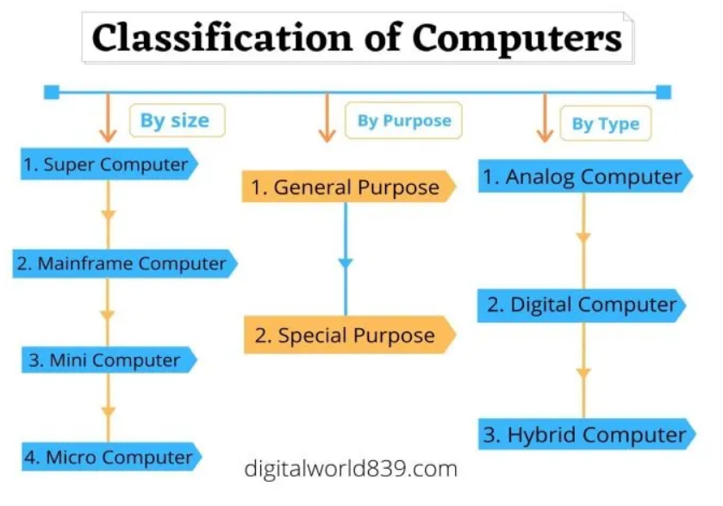
Classification of Computer Cont.……

