Slide 1
HUMAN RIGHTS IN RELATION TO DEVELOPMENT IN TANZANIA
The concept
Generations/aspects of human rights
Rights of vulnerable groups
Relation to development

Slide 2
Concept.
Human rights are the rights to which everyone is entitled no matter who they are or where they live simply because they are human beings (Mwakajinga, 2013).

Slide 3
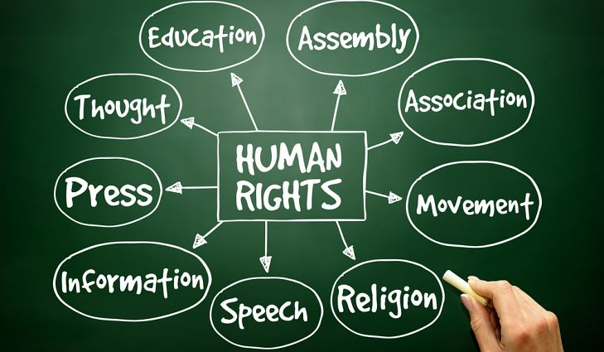

Slide 4
Generations of human rights
3 GENERATIONS | BASIC PRINCIPLES | MAIN VALUE
FIRST- GENERATION It originates from various constitutional documents like -the Cyrus Cylinder 539BC(religion freedom & racial equality) -Magna Charta in 1215 (human freedom) - Petition of Rights in 1628(civil liberty) - The Bill of Rights (Declaration of Rights) in 1689, England - The American Declaration of Independence in 1776(1st constitution) - The French Declaration of Human and Citizen Rights in 1789. A fundamental moment in the recognition of human rights is the French Revolution (1789). Its ideals of freedom, equality and fraternity are a guide for the different generations rights. It is a symbol of liberty, recognition of civil & political rights, ppls participate in decision-making and they have the capacity to act. | Civil and political rights: Right to live, property, freedom of conscience and expression, freedom of movement and association and the right to participate in politics. Right to freedom of religion. Person’s freedom of association. Freedom to participate in public affairs | freedom

Slide 5
Cont...
Second generation The social and community dimension. Rights for equality and justice, social responsibilities. To promote, protect, guarantee or motivate certain rights. | Economic, social and cultural rights: the right to culture, education, healthcare & work. Freedom of association | equality
Third-generation The modern version of fraternity and it is called solidarity. To promote human interests like peace and global understanding of mankind | Environmental, developmental and peace the right to peace; the right to development; the right to humanitarian assistance; environmental law; the right of sexual minorities, ethnic, religious, linguistic, the right of people to self-determination; | solidarity

Slide 6
VULNERABLE GROUPS
These are groups within the society which for various reasons are in a greater danger of being victims of human rights violations.
These groups require more protection to enjoy their fundamental human rights. They are in danger of being exploited, humiliated, marginalised, killed, etc.

Slide 7
VULNURABLE GROUPS
Disables; are defined as an objectively measurable condition of impairment, physical or mental. People living with disabilities like lame, deaf, and albino. They can’t access education, equal participation in economic activities, exploitation, brutal killings and valueless. These conditions force them to depend on others, being beggars in the cities.

Slide 8
Types of Disabilities in Tanzania
(a) Albinism – 16,477
(b) Seeing – 848,530
(c) Hearing – 425,322
(d) Walking – 525,019
(e) Remembering – 401,901
(f) Self-care – 324,725
(g) Other Disability – 99,798
THRR REPORT-2014

Slide 9
CONT...
2. Elderly; 3.9% of country population is elderly people according to National census (2012). They lack social protection like health care, food and shelter. They become victims of torture, attacks and brutal killings as a result of believes in witchcraft. Eg, about 27 older women, were killed in Butiama District during the first six months of the year 2014 alone, because of allegations of witchcraft. Within the same period, other 10 older women were killed in Musoma District for different reasons, including jealousy, vengeance and other family conflicts.

Slide 10
Cont...
3. women; they are humiliated, tortured, discriminated, exploited, sexually abused, sexual violence and valueless. This category includes women, girls and pregnant women. There are many violations reported in the country like; killings of 26 women in Mbeya in 2014, and 2878 women raped. The 2010, Tanzania Demographic and Health Survey indicated that almost half (45%) of women aged 15-49 had experienced either physical or sexual violence . According to the 2010 Demographic Health Survey, 37% of women were married before attaining the age of 18 (THRR REPORT, 2014)

Slide 11
Cont...
4. Children; child abuse and torture are observed in Tanzania. Children depend on adult people to attain their fundamental human rights like education, health care, food and shelter. Unfortunately, the closest relative of children are the ones used to humiliate, discriminate and violate them. Eg in August 2014, two children were killed by their father,

Slide 12
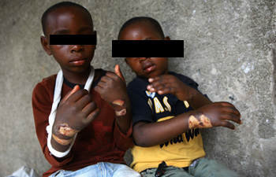
Children tortured by their father THRR REPORT (2014)

Slide 13
INITIATIVES TAKEN BY TANZANIA GOVERNMENT TO SAVE VULNERABLE GROUPS
There are several initiatives taken by the government to protect vulnerable groups against various violations:
The government signed and adopted various declaration against women abuse/ violation. Eg the Universal Declaration of Human Rights (UDHR) of 1948 which says “Everyone is entitled to all rights and freedoms set forth in this Declaration, without distinction of any kind, such as race, color, sex, language, religion, political or other opinion, national or social origin, property, birth or other status.” . Also, “the Convention on the Right of the Child, 1980 (CRC) provides for non-discrimination of children based on gender, race or any other qualification whatsoever”.

Slide 14
Cont...
2. The constitution of United Republic of Tanzania, 1977 on part III states the fundamental human rights. Article 12(1) of CURT provide that “All human beings are born free, and are all equal.”
3. Formulation of laws: The Employment and Labour Relations Act, 2004 provides for non-discrimination in employment opportunities as well as the right to maternity leave.

Slide 15
Cont...
The Land Act, 1999 and the Village Land Act, 1999 both include women’s rights with regard to land ownership and use
The Marriage Act, 1971, prohibit early marriage to children and sexual abuses for both children and women.
The Children Act 2009 as well requires that children offenders be placed in a separate place from the adults.
“The police officer shall make arrangements for preventing, so far as practicable, a child while in custody, from associating with an adult charged with an offence unless he is a relative.”
The Persons with Disabilities Act, 2010, the law provides that people with disabilities have the right to participate in political and public life in an inclusive setting and the right to quality healthcare services

Slide 16
Cont...
4. Policies adaptation and formulation
a. The Tanzania Disability Policy of 2003, The Policy focuses on engaging people with disabilities in productive work and social security, integrates issues relating to people with disabilities in the country’s legislation. Thus, issues related to vocational training, employment, care of PWDs and other essential services.

Slide 17
Cont...
B. Adaptation of gender and development policy in 2000 which ensure sustainable and coordination for proper planning and implementation of gender based programmes.

Slide 18
Cont…
5. Incorporation of Human Rights in education curriculum. Eg the curriculum of College of Business Education
6. Establishment of gender desk;
7. Establishment of NGOs and other government chambers for Human rights.

Slide 19
HUMAN RIGHTS IN RELATION TO DEVELOPMENT.
The human rights can not be ties apart from development in the sense that, the development of a particular community needs the fully participation of both sex (male&female), various groups, rights of accessing various resources and the choices.
The relation between human rights and development are considered to from the second generation of human rights which encompass the right to work, right to free choice of employment and to just and favorable conditions of work, the right to form and join trade unions, the right to strike, the right to social security; and the right to own property.

Slide 20
Cont...
Equal participation of both sex (male & female) and various groups in economical activities. Through various governmental initiatives to eradicate poverty everyone has the opportunity to participate to rise up his or her income. Eg both sex can establish companies.

Slide 21
Cont...
Equal employment opportunities to both sex and all vulnerable groups; through both the Employment and Labour Relations Act, 2004 & the Persons with Disabilities Act, 2010, everyone is able and free to find the work of his or her choice.

Slide 22
Cont...
Ownership of properties like land help all people to use them economically to rise their income. Eg, The Land Act, 1999 and the Village Land Act, 1999, give women rights to own and control land in various ways like establishing economical activities or use it to access loan from various financial institutions.

Slide 23
Cont...
Equal opportunity of accessing education; both sex and all vulnerable groups are free to access education in various levels. For example, The Law of Marriage Act, 1971, that prohibit early marriage for girls give them the opportunity to have education before marriage.

Slide 24
Cont...
The right of movement allows people to conduct various economical activities within the country or abroad. This accelerate the development of an individual as well as the country. For example, Tanzanians are able to move to and from other part of the world for various activities that contribute much on our economy. Also, other people can come in our country either to invest or for tour, all of these activates accelerate our development.

Slide 25
qz
Explain with examples the initiatives taken by Tanzania government for human rights.
Development and human rights are inseparable components. Substantiate

