Slide 1
Computer Networks
By Eng.Makanta.A.A
Assistant Lecturer
CBE

Slide 2
A computer network is a collection of computing devices that are connected with each other for the purpose of information and resource sharing among a wide variety of users.
Each device in the network is called a node and this node can be connected to other nodes through wired or wireless media.

Slide 3
Components of Computer Networks
Computer networks components comprise both physical parts/hardware as well as the software part required for installing computer networks, both at organizations and at home. The hardware components are the server, client, peer, transmission medium, and connecting devices. The software components are operating system and protocols.
The below figure shows a network along with its components −

Slide 4
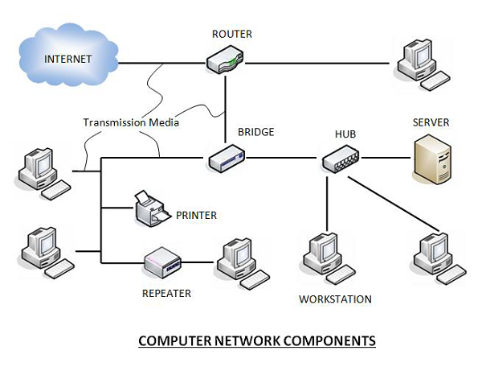

Slide 5
Hardware Components
Servers −Servers are high-configuration computers that manage the resources of the network. The network operating system is typically installed in the server and so they give user accesses to the network resources. Servers can be of various kinds: file servers, database servers, print servers etc.
Clients − Clients are computers that request and receive service from the servers to access and use the network resources.
Peers − Peers are computers that provide as well as receive services from other peers in a workgroup network.
Transmission Media − Transmission media are the channels through which data is transferred from one device to another in a network. Transmission media may be guided media like coaxial cable, fibre optic cables etc; or maybe unguided media like microwaves, infra-red waves etc.

Slide 6
Connecting Devices
Connecting devices act as middleware between networks or computers, by binding the network media together. Some of the common connecting devices are:
a. Routers
b. Bridges
c. Hubs
d. Repeaters
e. Gateways
f. Switches

Slide 7
Software Components
Networking Operating System − Network Operating Systems is typically installed in the server and facilitate workstations in a network to share files, database, applications, printers etc.
Protocol Suite − A protocol is a rule or guideline followed by each computer for data communication. Protocol suite is a set of related protocols that are laid down for computer networks. The two popular protocol suites are −
a. OSI Model ( Open System Interconnections)
b. TCP / IP Model

Slide 8
Features of Computer Network
Sharing − Computer networks enable sharing of files, software, hardware resources and computing capabilities.
Speed: The communication speed among the components is fast enough to be comparable with a centralized system.
Scalability − Sizes of computer networks dynamically increase with time. The networks have to be scalable so that they can evolve adequately for future deployments.
Integration − All the components of the network work in a coordinated manner for a seamless user experience.
Security − Networks allow security and access rights to the users for restricted sharing of resources and information.
Cost Effectiveness − Networking reduces the deployment cost of hardware and software of a centralized system.

