Slide 1
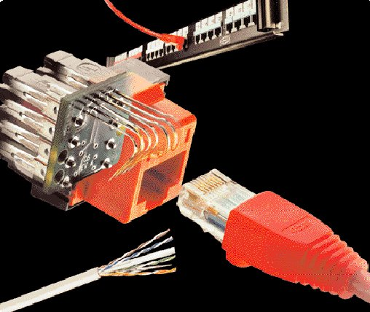
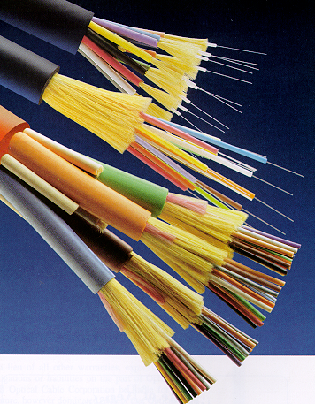
Cabling
UTP AND FIBER CABLING

Slide 2
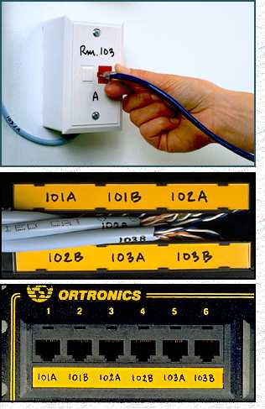
Structured Cabling Infrastructure
Cabling
Mounted and permanent
Allows patching
Comfort that infrastructure is OK
Components:
  Information Outlet with Face Plate
  Patch Panel
  UTP Cable
  Patch Cord

Slide 3
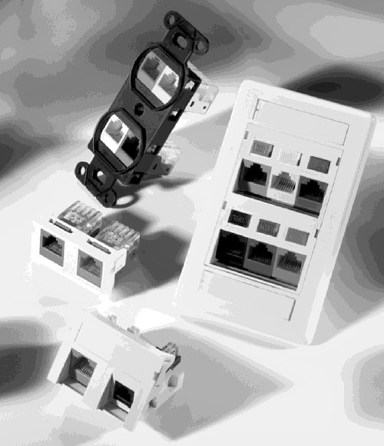
I/O & Faceplates
Cabling
Faceplate mounts on or in wall or in raceway
Single or Dual Information Outlet (I/O)
Provide network connectivity to the Hosts through a Patch Cord

Slide 4
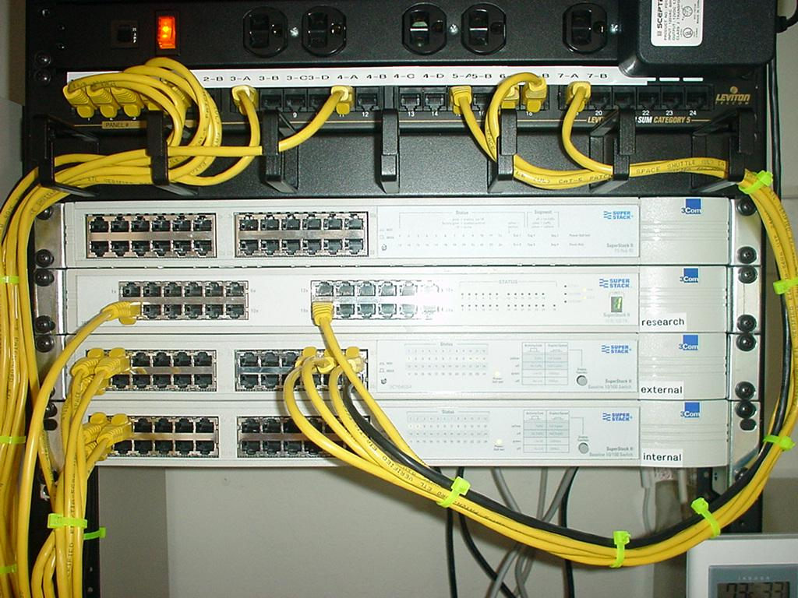
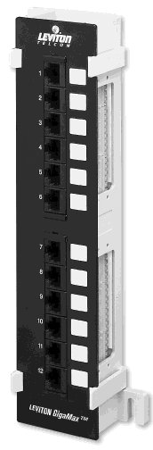
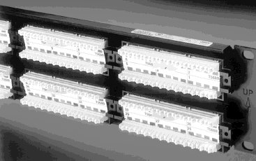
Patch Panel
Cabling
Termination punchdown in back
Patch cord plugin in front

Slide 5
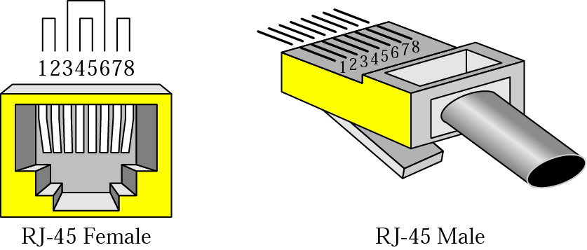
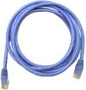
Patch Cord & UTP Connectors
Cabling

Slide 6
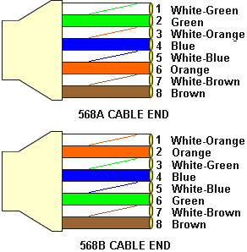
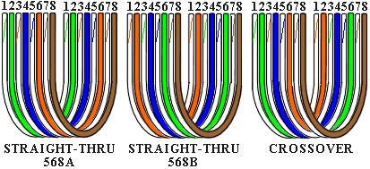
Color Codes
Cabling
Data Tx: 1 & 2
Data Rx: 3 & 6
Crossover
  1 ⬄ 3
  2 ⬄ 6
PoE +VDC: 4 & 5
PoE -VDC: 7 & 8

Slide 7

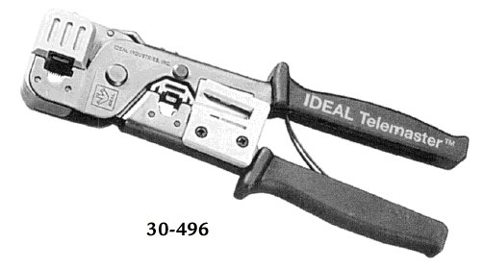
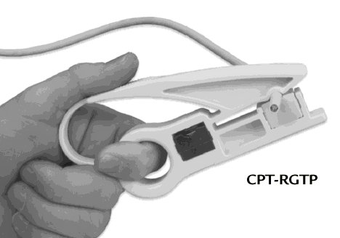
Cutting, Striping & Crimping Tools
Cabling
Make your own patch cords
Cuts and strips pairs
RJ45 end crimped onto ends of wire

Slide 8
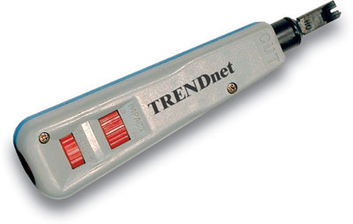
Punching Tool
Cabling
Terminates wires to back of patch panels and in Information Outlets

Slide 9


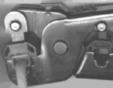
Making Cables
Cabling

Slide 10
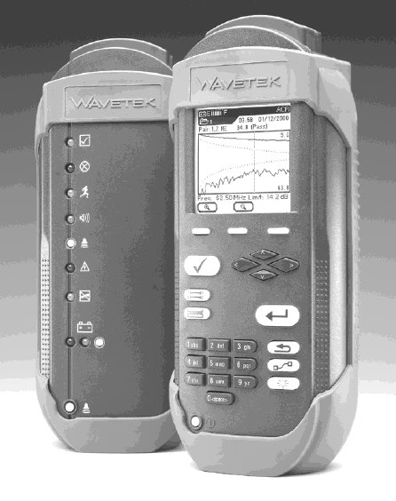
Wire Testing Equipment
Cabling
Test wire for correct termination of 8 wires
Test for speed capabilities

Slide 11
Cabling Rules
Cabling
Try to avoid running cables parallel to power cables.
Do not bend cables to less than four times the diameter of the cable.
If you bundle a group of cables together with cable ties (zip ties), do not over-cinch them. You should be able to turn the tie with fingers.
Keep cables away from devices which can introduce noise into them. Here's a short list: copy machines, electric heaters, speakers, printers, TV sets, fluorescent lights, copiers, welding machines, microwave ovens, telephones, fans, elevators, motors, electric ovens, dryers, washing machines, and shop equipment.
Avoid stretching UTP cables (tension when pulling cables should not exceed 25 LBS).
Do not run UTP cable outside of a building. It presents a very dangerous lightning hazard!
Do not use a stapler to secure UTP cables. Use telephone wire/RJ6 coaxial wire hangers which are available at most hardware stores.

Slide 12

Fiber Optic Cabling Infrastructure
Cabling
Components:
  Fiber Cable
  Fiber Pigtail
  Fiber Connectors
  LIU
  Coupler
  Fiber Patch Cord

Slide 13
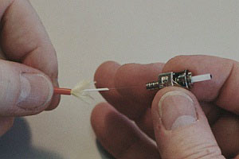
Fiber Optic Connectors
Cabling
Terminates the fibers
Connects to other fibers or transmission equipment

Slide 14
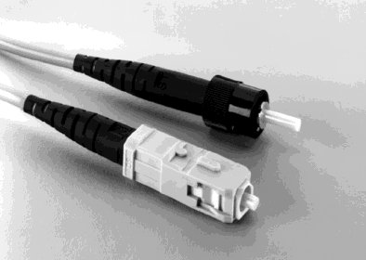
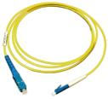
Fiber Patch Cords & Pigtails
Cabling
Ends are typically either SC or ST
Pigtails have connectors on only one side and Patch Cords have it on both sides.
Pigtails are spliced to the fiber to terminate the fiber
Patch Cord connects switches to the Fiber cable

Slide 15
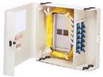
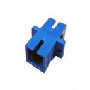
LIU & Couplers
Cabling

Slide 16
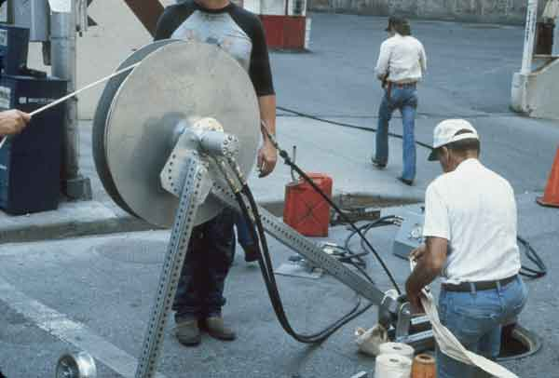
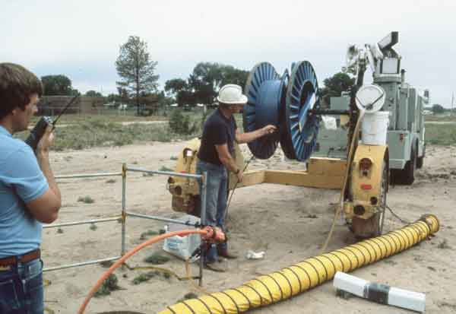
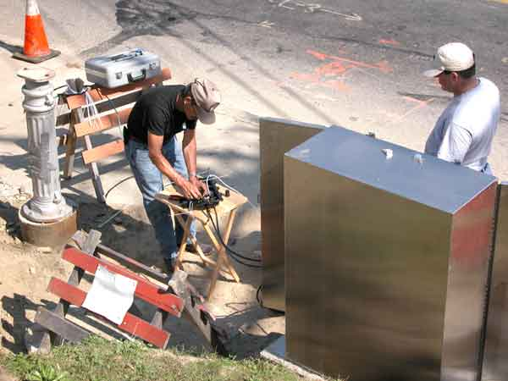
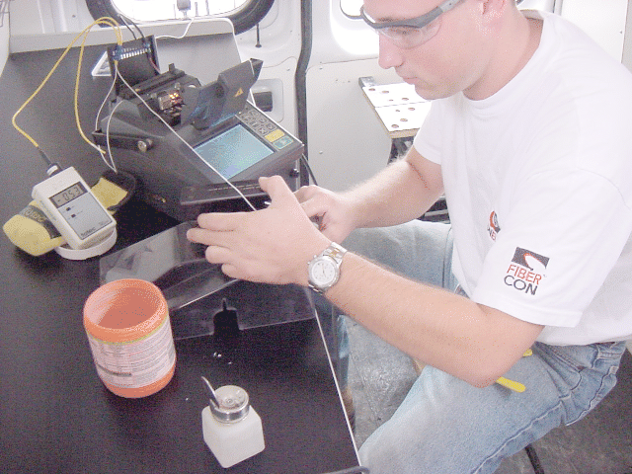
Fiber Optic Installation –
Outside Plant
Cabling

Slide 17

Fiber Optic Installation –
Outside Plant
Cabling
Fiber is blown in HDPE Pipes, 1 m deep.
The HDPE pipes is covered with sand and brick lining
Fiber Roles are typically 2 Km. Fiber cables are spliced using Jointers
Faults like fiber cut are located using OTDR (Optical Time Domain Reflectometer)

