Slide 1
Ethernet Cable

Slide 2
Outline
Introduction
Ethernet Cable
Category
How to wire
Straight through
Crossover
Reference

Slide 3
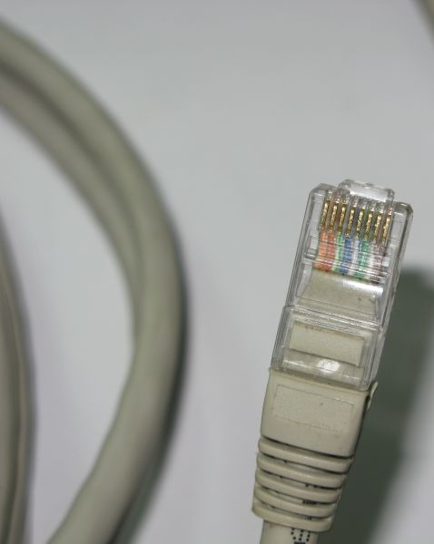
Ethernet Cable
The name, Ethernet Cable, always refers to the following category:
Category 5
Category 5e
Category 6
Or more than those categories.

Slide 4
Category
Category | Data Rate | Signal Frequency | Standard
Cat5 | 100 Mbps | 100 MHz | TIA/EIA
Cat5e | 100 Mbps /1 Gbps | 100 MHz | TIA/EIA-568-B
Cat6 | 1Gbps / 10 Gbps | 250 MHz | TIA/EIA-568-B
Cat6a | 1Gbps / 10 Gbps | 500 MHz | ANSI/TIA/EIA-568-B.2-10
TIA/EIA is a set of three telecommunications standards from the Telecommunications Industry Association.

Slide 5
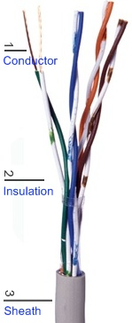
Ethernet Cable
It is composed of 4-pair twist wirings.
Orange
Green
Blue
Brown

Slide 6
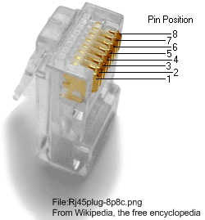
Ethernet Cable
Color |  | Pin (T568B)
 | White/Orange | 1
 | Orange | 2
 | White/Green | 3
 | Blue | 4
 | White/Blue | 5
 | Green | 6
 | White/Brown | 7
 | Brown | 8
You can use the order of rainbow colors to memorize the order of this wiring.

Slide 7
Ethernet Cable
Pin | Usage
1 | Transmission (Tx+)
2 | Transmission (Tx-)
3 | Receive (Rx+)
4 | --
5 | --
6 | Receive (Rx-)
7 | --
8 | --
We can use the concept to justify the order of the wiring colors of straight through and crossover.

Slide 8
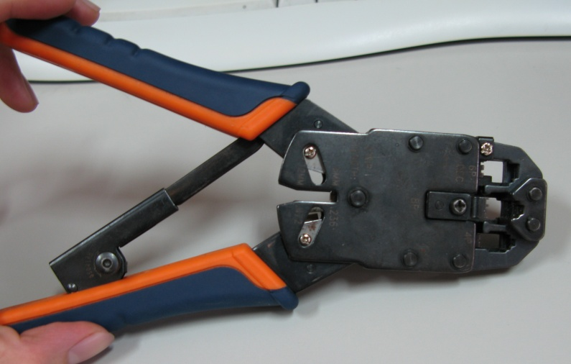
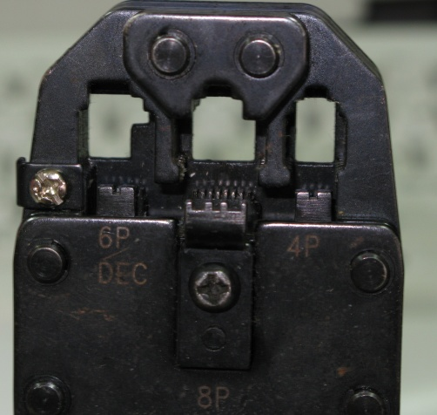
How to wire
Prepare the materials and tools.
Cable & RJ-45 plugs
Scissors
Crimping tool
Crimping tool
For RJ-45 plug.

Slide 9
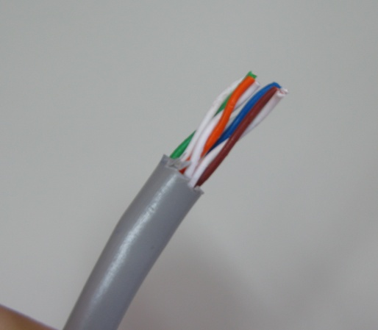
How to wire
Strip off suitable length of the cable sheath.
About 2-2.5 cm
You can mark the position first.

Slide 10
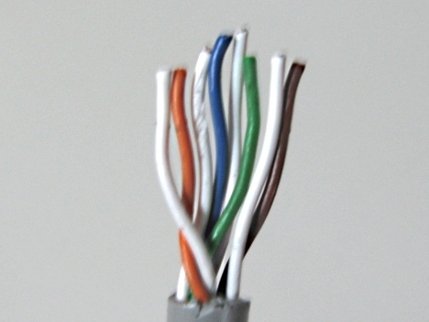
How to wire
Align the colored wires according to the specific order. (Later we will talk about.)
1 2 3 4 5 6 7 8

Slide 11
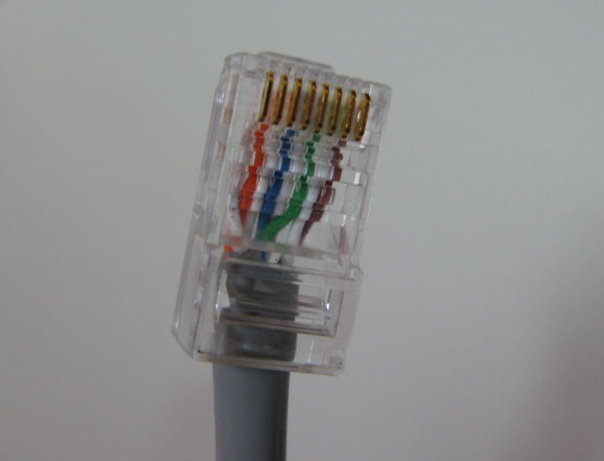


How to wire
Straight Through
All order of the wirings is the same as the other side.
1→8
1 2 3 4 5 6 7 8
1 2 3 4 5 6 7 8

Slide 12
Straight Through
Host A |  |  |  | Host B
Pin | Usage | Color |  | Color | Usage | Pin
1 | Tx+ |  |  |  | Tx+ | 1
2 | Tx- |  |  |  | Tx- | 2
3 | Rx+ |  |  |  | Rx+ | 3
4 | -- |  |  |  | -- | 4
5 | -- |  |  |  | -- | 5
6 | Rx- |  |  |  | Rx- | 6
7 | -- |  |  |  | -- | 7
8 | -- |  |  |  | -- | 8

Slide 13
How to wire
Crossover
We need to change the order of the transmission and receiving wirings.
1→8
1 2 3 4 5 6 7 8
1 2 3 4 5 6 7 8

Slide 14
Crossover
Host A |  |  |  | Host B
Pin | Usage | Color |  | Color | Usage | Pin
1 | Tx+ |  |  |  | Tx+ | 1
2 | Tx- |  |  |  | Tx- | 2
3 | Rx+ |  |  |  | Rx+ | 3
4 | -- |  |  |  | -- | 4
5 | -- |  |  |  | -- | 5
6 | Rx- |  |  |  | Rx- | 6
7 | -- |  |  |  | -- | 7
8 | -- |  |  |  | -- | 8

Slide 15
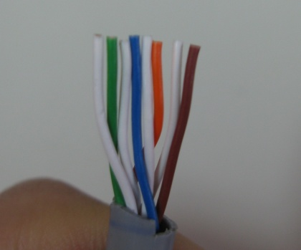
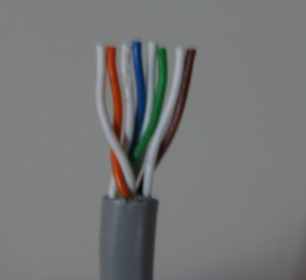
How to wire
Trim all the wires to the same length.

Slide 16
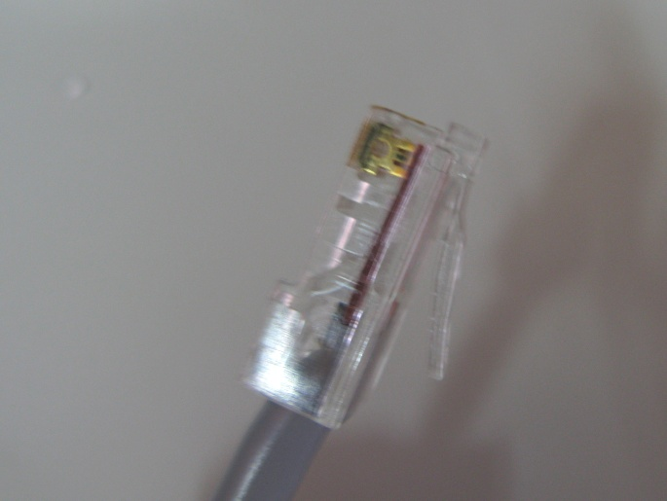
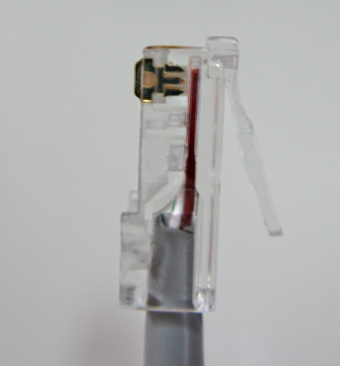
How to wire
Insert the wires into the RJ45 plug.

Slide 17
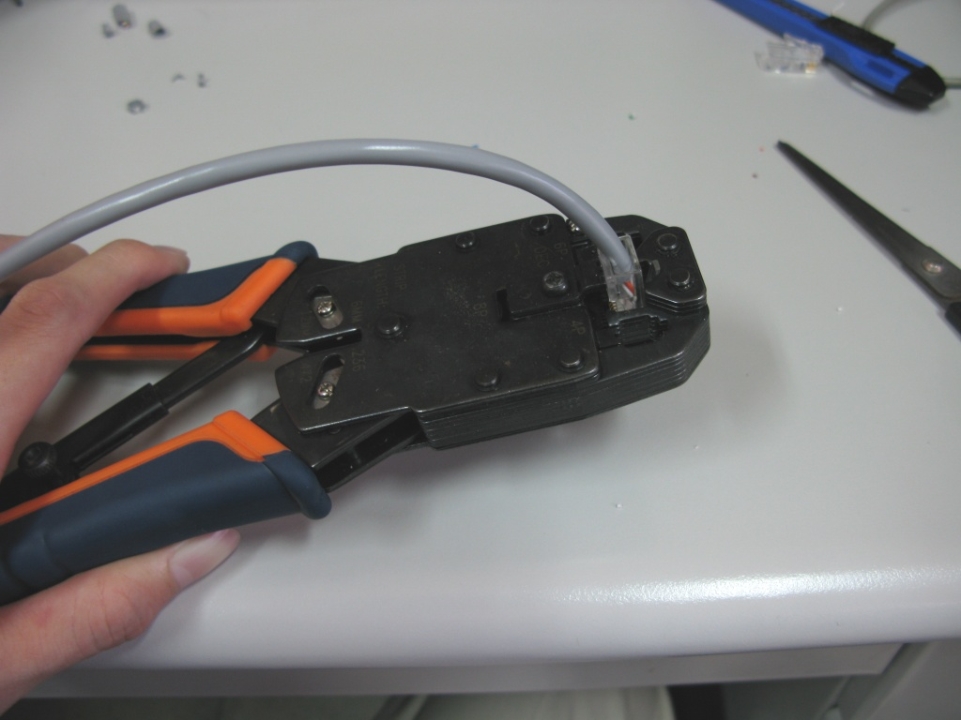
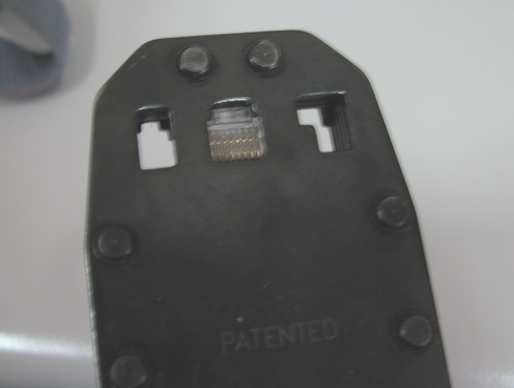
How to wire
Crimp the RJ45 plug with the crimping tool.

Slide 18
How to wire
Verify the order of the wires is correct and all the wires are correctly making good contact with the metal contacts in the RJ45 plug.
Correct
Incorrect

Slide 19
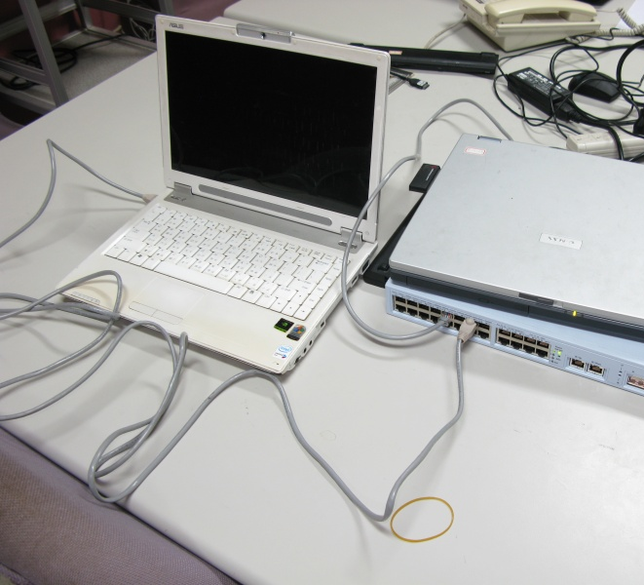
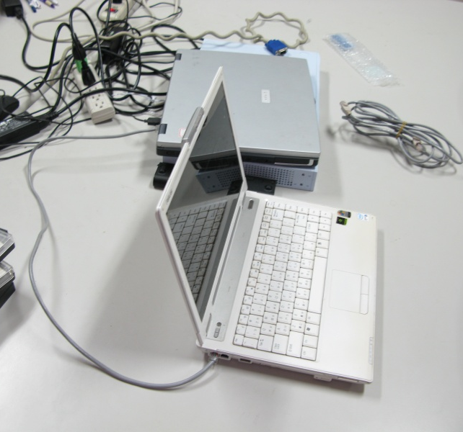
How to wire
Cut the cable into suitable length and repeat the below steps for the other side.
Please be sure what kind of the cable you are wiring.
Testing
Straight Through
Crossover

Slide 20
Reference
Wikipedia http://en.wikipedia.org/wiki/Category_5_cable
Cat5e Cable http://www.cat5ecable.co.uk/
How to wire Ethernet Cables http://www.ertyu.org/steven_nikkel/ethernetcables.html

