Slide 1
Network Topologies
LAN topologies
WAN topologies

Slide 2
LAN topologies
Physical
  Describes the geometric arrangement of components that make up the LAN
Logical
  Describes the possible connections between pairs of networked end-points that can communicate

Slide 3
LAN Topologies(Physical)
Bus
Star
Ring
Switched
Daisy chains
Hierarchies

Slide 4
Bus topology
All networked nodes are interconnected, peer to peer, using a single, open-ended cable
Both ends of the bus must be terminated with a terminating resistor to prevent signal bounce

Slide 5
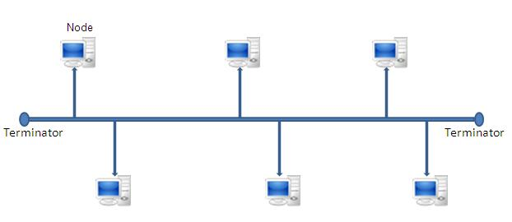
Bus topology

Slide 6
Advantages of Bus topology
Easy to implement and extend
Well suited for temporary networks that must be set up in a hurry
Typically the least cheapest topology to implement
Failure of one station does not affect others

Slide 7
Disadvantages of Bus topology
Difficult to administer/troubleshoot
Limited cable length and number of stations
A cable break can disable the entire network; no redundancy
Maintenance costs may be higher in the long run
Performance degrades as additional computers are added

Slide 8
Ring topology
started out as a simple peer-to-peer LAN topology
Each networked workstation had two connections: one to each of its nearest neighbors
Data was transmitted unidirectionally around the ring
Sending and receiving of data takes place by the help of TOKEN

Slide 9
Token Passing
Token contains a piece of information which along with data is sent by the source computer
This token then passes to next node, which checks if the signal is intended to it
  If yes, it receives it and passes the empty to into the network
  otherwise passes token along with the data to next node

Slide 10
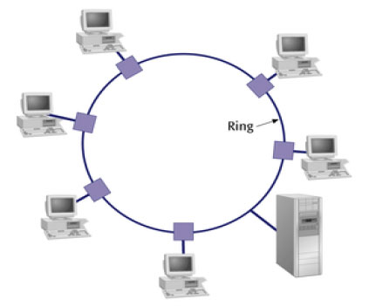
Ring topology

Slide 11
Advantages of Ring topology
This type of network topology is very organized
Performance is better than that of Bus topology
No need for network server to control the connectivity between workstations
Additional components do not affect the performance of network
Each computer has equal access to resources

Slide 12
Disadvantages of Ring topology
Each packet of data must pass through all the computers between source and destination, slower than star topology
If one workstation or port goes down, the entire network gets affected
Network is highly dependent on the wire which connects different components

Slide 13
Star topology
Have connections to networked devices that “radiate” out form a common point
Each networked device in star topology can access the media independently
Have become the dominant topology type in contemporary LANs
Stars have made buses and rings obsolete in LAN topologies

Slide 14
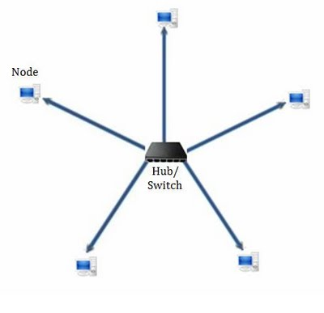
Star topology

Slide 15
Advantages of star topology
Compared to Bus topology it gives far much better performance
Easy to connect new nodes or devices
Centralized management. It helps in monitoring the network
Failure of one node or link doesn’t affect the rest of network

Slide 16
Disadvantages of star topology
If central device fails whole network goes down
The use of hub, a router or a switch as central device increases the overall cost of the network
Performance and as well number of nodes which can be added in such topology is depended on capacity of central device

Slide 17
WAN Topologies
The topology of a WAN describes the way the transmission facilities are arranged relative to the locations that they interconnect
Numerous topologies are possible, each one offering a different mix of cost, performance and scalability

Slide 18
WAN Topologies
Peer-to-peer WANs
Ring WANs
Star WANs
Full-mesh WANs
Partial-mesh WANs
Two-tiered
Three-tiered
Hybrids

Slide 19
Peer-to-peer topology
A peer-to-peer WAN can be developed using leased private lines or any other transmission facility
This WAN topology is a relatively simple way of interconnecting a small number of sites
Represents the least-cost solution for WANs that contain a small number of internetworked locations

Slide 20
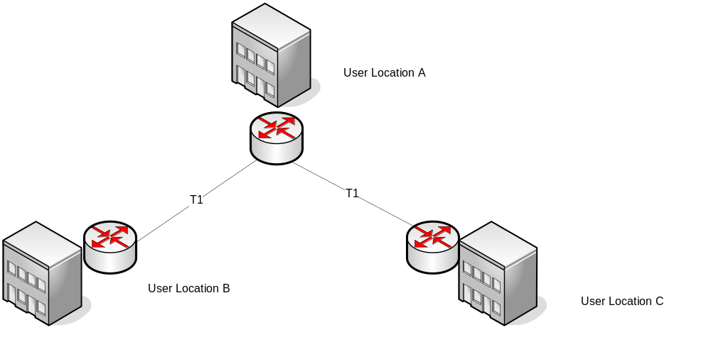
Peer-to-peer

Slide 21
Advantage/Disadvantage of Peer-to-peer
Advantage:
  It is inexpensive relative to other options
Disadvantages:
  They don’t scale very well. As additional locations are introduced to the WAN, the number of hops between any given pair of locations remains highly inconsistent and has an upward trend
  An equipment or facility failure anywhere in a peer-to-peer WAN can split the WAN

Slide 22
Ring topology
Can be developed fairly easily from a peer-to-peer network by adding one transmission facility and an extra port on two routers
A ring-shaped WAN constructed with point-to-point transmission facilities can be used to interconnect a small number of sites and provide route redundancy at a potentially minimal incremental cost
Can use dynamic routing protocols

Slide 23
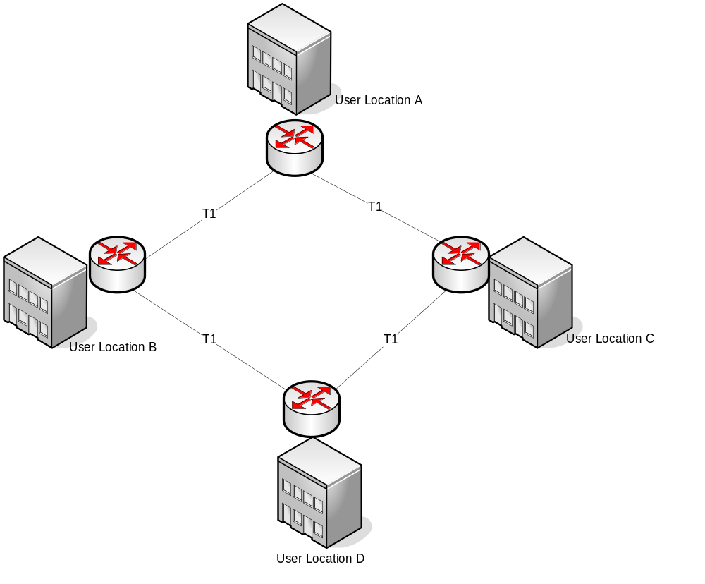
Ring topology

Slide 24
Advantages/Disadvantages of Ring topology
Advantages:
  It provides alternative routes
  It is less expensive than all but the peer-to-peer WAN
Disadvantages:
  Depending on the geographic dispersion of the locations, adding an extra transmission facility to complete the ring may be cost prohibitive
  Rings are not very scalable

Slide 25
Star network Topology
constructed by homing all locations into a common location
The star topology can be constructed using almost any dedicated transmission facility including frame relay and point-to-point private lines

Slide 26
Advantages/Disadvantages of star topology
Advantages:
  More scalable than a peer-to-peer or ring network
  Improved network performance. Hop count of three
Disadvantages:
  It creates a single point of failure
  There is no route redundancy

Slide 27
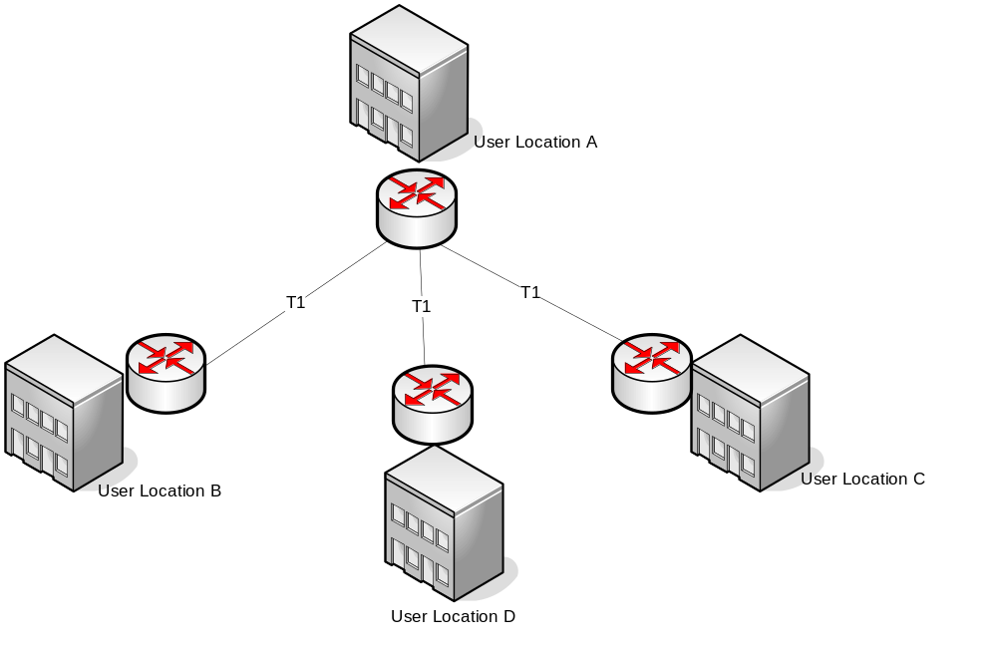
Star topology

Slide 28
Full-mesh topology
This topology features the ultimate reliability and fault tolerance
Every networked node is directly connected to every other networked node
Redundant routes to each location are plentiful, hence static routing impractical.
Use dynamic routing protocols
One application would be to provide interconnectivity for a limited number of routers that require high network availability
Another potential application is to fully mesh just parts of the WAN, such as the backbone of a multitiered WAN or tightly coupled work centers

Slide 29
Advantages/Disadvantages of full-mesh
Advantages:
  Minimizes the number of hops between any two network-connected machines
  Can be built with virtually any transmission technology
Disadvantages:
  These WANs can be fairly expensive to build
  A finite (although substantial) limit on the scalability of the network

Slide 30
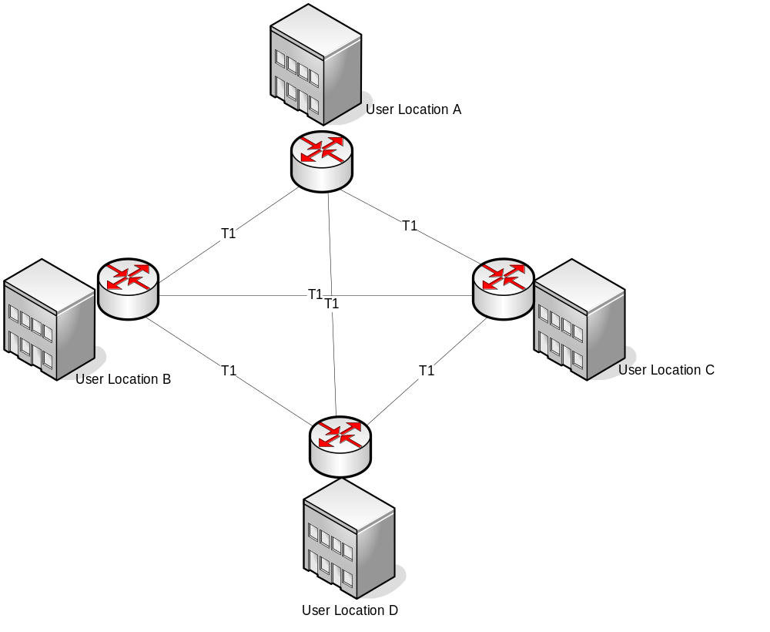
Full-mesh topology

