Slide 1

Home Health Services Analysis
Mako, Samson, Ochirbat

Slide 2

Project Outline
The project aims to examine the impact of home health services on individuals' quality of life.

Slide 3
Work Flow

Slide 4
Questions
What are the main objectives of the project when examining home health services across the United States?
What specific aspects of an individual's quality of life will be assessed in relation to home health services?
How do home health services impact activities of daily living for individuals with chronic illnesses or injuries?
How do patient outcomes and satisfaction play a role in determining the overall effectiveness and value of home health services?

Slide 5
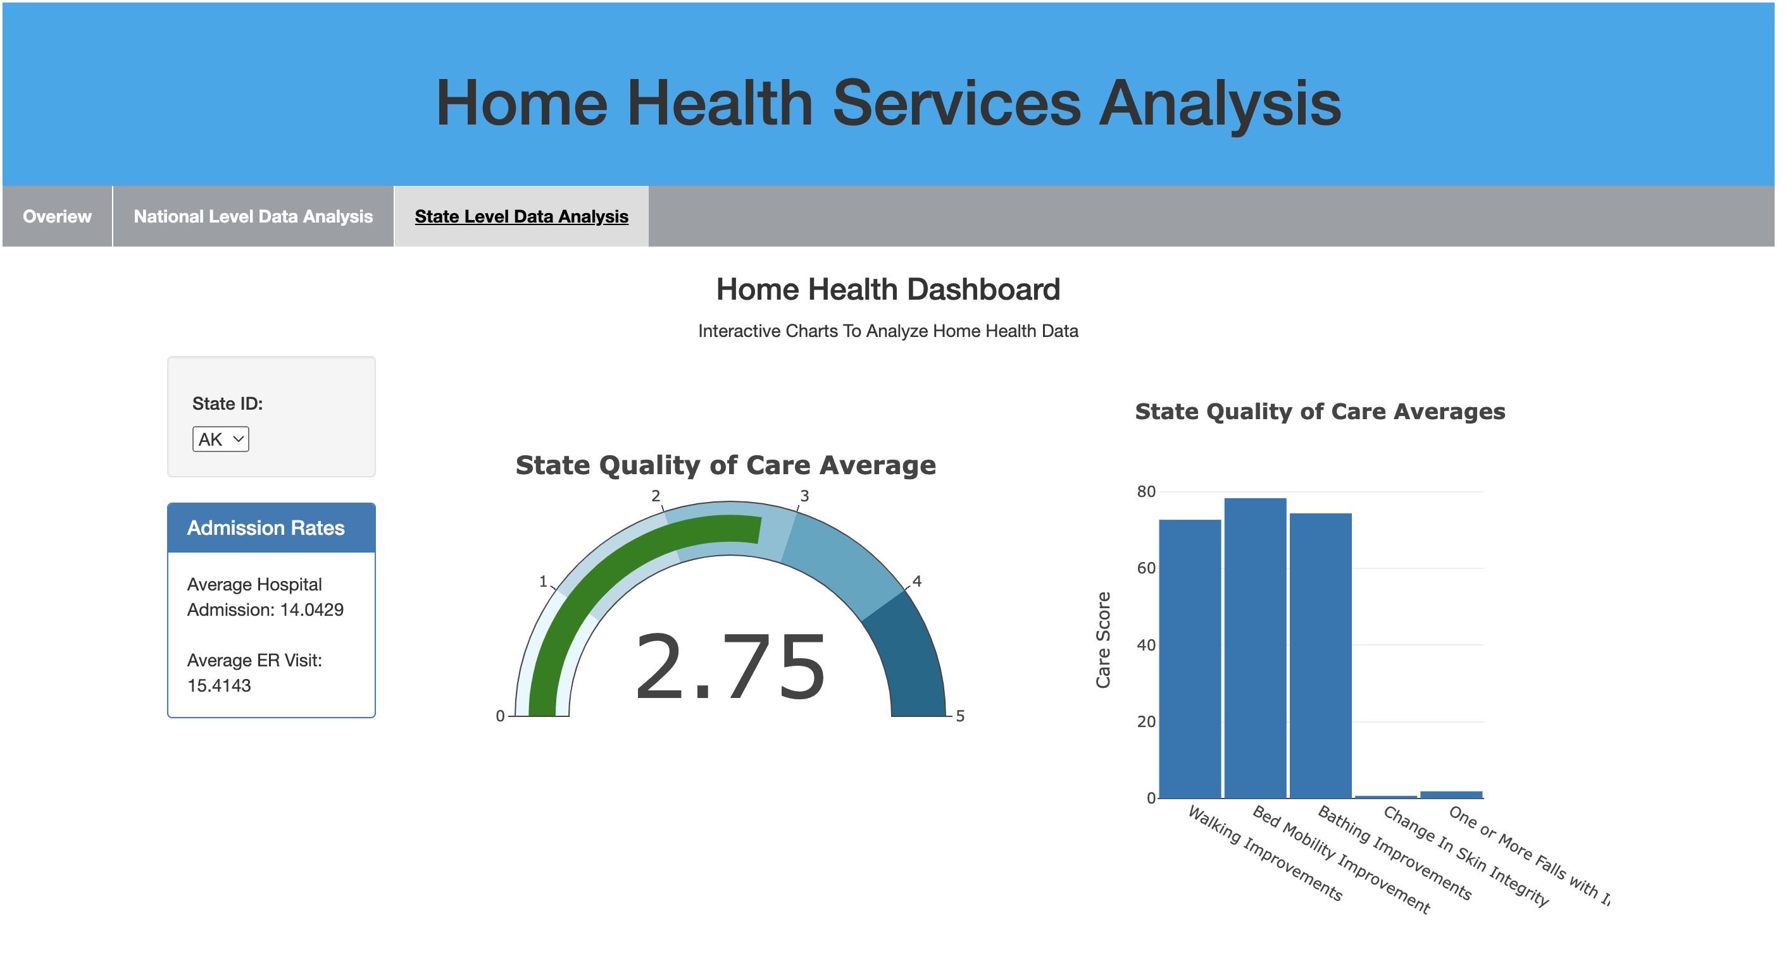

Slide 6
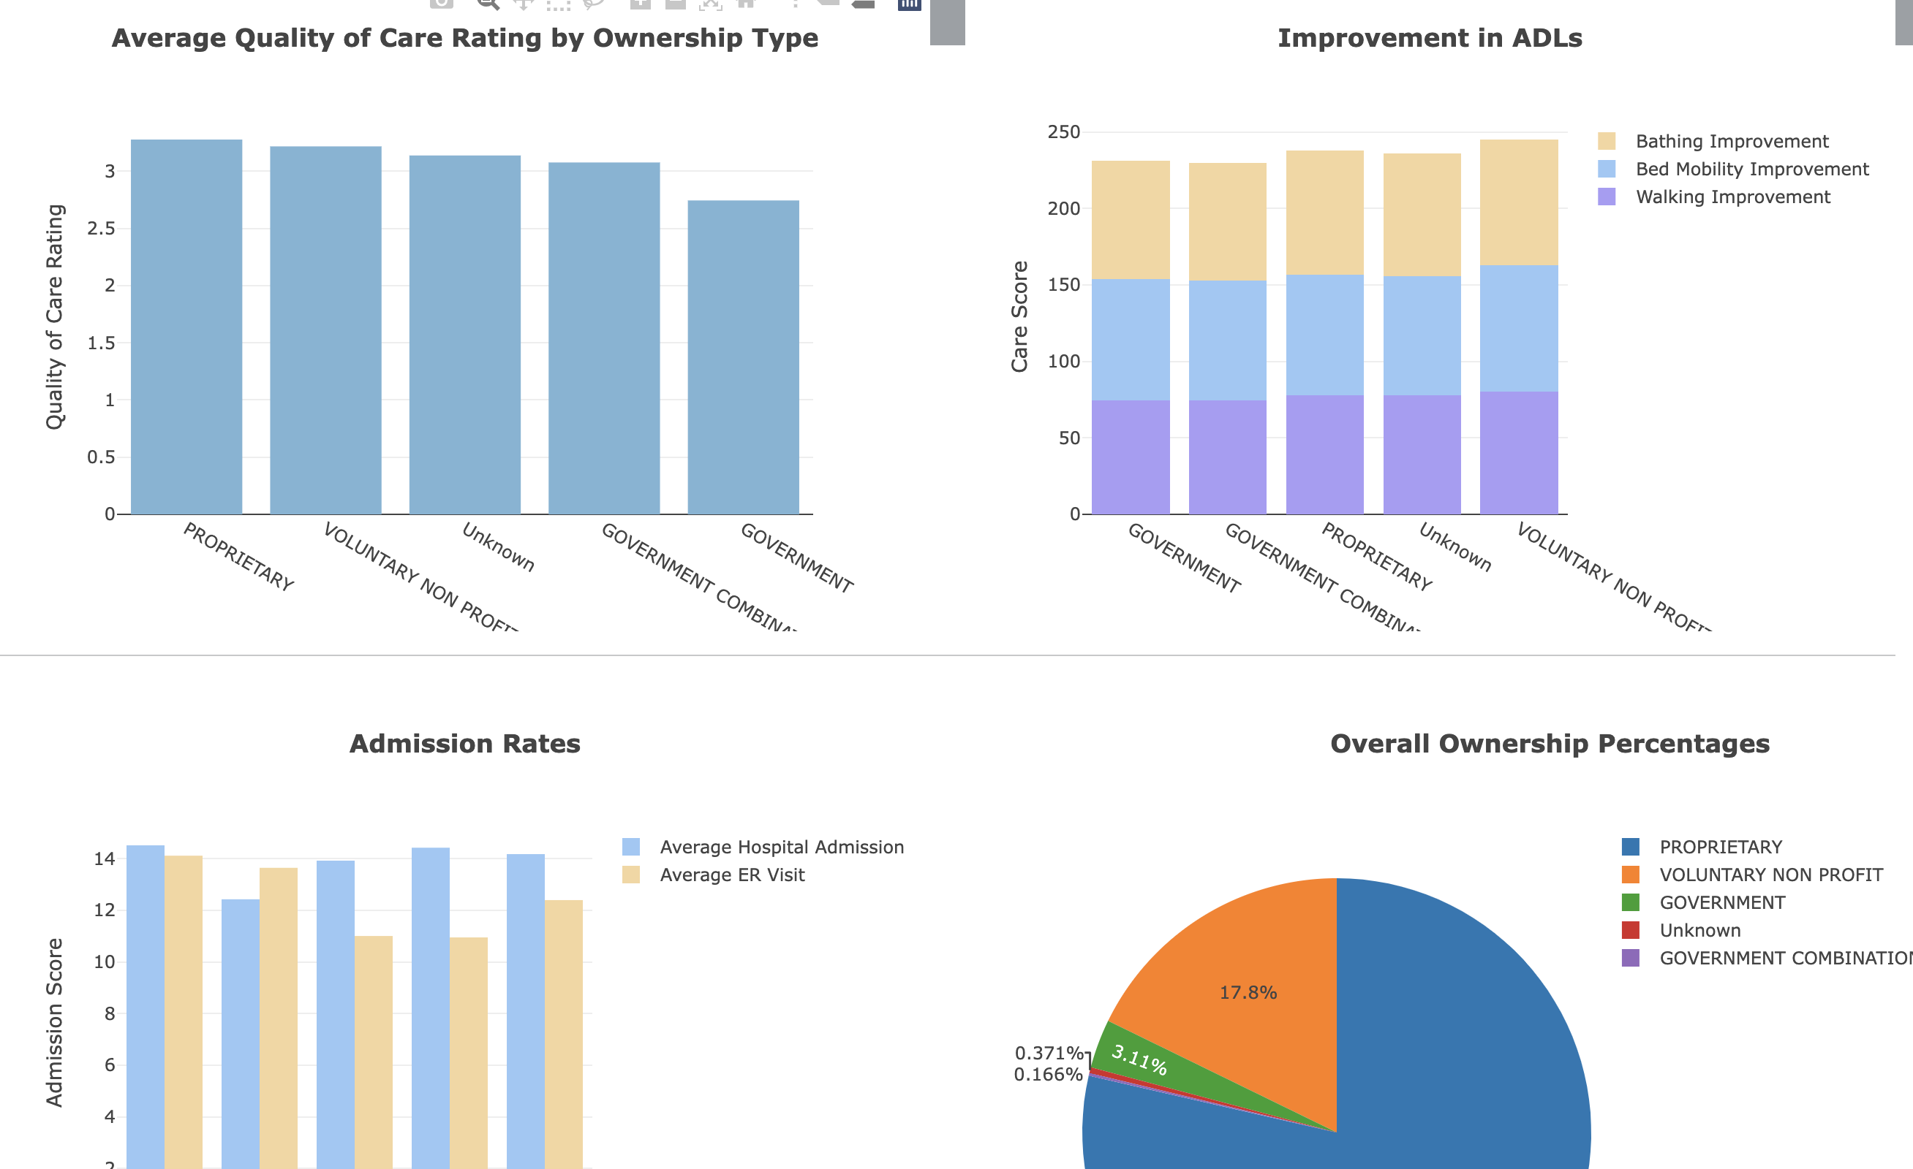

Slide 7
Conclusion
Higher emergency room visit rates for government-owned home health services.
Slightly lower average improvements in daily activities for government-owned services.
Government-owned agencies impact fewer individuals, constituting a small percentage in the dataset.
No significant correlation between certification date and care quality ratings.

