Slide 1

Population Distribution in Spain
POPULATION DISTRIBUTION IN SPAIN
And the factors that affect it
ANALYSED DATA FROM 2016- 2020
Miguel Barriola Arranz

Slide 2

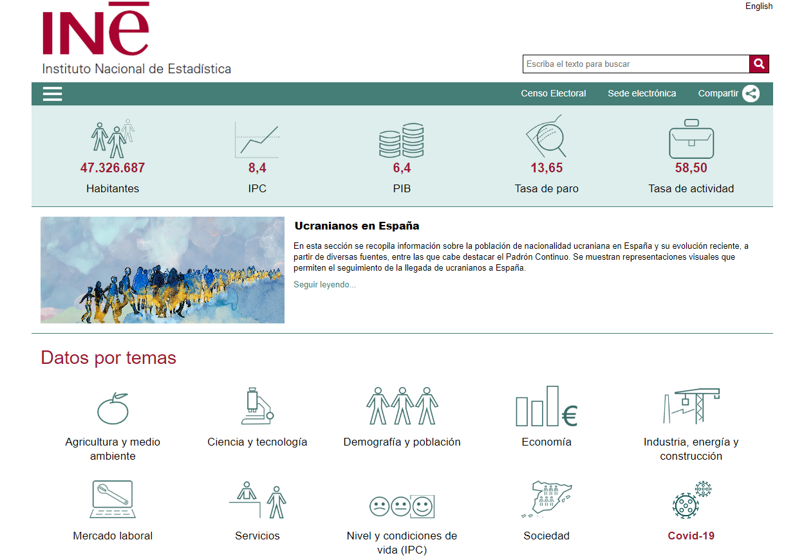
Information Source

Slide 3
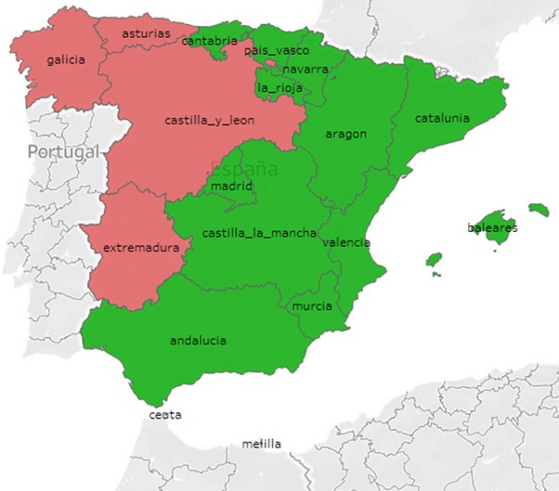

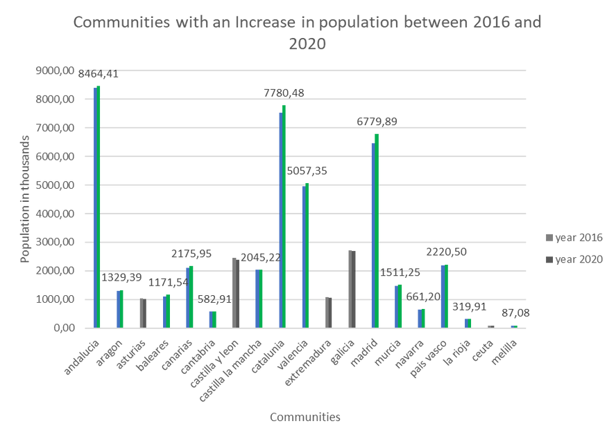
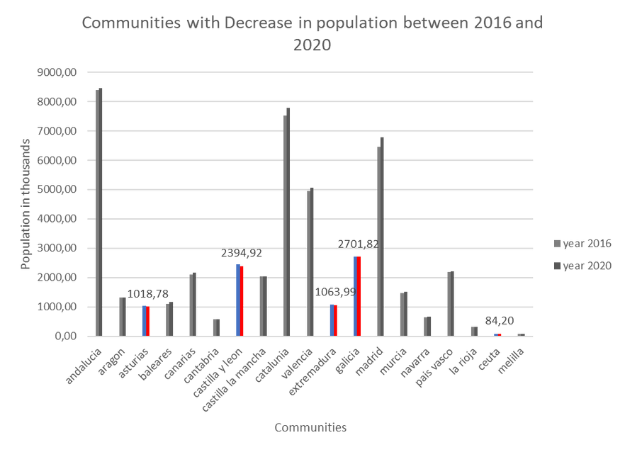
POPULATION DISTRIBUTION IN SPAIN
Population flux
In Spanish Communities between 2016 and 2020

Slide 4



Objective
POPULATION DISTRIBUTION IN SPAIN
Identify if there are:
Economic Social
Geographic
Factors that contribute to the increase in population distribution in Spain

Slide 5

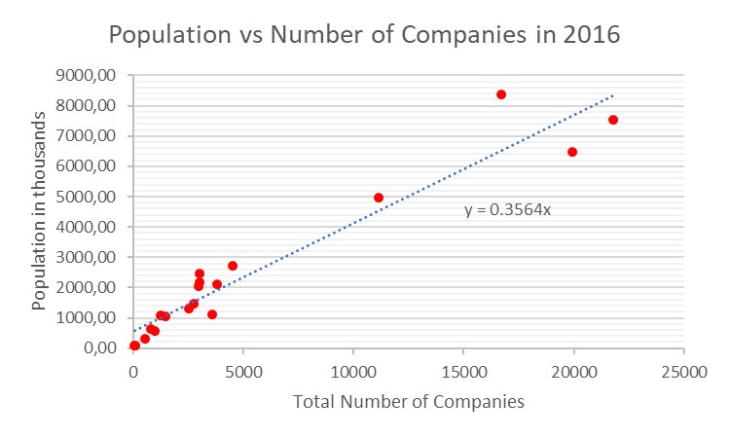
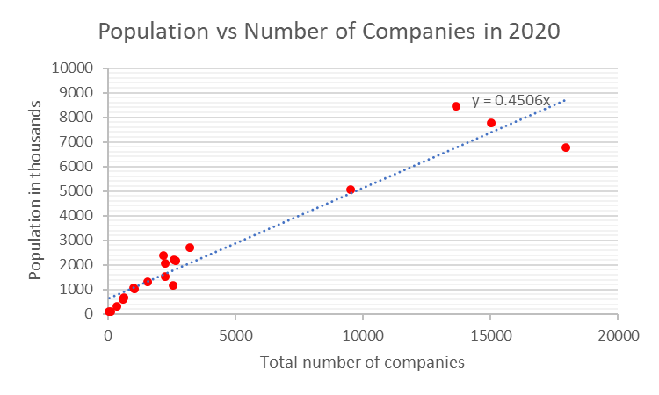
POPULATION DISTRIBUTION IN SPAIN
Economic
Number of Companies

Slide 6

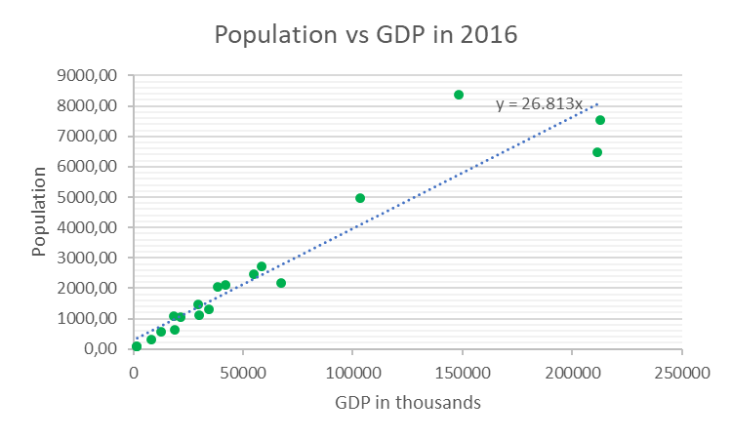
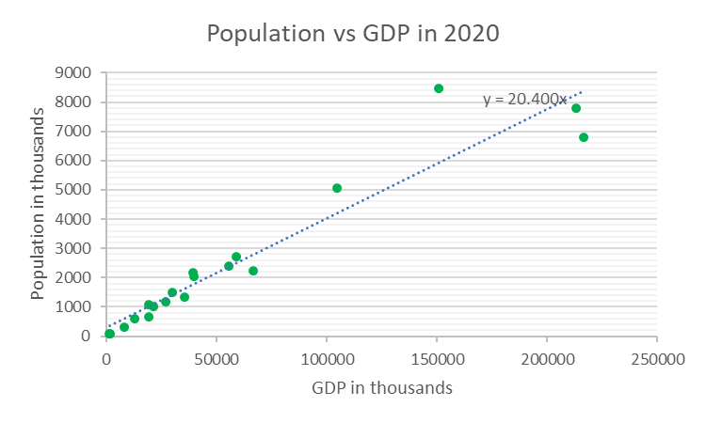
POPULATION DISTRIBUTION IN SPAIN
Economic
GDP

Slide 7
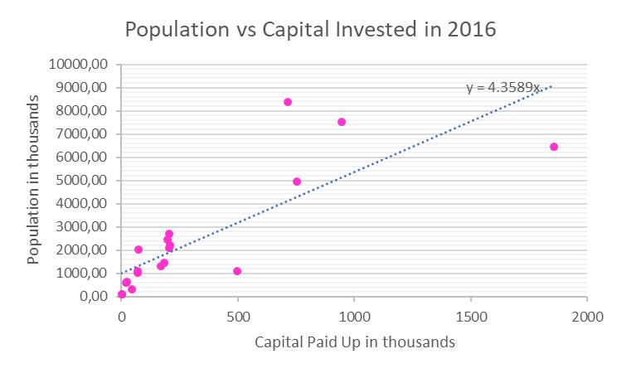
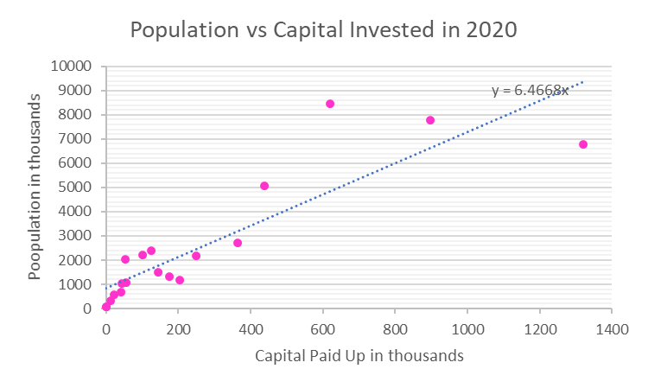
POPULATION DISTRIBUTION IN SPAIN
Economic
Capital Invested

Slide 8
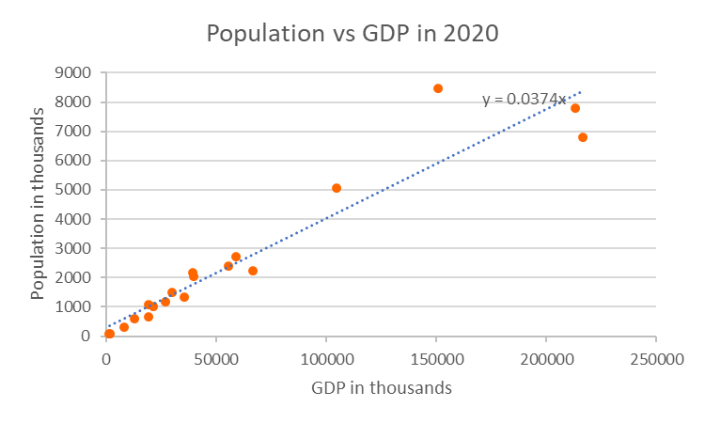
Economic
POPULATION DISTRIBUTION IN SPAIN
Larger Population
Positive correlation between Gross Domestic Product (GDP), Capital Invested and Number of Companies with Population across different communities
GDP

Slide 9



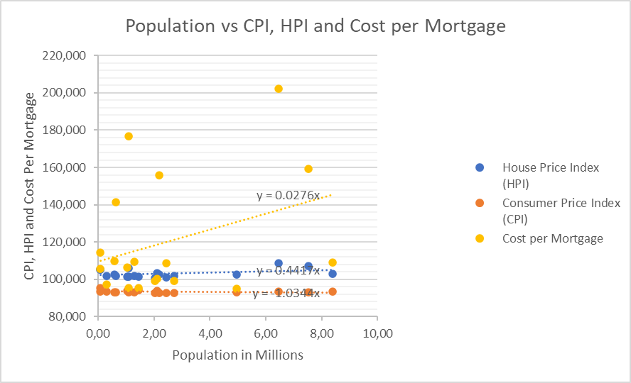
Social
POPULATION DISTRIBUTION IN SPAIN
CPI, HPI,
Cost Per Mortgage
Little to no correlation between Consumer Price Index and House Price Index and Cost per Mortgage with Population
Larger Population

Slide 10
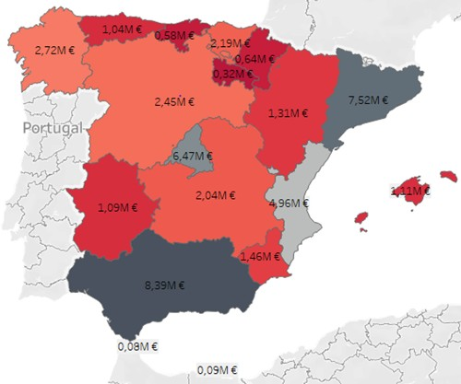

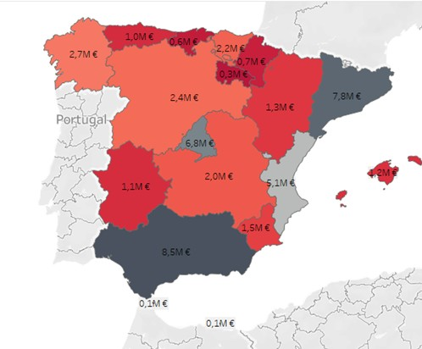
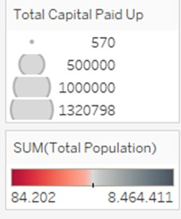

Geographic
POPULATION DISTRIBUTION IN SPAIN
Population levels vary widely across the country (between 2016 and 2020)
2016
Further study to determine correlation between geographical location and population
2020

Slide 11



Conclusions
POPULATION DISTRIBUTION IN SPAIN
01
02
Spanish Communities with Increasing Capital Investments tend to have higher population.
No strong correlation between
CPI, HPI and Population

Slide 12


Further variables to explore
POPULATION DISTRIBUTION IN SPAIN
Health/ Life expectancy
Is there a correlation between health/ life expectancy of a Community with the Population Flux?
Geographical
Correlation between Population Distribution of Spanish Communities located in the Coast vs Mainland Communities?
01
02
Breakdown of cities within Communities as well as Socio- economic/ geographic variables
03

Slide 13
Thank You
POPULATION DISTRIBUTION IN SPAIN

