Slide 1

PREDICTING FAULTY PUMPS
DATA MINING FOR SUSTAINABLE WATER MANAGEMENT
MIGUEL BARRIOLA ARRANZ
07/12/2024

Slide 2

INTRODUCTION
Project to predict the status of water pumps in Tanzania
Objectives of the analysis:
Classify pumps in Tanzania as functional, or non-functional
Improve water access in Tanzania

Slide 3


STAKEHOLDERS
Government agencies and NGOs
Tanzanian government and international development organizations

Slide 4

BUSINESS CASE
Core objective:
1. Enable the identification of functional and non-functional pumps in Tanzania
Results implications:
Guide decisions on maintenance, investments, and resource allocation
Support sustainable water management in Tanzania

Slide 5
DATA
DATASET OVERVIEW
Source: DrivenData
Link to the source: https://www.drivendata.org/competitions/7/pump-it-up-data-mining-the-water-table/page/23/
Training dataset: 60000 records
Testing dataset: 15000 records
DATASET DESCRIPTION
Certain fields: Geographic location, water access point, quantity of water

Slide 6
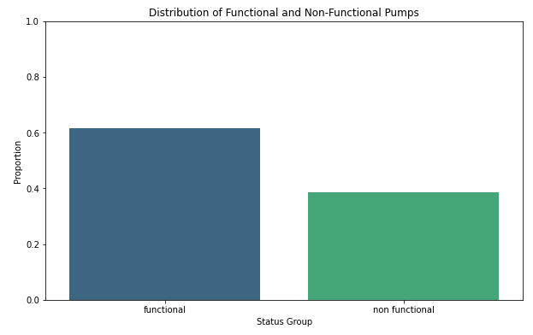
PUMPS STATUS
36.576
22.824

Slide 7
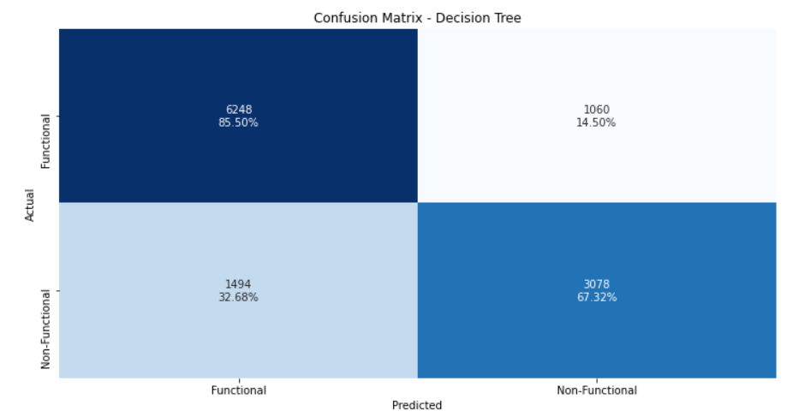
MODELING APPROACH
Models tested: Logistic
Regression Decision Tree

Slide 8
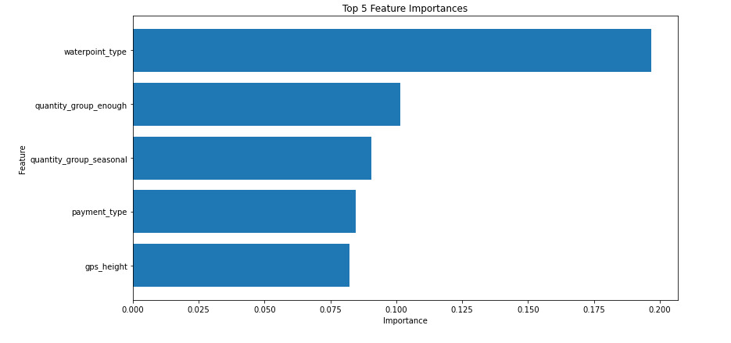
FEATURE IMPORTANCE
Here are the most important variables that better discriminate between functional and non-functional:
Waterpoint_type (ie. Water Access point)
Quantity_group (ie. Quantity of wáter)
Payment_type (ie. Payment method)

Slide 9
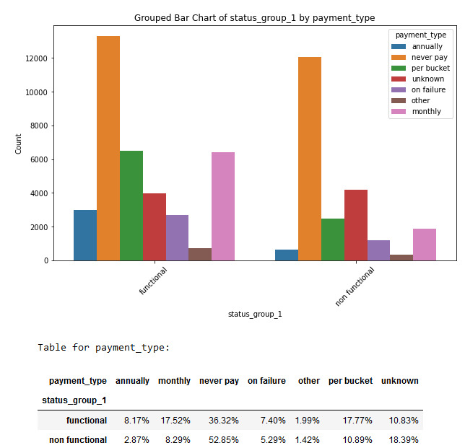
RECOMMENDATIONS
Align Payment Plans:
Providing financial assistance more accessible (with monthly or per-bucket payments)

Slide 10
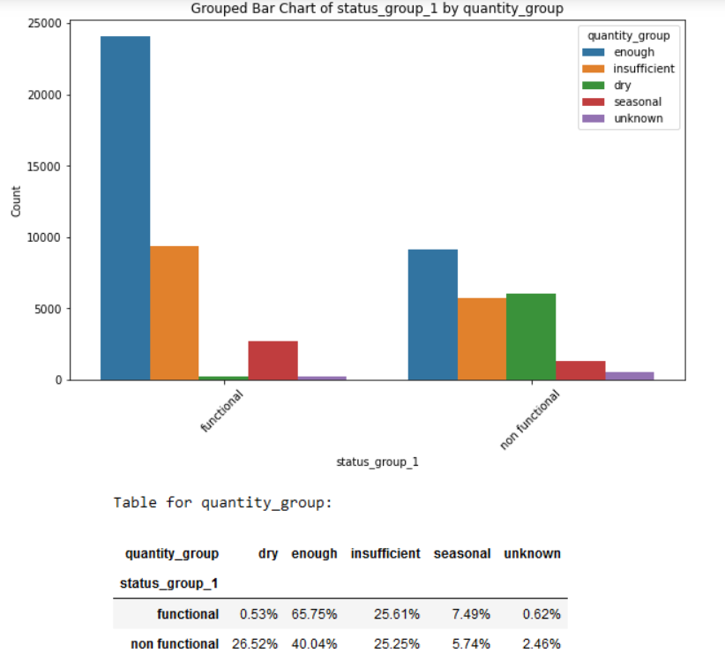
RECOMMENDATIONS
2. Use Dry Pumps as Indicators:
Using dry as an indicator helps identify non- functional pumps for targeted repairs

Slide 11
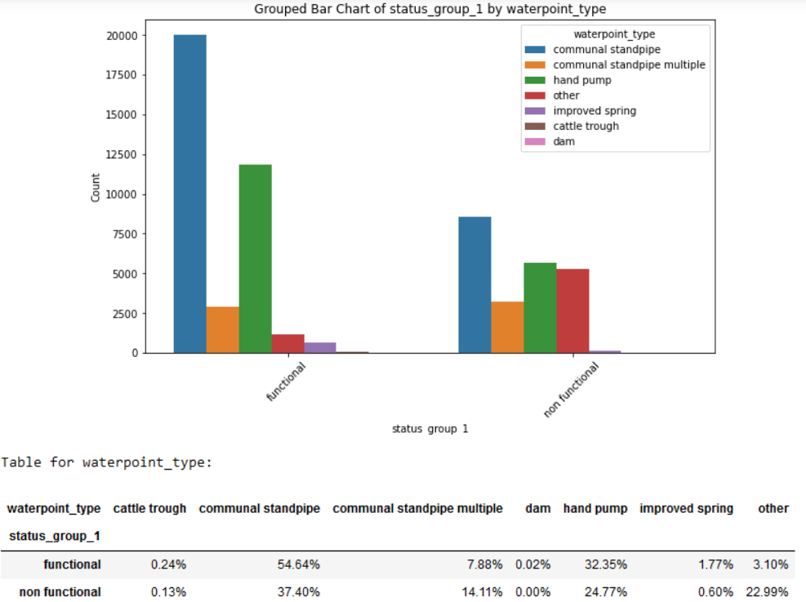
RECOMMENDATIONS
3. Identify Non-Common Types:
Invest in communal standpipe multiple as it best detects pump functionality

Slide 12
THANK YOU VERY MUCH
Miguel Barriola Arranz
LinkedIn: https://www.linkedin.com/in/miguel- barriola-arranz/
Medium: https://medium.com/@mbarriolaarranz

