Slide 1
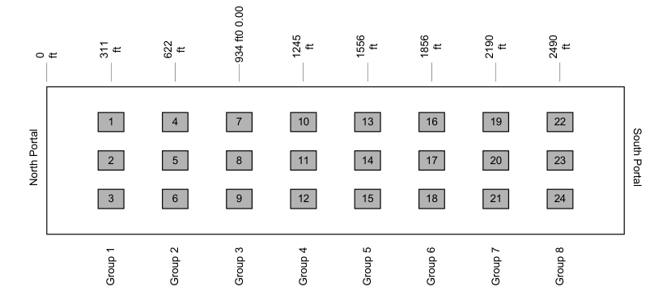
0
m
95
m
190
m
285
m
379
m
474
m
1
4
7
10
13
2
5
8
11
14
3
6
9
12
15

Slide 2
Fire Zone
North Portal
South Portal
V
V
V
V
V
V
V
V
T
T
T
T
T
T
T
T
T
T
20 m
106 m
211 m
321 m
426 m
508 m
554 m
615 m
682 m
723 m
834 m
Loop 214
Loop 213
Loop 211
Loop 209
Loop 208
Loop 207
Loop 307
Loop 205
Loop 302
Loop 301
Loop 202
Fire Zone
Legend
V
Air Velocity Sensor
T
Air Temperature Sensor
V
V
V
V
T
T
T
T
T
T
T
554 m
586 m
604 m
615 m
628 m
645 m
682 m
Loop 307
Loop 306
Loop 305
Loop 205
Loop 304
Loop 303
Loop 301

