Slide 1
Hadoop: MapReducing MinMax
Michael Bartling

Slide 2

Outline
Introduction to MapReduce
The Hadoop MapReduce Framework
Word Count MapReduce Example
Running C Programs on Hadoop Clusters
MapReducing a C-based MinMax program
Comments

Slide 3
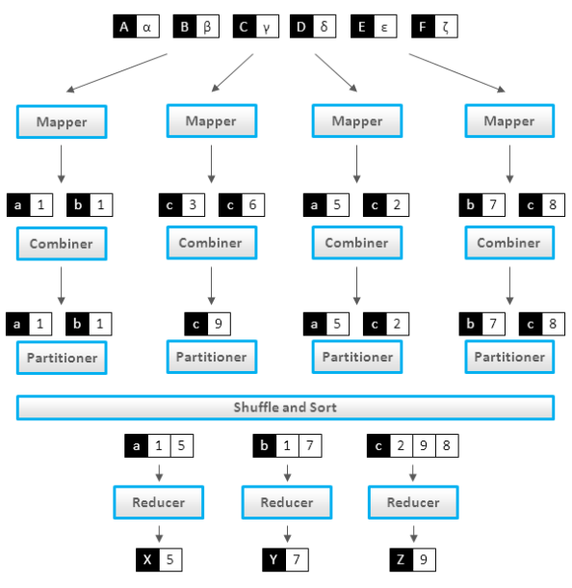
Introduction to MapReduce
2 Main Functions
Map input data to a user-defined set of <key, value> pairs
Reduce outputs of map to a smaller set of <key, value pairs>
Treat Map and Reduce as running on separate machines
Figure:
Black boxes = key,
white boxes = values
http://highlyscalable.wordpress.com/2012/02/01/mapreduce-patterns/

Slide 4
Hadoop MapReduce: What is it?
Formal Definition:
Apache Hadoop is a framework for running applications on large [computing] cluster
This framework provides transparent and reliable data paths to applications
Hadoop MapReduce is a framework for:
1. Mapping large complex computations over a cluster
2. Grabbing the individual results
3. And Reducing– or combining– these results to form a desired system output
Each stage of MapReduce outputs a set of <key, value> pairs
Ex) for a word count <key, value> could be <“Hat”, 50> signifying 50 instances of the word “Hat” in a document

Slide 5
Word Count
Take a large Book and divide by chapters
Each Mapper Node gets a chapter to work on
for each word seen, the Map routine prints the word (the key) and a “1” (the value)
The Reducer keeps a running sum of these words as they appear

Slide 6
Conceptual Example: Word Count
Big Book
Partitioned
into Chapters
Map the Chapter Word Count
Reduce the Word Counts
…
Map Instance
Reduce(word, counts [c1, c2 …])
sum = 0
for each count in counts
sum += count
emit (word, sum)
Note: Hadoop Automagically
Groups values by Key
…
…
<Word,
Count>
Map(chapter)
for each word in chapter
emit (word, 1)
Chapter k
…
…
…
Map Instance
Reduce Instance

Slide 7
C programs in Hadoop
Use Hadoop Pipes interface to run non-Java
Similar to Unix Piping
Allows for C programs to run on Hadoop
Pipes Requires:
Process STDIN line-by-line
Write output lines to STDOUT
All keys/values must be tab delimited
Functionally similar to:
$ cat mapReduceInputs | map | sort | reduce >> outputFile

Slide 8
MinMax: Zoom Out
Note: The Hadoop Framework automagically sorts the outputs of Map by Key
Shuffle Sorting

Slide 9
MinMax Inputs
Num₁ | Num₂ | Num₃ | Num₄ | Num₅ | … | Num_{N1} | \n
Num₁ | Num₂ | Num₃ | Num₄ | Num₅ | … | Num_{N1} | \n
Num₁ | Num₂ | Num₃ | Num₄ | Num₅ | … | Num_{N2} | \n
Num₁ | Num₂ | Num₃ | Num₄ | Num₅ | … | Num_{N3} | \n
Num₁ | Num₂ | Num₃ | Num₄ | Num₅ | … | Num_{N4} | \n
Num₁ | Num₂ | Num₃ | Num₄ | Num₅ | … | Num_{N5} | \n
…

Slide 10
MinMax: The Mapping
…
…

Slide 11
MinMax: Zoom Out
The Hadoop Framework automagically sorts the outputs of Map by Key
Shuffle Sorting

Slide 12
MinMax: Reduce
Next, the Reducer Node(s) literally reduce the Mapper Outputs to one
<"Min", MIN_{Global}> and one <"Max", MAX_{Global}> .
In other words, the minimum and maximum of the massive input file.

Slide 13
MinMax: Reduce

Slide 14
Comments
Hadoop is written in Java for Java. C programs on Hadoop may not perform as well as Java Programs
Hadoop on TAMU eos Cluster
Tricky to put/get test data to Hadoop due to access restrictions
Interactive Mode (Hadoop browser interface) doesn’t work
Path Variables for Hadoop such as Hadoop_Home must be manually set
Currently, only interface into Hadoop Cluster is Hadoop fs commands
SSH into HDFS on eos prone to disconnection
Hadoop Streaming ok at specifying number of reduce tasks (occasionally will need to manually specify this)

Slide 15
MinMax Code
For all of the code and examples, please visit
https://github.com/mbartling/Hadoop_playground

