Slide 1

Agile method
By matthew bartrum
Notes:
Hello everyone! My name is Matthew Bartrum. I have to show you what the Agile method is about and

Slide 2





Team roles
Product Owner
Customer
Scrum Master
Delevoper
Tester
Notes:
The first thing I want to talk about is the team roles . Our first and most important role is our customer. They are who we are developing the program for.
The Product owner is our key leader throughout this project. They work with the customer to figure out everything that they need. They are also our translator for our Scrum Master.
Scrum Master is kind of like our product manager of the team. They help lead the scrum meetings and develop the team they need for the sprints. They are here for the team and help things flow.
Developer are the people who develop the program
Testers test over the developers work to see if the product is working properly.

Slide 3
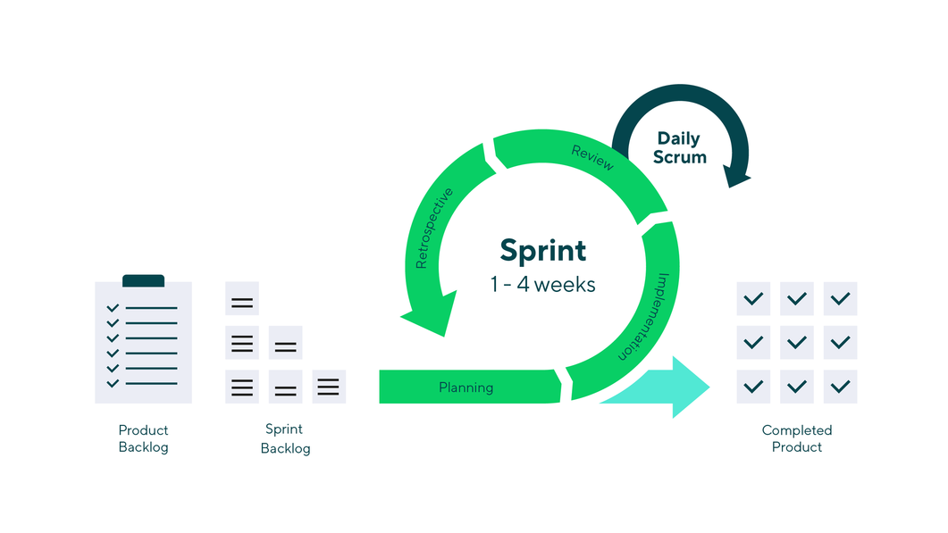
Phases of Agile
Notes:
Phases of the Agile method is pretty simple. It all starts before the sprint with the product backlog that gets tranformed into the sprint backlog. During each spring it starts with planning, implenmation, review and retro. This will keep repeating dependping on how long the sprint is. Once the sprint is done it grabs next from the back log. As you can see it in constant work coming in and coming out. However the cool thing that Agile has is Daily Scrum

Slide 4

Daily Scrum
Communication
input
feedback
Notes:
Daily Scrum is around a 15 minute long meeting. This is startup meeting before the work is started. Every team member meets up and goes over the current sprint. Communication is key in a daily scrum. Everyone needs to speak and listen. Many groups use a ball to toss it around to let that person speak. Feedback is also key to this as well. This will allow to see where you need help and how you can help others.

Slide 5
Why Agile and not waterfall
Flexibility
Speed
Scope
Notes:
Choosing between waterfall and agile can be tough at times. The things that Agile do better than is flexibility. Waterfall it's hard to swim upstream with how strict everything has to be A to B. However Agile has that ability to be flexible because they have everything done durning the sprints. Speed is also very key to Agile. Sprints last no longer than 4 weeks. If you have a shorter project you might as well have setup that is Agile. Finally the Scope is pretty simple and productive for Agile. It's a constanst circle which is better than a waterfall most of the time.

Slide 6
Why waterfall not agile
Long projects
Strong documentation
Notes:
Waterfall comes in handy if you have a long project that has strict goals and has a lot wait and go time during a project. Finally Waterfall has strong documentaiton that allow clear information that would good for any audit. Before I say one is better than the other, I would like say that I think a lot of the times it is best to use both in your situation.

Slide 7
For more information
Wrike
Leading Agile

Slide 8

Thank You
Matthew.bartrum@snhu.edu
Notes:
Thank you! Feel free to contact me if you have any questions.

