Slide 1
Team 2: Trig Made Simple
By: Brian Beuerman, Timothy Campbell
Co-mentors: Dr. Marilyn Reba, Mr. Allen Guest, Dr. Meredith Burr

Slide 2
Introduction
Trigonometric reference
Contains unit circles and graphs
Sine
Cosine
Tangent
Designed for incoming college students
Facilitate the teaching process of entry-level calculus to students

Slide 3
Objective
Unit circle and trigonometric graph reference
Three pages
Unit Circle with angles and side lengths
Unit Circle with corresponding trigonometric graphs
Trigonometric functions graphed alongside their inverses
Emphasis of user activity

Slide 4
Implementation
Visuals
Drawing unit circles and graphs
User Interactivity
Instant feedback
MathJax
JavaScript display engine for mathematics

Slide 5
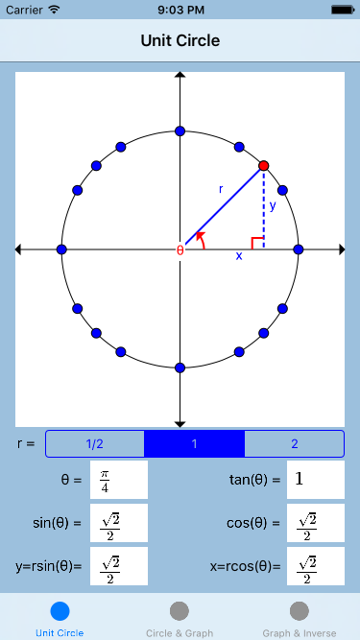
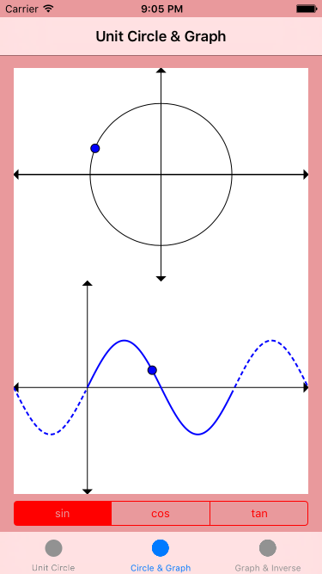
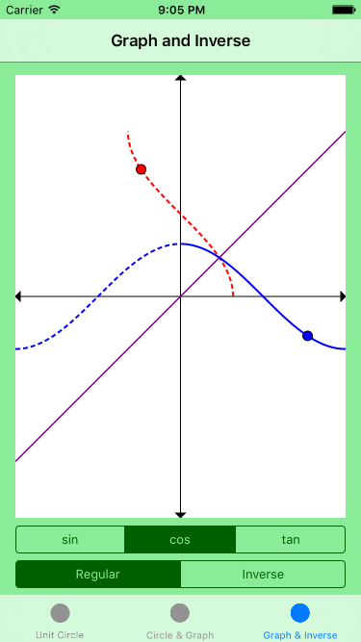
StoryBoard

Slide 6
App Demo

Slide 7
Future Goals
The goals we have for the future of this app are:
CoreCalc App (courtesy of Volodymyr Budnichenko)
Multiple Choice Questions
MathJax
Authoring Tool

Slide 8
Thank You
Volodymyr Budnichenko
CoreCalc
MathJax
Dr. Pargas
For guiding us in our project

