Slide 1
Oracle Metrics Association Mining
Bern Winter School on Machine Learning
Mürren, January 2020
Project
Marco Bassi
March 16, 2020

Slide 2
Project Objective
Find patterns in Oracle database metrics using Association Mining.
Result consists of association rules {lhs} ⇨ {rhs}, e.g.
{Enqueue Requests Per Sec, User Transaction Per Sec} ⇨
{User Commits Per Sec}
Association Mining is a machine learning method for identifying associations among items. The method is widely-used for market basket analysis, and for detecting fraudulent credit card use
{butter, jelly} ⇨ {bread}
{torch light} ⇨ {battery}

Slide 3
Benefits and Drawbacks
☺ unsupervised learning, i.e. no training and no labels
☺ very large number of variables, and large and complex data
☺ fast
☺ output (rules) are easy to understand
☹ not for small datasets
☹ takes effort to separate “obvious” rules from new insights
☹ beware of conclusions due to random patterns in the data

Slide 4
Data Preparation – 1
Inputdata selected from Oracle dynamic performance view DBA_HIST_SESSION_METRIC
Hourly snapshots of aggregated values for 158 metrics (avg, min, max, std.dev), for last 30 days:
Buffer Cache Hit Ratio, Memory Sorts Ratio, Redo Allocation Hit Ratio, User Transaction Per Sec, …
Better: “realtime” metric values, taken every 60 secs; but unfortunately not available at the time of writing.
Metrics values are numeric. “Itemize” values by subdividing into groups “high”, “medium” and “low” wrt. quantiles Q1 and Q3.
For first attempt, only take “high” values into account.

Slide 5
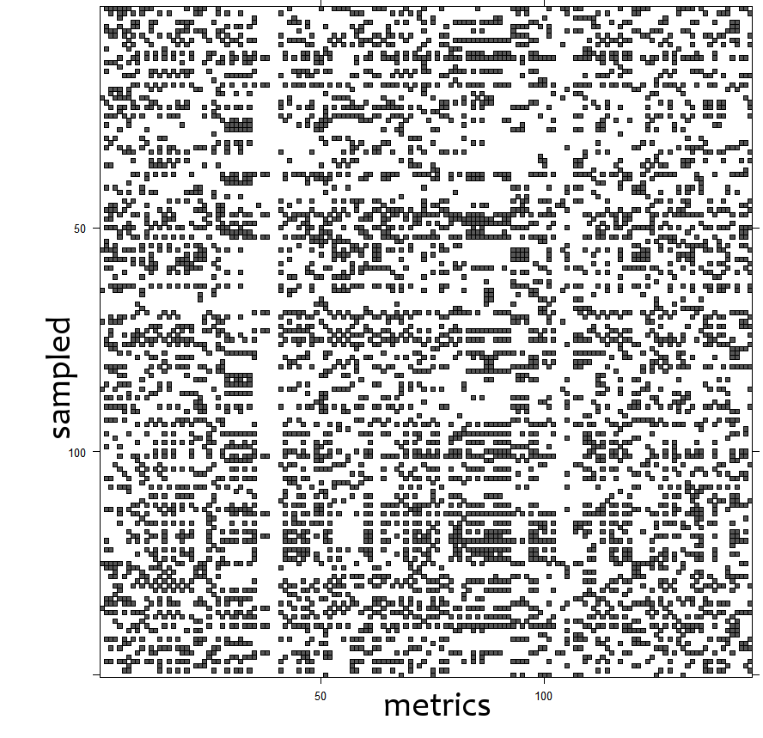
Analysis Procedure – 1
Environment: R version 3.4.4, x86_64 (Windows 10)
Package arules version 1.6-3
Step 1: Load data into data structure itemMatrix (sparse matrix); see below 100 randomly selected samples

Slide 6
Analysis Procedure – 2
Step 2: Use Apriori-Algorithm to find association rules
Parameters: threshold for support, confidence and lhs+rhs size
support: how frequently the itemset (items in lhs and rhs of the rule) occurs in the data samples.
confidence: proportion of the samples, where the lhs itemset results into the rhs itemset.
minlen: minimum total number of items in lhs and rhs.
First attempt
support=0.2, confidence=0.9, minlen=2 ⇨ set of 2176 rules

Slide 7
Analysis Procedure – 3
Rules sorted by lift
[1] {Physical Write Bytes Per Sec (2) H} 3.997175
=> {Physical Writes Per Sec (2) H}
[2] {Physical Writes Per Sec (2) H} 3.997175
=> {Physical Write Bytes Per Sec (2) H}
[3] {User Transaction Per Sec (2) H} 3.997175
=> {User Commits Per Sec (2) H}
[4] {User Commits Per Sec (2) H} 3.997175
=> {User Transaction Per Sec (2) H}
[5] {Host CPU Usage Per Sec (2) H} 3.997175
=> {Host CPU Utilization (%) (2) H}
...
Lift: a measure for the importance of a rule. The lhs and rhs itemsets are found together in samples more often by this factor, than would be expected by chance.
The rules shown above are of absolutely no use!

Slide 8
Improving model performance – 1
Subsetting the rules, e.g. for metrics concerning the Library Cache
lc.rules <- subset(rules, items %pin% "Library Cache") ⇨ 4 rules
[1] {Library Cache Miss Ratio (2) H} 3.661220
=> {Hard Parse Count Per Txn (2) H}
[2] {Hard Parse Count Per Txn (2) H} 3.661220
=> {Library Cache Miss Ratio (2) H}
[3] {Library Cache Miss Ratio (2) H,
Redo Writes Per Txn (2) H} 3.893877
=> {Enqueue Waits Per Txn (2) H}
[4] {Enqueue Waits Per Txn (2) H,
Library Cache Miss Ratio (2) H} 3.828979
=> {Redo Writes Per Txn (2) H}
Rules [3] resp. [4] are worth further exploring

