Slide 1
Customer Segmentation for targeted Advertisement
By: Gabriel Berardi, Mickael Bastard and Felix von Wendorff
MSc Data Analytics, University of Glasgow
April 1, 2022

Slide 2
Goals
Identify clusters of consumers that respond differently to promotions
Derive a strategy to optimally approach each cluster of consumers
Define how much money should be invested per cluster to optimize revenue

Slide 3
Ethical Considerations
The dataset that we analysed contains personal identifiable information
(e.g. age, gender, income)
The data is structured so that the identity of a single customer is not revealed directly
Therefore, we deemed our data analysis to be ethically justifiable

Slide 4
Data processing pipeline
Data reading
Data imputation
Feature engineering
One-hot encoding
Input for clustering
Source:
Portfolio
Profile
Transcript
Missing values
Encode categorical data to binary data
Missing values:
Income
Gender
Age
Table concatenation and variable calculation
Input to clustering algorithm

Slide 5
data Imputation and outlier handling
For 2,175 out of the 17,000 individuals in the dataset, they have:
An age of 118
No gender
No income
No other outliers or missing values detected
→ imputation with the mean of all ages ≠ 118
→ imputation according to distribution of M, F and O genders
→ imputation with the mean of all incomes

Slide 6
Feature Engineering AND VARIABLE GENERATION
19 variables created
Concatenation of profile and transcript tables using id_membership
TOTAL AVERAGE SPEND PER CUSTOMER
TOTAL SPEND PER CUSTOMER
TOTAL AVERAGE SPEND ON DISCOUNT OFFERS PER CUSTOMER
TOTAL AVERAGE SPEND ON BOGO OFFERS PER CUSTOMER
Calculation of derivative variables:
DELTA SPENT ON DISCOUNT OFFERS VS AVERAGE SPENT PER CUSTOMER
DELTA SPENT ON BOGO OFFERS VS AVERAGE SPENT PER CUSTOMER

Slide 7
One-hot encoding
Encode categorical data to binary data
Example: a customer became a member on 2017-04-21
year_joined_2013 | year_joined_2014 | year_joined_2015 | year_joined_2016 | year_joined_2017 | year_joined_2018
0 | 0 | 0 | 0 | 1 | 0

Slide 8
CLUSTERING using k-means
Simple
Two steps algorithm [1]:
- Assignment step
- Update step
Fast
Algorithm is often considered to be of "linear" complexity [2]
Efficient
It has been successfully used in market segmentation [2]
[1] D. J. C. MacKay, ‘Information Theory, Inference, and Learning Algorithms’
[2] ‘k-means clustering’, Wikipedia. Feb. 11, 2022. Accessed: Mar. 10, 2022. [Online]. Available: https://en.wikipedia.org/w/index.php?title=K-means_clustering&oldid=1071172431
Notes:
To cluster customers in different segments → chose to use K-means algorithm
Simple:
The algorithm proceeds by alternating between two steps
Assign each observation to the cluster whose center (i.e. centroid) is closest
Recompute the centre of each cluster as the average of all observations that are within a cluster
Iterate through these 2 steps until the centre of each cluster does not move any more.
Fast: K-means is considered to be of linear complexity
Efficient: K-means has been successfully used to segment customers

Slide 9
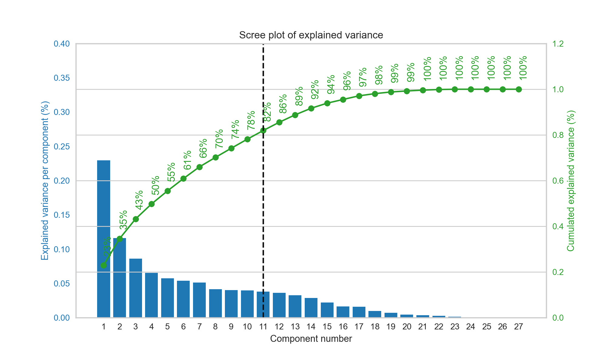
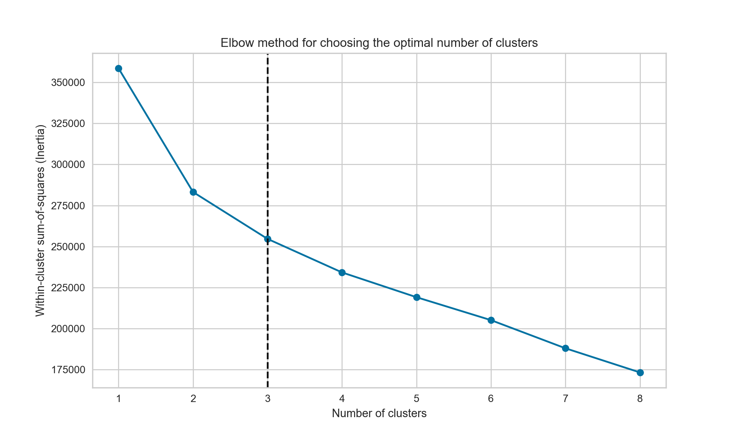
Requirements for k-means
Feature Scaling
(1)
Feature Reduction
(2)
How many clusters?
(3)
(2)
(3)
Notes:
There are 3 requirements while performing K-means
1. Feature scaling : If we do not scale the variables before running K-Means, then the results will be driven by the variable having the largest mean and variance. (i.e. “total spend”)
Then, it is important to standardize the variables to have mean zero and standard deviation one before applying K-Means.
2. Feature reduction via PCA: K-means algorithm is both more effective and more efficient with a small number of dimensions.
By looking at the scree plot (showing the explained variance against the number of components), we can determine the optimal number of principal components (i.e. features) we keep while preserving at least 80% of the variance.
In our case study, we chose to keep the 10 first principal components that explain roughly 80% of the variance.
(Then, we apply PCA on our original dataset and reduce our dataset to 10 principal components.)
3. The Number of clusters
To perform K-means, we must decide how many clusters we expect in the data. For determining the optimal number of clusters, we used the elbow method.
A bit of background first:
In general, increasing the number of clusters always results in a better fit and explains more variation (i.e. which can be translated by a lower total within-cluster variation).
However, it does not make sense to keep increasing the number of clusters since the model will overfit the data at some point.
While plotting the variation as a function of the number of clusters, the idea is to pick the elbow of the curve which reflects the optimal number of clusters (which is 3 here)
This bend shows the transition from the under-fitting region to the over-fitting region.
Therefore, the idea is to find the optimal number of clusters where the total within-cluster variation also called the distortion score stops decreasing rapidly.
To achieve this, we compute the distortion score for different number of clusters k (i.e. from 1 to 9) and we plot the curve of the distortion score against the number of clusters.

Slide 10
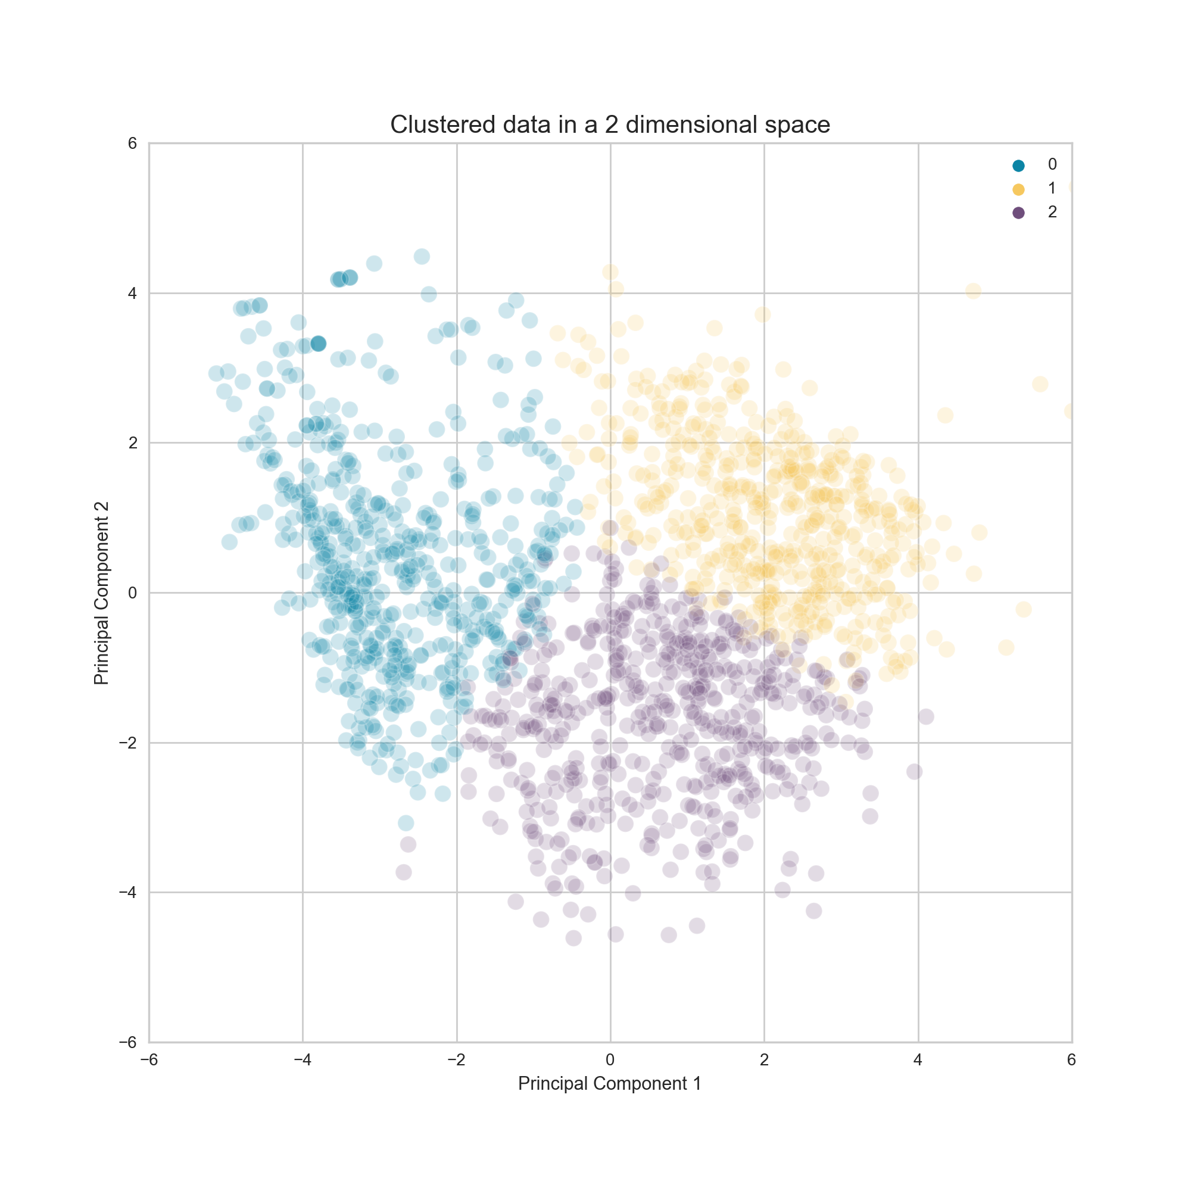
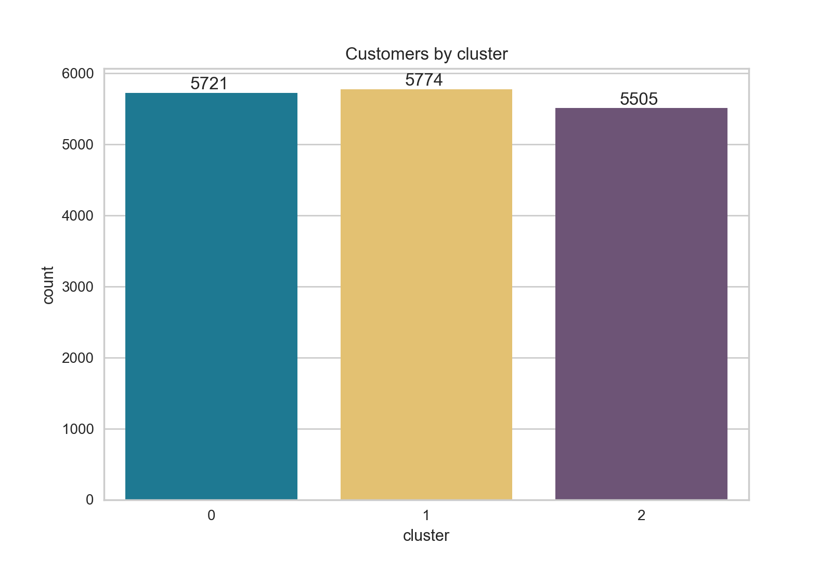
Clustering results – Quality of the Clusters (1/2)
Notes:
While plotting the clusters in a 2-dimensional space PC1 and PC2 explaining only 35% of the variance → the 3 clusters are relatively well separated
While looking at the size of the clusters → we see that their size is very similar

Slide 11
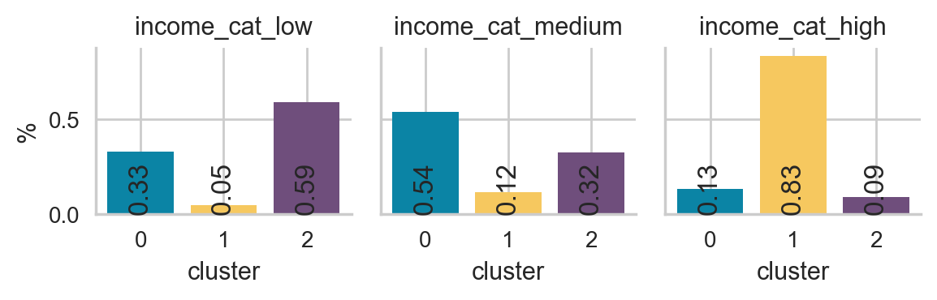
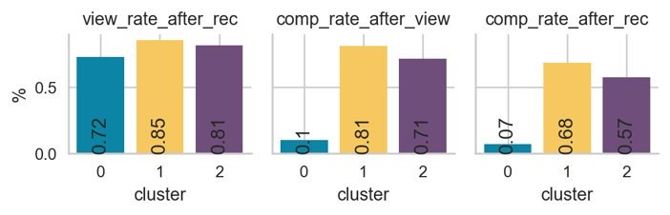
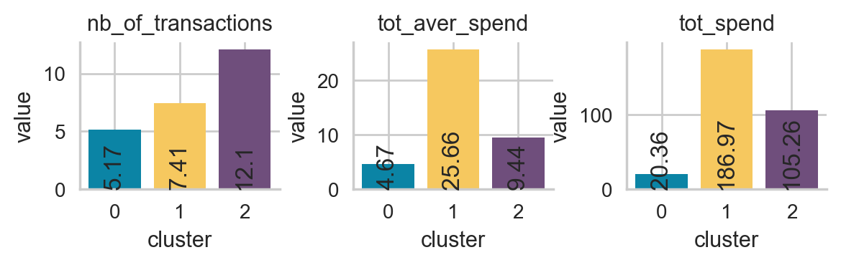
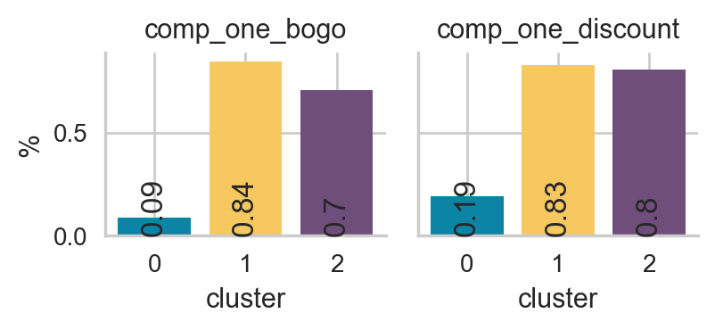
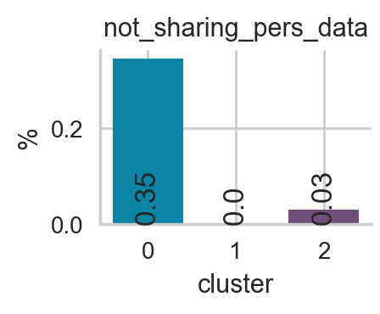
Clustering results – variables (2/2)
low < 54 k$
54 k$ <= medium <= 73 k$
73 k$ < high
Notes:
Only look at some of the variables used to cluster the data (12 out of 27)
To get this slide, the labels of the clusters have been assigned to the original dataset so that we can compute the variable mean for each cluster and do an interpretation in the original space.
In this slide, we have one socio-economic variable (income)
Gender Category
Age Category
Income Category
When the customers became a member

Slide 12
Characteristics of the identified clusters
Income
Medium (51%) & low income (34%)
High income (84%)
Low (57%) & medium income (34%)
Compl. rate
Very low completion rate (9%)
High completion rate (69%)
Relatively high completion rate (57%)
Tot. aver. spend
Low total average spend (5.2 $)
High total average spend (25.9 $)
Medium total average spend (9.3 $)
Total spend
Low total spend (21.4 $)
High total spend (191.4 $)
High total spend (106.4 $)
Offer spend
Spend less on average while
using bogo & discount offers
Spend slightly less on average while
using bogo & discount offers
Spend more on average while
using bogo & discount offers
"the suspicious
Low & Mid-earners"
"the steady
high-earners"
"the engaged low-earners"

Slide 13

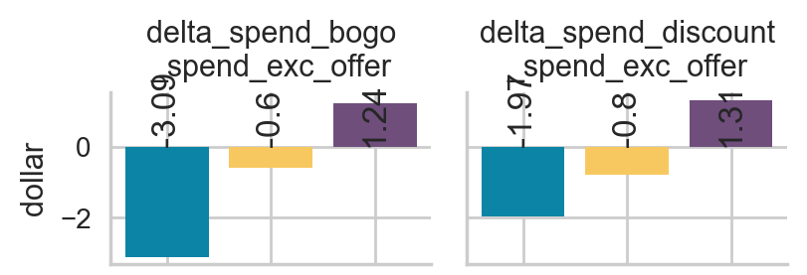
RECOMMENDED MARKETING STRATEGY
"the suspicious
Low & Mid-earners"
This group should not be targeted with any offers, as this showed to be counterproductive.
"the steady
high-earners"
This group didn't significantly respond to the offers made during this campaign.
However but other types of offers could be tried in the future.
"the engaged
low-earners"
This group should be targeted with offers, especially discount offers, as this had the biggest impact on revenue.
Notes:
Invest at most $1.24 per customer for buy one, get on free promotion
Invest at most $1.31 per customer for discount promotions

Slide 14
Recommendations for improvements
Create a statistically significant control group of individuals who did not receive any promotions
Determine the return on investment for individual promotions and only utilize the most profitable ones
Calculate customer acquisition price per individual not per group

Slide 15
SUMMARY
GOALS
Identify cluster of consumers that respond differently to promotions
Derive a strategy to optimally approach each cluster of consumers
Define how much money should be invested per cluster to optimize revenue
RESULTS
"the suspicious
Low & Mid-earners"
LEAVE ALONE
0 dollar
"the steady
high-earners"
Try other offers
0 dollar
"the engaged
low-earners"
Target with offers
Bogo: 1.24 $, Discount: 1.31 $

Slide 16
Thank you

