Slide 1
Customer Segmentation for targeted Advertisement
By: Gabriel Bernardo, Mickael Bastard and Felix von Wendorff
April 1, 2022

Slide 2
GoalS
Identify distinct cluster of consumers that respond differently to promotions
Identify how to optimally approach each cluster
Define how much money should be invested per customer to attract additional revenue

Slide 3
Data cleaning and outlier detection
Age 118:

Slide 4
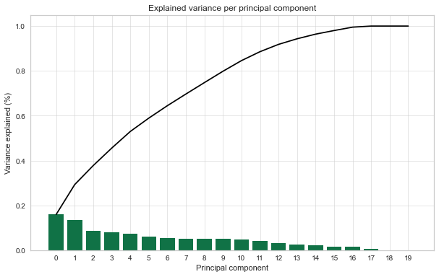
Clustering preparation
Because K-means clustering is isotropic, standardize features by removing the mean and scaling to unit variance
Reduce dimensionality by using Principal Component Analysis (PCA) to identify variables that explain the most variance in the data
More than 80% of the variance is explained by 10 components

Slide 5
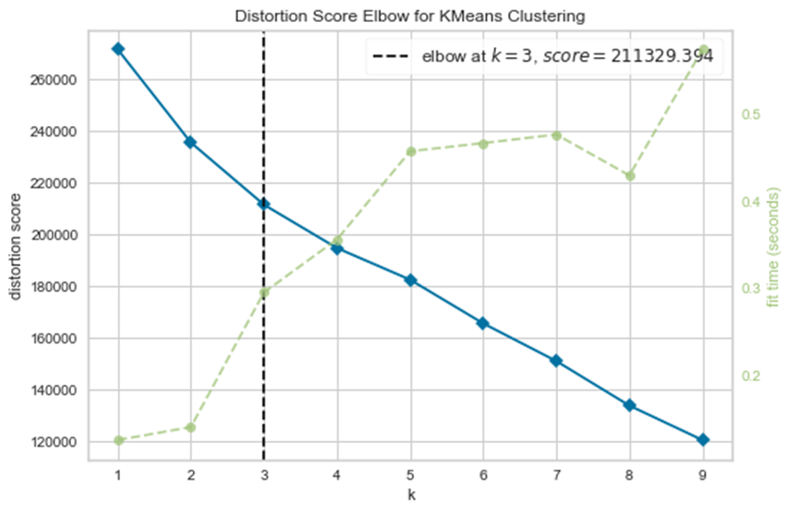
Clustering mechanism
Elbow method applied to determine number of clusters
Alternatives tried: silhouette Analysis and gap statistics
Three clusters led to optimum results

Slide 6
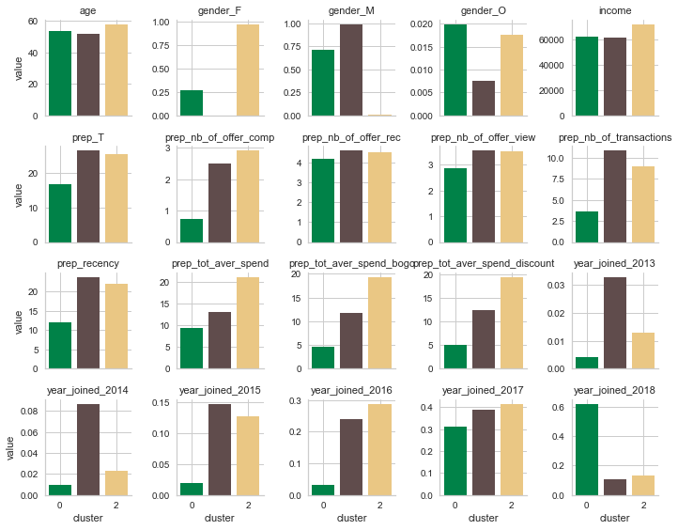

Slide 7
Notable Cluster Attributes
Group 1
Group 2
Group 3
Women who spend a lot and complete a lot of offers
Mostly men not completing offers, and spending less when they use offers
Men spending on average always the same
Mainly Women (almost 100%)
2 to 4 years of seniority (joined mostly between 2015 and 2017)
High recency (More than 20 days)
High total average spend (i.e. around 20 dollars)
High total average spend on bogo and discount offers (i.e. around 20 dollars)
High number of offer completed (i.e. around 3)
High number of transactions (i.e. more than 7)
Mainly Men (75% of men and 25% of women)
Joined lately in 2017 and 2018 (90% of them)
Low recency (about 10 days) --> joined less than 2 years ago
Low total average spend (i.e. less than 10 dollar)
Low total average spend on bogo and discount (i.e. 5 dollar)
--> spend less when they use bogo and discount offers (5<10)
Low number of offer completed (i.e. less than one)
Low number of transactions (i.e. around 3)
Mainly Men (almost 100%)
Has more than one year seniority
High recency (More than 20 days)
Medium total average spend (i.e. around 12 dollars)
Medium total average spend on bogo and discount offers (i.e. around 12 dollars)
--> Spend the same when they complete bogo and discount offers
Medium number of offer completed (i.e. around 2.5)
High number of transactions (i.e. more than 10)

Slide 8
Recommended Marketing Strategy
Group 1
Group 2
Group 3
Women who spend a lot and complete a lot of offers
Mostly men not completing offers, and spending less when they use offers
Men spending on average always the same
Responds well to promotions
Life time value of customer increases with promotions
Do not send promotions
This group spends less if when targeted in advertisement not more
Do not send promotions
This group spends the same amount regardless of how many promotions they receive

Slide 9
Recommendations for improvements
Create a statistically significant control group of individuals who did not receive any promotions
Determine ROI for individual promotions and only utilize the most profitable ones
Calculate customer acquisition price per individual not per group

