Slide 1

Exploratory Data Analysis
G2M Cab Investment
July 21, 2021

Slide 2

Agenda
Executive Summary
Problem Statement
Approach
EDA
EDA Summary
Recommendations

Slide 3
Background – G2M Cab Industry Case Study
Hypotheses:
1. Is there a preference for gender?
2. Do consumers prefer one company more than others?
3. What area are cabs most popular?
4. Is there seasonality in demand for cabs?
5. Is there a difference in demand by age?

Slide 4
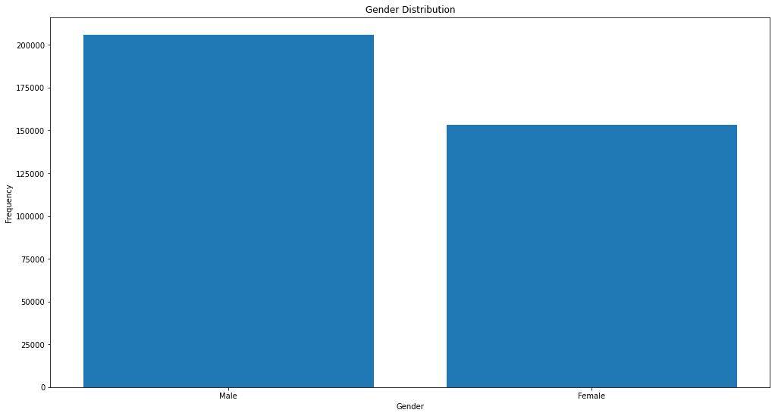
Demographic Analysis

Slide 5
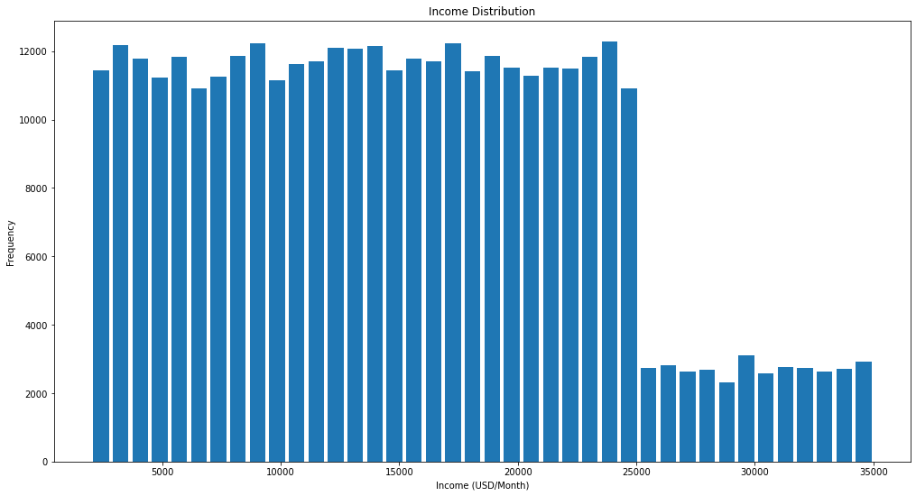
Demographic Analysis

Slide 6
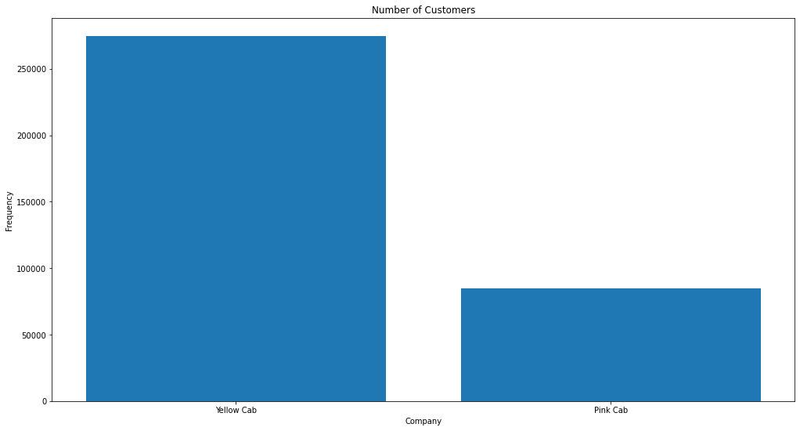
Demographic Analysis

Slide 7
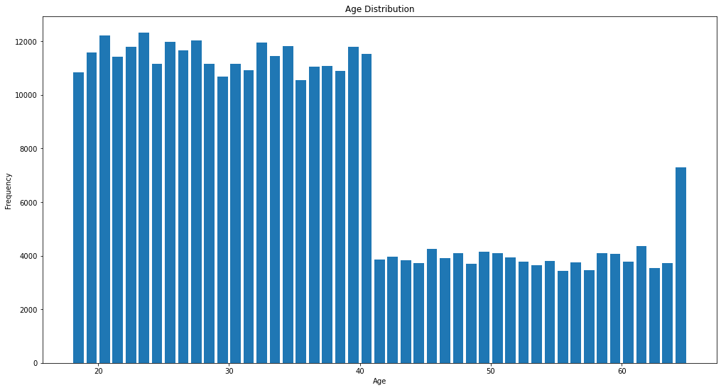
Demographic Analysis

Slide 8
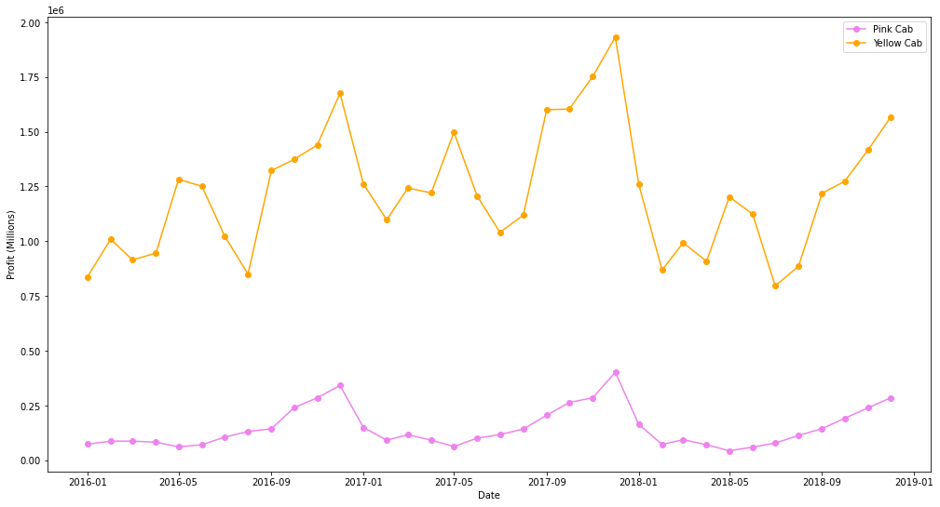
Profit Analysis

Slide 9
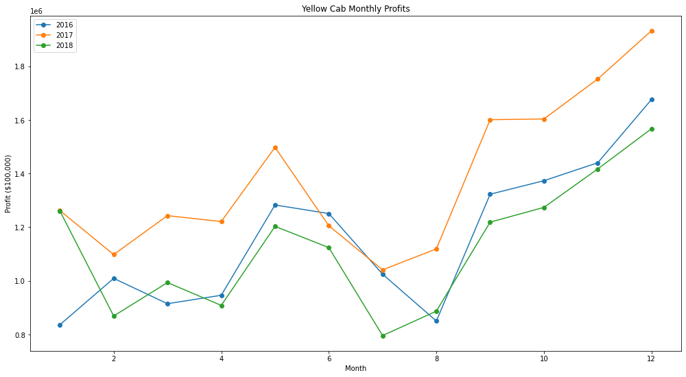
Profit Analysis

Slide 10
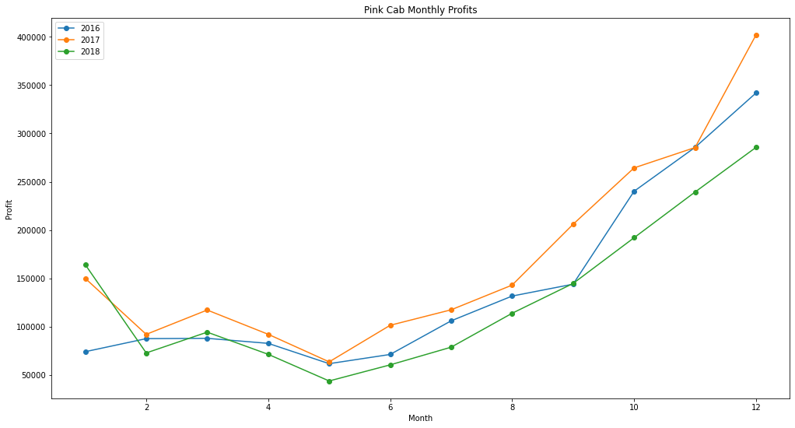
Profit Analysis

Slide 11
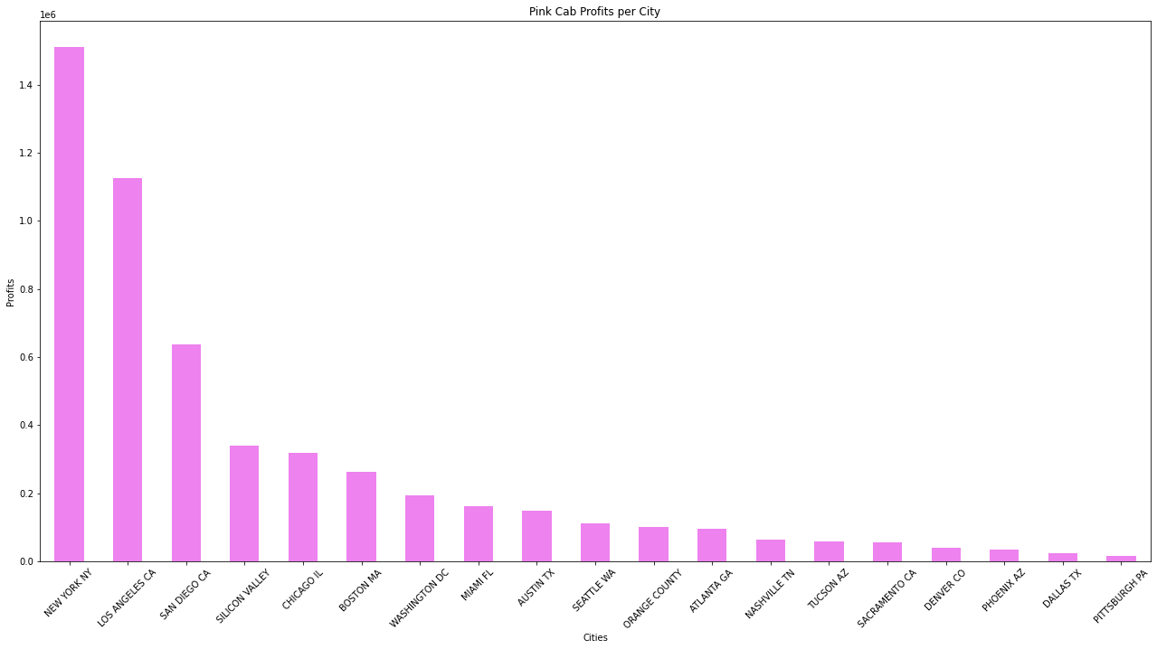
Location Analysis

Slide 12
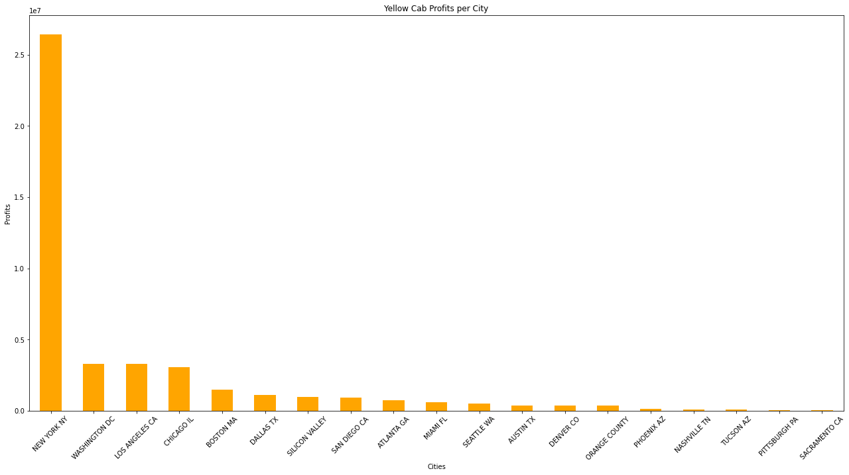
Location Analysis

Slide 13
Conclusions
Conclusion
1. Is there a preference for gender? We see that there are more male users that use the cab companies overall.
2. Do consumers prefer one company more than others? We see that there are more users of Yellow Cab compared to Pink Cab.
3. What area are cabs most popular? Both companies see the most demand in New York.
4. Is there seasonality in demand for cabs? For Yellow Cab, we see a spike in profits during the months after August, and a high during May. Compared to Pink cab, we see that there is an upward trend in profits beginning from the month of May.
5. Is there a difference in demand by age? 50% of the users are under the age of 33 which shows that the use of these companies do appeal to a younger age group of people.

Slide 14
Thank You

