Slide 1



OpenTURNS
G. Blondet, Phimeca Engineering SA
‘HPC and Uncertainty Treatment – Examples with Open TURNS and Uranie’
EDF – Phimeca – Airbus Group – IMACS – CEA
PRACE Advanced Training Center – May, 10-12, 2021

Slide 2
Outline
Overview of OpenTURNS (OT)
Doc and Users
OT in pictures
OT in practice

Slide 3
Outline
Overview of OpenTURNS
What is OpenTURNS?
Uncertainty methodology
OpenTURNS features
Uncertainty quantification with OpenTURNS
Innovations
Doc and Users
OT in pictures
OT in practice

Slide 4
What is Open TURNS?
Partnership since 2005 between:
EDF - R&D EADS - Innovation Works Phimeca IMACS (since 2014)
Open-source initiative to Treat Uncertainties, Risks’N Statistics
Open-source platform for uncertainty treatment
Uncertainty propagation
Uncertainty quantification and Uncertainty ranking
Meta-model building
working on Unix/Linux platform and Windows (since 2010)
Open TURNS includes:
C++ scientific library including the methods for performing uncertainties treatment (statistic, reliability, etc.);
A python module : simplify your work with an interpreted language;
A complete documentation;
A website: http://openturns.github.io/

Slide 5
Uncertainty methodology (1/2)
Global Methodology of Treatment of Uncertainties
developed first at EDF R&D in 1990 and then improved by contributions from other companies
Step A : Study Specification
Uncertainty sources, model, variable of interest and criteria
Step B : Uncertainty Quantification
Joint probability density function of the input uncertain parameters modeling
Step C : Uncertainty Propagation
Variable of interest uncertainty assessment
Step C’ : Uncertainty Ranking / sensitivity analysis
Uncertainty sources ranking with respect to their influence on the variable of interest uncertainty

Slide 6
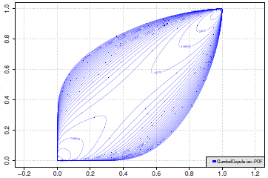

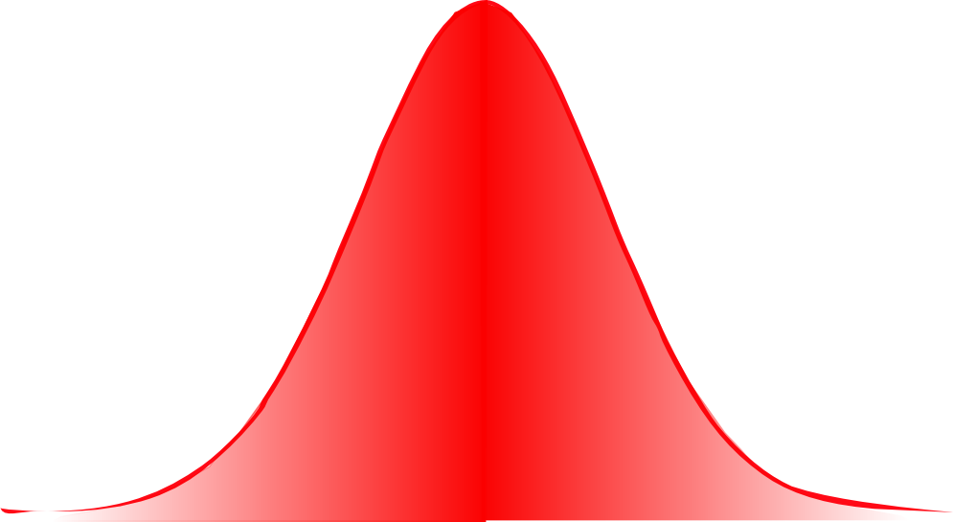

Uncertainty methodology (2/2)
Step C’ : Sensitivity analysis
Step C : Uncertainty Propagation
Step B :
Uncertainty quantification
Probabilistic model
(joint distribution)
Direct methods, statistics, expert assessment
Step A : Study specification
Input variables
Variables : x
Parameters : θ
Numerical model
f(x,θ)
Quantity of interest
Ex : variance, probability
Variables of interest
Y = f(x,θ)
Y ^{R} = f ^{R}(x)
Real system
f ^{R}(x)
Step B’: Calibration / Validation
Variables observed
Y_{obs}(x_{i})
Correcting model
Decision criterion
Ex: Probability < 10^{-b}

Slide 7
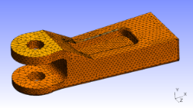

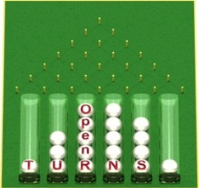

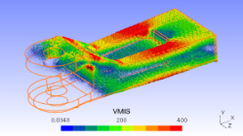
OpenTURNS features
Code linked to OpenTURNS
Interface with python functions ➔ to perform complex wrappers without compilation + parallelization functionalities
Standard Interface for the wrappers of any complexity (distributed wrapper, binary data) development requiring the development of an external wrapper
SalomeMeca compatible ➔ software including the 3 components to perform a mechanical and probabilistic data models coupling (linked to YACS)
GUI of OpenTURNS within SalomeMeca
Mechanical modeling
FE modeling
Probabilistic modeling

Slide 8
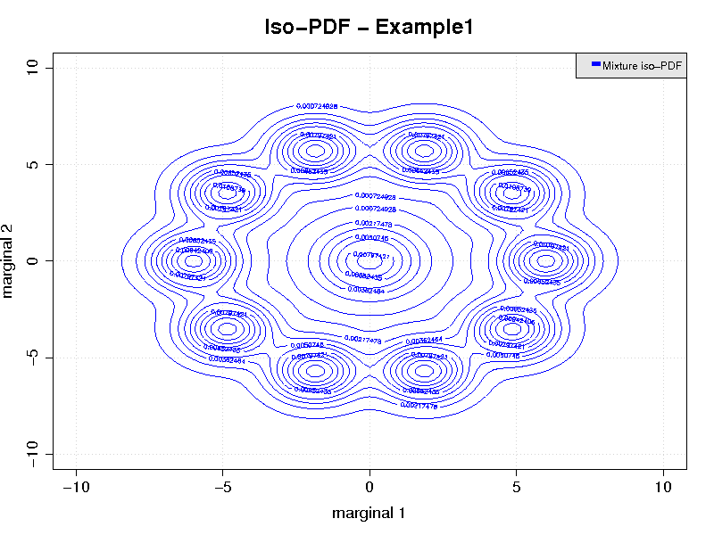
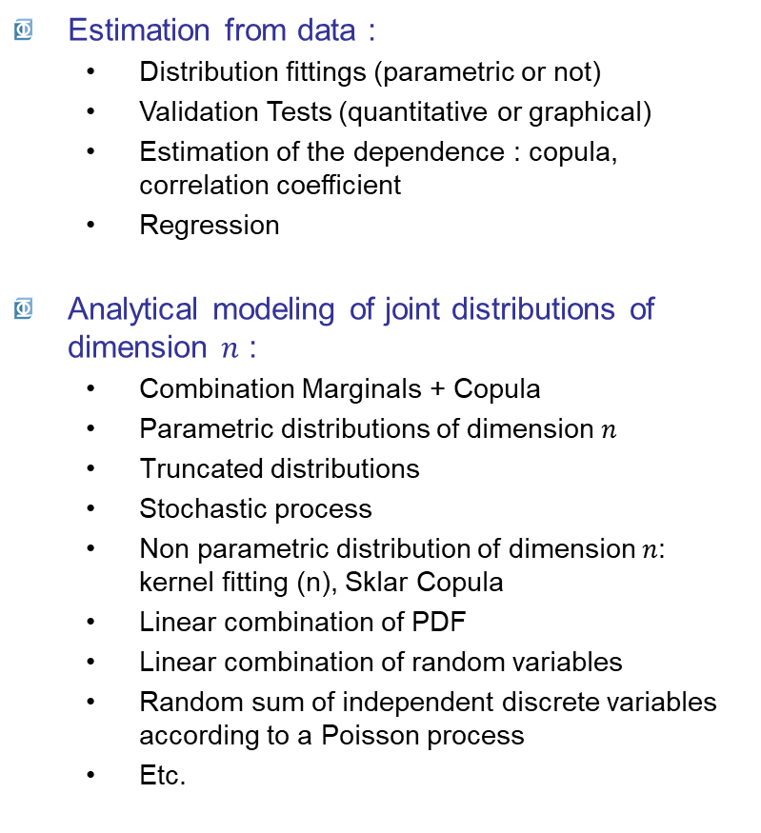
Uncertainty quantification with OpenTURNS
Estimation from data :
Distribution fittings (parametric or not)
Validation Tests (quantitative or graphical)
Estimation of the dependence : copula, correlation coefficient
Regression
Analytical modeling of joint distributions of dimension $n$ :
Combination Marginals + Copula
Parametric distributions of dimension $n$
Truncated distributions
Stochastic process
Non parametric distribution of dimension $n$: kernel fitting (n), Sklar Copula
Linear combination of PDF
Linear combination of random variables
Random sum of independent discrete variables according to a Poisson process
Etc.

Slide 9
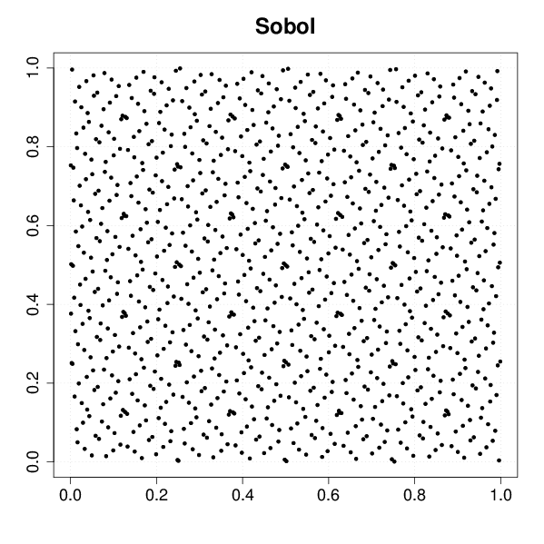
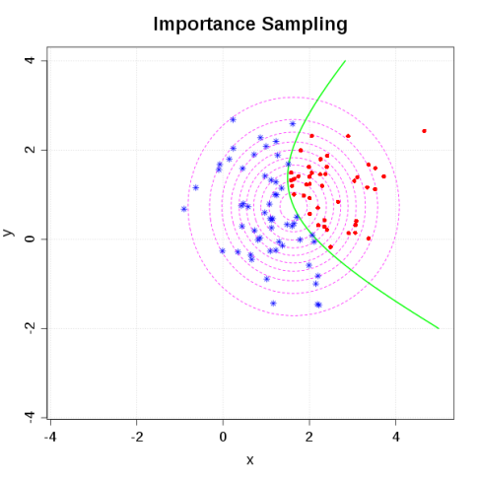
Uncertainty propagation with OpenTURNS
Sampling data:
Random generator
Stratified design of experiment
Latin Hypercube Sampling
Low Discrepancy Sequence
Markov chain
Probability estimation:
Isoprobabilistic transformation
FORM / SORM
Monte Carlo simulation
Importance simulation
Directional simulation
Latin hypercube simulation
Simulation algorithms

Slide 10
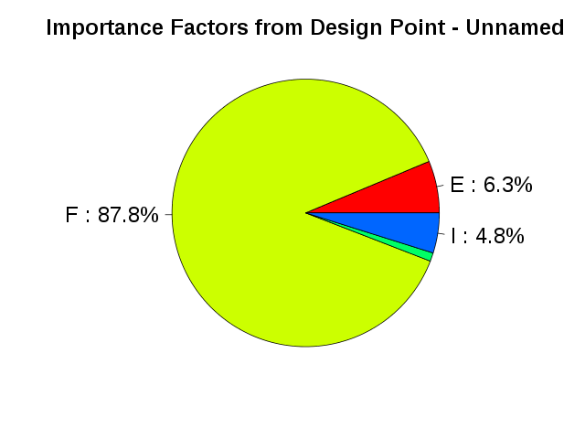
Uncertainty ranking with OpenTURNS
Ranking and sensitivity analysis:
Importance factor from Taylor decomposition
Ranking from correlation
Sensitivity analysis
Importance factor from reliability methods
Tools
Optimization algorithm
Response surface:
Parametric approximation
Functional chaos expansion
Kriging
Graph
and Modules…

Slide 11

Innovative and recently implemented algorithms
the most recent and efficient algorithms of non uniform distribution generation
Ziggurat method (2005) for the normal distribution
sequential reject algorithm (1993) for the binomial distribution,
Tsang & Marsaglia method (2000) for the gamma distribution,
Lebrun algorithm (2012) for the MultiNomial distribution,
the most recent algorithms for evaluating the CDF
Marsaglia algorithm for the exact statistics of Kolmogorov (2003),
Benton et Krishnamoorthy algorithm for the distributions non centered Student and non centered Chi2 (2003).
PhD results
Sparse chaos expansion polynomials : G. Blatman (EDF/R&D/MMC) (2010)
Accelerated simulation algorithm for the evaluation of low probabilities : M. Munoz (EDF/R&D/MRI) : (current dev)
Copulas for order statistics distributions: R. Lebrun (EADS) , Richard Fischer (EDF) (2013)

Slide 12
Outline
Overview of OpenTURNS
Doc and Users
OT in pictures
OT in practice

Slide 13
OpenTURNS: Doc and Users
Several guides intended for users
Installation : Windows/Linux, from anaconda or sources
API Reference : Python docstring of most of the objects, arguments and methods in OpenTURNS and available in HTML.
Examples Guide : application of the whole Global Methodology on classical mechanical examples‏
Reference Guide : Theory of the methods implemented within OpenTURNS
Contribute : how to contribute to OpenTURNS, core code, modules …
… and a sympathetic community :
Openturns.org : official web site
a particular page share to communicate about the software
the annual Users Day

Slide 14
OpenTURNS: Doc and Users
Mailing list for users: users@openturns.org:
Ask any question relative to the installation and use of Open TURNS
Community tools:
https://openturns.discourse.group/
https://gitter.im/openturns/community

Slide 15
Outline
Overview of OpenTURNS
Doc and Users
OT in pictures
OT in practice

Slide 16
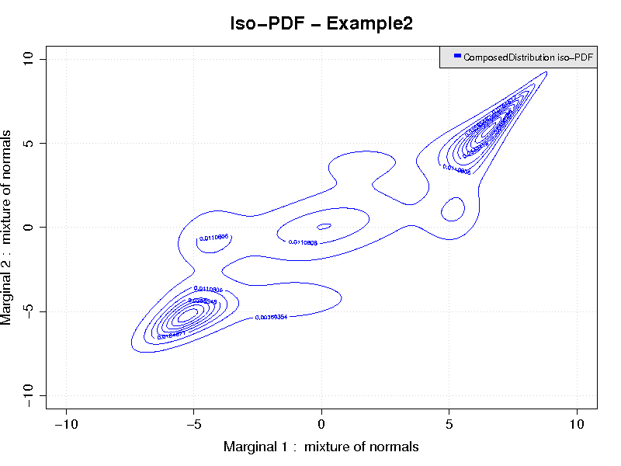
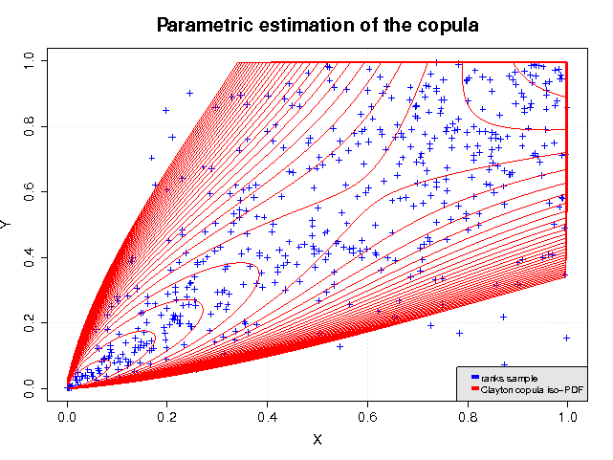
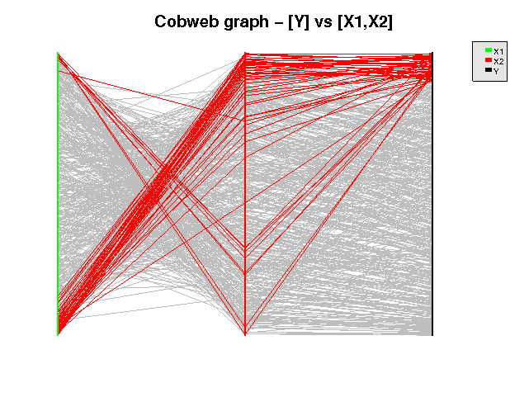
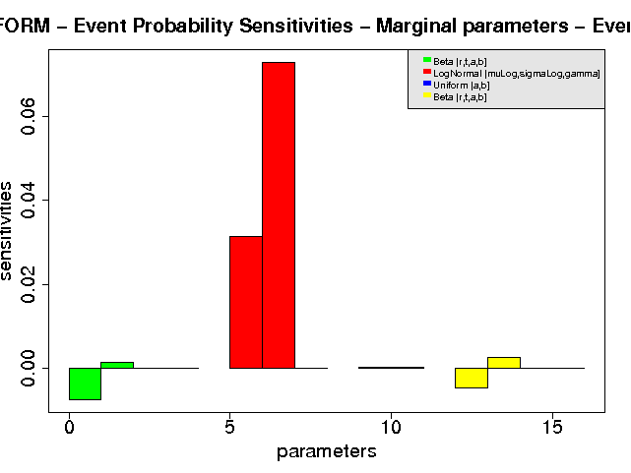
OpenTURNS in pictures

Slide 17
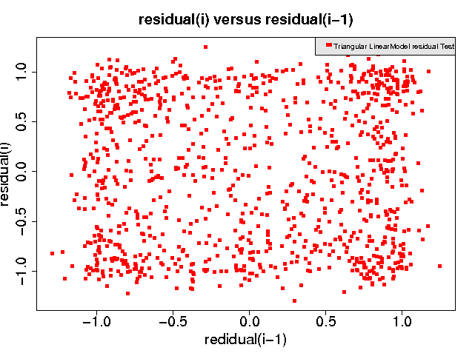
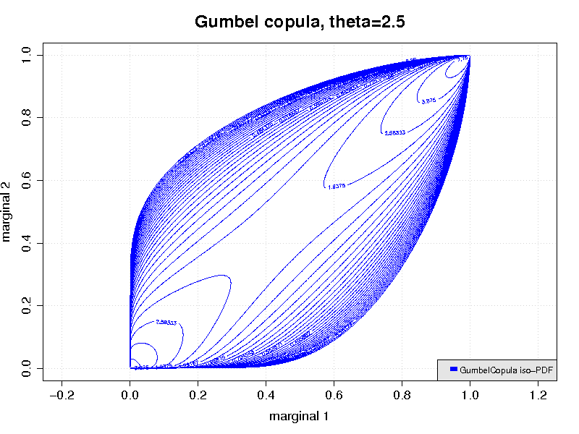
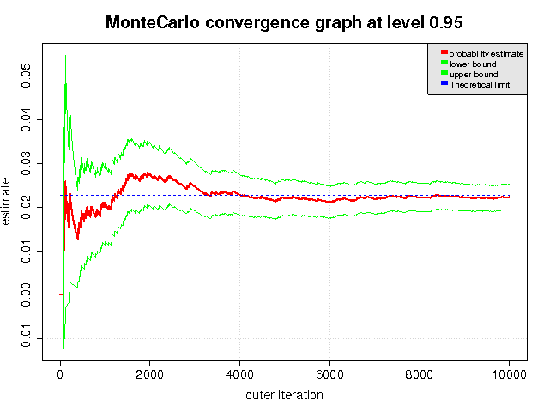
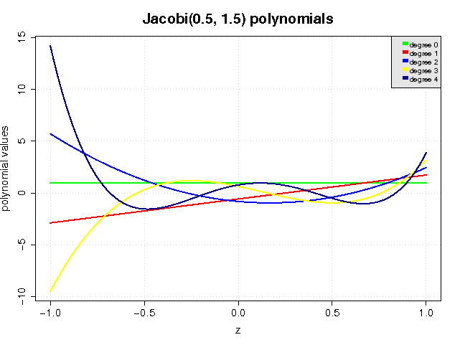
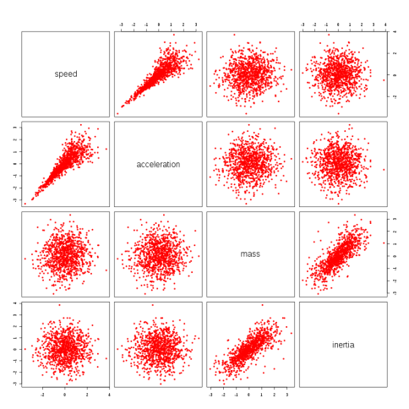
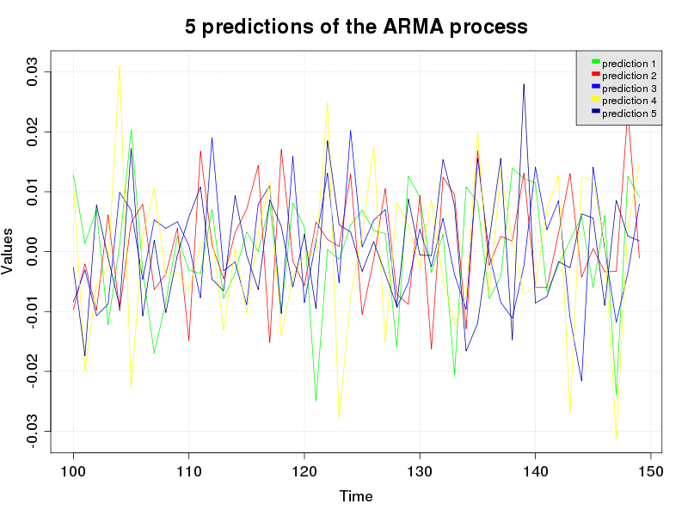
OpenTURNS in pictures

Slide 18
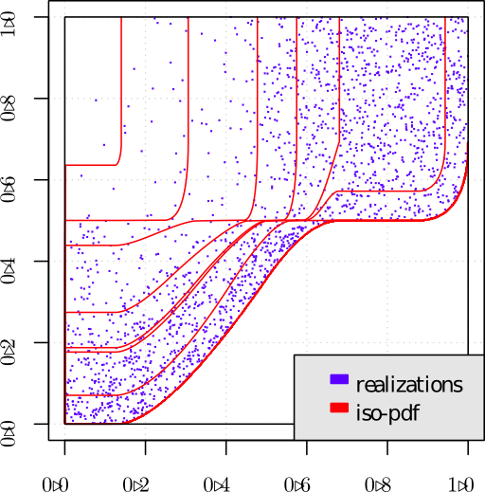
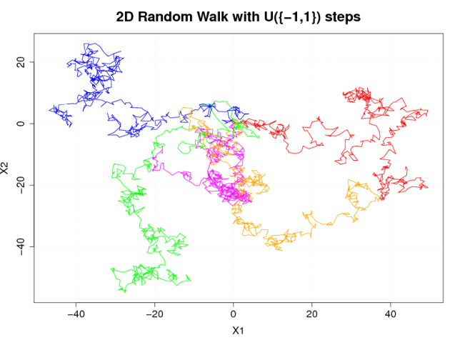
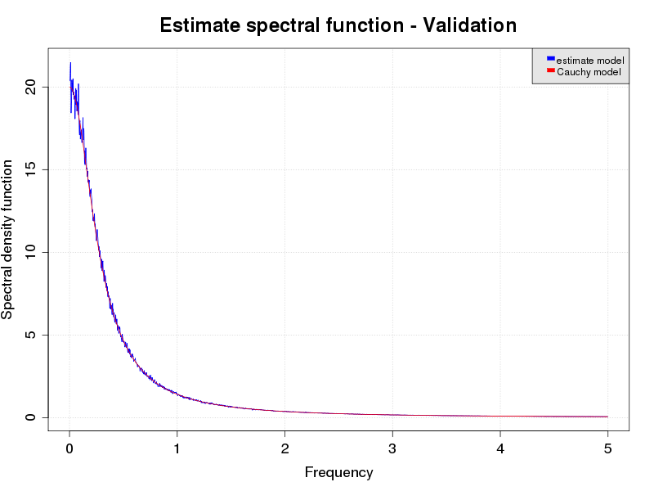
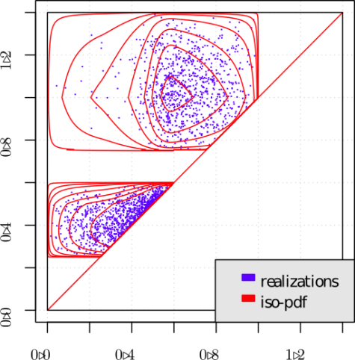
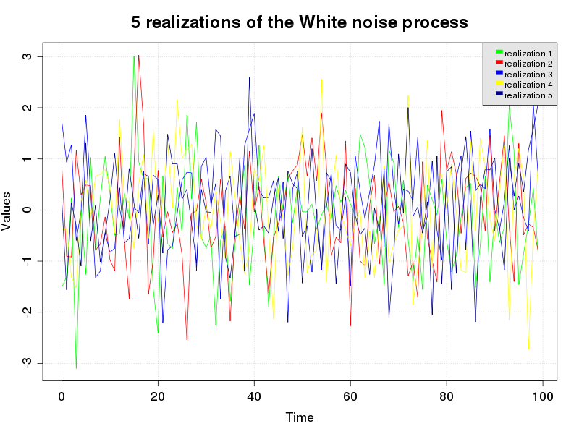
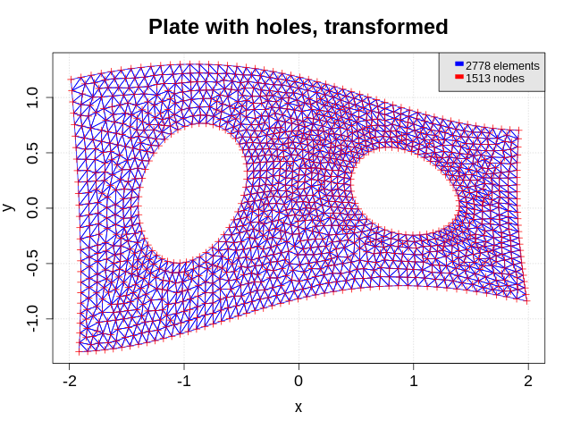
OpenTURNS in pictures

Slide 19
Outline
Overview of OpenTURNS
Doc and Users
OT in pictures
OT in practice

Slide 20

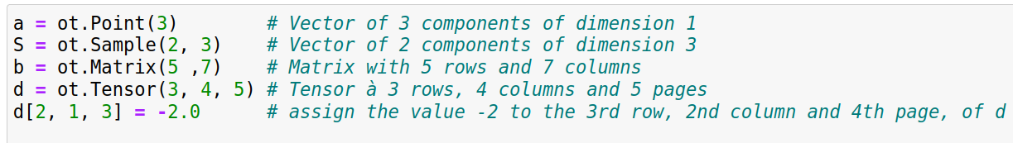

Basic commands in OT (1/3)‏
Importation of OpenTURNS functionalities
Mathematical objects

Slide 21
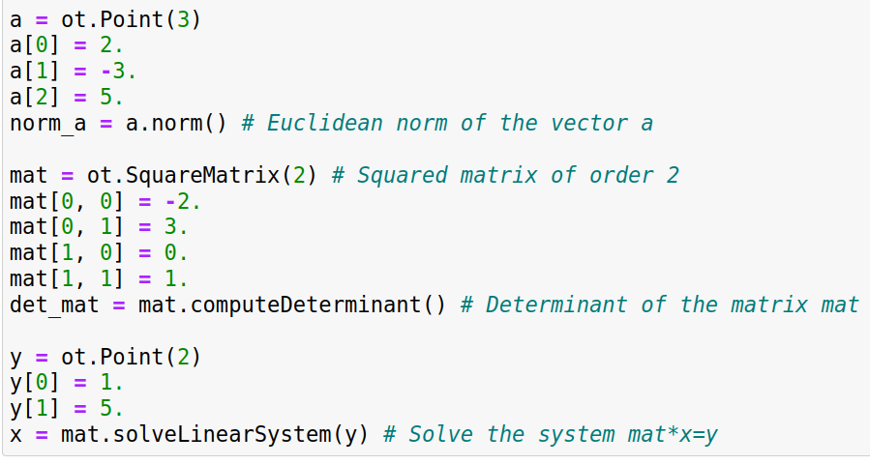
Basic commands in OT (2/3)‏
Methods
G. Blondet – Maison de la simulation – May, 10-12 2021

Slide 22
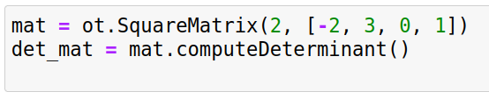
Basic commands in OT (3/3)‏
Methods
« () » at the end of the method
Name of the method
« . » between the objet and the method
Objet relative to the method
G. Blondet – Maison de la simulation – May, 10-12 2021

Slide 23
Example of uncertainty propagation
Bending beam under uniform loading
p
E, I
L
Maximal displacement
Probabilistic model
parameter | Symbol | Distribution | Mean | Standard Deviation
Length [mm] | L | Lognormal | 5000 | 50
Young modulus [MPa] | E | Lognormal | 30000 | 4500
Inertia [mm⁴] | I | Lognormal | 10⁹ | 10⁸
Load [N/mm] | p | Lognormal | 10 | 3
G. Blondet – Maison de la simulation – May, 10-12 2021

Slide 24
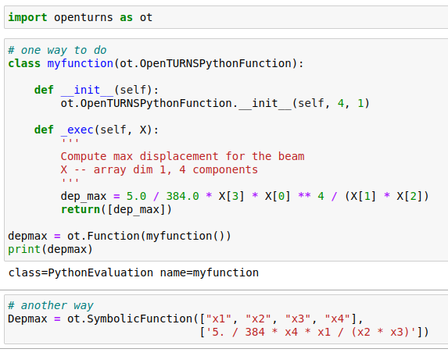
Model function
Defining a Function
G. Blondet – Maison de la simulation – May, 10-12 2021

Slide 25
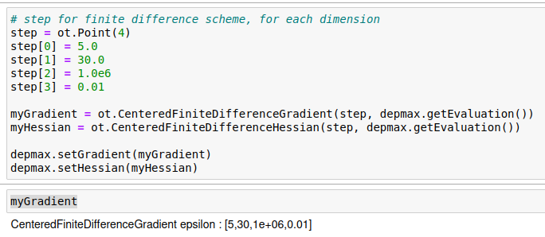
Defining the derivatives
Centered Finite difference
G. Blondet – Maison de la simulation – May, 10-12 2021

Slide 26
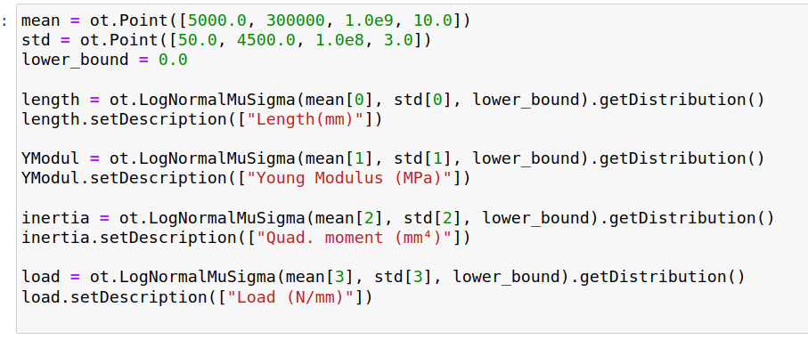
Defining the probabilistic model
1 – Define the marginals
G. Blondet – Maison de la simulation – May, 10-12 2021

Slide 27
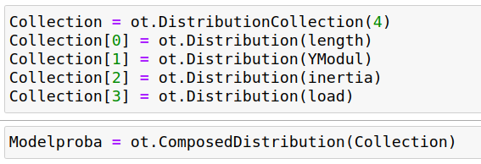
Defining the probabilistic model
2 – Define the composed distribution
G. Blondet – Maison de la simulation – May, 10-12 2021

Slide 28
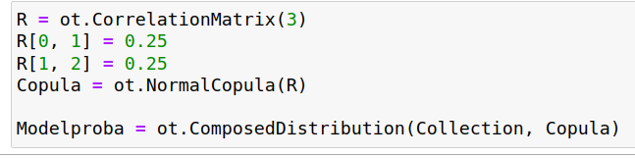
Defining the probabilistic model
2 bis – Define the correlation
If the variables are dependent, a copula can be added.
G. Blondet – Maison de la simulation – May, 10-12 2021

Slide 29
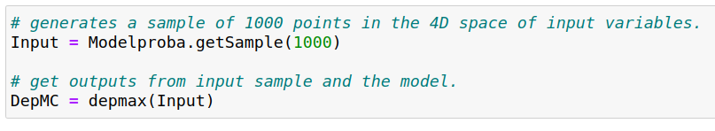
Propagation using MC simulations
3 - Get input and output
G. Blondet – Maison de la simulation – May, 10-12 2021

Slide 30
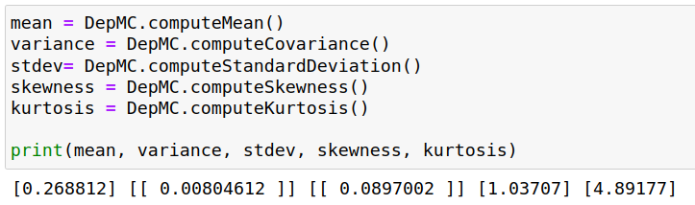
Result of the MC simulation
Estimation of the 4 first moments of the displacement
G. Blondet – Maison de la simulation – May, 10-12 2021

Slide 31
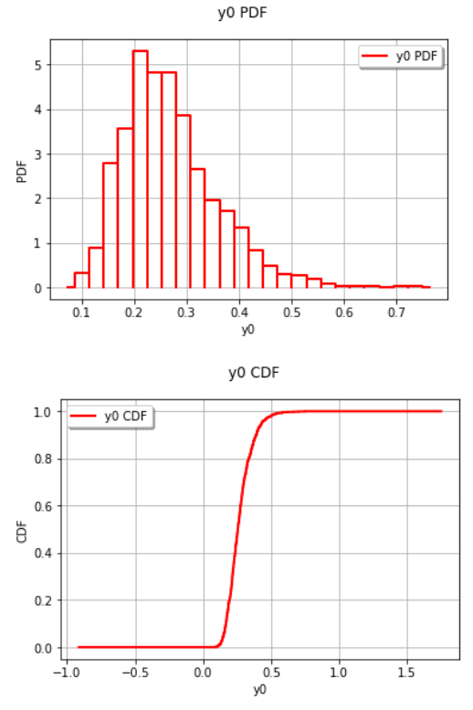
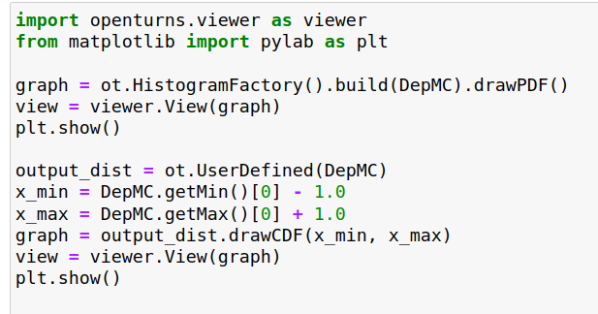
Histogram and empirical CDF
Graphs on the sample DepMC
G. Blondet – Maison de la simulation – May, 10-12 2021

Slide 32
