Slide 1


Probability theory basics
Gaëtan Blondet, Phimeca Engineering SA
‘HPC and Uncertainty Treatment – Examples with Open TURNS and Uranie’
EDF – Phimeca – Airbus Group – IMACS – CEA
PRACE Advanced Training Center – May, 12-14 2020

Slide 2
Motivation
Uncertainty includes variability, randomness and lack-of-knowledge.
Aleatory uncertainty
Lack of control over environmental variability and test settings, errors made during testing.
Can be better characterized but cannot be reduced with more measurements or simulations.
Epistemic uncertainty
Lack-of-knowledge and assumptions made during testing and modeling.
Can be reduced by collecting more information and evidence.
Note: Other theories have been developed to represent epistemic uncertainty such as Imprecise Theory (IP), Possibility theory, Fuzzy sets and fuzzy logic.
These sources of uncertainty can be modeled thanks to probability theory

Slide 3
Outline
General definitions
Random variables
Definitions
Cumulative distribution function and probability density function
Moments
Confidence intervals (CI)
Random vectors
Definitions
Moments
Copulas

Slide 4
Outline
General definitions
Random variables
Definitions
Cumulative distribution function and probability density function
Moments
Confidence intervals (CI)
Random vectors
Definitions
Moments
Copulas

Slide 5

Definitions
Random experiment
Repeatable procedure leading to possible outcomes.
Sample space Ω
Set of all possible outcomes of the experiment.
Event
Set of outcomes of an experiment (a subset of Ω).

Slide 6
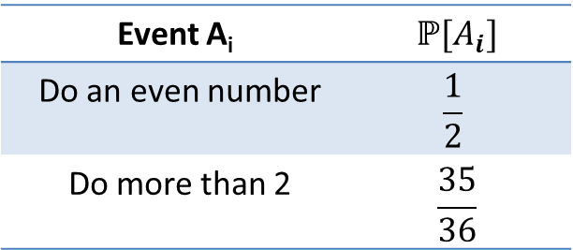
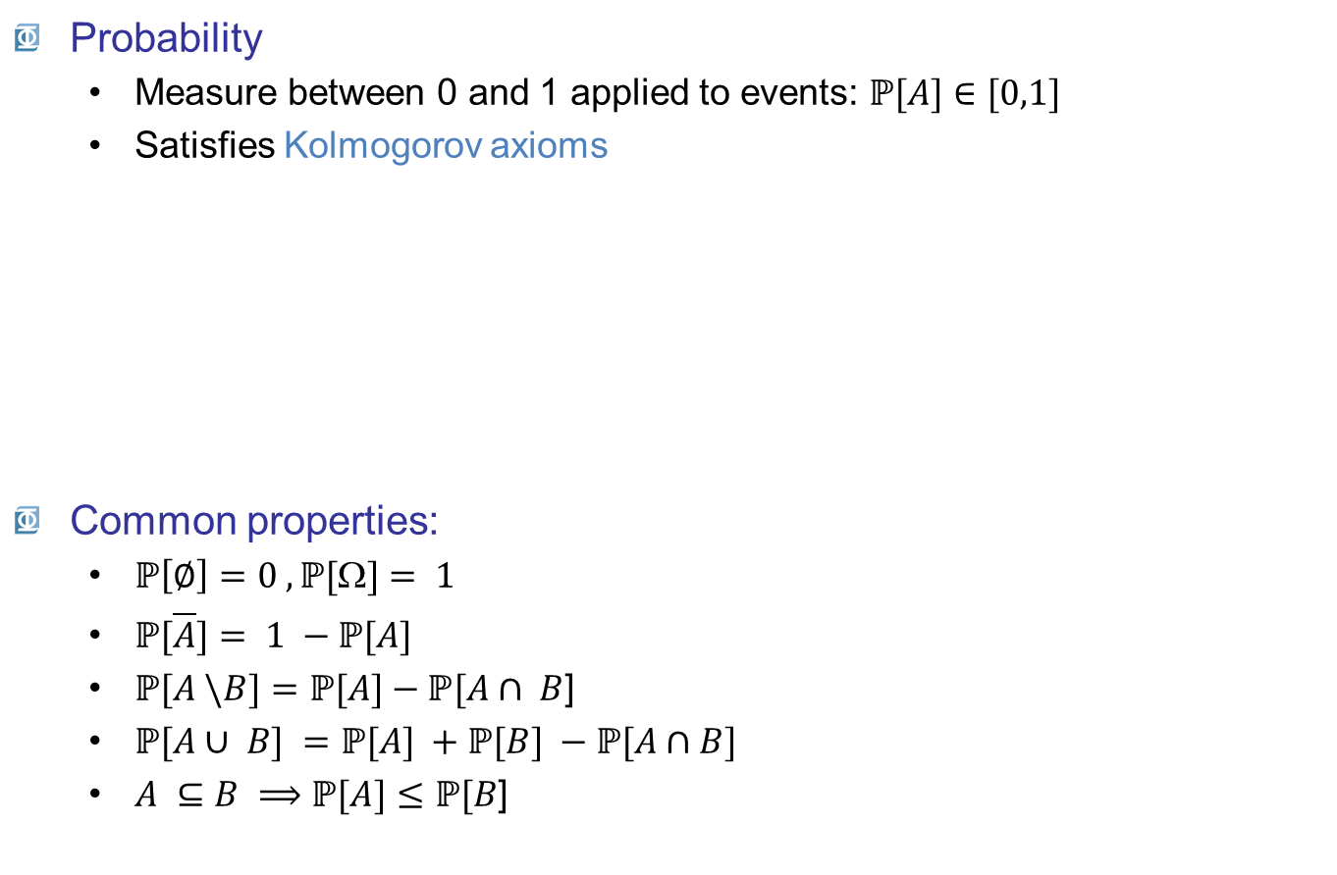
Definitions
Probability
Measure between 0 and 1 applied to events: $ℙ[A]∈[0,1]$
Satisfies Kolmogorov axioms
Common properties:
$ℙ\left[∅\right]=0 , ℙ[\text{W}]= 1$
$ℙ[\overline{A}]= 1 −ℙ[A]$
$ℙ[A \backslash B]=ℙ[A]−ℙ[A∩ B$]
$ℙ[A∪ B] =ℙ[A] +ℙ[B] −ℙ[A∩B]$
$A ⊆B ⟹ℙ[A]≤ℙ[B$]
Throwing 2 dice
Event A_{i} | $$ℙ[A_{i}]$$
Do an even number | $$\frac{1}{2}$$
Do more than 2 | $$\frac{35}{36}$$
B
Ω
A

Slide 7

Definitions
Conditional probability
probability of $A$ given $B$
$$ℙ[A|B]=\frac{ℙ[A∩ B]}{ℙ[B] }$$
Independence
B does not affect the probability of A, and vice versa:
$ℙ[A|B]=ℙ[A]⟹ℙ[A∩ B]=ℙ[A]ℙ[B$]

Slide 8

Definitions
Bayes’ theorem
Shows the probability of $A$ updated by the knowledge of $B$
Defined from the conditional probability definition
$$ℙ[A|B] = \frac{ℙ\left[B | A\right]}{ℙ[B\text{]} } ℙ[A]$$
Initial probability of A
Influence of the information
contained in B

Slide 9

Definitions
Frequentist interpretation of probabilities
Probabilities can be estimated by N observations
$$ℙ[A]=\lim_{N →∞}{\frac{N_{A}}{N}}$$

Slide 10
Outline
General definitions
Random variables
Definitions
Cumulative distribution function and probability density function
Moments
Confidence intervals (CI)
Random vectors
Definitions
Moments
Copulas

Slide 11

Random variables
Definition
A random variable (r.v.) $X$is a measurable function
$$\begin{matrix}X :Ω ⟶𝒟_{X} \\ ω ⟼x=X(ω)\end{matrix}$$
Can be discrete $(𝒟_{X}⊆ℤ$) or continuous ($𝒟_{X}⊆ℝ$)

Slide 12













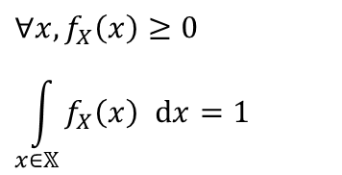




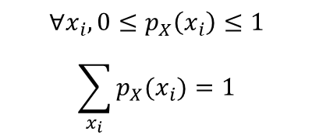
Random variables
Probability Density Function (PDF)
Discrete: probability mass function
Continuous: probability density function
$$p_{X}\left(x_{i}\right)=ℙ[X=x_{i}]$$
$$p_{X}\left(x\right)$$
$$ℙ[X=x_{4}]$$
$$∀x_{i}, 0≤p_{X}\left(x_{i}\right)≤1$$
$$\sum_{x_{i}}{p_{X}(x_{i})}=1$$
$$0$$
$$x_{1}$$
$$x_{2}$$
$$x_{3}$$
$$x_{4}$$
$$x_{5}$$
$$x$$
$$f_{X}\left(x\right) \text{dx}=ℙ[x<X+\text{dx}]$$
$$f_{X}\left(x\right)$$
$$∀x, f_{X}\left(x\right)≥0$$
$$\int_{x∈𝕏}{f_{X}\left(x\right) }dx=1$$
$$ℙ\left[x<X≤x+dx\right]$$
$$0$$
$$x$$
$$x+dx$$
$$x$$

Slide 13




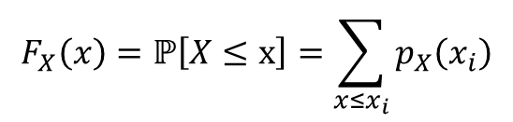






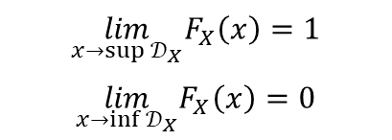






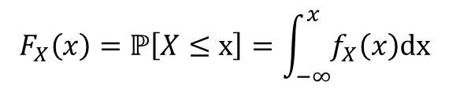
Random variables
Cumulative Distribution Function (CDF)
Discrete
Continuous
$$F_{X}\left(x\right)=ℙ\left[X≤x\right]=\sum_{x≤x_{i}}{p_{X}\left(x_{i}\right)}$$
$$F_{X}\left(x\right)$$
$$1$$
$$9/10$$
$$\lim_{x→sup{𝒟_{X}}}F_{X}\left(x\right)=1$$
$$\lim_{x→inf{𝒟_{X}}}F_{X}\left(x\right)=0$$
$$7/10$$
$$4/10$$
$$1/10$$
$$0$$
$$x_{1}$$
$$x_{2}$$
$$x_{3}$$
$$x_{4}$$
$$x_{5}$$
$$x$$
$$F_{X}\left(x\right)=ℙ\left[X≤x\right]=\int_{−∞}^{x}{f_{X}\left(x\right)\text{dx}}$$
$$F_{X}\left(x\right)$$
$$1$$
$$f_{X}\left(x\right)=\frac{dF_{X}\left(x\right)}{dx}$$
$$0$$
$$x$$
$$x$$

Slide 14
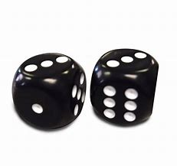


Random variables
Cumulative Distribution Function (CDF)
Discrete: Sum of 2 dice: Ω → {2,…,12}
Continuous: Wind speed: $Ω⟶ℝ^{+}$

Slide 15





Random variables
Sum of 2 independent random variables
Let S the sum of two independent continuous r.v. $X$ and $Y$ :
$$S =X + Y$$
The P.D.F of $S$ is the convolution of the two separate P.D.F of $X$ and $Y$.
Where: $f_{S}\left(y\right)=\int{f_{X}\left(x\right)f_{Y}\left(x−y\right)\text{d}x}$
$$f_{S}=f_{X}∗f_{Y}$$
Easier with characteristic functions
The convolution is commutative: $f_{X}∗f_{Y}=f_{Y}∗f_{X}$

Slide 16
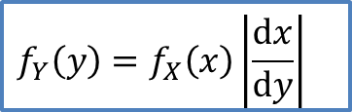

Random variables
Theorem of « composition of laws »
Let $X$ be a continuous r.v. and φ a continuously differentiable strictly monotonic function.
Then, the P.D.F. of $Y = φ(X)$ is:
$$f_{Y}\left(y\right)=f_{X}\left(x\right)\left|\frac{dx}{dy}\right|$$

Slide 17


Random variables
Characterization of a random variable
A probability distribution is characterized by its moments :
central value
dispersion
shape (asymmetry, shift, etc.)
$$f_{X}\left(x\right)$$
Centrale value
shape
dispersion
$$x$$

Slide 18

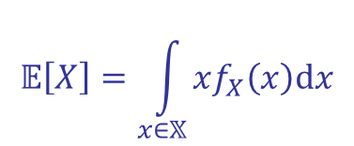
Random variables
Expected value (mean)
Case of discrete random variables:
$$𝔼\left[X\right]=\sum_{x_{i}}{x_{i}p_{X}(x_{i})}$$
Case of continuous random variables:
(if the sum converges)
$$𝔼\left[X\right]=\int_{x∈𝕏}{xf_{X}\left(x\right)\text{d}x}$$
(if the integral converges)

Slide 19
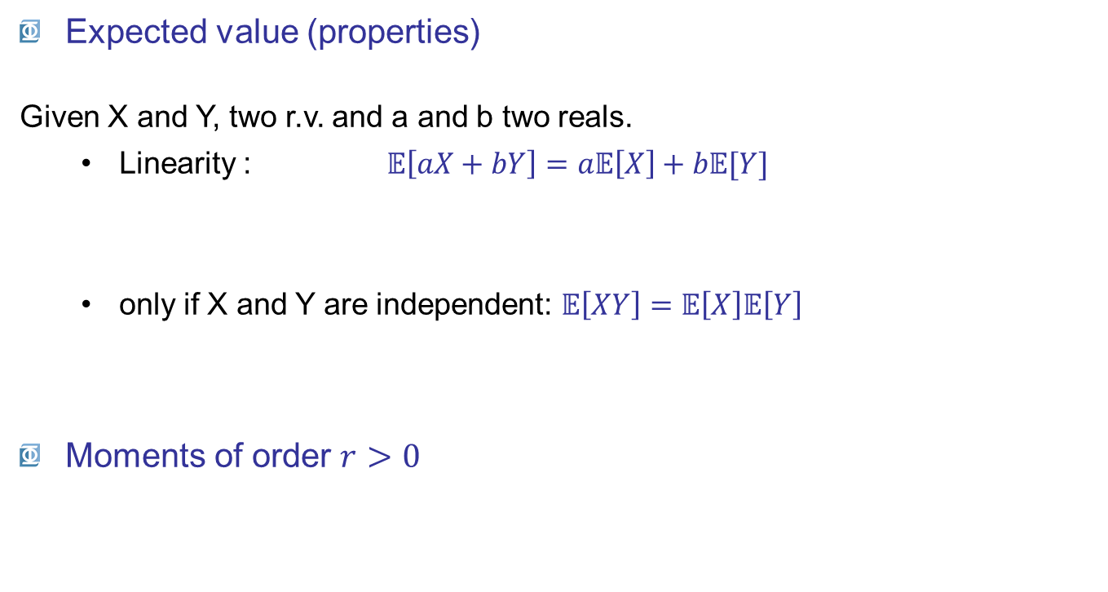
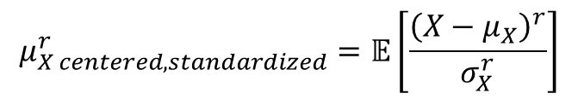


Random variables
Expected value (properties)
Given X and Y, two r.v. and a and b two reals.
Linearity : $𝔼\left[aX+bY\right]=a𝔼\left[X\right]+b𝔼[Y]$
only if X and Y are independent: $𝔼\left[XY\right]=𝔼\left[X\right]𝔼\left[Y\right]$
Moments of order $r>0$
$$μ_{X}^{r}=𝔼[X^{r}]$$
$$μ_{X centered}^{r}=𝔼[{(X−μ_{X})}^{r}]$$
$$μ_{X centered, standardized}^{r}=𝔼\left[\frac{{\left(X−μ_{X}\right)}^{r}}{σ_{X}^{r}}\right]$$

Slide 20



Random variables
r = 1 : Expected value (mean)
r = 2 : Variance
Dispersion around the mean
Coefficient of variation $\text{c}\text{.}\text{o}\text{.}\text{v}\text{.}=\frac{σ_{X}}{\left|μ_{X}\right|}, μ_{X}≠0$
$$μ_{X}=𝔼\left[X^{1}\right]=𝔼[X]$$
$$σ_{X}^{2}=\text{Var} \left[X\right]=𝔼\left[{\left(X−μ_{X}\right)}^{2}\right]$$
(if it exists, cf Cauchy distribution)

Slide 21
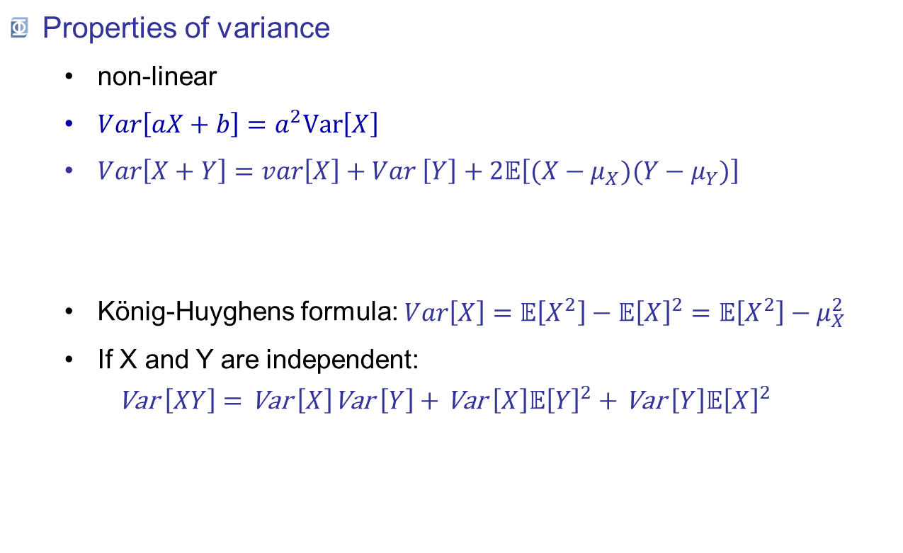


Random variables
Properties of variance
non-linear
$Var\left[aX+b\right]=a^{2}\text{Var}\left[X\right]$
$Var\left[X+Y\right]=var\left[X\right]+Var \left[Y\right]+2𝔼\left[(X−μ_{X})(Y−μ_{Y})\right]$
König-Huyghens formula: $\begin{matrix}Var\left[X\right]=𝔼\left[X^{2}\right]−𝔼{\left[X\right]}^{2}=𝔼\left[X^{2}\right]−μ_{X}^{2}\end{matrix}$
If X and Y are independent:
$$\text{Var} \left[XY\right]=\text{Var} \left[X\right]\text{Var} \left[Y\right]+\text{Var} \left[X\right]𝔼{\left[Y\right]}^{2}+\text{Var} \left[Y\right]𝔼{\left[X\right]}^{2}$$
$$Cov[X,Y]$$

Slide 22



Random variables
r = 3 : Skewness
(a)symmetry of the distribution
$$δ_{X}=𝔼\left[\frac{{\left(X−μ_{X}\right)}^{3}}{σ_{X}^{3}}\right]$$
r = 4 : Kurtosis
flattening of the distribution
$$κ_{X}=𝔼\left[\frac{{\left(X−μ_{X}\right)}^{4}}{σ_{X}^{4}}\right]$$
Symmetric distribution: $δ_{X}$= 0, as normal distribution
Normal distribution: $κ_{X}= 3$

Slide 23

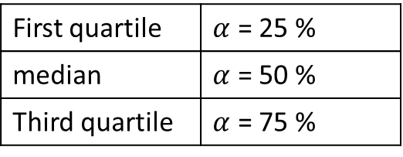
Random variables
Quantiles
The quantile $xα$ at probability level $α$, is
Confidence intervals
To sum up the variability of a r.v. bounded by two quantiles centered on the median.
Confidence interval at the probability level of $1 – α$:
$$F_{X}\left(x_{α}\right)=α ⇒ x_{α}=F_{X}^{−1}\left(α\right), 0≤α≤1$$
First quartile | $α$ = 25 %
median | $α$ = 50 %
Third quartile | $α$ = 75 %
$$\left[x_{α/2}; x_{1−α/2}\right]=\left[F_{X}^{−1}\left(α/2\right);F_{X}^{−1}\left(1−α/2\right) \right], 0≤α≤1$$

Slide 24
Outline
General definitions
Random experiment – Event
Measurable space
Kolmogorov axioms
Bayes’ theorem
Random variables
Definitions
Cumulative distribution function (CDF) and probability density function (PDF)
Discrete / continuous random variables
Statistical moments
Confidence intervals (CI)
Random vectors
Definitions
Moments
Copulas

Slide 25
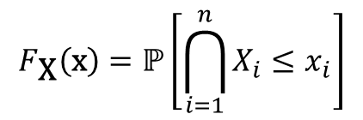
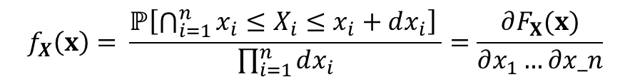
Random variables
Definition
A random vector is a measurable function
Defined by:
Its joint cumulative distribution function
Its joint probability density function
$$\begin{matrix}\text{X} :Ω→𝕏⊆ℝ^{n} \\ ω ↦\text{x}=\text{X}\left(ω\right)={\left(X_{1}(ω),…,X_{n}\left(ω\right)\right)}^{t}\end{matrix}$$
$$F_{\text{X}}\left(\text{x}\right)=ℙ\left[\bigcap_{i=1}^{n}{X_{i}≤x_{i}}\right]$$
$$f_{X}\left(x\right)= \frac{ℙ\left[\bigcap_{i=1}^{n}{x_{i}≤X_{i}≤x_{i}+dx_{i}}\right] }{\prod_{i=1}^{n}{dx_{i}}}=\frac{∂F_{X}(x)}{∂x_{1}…∂x_n}$$

Slide 26
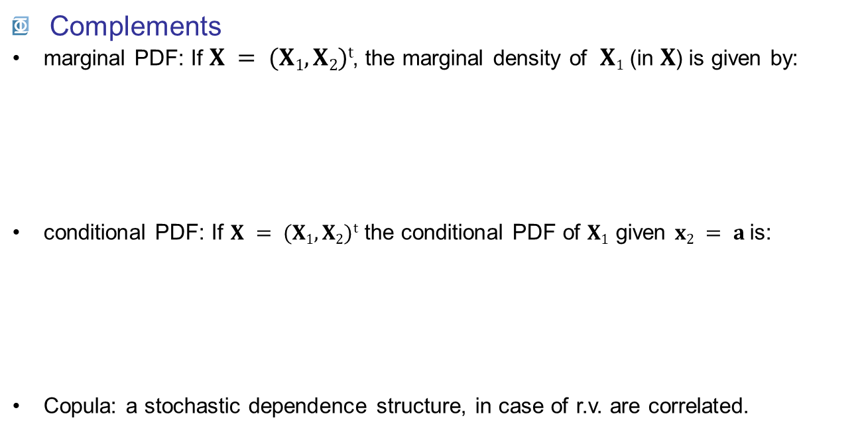
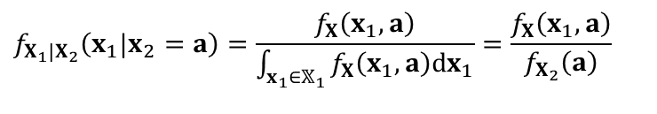
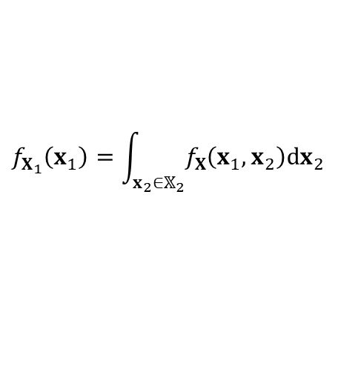
Random vectors
Complements
marginal PDF: If $X = (X1, X2)t$, the marginal density of $X1$ (in $X$) is given by:
conditional PDF: If $X = (X1, X2)t$the conditional PDF of $X1$ given $x2 = a$is:
Copula: a stochastic dependence structure, in case of r.v. are correlated.
$$f_{X_{1}}\left(x_{1}\right)=\int_{x_{2}∈𝕏_{2}}{f_{X}\left(x_{1},x_{2}\right)dx_{2}}$$
$$f_{X_{1}|X_{2}}\left(x_{1}|x_{2}=a\right)=\frac{f_{X}\left(x_{1},a\right)}{\int_{x_{1}∈𝕏_{1}}{f_{X}\left(x_{1},a\right)dx_{1}}}=\frac{f_{X}\left(x_{1},a\right)}{f_{X_{2}}\left(a\right)}$$

Slide 27
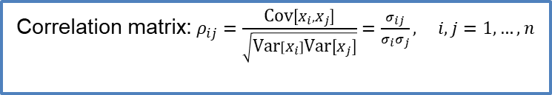

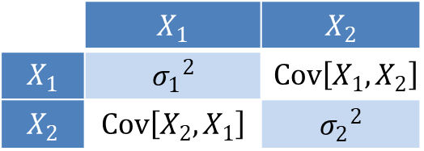
Random vectors
Moments
Expected value: vector of expected values of random variables
Covariance matrix:
$$𝔼\left[\text{X}\right]={\left(𝔼\left[X_{i}\right], i=1,…, n\right)}^{t}$$
$σ_{ij}=Cov\left[X_{i},X_{j}\right]=$ $𝔼\left[{(X}_{i}−{μ_{X}}_{i})(X_{j}−μ_{X_{j}})\right], i,j=1,…, n$
 | $$X_{1}$$ | $$X_{2}$$
$$X_{1}$$ | $${σ_{1}}^{2}$$ | $$Cov\left[X_{1},X_{2}\right]$$
$$X_{2}$$ | $$Cov\left[X_{2},X_{1}\right]$$ | $${σ_{2}}^{2}$$
Correlation matrix:$ρ_{ij}=\frac{\text{Cov}\left[X_{i},X_{j}\right]}{\sqrt{\text{Var}\left[X_{i}\right]\text{Var}\left[X_{j}\right]}}=\frac{σ_{ij}}{σ_{i}σ_{j}}, i,j=1,…,n$

Slide 28
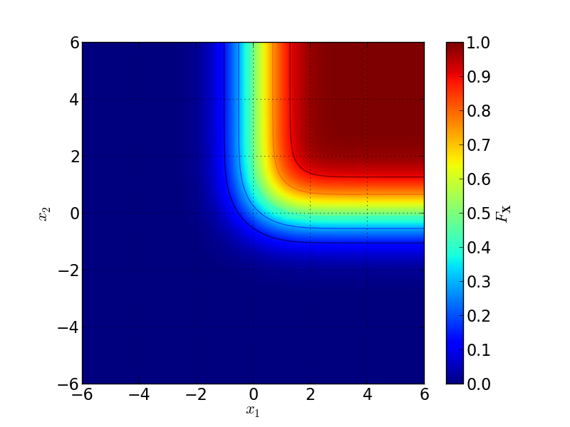
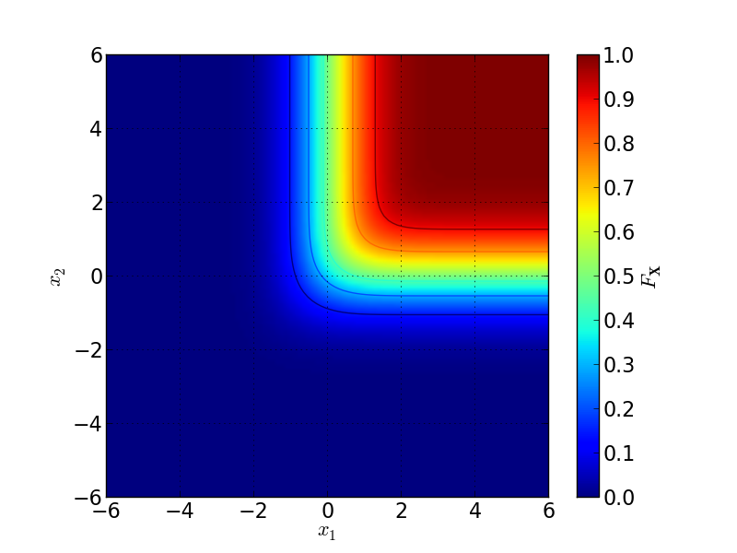
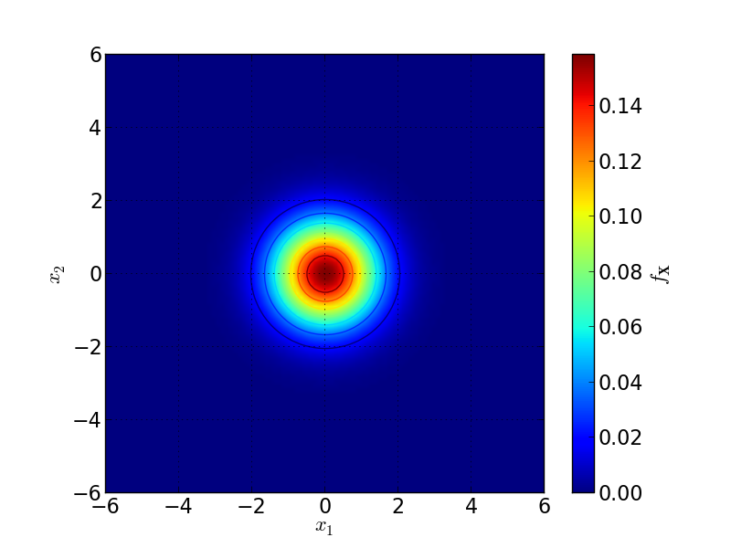
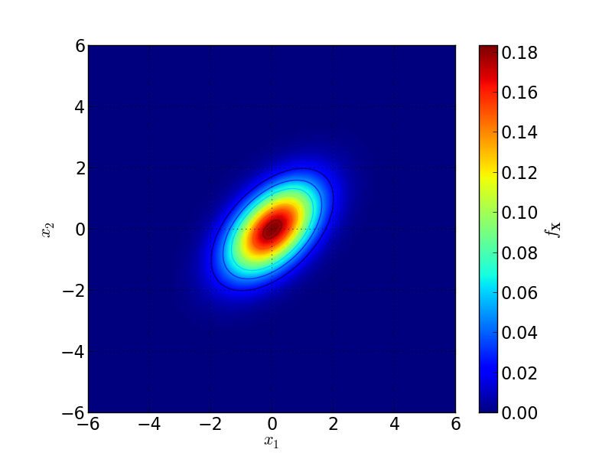

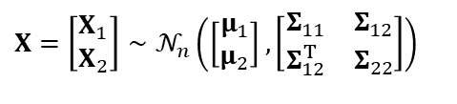

Random vectors
Multivariate normal distribution
$$X=\left[\begin{matrix}X_{1} \\ X_{2}\end{matrix}\right]∼𝒩_{n}\left(\left[\begin{matrix}μ_{1} \\ μ_{2}\end{matrix}\right],\left[\begin{matrix}Σ_{11} & Σ_{12} \\ Σ_{12}^{T} & Σ_{22}\end{matrix}\right]\right)$$
$$μ=\left[\begin{matrix}0 \\ 0\end{matrix}\right],Σ=\left[\begin{matrix}1 & 0 \\ 0 & 1\end{matrix}\right]$$
$$μ=\left[\begin{matrix}0 \\ 0\end{matrix}\right],Σ=\left[\begin{matrix}1 & 0,5 \\ 0,5 & 1\end{matrix}\right]$$

Slide 29
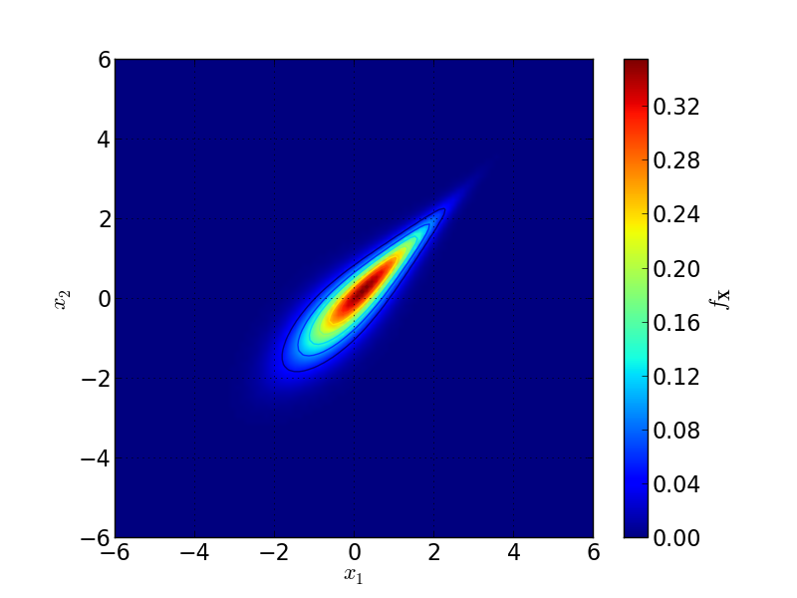

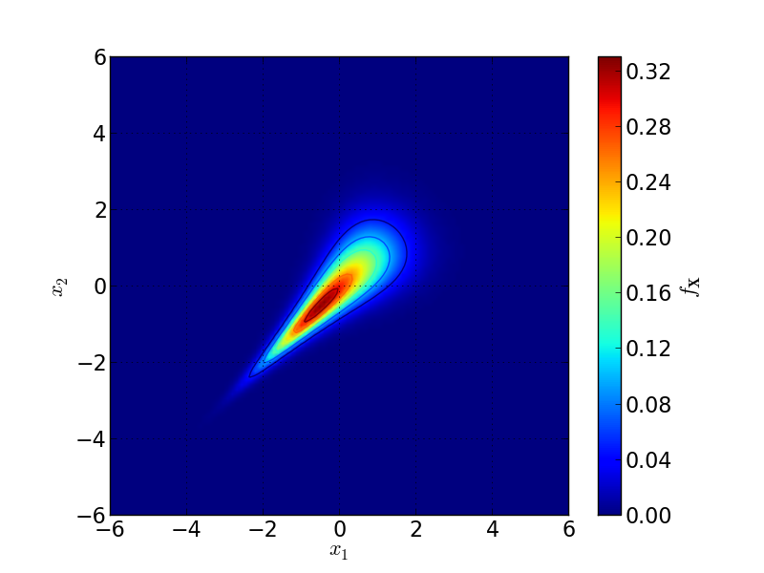
Random vectors
Multivariate normal distribution with copulas
Gaussienne (ρ₀ = 0,5)
Gumbel (θ = 3)
Frank (θ = 3)
Clayton (θ = 3)

Slide 30
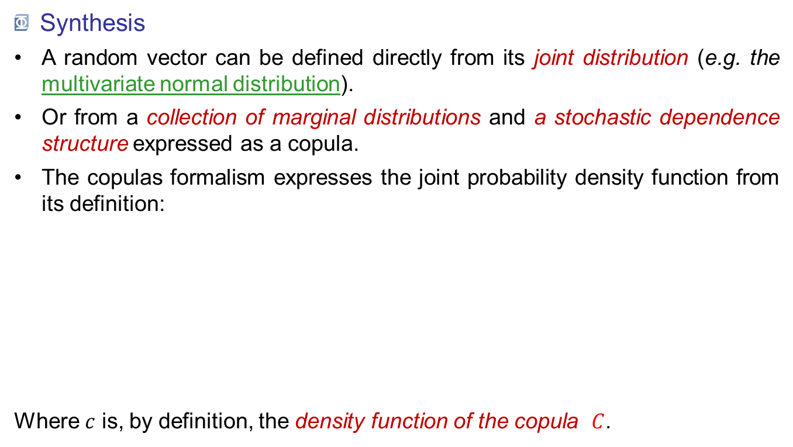
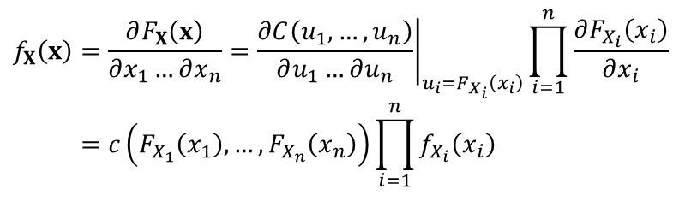
Random vectors
Synthesis
A random vector can be defined directly from its joint distribution (e.g. the multivariate normal distribution).
Or from a collection of marginal distributions and a stochastic dependence structure expressed as a copula.
The copulas formalism expresses the joint probability density function from its definition:
Where $c$ is, by definition, the density function of the copula $C$.
$$f_{X}\left(x\right)=\frac{∂F_{X}\left(x\right)}{∂x_{1}…∂x_{n}}={\left.\frac{∂C\left(u_{1},…,u_{n}\right)}{∂u_{1}…∂u_{n}}\right|}_{u_{i}=F_{X_{i}}\left(x_{i}\right)}\prod_{i=1}^{n}{\frac{∂F_{X_{i}}\left(x_{i}\right)}{∂x_{i}}} \\ =c\left(F_{X_{1}}\left(x_{1}\right),…,F_{X_{n}}\left(x_{n}\right)\right)\prod_{i=1}^{n}{f_{X_{i}}\left(x_{i}\right)}$$

