Slide 1



OpenTURNS and HPC within SALOME platform O. Mircescu EDF R&D
HPC and Uncertainty Treatment
Examples with OpenTURNS
EDF – PhiMeca – IMACS – Airbus Group – CEA
Prace Advanced Training Center
May 12th 2019

Slide 2
OUTLINE
Presentation of Salome
Persalys – graphical user interface for OpenTURNS
Step by step example
Persalys – distribution and future evolutions

Slide 3

Presentation of Salome (1/5)
What’s Salome ?
Modular simulation platform
An open framework to build domain specific solutions
Who is developing Salome ?
EDF, CEA and OpenCascade partnership

Slide 4
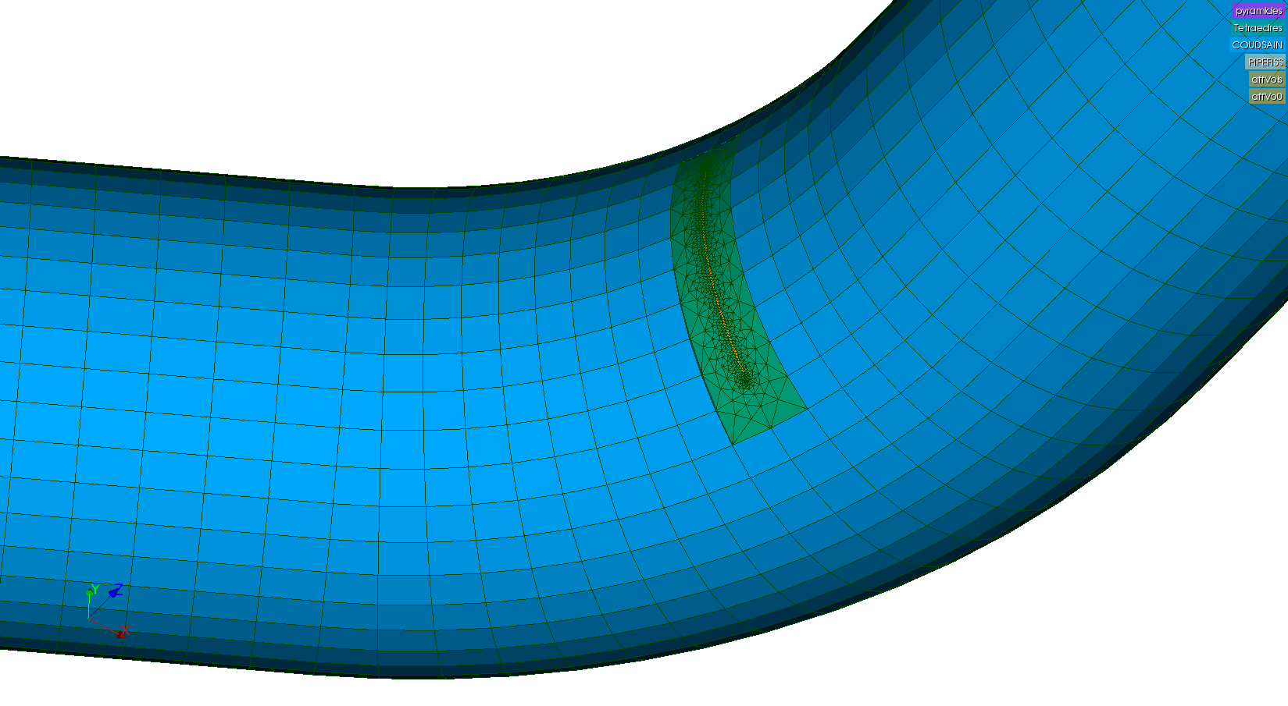
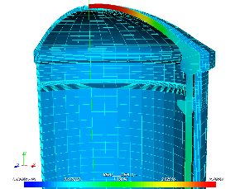
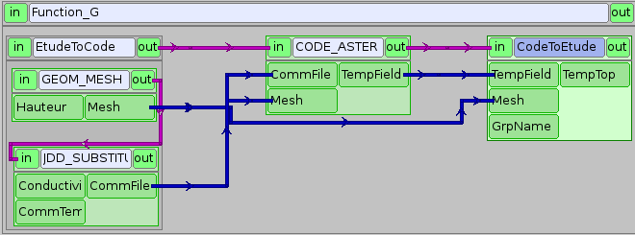
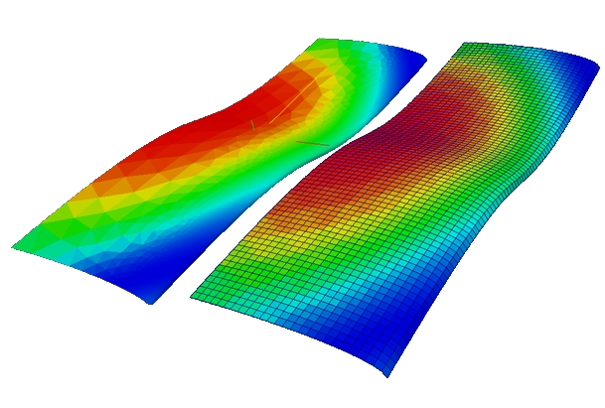
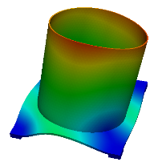
Presentation of Salome (2/5)
A middleware providing generic tools for numerical simulations
Geometry modelling, meshing, field handling and visualization
Data Exchange Model for interoperability between solvers and tools
Computation scheduling (YACS)
3D Modelling
(CAD, meshing, visualization)
Computation scheduling
(workflow, distribution)
Complex data processing
(fields, matrix, etc)
+
+
= SALOME Platform

Slide 5
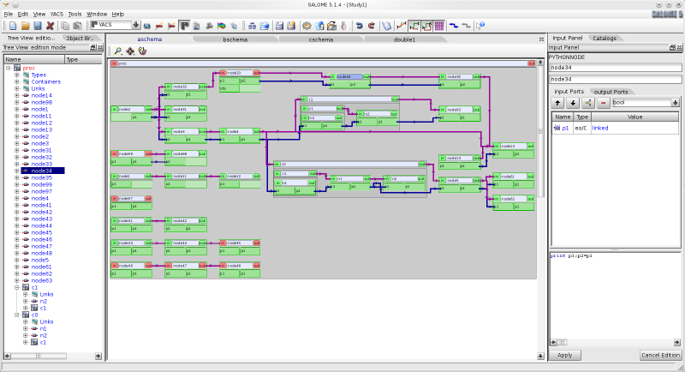
Presentation of Salome (3/5)
Presentation of YACS
Distribution of computations on multiple resources
Parallelism and parametric computation
Chaining computation nodes
GUI and APIs for Python and C++

Slide 6
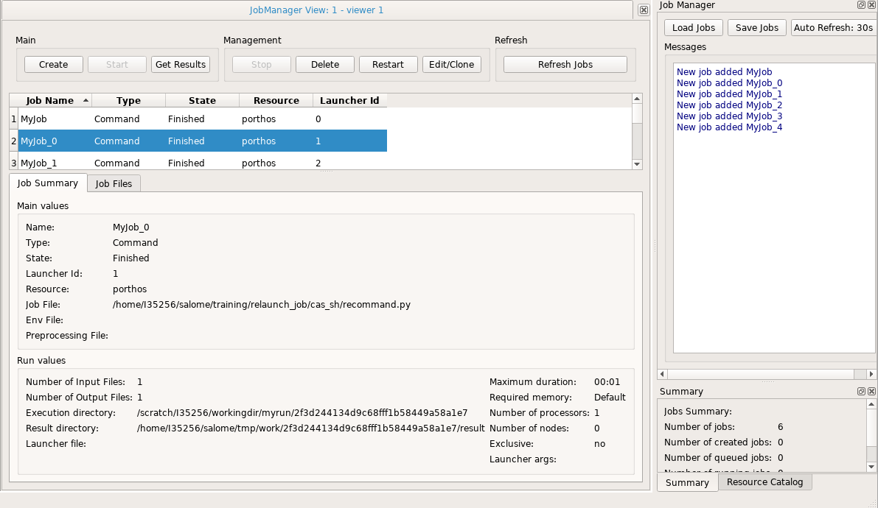
Presentation of Salome (4/5)
Presentation of JOBMANAGER
Create, launch and monitor jobs on computer clusters
Single interface for several batch managers (Slurm, PBS, COORM, OAR, SGE, LSF)
GUI and APIs for Python and C++
Jobs can run scripts or YACS schemas

Slide 7
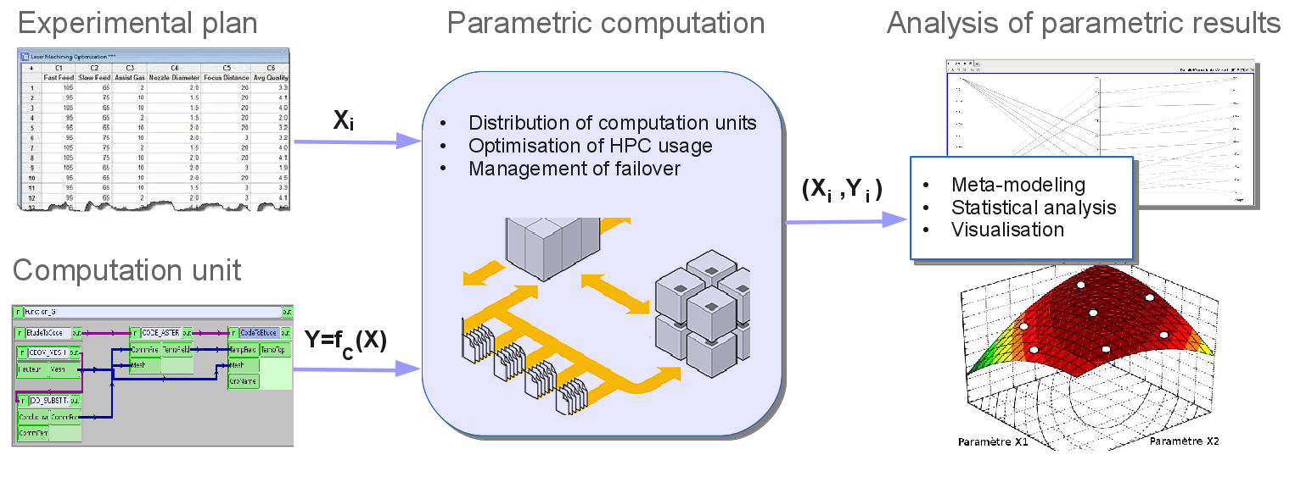
Presentation of Salome (5/5)
Parametric layer
Simplified interface for parametric studies
Uses YACS and JOBMANAGER

Slide 8
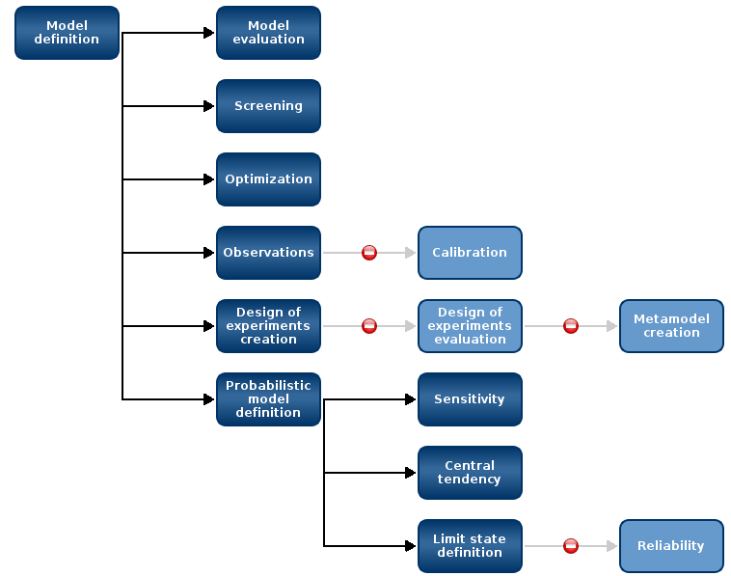
Persalys (1/5)
Graphical user interface for OpenTURNS
Guide the user in a homogeneous environment through the roadmap defined by the global methodology of treatment of uncertainties

Slide 9
Persalys (2/5)
Persalys is more than a simple GUI !
Persalys is based on a high level object model (study workflow)
Persalys includes a layer over OpenTURNS tools.
Persalys has been designed to mix beginners and advanced users
How can you use it ?
Standalone binary (persalys)
In a dedicated salome module (Persalys)
Can be used in a customized salome module (ASTER STUDY, CFD STUDY)

Slide 10
Persalys (3/5)
Two complementary ways to pilot Persalys : Python and widgets
The design of Persalys allows a strong relationship between Python scripting and graphical interface (Model/View paradigm).
Actions you perform on gui can be mapped into a Python representation.
Load python script and dump python script.
Start session with graphical interface then continue with script then…
Persalys offers software bricks usable outside a dedicated tool

Slide 11
Persalys (4/5)
Persalys is an excellent target for High Performance Computing (HPC)
A large number of independent evaluations
Salome features used by Persalys:
Manage a catalog of available computation resources
Make the evaluations parallel and distributed
Communicate with the batch manager
Define the job parameters
Submit and keep track of a job
Define the execution environment
Define a working directory
Copy data from the local workstation to the remote cluster
Fetch the results

Slide 12
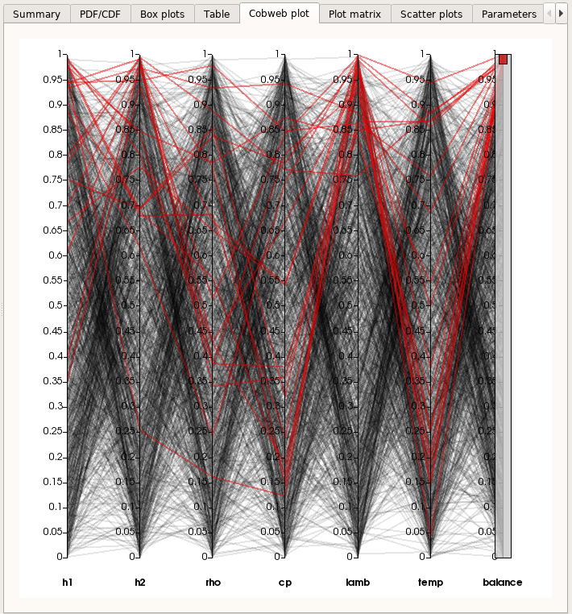
Persalys (5/5)
SALOME software bricks used by Persalys
YACS & JOBMANAGER
GUI Python console widget
PARAVIS widgets

Slide 13
a study step by step
Install and configure Salome
Define the function to be studied
Create a model (YACS or python models in the GUI)
Define the laws of input parameters
Choose the type of study (central tendency, etc.)
Choose the execution parameters
Run the study and wait for results
Analyse the results

Slide 14
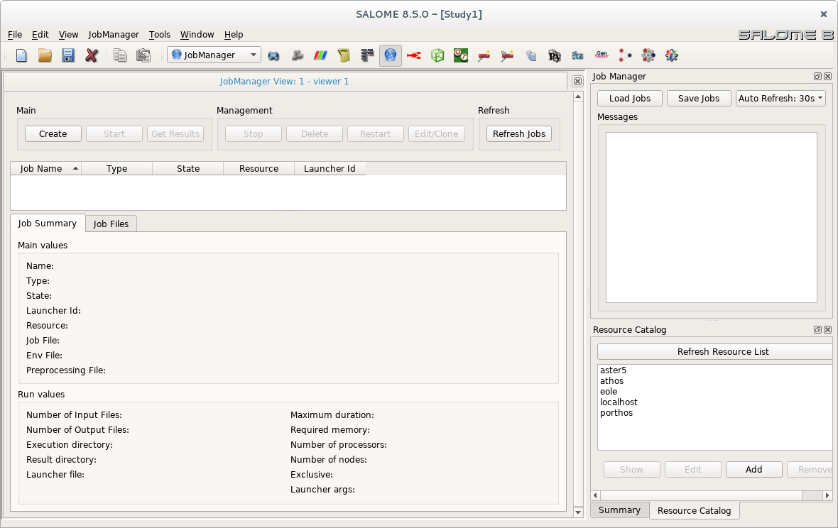
Install and configure Salome
Installation steps
Install Salome on your personal computer
https://www.salome-platform.org/contributions/edf_products
Install Salome on the remote cluster
Make sure you can connect to cluster without typing the password (ssh-copy-id)
Declare the cluster installation in your local resource catalog (JOBMANAGER module)
1st click
2nd click

Slide 15
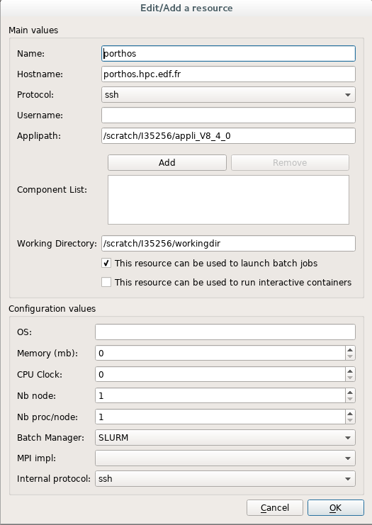
Configure available resources
Salome resources
Salome has to be installed on every machine you want to use
You have to declare each installation in your local catalog of resources
Main parameters:
Name
IP adresse
User name
Path to Salome installation
Batch manager

Slide 16
Define the function to be studied
Identify uncertain parameters – inputs and outputs of your study
Use the python language
Input parameters must be only float variables
Return statement must contain only float variables
The name of the function should be “_exec”
The python function should:
Generate the input files for the solver based on the input parameters
Create a specific working directory for each execution of the function
Launch the solver
Retrieve the results from the output files of the solver
Test your function

Slide 17
Example of a study function
Syrthes : thermal radiation solver
Heat exchange computation with SYRTHES
def _exec(h1, h2, rho, cp, lamb):
e = Study(h1, h2, rho, cp, lamb)
e.defineWorkDirectory()
if not e.caseExists():
e.prepareCase()
e.runCase()
temp, balance = e.getResults()
return temp, balance
h1 T1
Face S1
h2 T2
Face S2
Heat exchange coefficient: h1, h2
Conductivity: lamb
Density: rho
Heat capacity: cp

Slide 18


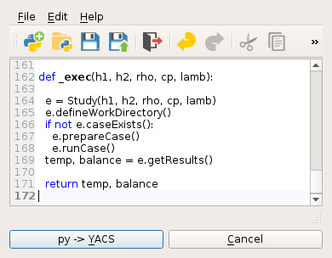
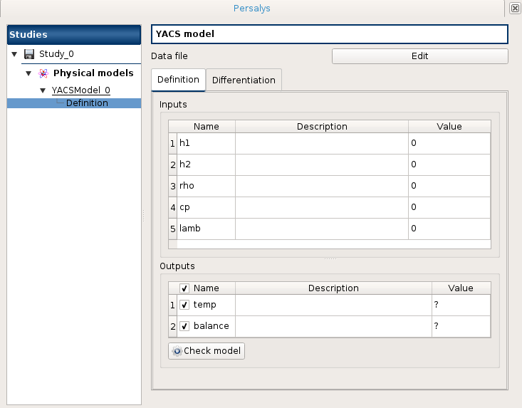
Create a model
Open the Persalys module in a Salome session
Create a new study with a YACS model
Set the python script in the YACS model

Slide 19
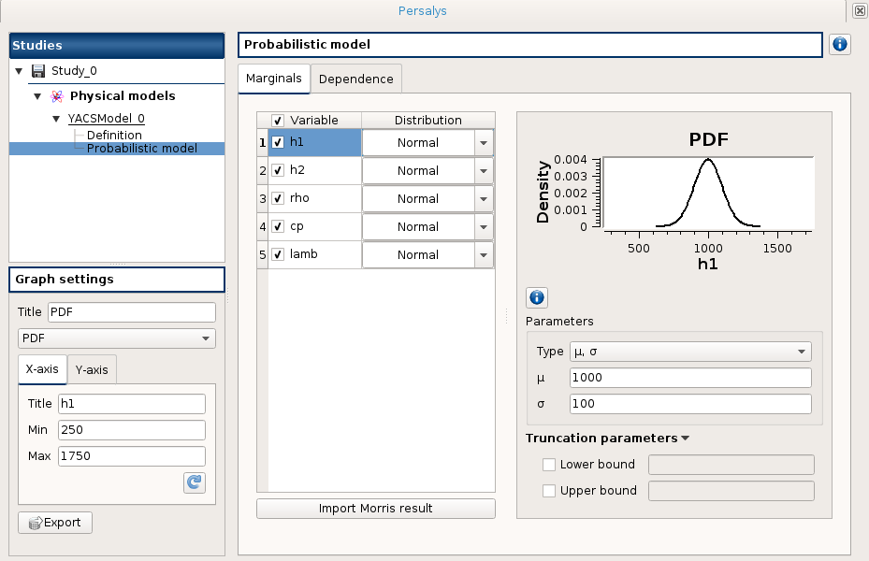
Define the laws of input parameters
Probabilistic model
User design of experiments

Slide 20
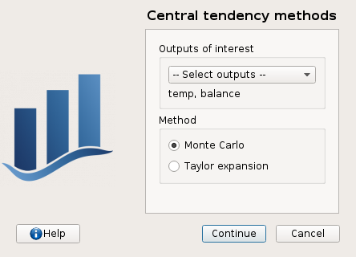
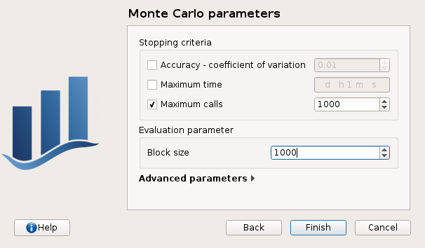
Choose the type of study

Slide 21
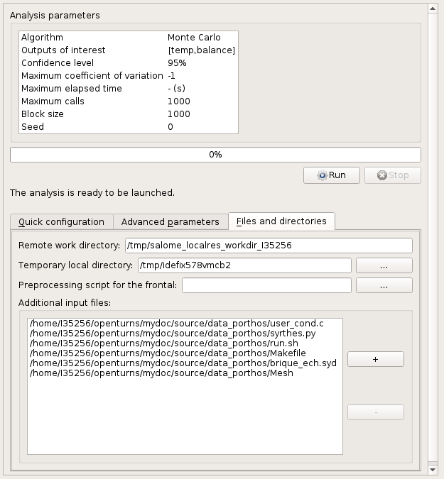
Run the study and wait for results
Choose
Computing resource
Job parameters
Number of nodes
Time to execute
Etc.
Remote working directory
Local files to be copied to the remote working directory

Slide 22
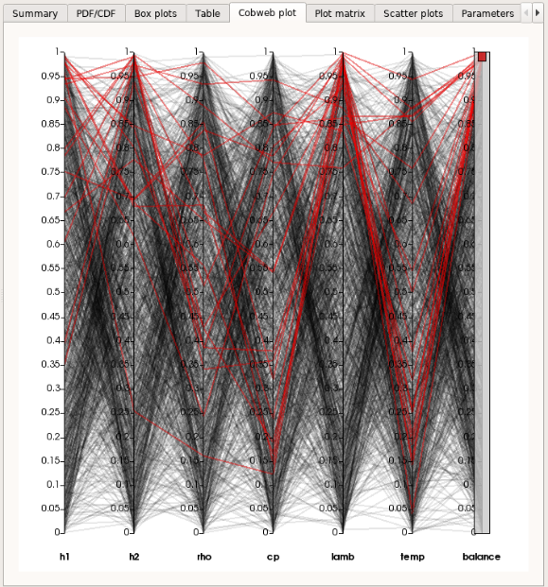
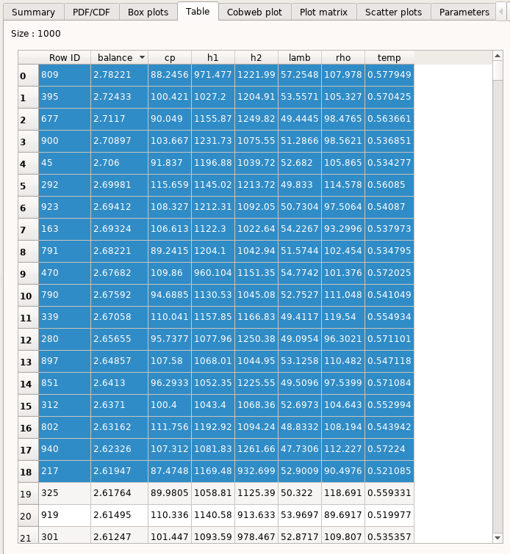
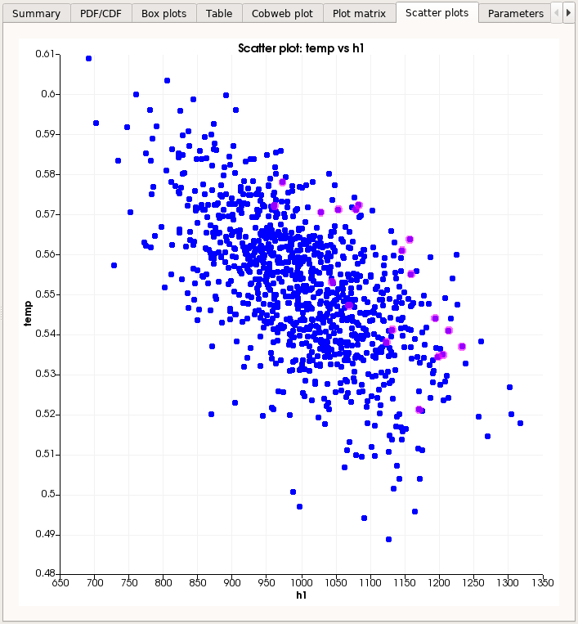
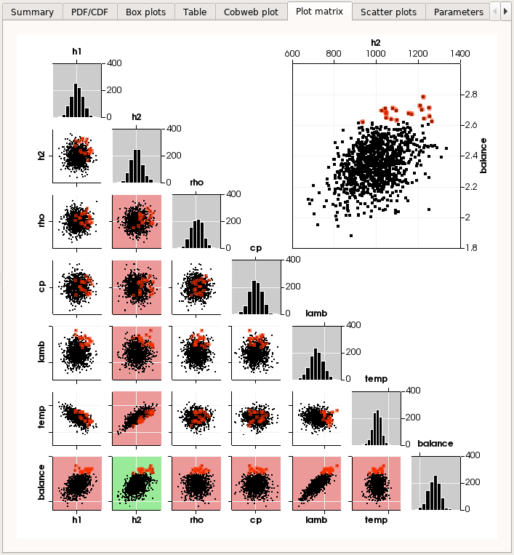
Result analysis tools
Box plots, Cobweb plot, Plot matrix, Scatter plots

Slide 23
Persalys - Distribution and future evolutions (1/2)
Distribution of SALOME + OpenTURNS platform
LGPL license for the whole platform (SALOME + OpenTURNS + Persalys)
Download SALOME platform with OpenTURNS here:
http://www.salome-platform.org/contributions/copy_of_combs
Persalys is also available stand alone, but without the support for launching on remote resources

Slide 24
Persalys - Distribution and future evolutions (2/2)
Improvements to come
Launch, leave and reconnect to a job
Avoid multiple job submissions for one OpenTURNS study
Management of a partially executed study
Management of failed computations

Slide 25
Questions?

