Slide 1


Rare events probability estimation
Gaëtan Blondet, Phimeca Engineering SA
‘HPC and Uncertainty Treatment – Examples with Open TURNS and Uranie’
EDF – Phimeca – Airbus Group – IMACS – CEA
PRACE Advanced Training Center – May, 27-29 2019

Slide 2

Outline
Problem definition
Brute-force estimation using Monte Carlo sampling
Importance sampling
Isoprobabilistic transformation
Most-probable-failure-point(s)-based methods

Slide 3
Outline
Problem definition
Brute-force estimation using Monte Carlo sampling
Importance sampling
Isoprobabilistic transformation
Most-probable-failure-point(s)-based methods

Slide 4
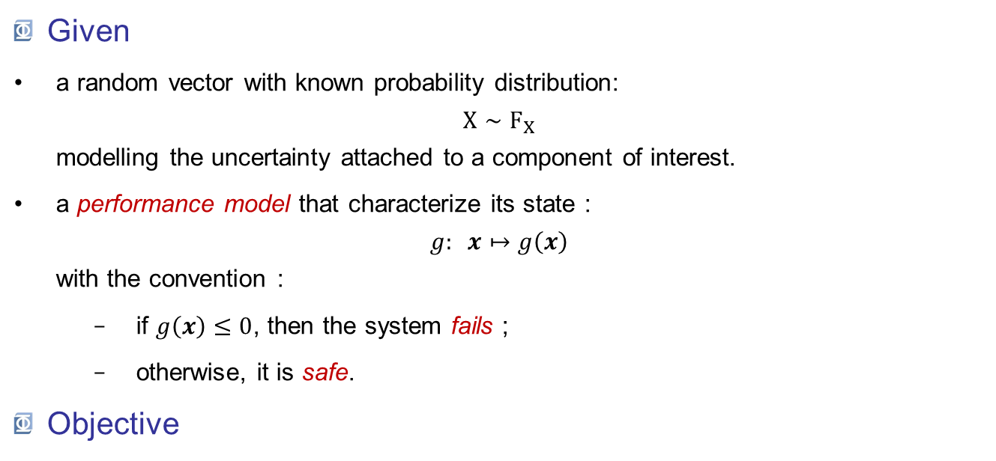
Problem definition
Given
a random vector with known probability distribution: $X∼F_{X}$ modelling the uncertainty attached to a component of interest.
a performance model that characterize its state : $g: x↦g\left(x\right)$ with the convention :
if $g\left(x\right)≤0$, then the system fails ;
otherwise, it is safe.
Objective
Quantify the component safety level in the form of a (subjective) failure probability.
« subjective probability » = A probability that is condionned by assumptions/choices (probabilistic + performance models)

Slide 5
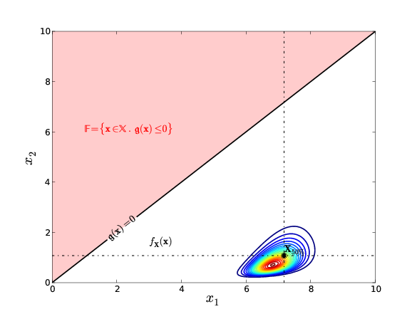
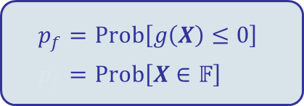
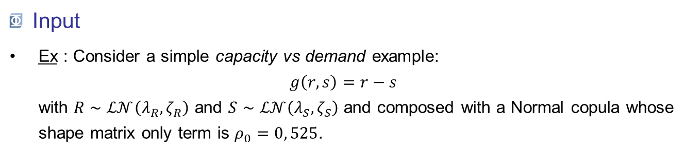
Problem definition
Input
Ex : Consider a simple capacity vs demand example: $g\left(r,s\right)=r−s$ with $R∼ℒ𝒩\left(λ_{R},ζ_{R}\right)$ and $S∼ℒ𝒩\left(λ_{S},ζ_{S}\right)$ and composed with a Normal copula whose shape matrix only term is $ρ_{0}=0, 525$.
« Failure domain »
« Limit-state function »
$$p_{f}=Prob\left[g\left(X\right)≤0\right] \\ p_{f}=Prob\left[X∈𝔽\right]$$
« Safe domain »

Slide 6
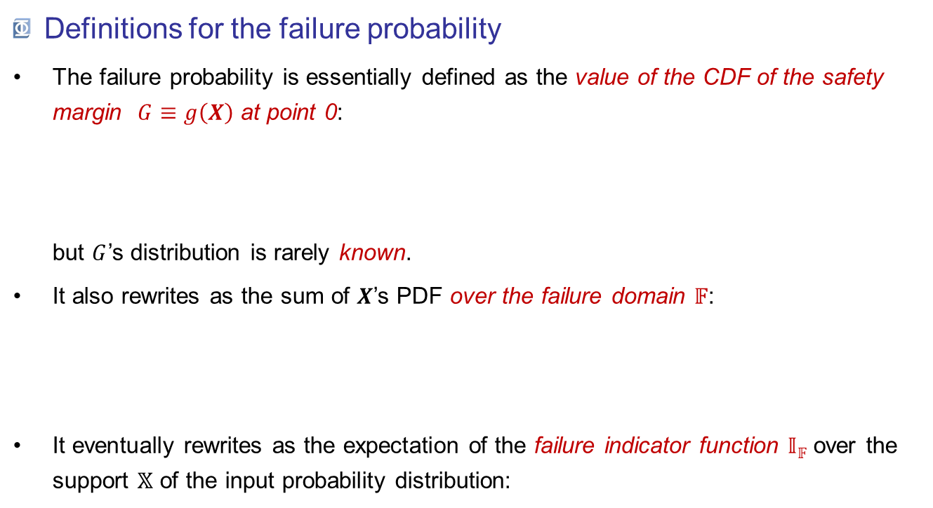
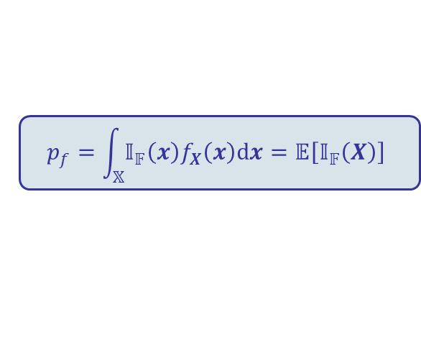
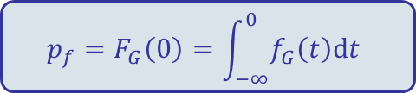
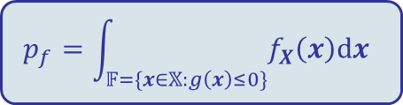
Problem definition
Definitions for the failure probability
The failure probability is essentially defined as the value of the CDF of the safety margin $G≡g\left(X\right)$ at point 0: but $G$’s distribution is rarely known.
It also rewrites as the sum of $X$’s PDF over the failure domain 𝔽:
It eventually rewrites as the expectation of the failure indicator function 𝕀_{𝔽} over the support 𝕏 of the input probability distribution:
$${p_{f}=F}_{G}\left(0\right)=\int_{−∞}^{0}{f_{G}\left(t\right)dt}$$
$$p_{f}=\int_{𝔽=\{x∈𝕏:g\left(x\right)≤0\}}{f_{X}\left(x\right)dx}$$
$$p_{f}=\int_{𝕏}{{𝕀_{𝔽}\left(x\right)f}_{X}\left(x\right)dx}=𝔼\left[𝕀_{𝔽}\left(X\right)\right]$$

Slide 7
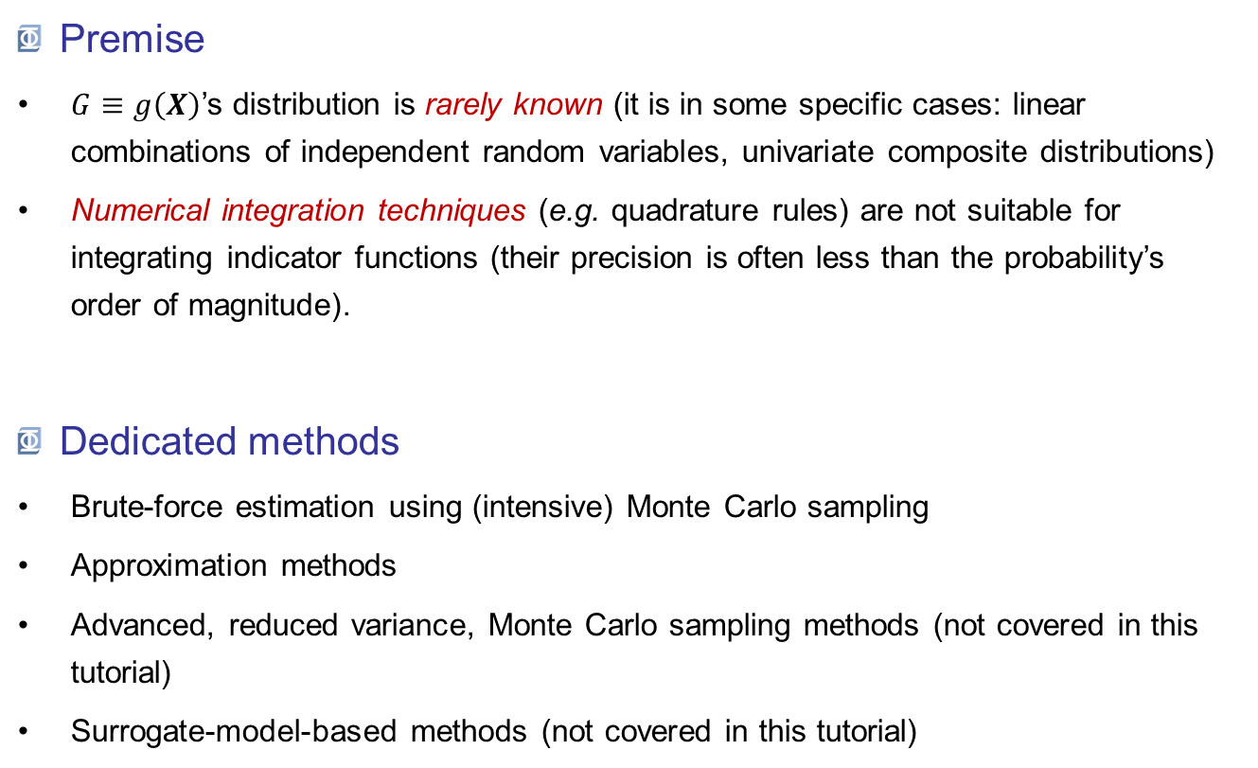
Problem definition
Premise
$G≡g\left(X\right)$’s distribution is rarely known (it is in some specific cases: linear combinations of independent random variables, univariate composite distributions)
Numerical integration techniques (e.g. quadrature rules) are not suitable for integrating indicator functions (their precision is often less than the probability’s order of magnitude).
Dedicated methods
Brute-force estimation using (intensive) Monte Carlo sampling
Approximation methods
Advanced, reduced variance, Monte Carlo sampling methods (not covered in this tutorial)
Surrogate-model-based methods (not covered in this tutorial)

Slide 8
Outline
Problem definition
Brute-force estimation using Monte Carlo sampling
Importance sampling
Isoprobabilistic transformation
Most-probable-failure-point(s)-based methods

Slide 9
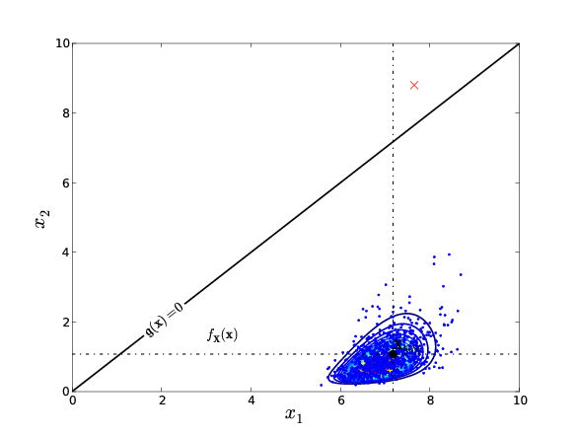








Brute-force Monte Carlo estimation
Principle
The crude Monte Carlo estimator of the failure probability is the empirical average of the Bernoulli failure experiment :
$${\hat{P}}_{f, MCS}=\frac{1}{N}\sum_{i=1}^{N}{𝕀_{𝔽}\left(X^{\left(i\right)}\right)}$$
where: $$𝕀_{𝔽}\left(X\right)∼ℬer\left(p_{f}\right)$$
$$f\left(i\right)$$
$${1−p}_{f}$$
$$p_{f}$$
$$i$$
$$0$$
$$1$$

Slide 10
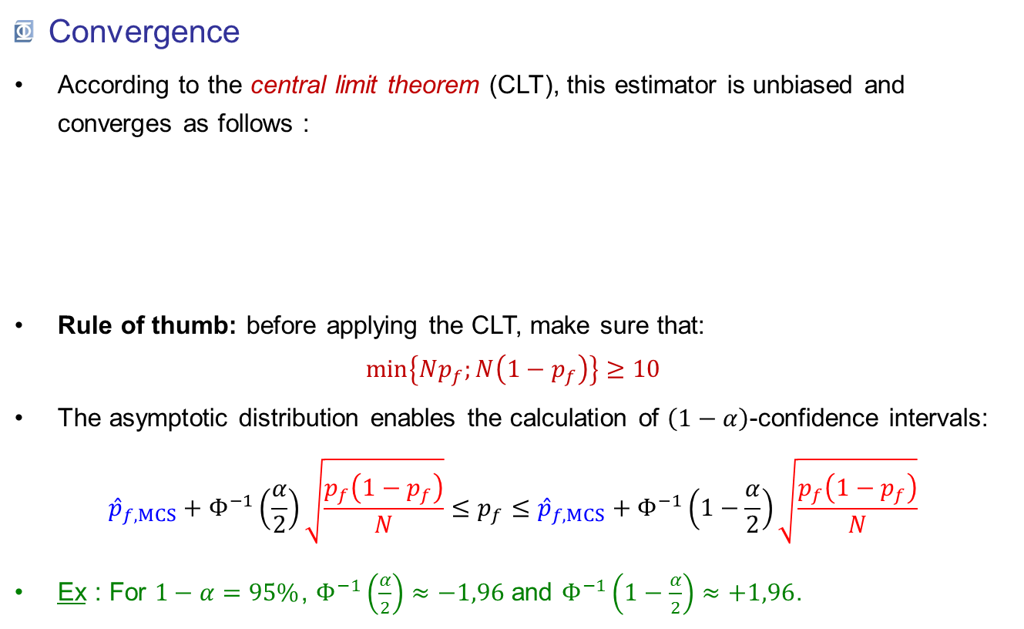
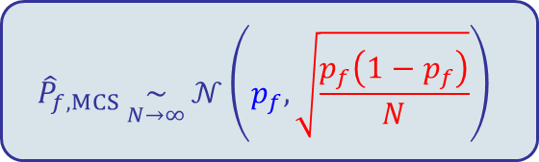
Brute-force Monte Carlo estimation
Convergence
According to the central limit theorem (CLT), this estimator is unbiased and converges as follows :
Rule of thumb: before applying the CLT, make sure that: $\min\left\{Np_{f};N\left(1−p_{f}\right)\right\}≥10$
The asymptotic distribution enables the calculation of $\left(1−α\right)$-confidence intervals: ${\hat{p}}_{f, MCS}+Φ^{−1}\left(\frac{α}{2}\right)\sqrt{\frac{p_{f}\left(1−p_{f}\right)}{N}}≤p_{f}≤{\hat{p}}_{f, MCS}+Φ^{−1}\left(1−\frac{α}{2}\right)\sqrt{\frac{p_{f}\left(1−p_{f}\right)}{N}}$
Ex : For $1−α=95\%$, $Φ^{−1}\left(\frac{α}{2}\right)≈−1,96$ and $Φ^{−1}\left(1−\frac{α}{2}\right)≈+1,96$.
$${\hat{P}}_{f, MCS}\underset{N→∞}{∼}{𝒩\left(p_{f},\sqrt{\frac{p_{f}\left(1−p_{f}\right)}{N}}\right)}$$

Slide 11
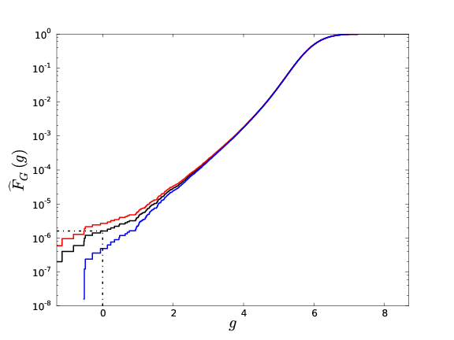

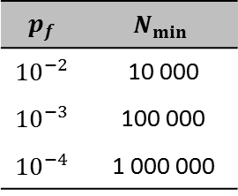
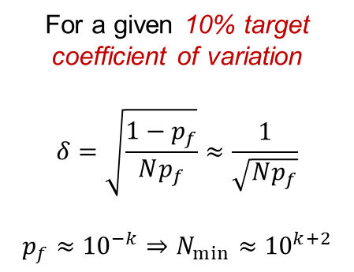
Brute-force Monte Carlo estimation
Convergence
The required sample size drastically increases as the probability gets low:
For a given 10% target coefficient of variation
$$δ=\sqrt{\frac{1−p_{f}}{Np_{f}}}≈\frac{1}{\sqrt{Np_{f}}}$$
$$p_{f}≈{10}^{−k}⇒N_{min}≈{10}^{k+2}$$
$$p_{f}$$ | $$N_{min}$$
$${10}^{−2}$$ | 10 000
$${10}^{−3}$$ | 100 000
$${10}^{−4}$$ | 1 000 000
$${\hat{p}}_{f MCS}≈1,45×{10}^{−6}$$

Slide 12
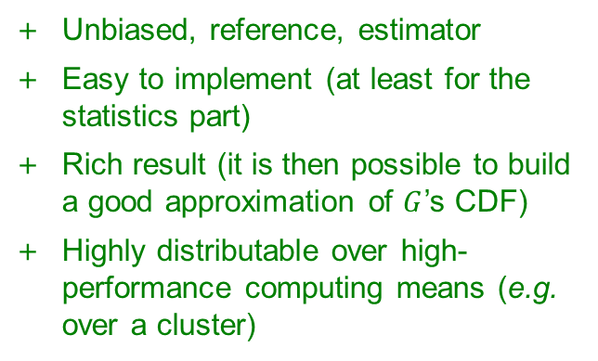
Brute-force Monte Carlo estimation
Pros & cons
Unbiased, reference, estimator
Easy to implement (at least for the statistics part)
Rich result (it is then possible to build a good approximation of $G$’s CDF)
Highly distributable over high-performance computing means (e.g. over a cluster)
Slow convergence : requires important computing resources
When shoud it be used?
When you don’t have a choice (when no other more clever method is applicable)!
When the performance function is fast to evaluate :
Simple closed-form expressions ;
HPC resources available.

Slide 13
Outline
Problem definition
Brute-force estimation using Monte Carlo sampling
Importance sampling
Isoprobabilistic transformation
Most-probable-failure-point(s)-based methods

Slide 14
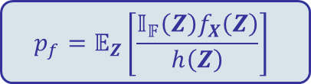

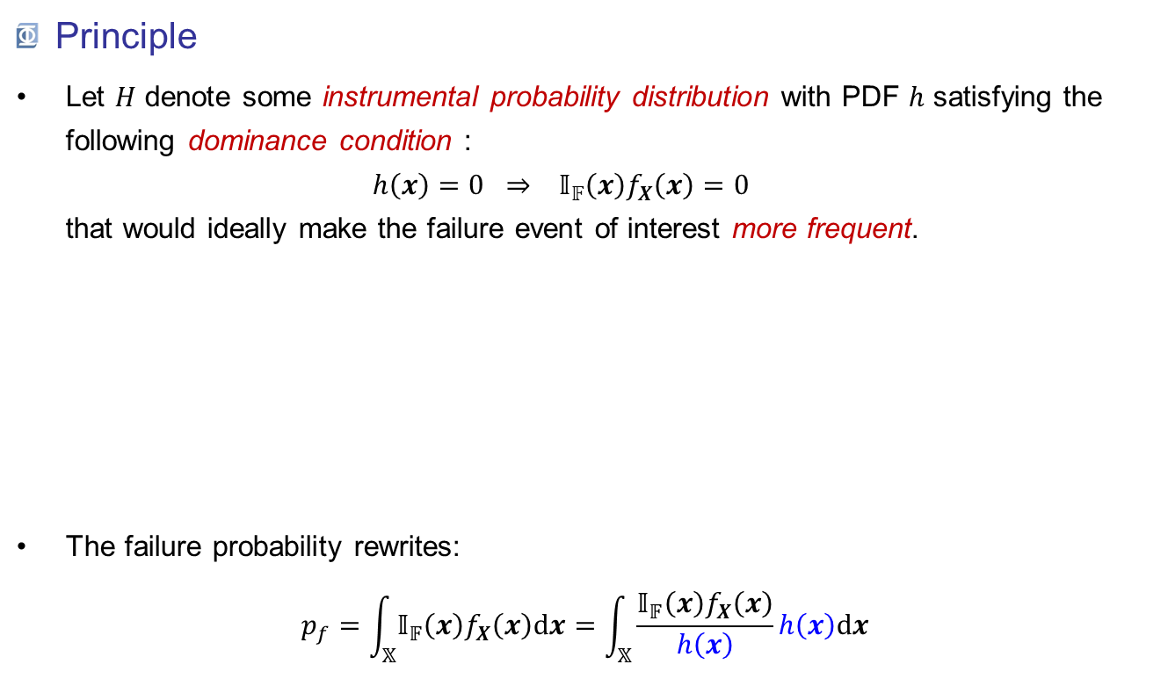
Importance sampling
Principle
Let $H$ denote some instrumental probability distribution with PDF $h$ satisfying the following dominance condition : $h\left(x\right)=0 ⇒ 𝕀_{𝔽}\left(x\right)f_{X}\left(x\right)=0$ that would ideally make the failure event of interest more frequent.
The failure probability rewrites: $p_{f}=\int_{𝕏}{𝕀_{𝔽}\left(x\right)f_{X}\left(x\right)dx}=\int_{𝕏}{\frac{𝕀_{𝔽}\left(x\right)f_{X}\left(x\right)}{h\left(x\right)}h\left(x\right)dx}$
density
Dominates the black PDF
Does not dominate the black PDF
$$x$$
$$p_{f}=𝔼_{Z}\left[\frac{𝕀_{𝔽}\left(Z\right)f_{X}\left(Z\right)}{h\left(Z\right)}\right]$$

Slide 15
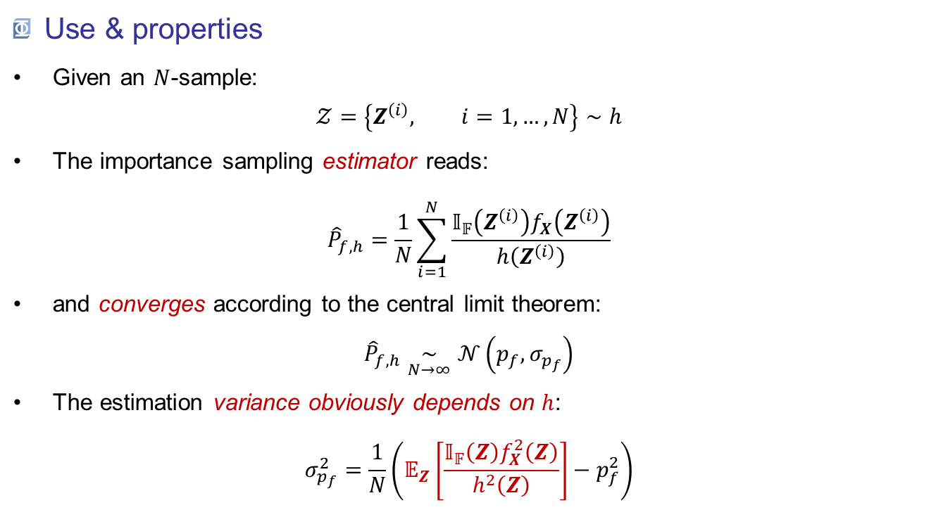
Importance sampling
Use & properties
Given an $N$-sample: $𝒵=\left\{Z^{\left(i\right)}, i=1,…,N\right\}∼h$
The importance sampling estimator reads: ${\hat{P}}_{f,h}=\frac{1}{N}\sum_{i=1}^{N}{\frac{𝕀_{𝔽}\left(Z^{\left(i\right)}\right)f_{X}\left(Z^{\left(i\right)}\right)}{h\left(Z^{\left(i\right)}\right)}}$
and converges according to the central limit theorem: ${\hat{P}}_{f,h}\underset{N→∞}{∼}𝒩\left(p_{f},σ_{p_{f}}\right)$
The estimation variance obviously depends on $h$: $σ_{p_{f}}^{2}=\frac{1}{N}\left(𝔼_{Z}\left[\frac{𝕀_{𝔽}\left(Z\right)f_{X}^{2}\left(Z\right)}{h^{2}\left(Z\right)}\right]−p_{f}^{2}\right)$

Slide 16
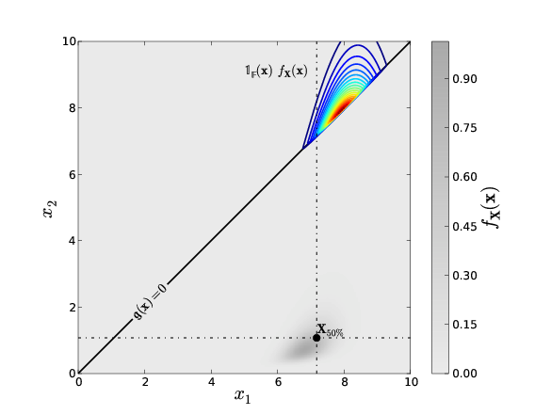
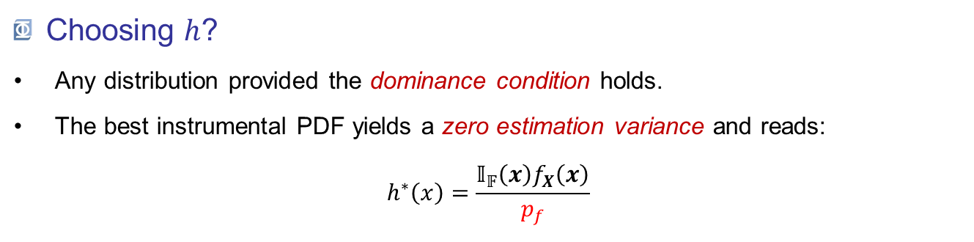
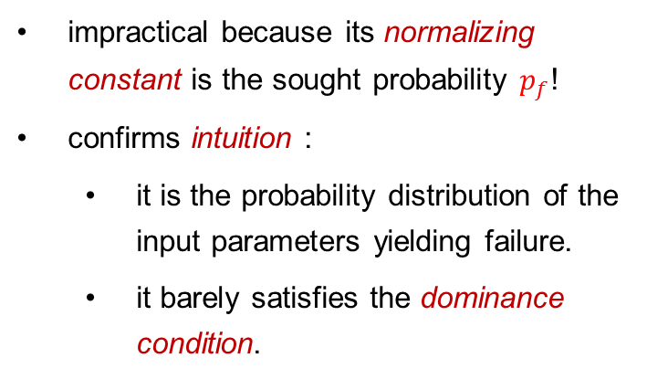
Importance sampling
Choosing $h$?
Any distribution provided the dominance condition holds.
The best instrumental PDF yields a zero estimation variance and reads: $h^{∗}\left(x\right)=\frac{𝕀_{𝔽}\left(x\right)f_{X}\left(x\right)}{p_{f}}$
impractical because its normalizing constant is the sought probability $p_{f}$!
confirms intuition :
it is the probability distribution of the input parameters yielding failure.
it barely satisfies the dominance condition.

Slide 17
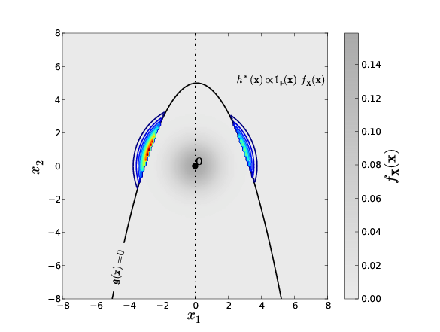
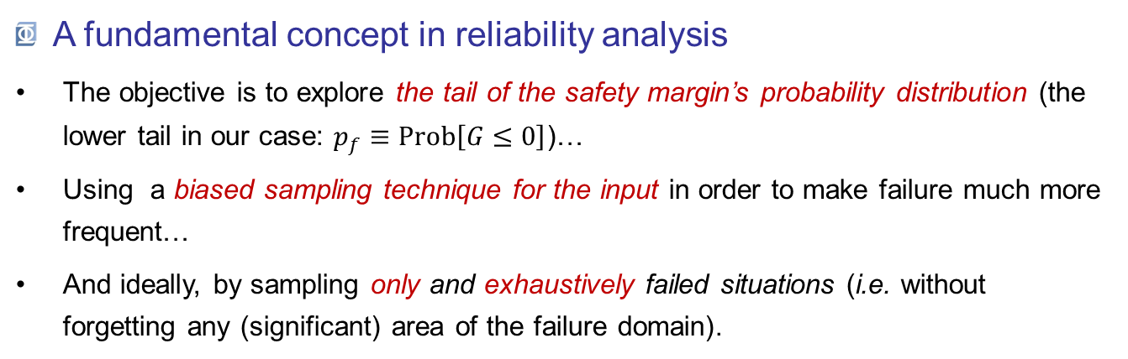
Importance sampling
A fundamental concept in reliability analysis
The objective is to explore the tail of the safety margin’s probability distribution (the lower tail in our case: $p_{f}≡Prob\left[G≤0\right]$)…
Using a biased sampling technique for the input in order to make failure much more frequent…
And ideally, by sampling only and exhaustively failed situations (i.e. without forgetting any (significant) area of the failure domain).

Slide 18
Outline
Problem definition
Brute-force estimation using Monte Carlo sampling
Importance sampling
Isoprobabilistic transformation
Most-probable-failure-point(s)-based methods

Slide 19
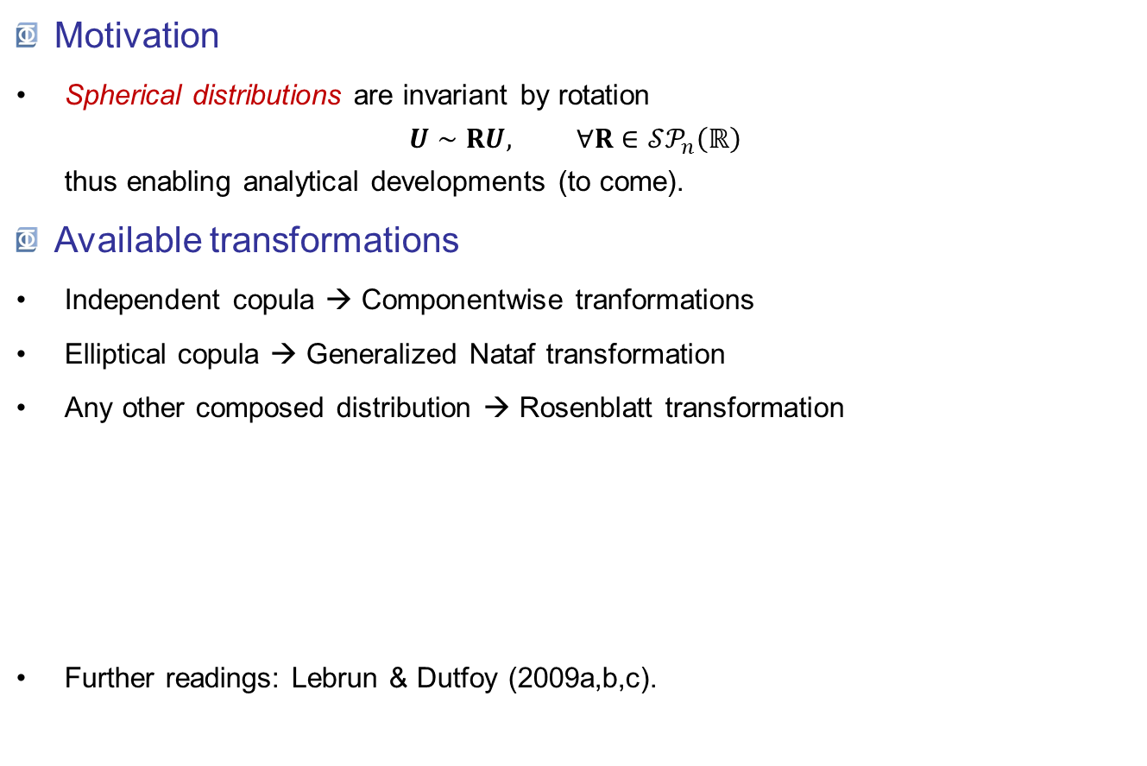
Isoprobabilistic transformation
Motivation
Spherical distributions are invariant by rotation $U∼RU, ∀R∈𝒮𝒫_{n}\left(ℝ\right)$ thus enabling analytical developments (to come).
Available transformations
Independent copula → Componentwise tranformations
Elliptical copula → Generalized Nataf transformation
Any other composed distribution → Rosenblatt transformation
Further readings: Lebrun & Dutfoy (2009a,b,c).
The choice for the most-suitable transformation is automatic in OpenTURNS.

Slide 20
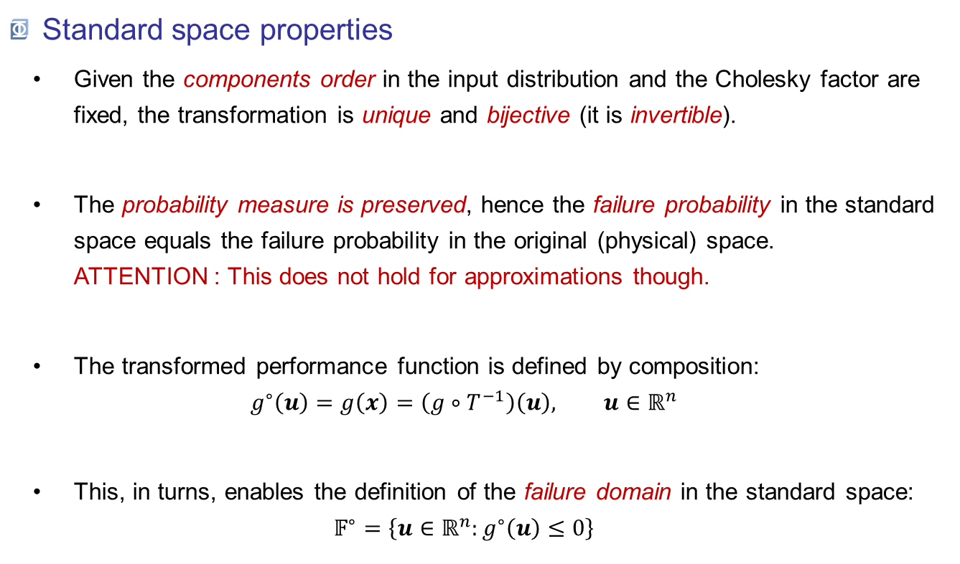
Isoprobabilistic transformation
Standard space properties
Given the components order in the input distribution and the Cholesky factor are fixed, the transformation is unique and bijective (it is invertible).
The probability measure is preserved, hence the failure probability in the standard space equals the failure probability in the original (physical) space. ATTENTION : This does not hold for approximations though.
The transformed performance function is defined by composition: $g^{∘}\left(u\right)=g\left(x\right)=\left(g∘T^{−1}\right)\left(u\right), u∈ℝ^{n}$
This, in turns, enables the definition of the failure domain in the standard space: $𝔽^{∘}=\left\{u∈ℝ^{n}:g^{∘}\left(u\right)≤0\right\}$

Slide 21
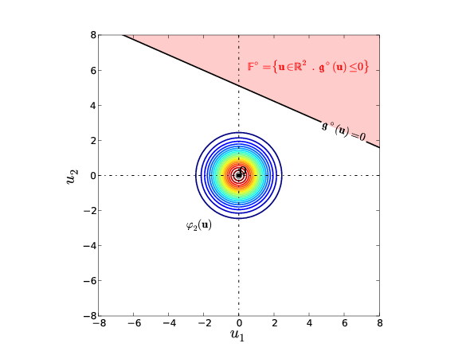
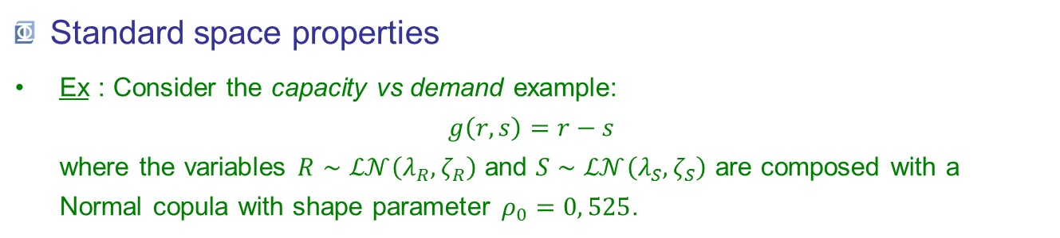
Isoprobabilistic transformation
Standard space properties
Ex : Consider the capacity vs demand example: $g\left(r,s\right)=r−s$ where the variables $R∼ℒ𝒩\left(λ_{R},ζ_{R}\right)$ and $S∼ℒ𝒩\left(λ_{S},ζ_{S}\right)$ are composed with a Normal copula with shape parameter $ρ_{0}=0, 525$.
Physical space
Standard space

Slide 22
Outline
Problem definition
Brute-force estimation using Monte Carlo sampling
Importance sampling
Isoprobabilistic transformation
Most-probable-failure-point(s)-based methods

Slide 23
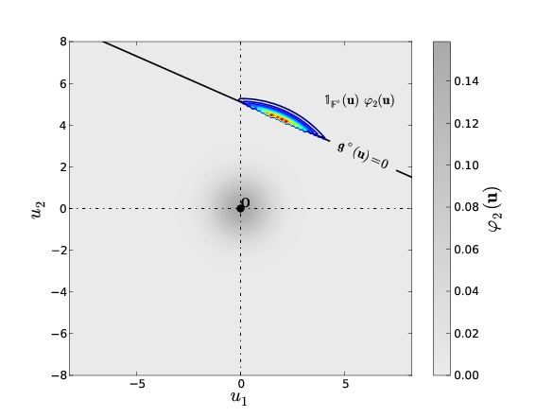


MPFP: FORM, SORM, P*-IS & FORM-$Σ$
Most probable failure point(s)
Let’s get back to the optimal importance sampling concept:
We define the most probable failure point(s) as the mode(s) of the optimal instrumental distribution: $u^{∗}=\arg{\max_{u∈ℝ^{n}}{𝕀_{𝔽^{∘}}\left(u\right)φ_{n}\left(u\right)}}$
The solution for this optimization problem is not nessarily unique, although it is often the case in many applications (e.g. in structural mechanics).
Physical space
Standard space

Slide 24
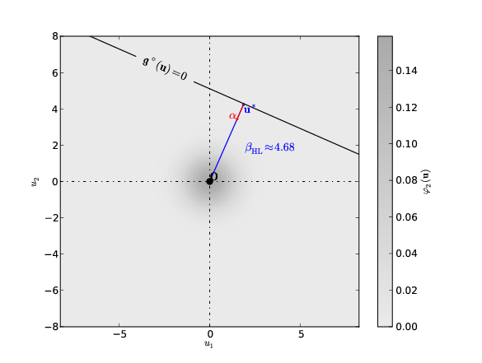
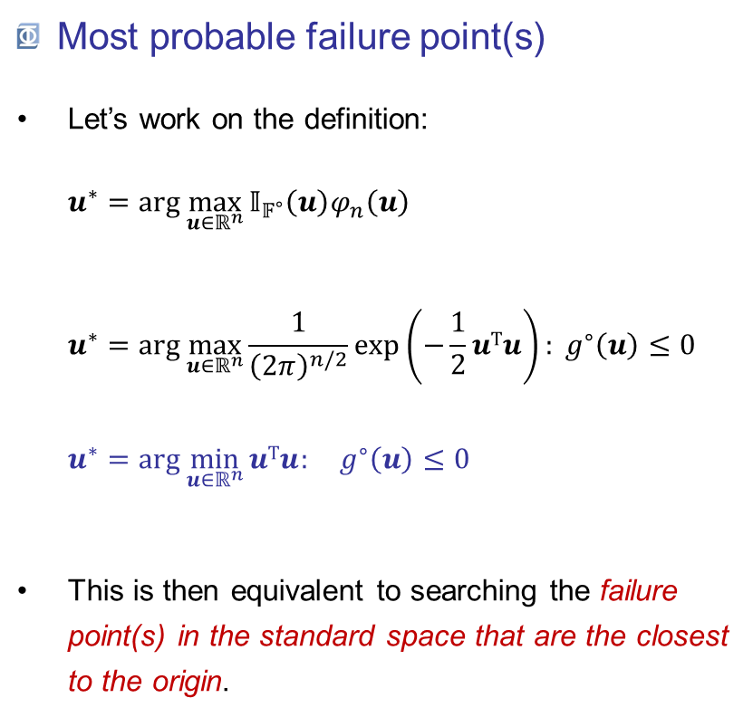
MPFP: FORM, SORM, P*-IS & FORM-$Σ$
Most probable failure point(s)
Let’s work on the definition: $u^{∗}=\arg{\max_{u∈ℝ^{n}}{𝕀_{𝔽^{∘}}\left(u\right)φ_{n}\left(u\right)}}$ $u^{∗}=\arg{\max_{u∈ℝ^{n}}{\frac{1}{{\left(2π\right)}^{n/2}}\exp\left(−\frac{1}{2}uTu\right): g^{∘}\left(u\right)≤0}}$ $u^{∗}=\arg{\min_{u∈ℝ^{n}}{uTu: g^{∘}\left(u\right)≤0}}$
This is then equivalent to searching the failure point(s) in the standard space that are the closest to the origin.

Slide 25
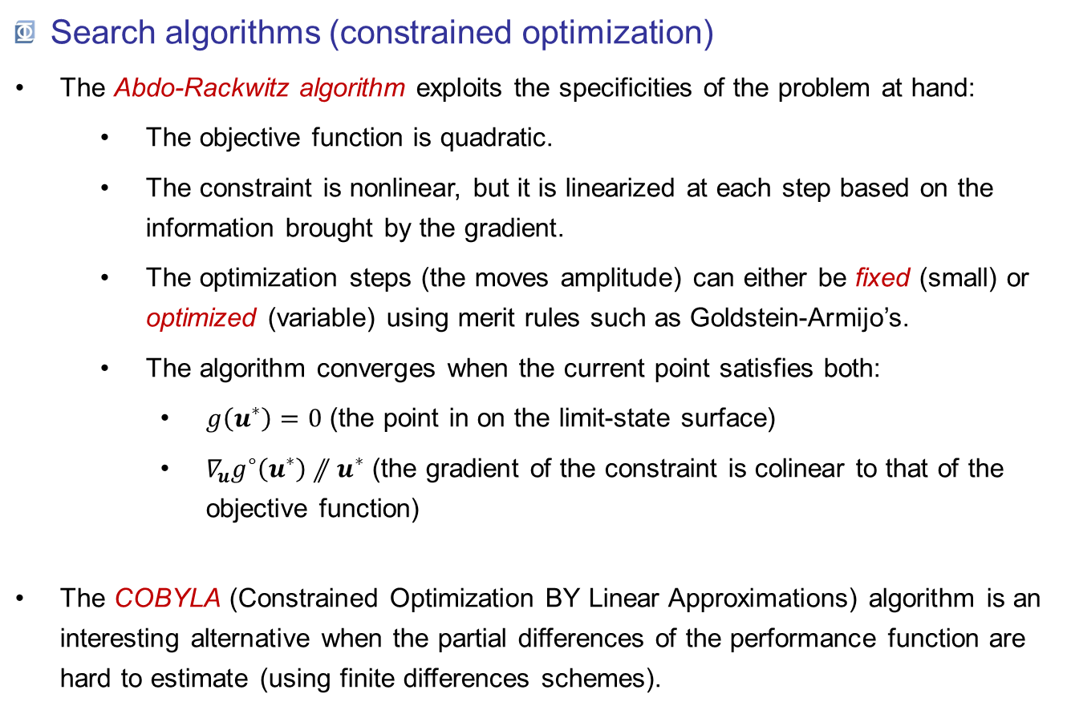
MPFP: FORM, SORM, P*-IS & FORM-$Σ$
Search algorithms (constrained optimization)
The Abdo-Rackwitz algorithm exploits the specificities of the problem at hand:
The objective function is quadratic.
The constraint is nonlinear, but it is linearized at each step based on the information brought by the gradient.
The optimization steps (the moves amplitude) can either be fixed (small) or optimized (variable) using merit rules such as Goldstein-Armijo’s.
The algorithm converges when the current point satisfies both:
$g\left(u^{∗}\right)=0$ (the point in on the limit-state surface)
$∇_{u}g^{∘}\left(u^{∗}\right)⫽u^{∗}$ (the gradient of the constraint is colinear to that of the objective function)
The COBYLA (Constrained Optimization BY Linear Approximations) algorithm is an interesting alternative when the partial differences of the performance function are hard to estimate (using finite differences schemes).

Slide 26

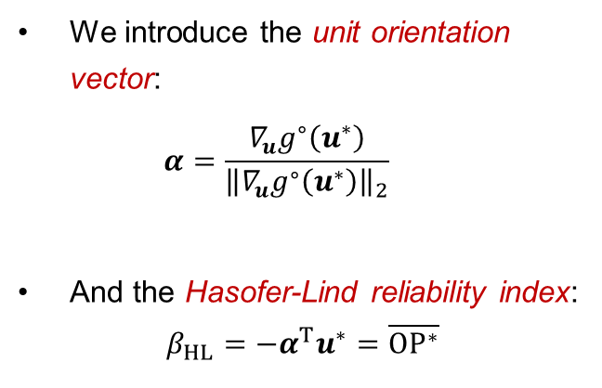
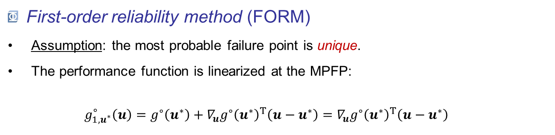
MPFP: FORM, SORM, P*-IS & FORM-$Σ$
First-order reliability method (FORM)
Assumption: the most probable failure point is unique.
The performance function is linearized at the MPFP: $g_{1,u^{∗}}^{∘}\left(u\right)=g^{∘}\left(u^{∗}\right)+{∇_{u}g^{∘}\left(u^{∗}\right)}^{T}\left(u−u^{∗}\right)={∇_{u}g^{∘}\left(u^{∗}\right)}^{T}\left(u−u^{∗}\right)$
We introduce the unit orientation vector: $α=\frac{∇_{u}g^{∘}\left(u^{∗}\right)}{{\left\|∇_{u}g^{∘}\left(u^{∗}\right)\right\|}_{2}}$
And the Hasofer-Lind reliability index: $β_{HL}=−α^{T}u^{∗}=\overline{OP^{∗}}$
$$P^{∗}$$

Slide 27
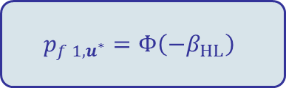
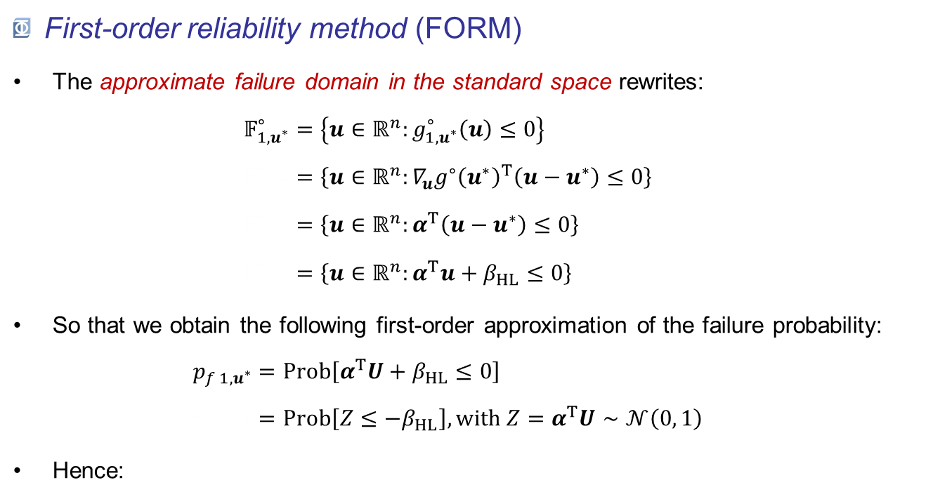
MPFP: FORM, SORM, P*-IS & FORM-$Σ$
First-order reliability method (FORM)
The approximate failure domain in the standard space rewrites: $𝔽_{1,u^{∗}}^{∘}=\left\{u∈ℝ^{n}:g_{1,u^{∗}}^{∘}\left(u\right)≤0\right\}$ $𝔽_{1,u^{∗}}^{∘}=\left\{u∈ℝ^{n}:{∇_{u}g^{∘}\left(u^{∗}\right)}^{T}\left(u−u^{∗}\right)≤0\right\}$ $𝔽_{1,u^{∗}}^{∘}=\left\{u∈ℝ^{n}:α^{T}\left(u−u^{∗}\right)≤0\right\}$ $𝔽_{1,u^{∗}}^{∘}=\left\{u∈ℝ^{n}:α^{T}u+β_{HL}≤0\right\}$
So that we obtain the following first-order approximation of the failure probability: $p_{f 1,u^{∗}}=Prob\left[α^{T}U+β_{HL}≤0\right]$ $p_{f 1,u^{∗}}=Prob\left[Z≤−β_{HL}\right],with Z=α^{T}U∼𝒩\left(0, 1\right)$
Hence:
$$p_{f 1,u^{∗}}=Φ\left(−β_{HL}\right)$$

Slide 28
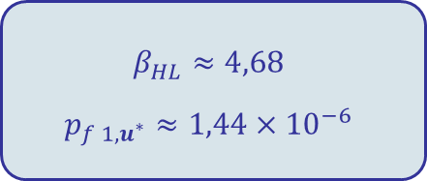
MPFP: FORM, SORM, P*-IS & FORM-$Σ$
First-order reliability method (FORM)
Ex : (capacity vs demand example)
$$β_{HL}≈4,68$$
$$p_{f 1,u^{∗}}≈1,44×{10}^{−6}$$
The limit-state surface being linear in the standard space, in this particular case, FORM is the reference solution.
Generally speaking, this is only an approximation.

Slide 29
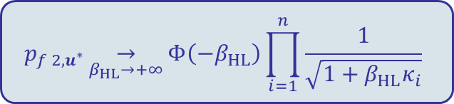
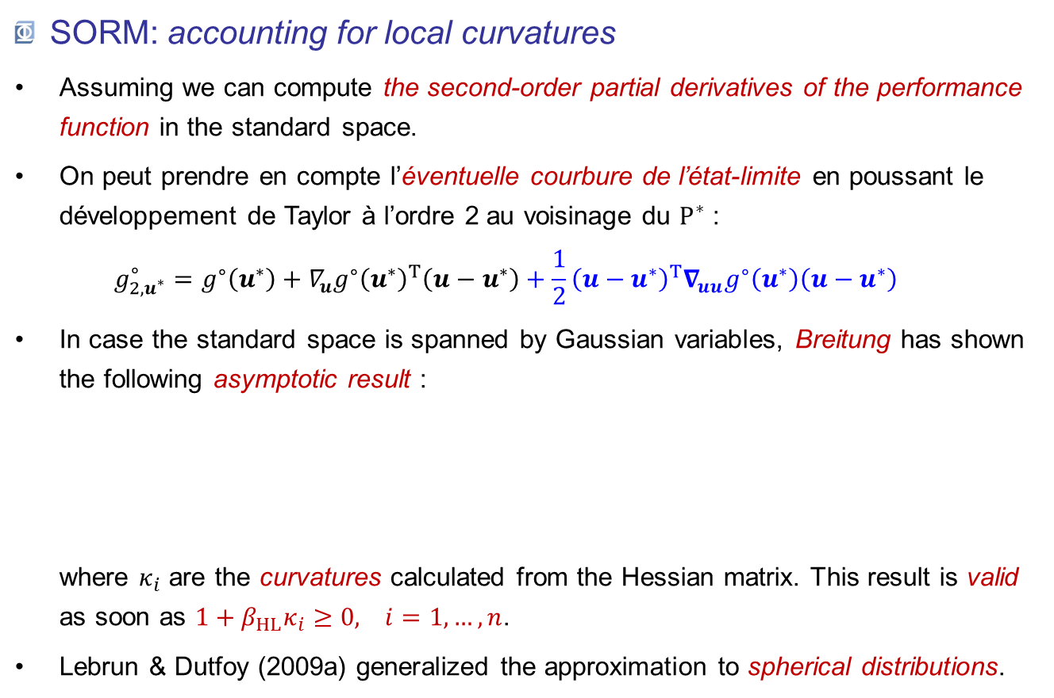
MPFP: FORM, SORM, P*-IS & FORM-$Σ$
SORM: accounting for local curvatures
Assuming we can compute the second-order partial derivatives of the performance function in the standard space.
On peut prendre en compte l’éventuelle courbure de l’état-limite en poussant le développement de Taylor à l’ordre 2 au voisinage du $P^{∗}$ : $g_{2,u^{∗}}^{∘}=g^{∘}\left(u^{∗}\right)+{∇_{u}g^{∘}\left(u^{∗}\right)}^{T}\left(u−u^{∗}\right)+\frac{1}{2}{\left(u−u^{∗}\right)}^{T}∇_{uu}g^{∘}\left(u^{∗}\right)\left(u−u^{∗}\right)$
In case the standard space is spanned by Gaussian variables, Breitung has shown the following asymptotic result : where $κ_{i}$ are the curvatures calculated from the Hessian matrix. This result is valid as soon as $1+β_{HL}κ_{i}≥0, i=1,…, n$.
Lebrun & Dutfoy (2009a) generalized the approximation to spherical distributions.
$$p_{f 2,u^{∗}}\underset{β_{HL}→+∞}{→}{Φ\left(−β_{HL}\right)\prod_{i=1}^{n}{\frac{1}{\sqrt{1+β_{HL}κ_{i}}}}}$$

Slide 30
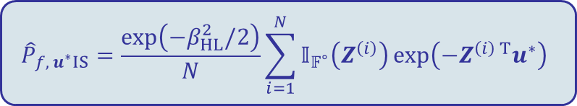
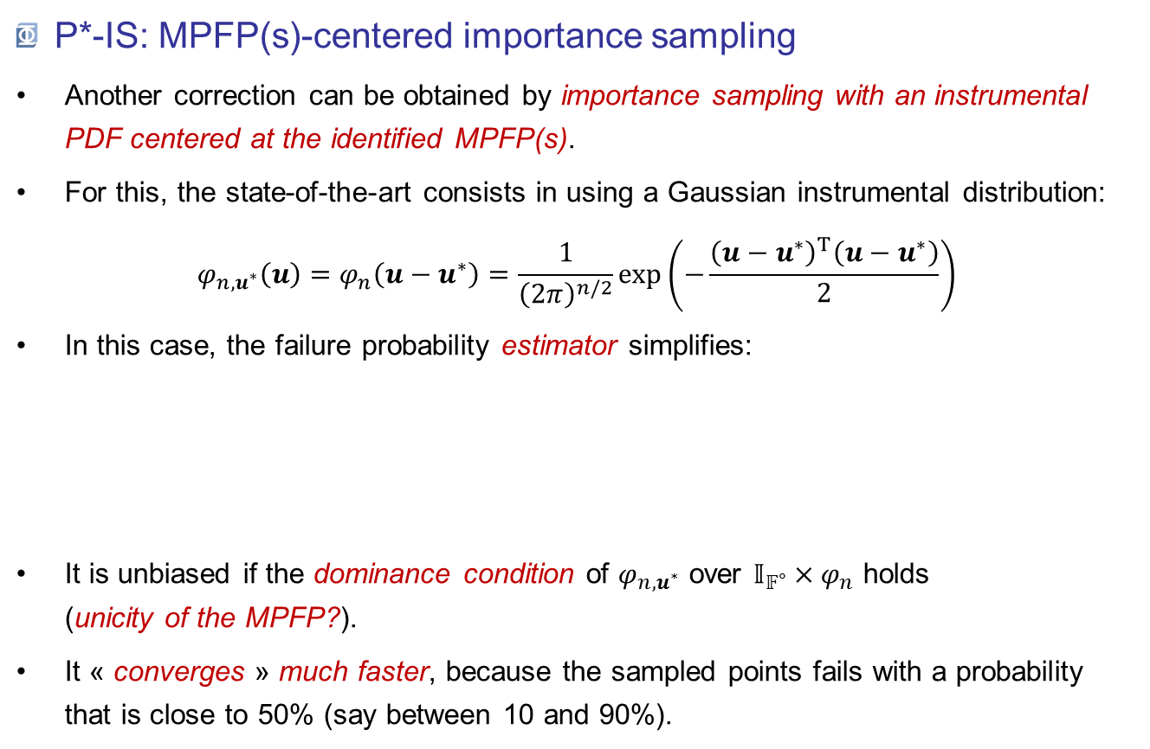
MPFP: FORM, SORM, P*-IS & FORM-$Σ$
P*-IS: MPFP(s)-centered importance sampling
Another correction can be obtained by importance sampling with an instrumental PDF centered at the identified MPFP(s).
For this, the state-of-the-art consists in using a Gaussian instrumental distribution: $φ_{n,u^{∗}}\left(u\right)=φ_{n}\left(u−u^{∗}\right)=\frac{1}{{\left(2π\right)}^{n/2}}\exp\left(−\frac{{\left(u−u^{∗}\right)}^{T}\left(u−u^{∗}\right)}{2}\right)$
In this case, the failure probability estimator simplifies:
It is unbiased if the dominance condition of $φ_{n,u^{∗}}$ over $𝕀_{𝔽^{∘}}×φ_{n}$ holds (unicity of the MPFP?).
It « converges » much faster, because the sampled points fails with a probability that is close to 50% (say between 10 and 90%).
$${\hat{P}}_{f, u^{∗}IS}=\frac{\exp\left(−β_{HL}^{2}/2\right)}{N}\sum_{i=1}^{N}{𝕀_{𝔽^{∘}}\left(Z^{\left(i\right)}\right)\exp\left(−Z^{\left(i\right) T}u^{∗}\right)}$$

Slide 31
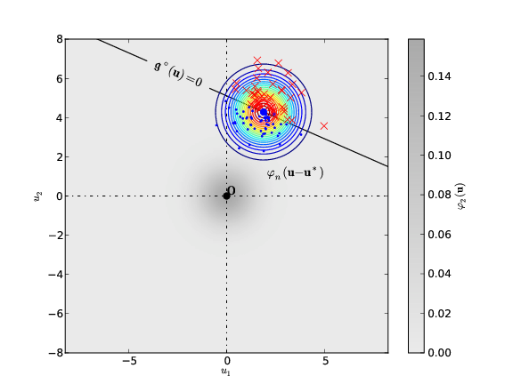
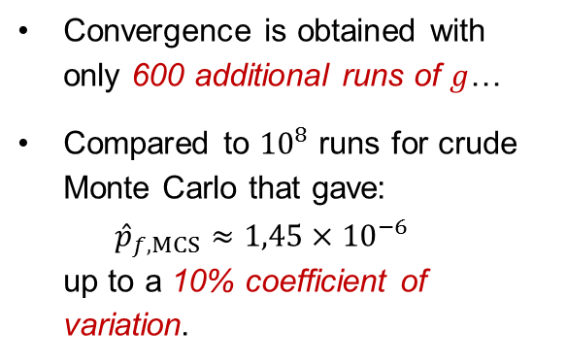
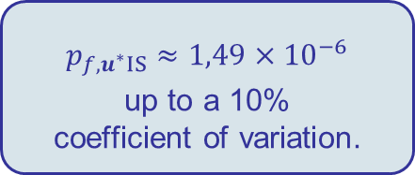
MPFP: FORM, SORM, P*-IS & FORM-$Σ$
P*-IS: MPFP(s)-centered importance sampling
Ex : (capacity vs demand example)
$$p_{f, u^{∗}IS}≈1,49×{10}^{−6}$$
up to a 10% coefficient of variation.
Convergence is obtained with only 600 additional runs of $g$…
Compared to ${10}^{8}$ runs for crude Monte Carlo that gave: ${\hat{p}}_{f,MCS}≈1,45×{10}^{−6}$ up to a 10% coefficient of variation.

Slide 32
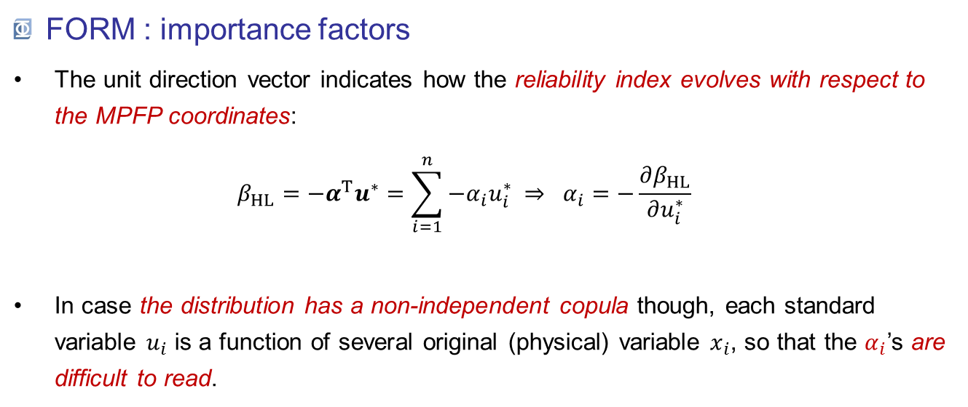
MPFP: FORM, SORM, P*-IS & FORM-$Σ$
FORM : importance factors
The unit direction vector indicates how the reliability index evolves with respect to the MPFP coordinates: $β_{HL}=−α^{T}u^{∗}=\sum_{i=1}^{n}{{−α}_{i}u_{i}^{∗}} ⇒ α_{i}=−\frac{∂β_{HL}}{∂u_{i}^{∗}}$
In case the distribution has a non-independent copula though, each standard variable $u_{i}$ is a function of several original (physical) variable $x_{i}$, so that the $α_{i}$’s are difficult to read.

Slide 33
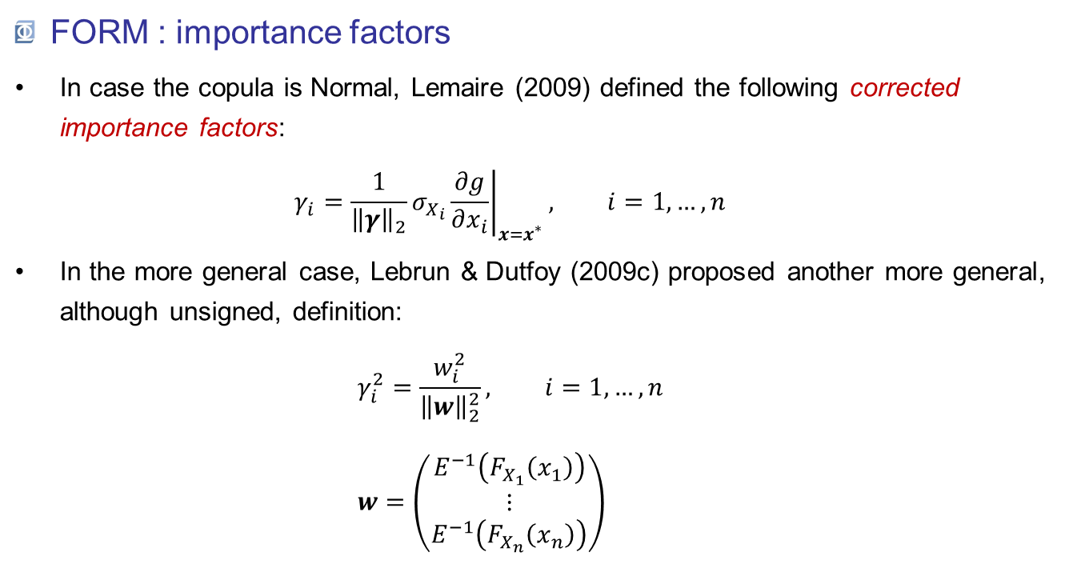
MPFP: FORM, SORM, P*-IS & FORM-$Σ$
FORM : importance factors
In case the copula is Normal, Lemaire (2009) defined the following corrected importance factors: $γ_{i}=\frac{1}{{\left\|γ\right\|}_{2}}σ_{X_{i}}{\left.\frac{∂g}{∂x_{i}}\right|}_{x=x^{∗}}, i=1,…,n$
In the more general case, Lebrun & Dutfoy (2009c) proposed another more general, although unsigned, definition: $γ_{i}^{2}=\frac{w_{i}^{2}}{{\left\|w\right\|}_{2}^{2}}, i=1,…,n$ $w=\left(\begin{aligned}E^{−1}\left(F_{X_{1}}\left(x_{1}\right)\right) \\ ⋮ \\ E^{−1}\left(F_{X_{n}}\left(x_{n}\right)\right)\end{aligned}\right)$

Slide 34
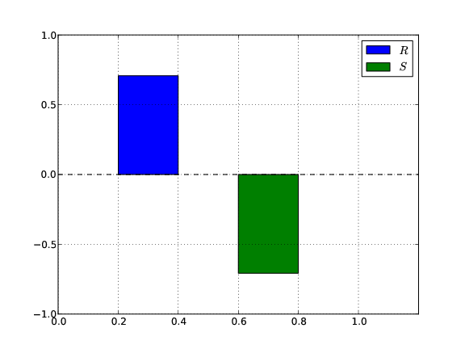
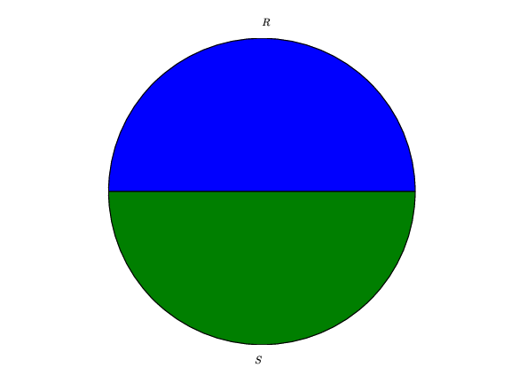

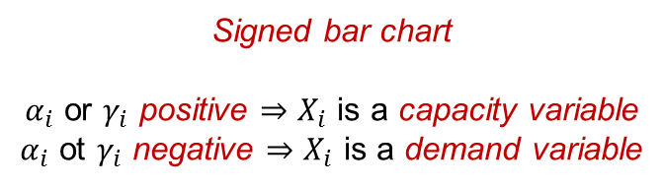

MPFP: FORM, SORM, P*-IS & FORM-$Σ$
FORM : importance factors
These results are often presented in either one or both of these two charts:
$$γ_{i}^{2}$$
$$γ_{i}$$
Signed bar chart $α_{i}$ or $γ_{i}$ positive $⇒X_{i}$ is a capacity variable $α_{i}$ ot $γ_{i}$ negative $⇒X_{i}$ is a demand variable
Pie chart The quadratic sum equals 1. Qualitative comparison of the importance of variables
w.r.t. failure.

Slide 35



MPFP: FORM, SORM, P*-IS & FORM-$Σ$
FORM : Multiple design points
Ex : Consider the following limit-state function: $g\left(x_{1},x_{2}\right)={b−x}_{2}−κ{\left(u_{1}−e\right)}^{2}$ where $X=U∼𝒩\left(0,I\right)$, $b=5$, $κ=0,5$ and $e=0,1$.
PMSoft implements an algorithm that is devoted to the search of multiple $P^{∗}$ using:
a smart reset strategy;
exclusion balls around the already found design points.
See Der Kiureghian & Dakessian (1998).
However the enumeration may lack completeness.

Slide 36


MPFP: FORM, SORM, P*-IS & FORM-$Σ$
FORM-$Σ$ : Serial combination of linear limit-states
Input: for the $n_{P^{∗}}$ identified MPFPs :
reliability indices: $β_{HL}=\left(β_{HL}^{\left(i\right)}, i=1,…,n_{P^{∗}}\right)$
importance factors in the standard space: $Α=\left(α^{\left(i\right)}, i=1,…,n_{P^{∗}}\right)$
Objective : combine these results into a single probability, the one associated to the serial system formed by the contributors.
Solution: where: $ρ_{ij}=α^{\left(i\right) T}α^{\left(j\right)}, i,j=1,…, n_{P^{∗}}$ are the « pairwise limit-states’ correlation » ($−1≤ρ≤1$).
$$p_{f, 1Σ}=Prob\left[U∈\bigcup_{i=1}^{n_{P^{∗}}}{\left\{u∈ℝ^{n}:α^{\left(i\right) T}u+β_{HL}^{\left(i\right)}≤0\right\}}\right]={1−Φ}_{n_{P^{∗}}}\left(β_{HL};0,ρ\right)$$

Slide 37


MPFP: FORM, SORM, P*-IS & FORM-$Σ$
FORM-$Σ$ : Serial combination of linear limit-states
Ex : Consider the following limit-state function: $g\left(x_{1},x_{2}\right)={b−x}_{2}−κ{\left(u_{1}−e\right)}^{2}$ where $X=U∼𝒩\left(0,I\right)$, $b=5$, $κ=0,5$ and $e=0,1$.
The correlation between the two limit-states is:
$$ρ_{12}=α^{\left(1\right) T}α^{\left(2\right)}≈−0,78$$
Hence the first-order approximation of the serial system failure probability is: $$p_{f1,Σ}=1−Φ_{2}\left(\left(\begin{aligned}3,09 \\ 2,91\end{aligned}\right);0,\left[\begin{matrix}1 & −0,78 \\ −0,78 & 1\end{matrix}\right]\right) \\ p_{f1,Σ}≈2,82×{10}^{−3}$$ The crude Monte Carlo estimate is: $${\hat{p}}_{f,MCS}≈3,12×{10}^{−3}$$
Up to a 10% coefficient of variation.

Slide 38

MPFP: FORM, SORM, P*-IS & FORM-$Σ$
Pros & Cons
The most probable failure point concept is interesting because:
Coordinates → singular configuration(s) of the system.
Importance factors → give clues for improving reliability.
Affordable computational cost.
The most probable failure point concept is dangerous:
non-unicity risk (FORM, SORM & basic P*-IS) ;
non-completeness risk (FORM-$Σ$).
Missing (FORM, SORM, FORM-$Σ$) or subjective (P*-IS) error metric.
When should it be used?
As a first approximation ;
Confirmed by an expert judgement about the identified failure modes.

Slide 39

Conclusions
Reliability methods aim at estimating the safety level attached to a component in the form of a subjective failure probability :
The methods reviewed in this presentation are implemented in OpenTURNS & Uranie.
Crude Monte Carlo sampling enables exploring the model:
without requiring any assumption,
at a great computational expense though (HPC may help).
Most-probable-failure-point(s)-based techniques enable:
a reduction of the computational effort (even if HPC may still help);
a deeper investigation of the system thanks to:
the most probable failure points coordinates;
the importance factors.
$$p_{f}=Prob\left[failure∣model\right]$$

Slide 40
Further readings
Ditlevsen, O. & Madsen, H. (1996). Structural reliability methods. John Wiley & Sons.
Lebrun, R. & Dutfoy, A. (2009a). A generalization of the Nataf transformation to distributions with elliptical copula. Prob. Eng. Mech., 24, 172–178.
Lebrun, R. & Dutfoy, A. (2009b). An innovating analysis of the Nataf transformation from the copula viewpoint. Prob. Eng. Mech., 24, 312–320.
Lebrun, R. & Dutfoy, A. (2009c). Do Rosenblatt and Nataf isoprobabilistic transformations really differ? Prob. Eng. Mech., 2009, 24, 577–584.
Lemaire, M. (2009). Structural reliability. Wiley. 480 pp.

