Slide 1


Probability theory basics
Gaëtan Blondet, Phimeca Engineering SA
‘HPC and Uncertainty Treatment – Examples with Open TURNS and Uranie’
EDF – Phimeca – Airbus Group – IMACS – CEA
PRACE Advanced Training Center – May, 10-12 2021

Slide 2
Motivation
Uncertainty includes variability, randomness and lack-of-knowledge.
Aleatory uncertainty
Lack of control over environmental variability and test settings, errors made during testing.
Can be better characterized but cannot be reduced with more measurements or simulations.
Epistemic uncertainty
Lack-of-knowledge and assumptions made during testing and modeling.
Can be reduced by collecting more information and evidence.
Note: Other theories have been developed to represent epistemic uncertainty such as Imprecise Theory (IP), Possibility theory, Fuzzy sets and fuzzy logic.
These sources of uncertainty can be modeled thanks to probability theory

Slide 3
Outline
General definitions
Random variables
Definitions
Cumulative distribution function and probability density function
Moments
Confidence intervals (CI)
Random vectors
Definitions
Moments
Copulas

Slide 4
Outline
General definitions
Random variables
Definitions
Cumulative distribution function and probability density function
Moments
Confidence intervals (CI)
Random vectors
Definitions
Moments
Copulas

Slide 5

Definitions
Random experiment
Repeatable procedure leading to possible outcomes.
Sample space Ω
Set of all possible outcomes of the experiment.
Event
Set of outcomes of an experiment (a subset of Ω).

Slide 6
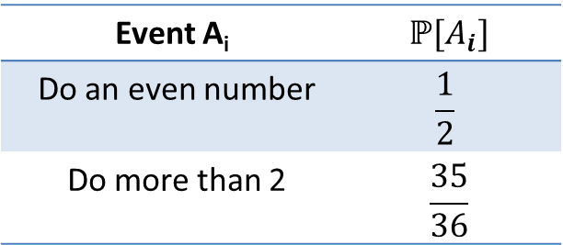
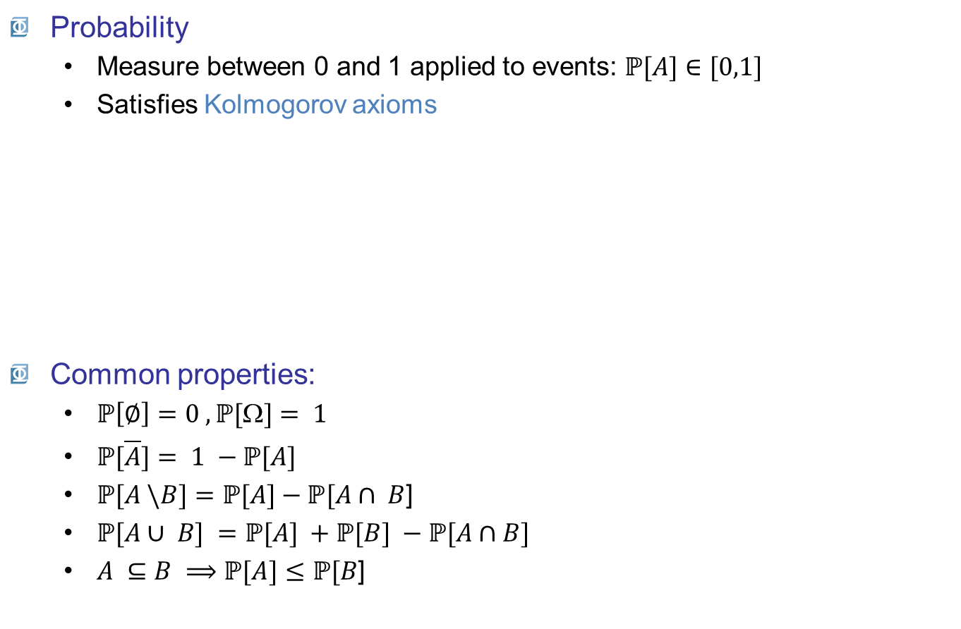
Definitions
Probability
Measure between 0 and 1 applied to events: $ℙ[A]∈[0,1]$
Satisfies Kolmogorov axioms
Common properties:
$ℙ\left[∅\right]=0 , ℙ[\text{W}]= 1$
$ℙ[\overline{A}]= 1 −ℙ[A]$
$ℙ[A \backslash B]=ℙ[A]−ℙ[A∩ B$]
$ℙ[A∪ B] =ℙ[A] +ℙ[B] −ℙ[A∩B]$
$A ⊆B ⟹ℙ[A]≤ℙ[B$]
Throwing 2 dice
Event A_{i} | $$ℙ[A_{i}]$$
Do an even number | $$\frac{1}{2}$$
Do more than 2 | $$\frac{35}{36}$$
B
Ω
A

Slide 7

Definitions
Conditional probability
probability of $A$ given $B$
$$ℙ[A|B]=\frac{ℙ[A∩ B]}{ℙ[B] }$$
Independence
B does not affect the probability of A, and vice versa:
$ℙ[A|B]=ℙ[A]⟹ℙ[A∩ B]=ℙ[A]ℙ[B$]

Slide 8

Definitions
Bayes’ theorem
Shows the probability of $A$ updated by the knowledge of $B$
Defined from the conditional probability definition
$$ℙ[A|B] = \frac{ℙ\left[B | A\right]}{ℙ[B\text{]} } ℙ[A]$$
Initial probability of A
Influence of the information
contained in B

Slide 9

Definitions
Frequentist interpretation of probabilities
Probabilities can be estimated by N observations
$$ℙ[A]=\lim_{N →∞}{\frac{N_{A}}{N}}$$

Slide 10
Outline
General definitions
Random variables
Definitions
Cumulative distribution function and probability density function
Moments
Confidence intervals (CI)
Random vectors
Definitions
Moments
Copulas

Slide 11

Random variables
Definition
A random variable (r.v.) $X$is a measurable function
$$\begin{matrix}X :Ω ⟶𝒟_{X} \\ ω ⟼x=X(ω)\end{matrix}$$
Can be discrete $(𝒟_{X}⊆ℤ$) or continuous ($𝒟_{X}⊆ℝ$)

Slide 12













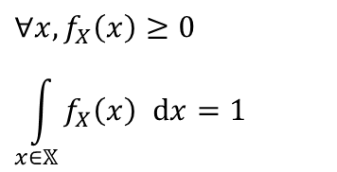




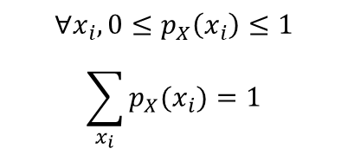
Random variables
Probability Density Function (PDF)
Discrete: probability mass function
Continuous: probability density function
$$p_{X}\left(x_{i}\right)=ℙ[X=x_{i}]$$
$$p_{X}\left(x\right)$$
$$ℙ[X=x_{4}]$$
$$∀x_{i}, 0≤p_{X}\left(x_{i}\right)≤1$$
$$\sum_{x_{i}}{p_{X}(x_{i})}=1$$
$$0$$
$$x_{1}$$
$$x_{2}$$
$$x_{3}$$
$$x_{4}$$
$$x_{5}$$
$$x$$
$$f_{X}\left(x\right) \text{dx}=ℙ[x<X+\text{dx}]$$
$$f_{X}\left(x\right)$$
$$∀x, f_{X}\left(x\right)≥0$$
$$\int_{x∈𝕏}{f_{X}\left(x\right) }dx=1$$
$$ℙ\left[x<X≤x+dx\right]$$
$$0$$
$$x$$
$$x+dx$$
$$x$$

Slide 13




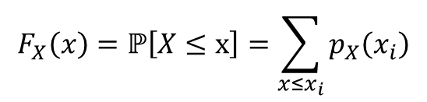






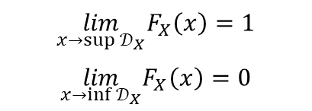






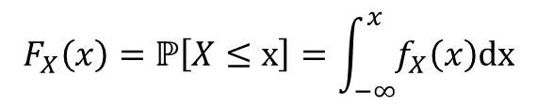
Random variables
Cumulative Distribution Function (CDF)
Discrete
Continuous
$$F_{X}\left(x\right)=ℙ\left[X≤x\right]=\sum_{x≤x_{i}}{p_{X}\left(x_{i}\right)}$$
$$F_{X}\left(x\right)$$
$$1$$
$$9/10$$
$$\lim_{x→sup{𝒟_{X}}}F_{X}\left(x\right)=1$$
$$\lim_{x→inf{𝒟_{X}}}F_{X}\left(x\right)=0$$
$$7/10$$
$$4/10$$
$$1/10$$
$$0$$
$$x_{1}$$
$$x_{2}$$
$$x_{3}$$
$$x_{4}$$
$$x_{5}$$
$$x$$
$$F_{X}\left(x\right)=ℙ\left[X≤x\right]=\int_{−∞}^{x}{f_{X}\left(x\right)\text{dx}}$$
$$F_{X}\left(x\right)$$
$$1$$
$$f_{X}\left(x\right)=\frac{dF_{X}\left(x\right)}{dx}$$
$$0$$
$$x$$
$$x$$

Slide 14
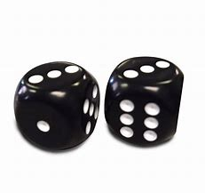
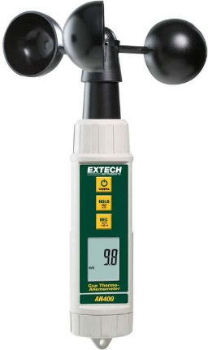

Random variables
Cumulative Distribution Function (CDF)
Discrete: Sum of 2 dice: Ω → {2,…,12}
Continuous: Wind speed: $Ω⟶ℝ^{+}$

Slide 15

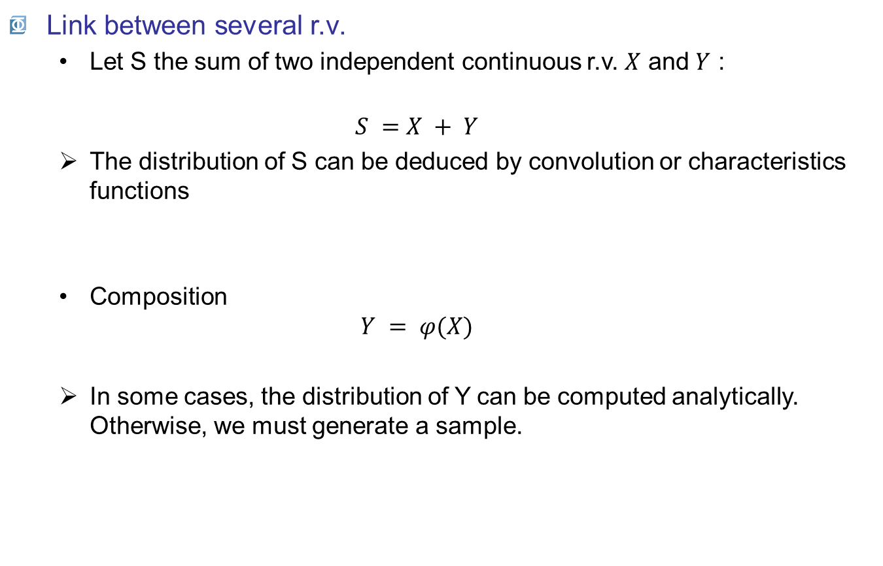
Random variables
Link between several r.v.
Let S the sum of two independent continuous r.v. $X$ and $Y$ :
$$S =X + Y$$
The distribution of S can be deduced by convolution or characteristics functions
Composition
$$Y = φ(X)$$
In some cases, the distribution of Y can be computed analytically. Otherwise, we must generate a sample.
Measure = true value + error
Output = f(input)

Slide 16
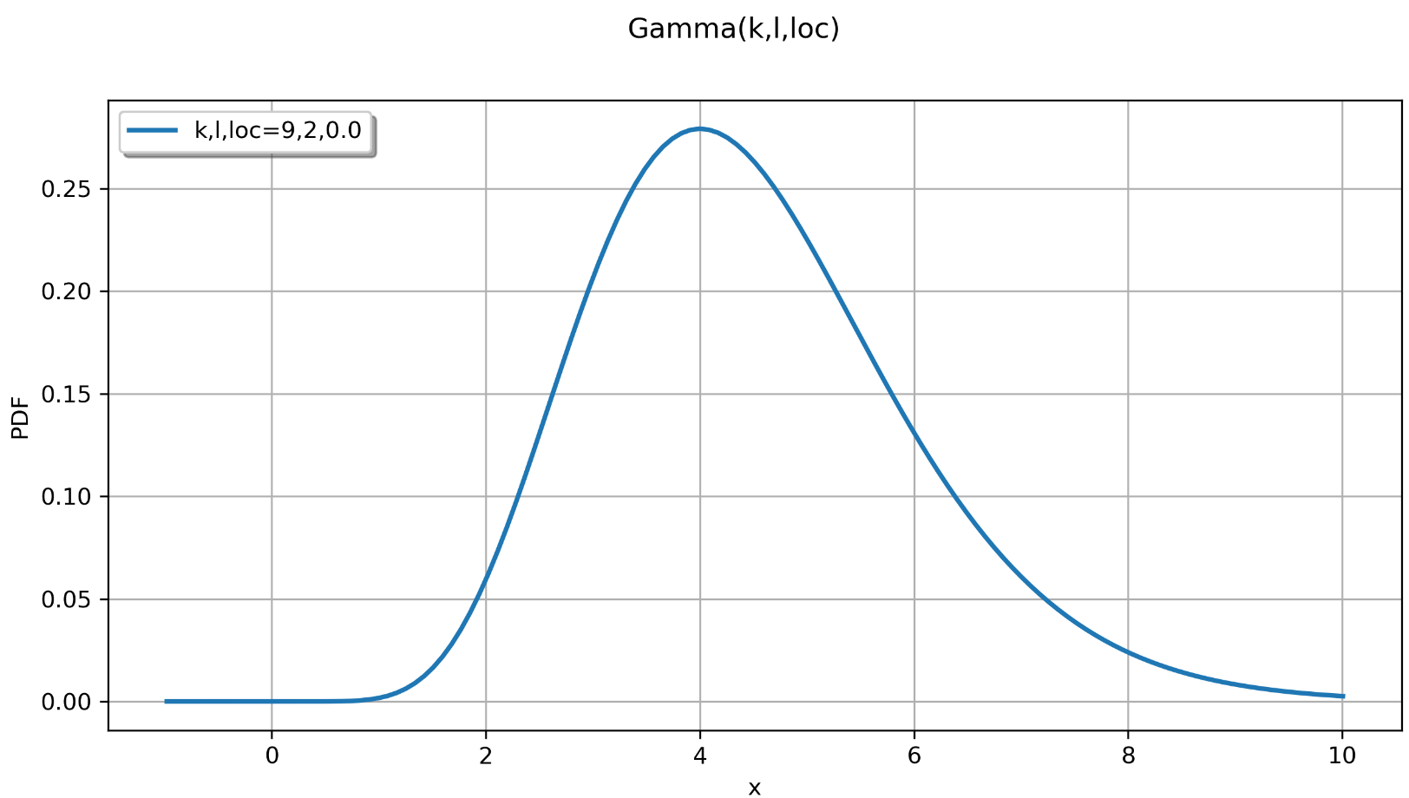
Random variables
Characterization of a random variable
A distribution is characterized by its moments :
central value
dispersion
asymmetry, peakedness
Central value
peakedness
dispersion
asymetry

Slide 17
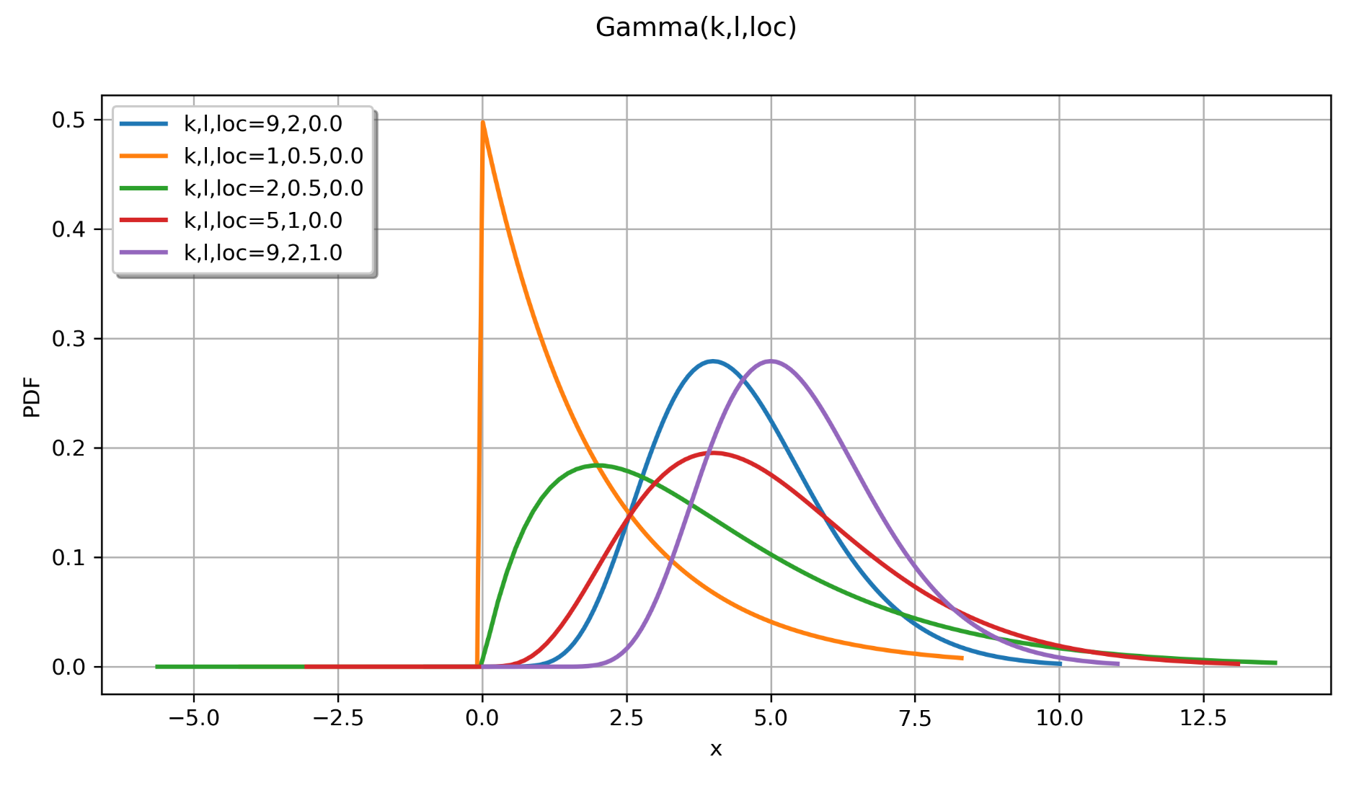
Random variables

Slide 18
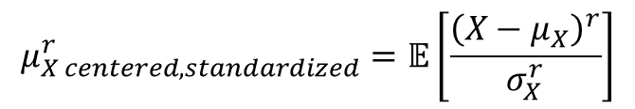
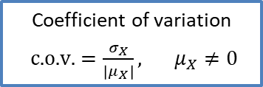

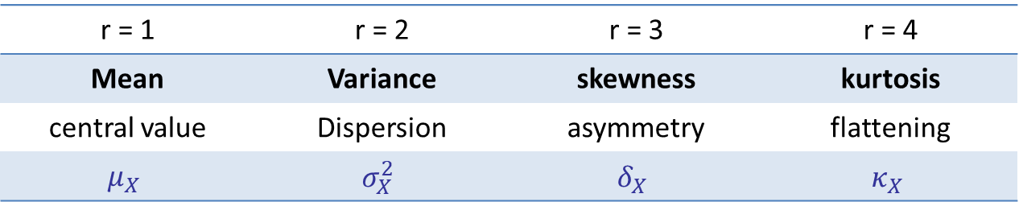
Random variables
Moments of order $r(>0$)
$$μ_{X centered, standardized}^{r}=𝔼\left[\frac{{\left(X−μ_{X}\right)}^{r}}{σ_{X}^{r}}\right]$$
r = 1 | r = 2 | r = 3 | r = 4
Mean | Variance | skewness | kurtosis
central value | Dispersion | asymmetry | flattening
$$μ_{X}$$ | $$σ_{X}^{2}$$ | $$δ_{X}$$ | $$κ_{X}$$
Coefficient of variation
$\text{c}\text{.}\text{o}\text{.}\text{v}\text{.}=\frac{σ_{X}}{\left|μ_{X}\right|}, μ_{X}≠0$

Slide 19
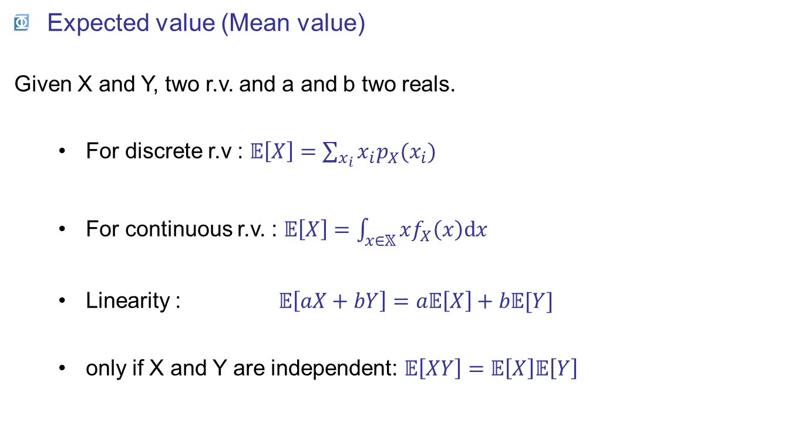
Random variables
Expected value (Mean value)
Given X and Y, two r.v. and a and b two reals.
For discrete r.v : $𝔼\left[X\right]=\sum_{x_{i}}{x_{i}p_{X}(x_{i})}$
For continuous r.v. : $𝔼\left[X\right]=\int_{x∈𝕏}{xf_{X}\left(x\right)\text{d}x}$
Linearity : $𝔼\left[aX+bY\right]=a𝔼\left[X\right]+b𝔼[Y]$
only if X and Y are independent: $𝔼\left[XY\right]=𝔼\left[X\right]𝔼\left[Y\right]$

Slide 20

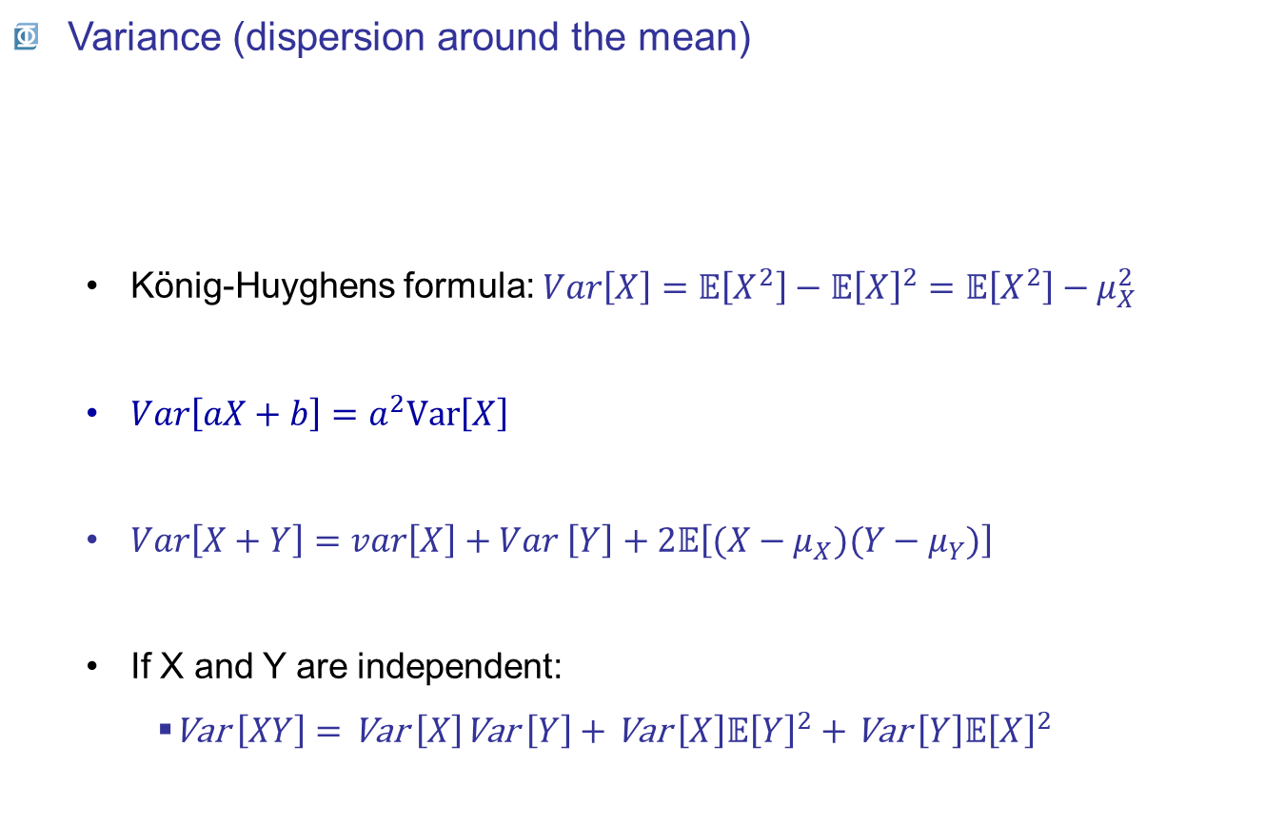

Random variables
Variance (dispersion around the mean)
König-Huyghens formula: $\begin{matrix}Var\left[X\right]=𝔼\left[X^{2}\right]−𝔼{\left[X\right]}^{2}=𝔼\left[X^{2}\right]−μ_{X}^{2}\end{matrix}$
$Var\left[aX+b\right]=a^{2}\text{Var}\left[X\right]$
$Var\left[X+Y\right]=var\left[X\right]+Var \left[Y\right]+2𝔼\left[(X−μ_{X})(Y−μ_{Y})\right]$
If X and Y are independent:
$\text{Var} \left[XY\right]=\text{Var} \left[X\right]\text{Var} \left[Y\right]+\text{Var} \left[X\right]𝔼{\left[Y\right]}^{2}+\text{Var} \left[Y\right]𝔼{\left[X\right]}^{2}$
$$σ_{X}^{2}=\text{Var} \left[X\right]=𝔼\left[{\left(X−μ_{X}\right)}^{2}\right]$$
(if it exists, cf Cauchy distribution)
$$Cov[X,Y]$$

Slide 21


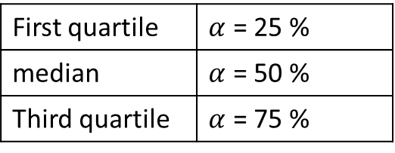
Random variables
Quantiles
The quantile $xα$ at probability level $α$, is
Confidence intervals
To sum up the variability of a r.v. bounded by two quantiles centered on the median.
Confidence interval at the probability level of $1 – α$:
$$F_{X}\left(x_{α}\right)=α ⇒ x_{α}=F_{X}^{−1}\left(α\right), 0≤α≤1$$
First quartile | $α$ = 25 %
median | $α$ = 50 %
Third quartile | $α$ = 75 %
Estimated moments are also random variables
$$\left[x_{α/2}; x_{1−α/2}\right]=\left[F_{X}^{−1}\left(α/2\right);F_{X}^{−1}\left(1−α/2\right) \right], 0≤α≤1$$

Slide 22
Outline
General definitions
Random variables
Definitions
Cumulative distribution function (CDF) and probability density function (PDF)
Discrete / continuous random variables
Statistical moments
Confidence intervals (CI)
Random vectors
Definitions
Moments
Copulas

Slide 23

Random vectors

Slide 24
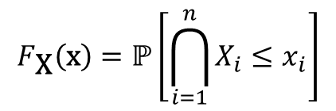
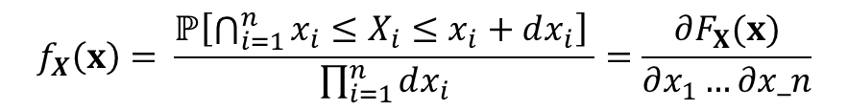
Random vectors
Definition
A random vector is a measurable function
Defined by:
Its joint cumulative distribution function
Its joint probability density function
$$\begin{matrix}\text{X} :Ω→𝕏⊆ℝ^{n} \\ ω ↦\text{x}=\text{X}\left(ω\right)={\left(X_{1}(ω),…,X_{n}\left(ω\right)\right)}^{t}\end{matrix}$$
$$F_{\text{X}}\left(\text{x}\right)=ℙ\left[\bigcap_{i=1}^{n}{X_{i}≤x_{i}}\right]$$
$$f_{X}\left(x\right)= \frac{ℙ\left[\bigcap_{i=1}^{n}{x_{i}≤X_{i}≤x_{i}+dx_{i}}\right] }{\prod_{i=1}^{n}{dx_{i}}}=\frac{∂F_{X}(x)}{∂x_{1}…∂x_n}$$

Slide 25
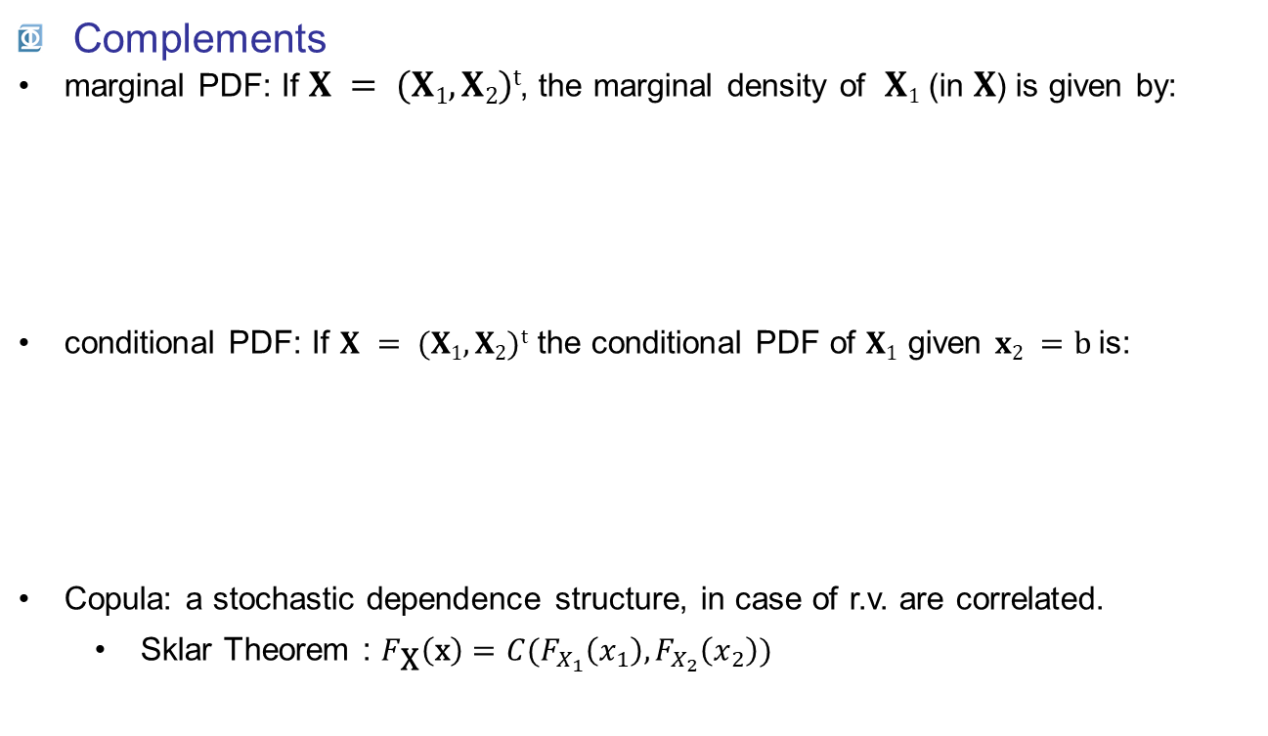
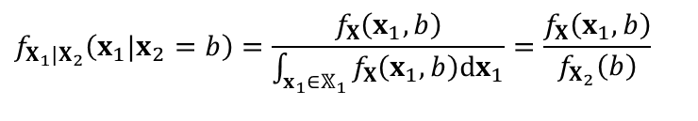
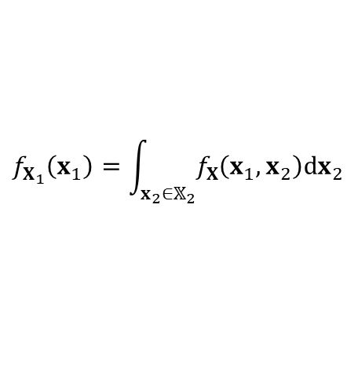
Random vectors
Complements
marginal PDF: If $X = (X1, X2)t$, the marginal density of $X1$ (in $X$) is given by:
conditional PDF: If $X = (X1, X2)t$the conditional PDF of $X1$ given $x2 =b$is:
Copula: a stochastic dependence structure, in case of r.v. are correlated.
Sklar Theorem : $F_{\text{X}}\left(\text{x}\right)=C(F_{X_{1}}\left(x_{1}\right),F_{X_{2}}\left(x_{2}\right))$
$$f_{X_{1}}\left(x_{1}\right)=\int_{x_{2}∈𝕏_{2}}{f_{X}\left(x_{1},x_{2}\right)dx_{2}}$$
$$f_{X_{1}|X_{2}}\left(x_{1}|x_{2}=b\right)=\frac{f_{X}\left(x_{1},b\right)}{\int_{x_{1}∈𝕏_{1}}{f_{X}\left(x_{1},b\right)dx_{1}}}=\frac{f_{X}\left(x_{1},b\right)}{f_{X_{2}}\left(b\right)}$$

Slide 26
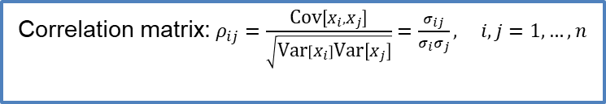

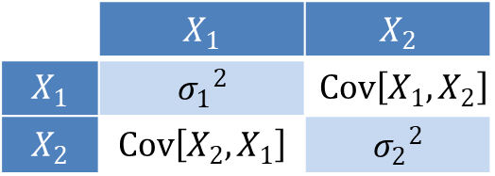
Random vectors
Moments
Expected value: vector of expected values of random variables
Covariance matrix:
$$𝔼\left[\text{X}\right]={\left(𝔼\left[X_{i}\right], i=1,…, n\right)}^{t}$$
$σ_{ij}=Cov\left[X_{i},X_{j}\right]=$ $𝔼\left[{(X}_{i}−{μ_{X}}_{i})(X_{j}−μ_{X_{j}})\right], i,j=1,…, n$
 | $$X_{1}$$ | $$X_{2}$$
$$X_{1}$$ | $${σ_{1}}^{2}$$ | $$Cov\left[X_{1},X_{2}\right]$$
$$X_{2}$$ | $$Cov\left[X_{2},X_{1}\right]$$ | $${σ_{2}}^{2}$$
Correlation matrix:$ρ_{ij}=\frac{\text{Cov}\left[X_{i},X_{j}\right]}{\sqrt{\text{Var}\left[X_{i}\right]\text{Var}\left[X_{j}\right]}}=\frac{σ_{ij}}{σ_{i}σ_{j}}, i,j=1,…,n$

Slide 27
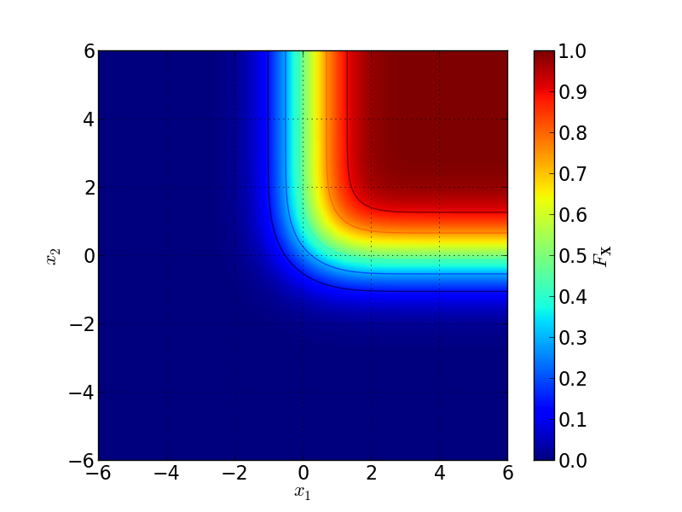
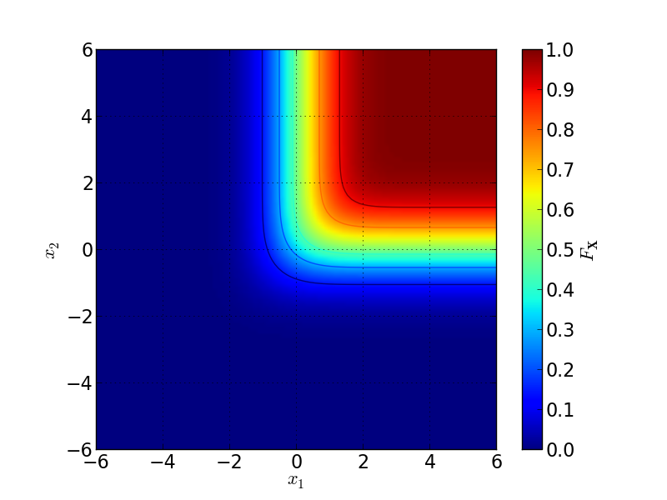
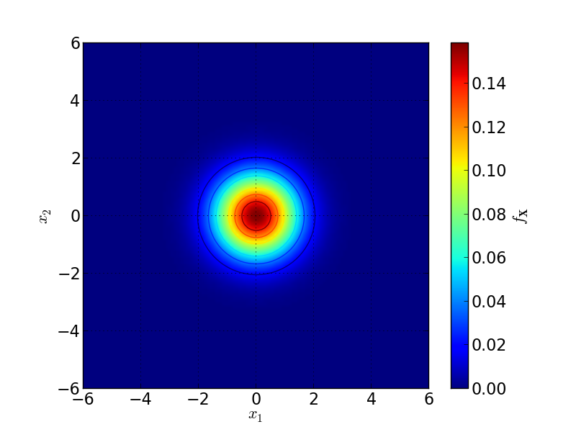
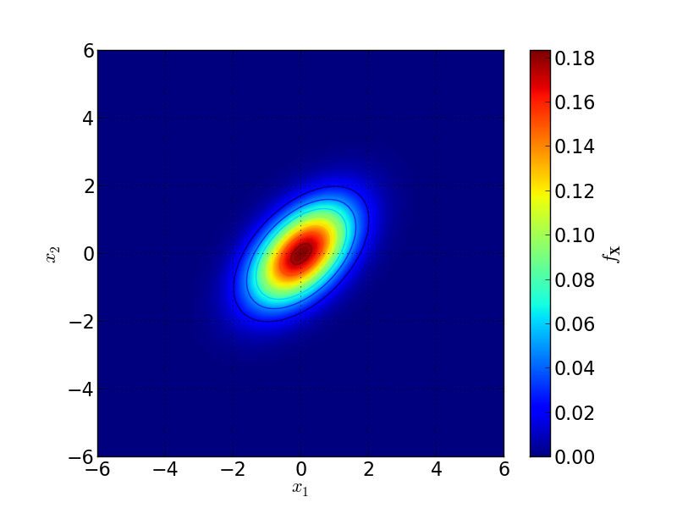

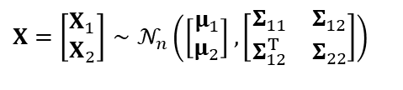

Random vectors
Multivariate normal distribution
$$X=\left[\begin{matrix}X_{1} \\ X_{2}\end{matrix}\right]∼𝒩_{n}\left(\left[\begin{matrix}μ_{1} \\ μ_{2}\end{matrix}\right],\left[\begin{matrix}Σ_{11} & Σ_{12} \\ Σ_{12}^{T} & Σ_{22}\end{matrix}\right]\right)$$
$$μ=\left[\begin{matrix}0 \\ 0\end{matrix}\right],Σ=\left[\begin{matrix}1 & 0 \\ 0 & 1\end{matrix}\right]$$
$$μ=\left[\begin{matrix}0 \\ 0\end{matrix}\right],Σ=\left[\begin{matrix}1 & 0,5 \\ 0,5 & 1\end{matrix}\right]$$

Slide 28
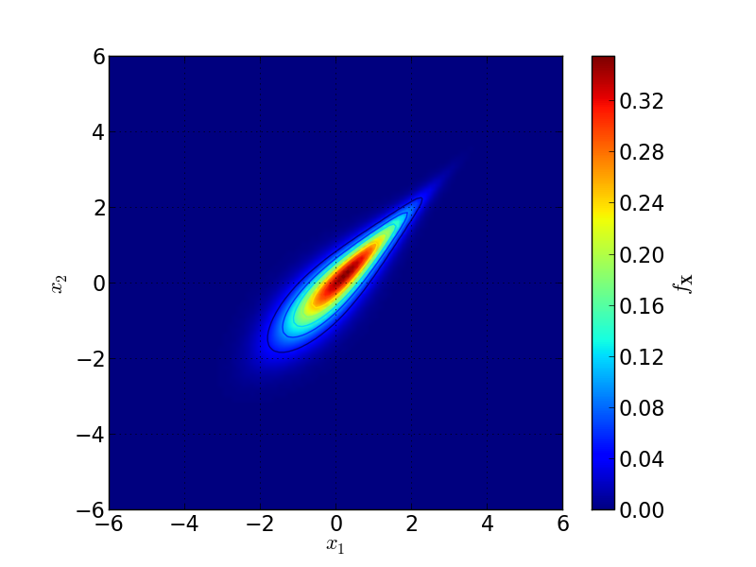

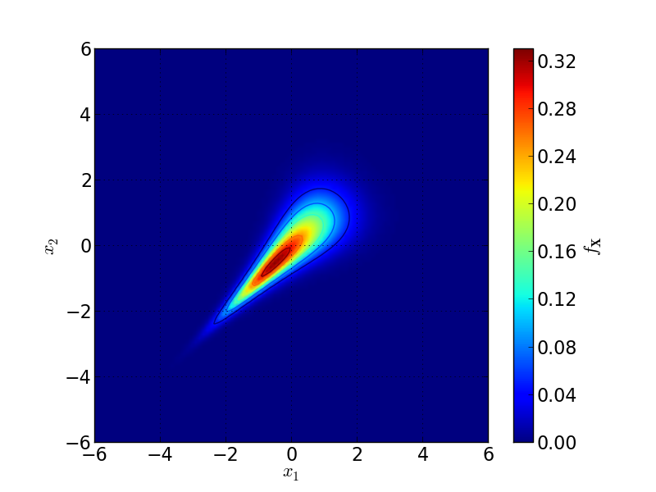
Random vectors
Multivariate normal distribution with copulas
Gaussienne (ρ₀ = 0,5)
Gumbel (θ = 3)
Frank (θ = 3)
Clayton (θ = 3)

Slide 29
Random vectors
Synthesis
Defined by a joint distribution …
… or a collection of marginal distributions, and a copula if required.
Used for multi-dimensional problems.

Slide 30
Some references
Probability, Random Variables and Stochastic Processes, 4th Edition International Edition, Athanasios Papoulis, S. Unnikrishna Pillai, Mc Graw Hill (2002) (www.mhhe.com/engcs/electrical/Papoulis)
Nelsen, Roger B. An introduction to copulas. Springer Science & Business Media, 2007.

