Slide 1

Covid-19 Vaccine Delivery
- Madhura Baxi

Slide 2
Motivation
Proposed Analysis
Seek Insight → What is the effect of different strategies of different countries and regions on vaccine administration?
Already Done:
What are the national and subnational trends in the number of vaccinations administered and number of people fully vaccinated ?
Assuming the current rate of vaccination, what percentage of the population will be fully vaccinated in each country & region by Fall 2021 ?
Data Description

Slide 3
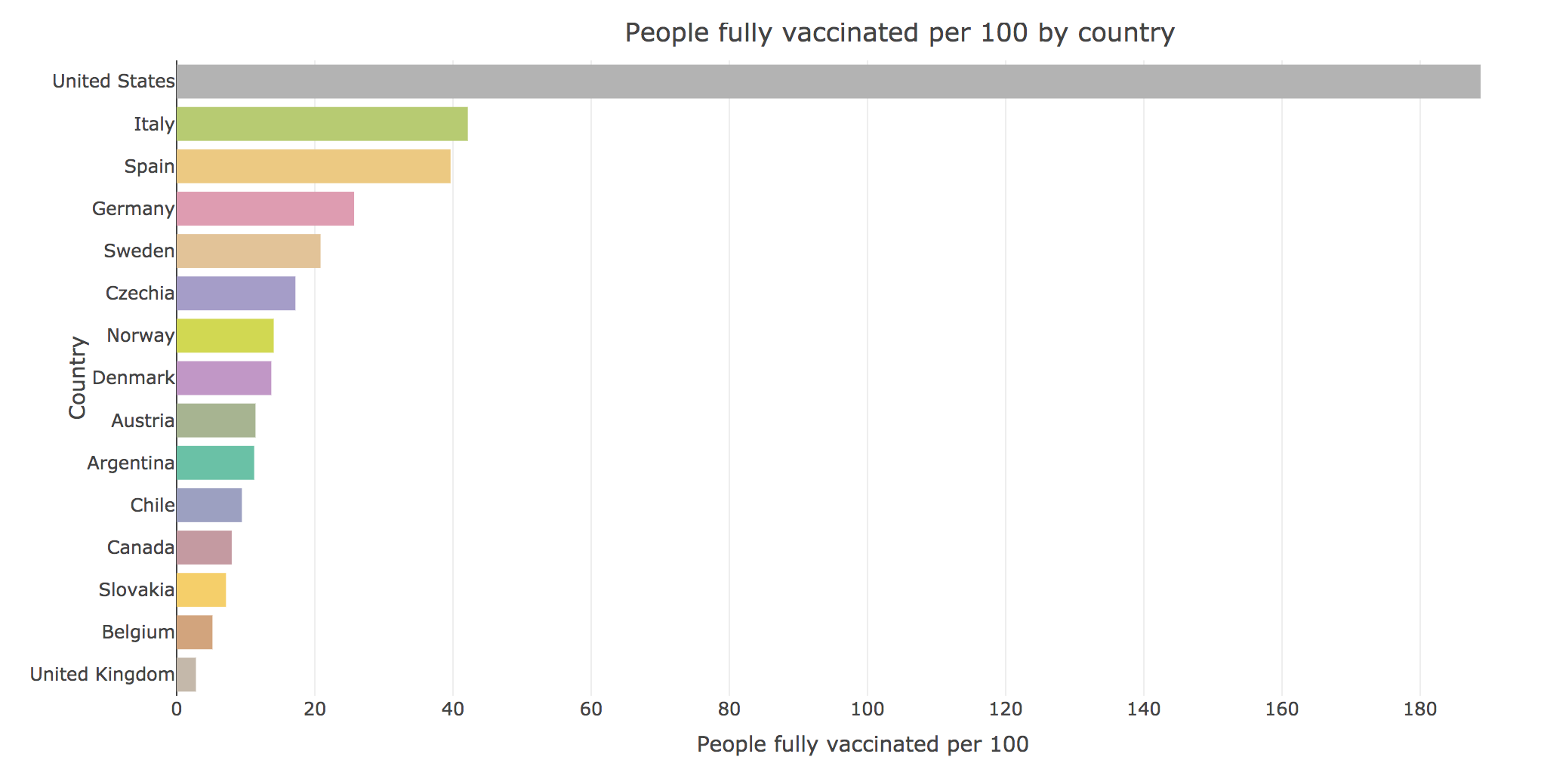
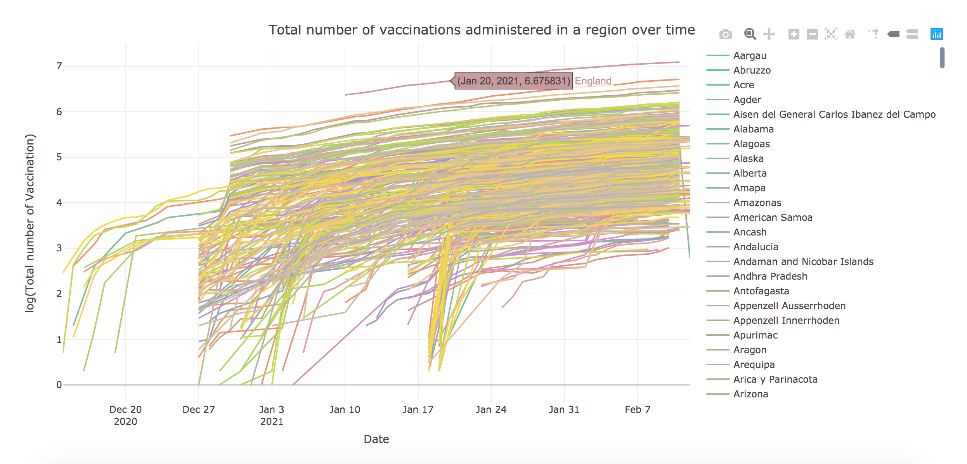
National and subnational trends: No of people fully vaccinated per 100 and vaccinations administered over time.
R: Plotly

Slide 4
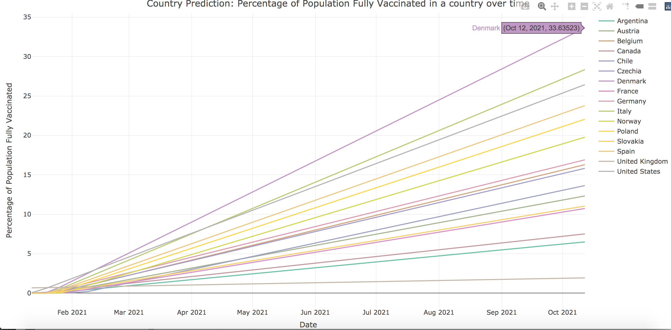
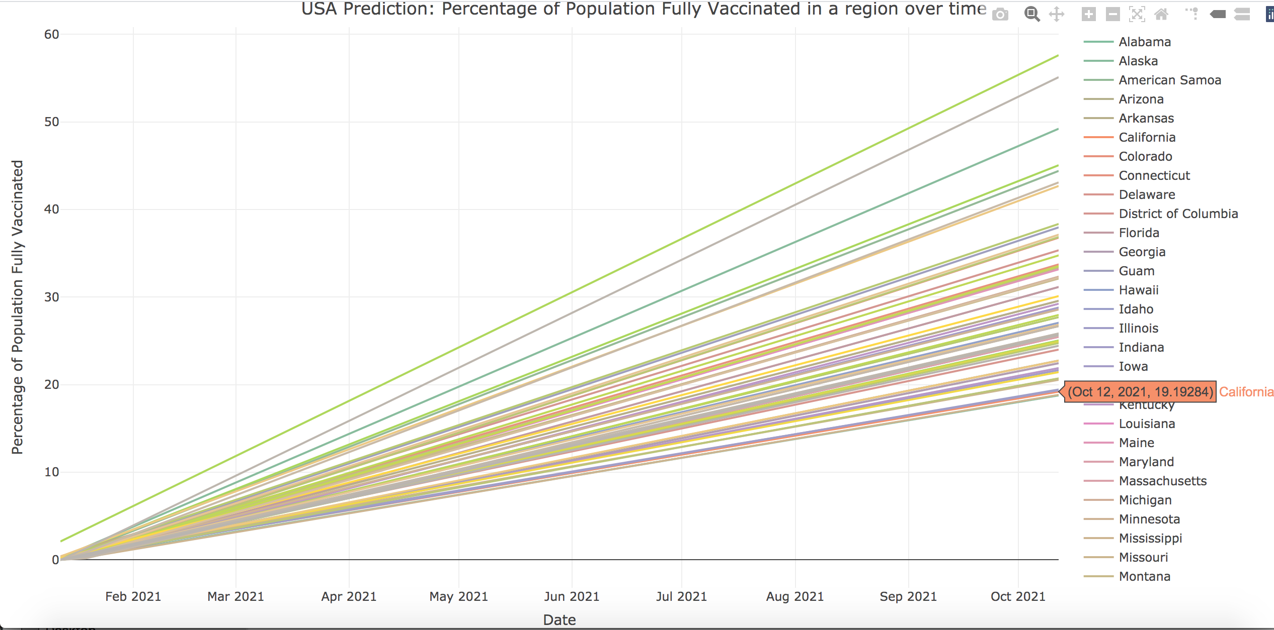
Top regions on track to be maximum % population fully vaccinated: Predicted using linear regression
Top 3 Countries:
Denmark
Italy
United States
Top 3 USA States:
Northern Mariana Islands
West Virginia
Alaska
Notes:
Top regions on track to be maximum % population fully vaccinated: Predicted using linear regression

Slide 5
Proposed Analysis
Seek Insight → What is the effect of different strategies of different countries and regions on vaccine administration?
Future Work:
Which region in each country currently has the lowest rate of vaccination and lowest rate of people fully vaccinated ?
Is the number of people fully vaccinated over time dependent on total number of vaccinations or country/region-specific strategies ?

