Slide 1
Progress Report – Model for TIS Identification by mRNA Sequence
邦齊
2026/05/25

Slide 2
Idea
Using sequential-based deep learning architectures
Less feature engineering
Capable to find out long distance cis-element regulation
Leverage pre-trained RNA foundation model
Roadmap
RNN ➔ Transformer ➔ Embed Token by Pretrained Model ➔ Fine-tuning on Pretrained RNA Model
➔ Explaining (sequence pattern)
➔ Sequence Generation

Slide 3
Conclusions
End-to-End deep-learning Based sequential model can achieve comparable result to traditional machine learning with extensive feature engineering
Fine-tuning on pretrained RNA foundation model to TIS classification task show potential efficacy on End-to-End modeling TIS prediction task
Larger Parameters and larger context show better performance on prediction TIS

Slide 4
Dataset
TISCalling/input_data at main · yenmr/TISCalling · GitHub
Category | Size | Description
True Positive | 4394 | TIS identified by Ribosome Profiling data (determined by ZTNB), intersect TIS by both bio-replicates
True Negative | 29877 | “These sites were located upstream of the most downstream TP TIS within the same transcript and were not marked as TP TISs” (Yen, 2025)
Note: it is possible multiple TIS from same transcript

Slide 5
Model Training Goal
One model for all TIS candidate (UTR/CDS, cognate/near-cognate)
Maximize AUPR for mixed groups of TIS
Maybe more focus on non-annotated TIS (Not adopted in this report)
Increase loss weight on non-annotated TIS
Select model by evaluation of dev-set that only include non-annotated TIS

Slide 6
Some Critical Choices
Sequence Classification or Token Classification ➔ sequence classification
If the input length is limited, whether to centralize candidate site? ➔ yes
How to feed the information of candidate TIS into network? ➔ by fix the position of candidate TIS in input (padding at both end when any ends with insufficient length)
Should I avoid group samples from same transcript (but different TIS) into same train/test group? ➔ yes
Which Evaluation Metric ➔ AUPR
How to fine-tuning with pretrained model ➔ try LoRA

Slide 7
Context Window Handling – to centralize TIS site in each sample
“P” stand for “Padding”
TIS
Seq1 PPPPPGAGAAFATGGGGCTTT
Seq2 TCGCGAGAACCATGGGGCTAG
Seq3 TCGCGAGAACCATGGGGPPPP

Slide 8
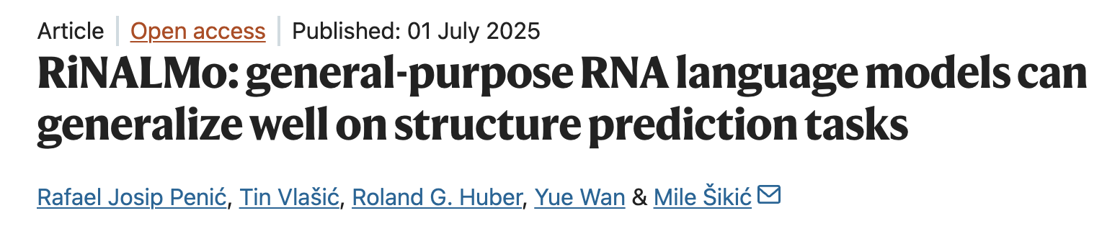
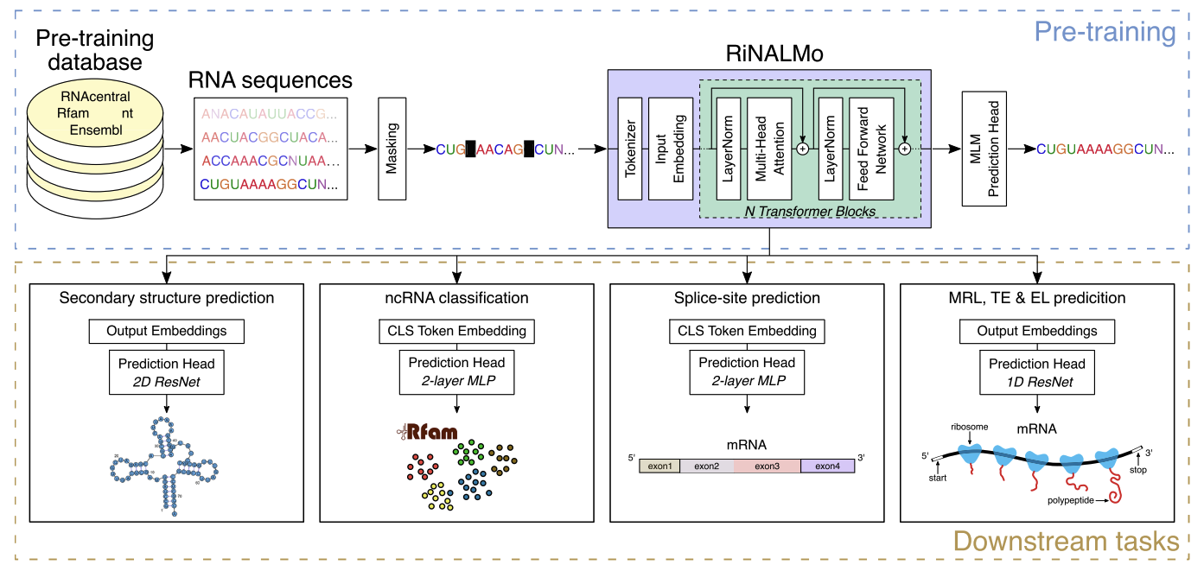
RiNALMo
650M parameters
pre-trained on 36M non-coding RNA (from RNAcentral)

Slide 9
Model Schema
Transformer (Pretrain RNA-LM + Classification Layer)
0 ~ 1
Sigmoid
Attention to rest
Pretrained RNA-LM
Tokenizer of RNA-LM
[CLS] A C C A U G G

Slide 10
Sample Grouping
train
val
test
Keep same transcript in same group (be one of train/dev/test) ➔ avoid model just remember the sequence had seems before
ATG
CTG
CTG
positive
Same group
ATG
CTG
CTG
negative
ATG
CTG
CTG
negative
ATG
CTG
positive
Same group
ATG
CTG
positive

Slide 11
Sample Grouping Based on Sequence Similarity
train
val
test
Instead using gene to group, group RNA on sequence similarity by mmseqs
default parameter:
mmseqs easy-cluster examples/DB.fasta clusterRes tmp --min-seq-id 0.5 -c 0.8 --cov-mode 1

Slide 12
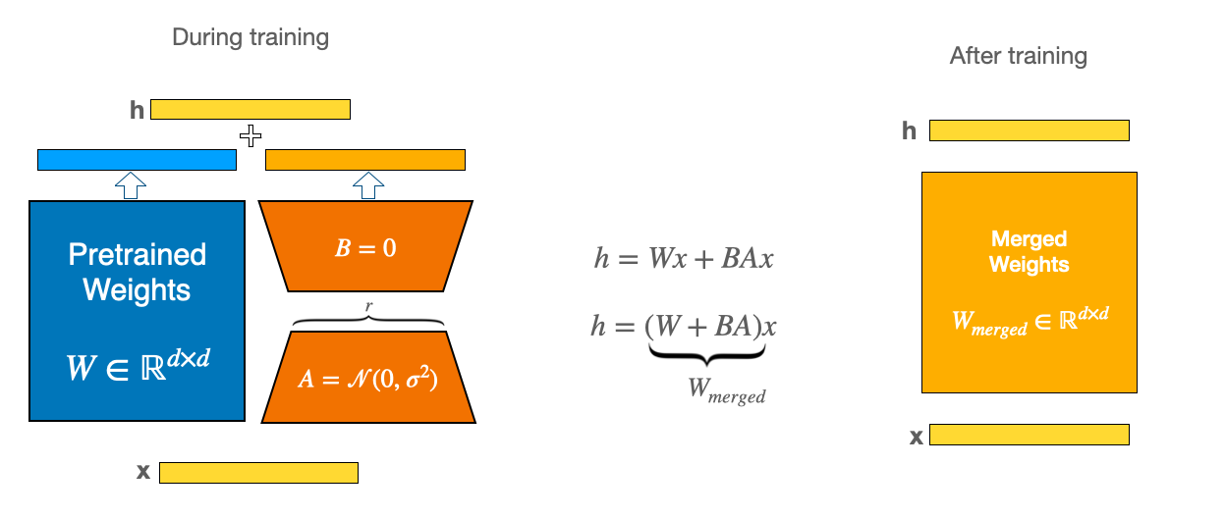
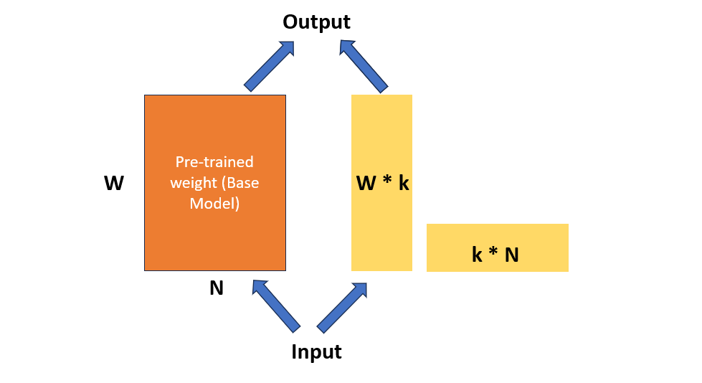
FT on Pretrained RNA model -- RiNALMo
Self-supervise learning from ncRNA
LoRA based PEFT (DoRA)

Slide 13
LoRA

Slide 14
Training / Evaluation Flow (two variant)
0.7 0.1 0.2
Single fold
Select candidate hyperparameters by val set; evaluate by test set
train
val
test
0.8 0.2
Trained with previous determined hyperparameters in each fold, average test result from each fold
train
test
train
test
train
5 fold average on test set
train
test
train
train
test
train
test
train

Slide 15
Performance - Compare to TISCalling
transcript-aware train/test split
5 fold cross validate on test set
Model | Context (nt) | category | Avg Test Set (~0.2X) | Avg. Balanced F1 | Avg. Balanced MCC | Avg. Balanced AUCROC
TISCalling (RF) | 200 | 5UTRATG | 318.6 | 0.861 | 0.724 | 0.939
TISCalling (GB) | 200 | 5UTRnonATG | 3534.6 | 0.890 | 0.780 | 0.958
TISCalling (RF) | 200 | CDSATG | 116.0 | 0.861 | 0.718 | 0.939
TISCalling (LGR) | 200 | CDSnonATG | 591.0 | 0.703 | 0.409 | 0.797
RiNALMo-giga (DoRA) CLS, fixed window | 200 | 5UTRATG | 384 | 0.893 | 0.779 | 0.962
RiNALMo-giga (DoRA) CLS, fixed window | 200 | 5UTRnonATG | 4977.4 | 0.834 | 0.744 | 0.983
RiNALMo-giga (DoRA) CLS, fixed window | 200 | CDSATG | 142.2 | 0.886 | 0.766 | 0.963
RiNALMo-giga (DoRA) CLS, fixed window | 200 | CDSnonATG | 675.8 | 0.483 | 0.425 | 0.883
RiNALMo-giga (DoRA) CLS, fixed window | 1000 | 5UTRATG | 414 | 0.948 | 0.896 | 0.990
RiNALMo-giga (DoRA) CLS, fixed window | 1000 | 5UTRnonATG | 5230 | 0.850 | 0.764 | 0.985
RiNALMo-giga (DoRA) CLS, fixed window | 1000 | CDSATG | 121 | 0.951 | 0.901 | 0.995
RiNALMo-giga (DoRA) CLS, fixed window | 1000 | CDSnonATG | 396 | 0.477 | 0.416 | 0.894
Not cv result

Slide 16
Performance between different context selection
Parameter (million) | Context (hundred nt) | left window (hundred nt) | right window (hundred nt) | (Aupr – 0.9) * 10000 | mcc | CV result | Split method
659 | 2 | 1 | 1 | 783 | 907 | V | Gene id
34 | 3 | 2 | 1 | 740 | 884 |  | Gene id
34 | 4 | 2 | 2 | 763 | 900 | V | Gene id
34 | 5 | 1 | 4 | 811 | 921 |  | Gene id
34 | 5 | 2 | 3 | 783 | 900 |  | Gene id
34 | 5 | 3 | 2 | 770 | 912 | V | Gene id
34 | 5 | 3 | 2 | 771 | 905 | V | Seq sim.
34 | 5 | 4 | 1 | 764 | 906 |  | Gene id
34 | 6 | 1 | 5 | 818 | 915 |  | Gene id
34 | 8 | 3 | 5 | 827 | 909 |  | Gene id
34 | 10 | 5 | 5 | 820 | 910 |  | Gene id
150 | 10 | 5 | 5 | 837 | 924 |  | Gene id
659 | 10 | 5 | 5 | 877 | 951 |  | Gene id
Recommend using AUPR as comparing score (more stable)
Gradually performance decreasing when move 500nt window around TIS from right to left (but cv is required)
Larger model and larger context show performance improving
Performance show no significant difference between cluster by gene_id or by sequence similarity

Slide 17
Group Split by Transcript or by Sequence-Similarity
Steps
Export sequence as Fasta
Run MMseqs2 with command (easy-cluster mmseqs_work/input.fasta mmseqs_work/clusterRes mmseqs_work/tmp --min-seq-id 0.5 -c 0.8 --cov-mode 1) to cluster similar sequence
Read cluster_id of each sequence
Split training / dev / test group by using sklearn.model_selection.StratifiedGroupKFold
sgkf = StratifiedGroupKFold(
n_splits=n_splits, shuffle=True, random_state=seed)
for fold_idx, (train_rel, val_rel) in enumerate(
sgkf.split(indices, labels, groups=group_ids)):
…

Slide 18
What larger context model focus on when comparing to smaller context model
Using Integrated Gradient to evaluate each token’s input
Experiments
Saliency map on whole sequence
Saliency map on extra region out of TIS flanking region
Study the sequence pattern with high attribution score

Slide 19
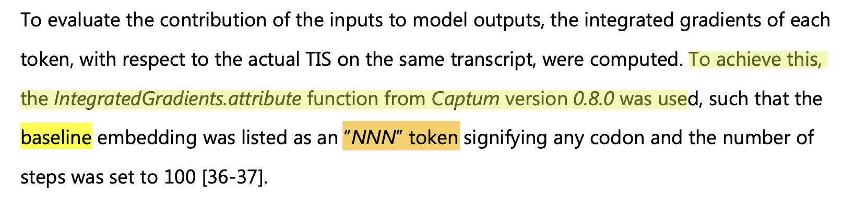
Integrated Gradient
Have to iterate with sufficient steps for convergency (relative delta < 0.05 is considered accetable)
Choose baseline
Replace token as “[MASK]” Token
Replace token as “[PAD]” Token ➔ not suitable (padding token may not trained during pre-training)
Average of “xxxxATGxxxx” sequence (according to the dataset distribution)
1k vs 201: ---[M]----[----201----]----[M]-----

Slide 20
Hard to Converge by Mask Token
By arbitrary picked sequence
model | baseline | steps | delta | relative delta | difference
giga-1k | mask token | 64 | -14.1960 | 1.5614 | 9.0916
giga-1k | mask token | 128 | 3.3869 | 0.3725 | 9.0916
giga-1k | mask token | 256 | -1.0490 | 0.1154 | 9.0916
giga-1k | mask token | 512 | 0.5066 | 0.0557 | 9.0916
giga-1k | mask token | 1024 | -0.8124 | 0.0894 | 9.0916
giga-1k | mask token | 2048 | 0.0370 | 0.0041 | 9.0916
giga-201nt | mask token | 64 | 1.1233 | 0.7712 | -1.4566
giga-201nt | mask token | 128 | -7.7278 | 5.3053 | -1.4566
giga-201nt | mask token | 256 | 1.0205 | 0.7006 | -1.4566
giga-201nt | mask token | 512 | -7.4202 | 5.0941 | -1.4566
giga-201nt | mask token | 1024 | 1.1718 | 0.8045 | -1.4566
giga-201nt | mask token | 2048 | -3.0214 | 2.0743 | -1.4566
giga-201nt | mask token | 4096 | 0.7857 | 0.5394 | -1.4566
giga-201nt | N token | 64 | 3.3694 | 0.8045 | -4.1880
giga-201nt | N token | 128 | 13.9159 | 3.3228 | -4.1880
giga-201nt | N token | 256 | -2.5844 | 0.6171 | -4.1880
giga-201nt | N token | 512 | 10.5374 | 2.5161 | -4.1880
giga-201nt | N token | 1024 | 4.8151 | 1.1497 | -4.1880
giga-201nt | N token | 2048 | -2.0104 | 0.4800 | -4.1880
giga-201nt | N token | 4096 | 0.6166 | 0.1472 | -4.1880
giga-1k | mask token out of 201 flank | 64 | 18.3302 | 2.0030 | 9.1513
giga-1k | mask token out of 201 flank | 128 | -6.6050 | 0.7218 | 9.1513
giga-1k | mask token out of 201 flank | 256 | -3.1762 | 0.3471 | 9.1513
giga-1k | mask token out of 201 flank | 512 | -2.7398 | 0.2994 | 9.1513
giga-1k | mask token out of 201 flank | 1024 | -1.3167 | 0.1439 | 9.1513
giga-1k | mask token out of 201 flank | 2048 | -0.8001 | 0.0874 | 9.1513

Slide 21
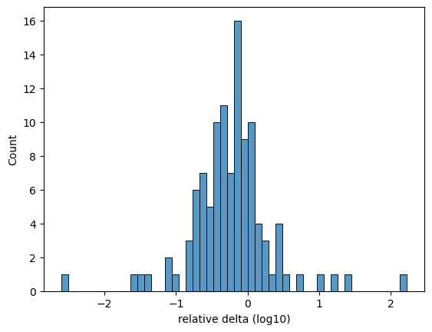
Distribution of Delta -- widely distributed
4 / 109 < 0.05
48 / 109 < 0.5

Slide 22
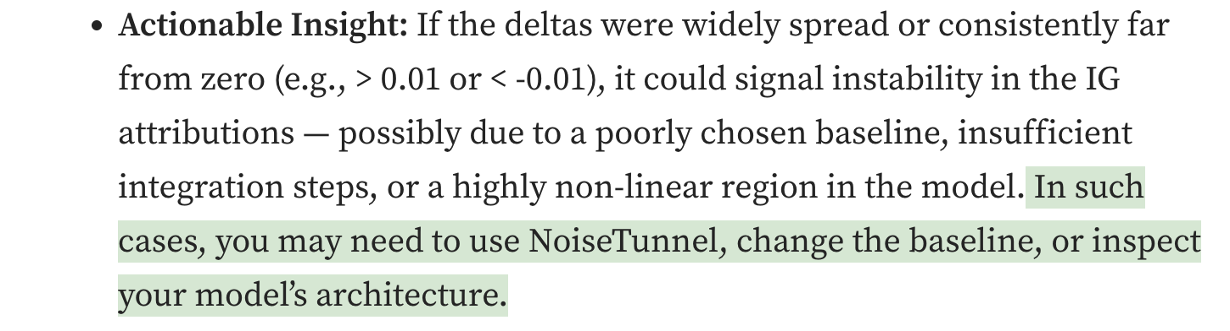
Have to Improve Convergence Problem
https://medium.com/@nivedhithadm/using-captum-for-interpreting-pytorch-models-in-production-ddf91fbbd3fd
Potential Action can try:
Re-train model without padding token masking , then use padding token as baseline
Re-train model without padding token masking, and use Mask token as Padding token

Slide 23
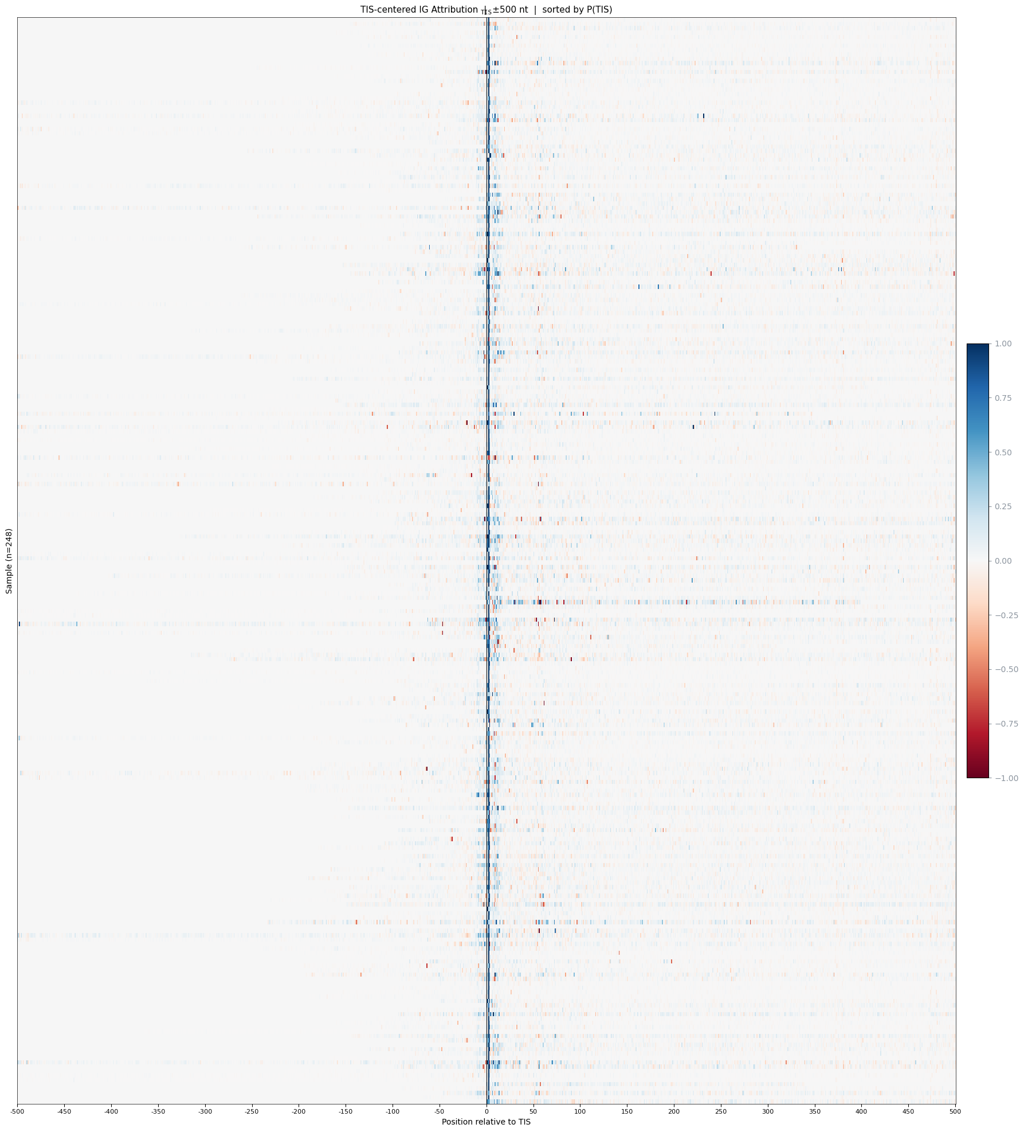
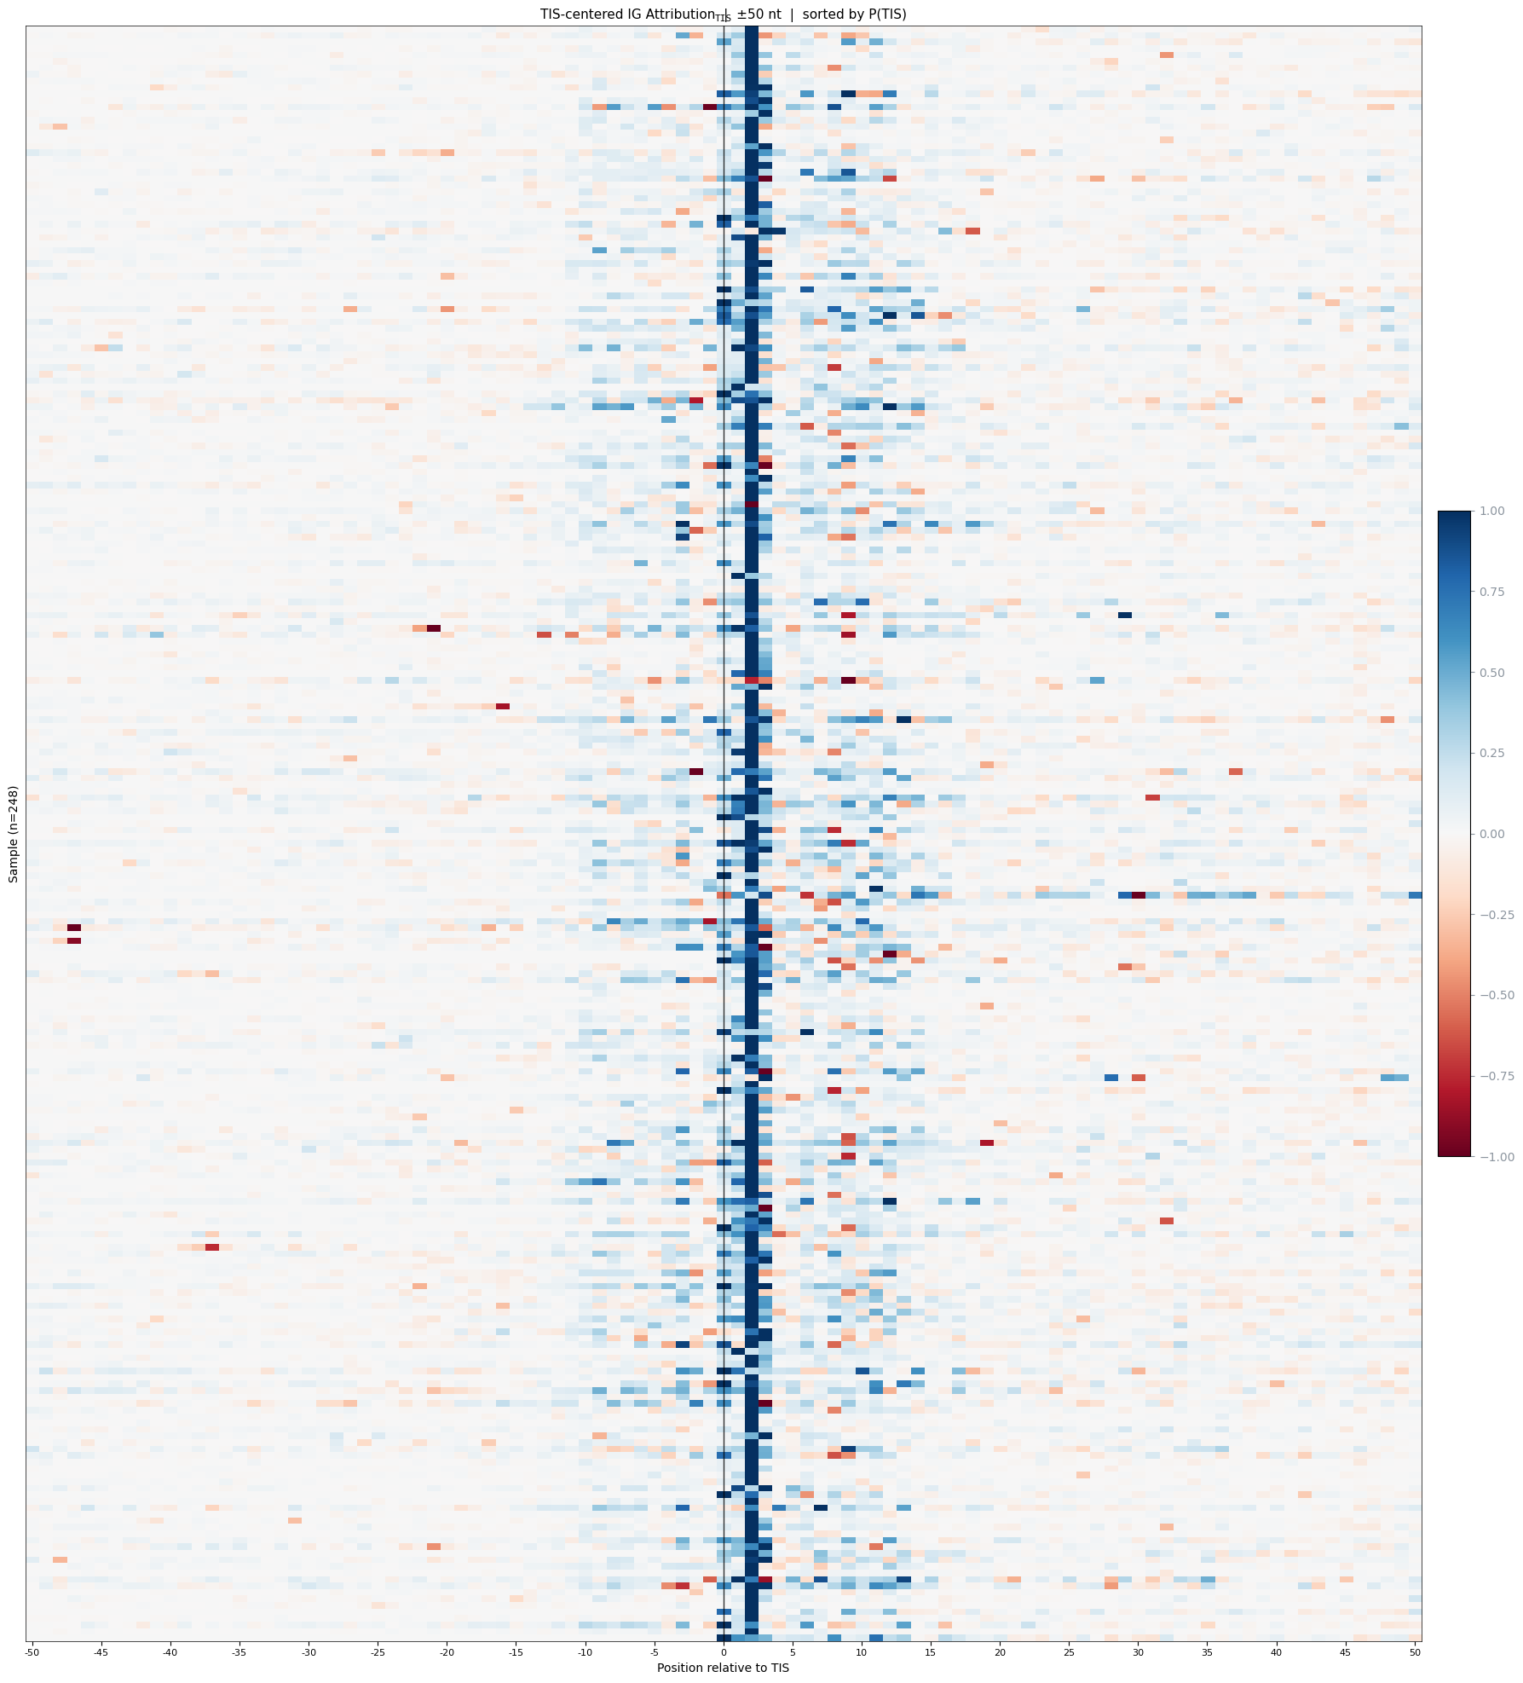
Heatmap of Positive Prediction Sample on Integrate Gradient Attributions
On select relative_delta < 0.1,
Predict as positive label
500nt on each side
50nt on each side

Slide 24
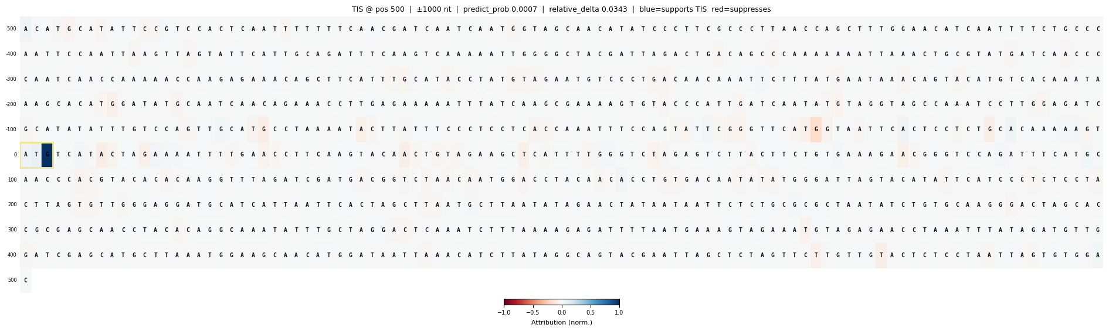
“[MASK]” Token as Baseline, Token Contribution to Negative Prediction
By RiNALMo Giga-1k
Normalize to abs(attrs).max()

Slide 25
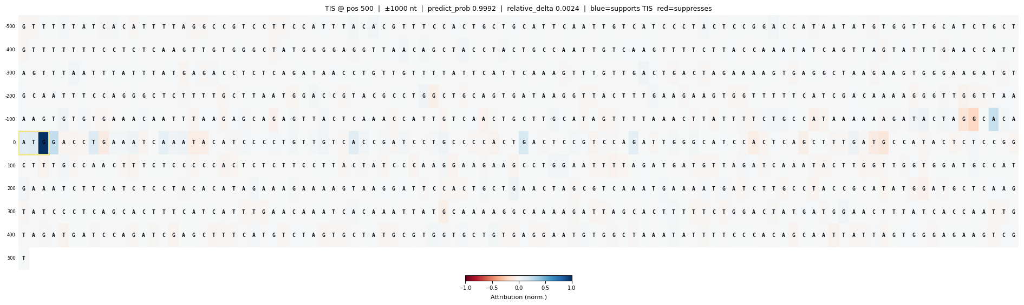
“[MASK]” Token as Baseline, Token Contribution to Positive Prediction
By RiNALMo Giga-1k

Slide 26
Select samples with prediction changed when provide larger context
Padding around TIS 201nt flank region to feed giga-1k model
TIS
normal
padding
Select sample if prediction changed
TIS
modified
padding
padding
padding
padding
201nt
Label | Total | Giga1k | Giga1k-input-truncated | Found
1 | 879 | 1 | 0 | 84
0 | 6006 | 0 | 1 | 25
Find out

Slide 27
Baseline for Extra Context Contribution
TIS
normal
padding
Select sample if prediction changed
TIS
baseline
padding
…MMMM…
…MMMM...
padding
201nt
Replace to [MASK] token

Slide 28
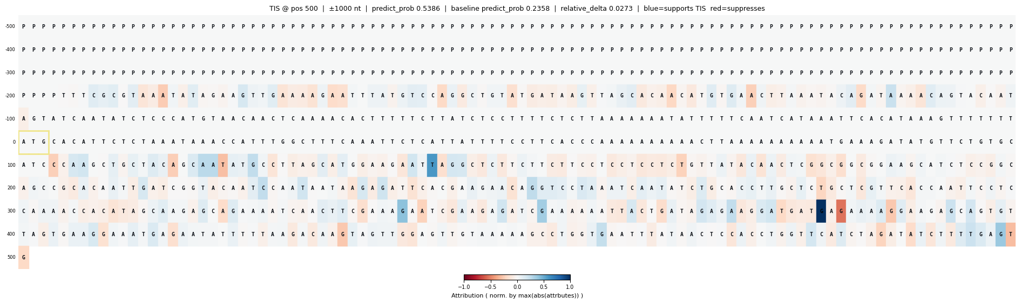
Token Contribution of Masking out of central 201 Token as Baseline
Predict Positive while baseline predict negative
201 flanking region (will show no attribution since this region server as baseline)

Slide 29
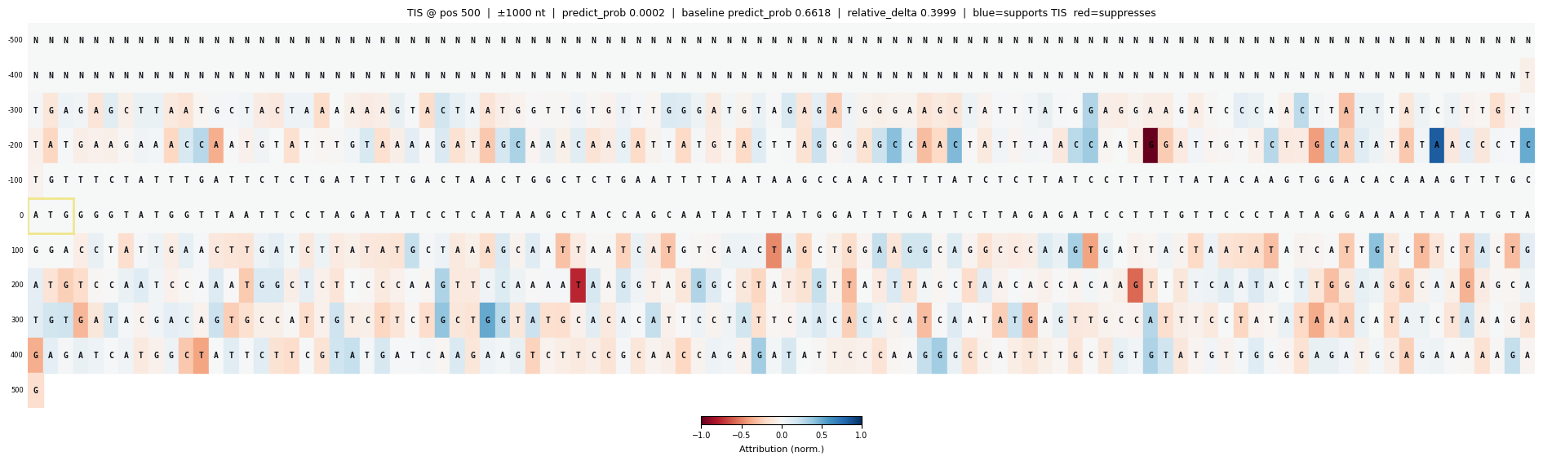
Token Contribution of Masking out of central 201 Token as Baseline
Predict Negative while baseline predict positive
Upstream start codon (?)
baseline

Slide 30
Conclusion on Integrate Gradient Data
難以收斂，多數的baseline方法不奏效，唯一奏效的baseline(Mask token)也只有在非常高的step數才能讓relative delta接近0.1
若以整個sequence作為baseline，可看到主要貢獻在分類判斷的位置會是靠TIS鄰近的幾個nt，而TIS (+0, +1 這兩個位置的貢獻不大，這應該是跟training data set已經預先篩選僅為幾個特定的codon有關）
若以只有提供中心200nt作為baseline，extra region的貢獻，attribution低於0.1的資料極少；此外序列會呈現許多個位置皆有正面和負面貢獻，目前還沒有觀察出pattern

Slide 31
Next Steps on Explanation
Study other explanation methods
Replacement /
Study the methods to investigate sequence pattern

