Slide 1





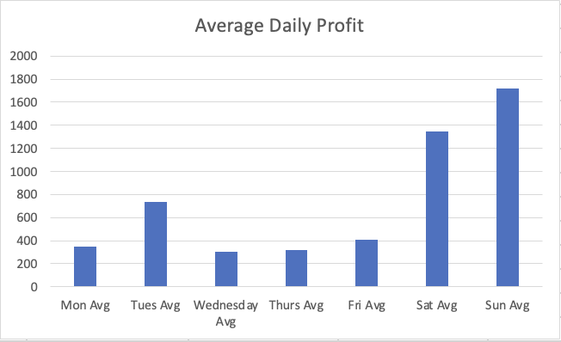
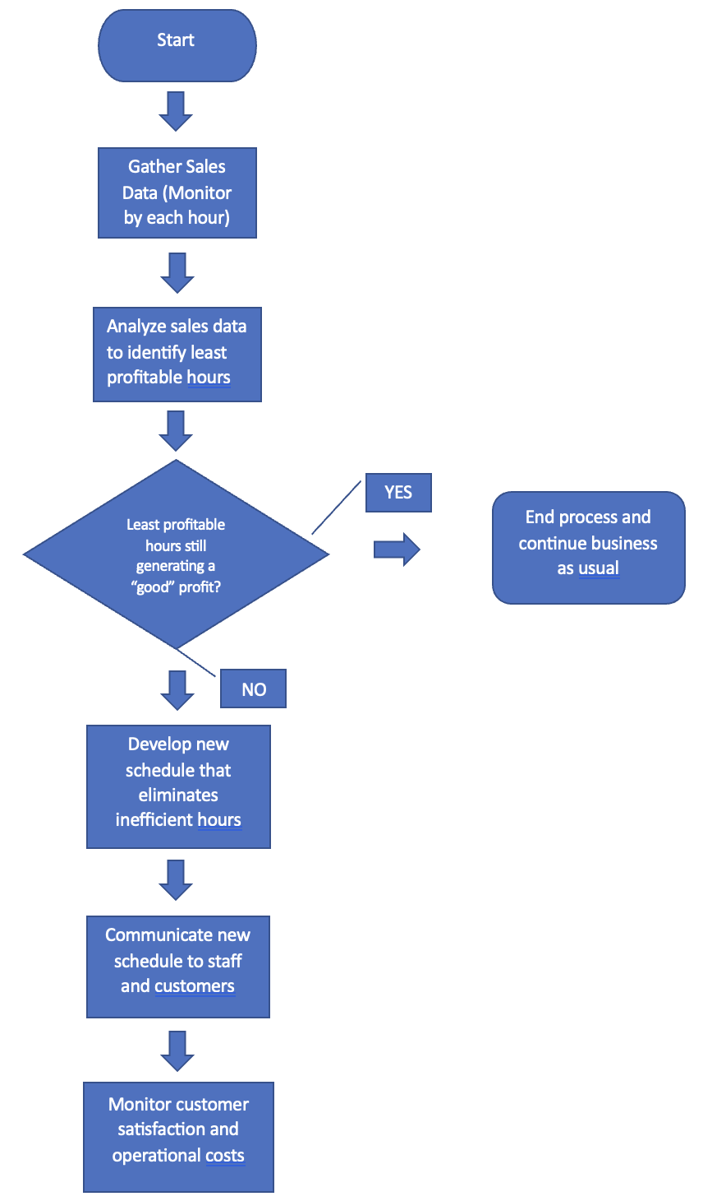
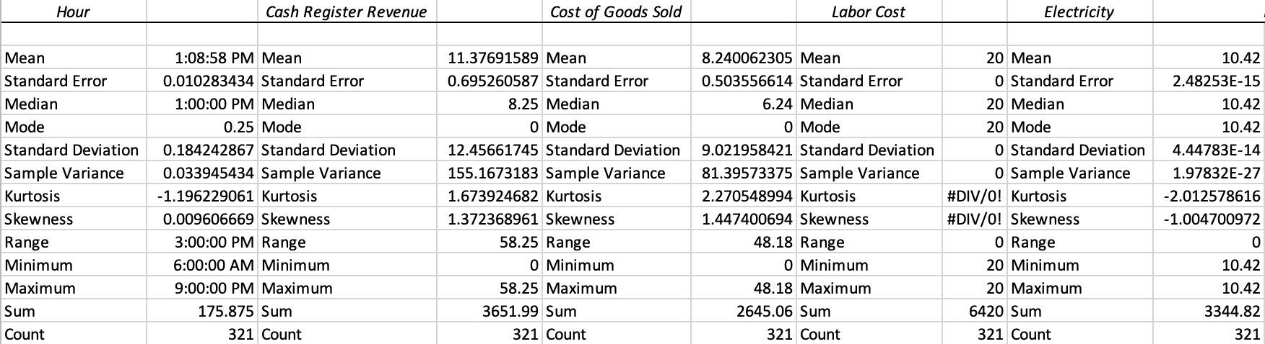
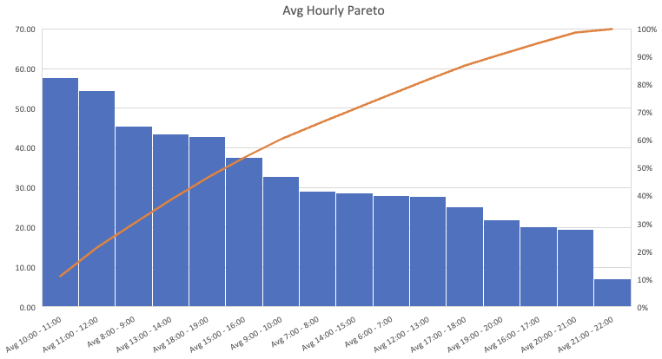


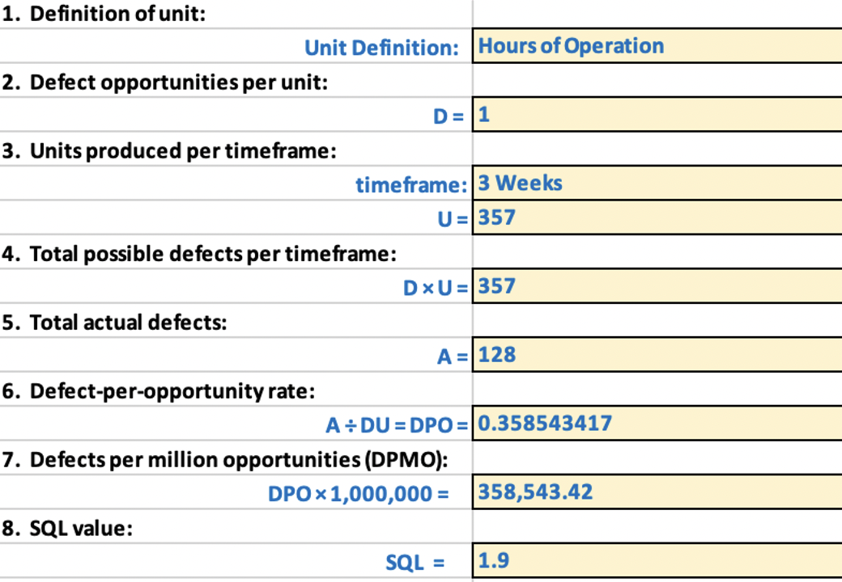
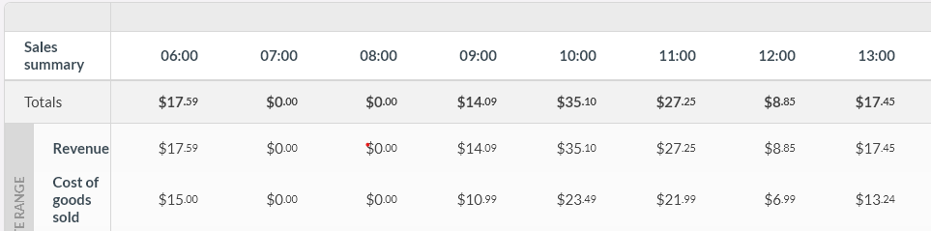
Business Hours Process Improvement
By: Matthew Belizaire
Key Dates: Define: Measure: Analyze: Improve: Control:
4/17/23 – 4/23/23 4/24/23 – 5/7/23 5/8/23 – 5/23/23 5/24/23 – 6/14/21 6/15/23 - Ongoing
Problem Statement:
Our laundromat business has been operating on extended hours for a many years. This has led to employee burnout and increased operational costs. The burnout is affecting the quality of work and potentially reducing customer satisfaction.
The business suspects that there are specific hours of operation that are less profitable.
The goal is to identify these hours, eliminate them to reduce operational costs, and minimize losses without negatively impacting customer satisfaction.
Process Map:
Should we close earlier on least profitable days?
Cut 3-week sample hours back by 36
Improved SQL to 2.05 from 1.86
Ranking
Sun
Sat
Tues
Fri
Mon
Thurs
Wed
Helps determine what data we need to analyze
Average hourly earnings indicate late nights earns the least
Identifies problem within design
The revenue generated during the sample hours and days are consistent and predictable. It suggests that the process is operating within acceptable limits.
Business Impact:
By optimizing our hours of operation, we can reduce operational costs and increase profits. We believe that we can save money every month by eliminating inefficient hours. Success will be measured by tracking our operational costs. The key output is the reduction of operational costs (employee wages, electricity bill, etc.). We are aiming to cut operational hours down by at least 8.4% per week, or about 10 hours.
Baseline SQL:
Sales Summary (Baseline):
< $1 earned within hour = defect
Filtering sales per hour on specified dates allowed for precise measurements

Slide 2
Define
Problem:
Our family’s laundromat business has operating on extreme hours for almost a decade
Suspected causes: Employee burnout and increased operational costs
Employee burnout leads to lower quality work and potentially decreased customer satisfaction
Objective:
Identify and eliminate less profitable hours of operation by 8.4% or 10 hours per week.
Reduce operational costs which saves us money while minimizing profit lost from customers (Cash Register Revenue)
Expected Benefits:
Reduce operational costs and increase profits
Improve employee well-being and work quality
Enhance or maintain overall customer satisfaction

Slide 3
Define: Business Impact
Why Fix the Problem?
Optimize hours of operation to:
Reduce operational costs (lower electricity bill, labor cost, etc.)
Estimated Benefit:
Monthly savings by eliminating inefficient hours
Key Measurements of Success:
Increased SQL
Improvement Objective/Goal:
Reduce hours of operation by >= 10 hours per week while minimizing financial loss
Actual Hour decrease dependent on analysis
Improved quality of processes (Sigma Quality Process)
Decrease employee burnout (too many hours has been a complaint)
Potentially increase profitability.
Reduction in weekly employee payout
Reduction in electricity costs
Reduction in weekly operating hours

Slide 4
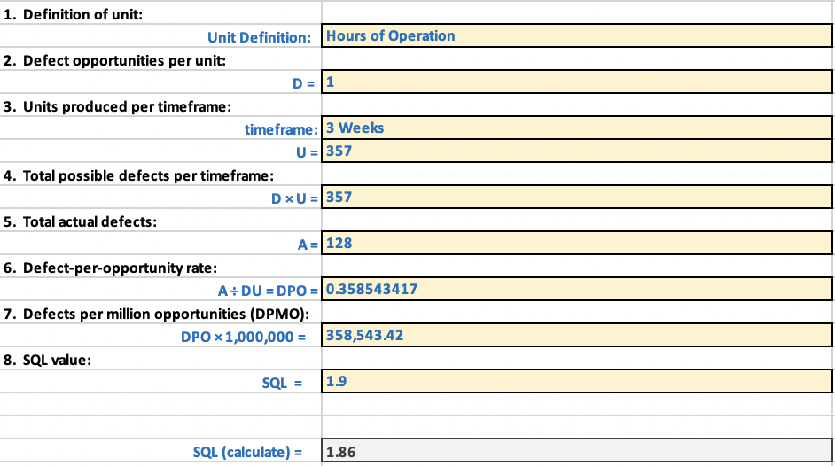
Define: Definitions and Terms
Baseline Sigma Quality Level:
The business operated for a total of 357 hours during the three-week sample period. Any hour that generated less than a dollar worth of cash register revenue is considered a defect process. Throughout the observation period, there were a total of 128 instances where the revenue generated during an hour fell below the designated threshold.

Slide 5
Measure: Data Stratification Tree
Questions About Process
What is the relationship between Cash Register Revenue and various factors?
Stratification factors
X Variables
Measurements
Are there any patterns in Cash Register Revenue that can be identified?
How does Cash Register Revenue vary based on different time periods and other variables?
Day of Week
Day of the week, Monday to Sunday
Cash Register Revenue
Hour of Day
Hour of the day, 6:00, 7:00, 8:00, etc.
Do certain days perform significantly better than others?
(Output Y)
Free Soap Day
0 = Not a free soap day, 1 = Free soap day
Does Cash Register Revenue show any trends based on specific hours of the day?
Daily profit, the total earned during specified period
Machine cycle revenue, the total earned from washers and dryers during specified period
Are there any significant variations in Cash Register Revenue during weekdays versus weekends?
Does the presence of a Free Soap Day promotion impact Cash Register Revenue?

Slide 6
Measure: Data Collected and Data Type
Cash Register Revenue (Continuous): The total revenue generated from sales transactions made at the cash register.
Cost of Goods Sold (Continuous) : Cash Register Revenue minus the sales tax.
Labor Cost (Continuous): The cost associated with employing workers.
Water (Continuous): The hourly average of how much the monthly water bill is. Helps estimate how much one hour adds towards that cost.
Rent (Continuous) : The cost of renting or leasing the premises or space where the business operates.
Electricity (Continuous): The hourly average cost of how much the monthly electricity bill is. Helps estimate how much an hour adds to that cost.
Hourly Machine Cycle Revenue (Continuous): The average hourly generated amount from the operation of washer and dryers. *Note: Hourly cost were not provided from data source, so this had to be averaged out as well as only the daily total earnings were reported.
Machine Cycle Revenue (Continuous): The total revenue generated from the operation of all washers and dryers.
Hourly Profit (Continuous): The profit earned per hour, calculated by subtracting the cost of goods sold, labor cost, water, rent, electricity, and other expenses from the hourly revenue.
Daily Profit (Continuous): The profit earned for the entire day, calculated by subtracting the cost of goods sold, labor cost, water, rent, electricity, and other expenses from the daily cash register and machine cycle revenue.
Free Soap Day (Discrete): A categorical variable indicating whether it was a day when soap was provided for free (0 for no, 1 for yes).
Date (Discrete): It represents specific calendar.
Day of Week (Discrete): It represents the days of the week.
Hour (Discrete): It represents specific hours (interval) of the day.

Slide 7
Manually collected data from VendHQ service.
VendHQ by Lightspeed is a robust and feature-rich POS system that helps retailers effectively manage their day-to-day operations, optimize sales, and gain insights into their business performance.
Filtered out relevant data for my process. Hourly intervals, correct dates, etc.
Collected 3 weeks worth of sample data from 4/24/23 - 5/7/23 because data was collected live, week to week to week from the initial conception of the project.
Ideal data would have least 6 months of data. This is possible with our legacy data but did not fit scope of project (And manual conversion would take too long!)
Collecting fewer samples would have left our findings and analyzation less precise in terms of our findings. Even the current sample size may not be conclusive enough.
Measure: Data Collection Process
Snippet of VendHQ Filtered Data:

Slide 8
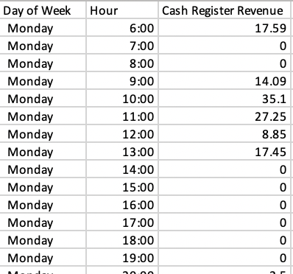


Measure: Measurement Error
As a small run family business, there are bound to be errors. Some of which are suspected to have made it into our sample of data. Here are some ways in where the measurement error could’ve stem from and how to minimize them:
Human Error: When manually collecting data, human errors can occur during data entry or recording. For example, typos, inattentiveness or misinterpretation of values can lead to inaccuracies. To minimize this error, we can implement double-checking procedures, stress the importance of accurate data representation to employees, use automated data entry tools, and provide proper training to the individuals responsible for data collection.
System or Software Errors: There may be instances where our VendHQ system or software could have technical issues that affect the accuracy of the data recorded. To minimize this error, we can ensure that we are using the latest version of the software and promptly report any issues to the VendHQ support team as we have in the past.
Data Transfer: If there is a step involved in transferring or recording data from VendHQ to a data collection tool or spreadsheet in this instance, errors can occur during this process. It's important to verify the accuracy of the data during the transfer and ensure that all fields are correctly mapped and recorded.
6 consecutive hours with no sales is extremely uncommon. Product of measurement error?
Here is some data from our sample that potentially experienced one of the above:

Slide 9
Analyze: Bar chart
Discovered which days in our 3-week sample performed the best
Rank:
Sunday, Saturday, Tuesday, Friday, Monday, Thursday, Wednesday
Gives us incentive to investigate why the poor performers are lagging behind
If no outright conclusion is drawn, we can look to these days as potentially having their hours cut, as is the goal.

Slide 10
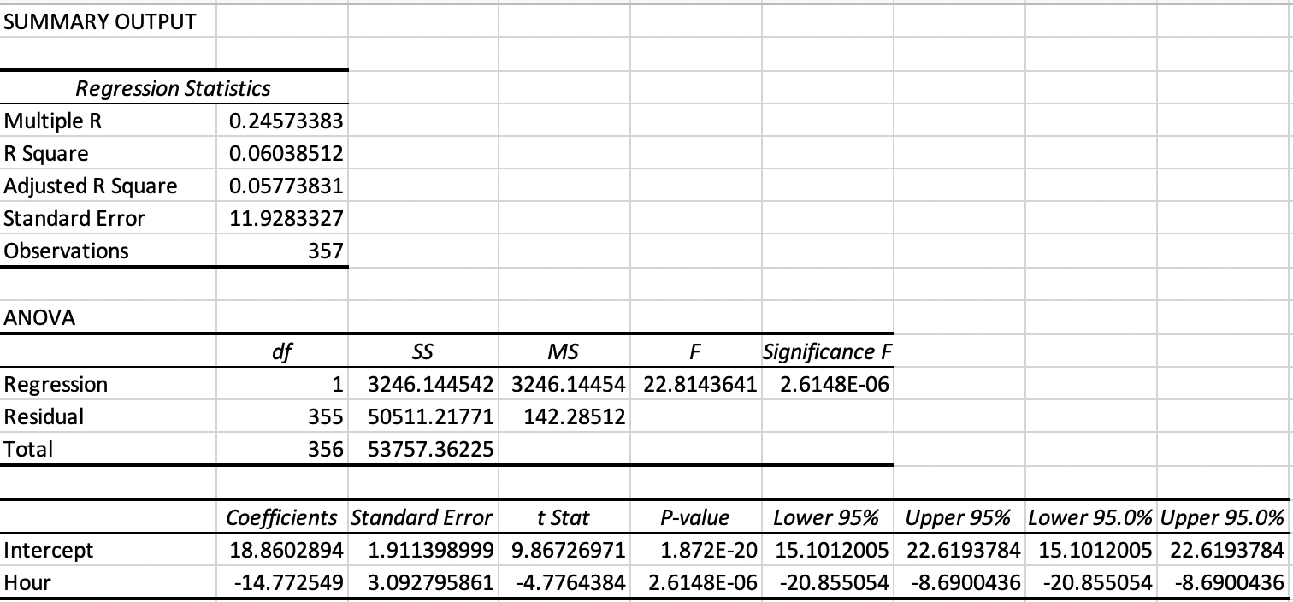
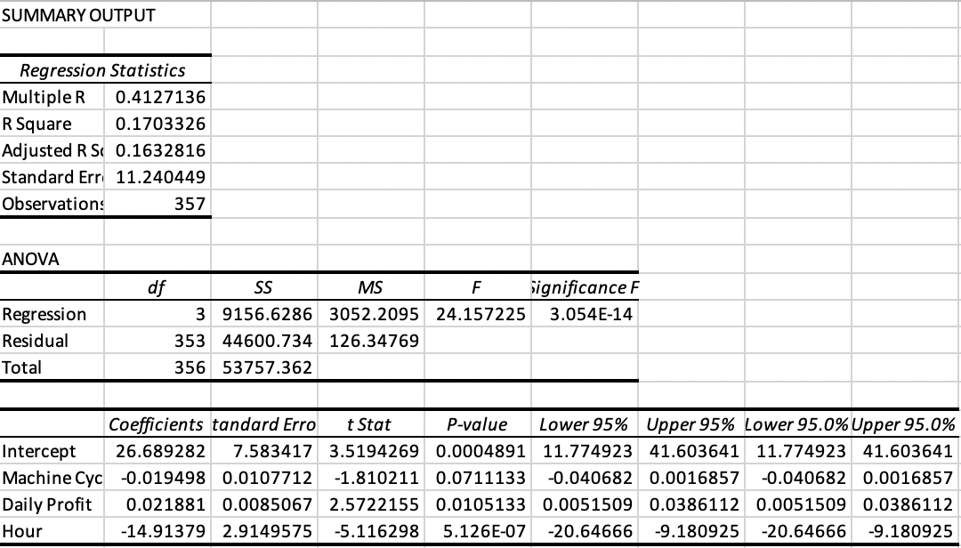
Analyze: Regression
Multiple R: The correlation coefficient between the predictor and response variables is 0.246, indicating a weak positive relationship.
R Square: The coefficient of determination is 0.060, indicating that only 6.0% of the variance in cash register revenue can be explained by the hour variable.
Both coefficients as well as the regression are statistically significant (p-value < 0.05).
Overall, the regression analysis indicates that the hour variable has a statistically significant but weak relationship with cash register revenue. It explains only a small portion of the total variation in the revenue, suggesting that other factors not included in the model may have a more substantial impact.
Had the sample size been larger, or there was less measurement error, this regression analysis could be much different, so do not take the current results as concrete evidence until more data is collected.
Note: Multiple Regression with Daily Profit, Machine Cycle Revenue, and Hour increase the correlation to Cash Register Revenue slightly

Slide 11
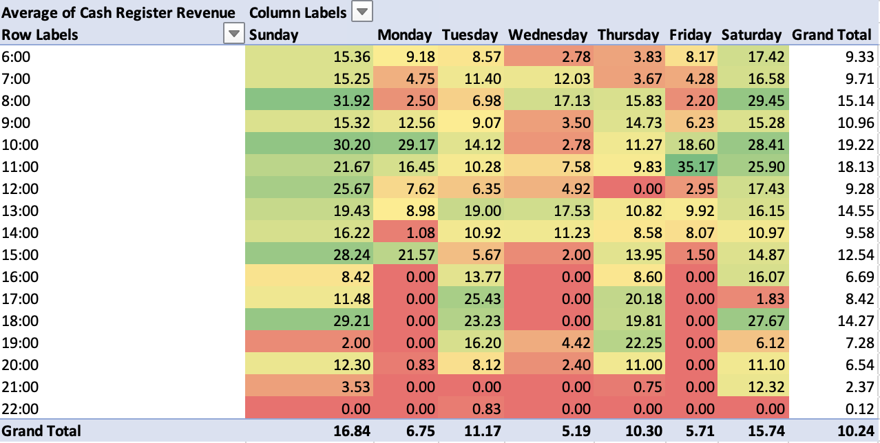
Analyze: Conditional Formatting
Conditional formatting allows for easily identifying trends. By applying conditional formatting to my range of data, I quickly identified patterns, trends, and outliers.
Here we see late hours perform the worst as indicated by the average earnings for those hours on the three-week sample
Allows us compare values within a dataset. As we see in the visualization, we can apply different formatting rules/colors to cells based on their relationships with other cells. In this case, the higher the value, the darker the shade of green, the lower the value, the darker the shade of red, with yellow being in the middle.
Gives us more insight on what hours can be eliminated with little risk to our earnings (based on cash register revenue)
It’s possible that machine cycle revenue is generating good money at later hours whereas cash register revenue is not (we do not have access to hourly interval data of machine cycle revenue, only the total and hourly average)
However there seems to be a relationship between machine cycle revenue and cash register revenue, although weak as seen below.
More data would need to be in the sample, while minimizing error to say so confidently. This implications however would tell us if people aren’t buying anything at the cash register, they aren’t using the machines either.

Slide 12
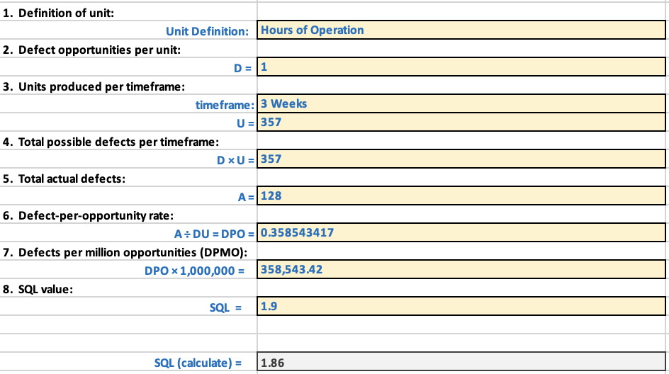
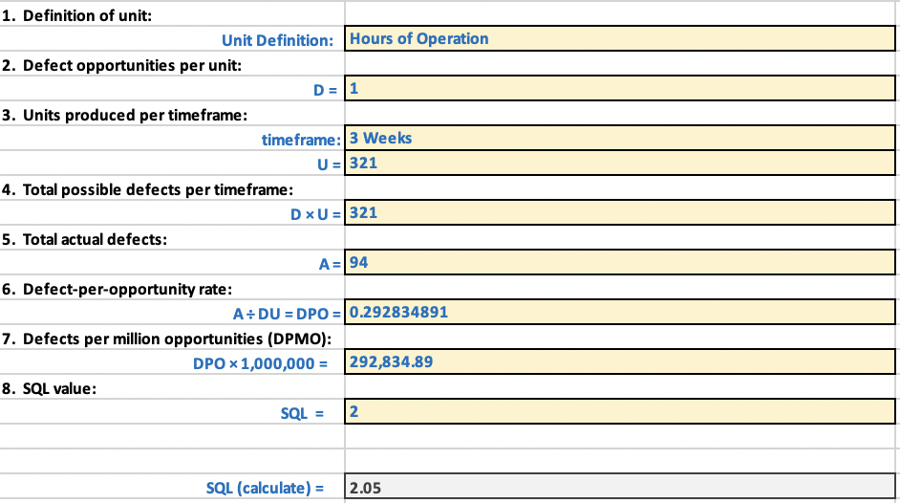
Analyze: Sigma Quality Level (SQL)
Before:
After:
The increase from 1.86 to 2.05 represents a significant improvement in our process performance. It indicates that we have successfully eliminated inefficiencies and implemented measures that enhance the quality of our work/process. This improvement can lead to decreased worker fatigue, saving on operational cost, while possibly maintaining customer satisfaction.
Sentiment analysis would have to be conducted on ”regulars” who come to our business during the hours that would be eliminated.
Ex: How would you feel if we closed earlier an hour earlier than normal on Friday?
Positive, Neutral, Negative
Questions like these would help us understand if the change is worth it.
Even if they respond negatively, as indicated by the sales data and correlation between machine cycle revenue and cash register revenue, they would be the minority of our customer base.
If customer satisfaction decreases with them or they change laundromats, things likely remains unchanged for the customers/majority who come at unaffected hours.
Are we willing to lose some of the minority crowd to achieve our main goal? (Hypothetical Question)

Slide 13
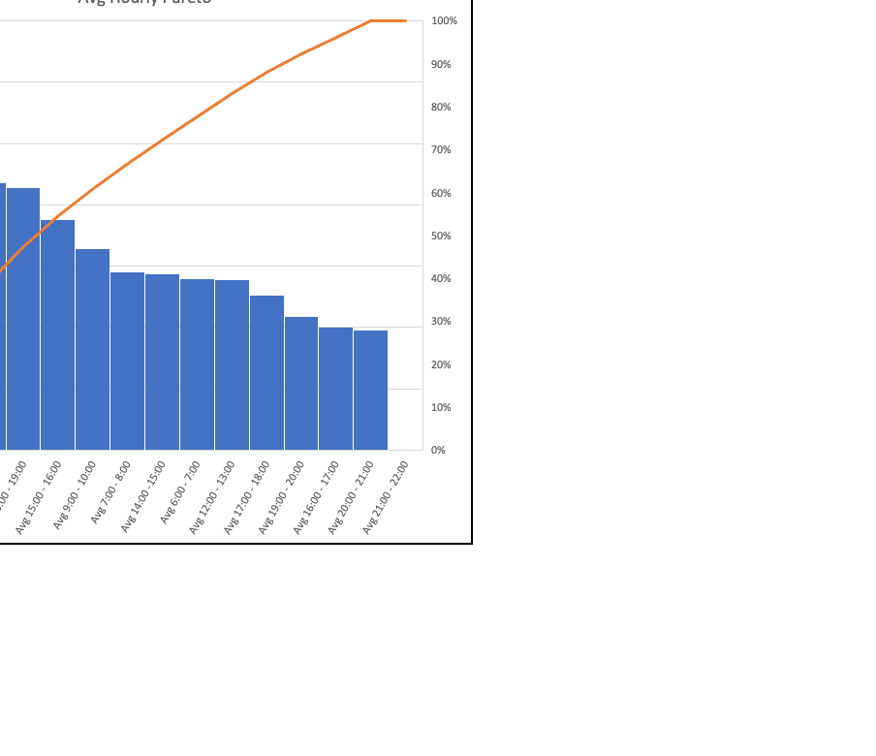
Improve
The varied analysis conducted allowed us to deduce where the inefficient hours were
A new dataset was created with these readjusted hours:
Mondays through Fridays now have their days ranging from 6:00 to 20:00, effectively removing two hours from our closing process
Saturdays and Sundays now have their days ranging from 6:00 to 21:00, effectively removing one hour from our closing process
Saturday and Sunday kept an additional hour because in our three-week sample, only they generated revenue during the 21:00 interval.
This Pareto chart of the average cash register revenue at different time intervals supports the fact that on average, later hours generate less money.
It seems natural to eliminate those hours instead of opening later

Slide 14
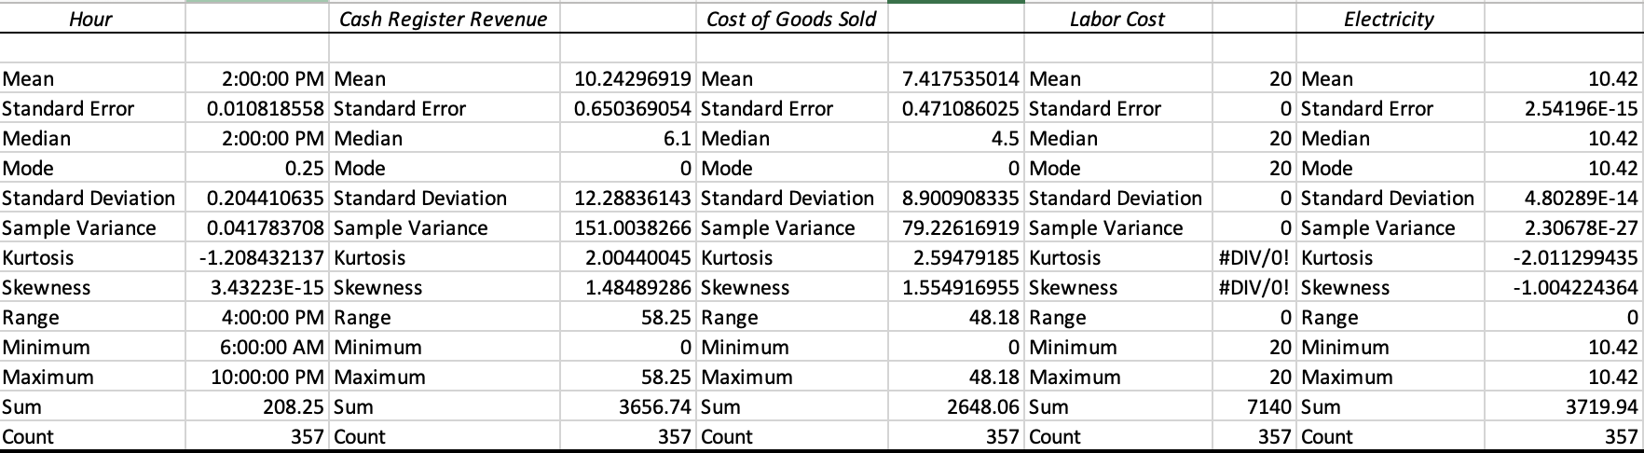
Improve: Statistics
Before:
Reduced our three-week sample hours of operation from 357 to 321.
Or 119-man hours a week to 107, a 12-hour difference! This is a 10% decrease in work hours per week, 1.6% above our initial goal of 8.4%.
Throughout the course of the year this will greatly benefit the mental health of employees while losing very little revenue if at all (since we are now saving on electricity and labor cost)
These differences in descriptive statistics indicate some changes in the central tendency, dispersion, shape of the distribution, and the range of values between the improved data and the original data.
The improved data shows a shift in the mean values and standard deviation for certain variables, indicating potential improvements in performance and efficiency.
Ex: The estimated cost of electricity dropped from 3719 to 3444, $375 in savings just in a 3-week sample
Dividing 375 by 3 weeks gives us 125 a week in savings. Throughout the year that is saving us $6500 alone!
We also must pay our employees less, saving on operational cost, and decreasing their burnout. The wage is not significant enough for them to deny the trade-off as we learned from anecdotal evidence.
After:

Slide 15
Improve: Additional Data Viz
These charts were imperative in the process towards deciding what hours to eliminate

Slide 16
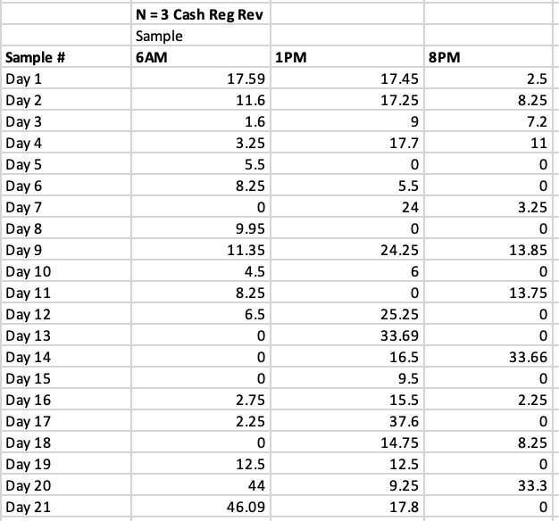
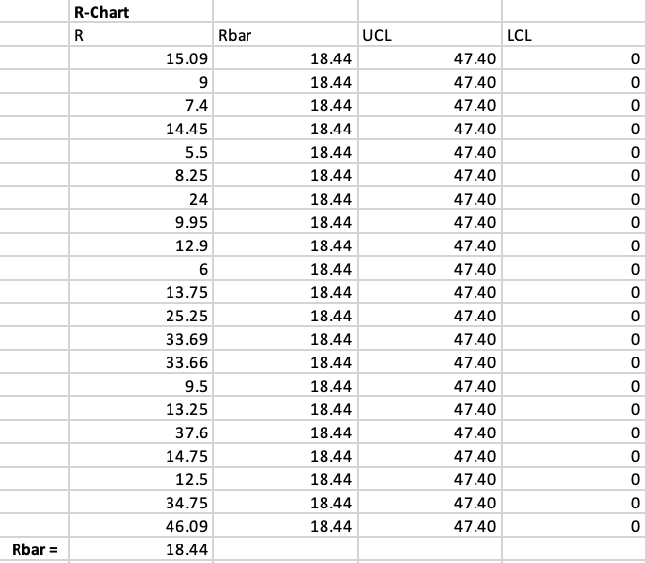
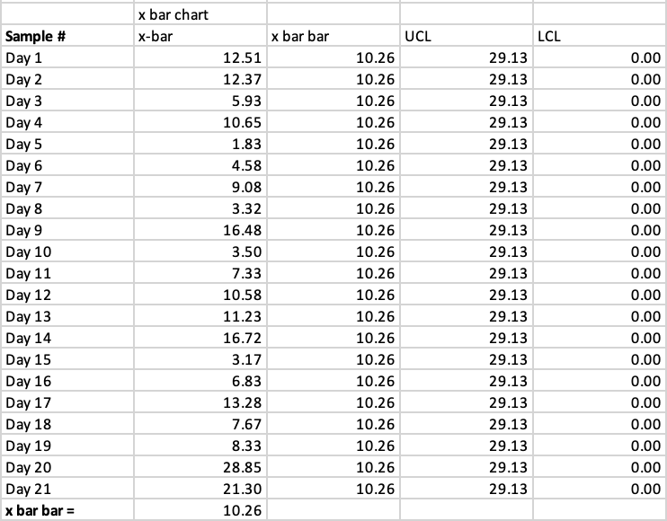
Control: Data
Took Cash Register Revenue data from approximately the beginning, middle, and end of the workday
Why R-Chart and x-bar Chart?
The X-bar and R charts are useful tools to analyze our cash register revenue data and help understand the average revenue and variability patterns over time. They provide insights into the stability of our process and assist in identifying potential issues or areas for improvement

Slide 17
Control: Control Charts
Is the R-Chart in control?
Yes
Is the x-bar Chart in control?
Yes
What does this tell us about the process?
Process is consistent and unless something is done differently
Around the end of the week (7th day interval) the data peaks within the pattern

Slide 18
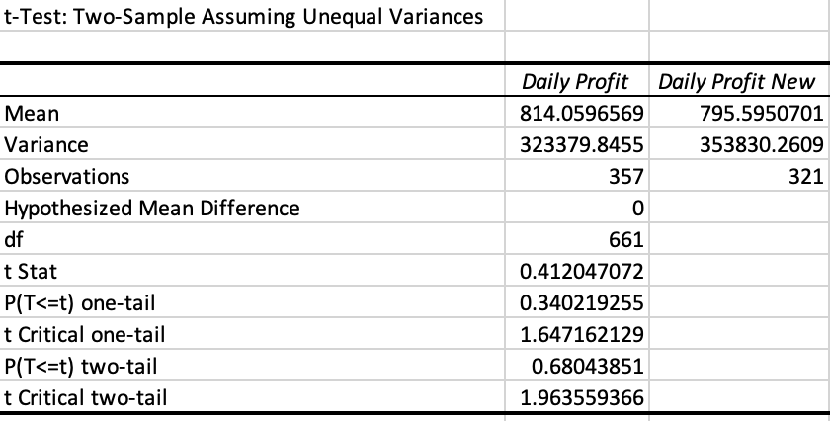
Conclusion
Ho: There is no significant difference in profitability between the two groups (laundromat's present hours and proposed change in hours).
Ha: There is a significant difference in profitability between the two groups.
The P-value 0.68 is greater than 0.05, therefore we would fail to reject the null hypothesis.
There’s not evidence to suggest a significant difference in profitability between the laundromat's proposed change in hours of operation and its present hours based on the current sample
Since there is no significant difference in profitability, closing earlier should be no issue for us as business owners if we choose to implement the new hours. We successfully minimized losses while lowering operational hours

Slide 19
The End

