Slide 1
Real Estate Investment Advisor:
Predicting Property Profitability & Future Value
Project type-Individual Project
Name:MB Bhanuprakash

Slide 2
Introduction
  Overview of real estate investment challenges
  Role of data-driven decision-making
  Project goal: build an ML-based investment advisor

Slide 3
Problem Statement
  Investors struggle to evaluate profitability accurately
  Property value depends on multiple dynamic factors
  Need a system to classify and predict future value

Slide 4
Objectives
  Predict future property value using ML models
  Classify properties as profitable or not
  Assist investors with actionable insights

Slide 5
Dataset & Features
  Historical property sales data
  Location, size, age, amenities
  Market trends and external indicators

Slide 6
EDA Insights
  Detected correlations between size and price
  Identified outliers and missing data
  Visualized distribution of key features

Slide 7
Methodology
  Data preprocessing and feature engineering
  Regression for price prediction
  Classification for profitability assessment

Slide 8
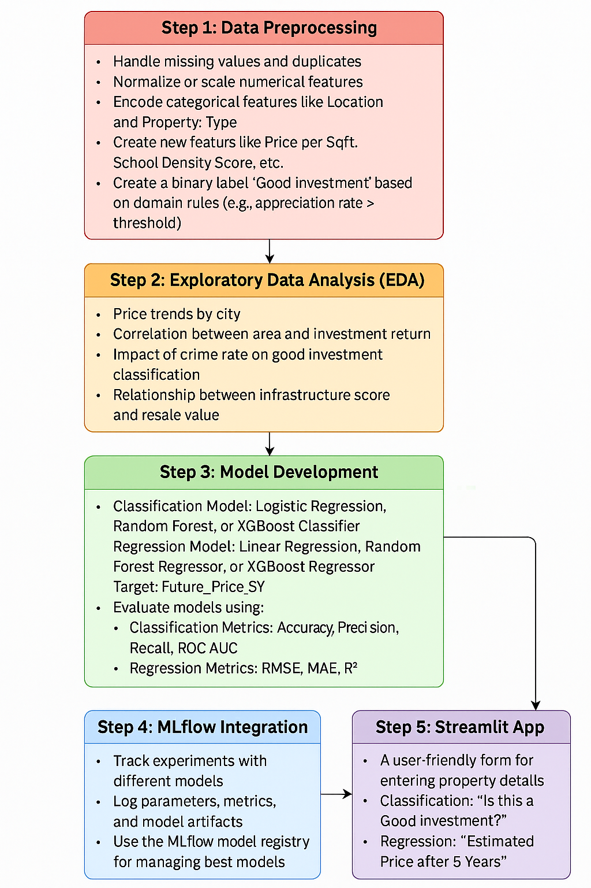

Slide 9
Model Building
  Algorithms used: Linear Regression, Random Forest, XGBoost
  Training–testing split: 80/20
  Metrics used: RMSE, R², Accuracy

Slide 10
Results
  Best performing model: Random Forest
  High accuracy in classification tasks
  Strong predictive capability for property value

Slide 11
Conclusion
  ML models provide reliable investment insights
  Improves decision-making for investors
  Future improvements can boost accuracy further

Slide 12
Future Scope
  Include real-time market data
  Add rental yield prediction
  Develop a full mobile/web application

