Slide 1




Coaching
Future Leaders Workshop
Presented by Jacob Scadden Quadram Institute Bioscience, UK

Slide 2

Definitions
The Oxford Learners Dictionary defines coaching as “the process of giving a student extra teaching in a particular subject^{”1}
To coach is to help a person develop their current skills to be able to progress to the next stage in their career/life
Coaching is a subdiscilipine of mentoring
Mentoring addresses the whole person and their career
Coaching focuses solely on a specific skill or vision

Slide 3
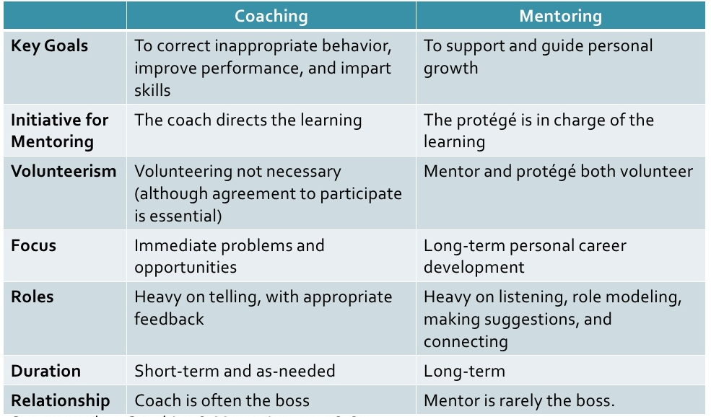
Coaching vs Mentoring
Notes:
Coaching
Correct behaviour
Coach directs learning
Voluteering not necessary
Immediate problems
Heavy on telling
Short term
Coach is often the boss
Mentoring
Personal growth
Mentee is in charge of learning
Volunteering is necessary
Long term
Heavy on listening
Mentor is rarely the boss

Slide 4

Benefits of Coaching
Developing key skill areas
Overcoming performance problems
Increasing productivity
Creating opportunities for promotion
Improving retention
Positive work culture
Notes:
-Practical skills and soft skills
-Issues around working effectively
-Keeps people within the same organisation

Slide 5

Who coaches?
Unlike mentoring coaching is usually done by a manager/supervisor
Their role is to:
Helping to match skills, work values and interests to future career opportunities
Have frequent meetings about coachee’s needs
Give specific feedback about performance
Be a role model to the coachee
Draft development plans with the coachee

Slide 6

Characteristics of a Good Coach
Knowing when to coach
As part of a team
Individually
During reviews
Knowing when NOT to coach
Person may not be willing
When the task needs to be lead
Success is measured by the coachee’s success not your own
Asking the right questions
Active listening
Meeting frequently
Become a good teacher
Give specific feedback

Slide 7
Do’s and Don’ts of Coaching
Do’s
Be a role model
Create a positive environment
Clearly establish expectations
Make notes of development plans and any adjustments
Don’ts
Make implied promises
Change from a coach to a boss
Be impatient
Focus solely on work attitude
Ignore the problem

Slide 8

Be Aware of Who You’re Coaching
Each person you coach will be different
They will respond differently to feedback and your behaviour
Treat each person as an individual
Appropriately address performance expectations
Draft development plans

Slide 9

GROW Model
Goal – What do you want to achieve?
Identify the problem and they want to do about it
Identify specific issue(s) and what they want to do about it
Reality – What is happening now?
Understand and establish the current situation
Raise their awareness of that situation
Options – What could you do?
Come up with a range of feasible, realistic options
Generate as many alternative courses of action
Will – What will you do?
Make things happen
Commit to acting upon their preferred solution

Slide 10
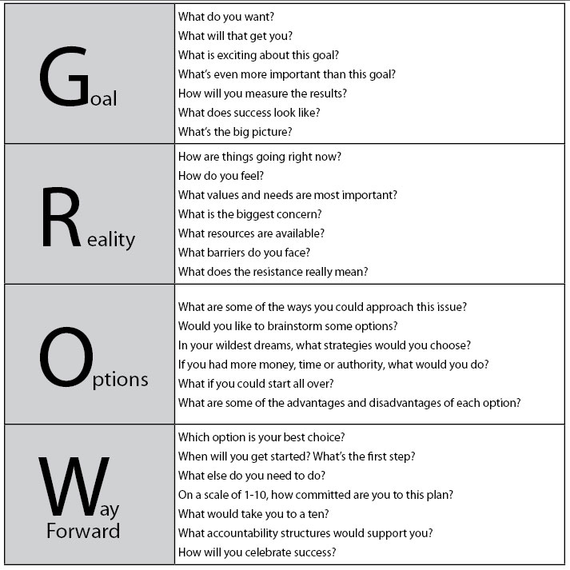
Questions to ask for GROW Model
Notes:
What do you want
What will that get you
What is the big pircture
How are things right now
How do you feel
What resources do you need
What are some ways you can approach the issue
Would you like to brainstorm some options
Which option is your best choice
What else do you need to do
Scale of 1 -10
What would take it to a 10

Slide 11
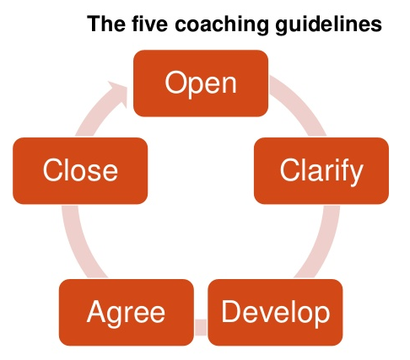
Coaching Discussion Approach

Slide 12
Coaching Discussion Approach
Opening
Communicate the purpose and the importance of the discussion
Clarify
The coach presents all the relevant information and issues
Develop
Involvement of coachee and collaborate to create solutions
Agree
Specifics future actions, timelines and resources required to achieve solutions
Close
Confirm agreements from meeting, next steps and commitments

Slide 13

Five Key Principles of Coaching
Maintain or enhance self-esteem
Listen and respond with empathy
Ask for help and encourage involvement
Share thoughts, feelings and rationale
Provide support without removing responsibility

Slide 14
Process Skills
Checking for understanding
Confirm that coach and coachee understand one another
Most effective method is to summarise the information in the form of a question and request confirmation
Making procedural suggestions
Making the process of coaching simpler and more efficient
Narrowing options

Slide 15


The Four ‘C’s
Clarity
Confirmation
Communication
Commitment

Slide 16

Elements of a good coaching session
Provide positive feedback
Coaching is a two way process
Open questions will gain more information
What do you think…?
Active listening
Non-verbal communication

Slide 17

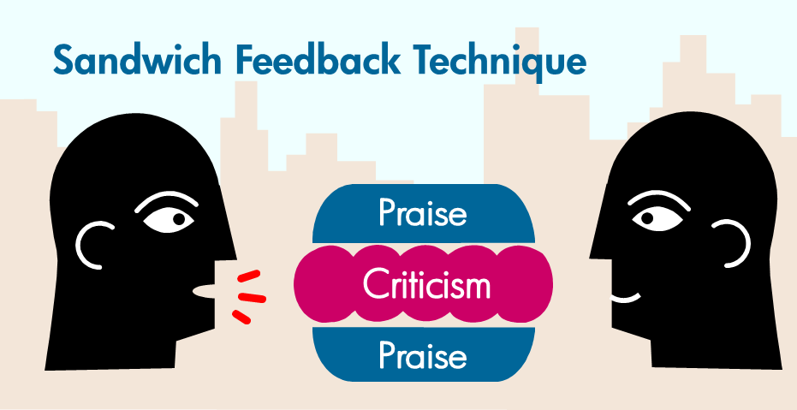
Providing Feedback
Feedback should be:
Positive, constructive and corrective
Clear and concise
Delivered as soon as possible
Use feedback sandwich
Positive feedback (what they are doing well)
Corrective feedback
Positive feedback (actions for improvement)

Slide 18

Providing Feedback
Plan what you intend to say and be sensitive to the emotional state of your coachee at the time
Be patient
Be specific, not general
Focus on behaviour that can be changed

Slide 19
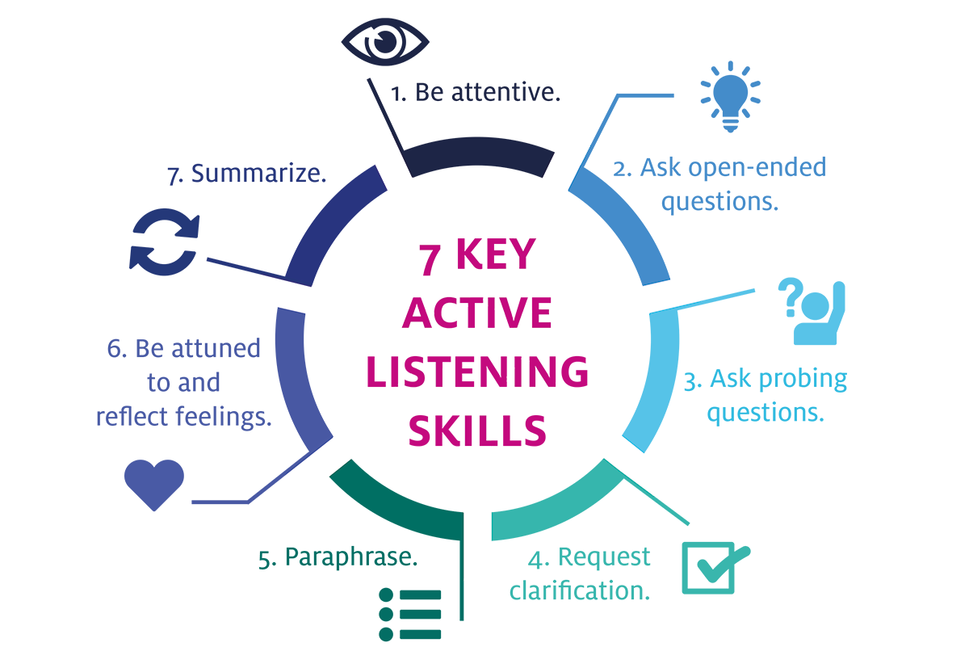
Active listening
Stop – pay attention and don’t interrupt
Look – make eye contact and be at the same level as the person
Listen – focus on what the person is saying
Respond – restate what has been said and use open questions

Slide 20
Any Questions?

Slide 21
What are the differences between coaching and mentoring?
Notes:
Coaching
Correct behaviour
Coach directs learning
Voluteering not necessary
Immediate problems
Heavy on telling
Short term
Coach is often the boss
Mentoring
Personal growth
Mentee is in charge of learning
Volunteering is necessary
Long term
Heavy on listening
Mentor is rarely the boss

Slide 22
Can you give some examples of an open ended question?
Notes:
What do you want
What will that get you
What is the big pircture
How are things right now
How do you feel
What resources do you need
What are some ways you can approach the issue
Would you like to brainstorm some options
Which option is your best choice
What else do you need to do
Scale of 1 -10
What would take it to a 10

Slide 23
What areas in scientific research is coaching used?

Slide 24
Assignment
In pairs discuss a problem you have had with your research…
Lack of motivation
Distracted easily
Problems coming up with new ideas
Lack of confidence talking to your supervisor
Use skills from this workshop to talk with the person to try to create a plan of action that’s best for them
Try not to lead the conversation
Ask open questions
Remember confidentiality
Any questions please email leadershipPU@gmail.com

Slide 25
References
Acknowledgements
Vanda Morgen
Ariadna Miquel-Clopes
Santie de Villiers
BBSRC
Quadram Institute Bioscience
ssDNAfrica
Oxford Learners Dictionary. Accessed 06/09/19. Available at: https://www.oxfordlearnersdictionaries.com/definition/english/coaching?q=coaching

