Slide 1




Leadership
Future Leaders Workshop
Presented by Jacob Scadden Quadram Institute Bioscience, UK

Slide 2

Definitions
The Oxford Learners Dictionary defines leadership as “the state or position of being a leader^{”1}
A leader is a person who leads a group of people e.g. a president of a country, a captain of a sports team or a PhD supervisor.
Leadership involves
Establishing a clear vision
Sharing that vision with others
Providing knowledge and methods to realise the vision
Coordinating and balancing conflicting interests from members of the group

Slide 3
Are Leaders Born or Made?
Leadership, as with any skill, can be learned and perfected
Some people become natural leaders at a young age
Charisma
Confidence
Communication
However, leadership is about promoting your vision and encouraging others to follow

Slide 4
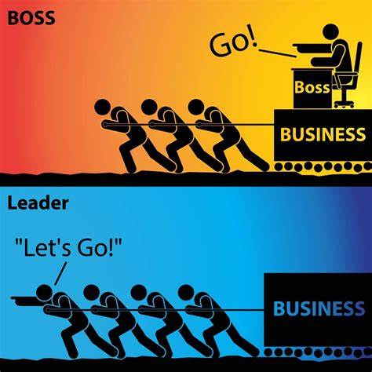
Leader vs Boss
Leader
Coaches employees
Generates enthusiasm
Says “We”
Helps to find solutions
Demonstrates methods
Develops people
Gives credit
Asks questions
Says “Lets go”
Boss
Drives employees
Inspires fear
Says “I”
Places blame
Knows methods
Uses people
Takes credit
Commands
Says “Go”

Slide 5
Management vs Leadership
Management encourages the efficient running of a system (Company) and uses this to drive the production of results consistently over time
Planning and budgeting
Controlling and problem solving
Leadership creates systems and visions/goals within a work environment to make the most of opportunities and to avoid risk as much as possible
Creates a strategy and goals
Communicates ideas
Motivation
Creating a positive work environment

Slide 6
Leadership and Power
French and Raven (1958)² developed a theory that suggested that there were several forms of “power” that a leader can utilise to inspire followers
These power bases can be divided into positional power (from authority) and personal power (from actions)
Positional Power
Legitimate
Reward
Coercive
Resource
Personal Power
Referent
Expert
Information
Connection
Notes:
Legitimate derives from authority from hierarchy
Reward stems from rewards that can be offered (bribery)
Coercive based on fear of punishment
Resource based on control of assets
Referent = likeability (relationships, charisma)
Expert provides skills and knowledge that encourages respect
Information stems from access to information
Connection is the span of the persons network and who they know

Slide 7
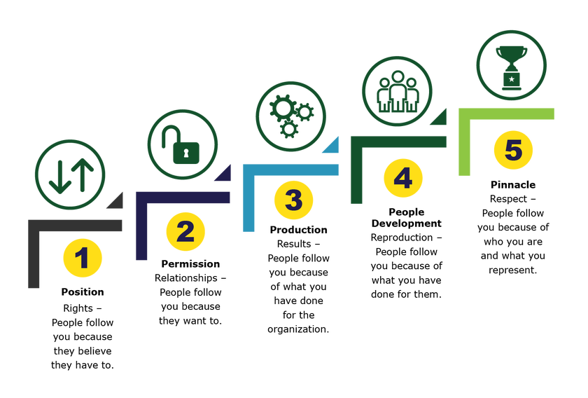
Five Levels of Leadership
TRAP!
John Maxwell’s Five levels of leadership³
Notes:
Permission – Establishes effective relationships with colleages, people follow leader beyond stated authority
Production – Collaborating to produce long-term sustainable results (management)
People development – leader helps to mentor and develop staff to create more self reliable leaders.
Pinnacle – Takes years to establish, helping to shape and create the workplace culture in a vibrant and tangible way

Slide 8
Know Yourself
Positive
In all aspects of work. Avoid rumours and gossip
Open
With others and new ideas
Willingness
Try new things and take calculated risks
Employing
Using courtesy, humour, patience and emotional intelligence
Remembering
Know your purpose and goals
Individual leadership begins with:
Self management
Coping with change
Controlling emotions
Self awareness
Personality trails
Communication style
Using POWER behaviours

Slide 9
Top Ten Tips to Help Increase Your Position at Work
Be authentic
Be a team player
Develop self-esteem and confidence
Avoid conflict
Help to generate a positive work environment
Develop your communication skills
Be visible in the workplace
Don’t complain unless you can offer a solution
Be goal orientated
Have a positive mind-set

Slide 10
Charismatic Leadership Concept
The primary idea is that charisma, the ability to attract people to you, is a key part of leadership
These people are:
Envisioning
Energising
Enabling
However, charismatic leaders can be narcissistic, seductive or possessive
True leaders inspire trust and confidence in others but also themselves

Slide 11
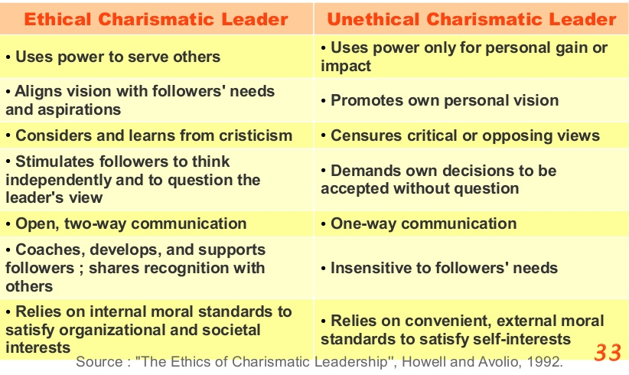
Ethical vs Unethical Charisma

Slide 12
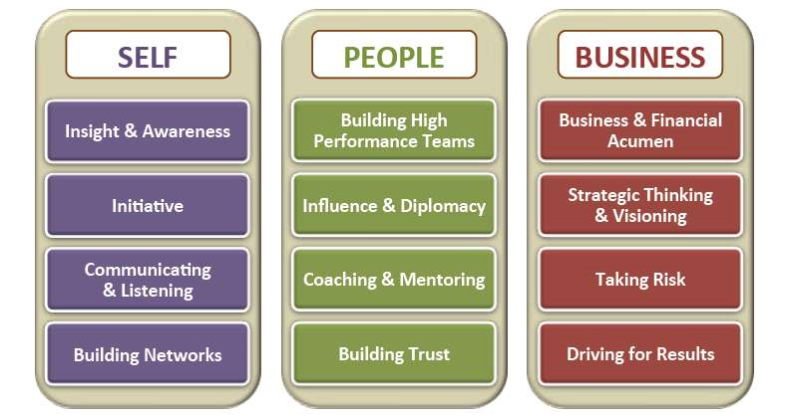
Development as a Leader

Slide 13
Goleman’s Emotional Intelligence Model
Emotional intelligence is the ability to monitor your own and other peoples emotions and to use that information to help you make decisions and perform actions
Self-Awareness
Self Regulation
Motivation
Empathy
Social Skill

Slide 14
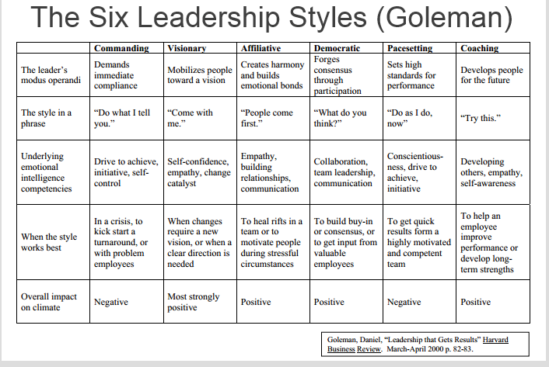
Leadership Styles

Slide 15
Leadership and Science
Who are the leaders in science?
Supervisors
Teachers/lecturers
Senior Students (PhD and MSc)
Lab technicians
Politicians
Science communicators
CEOs of biotechnology companies
You?

Slide 16
Why is Leadership in Science Important?
Sets a clear vision for the group
Research questions
Specialism
Creates a positive work environment which allows staff to thrive
Makes the most out of opportunities
Enthusiasm and motivation
Increased networking

Slide 17
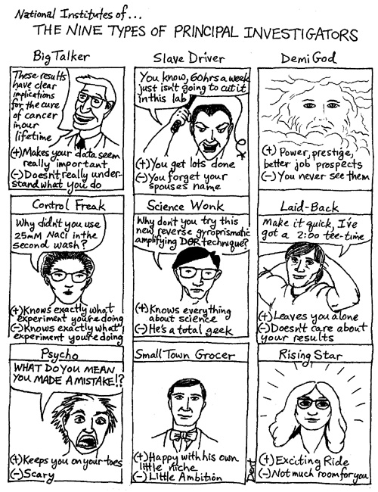
Work Driver

Slide 18
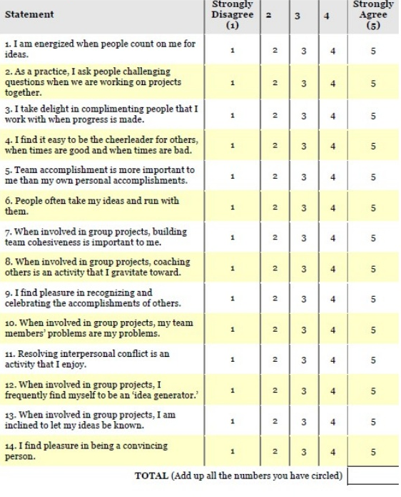
Leadership Proclivity
14-27 implies low motivation to lead
28-55 implies some uncertainty over motivation to lead
56-70 implies a strong motivation to lead
Be honest!!
No right or wrong answer!!

Slide 19
Conclusion
Leadership involves getting people to help in realising a vision
First step of leadership is to be self-disciplined
Be a role model
Remember to create a happy, constructive work environment
Be honest with yourself and your employees/colleagues
Seek solutions to problems rather than blame
The pinnacle of leadership is when people follow you because of what you represent
Leadership is very important in science

Slide 20
Any Questions?

Slide 21
What are the main differences between a boss and a leader?

Slide 22
What are the five levels of leadership?

Slide 23
What is emotional intelligence and why is it important?

Slide 24
Which leadership style best describes you?

Slide 25
Why is leadership important in science and research?

Slide 26
Assignment
Think about a leader in your life
Can be academic or extra curricular
What characteristics made them a leader?
What leadership style did they use?
Why did you follow them?
What they have done to improve their leadership?
Think about how you can use coaching and mentoring as part of leadership
Send work to leadershipPU@gmail.com

Slide 27
References
Acknowledgements
Vanda Morgen
Ariadna Miquel-Clopes
Santie de Villiers
BBSRC
Quadram Institute Bioscience
ssDNAfrica
Oxford Learners Dictionary. Accessed 06/09/19. Available at: https://www.oxfordlearnersdictionaries.com/definition/english/leadership?q=leadership
French JRP Jr, and Raven B, 1959. The bases of social power. In D. Cartwright (Ed.), Studies in social power (pp. 150-167).
Maxwell JC, 2011. The Five Levels of Leadership – Proven steps to Maximize your Potential, New York: Centre Street

