Slide 1




Peer-Mentoring
Future Leaders Workshop
Presented by Jacob Scadden Quadram Institute Bioscience, UK

Slide 2

Workshop Overview
Week 1 – Peer-Mentoring
Week 2 – Coaching and Active Listening Skills
Week 3 – Scientific Leadership
Week 4 – Team Management and Conflict Resolution
Week 5 – Personality and the Workplace
The following 5 weeks you will put these skills into practice
Three meetings will be organised for updates and issue resolutions

Slide 3

Definitions
The Oxford Learners Dictionary defines mentoring as “the practice of helping and advising a less experienced person over a period of time^{”1}
A mentor is an individual, usually with greater knowledge or expertise that is able to assist the development of a mentee, normally as career progression
A mentee is an individual that enters a guidance programme with a mentor to help develop and improve their career/personal prospects

Slide 4
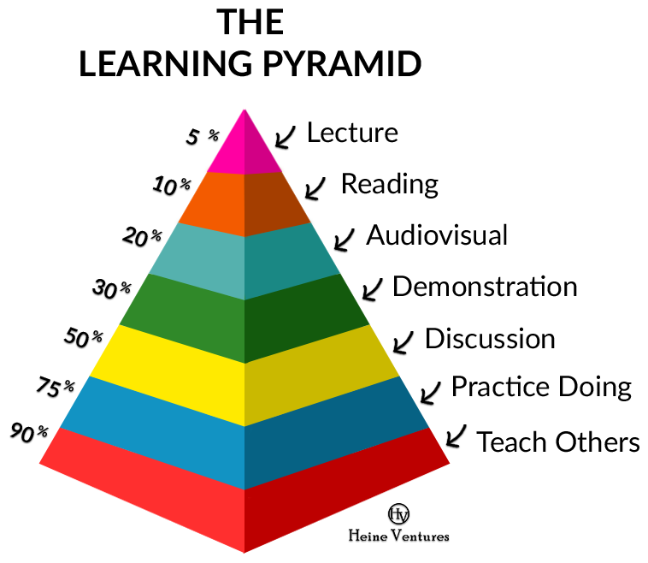
Why Peer-Mentoring?
Peer-Mentoring is where peers take on the role of a mentor within their own group
Increased openness and improved outcomes
Average student retention rates were analysed by the United States National Learning Lab, Maine²:
Image taken from Andrea’s Portfolio. Available at: https://sites.google.com/site/andreasportfoliopedagogy/2-the-learning-pyramid

Slide 5
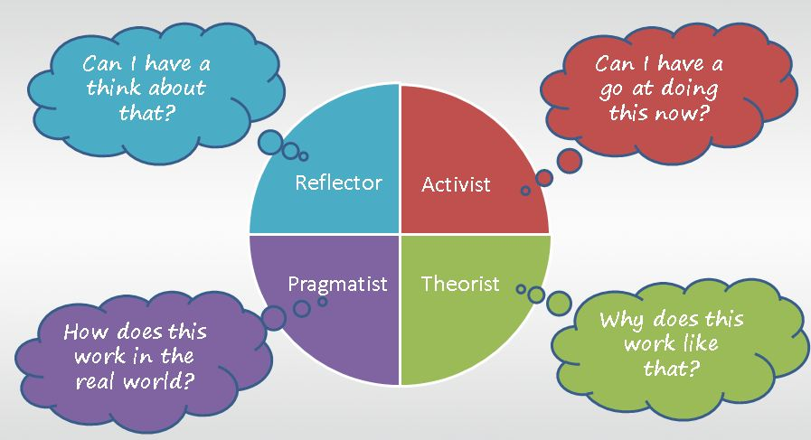
Honey and Mumford Learning Styles
Image taken from DPG. Available at https://community.dpgplc.co.uk/blog/honey-and-mumford-learning-styles-a-simple-picture

Slide 6

Benefits of Peer-Mentoring
Organisational
Increased Morale
Develops habits of confidentiality
Helps to achieve mission/vision
Improves teamwork and co-operation
Mentor
Improves self awareness
Develops ability to give and receive criticism
Networking
Improves leadership and communication skills
Helps to raise personal profile
Mentee
Develops reflective and analytical skills
Improves self confidence
Helps to accept criticism
Increases independence and maturity
Facilitates peer relationships

Slide 7

GROW Model
Goal – What do you want to achieve?
Identify the problem and they want to do about it
Identify specific issue(s) and what they want to do about it
Reality – What is happening now?
Understand and establish the current situation
Raise their awareness of that situation
Options – What could you do?
Come up with a range of feasible, realistic options
Generate as many alternative courses of action
Will – What will you do?
Make things happen
Commit to acting upon their preferred solution

Slide 8

Step 1 - Initiation
Clarify Values
Setting boundaries
Establishing respect and professionalism
Clarify Needs
What are their current skills?
What knowledge do they have?
Confidence
Why do you want to be their mentor
Set a Clear Vision
Write down goals
Be specific

Slide 9

Step 2 - Cultivation
Mentor starts providing advice to mentee
The mentee develops there own skills and there broader understanding
The mentee works towards pre-determined goals (from Step 1)
The mentor supports the mentee
Agree on the frequency of meetings
Key responsibilities
Measures of success
Mutual expectations
Confidentiality

Slide 10

Step 3 - Separation
Plan put in place for independence of mentee
Can be initiated by either the mentor or mentee
Communication is key
Reasons for ending
Goals reached
Inappropriate matching
Personality clash (Week 5)
Poor attendance to meetings/lack of communication
Mentor
Mentee

Slide 11

Step 4 - Redefinition
As the mentee has progressed they will rise to the level of the mentor
Redefinition of roles to a new professional relationship that can continue

Slide 12

Establishing Goals
Set specific goals with mentee
Encourage deliverable, short term goals
Promotes a sense of progress
Frequently review goals
Allows for adjustments and re-focussing
Always consider the mentee’s needs

Slide 13

Characteristics of a Good Mentor
Be a good listener
Build a relationship
Don’t abuse your authority
Foster independence
Provide introductions
Be constructive
Find your own mentors

Slide 14

Distance Mentoring
If a mentee is not available for a meeting in person it may be required that a phone call or skype session is arranged
Important to keep meetings regular
DON’T use email to provide feedback or discussing personal matters…only to set up meetings
Listen actively
Try to be as detailed and clear as possible
Summarise agreements

Slide 15

Cross-Gender Mentoring
Keep relationship with mentee professional
Be sensitive to each other’s reactions
Avoid perception of a personal relationship
Meet in public places
Be transparent with others about the mentor/mentee dynamic

Slide 16
Problems with Mentoring
Disadvantages for the mentee
Overdependence on the mentor
Micro-management from the mentor
Negative attitude towards mentor if goals are not reached
Disadvantages for the mentor
Dependence from the mentee
Time commitment towards the mentee
Negative attitude towards mentee if goals are not reached

Slide 17
Conclusion
A mentor and mentee both need to establish a friendly but professional relationship
Use Honey and Mumford to assess learning style of mentee
Use GROW model to make a realistic plan of action in a reasonable time frame
Benefits of peer-mentoring
The four steps of the mentoring process:
Initiation
Cultivation
Separation
Redefinition
Distance and cross-gender mentoring

Slide 18
Any Questions?

Slide 19
What is your current goal(s)?

Slide 20
What is your current situation?

Slide 21
Who do you think can be mentored?

Slide 22
Name some characteristics of a good mentor
Notes:
Be a good listener
Build a relationship
Don’t abuse your authority
Foster independence
Provide introductions
Be constructive
Find your own mentors

Slide 23
What does GROW mean?
Notes:
Goal – What do you want to achieve?
Identify the problem and they want to do about it
Identify specific issue(s) and what they want to do about it
Reality – What is happening now?
Understand and establish the current situation
Raise their awareness of that situation
Options – What could you do?
Come up with a range of feasible, realistic options
Generate as many alternative courses of action
Will – What will you do?
Make things happen
Commit to acting upon their preferred solution

Slide 24
ASSIGNMENT
Using the GROW model come up identify you career/research aims
Create aims for the next 6 months, 1 year and 5 years.
Try to be as specific as you can
Think about how you will stay motivated
This can be done individually but would be better in small groups/pairs to discuss ideas
Think about people that you work with that you could help to mentor or that could be a mentor for you
If you have any questions email leadershipPU@gmail.com
Deadline: 23rd September 2019

Slide 25
References
Acknowledgements
Vanda Morgen
Ariadna Miquel-Clopes
Santie de Villiers
BBSRC
Quadram Institute Bioscience
ssDNAfrica
Oxford Learners Dictionary. Accessed 04/09/19. Available at: https://www.oxfordlearnersdictionaries.com/definition/english/mentoring?q=mentoring
National Training Laboratories, The Learning Pyramid, Workshop Materials, Bethel, Maine. 1954.
Whitmore J, 2009. The impact of the inner game and Sir John Whitmore on coaching: a commentary. Annual Review of High Performance Coaching and Consulting; 4(2); 23-28.

