Slide 1




Personality in the Work Place
Future Leaders Workshop
Presented by Jacob Scadden Quadram Institute Bioscience, UK

Slide 2
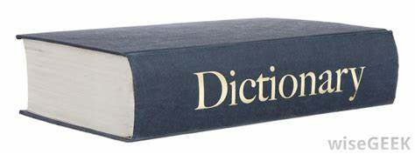
Definitions
The Oxford Learners Dictionary defines personality as “the various aspects of a person’s character that combine to make them different from other people^{”1}
It is important to recognise everybody is an individual
Likes
Dislikes
Learning style
Behaviour

Slide 3

How Does Personality Effect Work?
It can effect how you solve problems
How you are motivated
How you perform at your best
How you interact with your colleagues

Slide 4
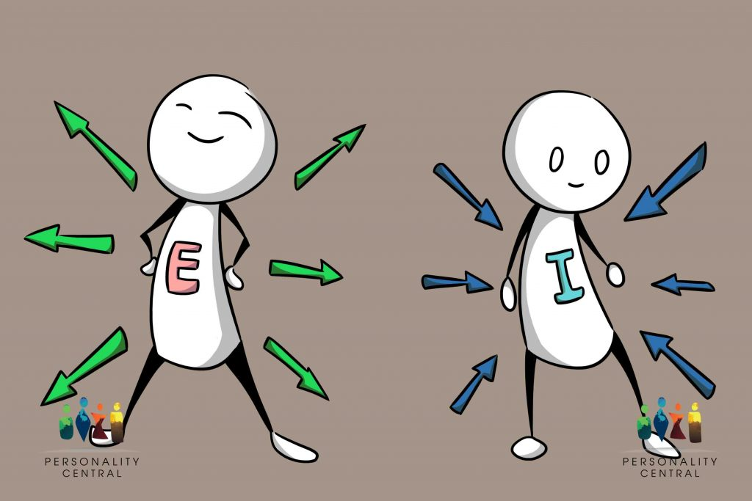
Energy Style
Extraverts
Energised when engaging with people and the world around them
Introverts
Energised when they are in a quiet space and have time alone
Ambivert
Requires both social stimulation as well as time spent alone

Slide 5
Extroverts at Work
Extraverts like to work with others, on teams and in spaces where they can interact with others
Extraverts like to “think out loud”, brainstorm and share ideas and plans with other people
Extraverts may enjoy speaking to groups or gain public recognition
Extraverts lose motivation when they have to work in isolation

Slide 6
Introverts at Work
Introverts like to work in quiet spaces where they can concentrate on their own thoughts
Introverts prefer to think through things on their own, then discuss their ideas with others
Introverts tend to be good at sustaining focus on projects that require depth of understanding
Introverts become drained when they have to speak publicly, work in large teams or meet lots of people

Slide 7
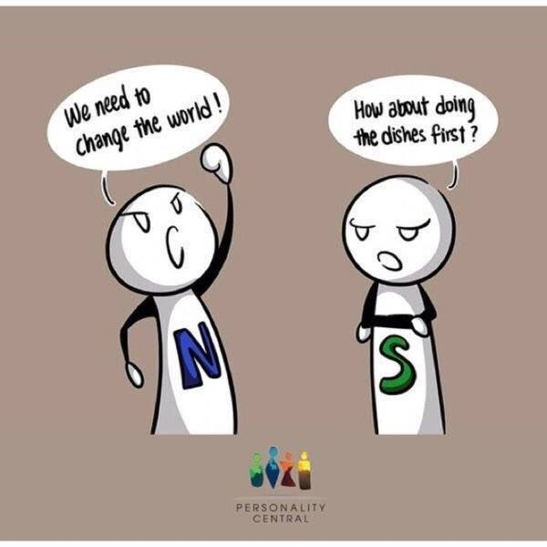
Cognitive Style
Sensors think about things in a practical way
Intuitives think about things in an abstract, imaginative way

Slide 8
Sensors at Work
Sensors are concrete thinkers who tend to focus on facts, events and details
Sensors rely on previous knowledge and experience when problem-solving
Sensors are practical, realistic people who like to go with what they know has worked in the past
Sensors enjoy hands on work and dislike working with theories, ideas and concepts

Slide 9
Intuitives at Work
Intuitives are imaginative, abstract thinkers who tend to focus on theories, ideas and concepts
Intuitives look for brand new solutions to problems and like to innovate and create
Intuitives are “big-picture” people who want to know the purpose and meaning of things
Intuitives typically have a low tolerance for routine work where they have no opportunity to be creative

Slide 10
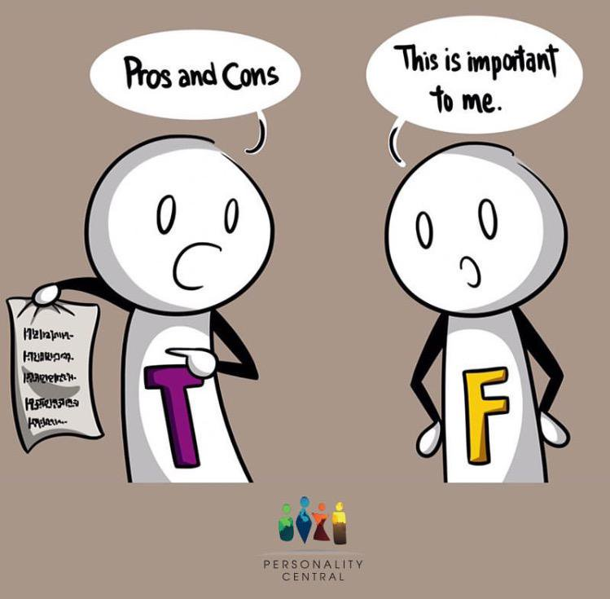
Values Style
Thinkers value objectivity, competence and logic
Feelers value empathy, relationships and a personal touch

Slide 11
Thinkers at Work
Thinkers prize logic and reason and prefer decisions to be objective
Thinkers tend to be focused on the task at hand rather than the people or relationships involved
Thinkers value competence and may be more competitive than cooperative
Thinkers usually feel that emotions and personal problems do not belong in the workplace

Slide 12
Feelers at Work
Feelers value relationships, connections and service to other people
Feelers want to do work that reflects their values and lets them help make the world a better place
Feelers like to cooperate and often put the task secondary to building a strong team
Feelers want a workplace with a personal touch, where people are appreciated and supported

Slide 13
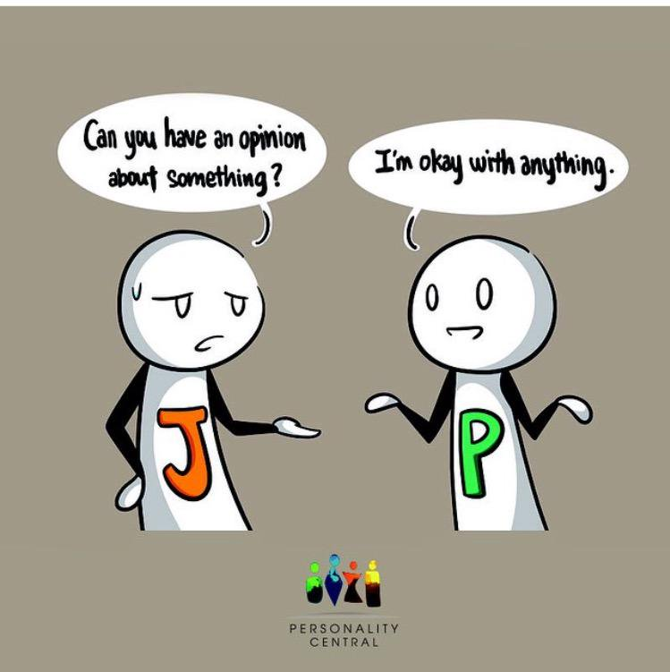
Self-Management Style
Judgers like to be organised and keep a schedule
Perceivers like to be flexible, open and spontaneous

Slide 14
Judgers at Work
Judgers appreciate organisation and order, and like a firm structure
Judgers like to plan ahead and prefer not change course once a plan is set
Judgers stick to schedules and deadlines and deliver results on time
Judgers may mot thrive in unpredictable workplaces or environments of constant change

Slide 15
Perceivers at Work
Perceivers appreciate flexibility in their wok and like to be free to adapt and change
Perceivers prefer not plan, believing that they are more effective when they can roll with the punches
Perceivers feel limited by schedules and deadlines; they like to work as inspiration strikes
Perceivers may have trouble delivering on time, but excel in situations that are unpredictable

Slide 16
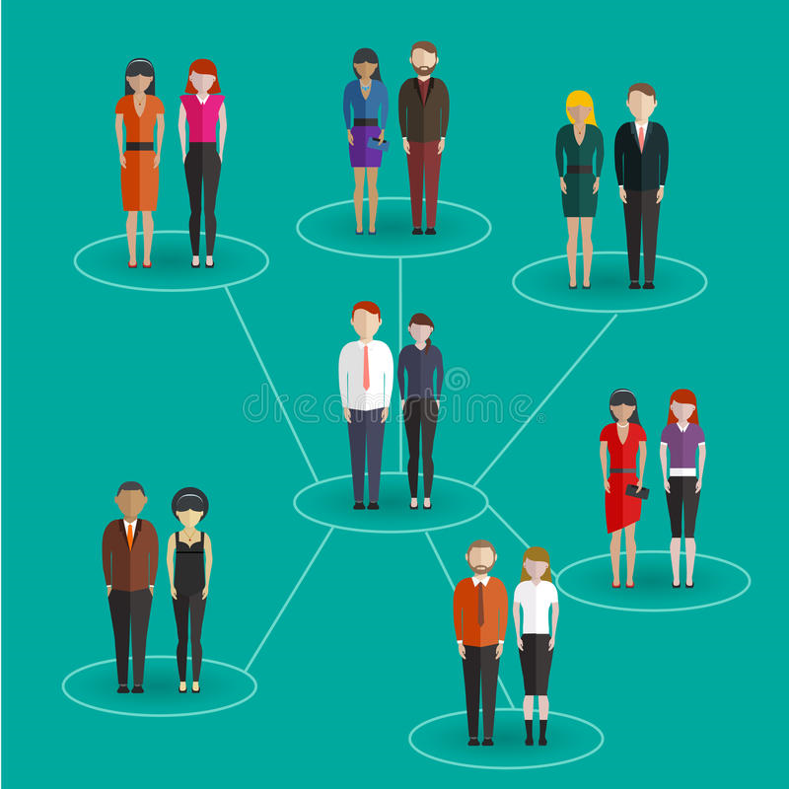
As a Leader Understanding Personality is Important…
Each style has its own strengths and weaknesses
Understanding what type you are can help you find the correct path for you
Understanding your colleagues types can help you…
Communicate
Collaborate
Create great results

Slide 17
Myers-Briggs Type Indicator
Developed by Katharine Cook Briggs and her daughter Isabel Briggs Myers²
Introspective self-report based on a questionnaire
Allows for the personality type of an individual to be gauged
Questions must be answered honestly
Provides more accuracy
Not infallible
Provides assessment into 1 of 16 personality types

Slide 18
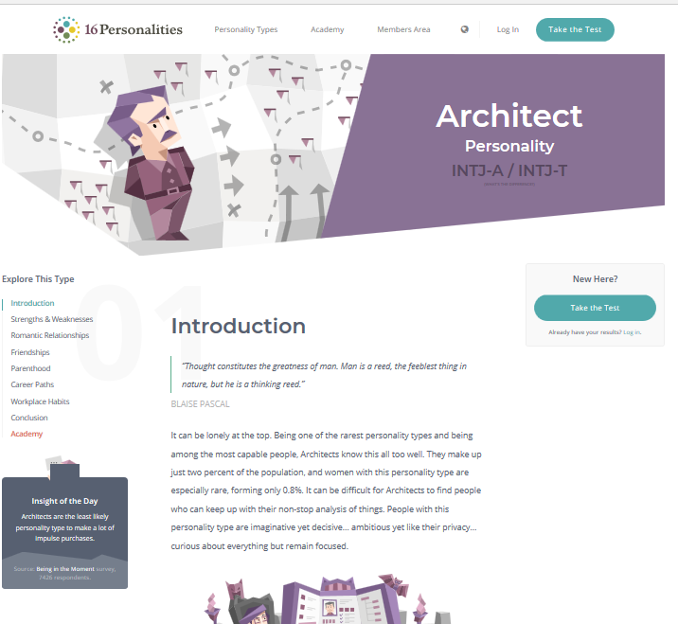
Jacob Scadden
INTJ
Introverted
Intuitive
Thinking
Judging
Try for free:
https://www.16personalities.com/free-personality-test

Slide 19
Conclusion
Each person is an individual and should be treated as such
By understanding your own personality and your colleagues you will be able to work together effectively
As a leader by identifying different personality traits in your team you can oversee the work so that it is efficiently done
Coaching can be an important part to make people more rounded

Slide 20
Any Questions?

Slide 21
Is it better to have a mix of personalities in your team?

Slide 22
How would personalities effect conflict resolution?

Slide 23
Why do you think it is important to understand your own personality?

Slide 24
Asante sana!

Slide 25
What next?
Use the skills that we have discussed in your own life to help with your degree
Establish peer-mentoring networks
Put yourself in positions that you can become a leader/team manager
Try a personality test and see how accurate it is
Next meeting 30th October 2019

Slide 26
References
Acknowledgements
Vanda Morgen
Ariadna Miquel-Clopes
Santie de Villiers
BBSRC
Quadram Institute Bioscience
ssDNAfrica
Oxford Learners Dictionary. Accessed 06/09/19. Available at: https://www.oxfordlearnersdictionaries.com/
Block, Melissa (September 22, 2018). "How The Myers-Briggs Personality Test Began In A Mother's Living Room Lab". NPR. Retrieved 23 September 2018.

