Slide 1
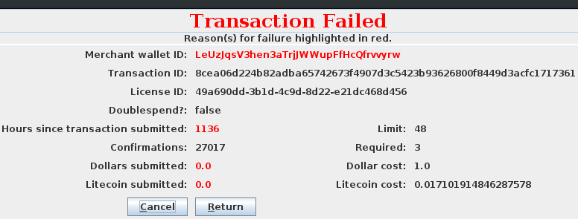
Unlicensed Panel
Retry
Transaction fails
License expires
Transaction succeeds
Failed Transaction Panel
Panel indicates the
reason for failure
Licensed Panel

Slide 2
LicenseManager

