Slide 1
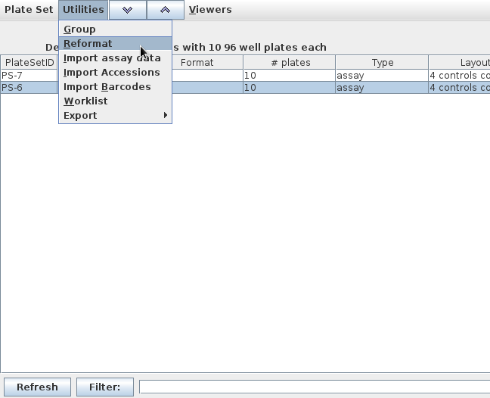
Highlight

Slide 2
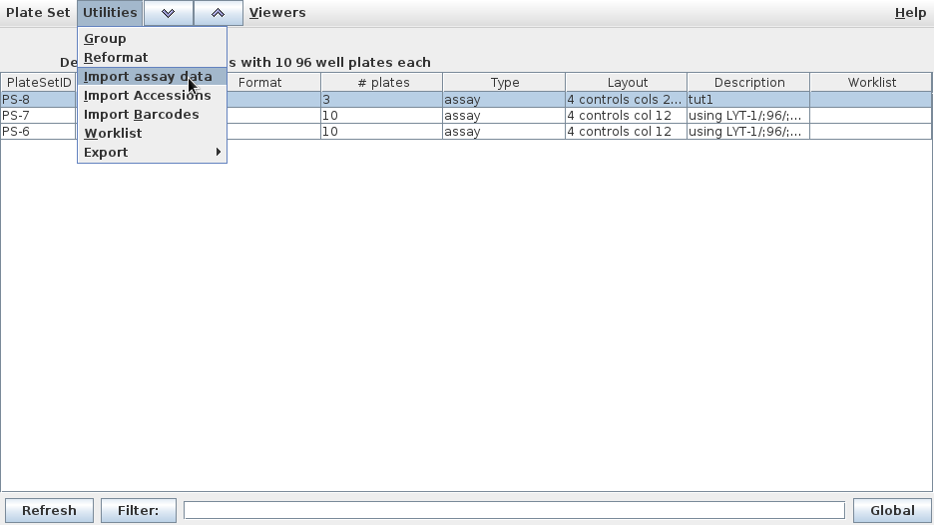

Slide 3


Well Type
Unknown
Positive
Negative
Blank
Well Type
Unknown
Positive
Negative
Blank

Slide 4
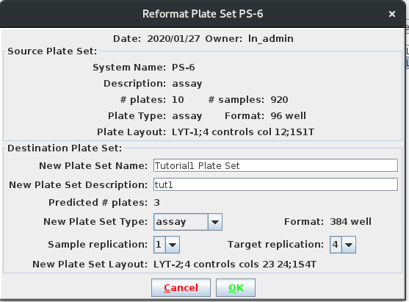

Slide 5
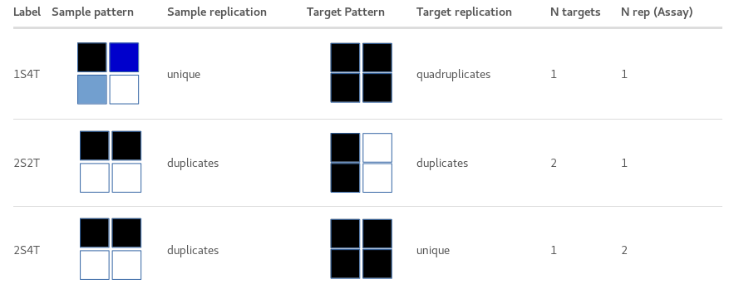



Slide 6
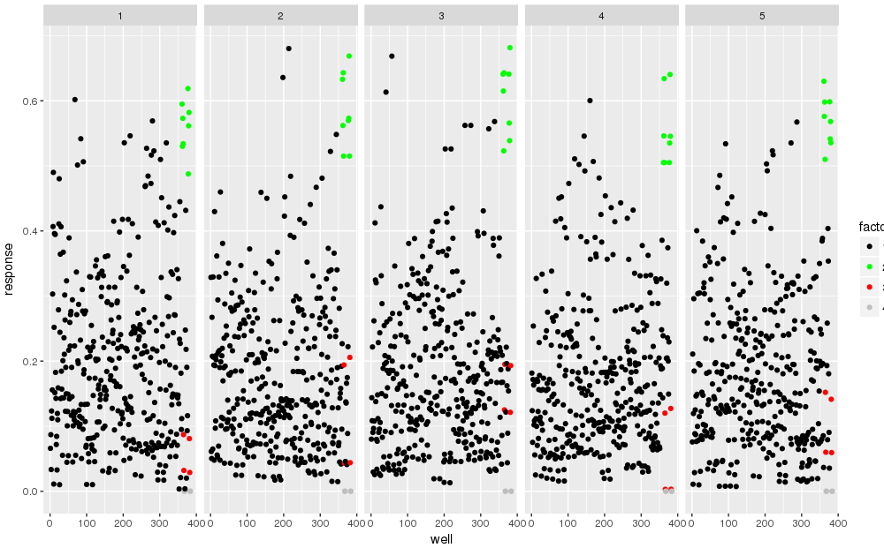
Well Type
Unknown
Positive
Negative
Blank

Slide 7
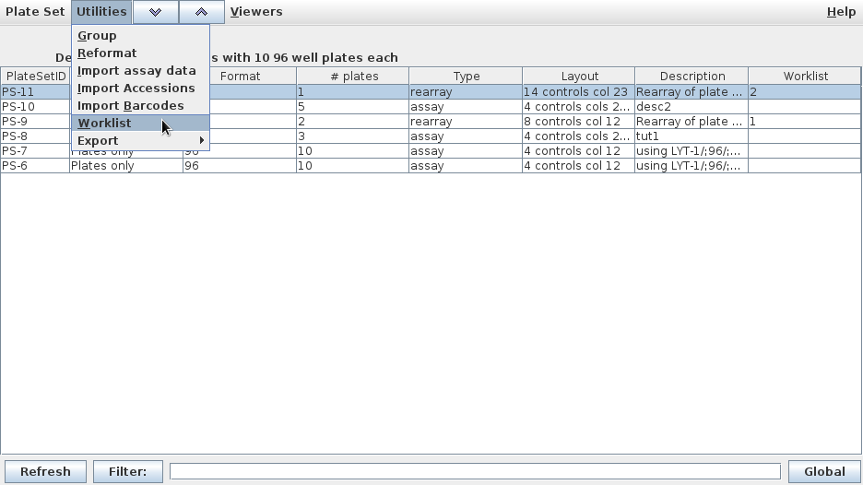

Slide 8


Slide 10
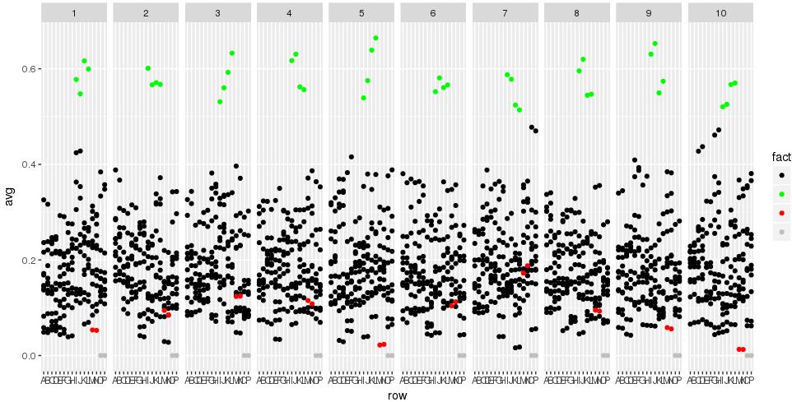
Well Type
Unknown
Positive
Negative
Blank

Slide 11
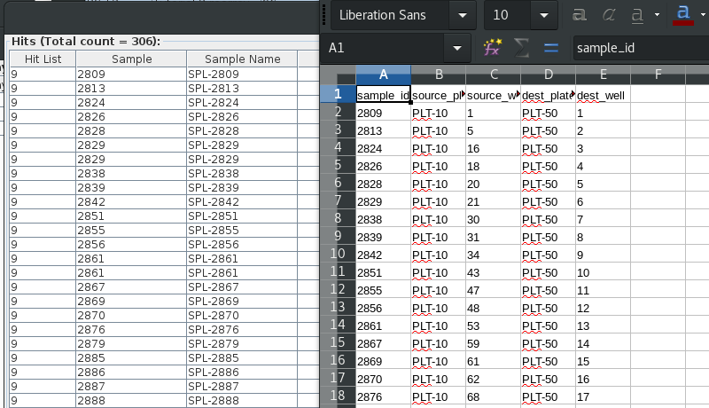
Hit List View Exported Work List

Slide 12
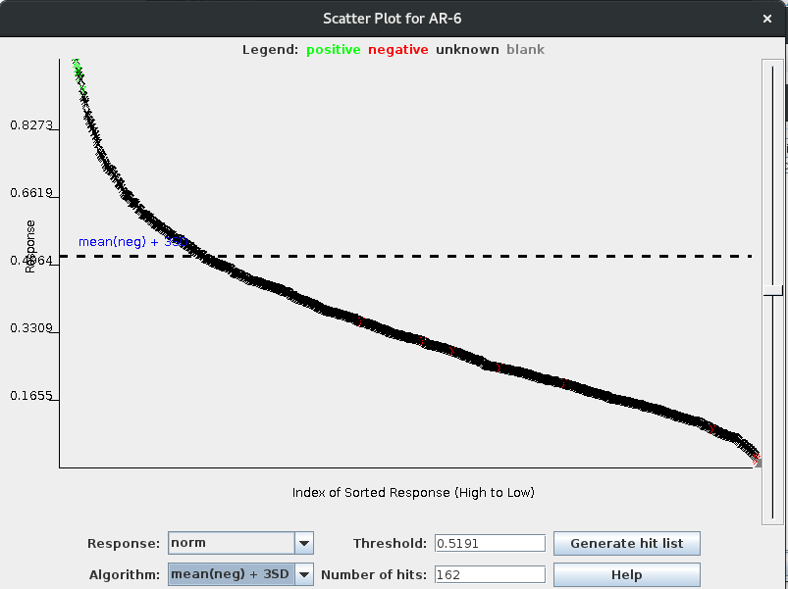

Slide 13
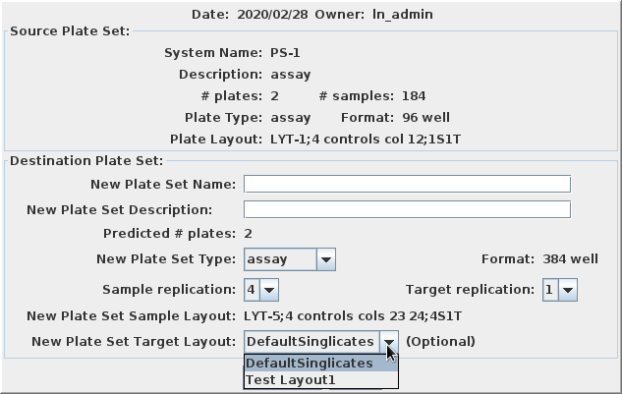

Slide 14
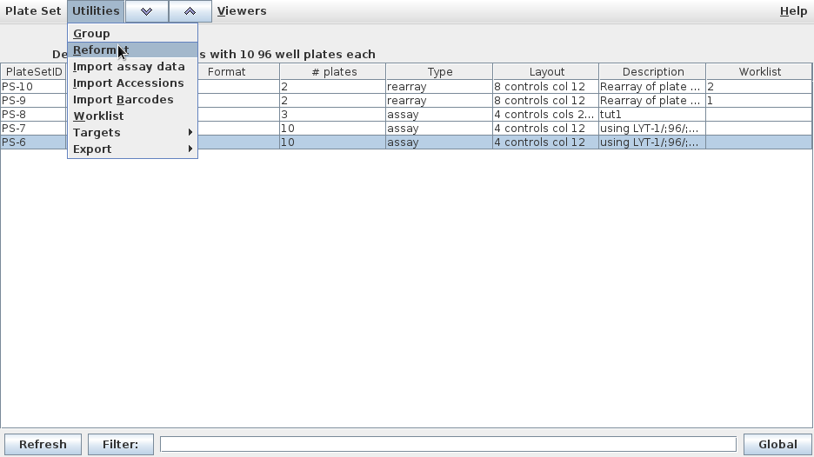
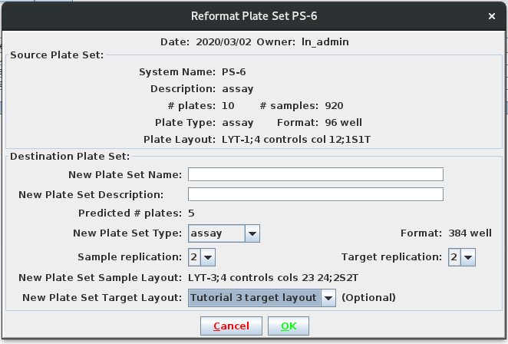

Slide 15
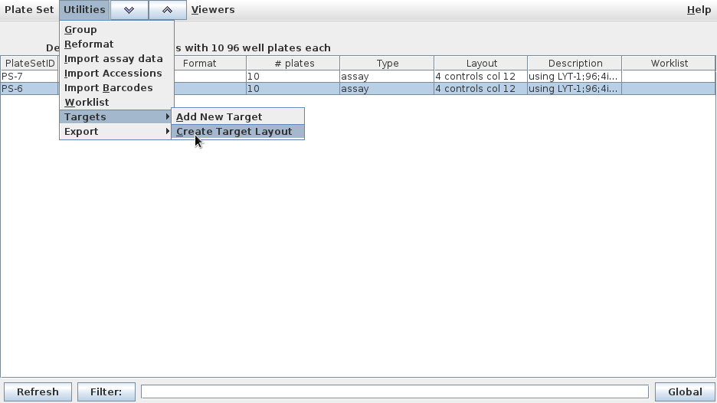

Slide 16
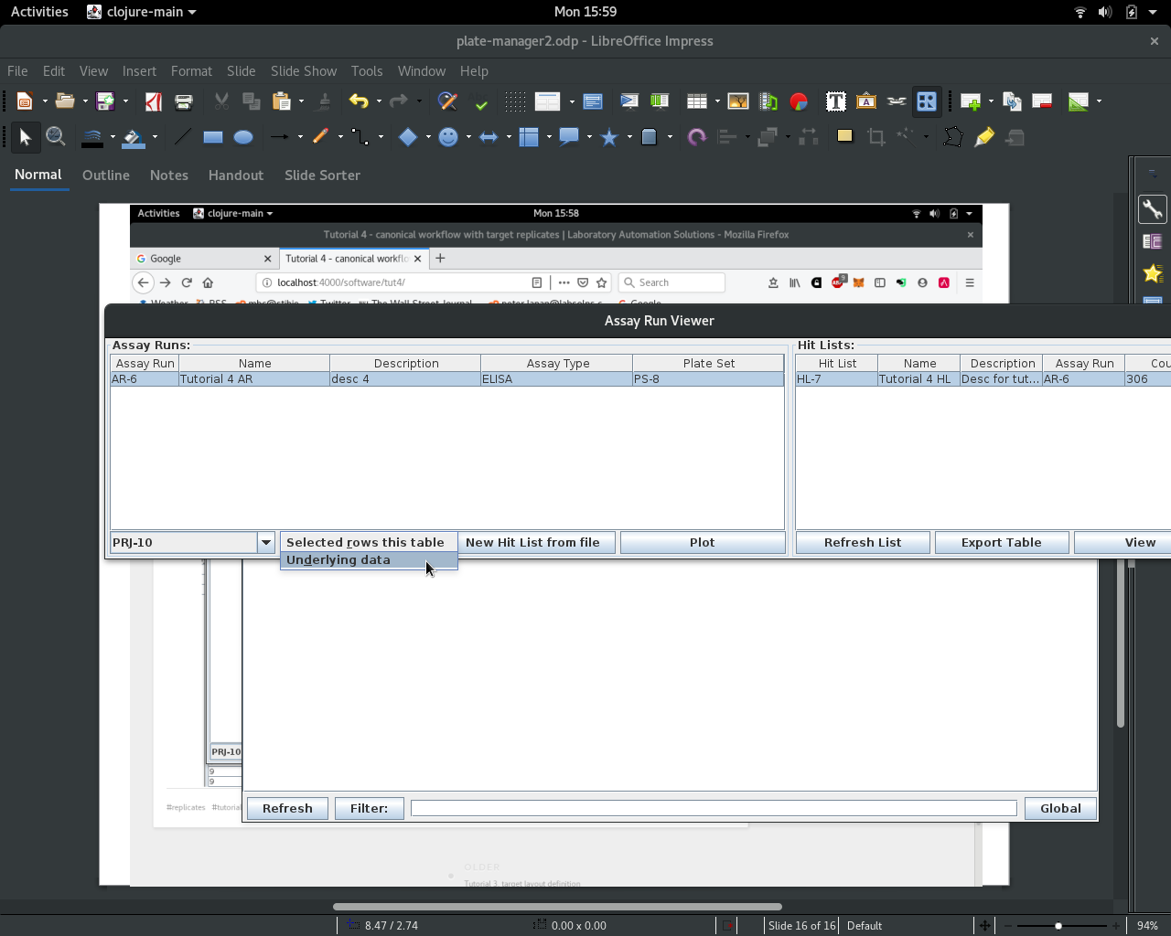

Slide 17
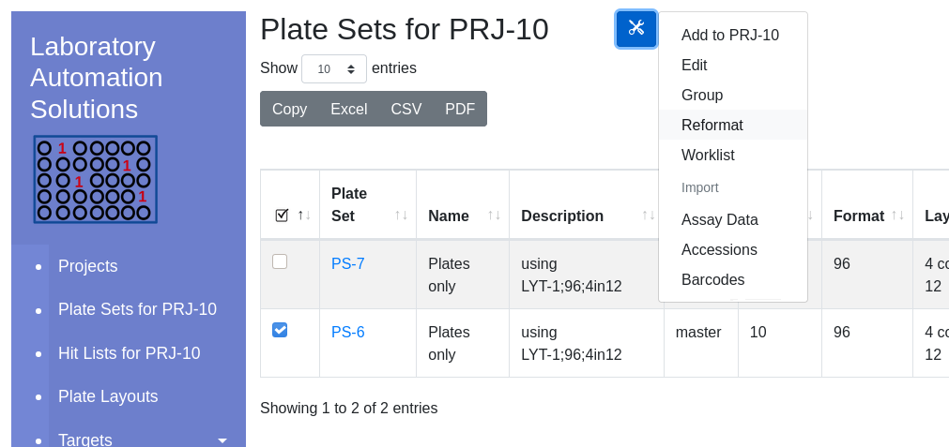
2. Select
1. Check

Slide 18
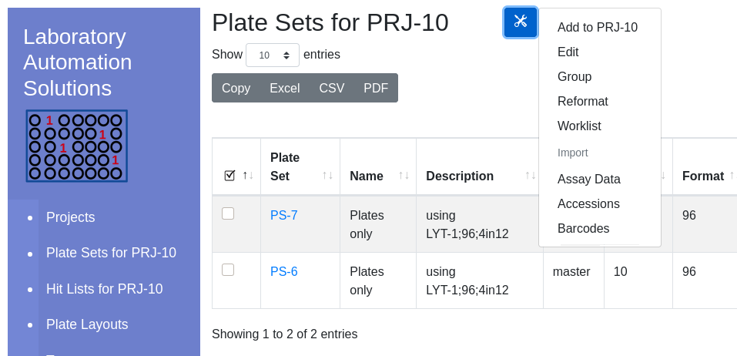
Export visible table
Export visible table
Export visible table
Tools Icon
Global Navigation
Hyperlink into enclosed entity
Default Project
Select entity for workflow

