Slide 1
Plate Manager
Project
Plate Set 1
Plate Set 2...
.
.
.
.
PLT-1
PLT-N+1
PLT-2
PLT-N+2
PLT-3
PLT-N+3
….
PLT- N-1
PLT- N...
PLT-N
PLT-N...

Slide 2
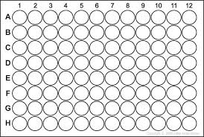
96 well plate
Well
Sample
Assay result 1
Assay result 2….

Slide 3
Store Sequences
LIMS*Nucleus
R
Spotfire
LIMS*Nucleus
Study
Management
Liquid handling
robot
Plate reader

Slide 4
Interacting with LIMS*Nucleus
File transfer
Primary key/ foreign key
Socket
LIMS*Nucleus

Slide 5
LIMS*Nucleus
Java/WebStart
PostgreSQL
Pg/SQL

Slide 6
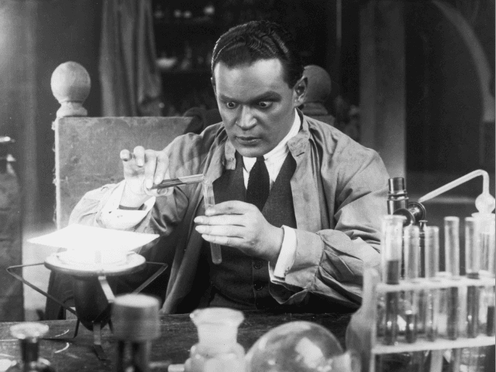

Slide 7
Project
Plate Set
Plate
Well
Sample

Slide 8
Create Plate Set of 96 well plates
Reformat into 384 well assay plates
Run assay
Associate data with plate set
Identify hits, create hit list
Re-array hits

Slide 9
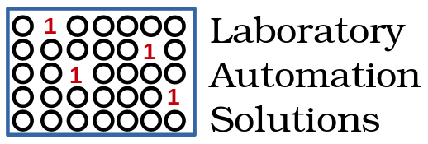

Slide 10
http://labsolns.com
peter.lapan@labsolns.com

Slide 12
Reformat uses the “Z” pattern
Column
1 2
Q1 | Q2
Q3 | Q4
Row
A
B

Slide 13
Duplicates are side-by-side
Column
1 2
Q1 | Q2
Q3 | Q4
Row
SPL-1
Rep 1
SPL-1
Rep 2
A
B
SPL-2
Rep 1
SPL-2
Rep 2

Slide 14
Monolith
Data
Results

Slide 15
LIMS*Nucleus
R
Spotfire
File transfer
Primary key/ foreign key
Socket
Liquid Handling Robot
Plate Reader
Sequence Store

Slide 16
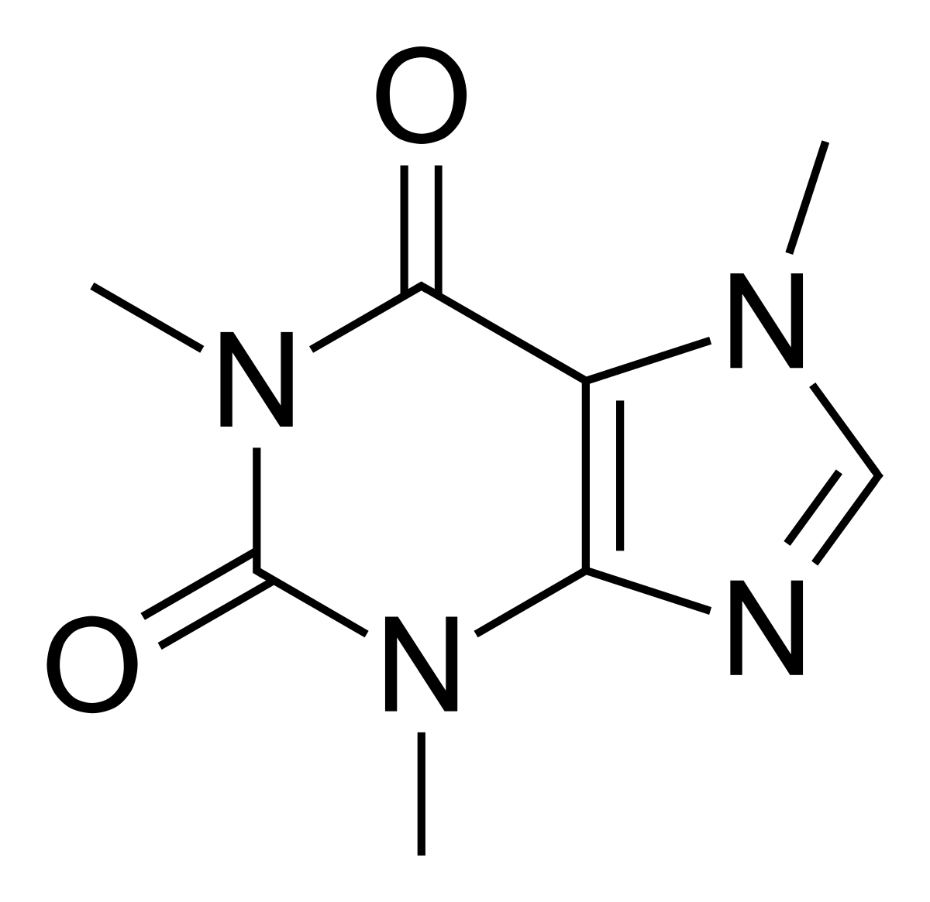
Sample
Sample
Y
Target
Target

Slide 17


Y
Sample
Target

Slide 18
Plate 1
Plate 2
Plate 3
Plate 4
Sample
Target
1 2
A
B
1S4T
2S4T
2S2T

Slide 19
Sample
Target
1S1T
4S1T

Slide 20
Columns
1 2 3 4 5 6 etc
A
B
C
D
1
2
1
1
1
3
4
Rows
1
1
1
1
1
1
1
1

Slide 21
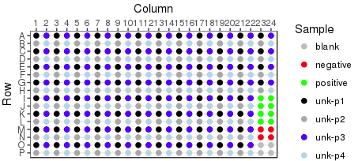

Slide 22
Sample
Target
1S1T
Assay #1
Assay #2
1S4T
Assay #3
Assay #4

Slide 23

Server
Client
Debian 11 Stretch
PostgreSQL
Debian 11 Stretch
Guile/Scheme
Artanis (Web Server)
Bootstrap/Datatables
Javascript
R-base (plot → *.png)

Slide 24
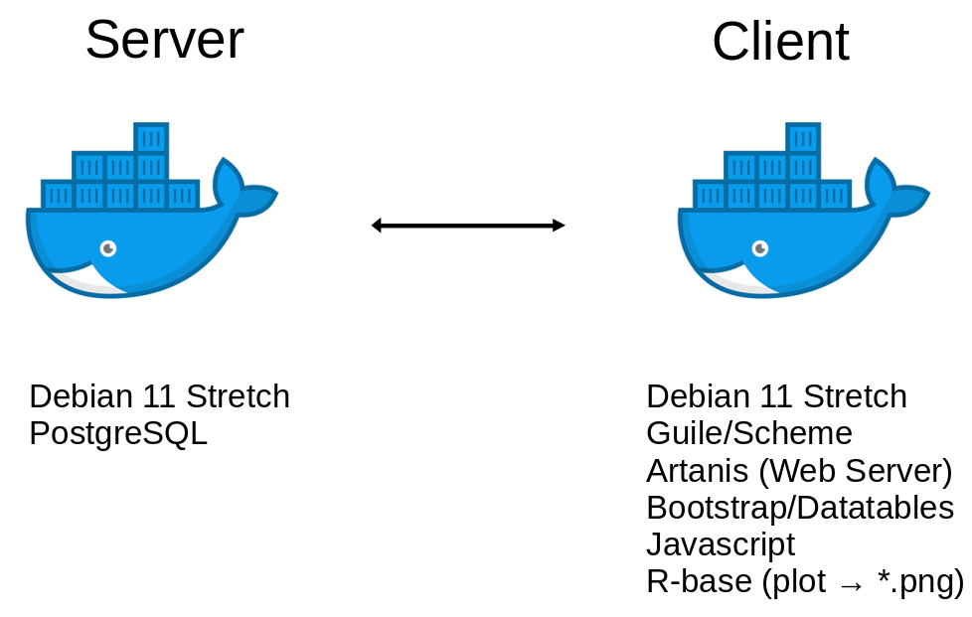

Slide 25
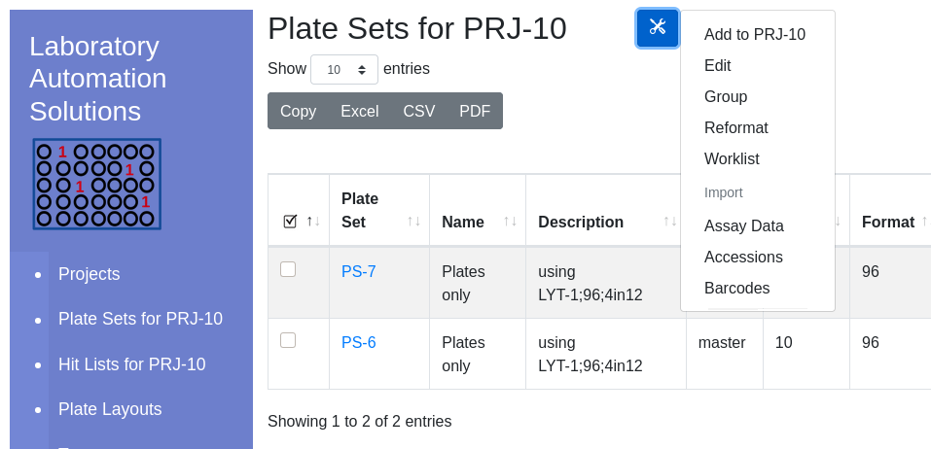
Export Buttons
Global Navigation
Current Project
Hyperlink to contained entity
Current Project

Slide 26
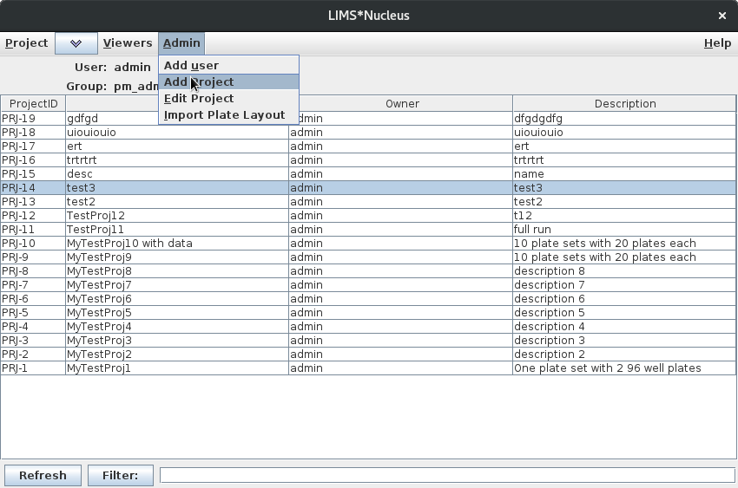

Slide 27
Project
Plate Set
Plate
Well
Sample

Slide 28
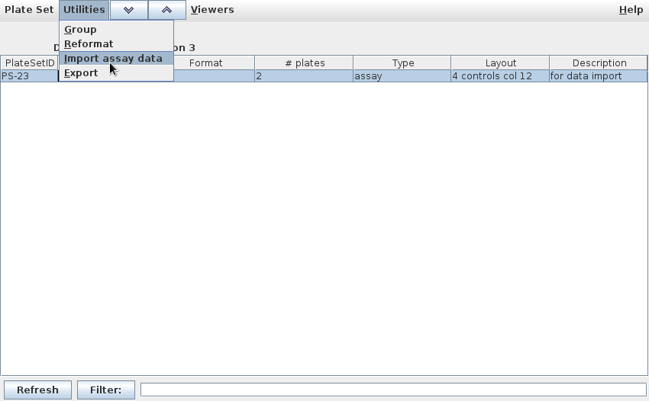
Select plate set

Slide 29
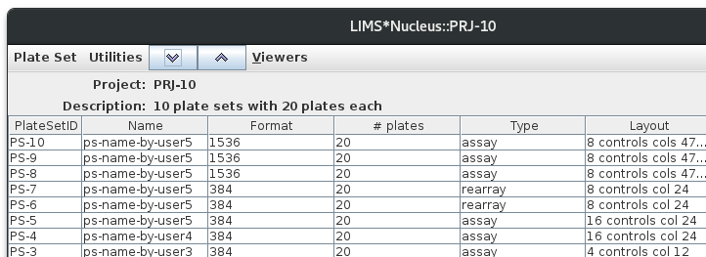
Navigate down
to plates
Navigate up
to project
Current entity displayed
in the client

Slide 30
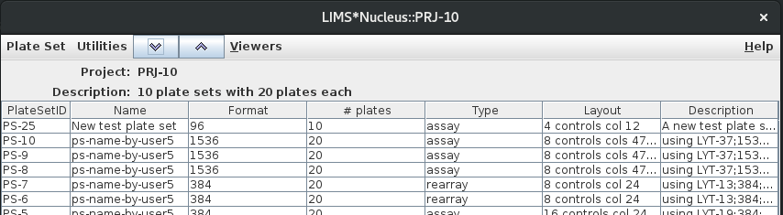

Slide 31
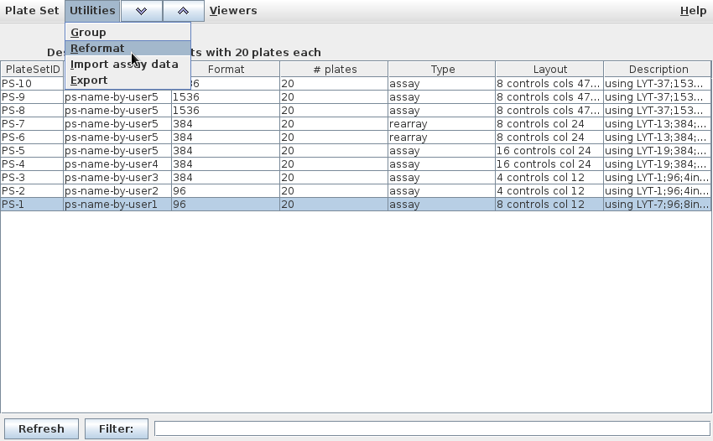
PS-1 selected

Slide 32
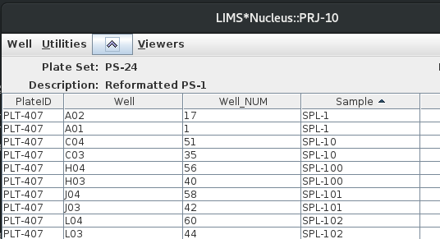

Samples
Targets

Slide 33
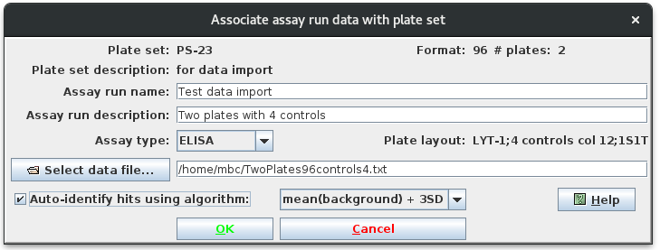

Slide 34
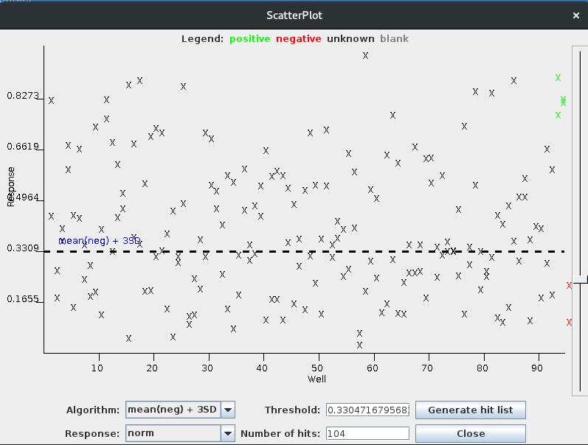

Slide 35
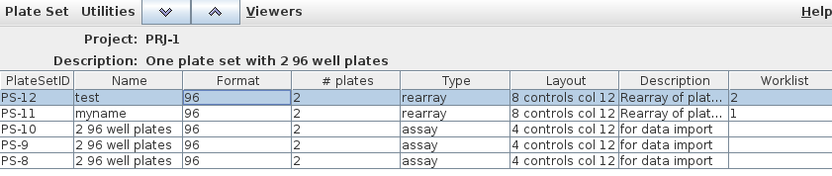
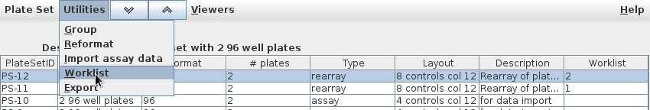

Slide 36
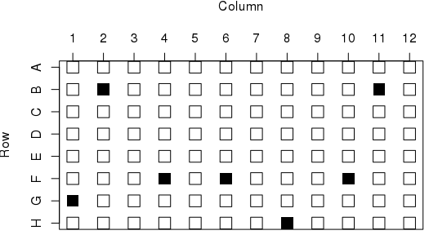
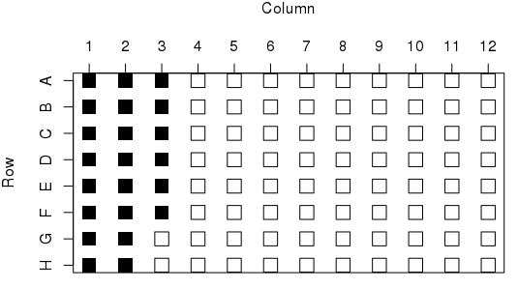
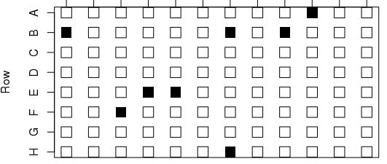

Slide 37
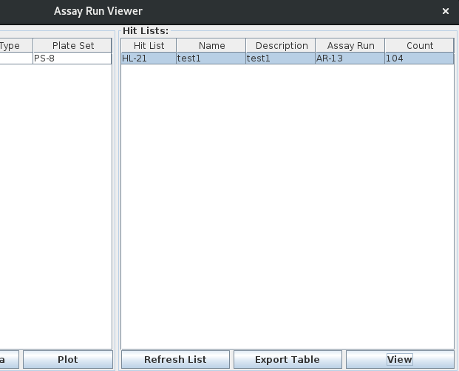

Slide 38
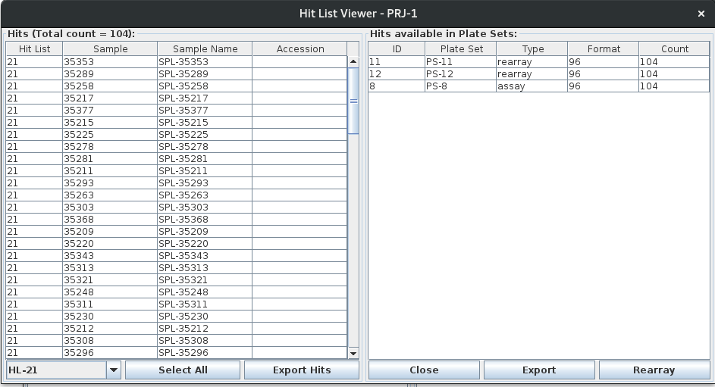

Slide 39
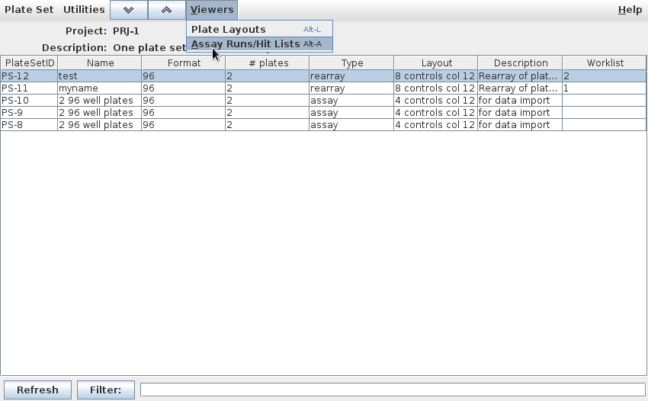

Slide 40
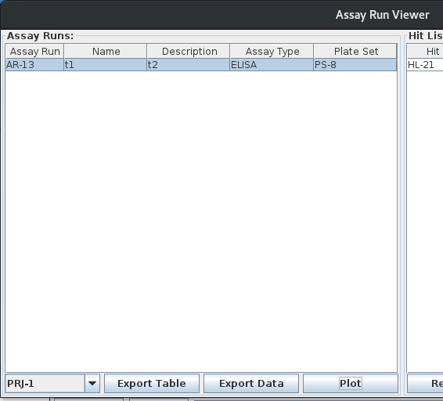

Slide 41
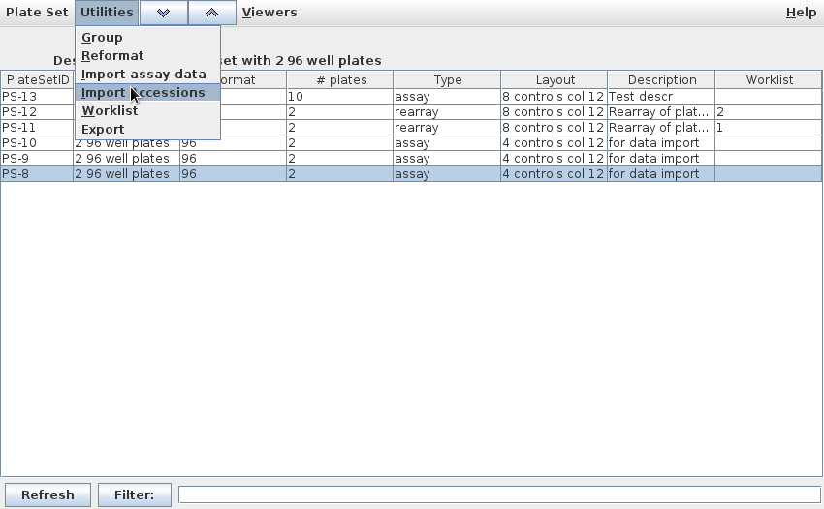

Slide 42
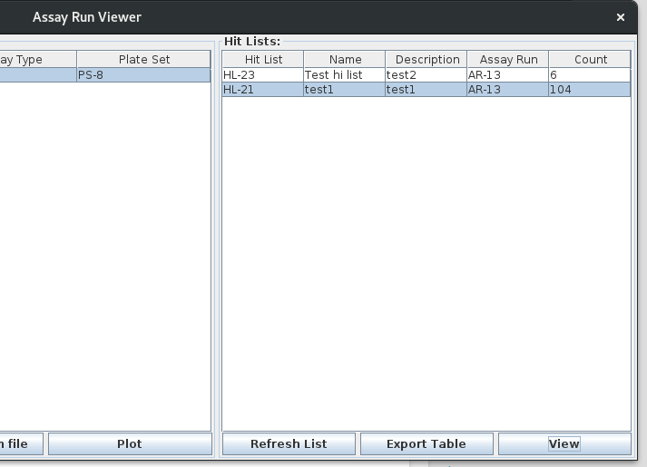

Slide 43
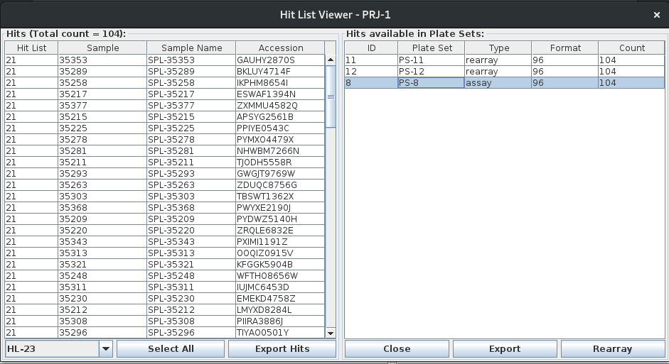

Slide 44
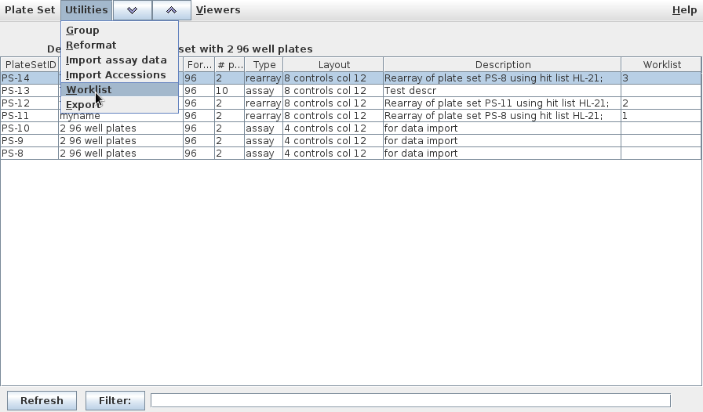
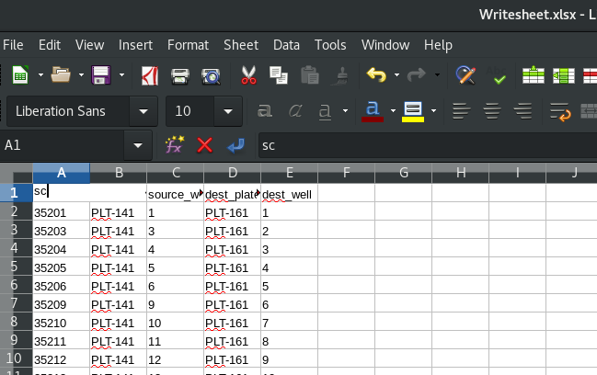
{% asset_img new-hit-list.png %}

Slide 45
Launch Application
Is the properties database ln-props present?
No
Is the properties file
limsnucleus.properties present?
Yes
No
Yes
Create ln-props
Login to the example cloud
database with hardcoded
ElephantSQL credentials
Is user=”null”?
No
Yes
Login with supplied credentials

Slide 46
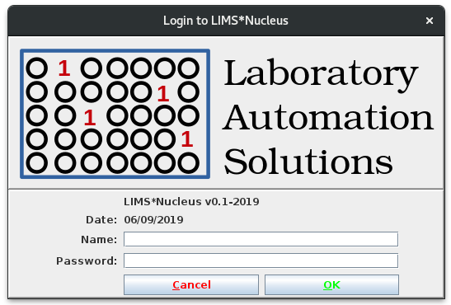
Yes
Session terminated
Are supplied credentials valid?
No

Slide 47
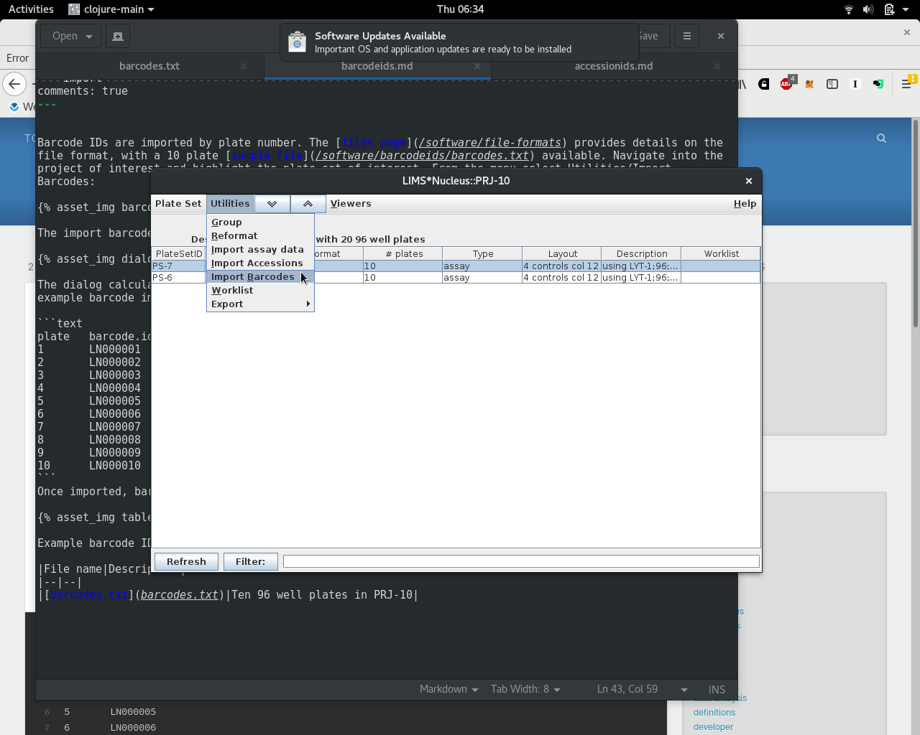

Slide 48
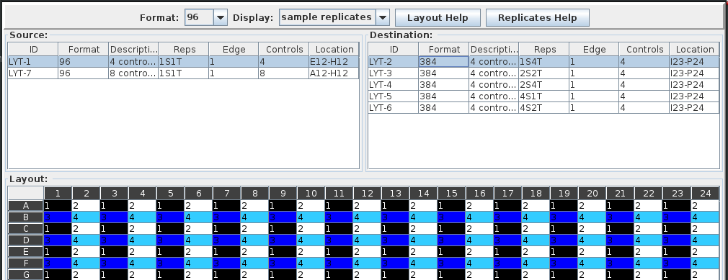
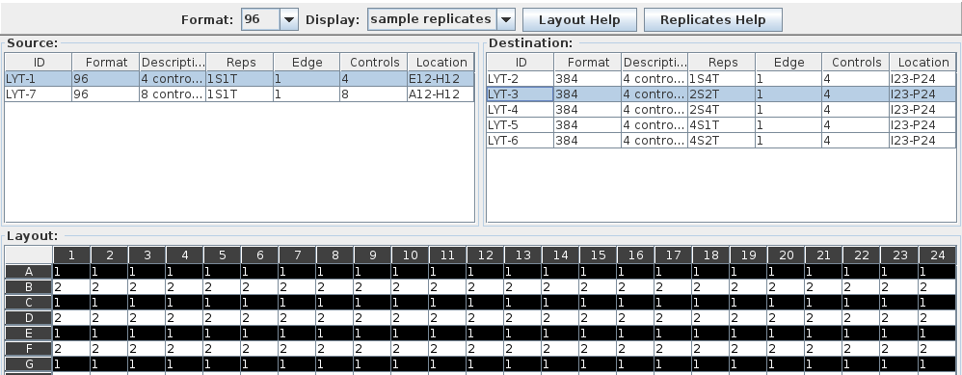

Slide 49
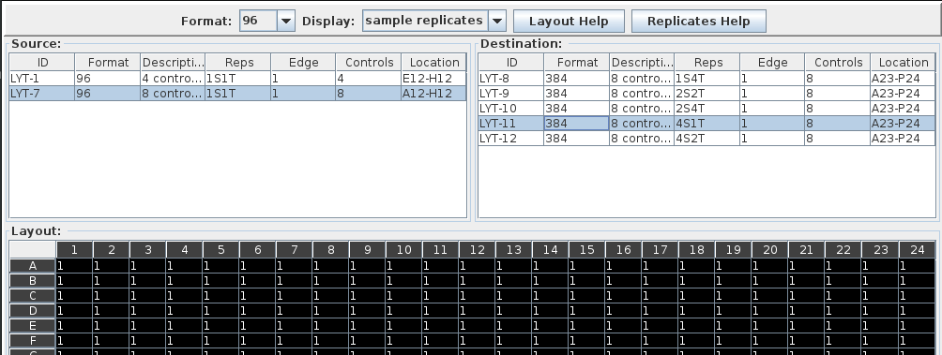
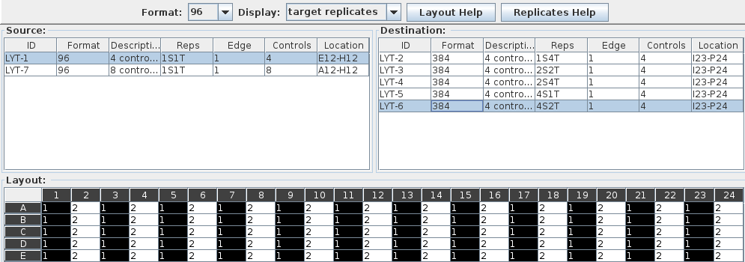

Slide 50
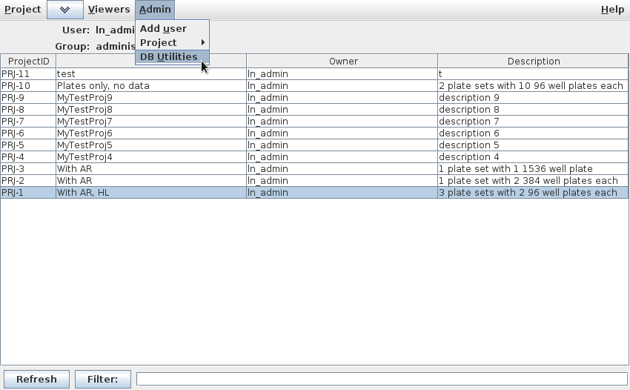

Slide 51
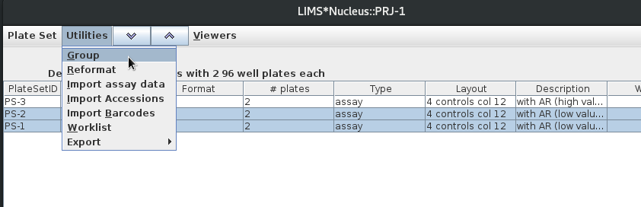
Select

Slide 52
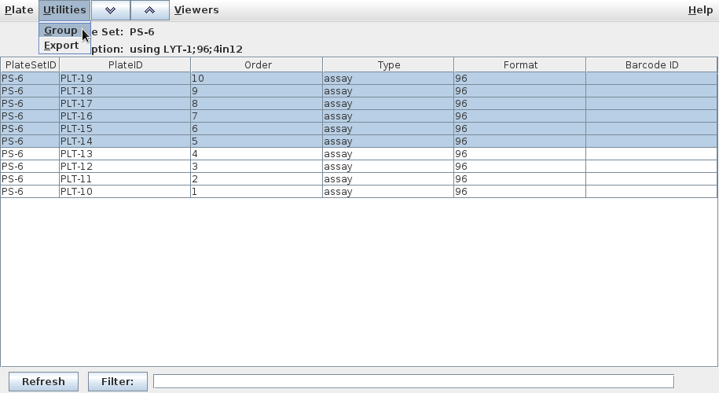
Select

Slide 53
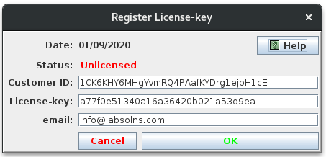
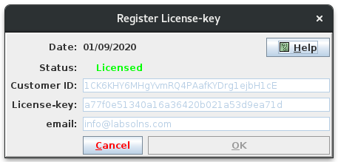

Slide 54
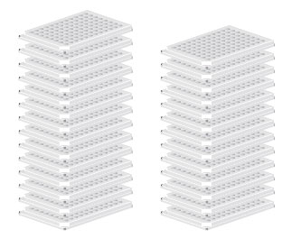
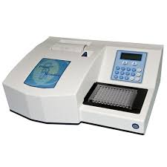
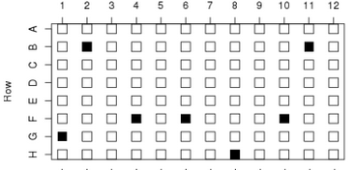
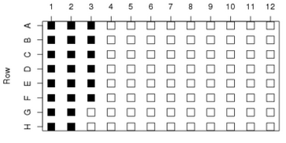
1. Plate Set
1.5 Reformat
2. Assay Run
5. Secondary
assay
3. Hit Identification
4. Rearray

Slide 55
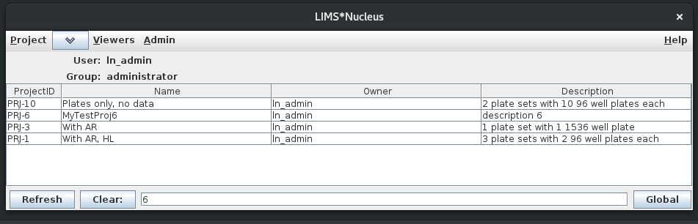
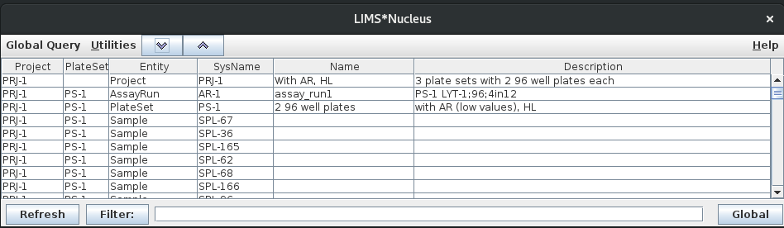
Navigate down Navigate up

