Slide 1
Heroes of CSS
Day 3
July 23, 2016

Slide 2
Admin Work

Slide 3
Homework Assignment
Also, at this point everyone should have access to the class repository in GitHub:
https://github.com/the-Coding-Boot-Camp-at-UT-Austin/07-16-NCC-Class-Content
Homework Assignment #1 is Due:
MW Class – Wednesday (7/27/2016 by 6:30pm)
TTH Class – Thursday (7/28/2016 by 6:30pm)

Slide 4
Homework Assignment
Really, work hard on this assignment! This assignment introduces you to fundamental concepts that we’ll be building the entire course-long.
Review In Class Material especially Exercises: https://github.com/the-Coding-Boot-Camp-at-UT-Austin/07-16-NCC-Class-Content/tree/master/Class-Content/01-html-css-three-days/1-Class-Content/1.2/Activities/3-HTML_CSS_Layout
Work with your peers! It’s much better than screaming at your computer alone.
Ask Questions on Slack! Your peers, TAs, and Instructors are all here to help when they can.

Slide 5
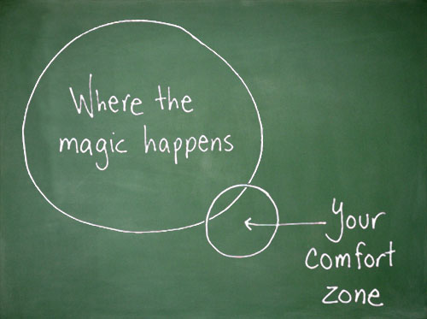
Most Important of All….
Just Submit SOMETHING (even if it seems pretty crummy)!

Slide 6
Homework Assignments, from #2 forward
Homework will be assigned on Fridays and be due the next Saturday @ 6:30pm, in order to:
Align the two class sections better with the syllabus
Give everyone 8 days to complete the assignment!

Slide 7
Warning!

Slide 8

Brace Yourselves
Today is going to be a bit tough.
But trust us!
It will all look easy a few weeks from now.

Slide 9
Brace Yourselves
Don’t expect to understand EVERYTHING at once.
Today is all about getting immersed.

Slide 10
CSS Recap

Slide 11
Critical Question
What is “CSS”?

Slide 12
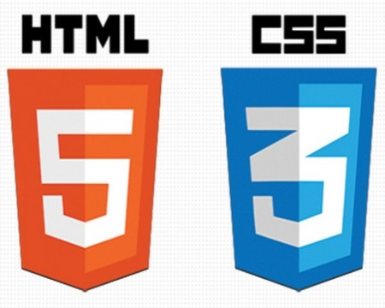

HTML / CSS Definitions (*yawn* unimportant)
HTML: Hypertext Markup Language – (Content)
CSS: Cascading Style Sheets – (Appearance)
HTML/CSS are the “languages of the web”. Together they define both the content and the aesthetics of a webpage – handling everything from the layouts, colors, fonts, and content placement. (Javascript is the third – handling logic, animation, etc.)

Slide 13


HTML / CSS Analogy
HTML Alone
Like writing papers in “Notepad.”
Can only write unformatted text.
HTML / CSS
Like writing papers in Microsoft Word.
Can format text, page settings, alignment, etc. based on “highlighting” and menu options.

Slide 14
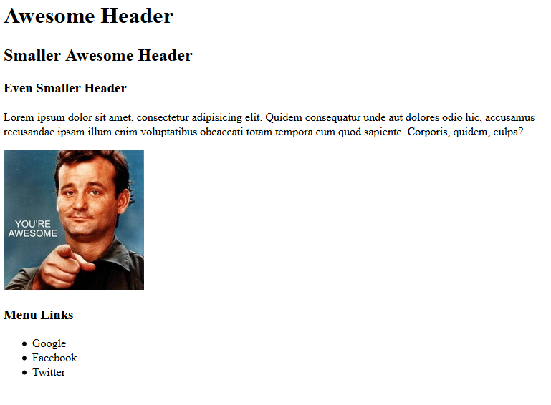
Basic HTML Page - Result

Slide 15
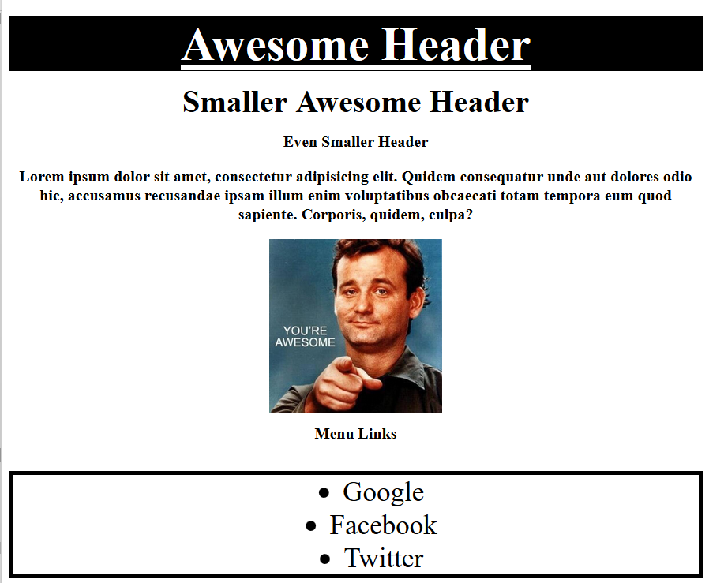
Enter CSS - Result

Slide 16
Critical Question
How do we style HTML…
Elements?
Classes?
IDs?

Slide 17
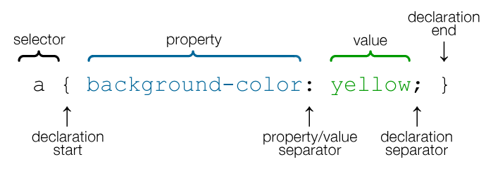
CSS Syntax
CSS works by hooking onto selectors added into HTML using “classes and identifiers.”
Classes use .classname, IDs use #Idname; and elements use just their name.
Once hooked, we apply styles to those HTML elements using CSS.

Slide 18
Lingering Questions
Questions so far?

Slide 19
Relative File Paths

Slide 20
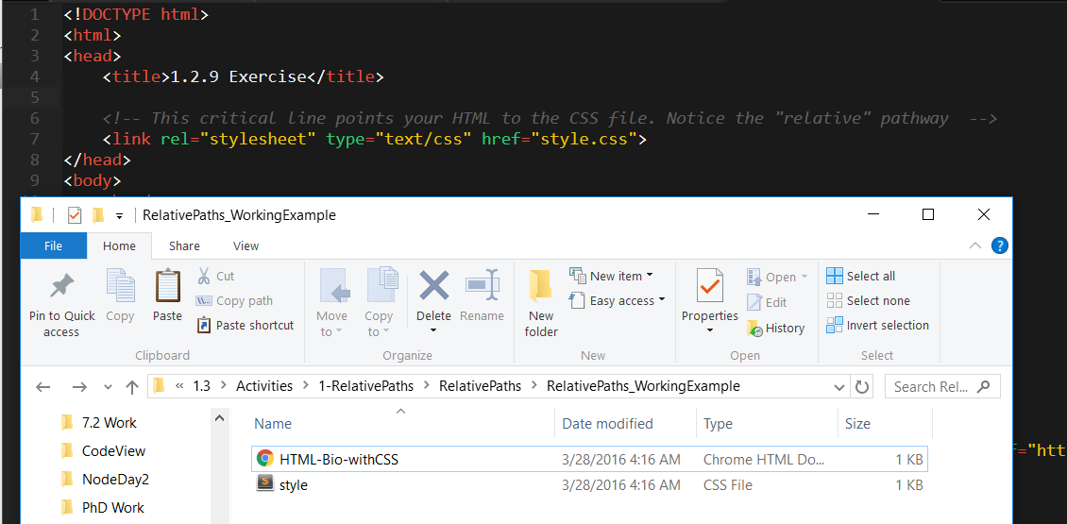
Relative File Paths
Relative file paths connect us with other files in our working directory. In this case, style.css is in the same folder as our html document.

Slide 21
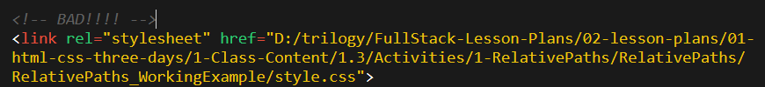

Absolutely No Absolute Paths
VERY VERY BAD
ALWAYS USE RELATIVE FILE PATHS.
If you deploy your sites without them, all of your links will fail.
The same will happen if you move your project from one folder to another.
Remember: there is no such thing as a “C:” drive on the internet.

Slide 22
Quick Demo
Instructor: Demo
(RelativePaths_DEMO | 1-RelativePaths)

Slide 23
> YOUR TURN!!
Activity: 1-RelativePaths| Suggested Time: 10 min
Assignment
1. Unzip the folder sent to you via Slack.
2. Edit the HTML files in all of the “RelativePaths” folders. You need to write relative paths that link the HTML documents with CSS stylesheets.
Tip: Check out the “RelativePaths_WorkingExample” folder.

Slide 24
Box Model

Slide 25
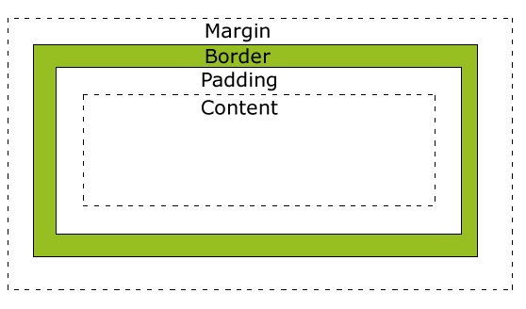
Boxes Upon Boxes
In CSS, every element rests within a series of boxes.
Each box has customizable space properties:
margin, border, and padding.
Typical spacing value: 20px 10px 10px 20px (top, right, bottom, left)

Slide 26
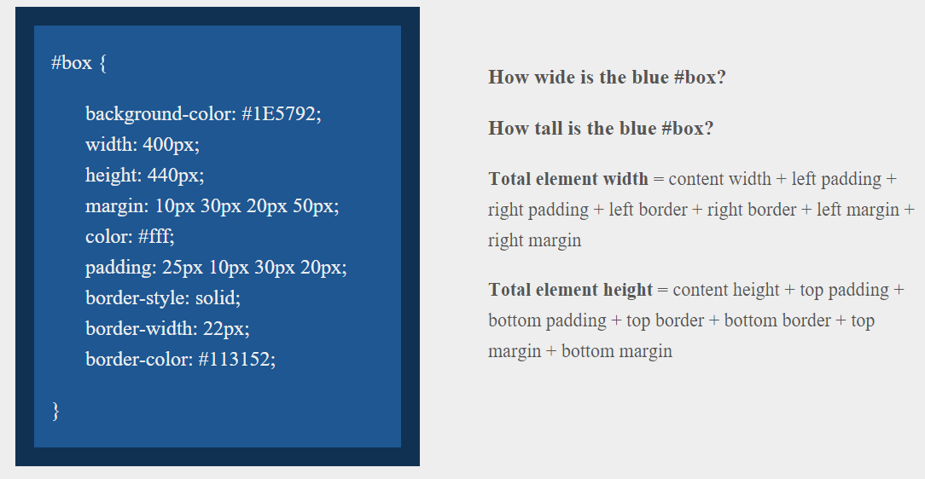
> YOUR TURN!!
Suggested Time: 10 min

Slide 27
> YOUR TURN!!
Answer
Width: 474 px (no margin), 554 px (with margin)
Height: 539 px (no margin), 569 px (with margin)

Slide 28
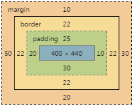
> YOUR TURN!!
Answer
Width: 474 px (no margin), 554 px (with margin)
Height: 539 px (no margin), 569 px (with margin)

Slide 29
We Be Floatin’

Slide 30

Take a Facebook Break…
Warning!
These next topics are fairly “tricky”… but VERY IMPORTANT.
Time to channel that inner genius.

Slide 31
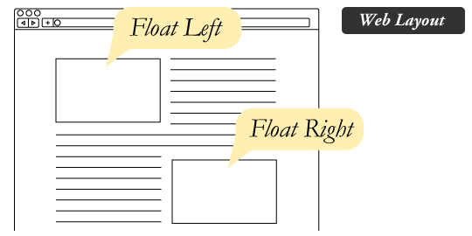
The Concept of “Flow”
By default, every HTML element displayed in the browser is governed by a concept called “flow.”
This means that HTML elements force their adjacent elements to flow around them.

Slide 32
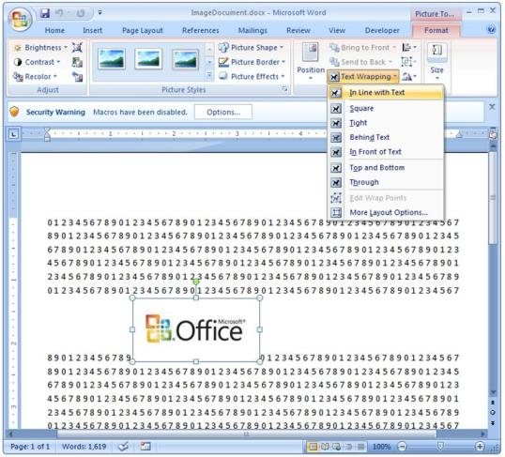
Flow Analogy to MS Word
This concept of “flow” is very similar to the wrap-text options you may be familiar with in Microsoft Word.
Just as in MS Word, you can have images in-line with text, on-top of text, etc.

Slide 33
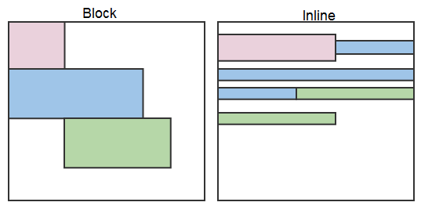
Block Elements
By default, web clients render many HTML elements as block elements. Paragraphs, headers, divs and more receive this treatment.
A block element will take up an entire line of space — unless you intervene with CSS properties.

Slide 34
Block Elements vs. Inline Elements
Now contrast the block elements with inline elements.
By using float CSS properties, we can command our website to display multiple HTML elements adjacently.

Slide 35
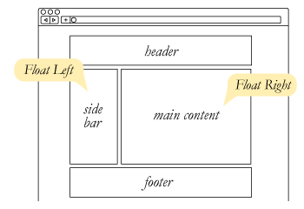
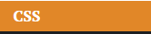
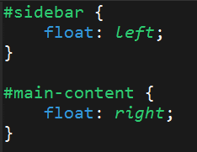
Floating
To transform these block elements into inline elements, we use a CSS property called float.
Floats are necessary for building web layouts

Slide 36
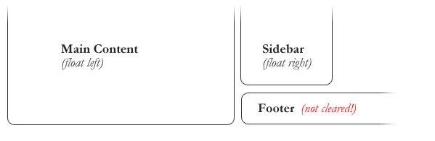
Clearing the Float
Floats often get in the way of our layouts.
Sometimes we don’t want to give each element the “inline” treatment.

Slide 37
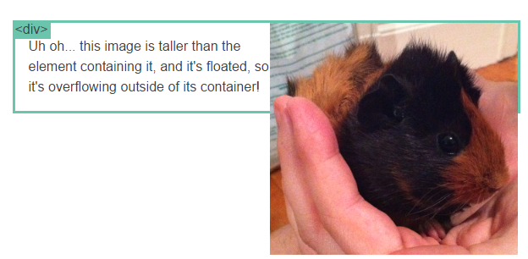
Clearfix Hack
Sometimes when elements don’t match up in size, we get situations like the above…

Slide 38
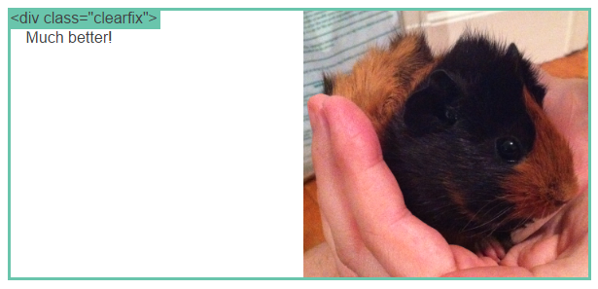
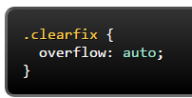
Clearfix Hack
We can get around this by using “the clearfix hack.”
By including the CSS property overflow: auto, the first element will fill up the empty parts of the flow.

Slide 39
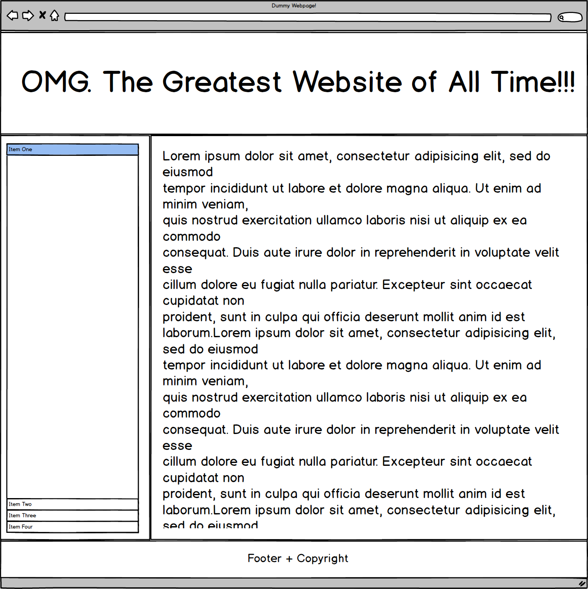
Quick Demo!

Slide 40
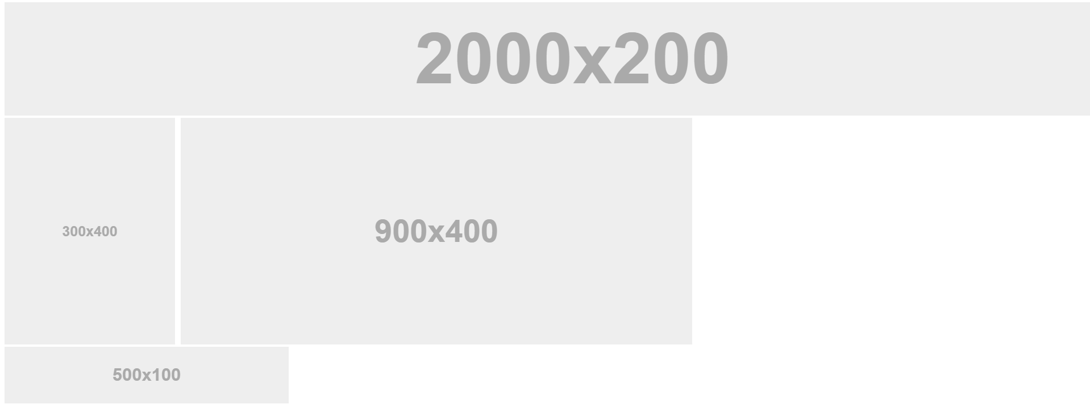
Quick Demo!

Slide 41
Quick Demo
Instructor: Demo
(2-FloatExamples)

Slide 42

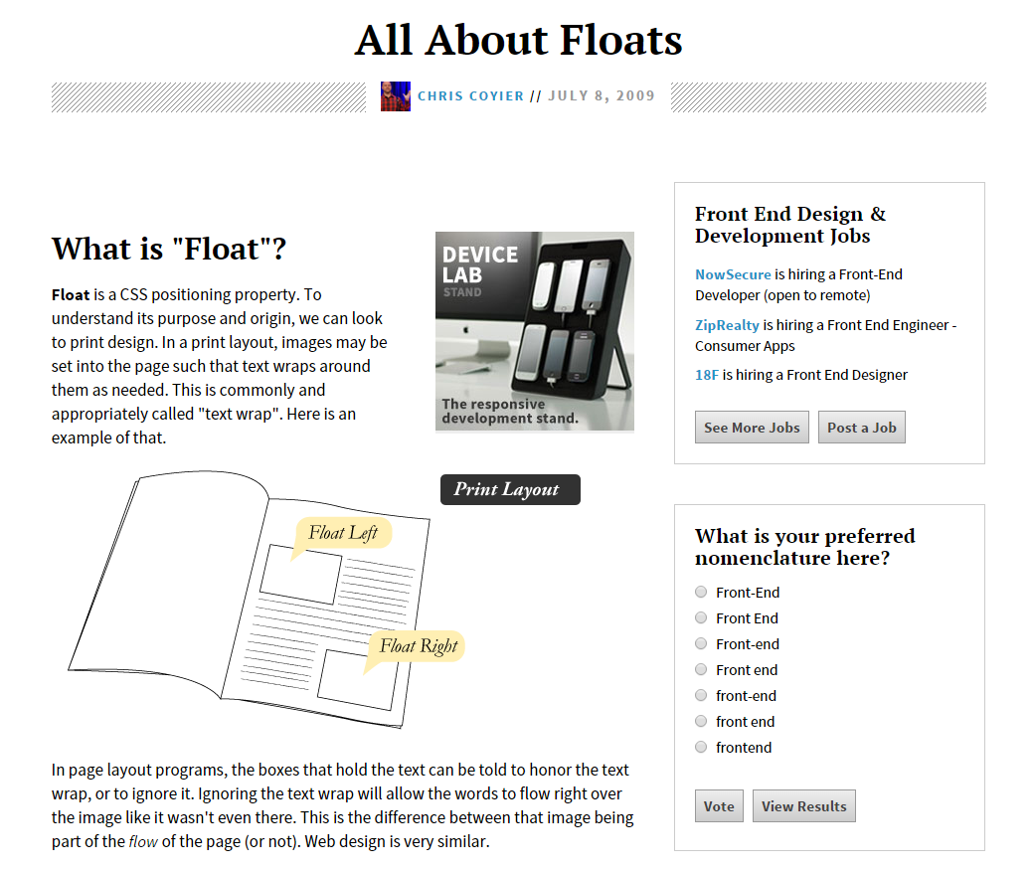
Fantastic Guide on Floats ****
To all serious front-end developers (this is a necessary read): https://css-tricks.com/all-about-floats/

Slide 43
> YOUR TURN!!
Activity: 3-FloatLayout-Activity | Suggested Time: 30 min
Assignment
In this activity, you’ll flex your newfound floating skills by creating a conceptual layout. Eyeball the design to your best ability.
Check your Slack for more instructions.

Slide 44
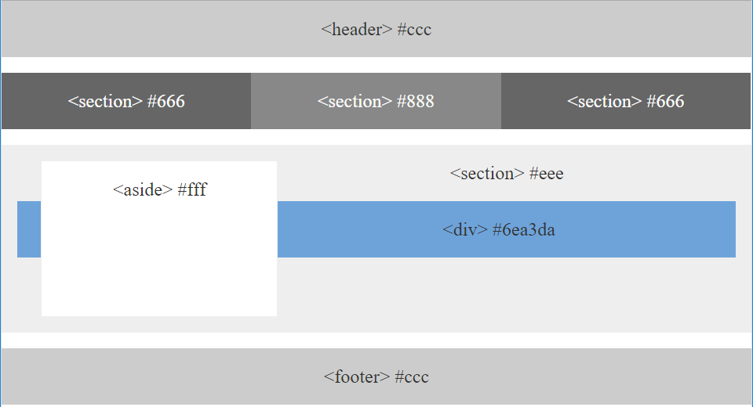
> YOUR TURN!!

Slide 45

Good work!
Your brain may rest now…

Slide 46
BREAK!

Slide 47
CSS Positioning

Slide 48
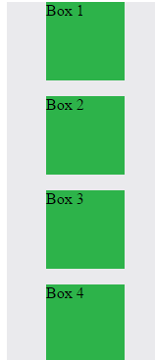
Position: Static (Default)
Four boxes placed statically (default)

Slide 49
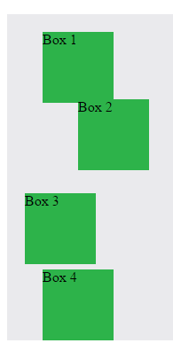
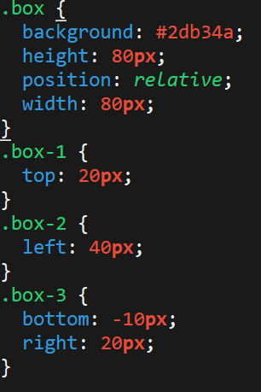
Position: Relative
Switching the boxes to relative will nudge the boxes in relation to their “original” location.

Slide 50
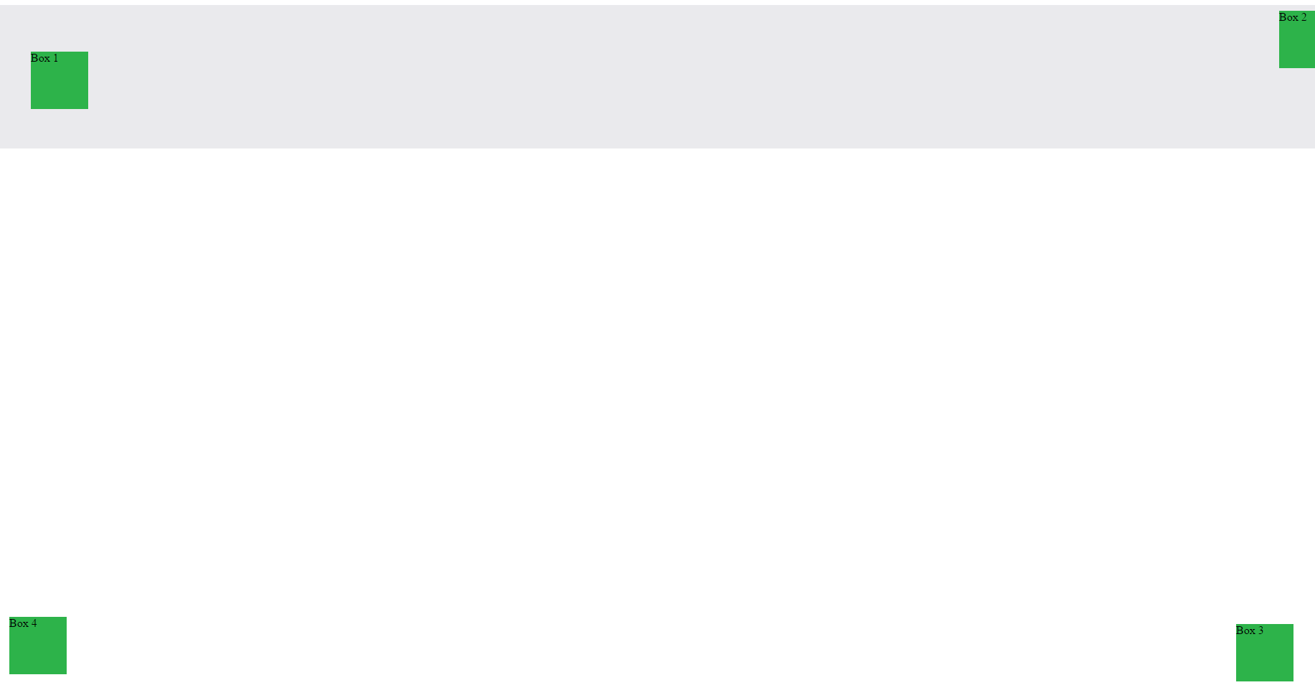
Position: Absolute
Position with location relevant to first “placed” element

Slide 51

Position: Fixed
Position with exact coordinates to the browser window

Slide 52
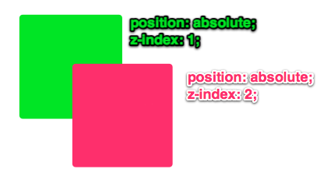
Layering with Z-Index
Z-Index allows you to layer elements on top of each other when they’re placed in absolute coordinates.

Slide 53
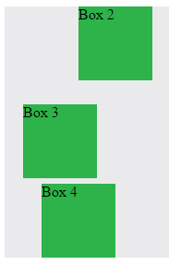
Hiding Things
“Display: none” allows us to hide elements from view.
This will become useful in later sections, when we’ll be hiding and revealing specific HTML elements of our choice.

Slide 54
Quick Demo
Instructor: Demo
(5-CSS_PositionedLayout)

Slide 55
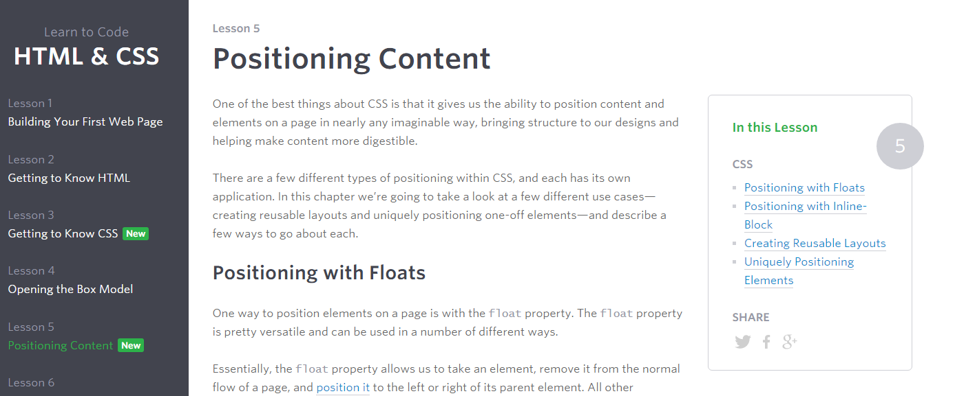
Great Resource
Another great read for front-end developers: http://learn.shayhowe.com/html-css/positioning-content/

Slide 56
> YOUR TURN!!
6-CSS_Positioned_Activity | Suggested Time: 30 min
Assignment
In this activity, you’ll flex your newfound positioning skills by creating another conceptual layout. Eyeball the design to your best ability.
Check your Slack for additional instructions.

Slide 57
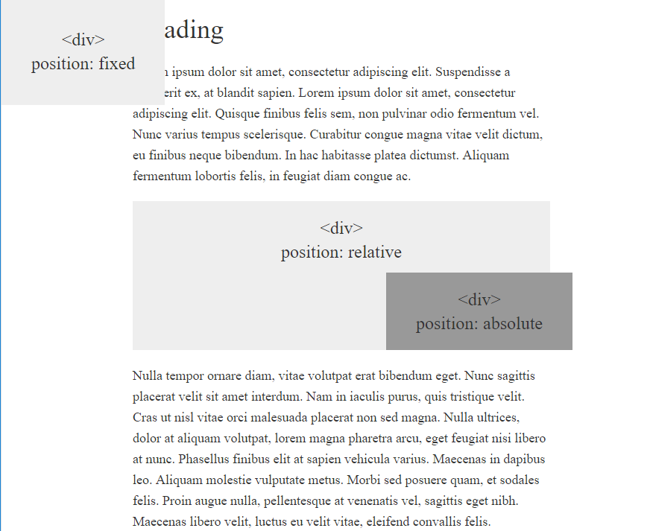
> YOUR TURN!!

Slide 58
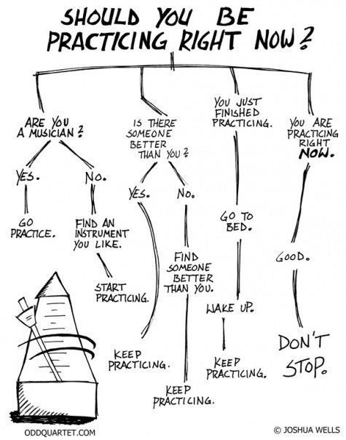
Advice
Re-do this at home. We designed this exercise
to firm up your HTML/CSS skills.
REMEMBER:
The best way to learn
web development
is to PRACTICE!

Slide 59
Chrome Inspector

Slide 60
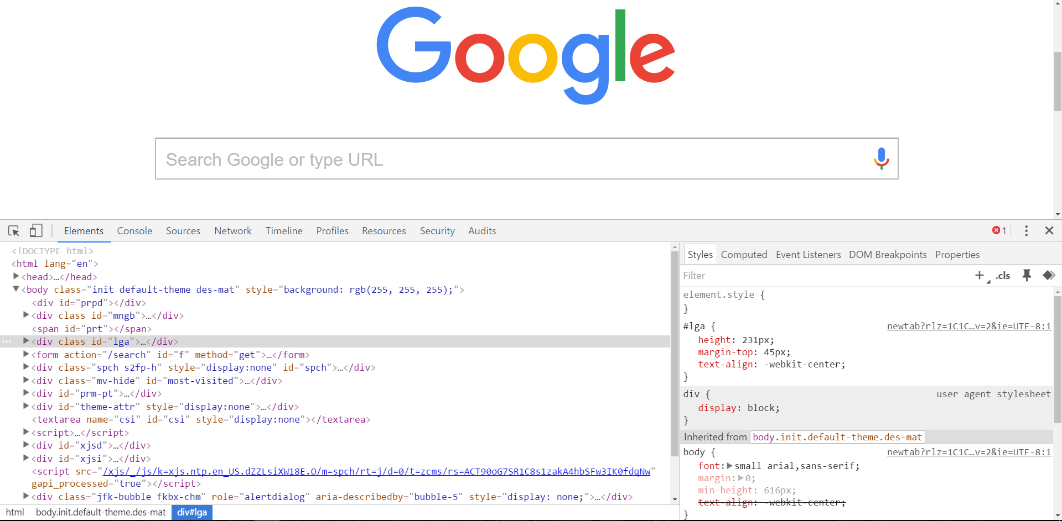
Chrome Inspector is Your Friend
To access chrome inspector: Right click on a page then hit “Inspect.”
It will allow you to inspect the HTML, CSS and more!

Slide 61
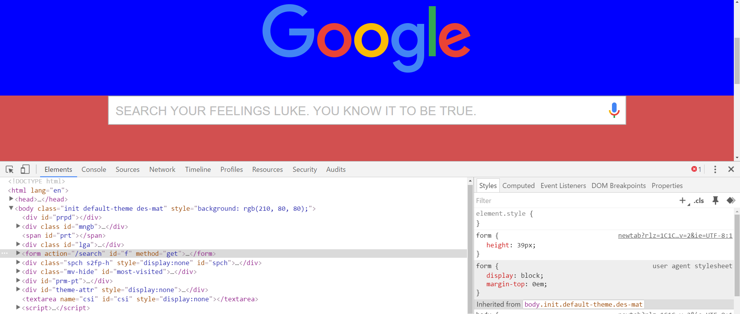
Chrome Inspector is Your Friend
You can even edit the HTML/CSS of a webpage and instantly view your changes in the browser!
This works on any website, whether yours or not.

Slide 62
Next Class!
We’ll be coming back to this
in our next class ☺

Slide 63
Recap + Reassurances

Slide 64


Slide 65
Questions?

Slide 66
EXTRA MATERIAL

Slide 67
> YOUR TURN!!
Assignment
Take a website you commonly visit (Amazon, Google, Huff Po, etc.) and heavily modify it with Google Developer Tools.
You have 15 minutes to test Chrome Inspector. Try modifying:
Content (change words).
Colors.
Spacing.
Any other CSS style rules.
When you’re done, send a screenshot to your class’s Slack.

Slide 68
CSS Resets

Slide 69
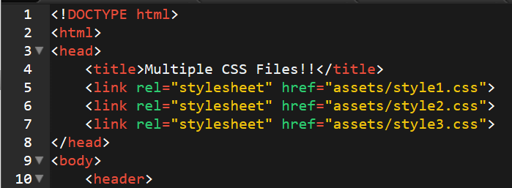
Loading Multiple CSS Files ***(Very Important!!!)***
We can link our documents to more than one stylesheet at a time—one of the most powerful features of CSS/HTML.
By tapping into different stylesheets simultaneously, we can create complex layouts with plenty of design rules.
Just remember: the loading order matters!!!

Slide 70
What Browser?
By a show of hands…
Which browser do you use?

Slide 71

Battle of the Browsers
Under the hood, web browsers often render webpages differently than their competition.
These disparities could mean HTML/CSS displaying differently in each web client.
Because of these potential divergences, web developers need to make their websites cross-browser compatible.

Slide 72
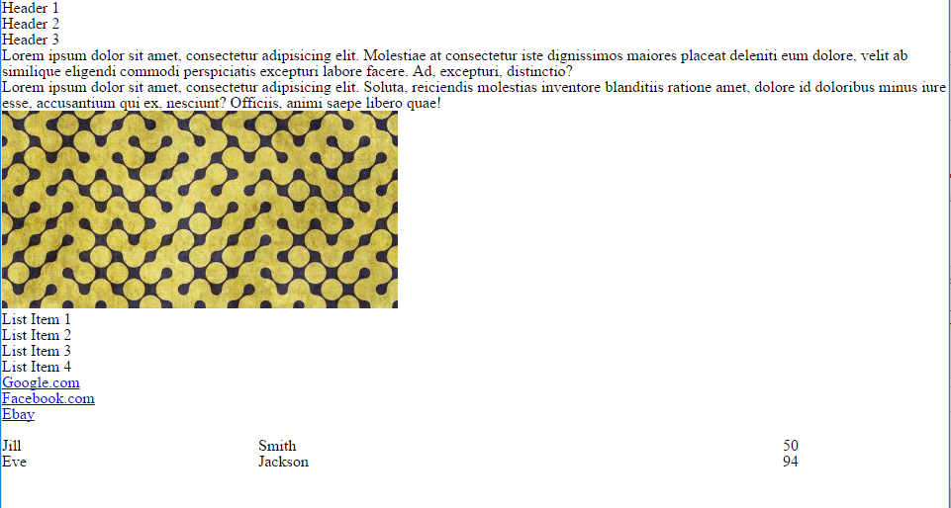
Reset.css (or Normalize.css)
Reset.css will “reset” all browser-specific CSS. This means your site will appear the same in all browsers.
However, you will have to re-style everything yourself.

Slide 73
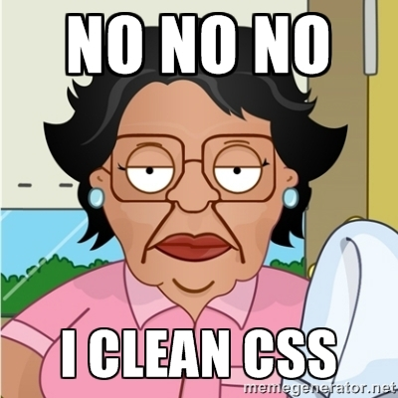
Why CSS Resets Matter
It’s important for creating browser-compatible websites.
It’s an example of using someone else’s CSS in your website!!!
It’s a common Front-End Developer Interview question.

Slide 74
> YOUR TURN!!
Assignment
Follow the instructions given via slack to incorporate a reset.css file into a basic HTML file.
Note the impact the reset file makes after its inclusion.

