Slide 1





~HexaTechies~
AK -15 Airport Authority of India
Team :
Mentor :
Mohit Bhatt Avinash Kumar
Aditya Singh M Vineeth
Chahat Bindra K Manohar
Dr. Vijay Kumar Bohat

Slide 2














Progress Checklist
Based on the given feedback we were asked to incorporate the following functionalities :
Giving access to specific authorities only
Final Issuance of License Certificate
INTEGRATED AND
FULLY FUNCTIONAL
Seamless approval process over blockchain
Retrieving project related info from
data sources
Centralized monitoring system
Guidelines in our website

Slide 3

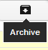


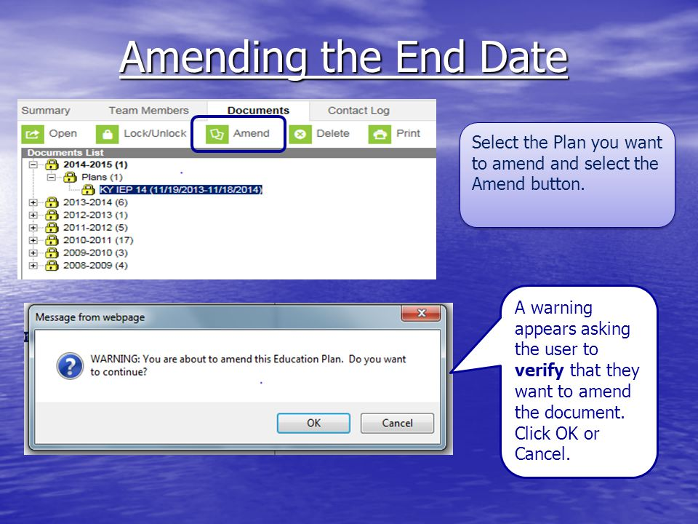



Progress Checklist
Archive Button
Fetching information from data source, linked to project
Digitally Signed Application
INTEGRATED AND
FULLY FUNCTIONAL
Amend Button
SPECIAL FEATURE
IN PROGRESS
Hosting the webapp over cloud
Update Button
0
Suggestion Mechanism

