Slide 1
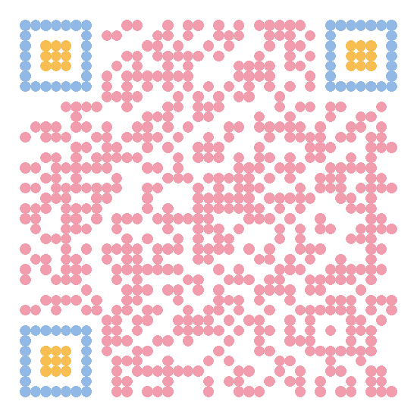




Motivation
Application & Parameters $λ$
Application & Parameters 𝜆
Algorithm
Circuit
Gates & Parameters $θ$
Gates & Parameters 𝜃
$$A(λ)$$
$$U(θ)$$
$$U\left(θ\left(λ\right)\right)$$

Slide 2
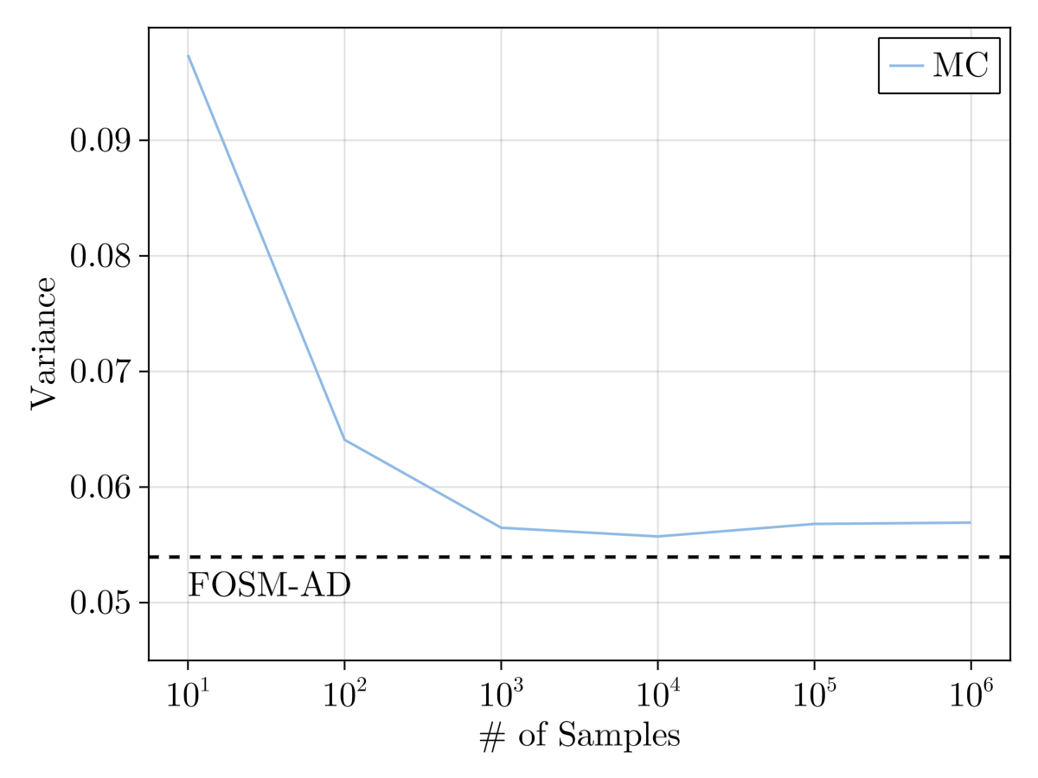
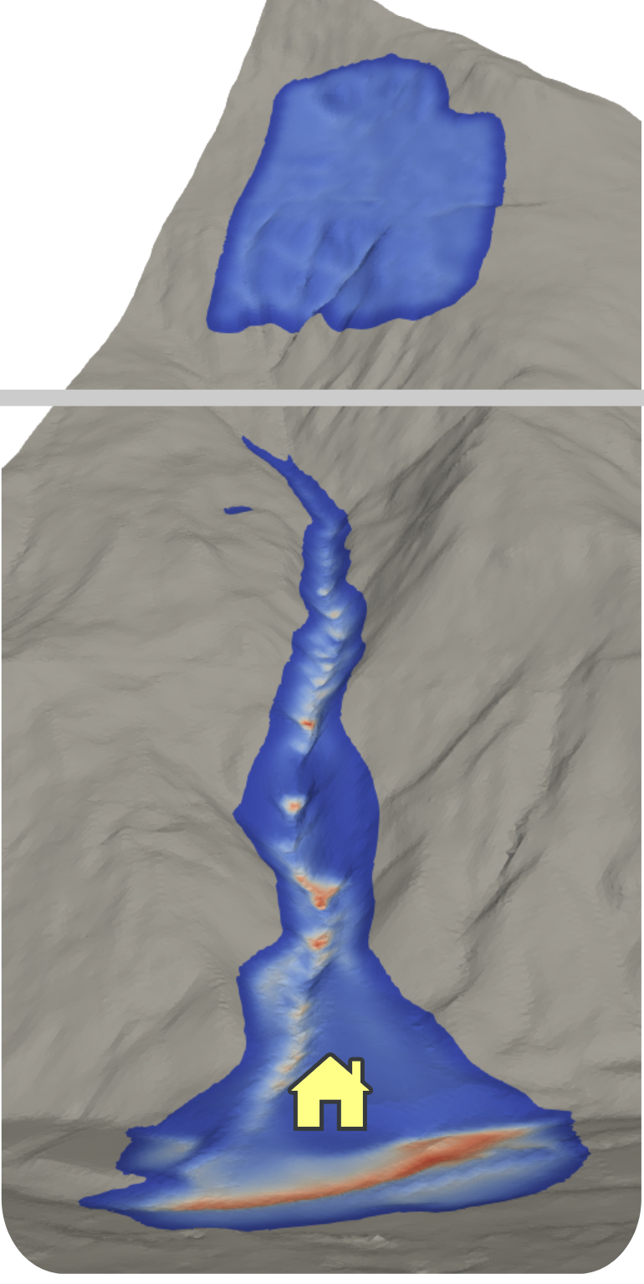

Motivation
Title: Differentiable Simulators for Efficient Topographic Uncertainty Propagation
Two Sentences:
GlissADe.jl is a differentiable simulator for gravity-driven mass flows that allows computing gradients of quantities of interest with respect to the high-dimensional input geometry, among other input parameters. Along with the First Order Second Moment method, this enables topographic uncertainty propagation to become tractable, in contrast to traditional Monte-Carlo approaches.
initial mass
deposit

