Slide 1
Predicting the right place to live before moving to another city
Miguel Burg Demay
July 2021.

Slide 2
Why Predicting the right place to live in another city
Moving can be cumbersome. It is not easy to find a place where one can fell at home
Would it not be amazing, if it was possible to know the places in a new town where one would be happy, before moving to this city?
For example, where people from New York should live in Toronto, to be happy?
Possible clientes for the proposed system:
Persons, who want to move to another city and have to look for a place to live there
Companies, which send workers to live for a while in another city
Agent/brokers, who could better advise their clients

Slide 3
Data acquisition and cleaning
Data from NY:
neighborhoods, boroughs, and geographical data from “newyork_data.json” file
venues categories from Foursquare within a circle with a radius of 500 m from each neighborhood
Data from Toronto:
neighborhoods and boroughs from the list of postal codes of Canada in Wikipedia - https://en.wikipedia.org/wiki/List_of_postal_codes_of_Canada:_M
geographic data from “Geospatial_coordinates.csv” file
venues categories from Foursquare within a circle with a radius of 500 m from each neighborhood
240 common venues categories (Toronto and NY)

Slide 4
One model for each client
3 clientes, 3 models
Client A: an active person, who likes parks and bus stations
Client B: a person who likes the american way of living. He would feel comfortable living near to baseball stadiums and american restaurants
Client C: a person with very random preferences, such as brazilian restaurants and commedy clubs
Logistic regression was selected as regression technique.
Identify the likelihood of the cliente feel happy in the chosen neighborhood due to the venues in the neighborhood
Jaccard-scores:
Model A: 0.64
Model B: 0.72
Model C: 0.88

Slide 5

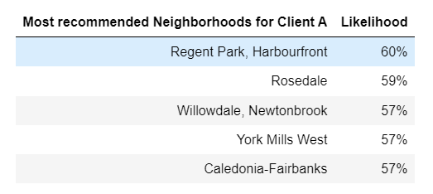
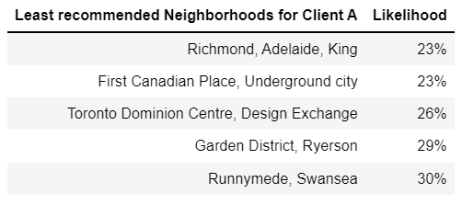
Results – client A
60% of chance to like living in Regent Park, Harbourfront in Toronto, due to the venues in Neighborhood
23% of chance to like living in Leaside

Slide 6
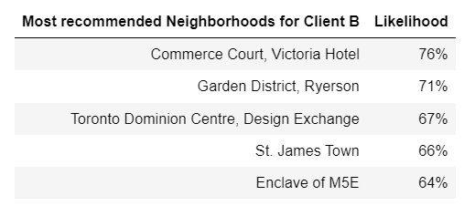
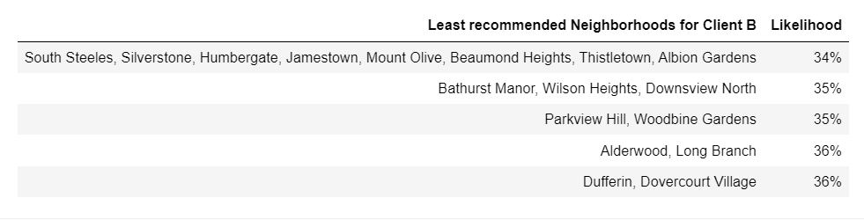
Results – client B
76% of chance to like living in Commerce Court, Victoria Hotel in Toronto, due to the venues in Neighborhood
34% of chance to like living in South Steeles, Silverstone, Humbergate, Jamestown, Mount Olive, Beaumond Heights, Thistletown, Albion Gardens

Slide 7
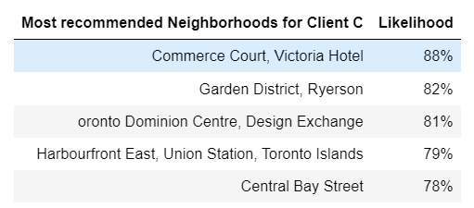
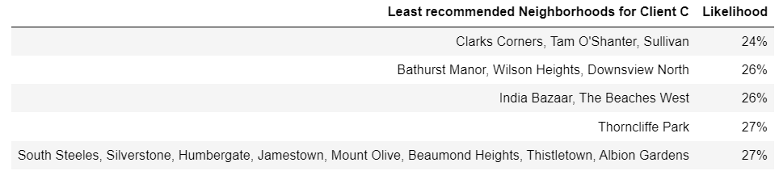
Results – client C
88% of chance to like living in Commerce Court, Victoria Hotel in Toronto, due to the venues in Neighborhood
24% of chance to like living in Clarks Corners, Tam O'Shanter, Sullivan

Slide 8
Conclusion
Built useful models to predict the likelihood of someone moving to another city likes living on each of new city neighborhoods
Models have room for improvement, mainly in the capture of clients' traits and desires

