Slide 1
Smart TV

Slide 2
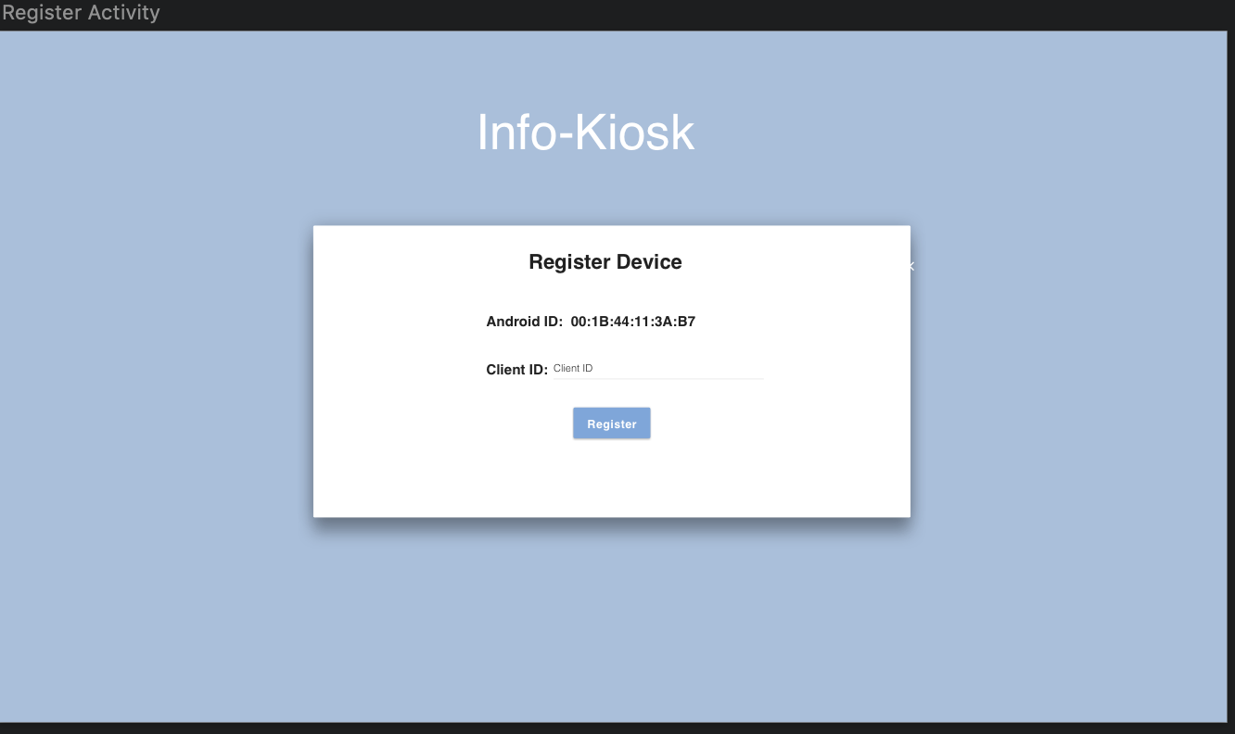
Smart TV: Register Device

Slide 3
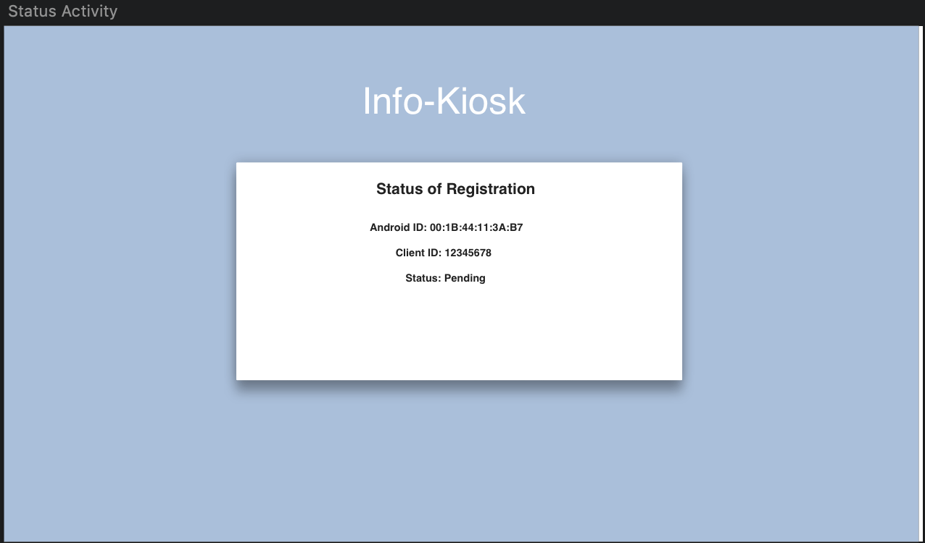
Smart TV: Pending Registration

Slide 4
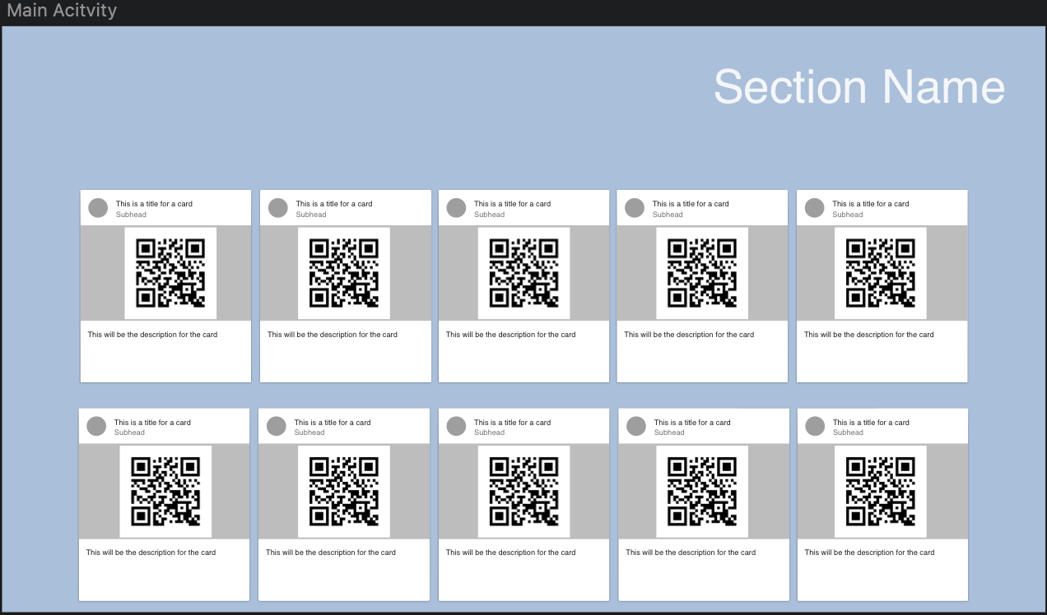
Smart TV: Dashboard

Slide 5
Web App

Slide 6
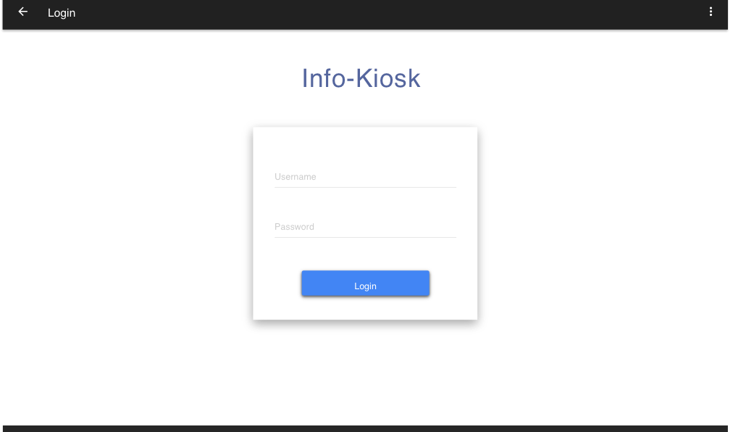
Web App: Log In

Slide 7
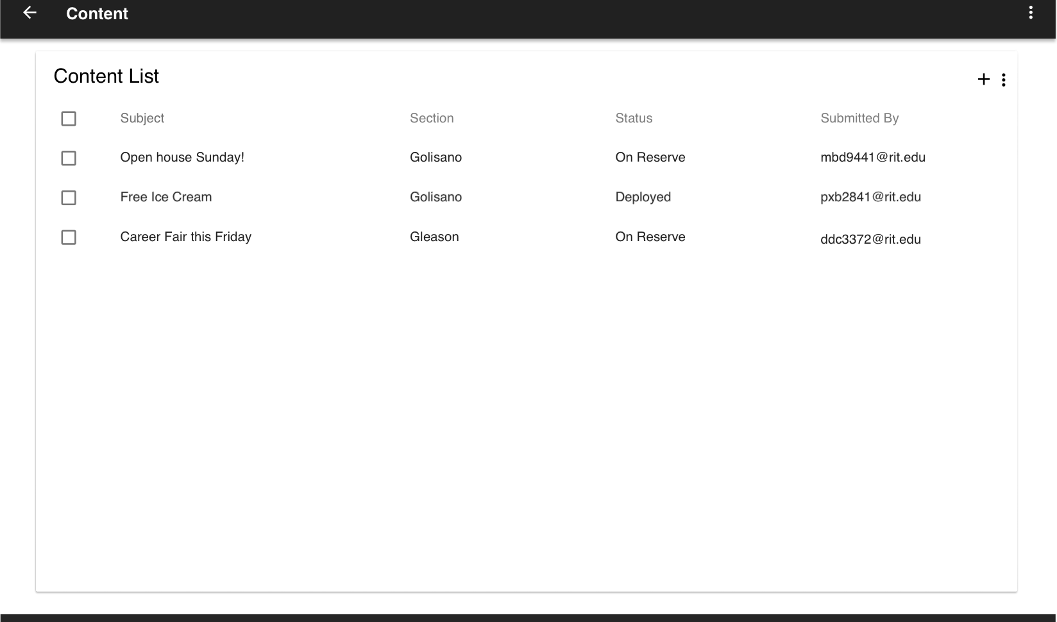
Web App: Content List

Slide 8
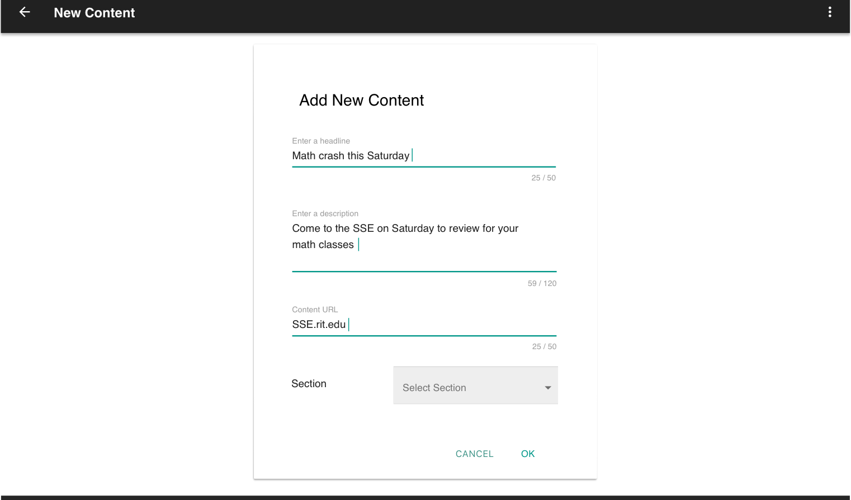
Web App: New Content

Slide 9
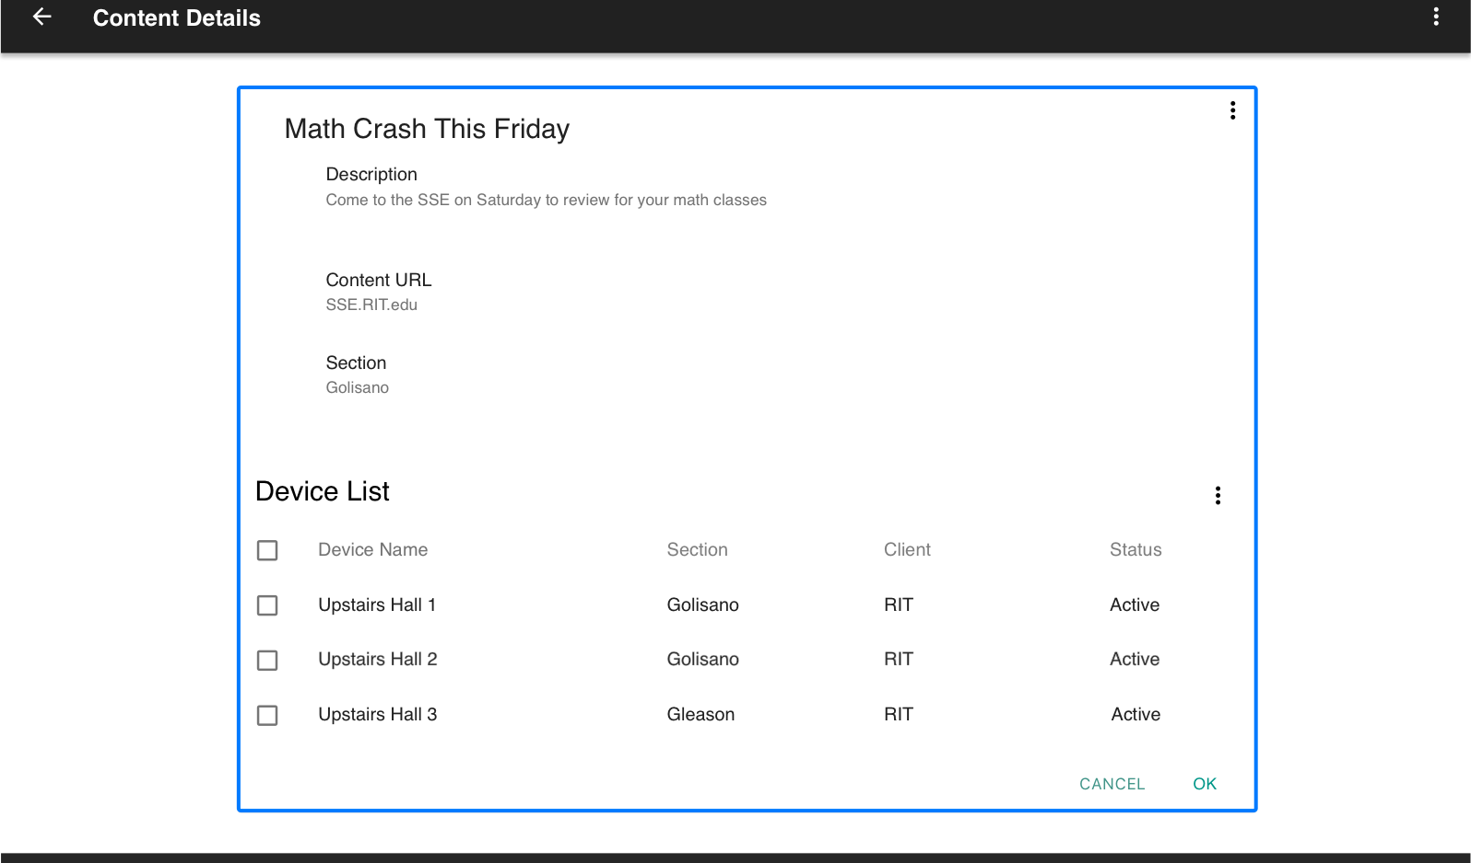
Web App: Content Details

Slide 10
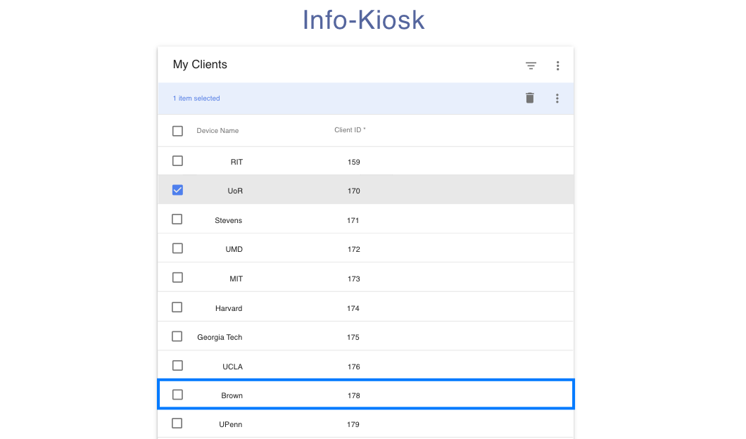
Web App: View Clients

Slide 11
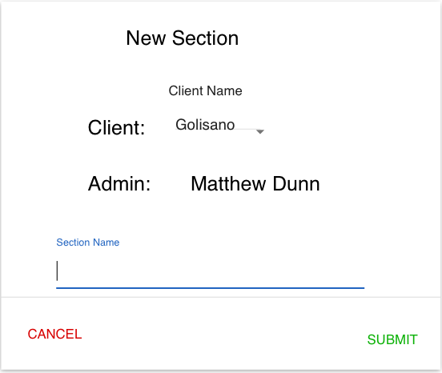
Web App: New Section

Slide 12
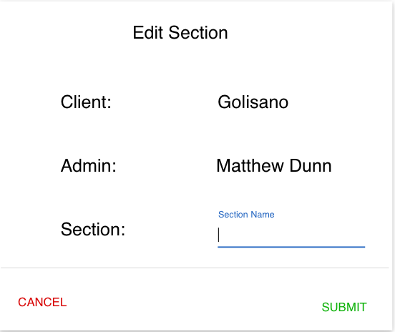
Web App: Edit Section

Slide 13
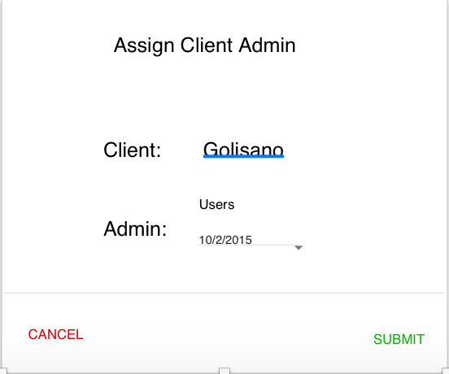
Web App: Assign a Client Admin to an Account

Slide 14
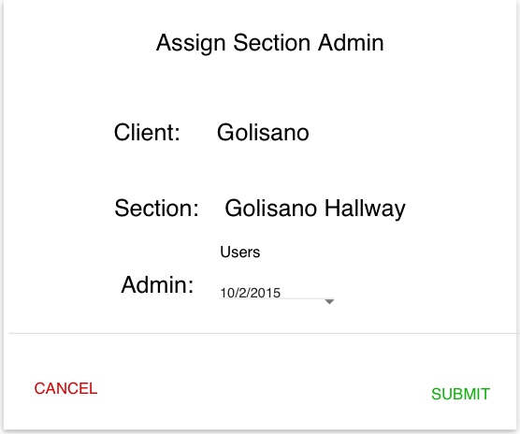
Web App: Assign a Section Admin to an Account

Slide 15
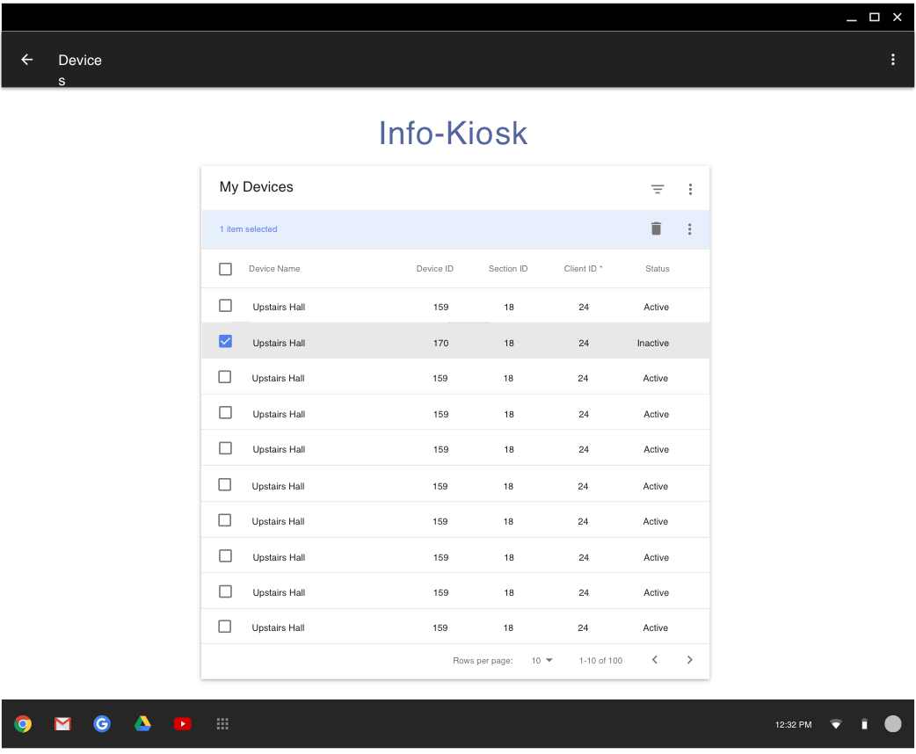
Web App: View All Devices

Slide 16
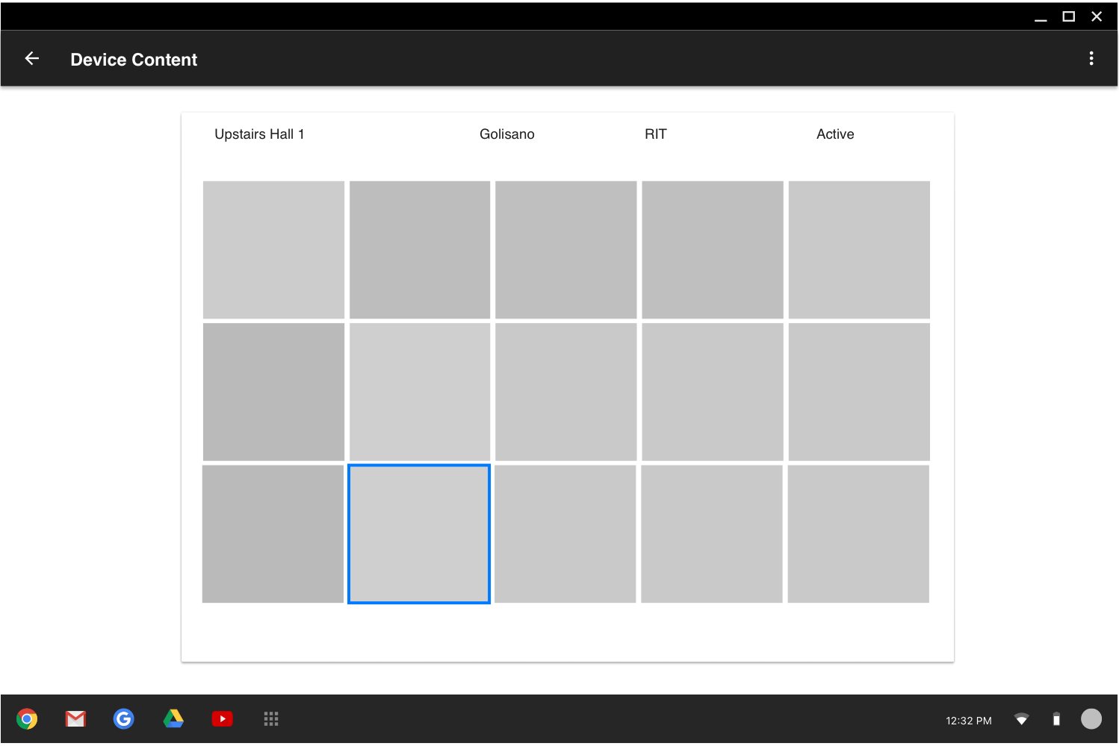
Web App: View Content Deployed to a Device

Slide 17
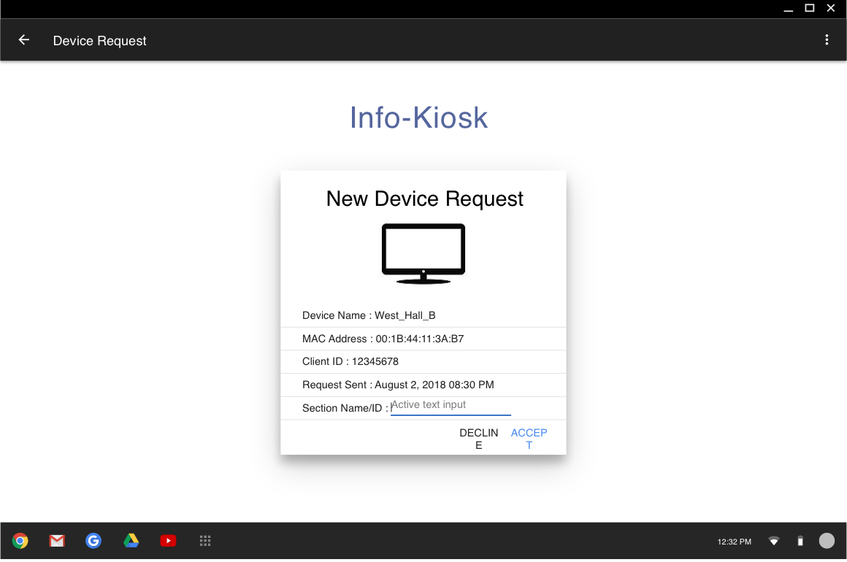
Web App: View Device Request

