Slide 1




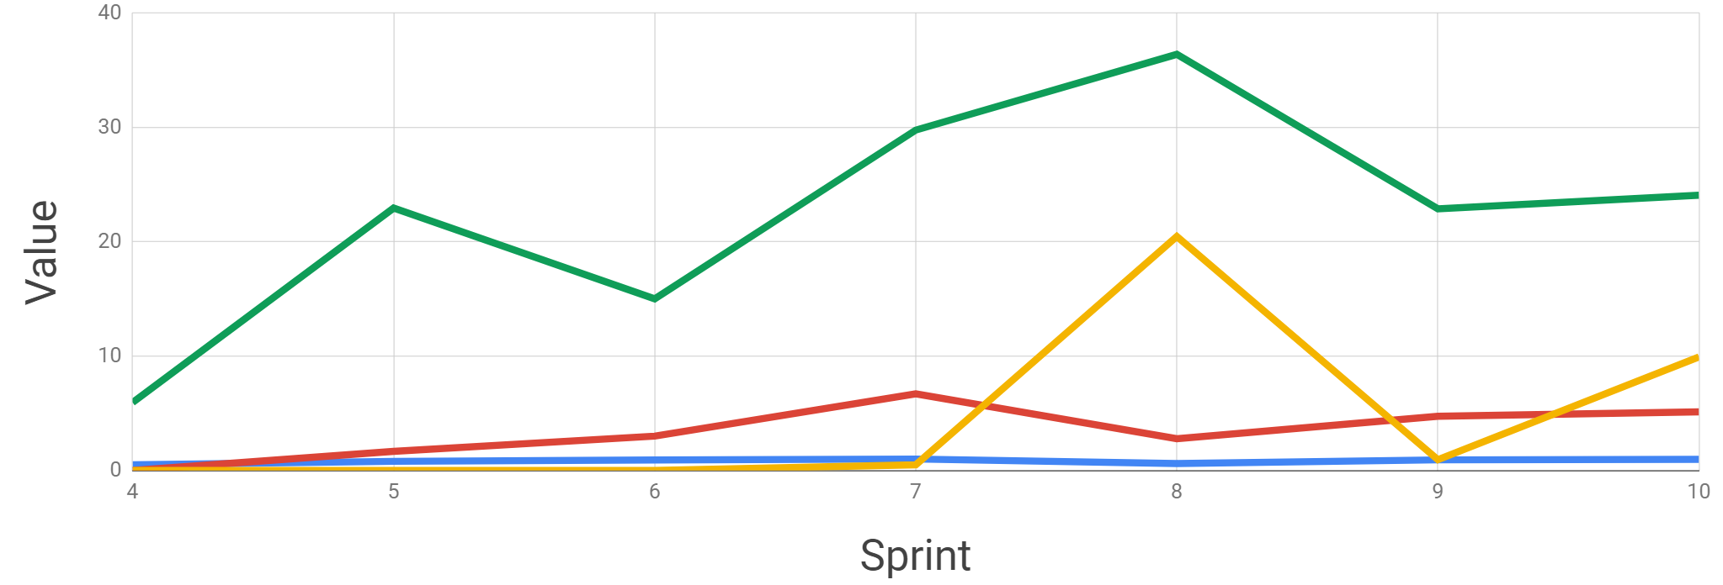
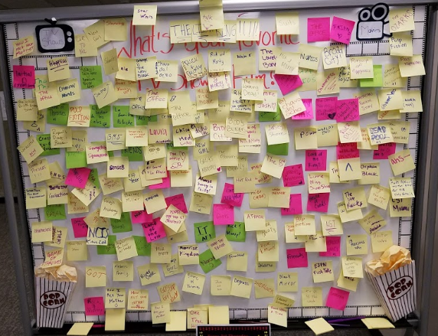
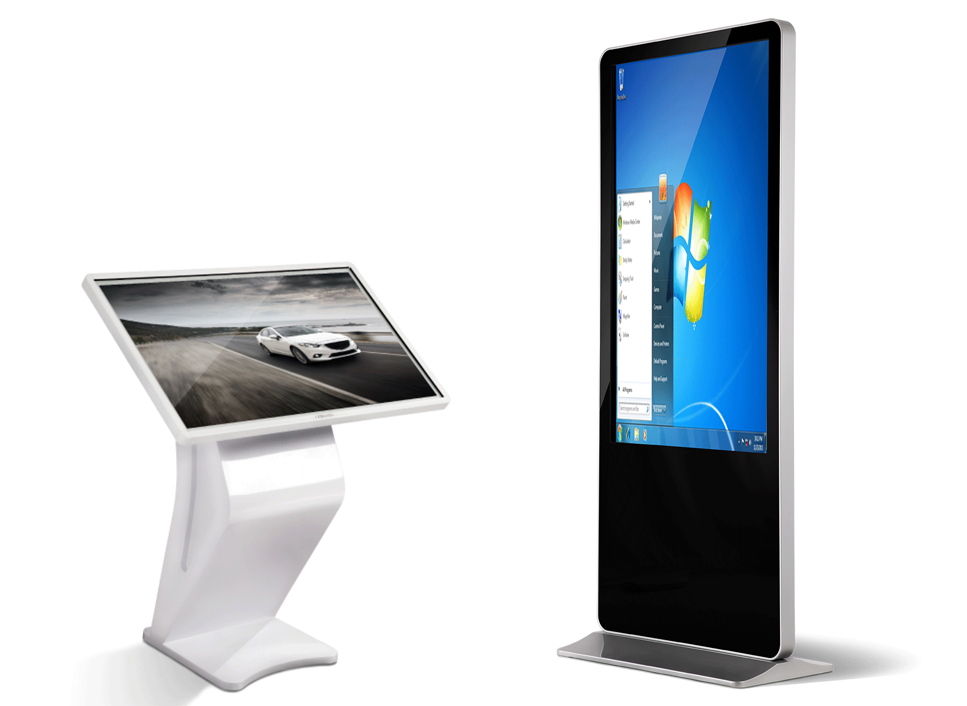
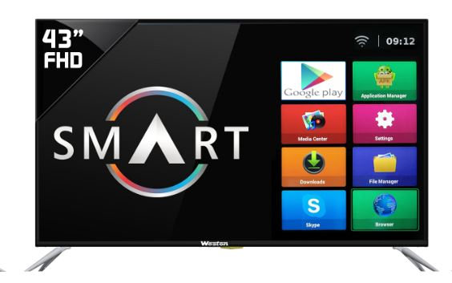


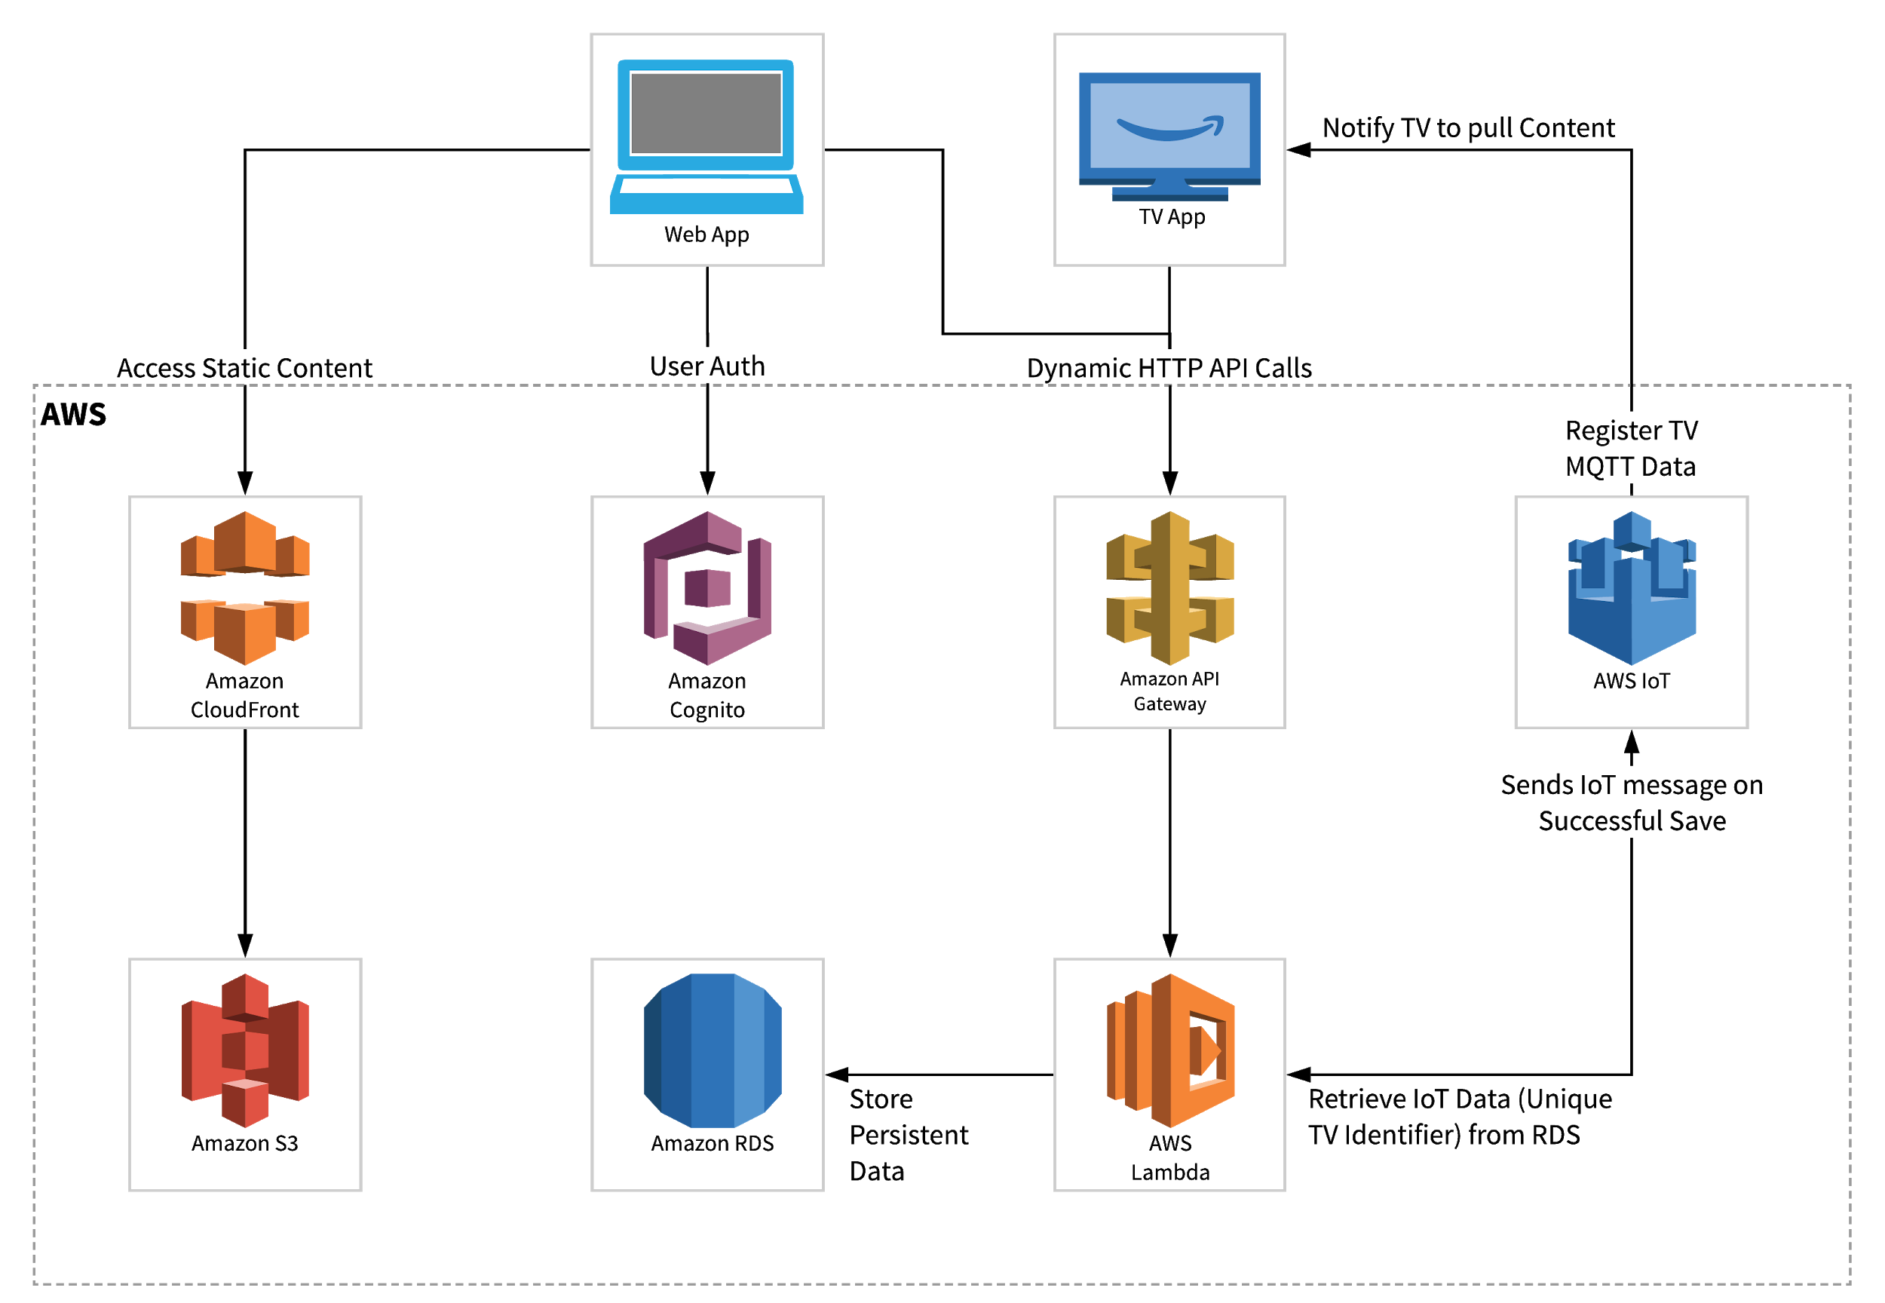
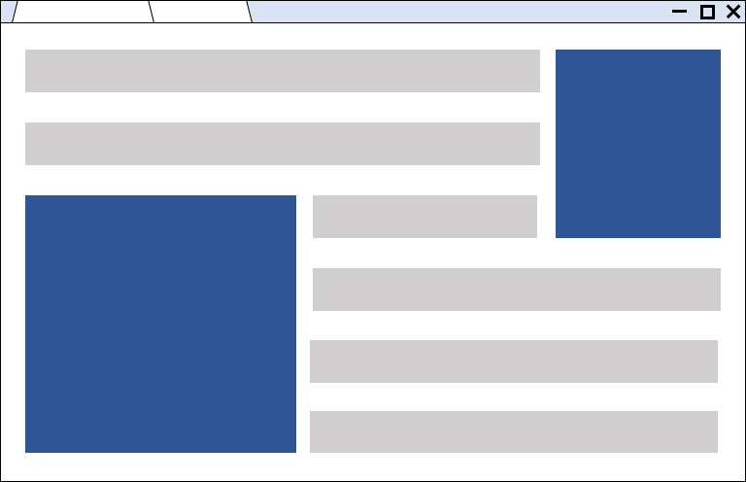
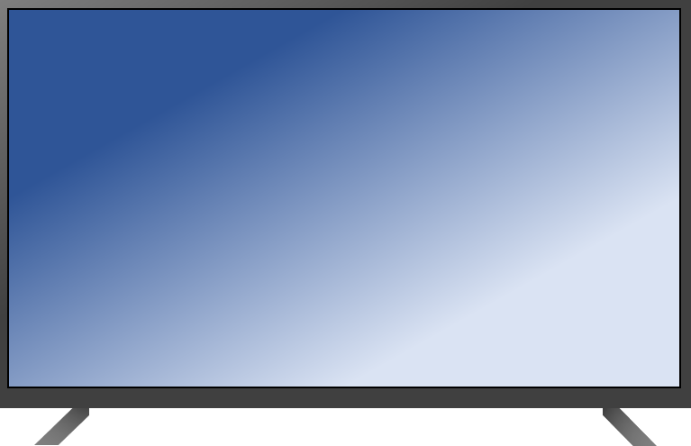






InfoKiosk / E-Bulletin
Celestial Orca
project coaCh: Kal Rabb
Philip Bedward Daniel Cox Matthew Dunn Aaron Liu
Motivation
Process
Metrics
Traditional bulletin boards can become cluttered very quickly with excessive information and old/expired notices.
Translating this to a digital format would allow for easier notice management which enables information to be displayed in a clean manner.
Our process evolved to better suit our needs, keep our efforts focused, and our tasks planned as the project matured
Originally, we kept track of work planned and work done on weekly 4-up charts
To form a “bigger picture,” we made a spreadsheet-style Gantt chart. We separated tasks in to “releases” with the relevant tasks grouped together.
We tried to use card-style tracking tools such as Trello, to no avail.
Eventually we started forming work in to 2-week Sprints
Velocity - Story Points Committed vs. Story Points Completed per sprint to plan future sprints better.
Average Test Time - The total time to run the test plan divided by total tests, to predict future test times.
Average Defect Discovery to Resolution - The total time to resolve defects divided by number of defects found was used to make planning our testing / defect resolution allotment better.
Average effort per person - The total number of hours spent per sprint divided by the team size, to give us a better idea of how much time we should commit each sprint.
Jira allowed us to easily plan and track sprints while passively collecting metrics related to velocity and effort. Testing was integrated into jira to provide visual insight into code performance.
We laid out a high-level schedule of what we wanted to accomplish each sprint and adjusted our sprints based on different commitments that arose.
Utilizing the power of the cloud and improvements in digital displays, we came up with a solution: a system which allows users to display content on Smart TVs that are managed via a web application, tied together over AWS.
Daily standups, better communication, weekly planning meetings and the revamped process kept us on track much better than the previous process.
Web Application
Infrastructure
Smart TV App
Developed to manage Smart TV App content and the groups associated with them.
The web application runs on a flexible, reliable, cross-platform framework.
This enables users to interface with the system from anywhere with ease.
Built to be highly scalable, our back end is hosted on a serverless AWS infrastructure. This allow users to easily deploy and run the application at a low cost without the need for extensive hardware.
Essentially a Virtual bulletin board; The Smart TV serves as a medium for different people to post and view information.
This includes job offerings, lost and found, apartments for rent, etc.
Conceptually, they are digital post-it notes with a QR code that takes the user to an external link with more information
Generate and push content
Submit, approve and deny content requests
Register and manage devices
Provide administrative support to clients
Manage your Client Account
Display content pushed, even after restarting
Real-time updates
Displays up to 10 cards at a time
QR codes allow navigation to external links
VSCode: Git repository integration, familiarity, package handling and context highlighting
Android Studio: Built-in Android Device Emulator to develop, deploy and test Smart TV application
Angular: Cross-platform, flexible, single-page applications
Android TV: Mostly device agnostic and universal based on our research
Material: Tons of support, Angular integration and libraries in design software like Sketch
Java: We picked Java over Kotlin since we were more familiar with the language.
Notes:
Final Design

Slide 2
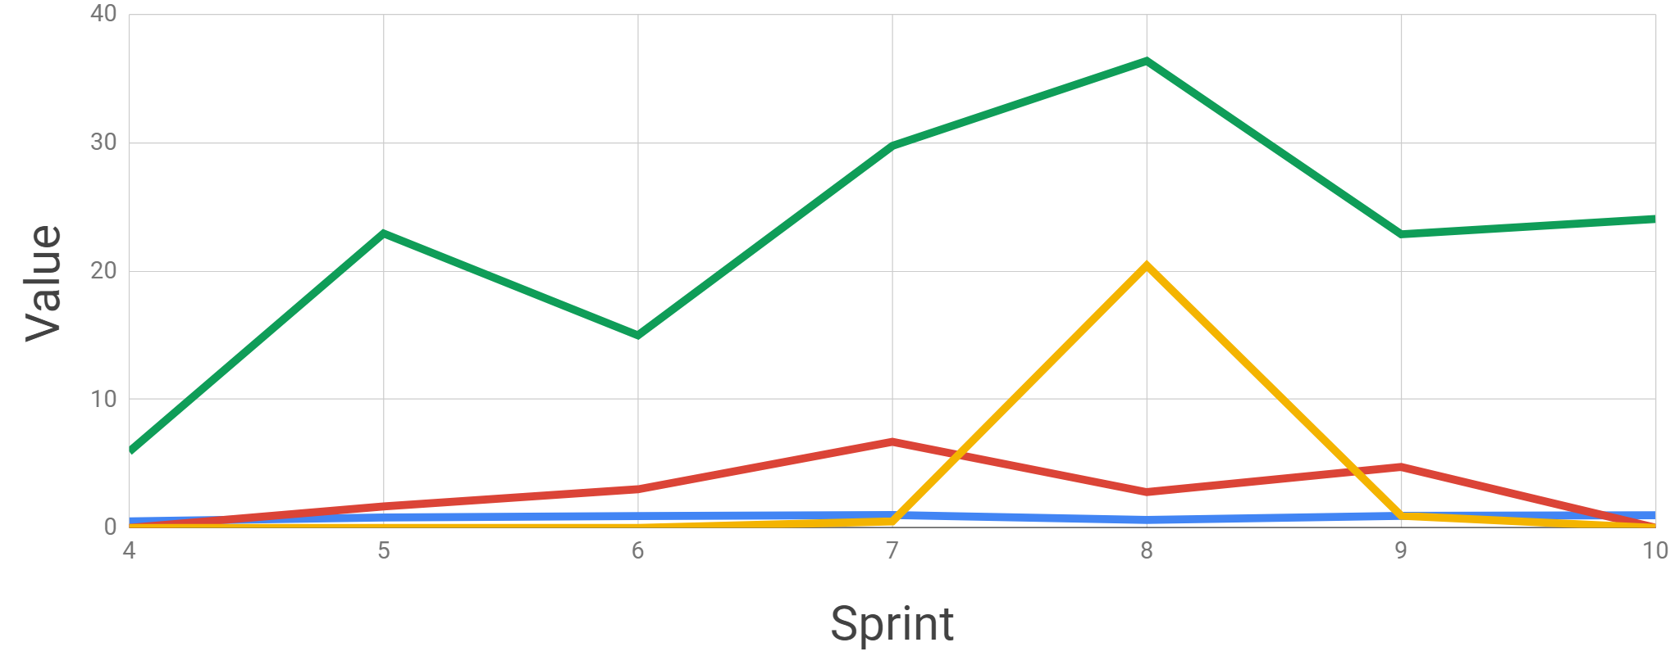
InfoKiosk / E-Bulletin
Celestial Orca
project coaCh: Kal Rabb
Philip Bedward Daniel Cox Matthew Dunn Aaron Liu
Motivation
Process
Metrics
Traditional bulletin boards can become cluttered very quickly with excessive information and old/expired notices.
Translating this to a digital format would allow for easier notice management which enables information to be displayed in a clean manner.
Our process evolved to better suit our needs, keep our efforts focused, and our tasks planned as the project matured
Originally, we kept track of work planned and work done on weekly 4-up charts
To form a “bigger picture,” we made a spreadsheet-style Gantt chart. We separated tasks in to “releases” with the relevant tasks grouped together.
We tried to use card-style tracking tools such as Trello, to no avail.
Eventually we started forming work in to 2-week Sprints
Velocity - Story Points Committed vs. Story Points Completed per sprint to plan future sprints better.
Average Test Time - The total time to run the test plan divided by total tests, to predict future test times.
Average Defect Discovery to Resolution - The total time to resolve defects divided by number of defects found was used to make planning our testing / defect resolution allotment better.
Average effort per person - The total number of hours spent per sprint divided by the team size to give us a better idea of how much time we should commit each sprint.
Jira allowed us to easily plan and track sprints while passively collecting metrics related to velocity and effort. Testing was integrated into jira to provide visual insight into code performance.
We laid out a high-level schedule of what we wanted to accomplish each sprint and adjusted our sprints based on different commitments that arose.
Utilizing the power of the cloud and improvements in digital displays, we came up with a solution: a system which allows users to display content on Smart TVs that are managed via a web application, tied together over AWS.
Daily standups, better communication, weekly planning meetings and the revamped process kept us on track much better than the previous process.
Web Application
Infrastructure
Smart TV App
Developed to manage Smart TV App content and the groups associated with them.
The web application runs on a flexible, reliable, cross-platform framework.
This enables users to interface with the system from anywhere with ease.
Built to be highly scalable, our application is built on a serverless AWS infrastructure. This allow users to easily deploy and run the application at a low cost without the need for extensive hardware.
Essentially a Virtual bulletin board; The Smart TV serves as a medium for different people to post and view information.
This includes job offerings, lost and found, apartments for rent, etc.
Conceptually, they are digital post-it notes with a QR code that takes the user to an external link with more information
Generate and push content
Submit, approve and deny content requests
Register and manage devices
Provide administrative support to clients
Manage your Client Account
Display content pushed, even after restarting
Real-time updates
Displays up to 10 cards at a time
QR codes allow navigation to external links
VSCode: Git repository integration, familiarity, package handling and context highlighting
Android Studio: Built-in Android Device Emulator to develop, deploy and test Smart TV application
Angular: Cross-platform, flexible, single-page applications
Android TV: Mostly device agnostic and universal based on our research
Material: Tons of support, Angular integration and libraries in design software like Sketch
Java: We picked Java over Kotlin since we were more familiar with the language.
Notes:
Aaron + Matt
no band, more spacing
+dans edits
with kals feedback

Slide 3

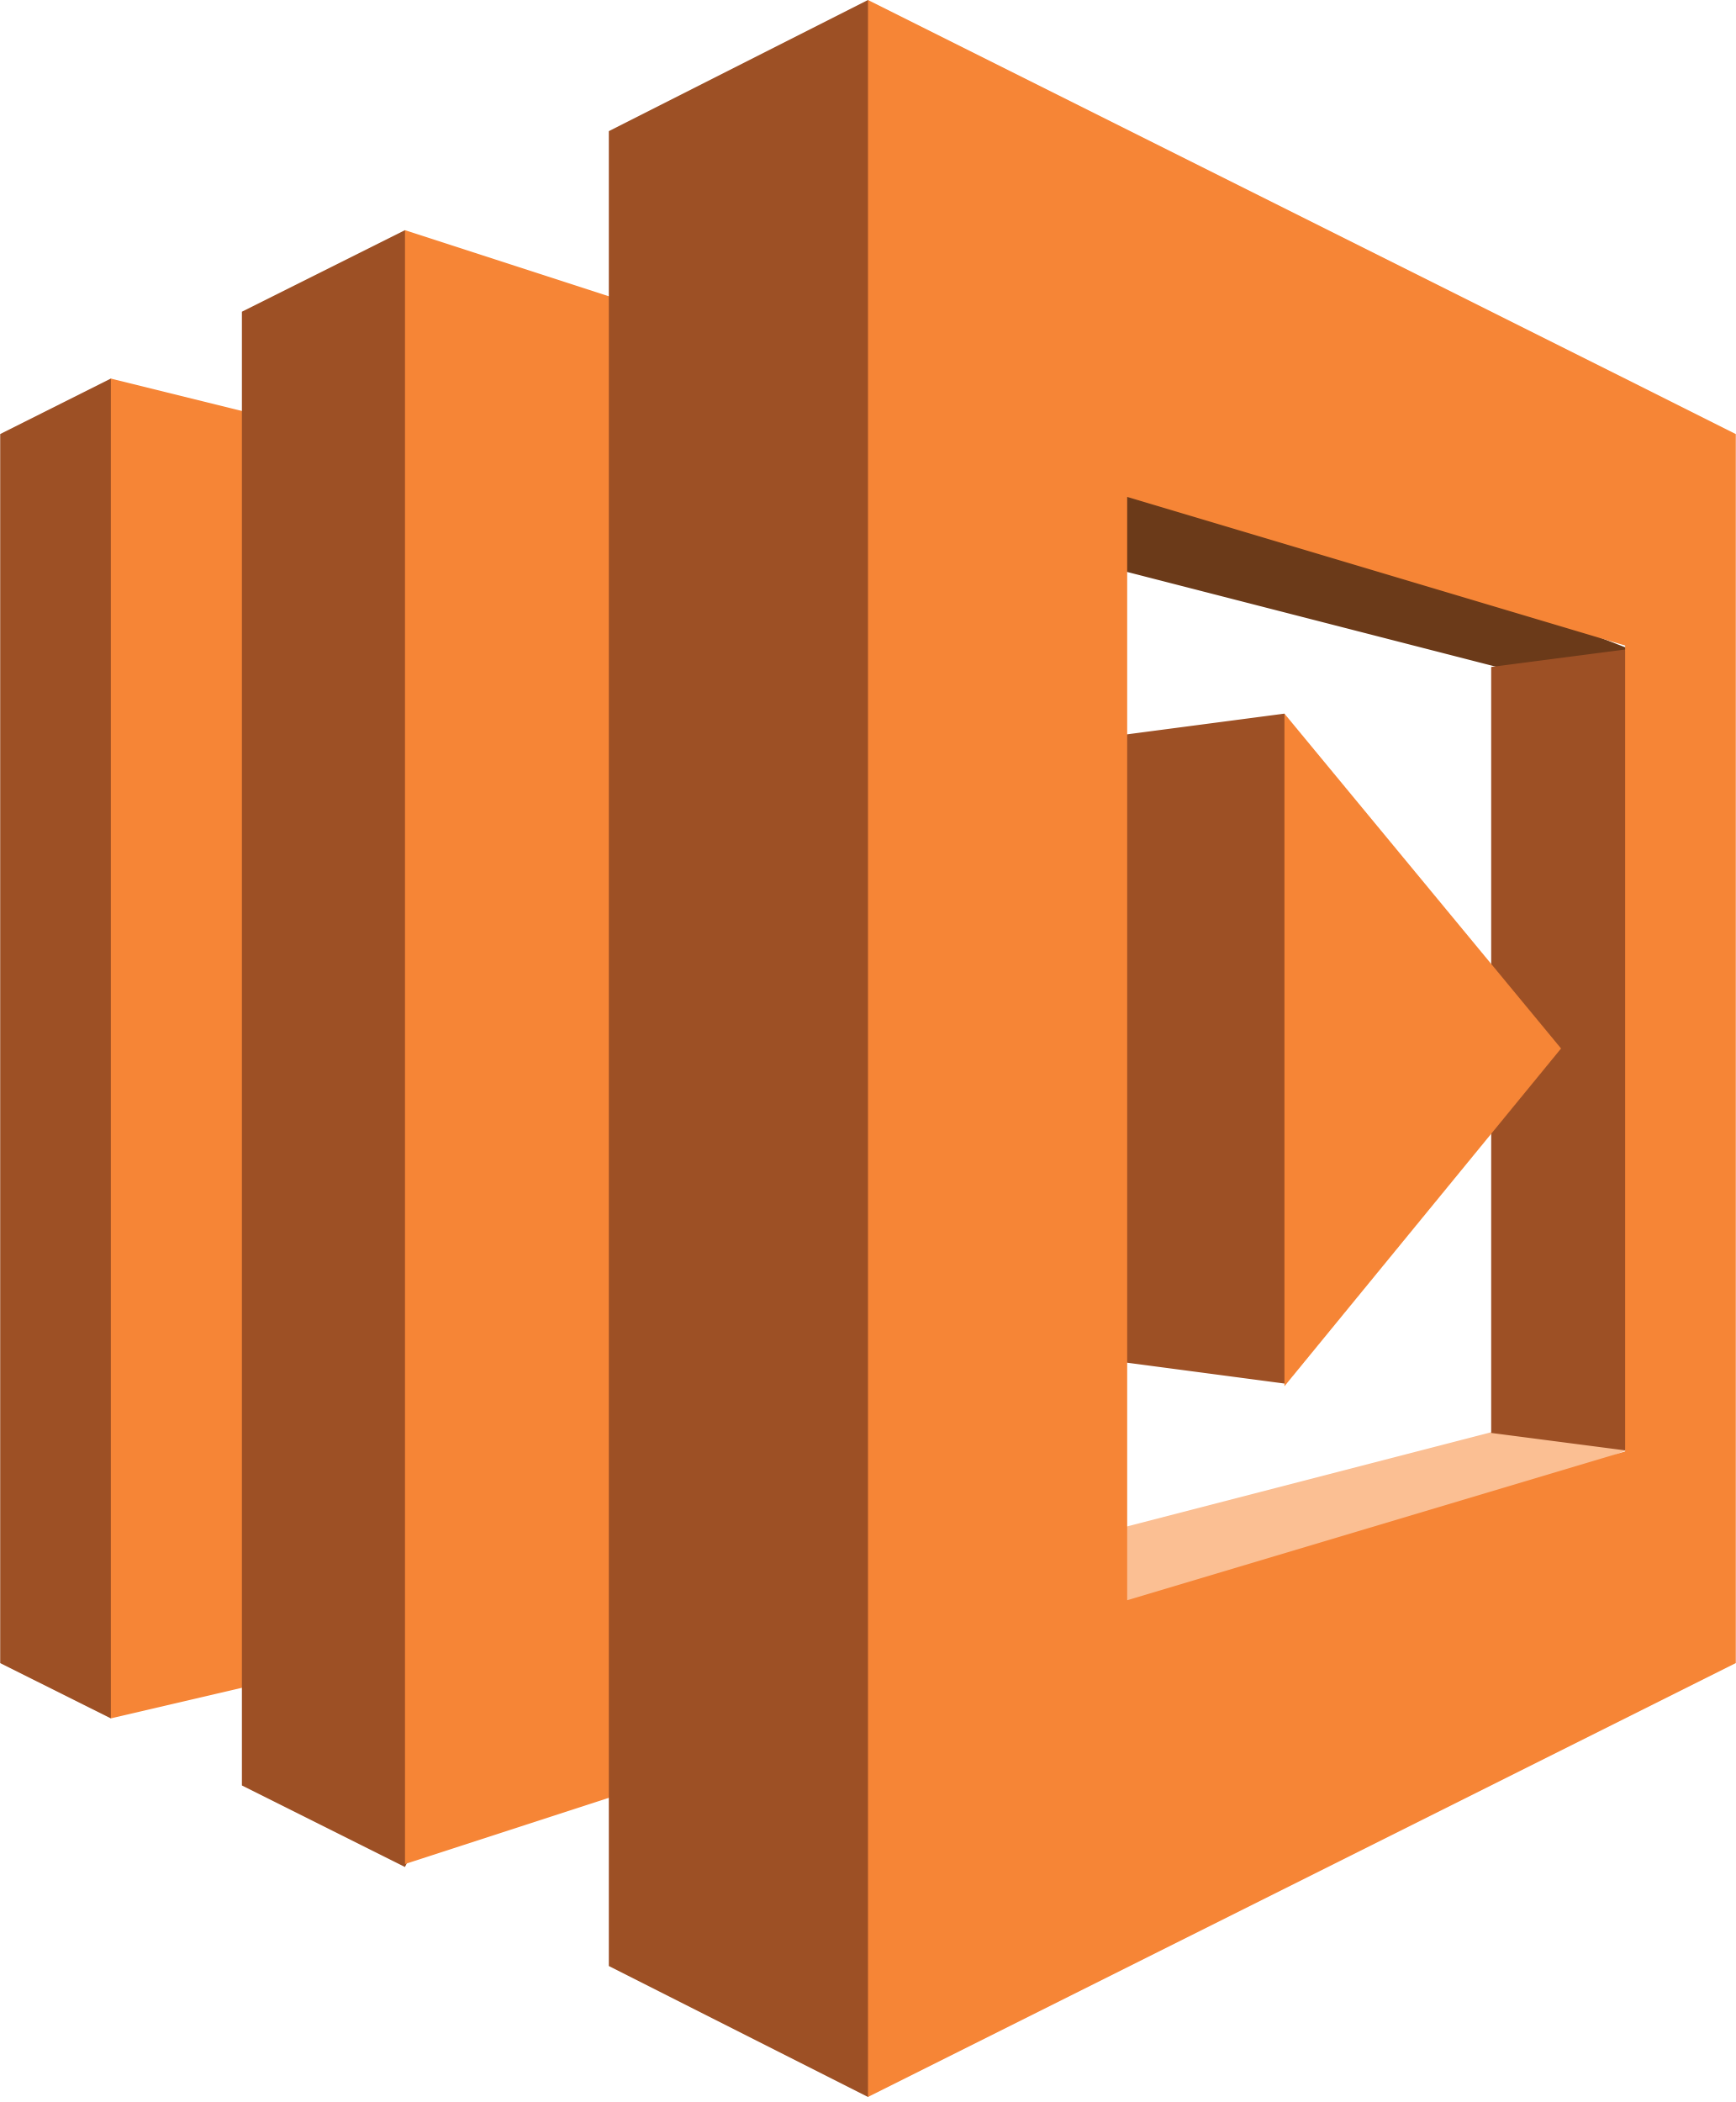
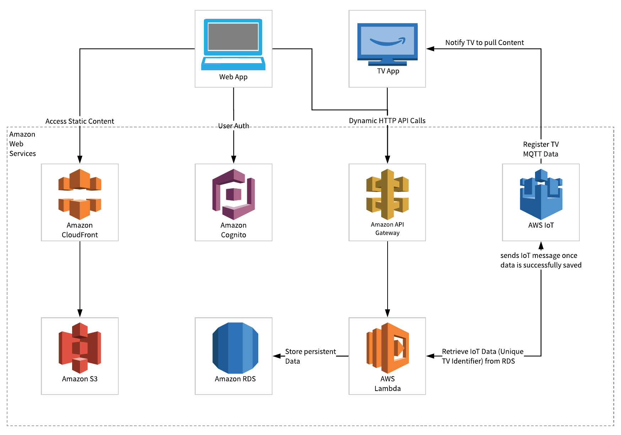


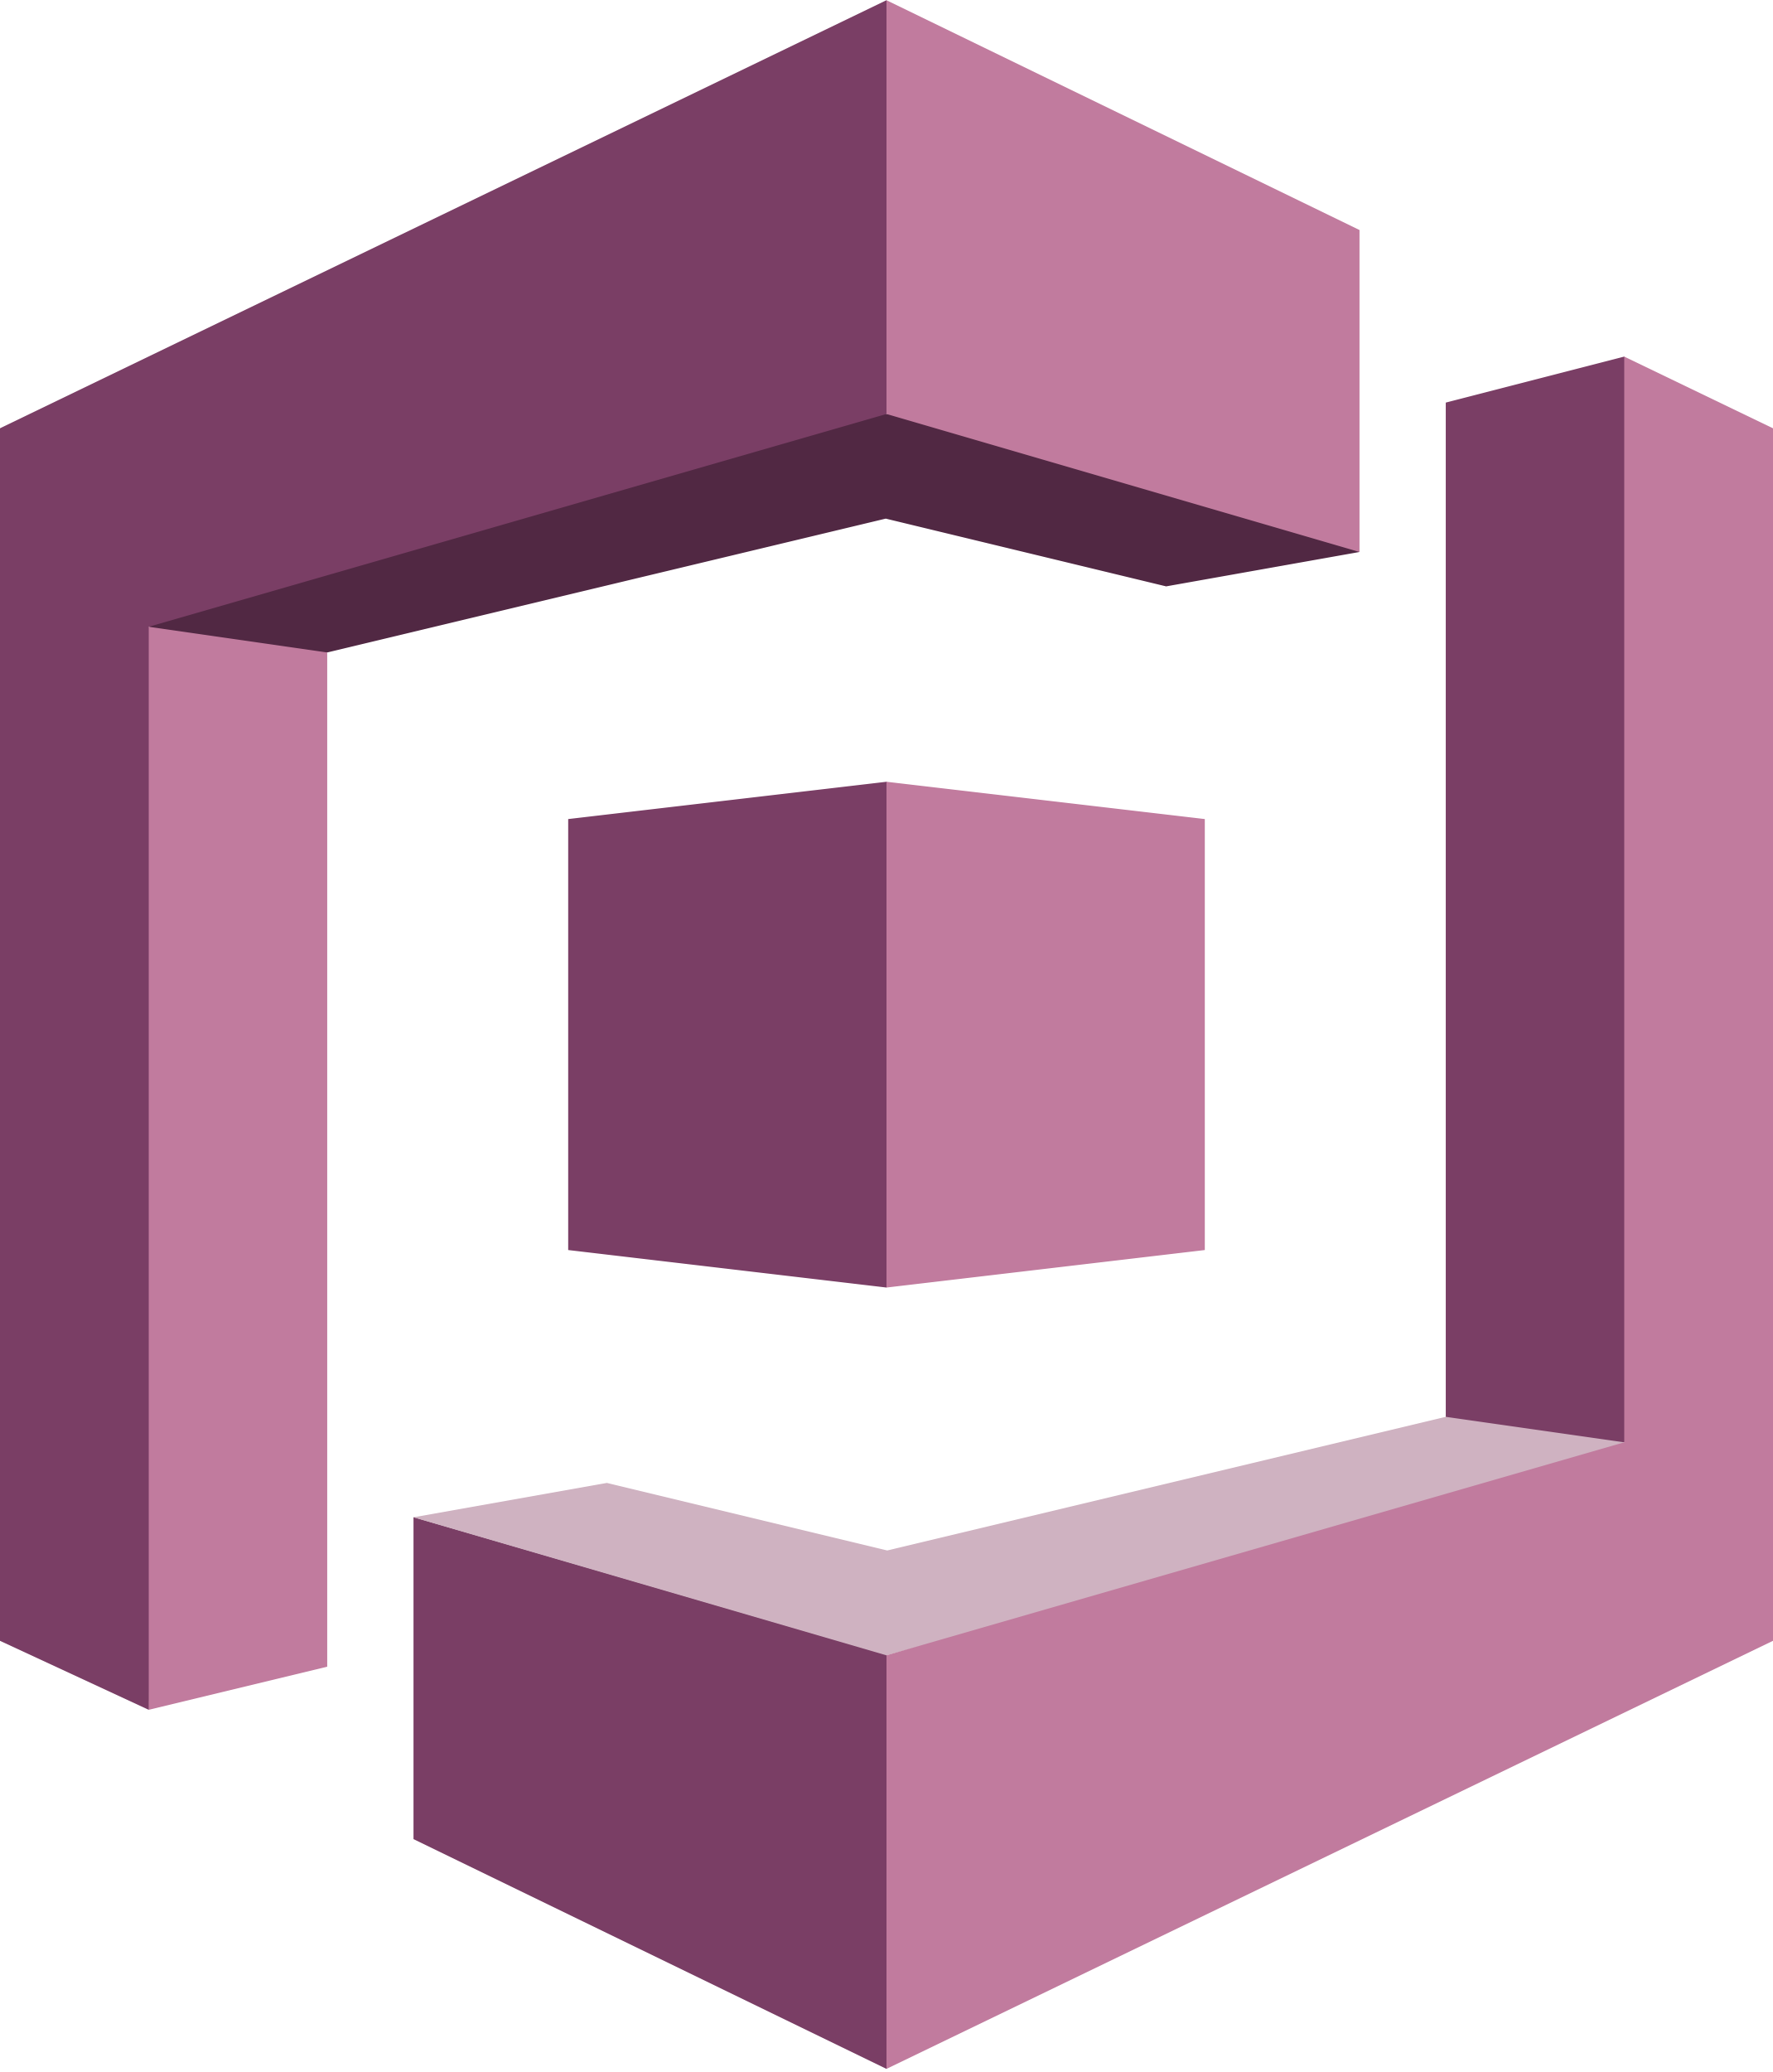

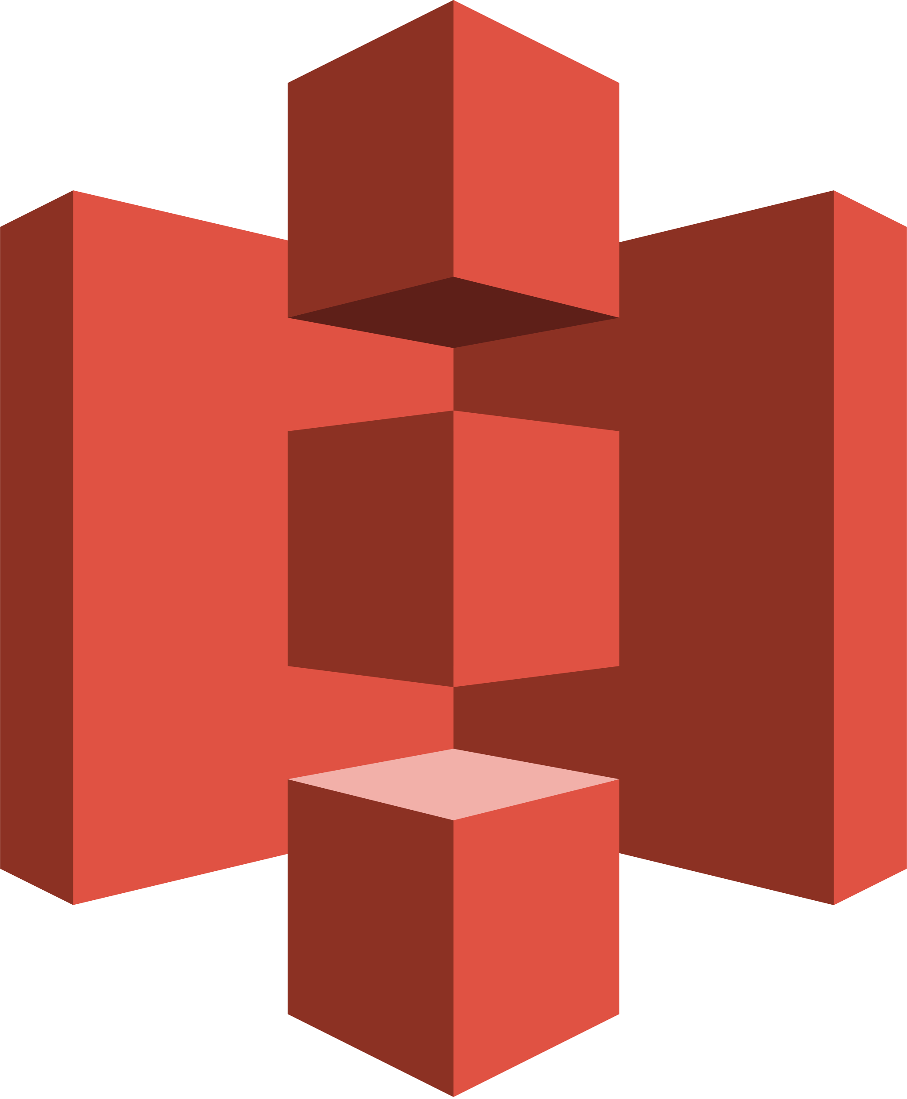

InfoKiosk / E-Bulletin
Celestial Orca
project coaCh: Kal Rabb
Philip Bedward Daniel Cox Matthew Dunn Aaron Liu
Motivation
Process
Metrics
Traditional bulletin boards can become cluttered very quickly with excessive information and old/expired notices.
Our process evolved to better suit our needs, keep our efforts focused, and our tasks planned as the project matured
Originally, we kept track of work planned and work done on weekly 4-up charts
To form a “bigger picture,” we made a spreadsheet-style Gantt chart. We separated tasks in to “releases” with the relevant tasks grouped together.
We tried to use card-style tracking tools such as Trello, to no avail.
Eventually we started forming work in to 2-week Sprints
Velocity - Story Points Committed vs. Story Points Completed per sprint to plan future sprints better.
Average Test Time - The total time to run the test plan divided by total tests, to predict future test times.
Average Defect Discovery to Resolution - The total time to resolve defects divided by number of defects found was used to make planning our testing / defect resolution allotment better.
Average effort per person - The total number of hours spent per sprint divided by the team size to give us a better idea of how much time we should commit each sprint.
Jira allowed us to easily plan and track sprints while passively collecting metrics related to velocity and effort. Testing was integrated into jira to provide visual insight into code performance.
Utilizing the power of the cloud and improvements in digital displays, we came up with a solution: a system which allows users to display content on Smart TVs that are managed via a web application, tied together over AWS.
We laid out a high-level schedule of what we wanted to accomplish each sprint and adjusted our sprints based on different commitments that arose.
Daily standups, better communication, weekly planning meetings and the revamped process kept us on track much better than the previous process.
Web Application
Infrastructure
Smart TV App
Developed to manage Smart TV App content and the groups associated with them. The web application runs on a flexible, reliable, cross-platform framework, which enables users to interface with the system from anywhere with ease.
Built to be highly scalable, our application is built on a serverless AWS infrastructure. This allow users to easily deploy and run the application at a low cost without the need for extensive hardware.
Essentially a Virtual bulletin board; The Smart TV serves as a medium for different people to post and view information. This includes job offerings, lost and found, apartments for rent, etc. Conceptually, they are digital post-it notes with a QR code that takes the user to an external link with more information
Generate and push content
Submit, approve and deny content requests
Register and manage devices
Provide administrative support to clients
Manage your Client Account
AWS Lambda: Serverless code to provide functionality
Display content pushed, even after restarting
Real-time updates
Displays up to 10 cards at a time
QR codes allow navigation to external links
Amazon RDS: Scalable and Secure Relational Database
AWS IoT: Links Smart TV and web app through pub/sub protocol
VSCode: Git repository integration, familiarity, package handling and context highlighting
Amazon Cognito: User Authentication
Android Studio: Built-in Android Device Emulator to develop, deploy and test Smart TV application
Amazon Cloudfront: Retrieve static content from S3 and serve it
Android TV: Mostly device agnostic and universal based on our research
Angular: Cross-platform, flexible, single-page applications
Amazon S3: Stores all static web app content
Material: Tons of support, Angular integration and libraries in design software like Sketch
Amazon API Gateway: REST API to interface with Lambda
Java: We picked Java over Kotlin since we were more familiar with the language
Notes:
Kal’s Feedback

Slide 4
InfoKiosk / E-Bulletin
Celestial Orca
project coaCh: Kal Rabb
Philip Bedward Daniel Cox Matthew Dunn Aaron Liu
The Problem
Process
Metrics
Our sponsor was visiting a campus and noticed many bulletin boards overflowing with tons of post-it notes.
This led to the concept of translating to a digital post-it note bulletin system.
Our process evolved to better suit our needs, keep our efforts focused, and our tasks planned as the project matured
Originally, we kept track of work planned and work done on weekly 4-up charts
To form a “bigger picture,” we made a spreadsheet-style Gantt chart. We separated tasks in to “releases” with the relevant tasks grouped together.
We tried to use card-style tracking tools such as Trello, to no avail.
Eventually we started forming work in to 2-week Sprints
Velocity - Story Points Committed vs. Story Points Completed per sprint to plan future sprints better.
Average Test Time - The total time to run the test plan divided by total tests, to predict future test times.
Average Defect Discovery to Resolution - The total time to resolve defects divided by number of defects found to make planning our testing / defect resolution allotment better.
Average effort per person - The total number of hours spent per sprint divided by the team size to give us a better idea of how much time we should commit each sprint.
Once the second semester started, we were looking for a story tracking tool.We considered BizCloud’s Redmine but decided to host our own Jira.
We laid out a high-level schedule of what we wanted to accomplish each sprint and adjusted our sprints based on different commitments that arose.
We had a lot of freedom in designing the system as the initial requirements were open-ended. Eventually the system was split into two parts and tied together by the cloud.
Daily standups, better communication, weekly planning meetings and the revamped process kept us on track much better than the previous process.
Web Application
Infrastructure
Smart TV App
Developed to manage Smart TV App content and the groups associated with them.
The front-end is completely decoupled from the back-end.
Our web-app style website runs on a flexible, reliable, cross-platform framework
Bizcloud experts is a cloud consulting company.
One of their requirements was to have our application/s be serverless.
Since they used AWS, we decided to build our beck end using their variety of services.
Essentially a Virtual bulletin board; a place for different people to post information to a group.
This includes job offerings, lost and found, apartments for rent, etc.
Conceptually, they are digital post-it notes with a QR code that takes the user to an external link with more information
Generate and push content
Submit, approve and deny content requests
Register and manage devices
Provide administrative support to clients
Manage your Client Account
AWS Lambda: Snippets of code to provide functionality
Display content pushed, even after restarting
Real-time updates
Displays up to 10 cards at a time
QR codes allow navigation to external links
Amazon RDS: Lambdas commit updates to the database
AWS IoT: Allows communication through pub/sub protocol
VSCode: Git repository integration, familiarity, package handling and context highlighting
Amazon Cognito: User Authentication
Android Studio: Built-in Android Device Emulator to develop, deploy and test Smart TV application
Amazon Cloudfront: Retrieve static content from S3 and serve it
Android TV: Mostly device agnostic and universal based on our research
Angular: Cross-platform, flexible, single-page applications
Amazon S3: Stores the web app code
Material: Tons of support, Angular integration and libraries in design software like Sketch
Amazon API Gateway: Calls lambdas when endpoints are accessed
Java: We picked Java over Kotlin since we were more familiar with the language.
Notes:
Aaron + Matt
no band, more spacing

Slide 5
InfoKiosk / E-Bulletin
Celestial Orca
project coaCh: Kal Rabb
Philip Bedward Daniel Cox Matthew Dunn Aaron Liu
The Problem
Process
Metrics
Our sponsor was visiting a campus and noticed many bulletin boards overflowing with tons of post-it notes.
This led to the concept of translating to a digital post-it note bulletin system.
Our process evolved to better suit our needs, keep our efforts focused, and our tasks planned as the project matured
Originally, we kept track of work planned and work done on weekly 4-up charts
To form a “bigger picture,” we made a spreadsheet-style Gantt chart. We separated tasks in to “releases” with the relevant tasks grouped together.
We tried to use card-style tracking tools such as Trello, to no avail.
Eventually we started forming work in to 2-week Sprints
Velocity
Story Points Committed vs. Story Points Completed per sprint.
Allows us to keep track of what’s doable and plan future sprints better.
Average Test Time
The total time it took to run the test plan divided by total tests.
Knowing our average test time allows us to predict future test times.
Average Defect Discovery to Resolution
The total time to resolve defects divided by number of defects found.
This makes planning our testing / defect resolution allotment better.
Average effort per person
The total number of hours spent per sprint divided by the team size.
Gives us a better idea of how much time we should commit each sprint.
Once the second semester started, we were looking for a story tracking tool.We considered BizCloud’s Redmine but decided to host our own Jira.
We laid out a high-level schedule of what we wanted to accomplish each sprint and adjusted our sprints based on different commitments that arose.
We had a lot of freedom in designing the system as the initial requirements were open-ended. Eventually the system was split into two parts and tied together by the cloud.
Daily standups, better communication, weekly planning meetings and the revamped process kept us on track much better than the previous process.
Web Application
Infrastructure
Smart TV App
Developed to manage Smart TV App content and the groups associated with them.
The front-end is completely decoupled from the back-end.
Our web-app style website runs on a flexible, reliable, cross-platform framework
Bizcloud experts is a cloud consulting company.
One of their requirements was to have our application/s be serverless.
Since they used AWS, we decided to build our beck end using their variety of services.
Essentially a Virtual bulletin board; a place for different people to post information to a group.
This includes job offerings, lost and found, apartments for rent, etc.
Conceptually, they are digital post-it notes with a QR code that takes the user to an external link with more information
Generate and push content
Submit, approve and deny content requests
Register and manage devices
Provide administrative support to clients
Manage your Client Account
AWS Lambda: Snippets of code to provide functionality
Display content pushed, even after restarting
Real-time updates
Displays up to 10 cards at a time
QR codes allow navigation to external links
Amazon RDS: Lambdas commit updates to the database
AWS IoT: Allows communication through pub/sub protocol
VSCode: Git repository integration, familiarity, package handling and context highlighting
Amazon Cognito: User Authentication
Android Studio: Built-in Android Device Emulator to develop, deploy and test Smart TV application
Amazon Cloudfront: Retrieve static content from S3 and serve it
Android TV: Mostly device agnostic and universal based on our research
Angular: Cross-platform, flexible, single-page applications
Amazon S3: Stores the web app code
Material: Tons of support, Angular integration and libraries in design software like Sketch
Amazon API Gateway: Calls lambdas when endpoints are accessed
Java: We picked Java over Kotlin since we were more familiar with the language.
Notes:
Aaron + Matt
no band, more spacing

Slide 6
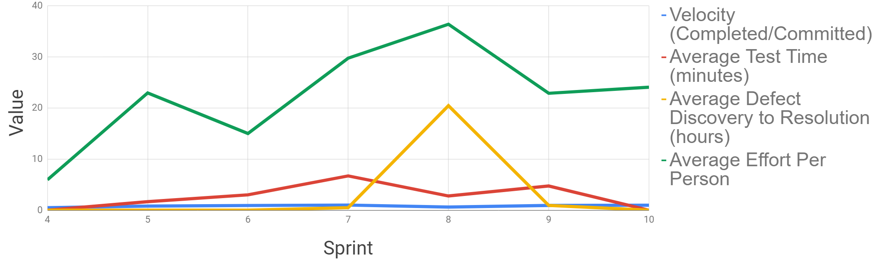
InfoKiosk / E-Bulletin
Celestial Orca
Philip Bedward Daniel Cox Matthew Dunn Aaron Liu
project coaCh: Kal Rabb Sponsor: Bizcloud EXPERTS
The Problem
Process
Metrics
Our sponsor was visiting a campus and noticed many bulletin boards overflowing with tons of post-it notes. This led to the concept of translating to a digital post-it note bulletin system.
Our process evolved to better suit our needs, keep our efforts focused, and our tasks planned as the project matured
Originally, we kept track of work planned and work done on weekly 4-up charts
To form a “bigger picture,” we made a spreadsheet-style Gantt chart. We separated tasks in to “releases” with the relevant tasks grouped together.
We tried to use card-style tracking tools such as Trello, to no avail.
Eventually we started forming work in to 2-week Sprints
Velocity
Story Points Committed vs. Story Points Completed per sprint.
Allows us to keep track of what’s doable and plan future sprints better.
Average Test Time
The total time it took to run the test plan divided by total tests.
Knowing our average test time allows us to predict future test times.
Average Defect Discovery to Resolution
The total time to resolve defects divided by number of defects found.
This makes planning our testing / defect resolution allotment better.
Average effort per person
The total number of hours spent per sprint divided by the team size.
Gives us a better idea of how much time we should commit each sprint.
Once the second semester started, we were looking for a story tracking tool.We considered BizCloud’s Redmine but decided to host our own Jira.
We laid out a high-level schedule of what we wanted to accomplish each sprint and adjusted our sprints based on different commitments that arose.
We had a lot of freedom in designing the system as the initial requirements were open-ended. Eventually the system was split into two parts and tied together by the cloud.
Daily standups, better communication, weekly planning meetings and the revamped process kept us on track much better than the previous process.
Web Application
Infrastructure
Smart TV App
Developed to manage Smart TV App content and the groups associated with them. The front-end is completely decoupled from the back-end. Our web-app style website run on a flexible, reliable, cross-platform framework
Bizcloud experts is a cloud consulting company.
One of their requirements was to have our application/s be serverless.
Since they used AWS, we decided to build our beck end using their variety of services.
Essentially a Virtual bulletin board; a place for different people to post information to a group. This includes job offerings, lost and found, apartments for rent, etc. Conceptually, they are digital post-it notes with a QR code that takes the user to an external link with more information
Generate and push content
Submit, approve and deny content requests
Register and manage devices
Provide administrative support to clients
Manage your Client Account
AWS Lambda: Snippets of code to provide functionality
Display content pushed, even after restarting
Real-time updates
Displays up to 10 cards at a time
QR codes allow navigation to external links
Amazon RDS: Lambdas commit updates to the database
AWS IoT: Allows communication through pub/sub protocol
VSCode: Git repository integration, familiarity, package handling and context highlighting
Amazon Cognito: User Authentication
Android Studio: Built-in Android Device Emulator to develop, deploy and test Smart TV application
Angular: Cross-platform, flexible, single-page applications
Amazon Cloudfront: Retrieve static content from S3 and serve it
Android TV: Mostly device agnostic and universal based on our research
Material: Tons of support, Angular integration and libraries in design software like Sketch
Amazon S3: Stores the web app code
Java: We picked Java over Kotlin since we were more familiar with the language.
Amazon API Gateway: Calls lambdas when endpoints are accessed
We need something to put down here or we can get rid of it and spread the above content better
Notes:
Aaron + Matt

Slide 7
InfoKiosk / E-Bulletin
Celestial Orca
Philip Bedward Daniel Cox Matthew Dunn Aaron Liu
project coaCh: Kal Rabb Sponsor: Bizcloud EXPERTS
The Problem
Process
Metrics
Our sponsor was visiting a campus and noticed many bulletin boards overflowing with tons of post-it notes. This led to the concept of translating to a digital post-it note bulletin system.
Fall Semester
In our first semester, especially towards the beginning, we used our weekly four-up charts to plan what we were going to accomplish in the coming week as well as track what had been completed. The need for a larger scope arose, so we looked into card tracking systems like Trello and even Github Projects. Ultimately this tracking style didn’t materialize itself very well. We also needed to further define our project schedule, so a Gantt chart built inside a spreadsheet was utilized to map out our project timeline. Towards the end of the semester, we also started utilizing sprints to block out chunks of time for things to be completed by. This began to increase our productivity.
Spring Semester
Coming in to the second semester, we bounced between using Bizcloud’s RedMine instance and using Jira. We decided to host an instance of Jira on a local machine and map out our project, sprints and projects within that. We also used it to develop our test plan. We also implemented daily stand-ups over a Slack channel to make sure we were all kept updated on each others progress. This greatly increased our productivity and visibility.
We had a lot of freedom in designing the system as the initial requirements were open-ended. Eventually the system was split into two parts and tied together by the cloud.
Web Application
Infrastructure
Smart TV App
Manage Smart TV App content
Front-end decoupled from the back-end
Web-app style website run on a flexible, cross-platform framework
[Dan can you add a brief sentence here about the use of aws as an infrastructure]
Virtual bulletin board - a place for different people to post information to a group
job offerings, lost and found, apartments for rent and such
Digital post-it notes
QR code takes the user to an external link with more information
Generate and push content
Submit, approve and deny content requests
Register and manage devices
Provide administrative support to clients
Manage your Client Account
Display content pushed, even after restarting
Real-time updates
Displays up to 10 cards at a time
QR codes allow users to navigate to external links
AWS Lambda: Snippets of code to provide functionality
VSCode: Git repository integration, familiarity, package handling and context highlighting
Angular: Cross-platform, flexible, single-page applications
Material: Tons of support, Angular integration and libraries in design software like Sketch
Amazon RDS: Lambdas commit updates to the database
AWS IoT: Allows communication through pub/sub protocol
Android Studio: built-in Android Device Emulator to develop, deploy and test Smart TV application
Android TV: Mostly device agnostic and universal based on our research
Java: Picked Java over Kotlin since we were more familiar with the language.
Amazon Cognito: User Authentication
Amazon Cloudfront: Retrieve static content from S3 and serve it to the client
Amazon S3: Stores the web app code
Amazon API Gateway: Calls lambdas when endpoints are accessed
Notes:
Aaron

Slide 8
InfoKiosk / E-Bulletin
Celestial Orca
Philip Bedward - Daniel Cox - Matthew Dunn - Aaron Liu
project coaCh: Kal Rabb
The Problem
Web Application
Infrastructure
Our sponsor was visiting a campus and noticed many bulletin boards overflowing with tons of post-it notes.
From this, the concept of translating that to a digital post-it note bulletin system came about
Manage Smart TV App content
Front-end decoupled from the back-end
Web-app style website run on a flexible, cross-platform framework
Amazon
Cognito
User Authentication
Generate and push content
Submit, approve and deny content requests
Register and manage devices
Provide administrative support to clients
Manage your Client Account
Amazon
Cloudfront
Amazon
S3
Retrieve static content from S3 and serve it to the client
Stores the web app code
VSCode: Git repository integration, familiarity, package handling and context highlighting
Angular: Cross-platform, flexible, single-page applications
Material: Tons of support, Angular integration and libraries in design software like Sketch
Amazon API
Gateway
AWS
Lambda
Calls lambdas when endpoints are accessed
Snippets of code to provide functionality
We had a lot of freedom in designing the system as the initial requirements were open-ended.
Eventually the system was split into 2 parts tied together by the cloud.
AWS
IoT
Amazon
RDS
Smart TV App
Used to get unique identifier from Smart TV
Lambdas commit updates to the database
Process
Virtual bulletin board - a place for different people to post information to a group
job offerings, lost and found, apartments for rent and such
Digital post-it notes
QR code takes the user to an external link with more information
?!?!?!
Display content pushed, even after restarting
Real-time updates
Displays up to 10 cards at a time
QR codes allow users to navigate to external links
Android Studio: built-in Android Device Emulator to develop, deploy and test Smart TV application
Android TV: Mostly device agnostic and universal based on our research
Java: Picked Java over Kotlin since we were more familiar with the language.
Notes:
Matt revised based on feedback

Slide 9



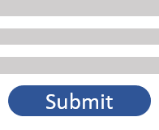

InfoKiosk / E-Bulletin
Celestial Orca
Philip Bedward - Daniel Cox - Matthew Dunn - Aaron LIu
project coaCh: Kal Rabb
Overview
Web Application
Infrastructure
The E-Bulletin is a Smart TV app developed to display QR codes that take you to external pages, as well as a brief description of them. The idea is that users can walk up to the TV, see a post-it note- like display, and if the content shown interests them, they can scan the QR code and get more information about it.
The Interactive Kiosk is a web app interface to manage the Administrators, devices and content as well as where the content is displayed.
The Smart TV App component of the system was an integral part of the requirements presented by Bizcloud Experts. It serves as a virtual bulletin board - a place for different people to post information to a group of people. This could include job offerings, lost and found, apartments for rent and the like. Each piece of information displayed on the Smart TV App is supposed to be essentially a short blurb about something. Think of it like digital post-it notes. Each post-it note is also accompanied by a QR code. This is to take the user to an external link, providing more information about the information displayed on the post-it note.
Amazon Cloudfront
Amazon
S3
A web service that uses “Edge Locations” to make distribution of static content faster.
A cloud-based data storage that allows access to data from anywhere, anytime.
Where did the idea come from?
Our sponsor was visiting a campus and noticed many bulletin boards overflowing with tons of post-it notes. From this, the concept of translating that to a digital post-it note bulletin system came about.
We had a lot of freedom in designing the system as the initial requirements were open-ended. Eventually the system was split into 2 parts tied together by the cloud.
Generate content
Submit content requests
Approve and deny content requests
Push content to smart TVs
Register devices
Provide administrative support to clients
View users in the system
Manage your Client Account
When the user visits the Web App URL, Amazon Cloudfront requests the Web App code stored on S3 and then serves it to the client.
Cloudfront sends a request to retrieve the Web App code from S3 and S3 returns the code to the user. All of the code for the Web App is stored on S3.
Amazon API Gateway
AWS
Lambda
Once an organization has a Client Account, they can begin managing members, Smart TVs and Content. This includes adding members, registering devices, and planning how they want to distribute content.
Visual Studio Code
Development
Angular
Framework
Material
User Interface
A service for managing REST and WebSocket APIs that access AWS or other web services.
A serverless compute service that only runs when called and scales to your needs.
Members of the organization can generate their own content and send it to a desired Smart TV. An end-user, say, a passer-by in the hallway, will be able to view this content on that Smart TV.
One of the IDEs we utilized was VSCode. It's Git repository integration, relative ease to use, package handling and context highlighting were a handful of reasons we relied on it.
Since our sponsor was familiar with Angular and the framework would allow us to achieve the functionality we needed, we utilized it to build our Web App.
Material's relatively easy implementation into Angular and design packages in tools like Sketch led us to choosing to use Material design over a more traditional plain HTML-CSS approach.
Both the Web App and the Smart TV App send requests to the API gateway which then calls upon lambdas to execute specific functions that will provide functionality to the application.
The API Gateway calls snippets of code called Lambdas which provide the backbone of the backend. These calls typically interact with the other AWS components like RDS and return data.
The end user will be able to interact with the set of mutable content on the Smart TV by reading content and scanning the QR codes with their smartphones relative to the content they were posted with to learn more.
Smart TV App
AWS
IoT
Amazon
SNS
There will also be a unique QR code per TV - this code will allow the user to navigate to the InfoKiosk website. From here, they will be able to request their own content be pushed to a TV.
One of the requirements for the project was a dashboard to be able to manage the content on the E-Bulletin from anywhere at any time. This assumedly included mobile devices. We also wanted to make sure our front-end was decoupled from the back-end since we already had to use the cloud. To cover this criteria, we opted for a web-app style website run on a flexible framework. We decided to use Angular to build out our web app functionality.
A way to keep track of smart devices and allow them access to amazon web services.
A push-based pub/sub messaging service that provides the ability to decouple systems.
Process
Able to display content pushed to it even after restarting
Pulls currently active content on start
When new content is pushed from the web app, a message is sent to the TV to pull new content
Can display up to 10 cards at a time
QR codes are displayed to allow users to navigate to external links
rhasghn
rhasghn
Fall Semester
In our first semester, especially towards the beginning, we used our weekly four-up charts to plan what we were going to accomplish in the coming week as well as track what had been completed. The need for a larger scope arose, so we looked into card tracking systems like Trello and even Github Projects. Ultimately this tracking style didn’t materialize itself very well. We also needed to further define our project schedule, so a Gantt chart built inside a spreadsheet was utilized to map out our project timeline. Towards the end of the semester, we also started utilizing sprints to block out chunks of time for things to be completed by. This began to increase our productivity.
Amazon
Cognito
Amazon
RDS
Spring Semester
Coming in to the second semester, we bounced between using Bizcloud’s RedMine instance and using Jira. We decided to host an instance of Jira on a local machine and map out our project, sprints and projects within that. We also used it to develop our test plan. We also implemented daily stand-ups over a Slack channel to make sure we were all kept updated on each others progress. This greatly increased our productivity and visibility.
Android Studio
IDE
Android
Deployment
Java
Development
Authentication and authorization methods to access web and mobile apps.
An server-independent, scalable database that removes the hassle of hardware configuration.
Android Studio has a built in Android Device Emulator - using this we were able to develop our Smart TV application and deploy it to a virtual Android device to test it.
For our initial release, we decided on using Android TV for our Smart TVs since they were mostly device agnostic.
Java or Kotlin were the choices for developing the Smart TV app. We went with Java since we were more familiar with the language.
Any requests to authenticate to AWS will access Cognito to validate credentials. Cognito will also serve up tokens that will allow the user to continue authenticating until the tokens become invalid.
rhasghn
Notes:
Too cluttered / wordy
Layout not *terrible*
“You need to try this again”
Matt [Original]

