Slide 1
FileSync
Bysiek Mateusz
Witan Maciej
Computer Science A/R,
.NET 2011

Slide 2
FileSync: planned features
File backup
File/directory synchronisation
Sharing between users
Access rights management
Meta-data comparison
Safety
Low bandwidth cost

Slide 3
Description
User can log in to the system and select directories, which will be synced with server.
He can log in from multiple machines, and for each one he can define a different list of paths to which the directories in the database point.
Directory may be shared among multiple users.
One of the users is the owner of the dir.
...

Slide 4
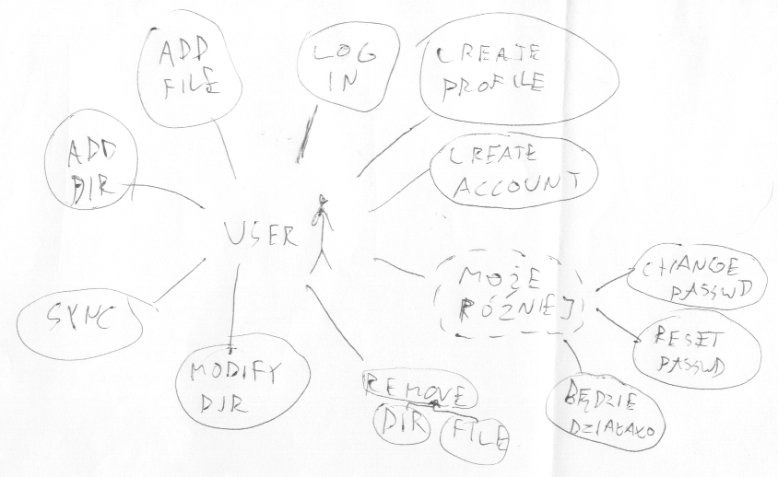

Slide 5
Use cases
User may:
  create account
  define machine
  modify machine definition
  remove machine definition
  log: in / out
  add: directory / file
  synchronise data with database
  modify directory properties
  remove: directory / file
  change password
  reset password

Slide 6
FileSync: used things
MS SQL Server Management Studio
MS Visual Studio 2010
  WPF (C#, XAML)
  ADO.NET EF

Slide 7
MS SQL Management Studio
We've created new database
Server has MS SQL user access
Created tables directly in diagram
  renaming was tricky ;)
  structure reflects the final objective
    not all tables will be used in the first part of the project
  and the final result was more or less...

Slide 8
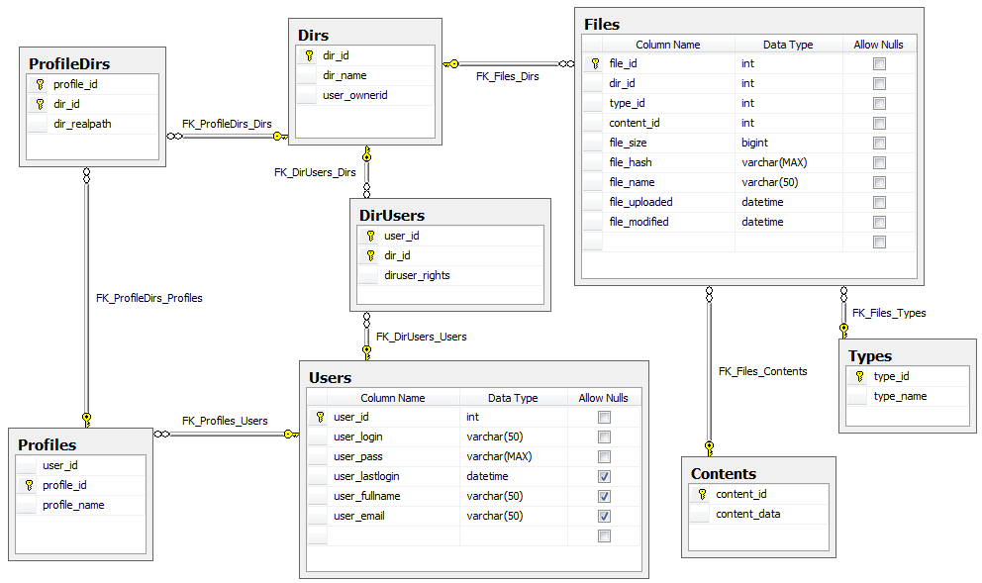

Slide 9
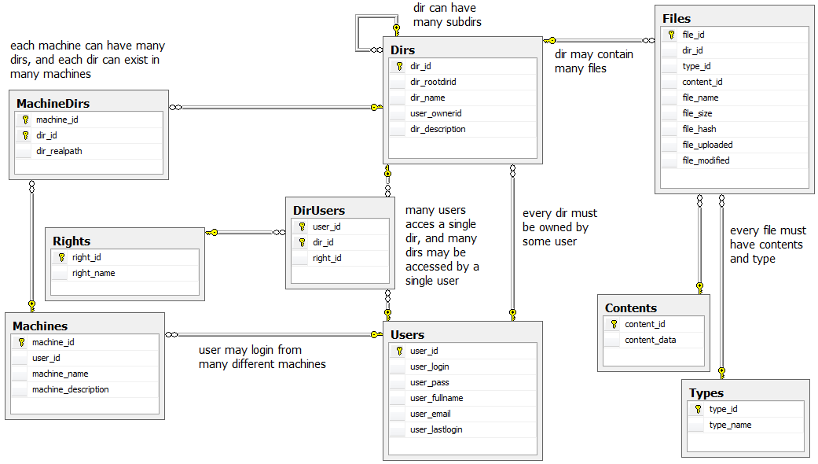

Slide 10
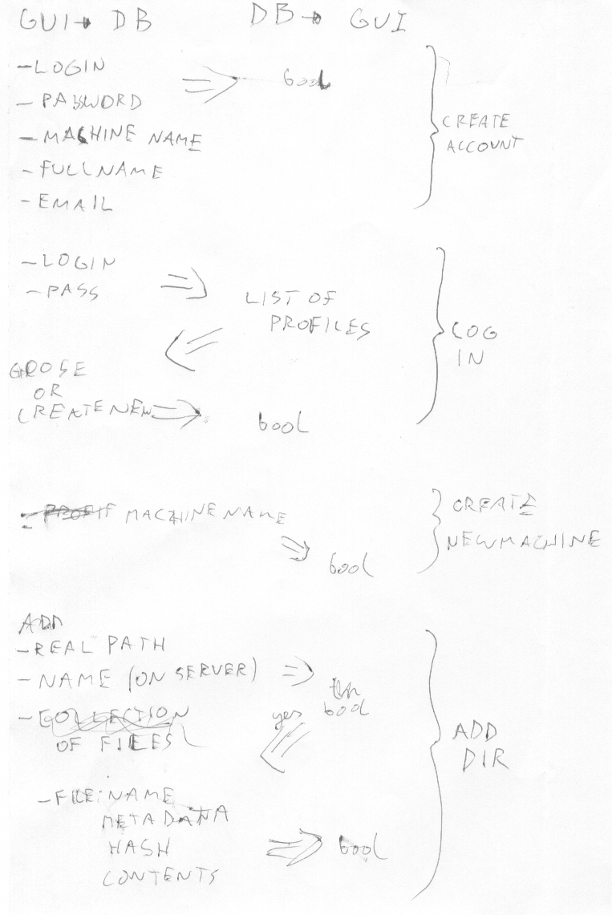

Slide 11
Visual Studio
WPF project contains:
  XAML front-end
    some C# code behind it, to access interface
  interface GUI<->EF
    C# methods reflect declared use cases
    natural consequence of using layers in the project
  ADO.NET Entity Data Model
    Entities created by importing from DB

Slide 12
Encountered (& solved) problems
Entity Framework: missing class

Slide 13
Stay tuned for more :)
It will work!
Thank you for attention.

Slide 14
Description, continued

