Slide 1
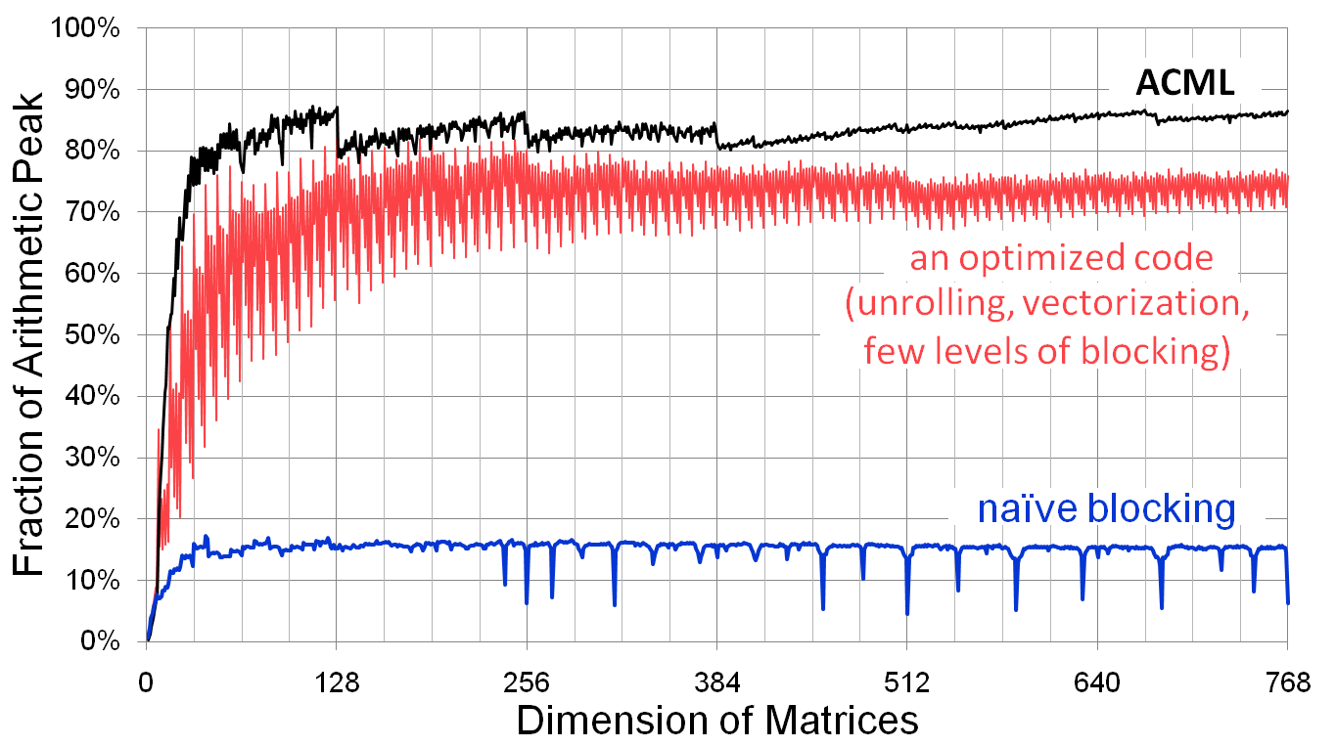
Notes on Homework 1
What is Peak ?
Notes:
CS267 Lecture 2
CS267 Lecture 2

Slide 2
Summary of SSE intrinsics
#include <emmintrin.h>
Vector data type:
__m128d
Load and store operations:
_mm_load_pd
_mm_store_pd
_mm_loadu_pd
_mm_storeu_pd
Load and broadcast across vector
_mm_load1_pd
Arithmetic:
_mm_add_pd
_mm_mul_pd
Notes:
CS267 Lecture 2
CS267 Lecture 2

Slide 3
2x2 Matrix Multiply
C₀₀ += A₀₀B₁₀ + A₀₁B₀₀
C₁₀ += A₁₀B₁₀ + A₁₁B₀₀
C₀₁ += A₀₀B₁₁ + A₀₁B₀₁
C₁₁ += A₁₀B₁₁ + A₁₁B₀₁
Rewrite as SIMD algebra
C00_C10 += A00_A10 * B10_B10
C01_C11 += A00_A10 * B11_B11
C00_C10 += A01_A11 * B00_B00
C01_C11 += A01_A11 * B01_B01
02/11/2009
CS267 Lecture 7

Slide 4
Example: multiplying 2x2 matrices
#include <emmintrin.h>
c1 = _mm_loadu_pd( C+0*lda ); //load unaligned block in C
c2 = _mm_loadu_pd( C+1*lda );
for( int i = 0; i < 2; i++ )
{
a = _mm_load_pd( A+i*lda );//load aligned i-th column of A
b1 = _mm_load1_pd( B+i+0*lda ); //load i-th row of B
b2 = _mm_load1_pd( B+i+1*lda );
c1=_mm_add_pd( c1, _mm_mul_pd( a, b1 ) ); //rank-1 update
c2=_mm_add_pd( c2, _mm_mul_pd( a, b2 ) );
}
_mm_storeu_pd( C+0*lda, c1 ); //store unaligned block in C
_mm_storeu_pd( C+1*lda, c2 );
Notes:
CS267 Lecture 2
CS267 Lecture 2

Slide 5
Other Issues
Checking efficiency of the compiler helps
  Use -S option to see the generated assembly code
  Inner loop should consist mostly of ADDPD and MULPD ops, ADDSD and MULSD imply scalar computations
Consider using another compiler
  Options are PGI, PathScale and GNU
  Cray C compiler doesn’t seem to have any way to use SSE
    It is capable of auto-vectorizing loops it recognizes
Look through Goto and van de Geijn’s paper
Don’t ignore the other optimizations
  more compiler flags
  loop unrolling
  inlining
  keywords (ask your classmates!)
Notes:
CS267 Lecture 2
CS267 Lecture 2

